Slide 1

ngUikAk; jho;ikAk;
ghlk; 3 Vg;uy; 18, 2026

Slide 2

“jd;idj;jhd; cah;j;Jfpwtd; vtDk; jho;j;jg;gLthd;> jd;idj;jhd; jho;j;Jfpwtd; cah;j;jg;gLthd; vd;whh;.”
(Y}f;fh 14:11)

Slide 3


vd;dplk; kjpg;Gkpf;fJ vJ? mjw;F gjpyspg;gJ xU fbdkhd Nfs;tp.
ehd; mjpfk; Ngrpdhy; (mJ xU ngUkpjjpw;Fupa epiy vd;whYk;), ehd; vj;jifatdhf ,Uf;fpNwNdh my;yJ vd;dnty;yhk; nfhz;bUf;fpNwNdh – mit midj;ijAk; ehNd Rakhf rhjpj;Njd; vd;gij ehd; xg;Gnfhs;fpNwd;.
Njtd; vd;id jk; kfdhf fUJtjhy;> ehd; epiwa Ngrpdhy; vd;d?
ehd; VJk; $whky; ,Ue;jhy; (xU gzpthd epiy), ehd; vj;jifatdhf ,Uf;fpNwNdh my;yJ vd;dnty;yhk; nfhz;bUf;fpNwNdh – mit midj;Jk; NjtdplkpUe;Nj te;jit vd;gij ehd; xg;Gnfhs;fpNwd;.
vdf;F Rakjpg;G ,y;yhjjhy; ehd; VJk; nrhy;yhky; ,Uf;fpNwdh?
ngUikapd; cjhuzq;fs;
Y}rpgu;
,NaRtpd; rP\u;fs;
jho;ikapd; cjhuzq;fs;
Maf;fhud;
NkhNr
,NaR, xU rpwe;j cjhuzk;

Slide 4

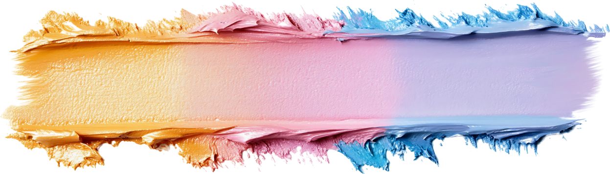
ngUikapd; cjhuzq;fs;

Slide 5





Y}rpgu;
“Vnddpy;> khk;rj;jpd; ,r;irAk;> fz;fspd; ,r;irAk;> [Ptdj;jpd; ngUikAkhfpa cyfj;jpYs;sitfnsy;yhk; gpjhtpdhYz;lhditfsy;y> mitfs; cyfj;jpdhYz;lhditfs;.” (1 Nahthd; 2:16)
ehk; ngUikiag; gw;wp NgRtjdhy;> ,e;j czu;T Kjypy; vtuplk; Njhd;wpaNjh> mtiug; gw;wpNa Ngr Ntz;Lk;: Y}rpgu;. jd; epiyNahL jpUg;jpaile;Jtplhky;, mijtpl cau;e;jnjhU epiyf;F cau mtu; jPu;khdpj;jhu;. mtu; jd;id vj;jidf;F cau;j;jpf; nfhs;s tpUk;gpdhnud;why;> NjtDila rpk;khrdj;ijNa Mf;fpkpf;f Ntz;Lk; vd;W Vq;fj; njhlq;fpdhu; (Vrhah 14:12-14).
ekf;F tpUg;gkhd vijAk; nra;tjw;Fk;> ehk; tpUk;Gk; vijAk; nrhe;jkhf;fp nfhs;tjw;Fk;> Gfo; my;yJ nry;tj;ij <l;bj; jUk; gjtpfis miltjw;Fk; Md tpUg;gj;ij ehk; “kuG topahf ngw;wpUf;fpNwhk;”. ,ij jhd; ,t;Tyfk; ekf;F toq;FfpwJ (1 Nahthd; 2:16).
Mdhy; midj;J ngUtpUg;gq;fSk; mfq;fhuk; MfptpLtjpy;iy. xU Foe;ijapd; ntw;wpapypUe;J ngwg;gLk; kdepiwNth my;yJ jdpg;gl;l yl;rpaNkh> mtrpakhfNt xU MNuhf;fpakw;w mfq;fhuk; MfptpLtjpy;iy.
ehk; epidtpy; nfhs;s Ntz;ba Kf;fpakhd tp\ak; vd;dntd;why;> ekJ cilikfs;> jpwd;fs; kw;Wk; rhjidfs; Mfpait ekJ kjpg;ig jPu;khdpg;gjpy;iy. ekJ tho;tpy; ,iwtd; nra;Ak; fhupaq;fSf;fhf mtUf;F kfpik nrYj;jhky; ,Ug;gNj mfq;fhuk; MFk;.

Slide 6



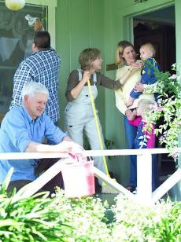

,NaRtpd; rP\u;fs;
“md;wpAk; jq;fspy; vtd; nghpatdhapUg;ghd; vd;W mth;fSf;Fs;Ns thf;Fthjk; cz;lhapw;W.” (Y}f;fh 22:24)
mtu;fs; ,NaRNthL 3 Mz;LfSf;Fk; Nkyhf fopj;jpUe;jhu;fs;. mtu; rw;W Kd;G jhd; mtu;fSila ghtq;fis fOtp> midtUf;fhfTk; rpe;jg;gltpUf;Fk; jdJ ,uj;jj;ijg gw;wp $wpapUe;jhu;. MapDk;, mtu;fs; ,uT czT mUe;jpf; nfhz;bUe;j NghJ, mtu;fSila ciuahly; ,it vtw;NwhLk; njhlu;gpy;yhjjhapUe;jJ: mtu;fspy; kpf ngupatu; ahu; vd;gNj me;j ciuahlyhf mike;jpUe;jJ? (Y}f;fh 22:24).
jq;fs; ngUikapd; fhuzkhf> cr;rgl;r ,lj;ij mila jhq;fNs jFjpahdtu;fs; vd;W mtu;fs; ek;gpdhu;fs;. jq;fs; czu;Tfspd; jPtpuj;ij czu mtu;fs; jtwptpl;lhu;fs;. jq;fs; ngUikapdpkpj;jk; mtu;fs; jq;fs; Njtid jq;fs; ,Ujaj;jpypUe;J tpyf;fp js;sp nfhz;bUe;jhu;fs;.
,NaR NeubahfNt tp\aj;jpw;F te;jhu;: “ehd; cq;fs; eLtpNy gzptpilf;fhuidg;Nghy; ,Uf;fpNwd;.” (Y}f;fh 22:27). NtW thu;j;ijfspy; nrhy;tjhdhy;: cq;fs; FUitg; Nghy ePq;fSk; rpwe;jtuhf jpfo tpUk;gpdhy;> gpwUf;F Nrit nra;Aq;fs;.
gpwu; ekf;F Nrit nra;a ehk; jFjpahdtu;fs; vd;W ekJ mfe;ij ekf;F nrhy;fpwJ (ehk; mtu;fis tpl rpwe;jtu;fs;). jho;ikahd Copau;fshf khWtjw;F ekf;F NjtDila mUs; Njit.

Slide 7

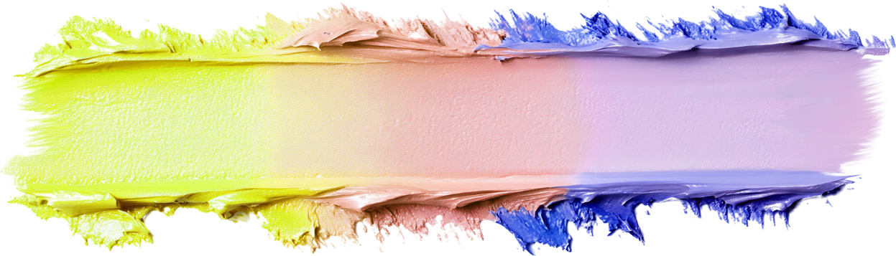
jho;ikapd; cjhuzq;fs;

Slide 8





Maf;fhud;
“Maf;fhud; J}uj;jpNy epd;W> jd; fz;fisAk; thdj;Jf;F VnwLf;fj; Jzpahky;> jd; khh;gpNy mbj;Jf;nfhz;L: NjtNd! ghtpahfpa vd;Nky; fpUigahapUk; vd;whd;. ” (Y}f;fh 18:13)
xU gupNrad;> jhd; nra;j ew;nray;fisAk;> tpz;Zyfpd; Kd; jdf;fpUe;j jFjpfisAk; Fwpj;J Njtdplk; vLj;Jiuj;J nfhz;bUe;jhd;. Mdhy; ,NaR> mtd; Njtdplk; my;y “jdf;Fs;Ns n[gk;gz;zpdhd;” vd;W $Wfpwhu; (Y}f;fh 18:11-12). ngUikf;F ,J xU rpwe;j cjhuzk;.
Maf;fhud; Njtdplk; cjtp Ntz;bf; nfhz;bUe;jhd;: Vnddpy;> mtd; xU ghtp (Y}f;fh 18:13). Njtdpd; Kd; jd;id gzpTld; rku;gpj;jhd;, mtdy;y “,tNd ePjpkhdhf;fg;gl;ltdha;j; jd; tPl;Lf;Fj; jpUk;gpg;Nghdhd;” Vnddpy; “jd;id cah;j;JfpwtndtDk; jho;j;jg;gLthd;> jd;idj; jho;j;Jfpwtd; cah;j;jg;gLthd;” (Y}f;fh 18:14).
ehk; ekJ ghtj;ij xg;Gf;nfhz;L fpwp];Jtpd; cjtpia Nfl;Fk; NghJ cz;ikahd jho;ik njhlq;FfpwJ. gpd;G…
ehk; kw;wtu;fis jho;e;jtu;fshf fUjkhl;Nlhk; (gpypg;. 2:3)
ehk; nghJ mq;fpfhuj;ij ehl khl;Nlhk; (Y}f;fh. 14:7-11)
kw;wtu;fs; ekf;F mq;fpfhuk; mspg;gij ehk; mDkjpg;Nghk; (ePjp. 27:2)
ehk; NjtDila mUis ngWNthk; (ahf;NfhG 4:6)
ehk; me;j mUis gpwUf;F toq;FNthk; (1 NgJU 4:10)

Slide 9

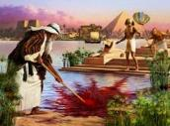






“tpRthrj;jpdhNy NkhNr jhd; nghpatdhdNghJ ghh;NthDila Fkhuj;jpapd; kfd; vd;dg;gLtij ntWj;J> mepj;jpakhd ghtre;Njh\q;fis mEgtpg;gijg;ghh;f;fpYk; NjtDila [dq;fNshNl Jd;gj;ij mEgtpg;gijNa njhpe;Jnfhz;L>” (vgpNuau; 11:24-25)
NkhNr
NkhNr vfpg;jpd; ghu;Nthdhf nghWg;Ngw;f gapw;Wtpf;fg;gl;lhu;. mtu; xU rpwe;j cj;jpahsuhfTk;> kpFe;j mwpTj;jpwd; nfhz;ltuhfTk; jpfo;e;jhu; (mg; 7:22). 40 tajpy;, mtu; ,ijnay;yhk; xJf;fp itj;Jtpl;L> jd; kf;fSld; ,iza KbT nra;jhu; (vgpNuau; 11:24-25).
mtNd me;j kPl;gu;! mtuJ typikkpf;f fuk; jd; rNfhjuu;fis tpLtpf;Fk;! mJ xU ngUk; jtW. mj;jifa ngUikia mtu; jd; cs;sj;jpy; Rke;jpUe;jtiu> Njtdhy; mtiu gad;gLj;j Kbatpy;iy.
ghiytdj;jpy; NjtNdhL ,ize;jpUe;J fopj;j NkYk; 40 Mz;Lfs;> mtiu kpfTk; jho;ikahd xU kdpjuhf khw;wpd(vz;. 12:3). ,g;NghJ nfhs;is Neha;fis mDg;Gtjw;Fk;; nrq;fliy flg;gjw;Fk;; gj;Jf; fl;lisfis ngWtjw;Fk;; NjtNdhL Neubahf NgRtjw;Fk;; ghiwia mbg;gjw;Fk; Njtdhy; mtiu gad;gLj;jgl Kbe;jJ… jhd; nra;j nray;fSf;F jhNd cupik nfhz;lhb> ngUikia ghuhl;bajw;fhf fpilj;j jz;lidiaf;$l> mtuhy; gzpTld; Vw;Wf;nfhs;s Kbe;jJ (vz;. 20:10-12).
gzpT vd;gJ ek;kpilNa jhdhfNt Njhd;Wtjpy;iy: khwhf> xt;nthU ehSk; Njtid Ntz;b> mtu; ek;Ks; mjid Cw;Wk;gb ehk; Nfl;f Ntz;Lk; vd;gij NkhNrapd; vLj;Jf;fhl;L ekf;F czu;j;JfpwJ.

Slide 10




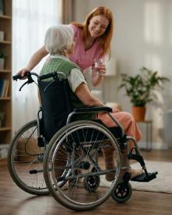

,NaR, xU rpwe;j cjhuzk;
“mth; kD\&gkha;f; fhzg;gl;L> kuzghpae;jk;> mjhtJ rpYitapd; kuzghpae;jKk; fPo;g;gbe;jtuhfp> jk;ikj;jhNk jho;j;jpdhh;.” (gpypg;gpau; 2:8)
,NaR kdpj cUntLg;gjw;F Kd;G nfhz;bUe;j me;j ngUikia> ,t;Tyfpy; vtUk; ,Jtiu ngw;wjpy;iy - ,dp ngwNghtJkpy;iy. MapDk; ek;kPJ nfhz;l md;gpdhy; mtu; midj;ijAk; Jwe;jhu;. mj;jifnjhU ,opTWjYf;F Kd;dhy;> ek;kplk; cs;sit> ehk; vj;jifNahu;> my;yJ ehk; vjpu;fhyj;jpy; vj;jifNahuhf Mff;$Lk; - ,itaidj;ijAk; ehk; xg;gpl;L ghu;f;ifapy; kpfTk; kq;fpg;Nghfpd;wd
ehk; mtUila fpUigapd; nraiy Gupe;J nfhz;L> mtUldhd cwtpw;fhd mtUila miog;gpw;F gjpyspg;Nghk; vd;Dk; ek;gpf;ifapy;> kdpjFyj;jpw;fhf kupg;gjw;fhf ,NaR guNyhfj;ij Jwe;jhu; (gpypg;. 2:5-8). mtu;, re;Njfj;jpw;fplkpd;wp, gzptpw;F xU kpfrpwe;j vLj;Jf;fhl;L.
“fpwp];J ,NaRtpypUe;j rpe;ijNa cq;fspYk; ,Uf;ff;fltJ@” (gpypg;. 2:5).
,e;j cjhuzj;ij gpd;gw;wp, “xd;iwAk; thjpdhyhtJ> tPz;ngUikapdhyhtJ nra;ahky;> kdj;jho;ikapdhNy xUtiunahUth; jq;fspYk; Nkd;ikahdth;fshf vz;zf;fltPh;fs;. mtdtd; jdf;fhditfisay;y> gpwUf;fhditfisAk; Nehf;Fthdhf.” (gpypg;. 2:3-4).

Slide 11

“ck;ik vd; KO ,Ujaj;NjhLk; Jjpg;Ngd;@ Njth;fSf;F Kd;ghf ck;ikf; fPh;j;jdk;gz;ZNtd;.
ckJ ghpRj;j MYaj;jpw;F Neuhf ehd; gzpe;J> ckJ fpUigapdpkpj;jKk; ckJ cz;ikapdpkpj;jKk; ckJ ehkj;ijj; Jjpg;Ngd;@ ckJ rfy gpu];jhgj;ijg;ghh;f;fpYk; ckJ thh;j;ijia ePh; kfpikg;gLj;jpapUf;fpwPh;.
ehd; $g;gpl;l ehspNy vdf;F kWcj;juT mUspdPh;@ vd; Mj;JkhtpNy ngyd;je;J vd;idj; ijhpag;gLj;jpdPh;@
fh;j;jhNt> g+kpapd; uh[hf;fnsy;yhUk; ckJ thapd; thh;j;ijfisf; Nfl;Fk;NghJ ck;ikj; Jjpg;ghh;fs;.
fh;j;jhpd; kfpik nghpjhapUg;gjpdhy;> mth;fs; fh;j;jhpd; topfisg; ghLthh;fs;.
fh;j;jh; cah;e;jtuhapUe;Jk;> jho;ikAs;stid Nehf;fpg; ghh;f;fpwhh;@ Nkl;bikahdtidNah J}uj;jpypUe;J mwpfpwhh;.
ehd; Jd;gj;jpd; eLtpy; ele;jhYk; ePh; vd;id caph;g;gpg;gPh;@ vd; rj;JUf;fspd; Nfhgj;Jf;F tpNuhjkhf ckJ ifia ePl;LtPh;@ ckJ tyJfuk; vd;id ,ul;rpf;Fk;.
fh;j;jh; vdf;fhf ahitAk; nra;J Kbg;ghh;@ fh;j;jhNt> ckJ fpUig vd;WKs;sJ@ ckJ fuj;jpd; fphpiafis nefpotplhjpUg;gPuhf.”
rq;fPk; 138

Slide 12

“Ra md;G, jd;idj; jhNd cau;j;jpf; nfhs;Sjy;, kw;Wk; ngUik Mfpatw;wpy; kpFe;j gytPdk; cs;sJ; Mdhy; jho;ikapy; kpFe;j typik cs;sJ. ehk; ek;ik gw;wpNa ngupjhf epidj;Jf;nfhs;Sk; NghJ ekJ fz;zpak; fhf;fg;gLtjpy;iy, khwhf ekJ rpe;jidfs; midj;jpYk; NjtNd epiwe;jpUe;J> ekJ ,jaq;fs; kPl;gu; kPjhd md;ghYk; xsptpRk;NghJ jhd; ekJ fz;zpak; epiyepWj;jg;gLfpwJ. Fzeydpy; cs;s vspikAk; ,jaj;jpd; jho;ikAk; kfpo;r;rpiaj; jUk;. mNj Ntisapy;> jw;ngUikahdJ kdepiwtpd;ik> Gyk;gy; kw;Wk; njhlu; Vkhw;wq;fisNa nfhz;LtUk;. ek;ikg; gw;wp FiwthfTk;> gpwiu kfpo;r;rpgLj;JtJ gw;wp mjpfkhfTk; rpe;jpf;f fw;Wf;nfhs;tNj ekf;F nja;tPf typikia ngw;Wj; jUk;.”
vyd; [p citl; (nl];bNkhdP]; /ghu; j ru;r;, mjp. 3, gf;. 476)

