Slide 1
MNuhf;;fpa nra;;jp
jpuhl;;ir gok;

Slide 2
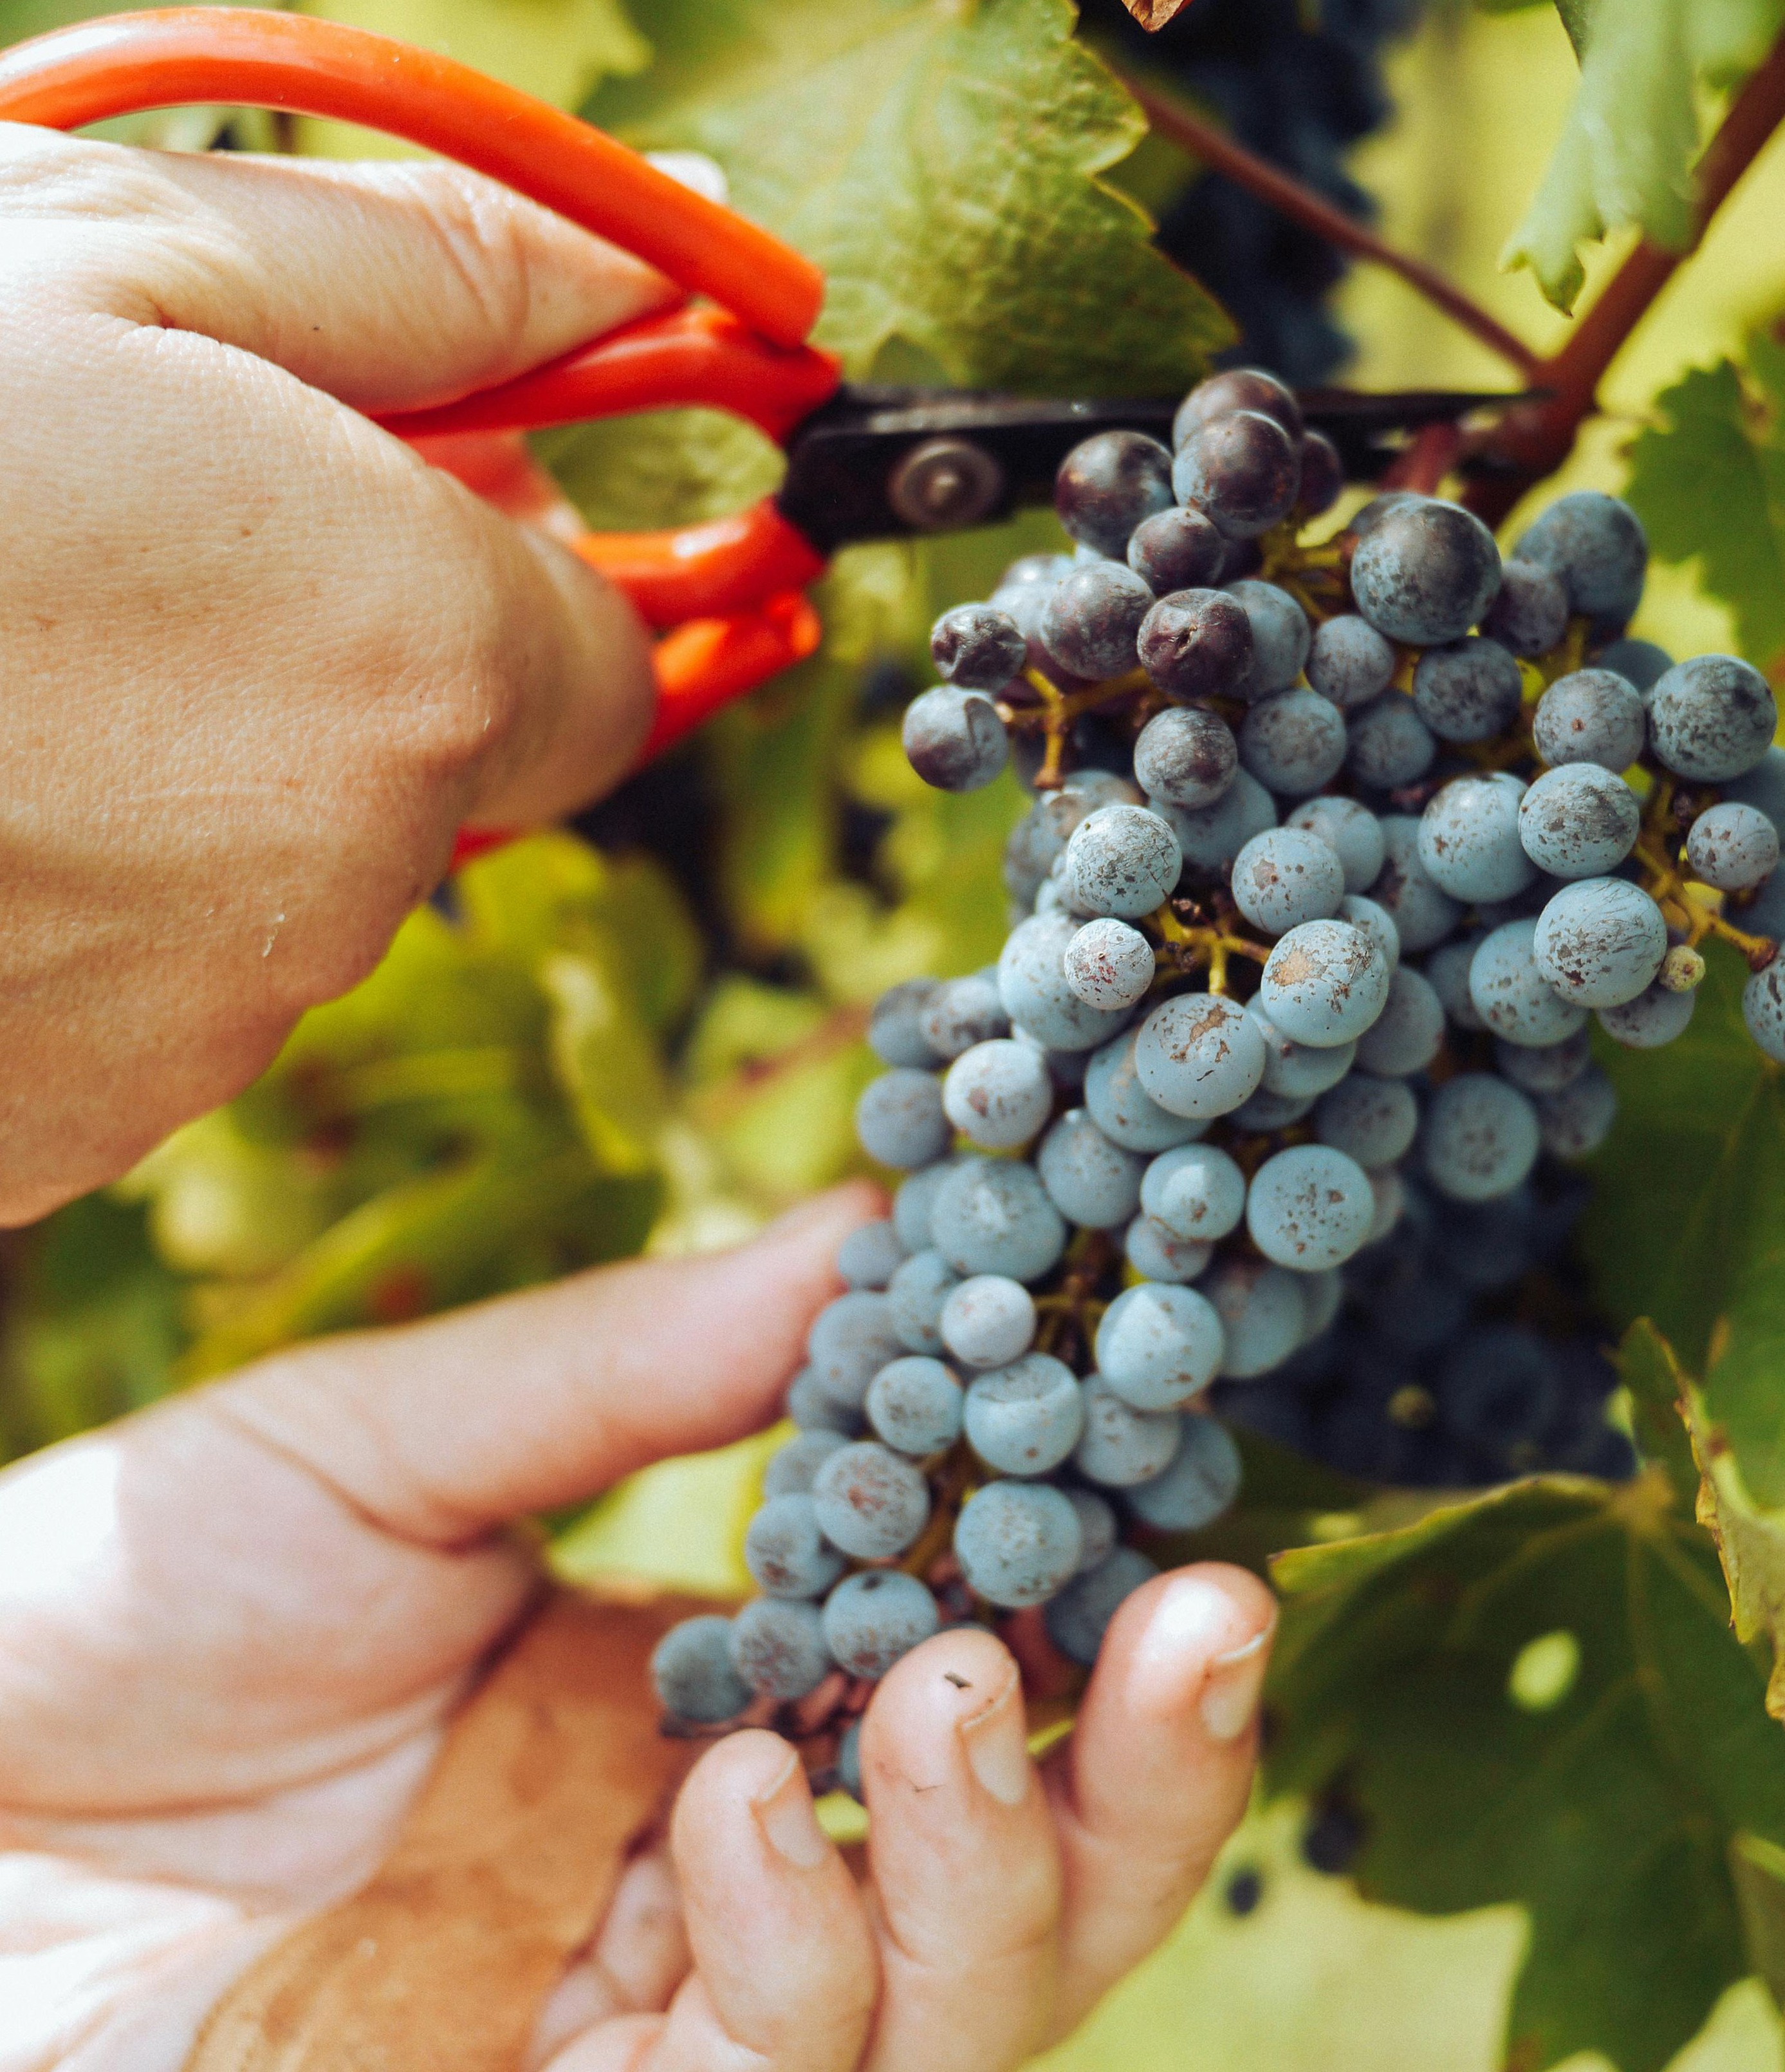
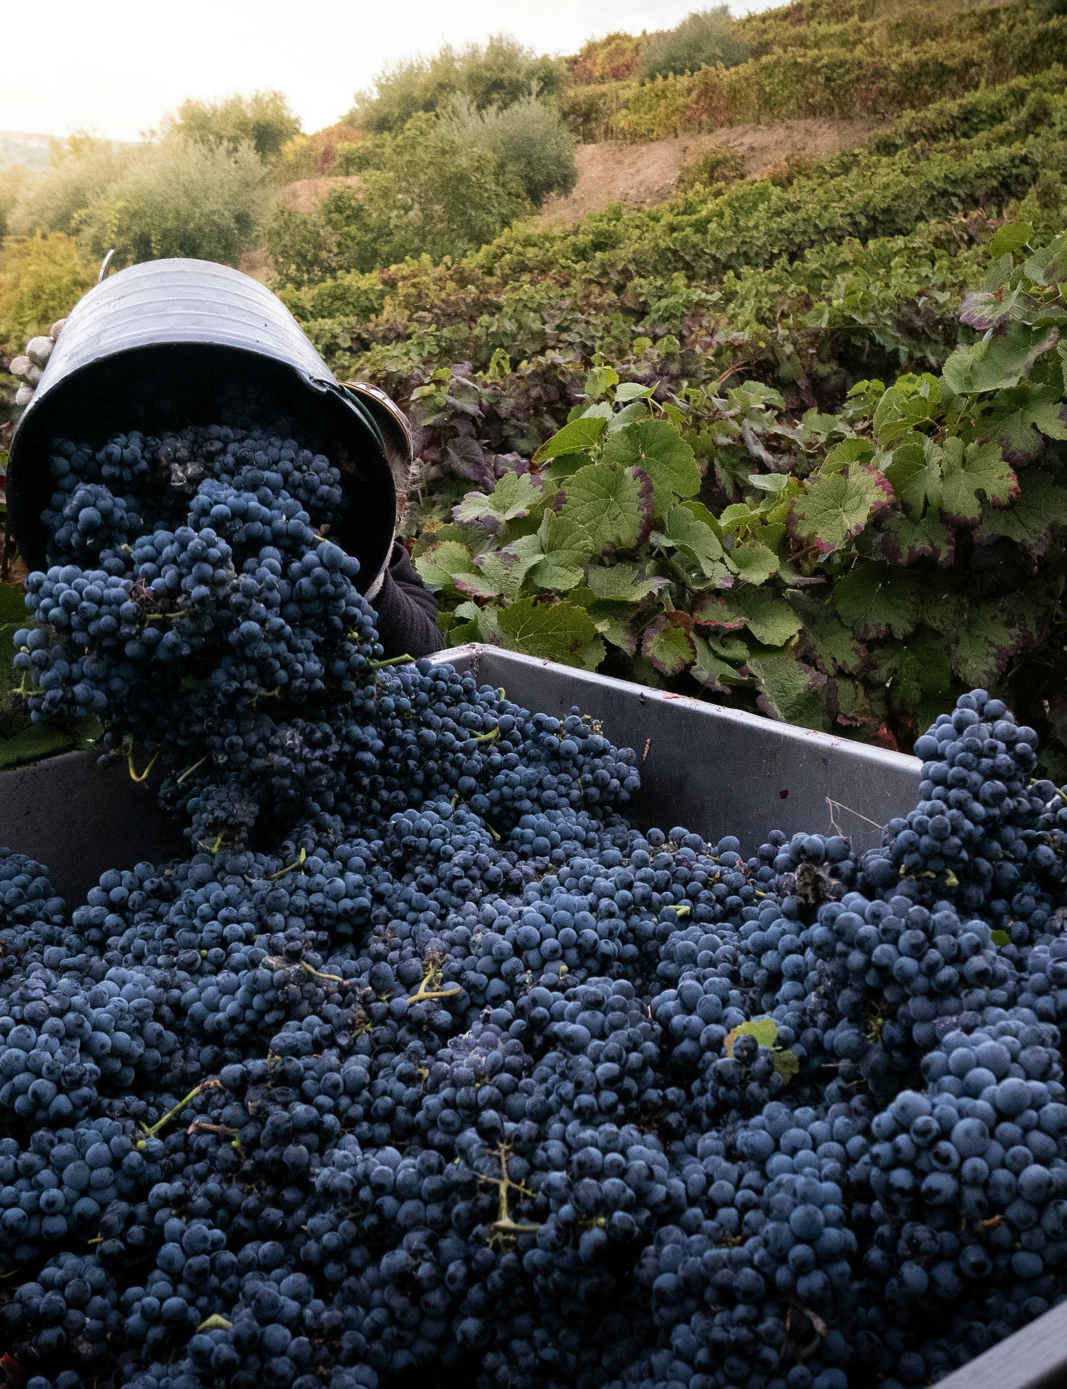
jpuhl;;ir gok;;
- jpuhl;irg;gok; vd;gJ ,iyAjph; nfhb tifapd; gokhFk;.
- ,J nfhbKe;jphp vd;Wk; miof;fg;gLfpwJ.
- kfhuh\;buh> fh;ehlfhTf;F mLj;jgbahfj; jkpo;ehLk; jpuhl;ir cw;gj;jpapy; Kf;fpa ,lk; tfpf;fpwJ.
jpuhl;irapd; jhtutpay; ngah;: vitis vinifera (tpb]; tpdp;/ nguh) MFk;. ,J tpl;Nlrp (vitaceae) FLk;gj;ij Nrh;e;j nfhb tifj; jhtuk;
- jpuhl;ir vd;gJ 15 Kjy; 300 tiu nfhj;jhf tsUk; xU tif gokhFk;

Slide 3

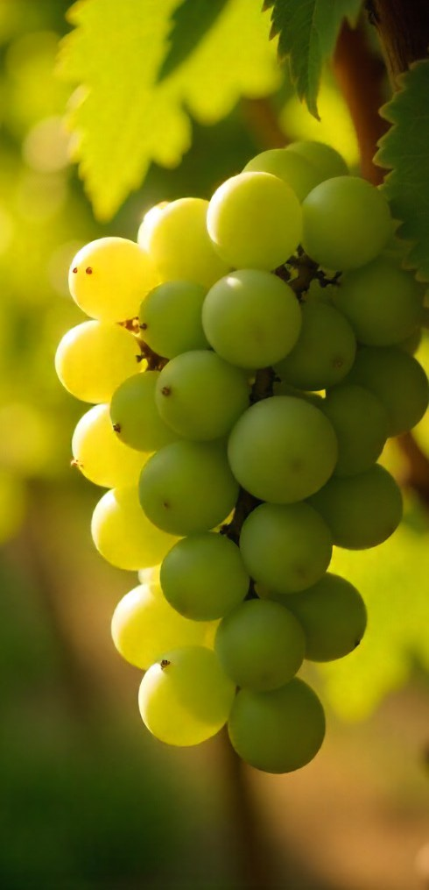
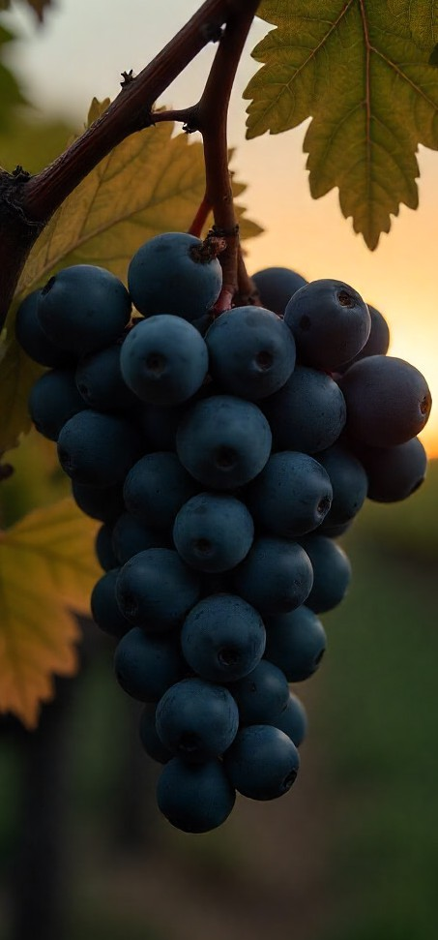
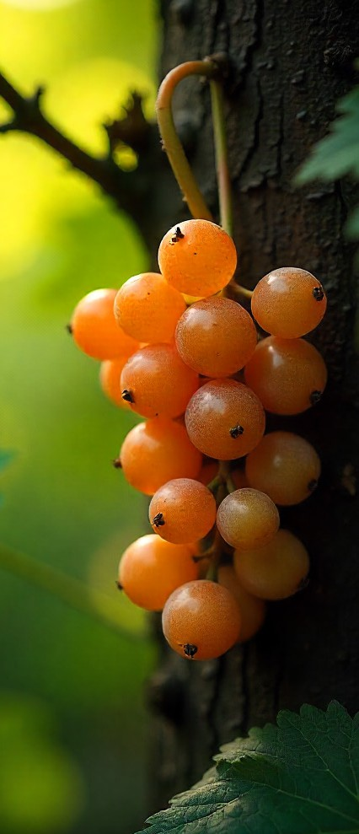
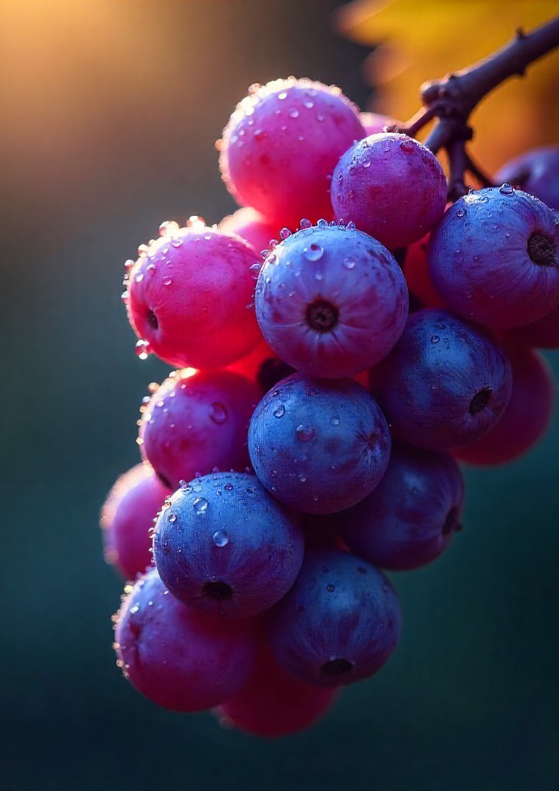
jpuhl;;ir tiffs;;
fUg;G jpuhl;ir
Nfhy;ld; jpuhl;ir
rptg;G jpuhl;ir
gr;irahd jpuhl;ir

Slide 4
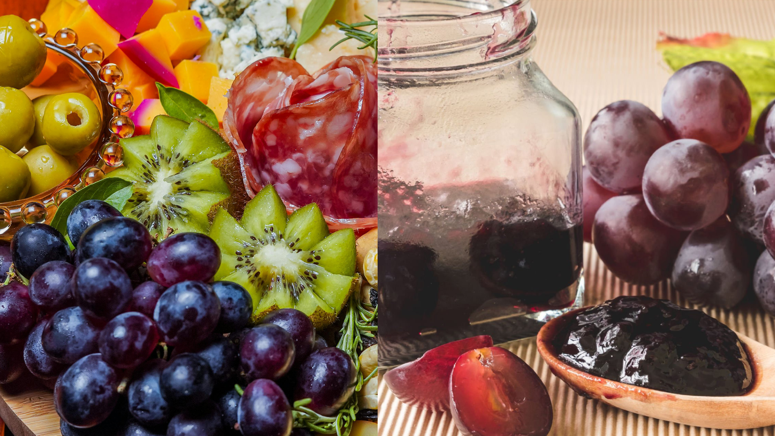
jpuhl;;irapypUe;;J ngwg;;gLk;; nghUl;;fs;;
jpuhl;ir rhyl;(Grape salad)
jpuhl;ir [hk; (Jam)

Slide 5
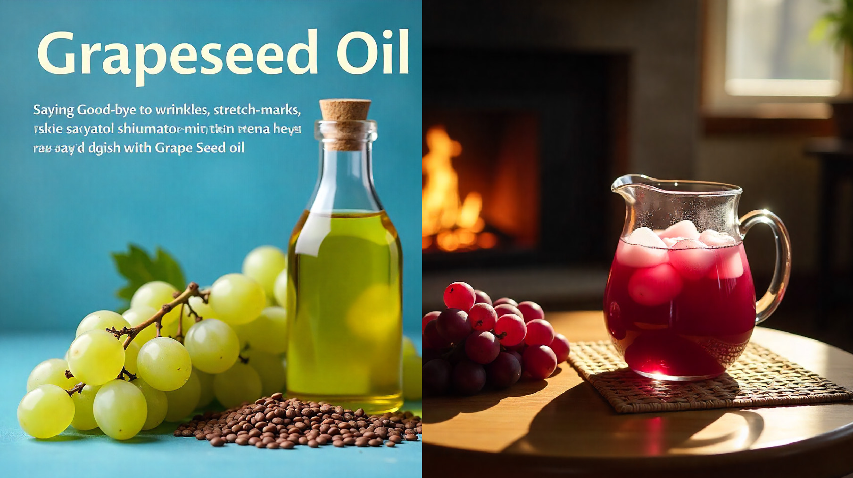
jpuhl;ir nfhl;il rhW (Grape Seed Extract)
jpuhl;ir rhW (Grapes Juice)

Slide 6
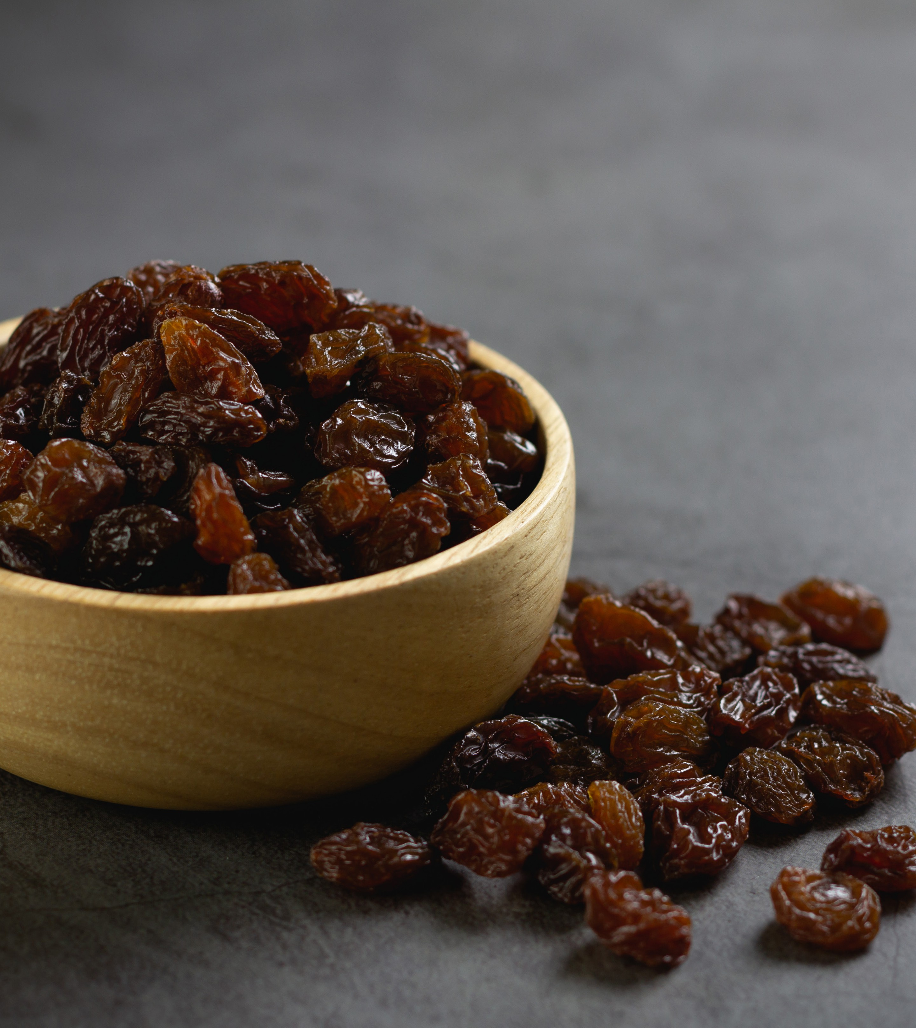
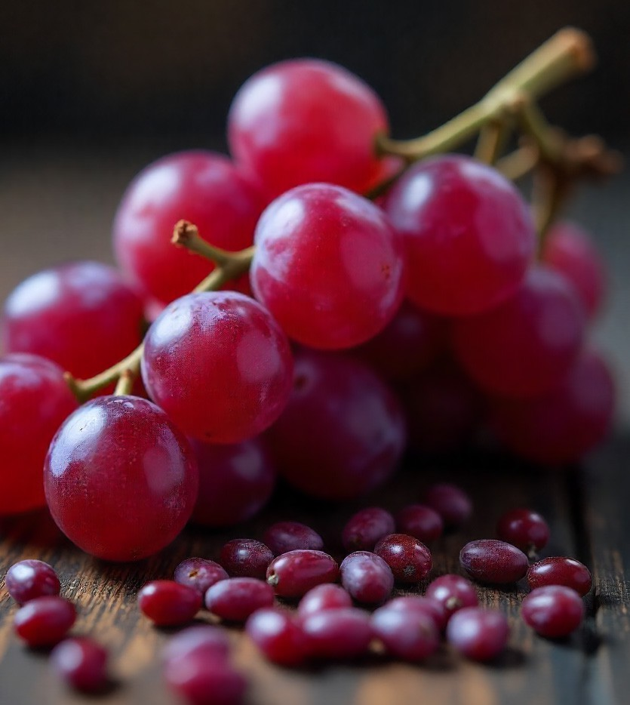
cyh; jpuhl;ir
jpuhl;ir nfhl;il (Grape Seed)

Slide 7
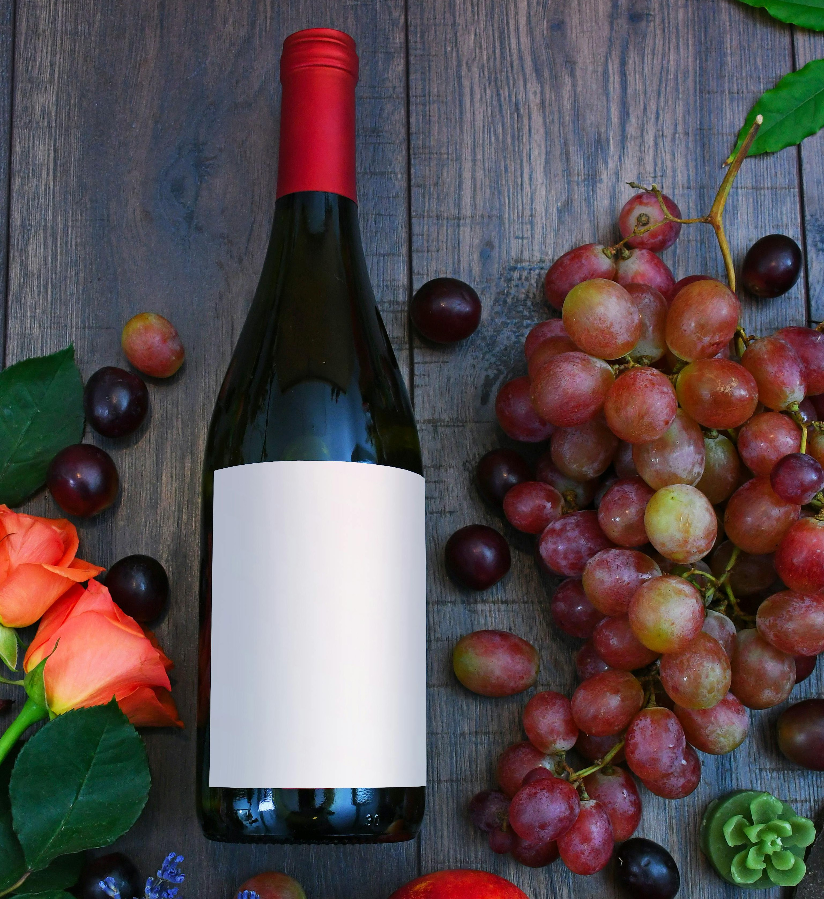
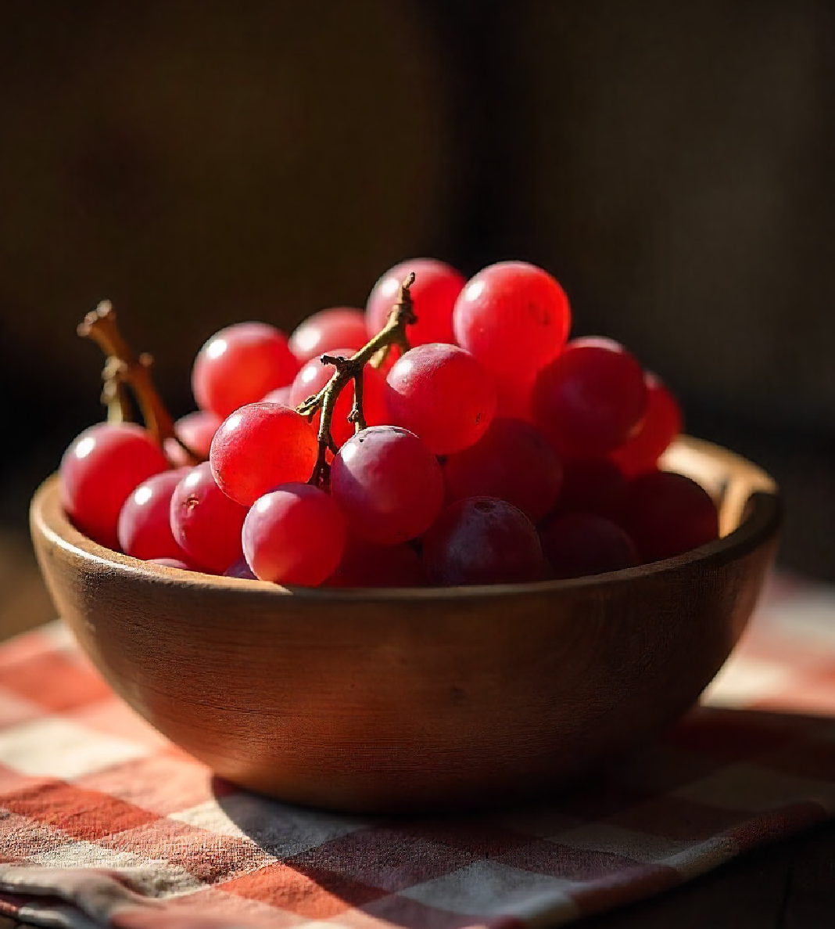
jpuhl;ir xapd;
jpuhl;ir gok;

Slide 8
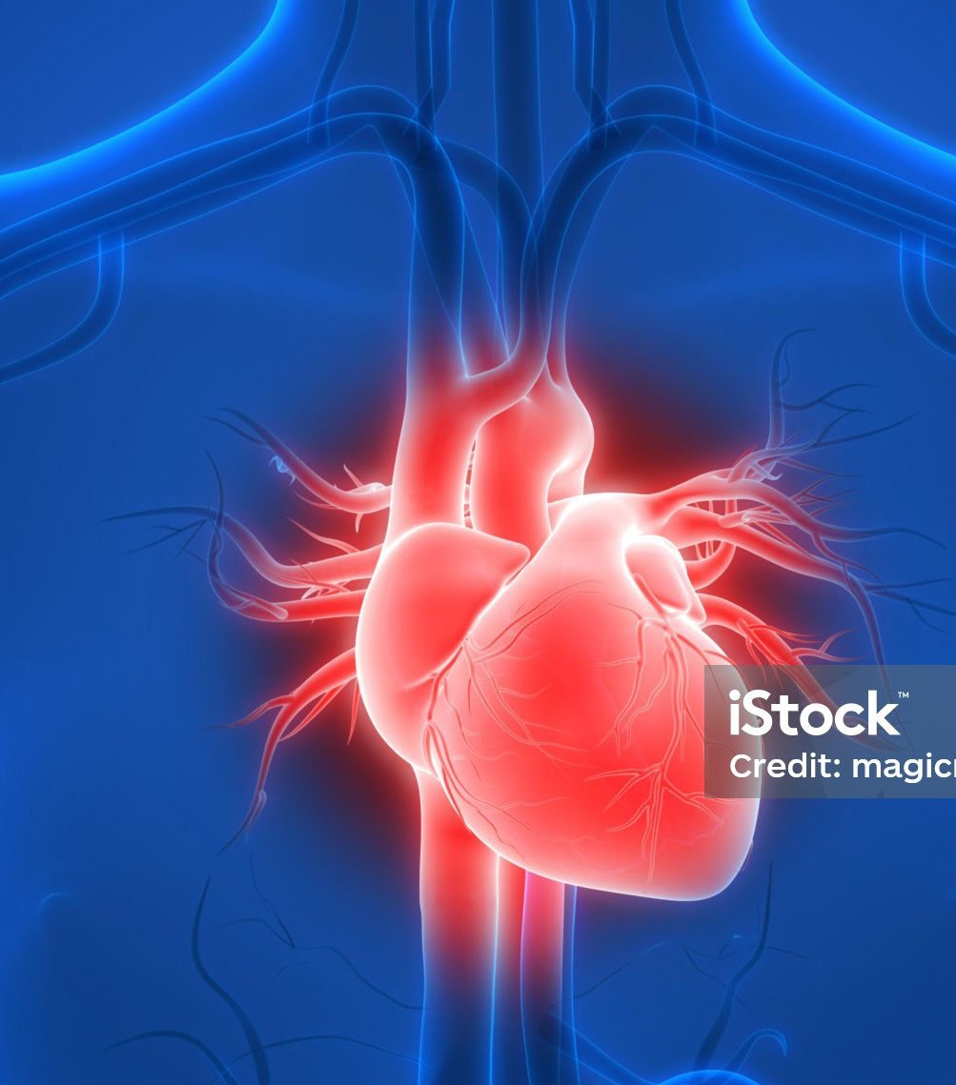

jpuhl;;irapd;; kUj;;Jt gad;;fs;;
,ja MNuhf;fpak;:
jpuhl;irapy; cs;s Md;bMf;]pld;l;fs; ,uj;j ehsq;fis MNuhf;fpakhf itj;jpUg;gNjhL>
,uj;j mOj;jj;ijf; fl;Lg;gLj;jTk; cjTfpwJ
Gw;WNeha; vjph;g;G:
jpuhl;irapy; cs;s rpy $Wfs;> Fwpg;ghf rptg;G jpuhl;irapy;> Gw;WNeha; nry;fis vjph;j;Jg; NghuhLk; Mw;wy; nfhz;lit.

Slide 9
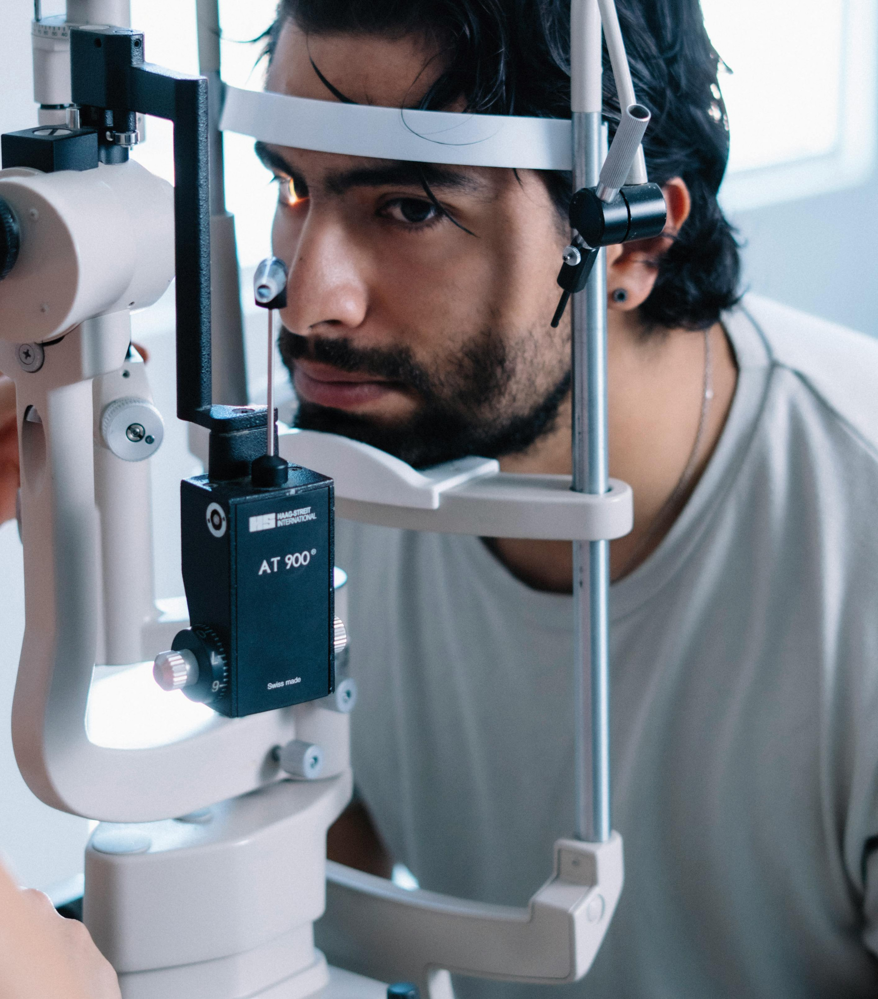
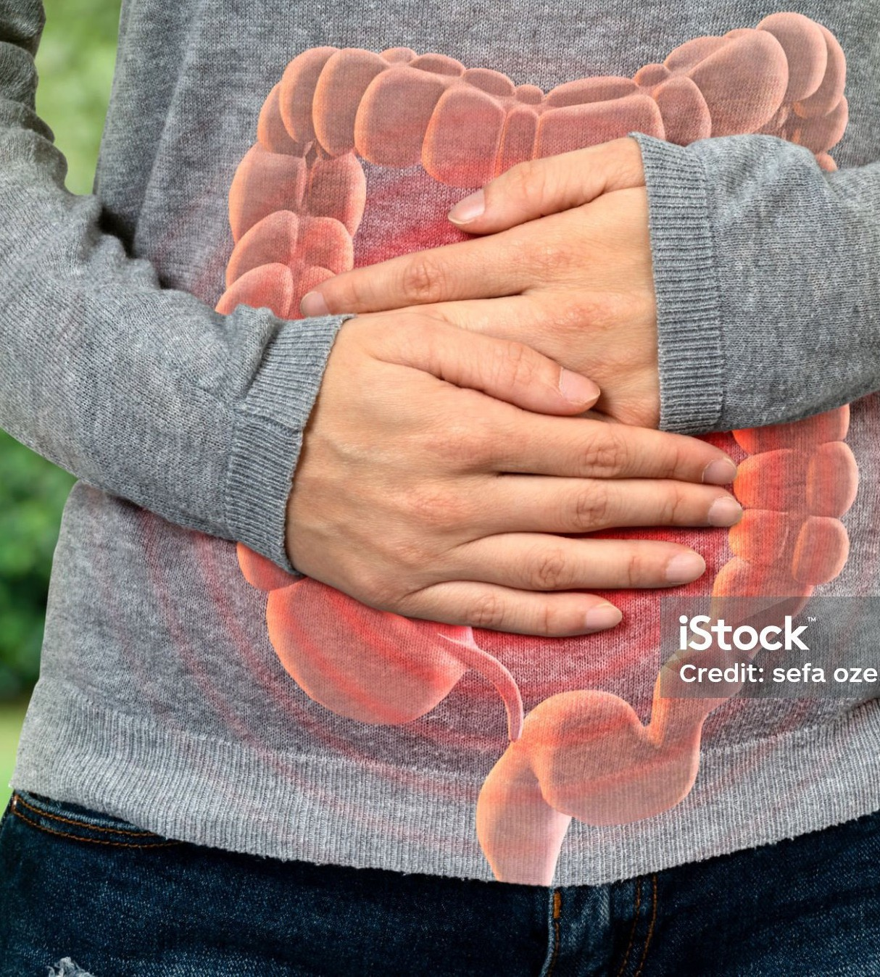
nrhpkhd MNuhf;fpak;:
ehh;r;rj;J epiwe;j jpuhl;ir nrhpkhdj;ij Nkk;gLj;jTk;> kyr;rpf;fiyj; jLf;fTk; cjTfpwJ.
fz; ghh;it:
gr;ir jpuhl;irapy; cs;s rpy itl;lkpd;fs; fz; ghh;itia Nkk;gLj;Jk;

Slide 10
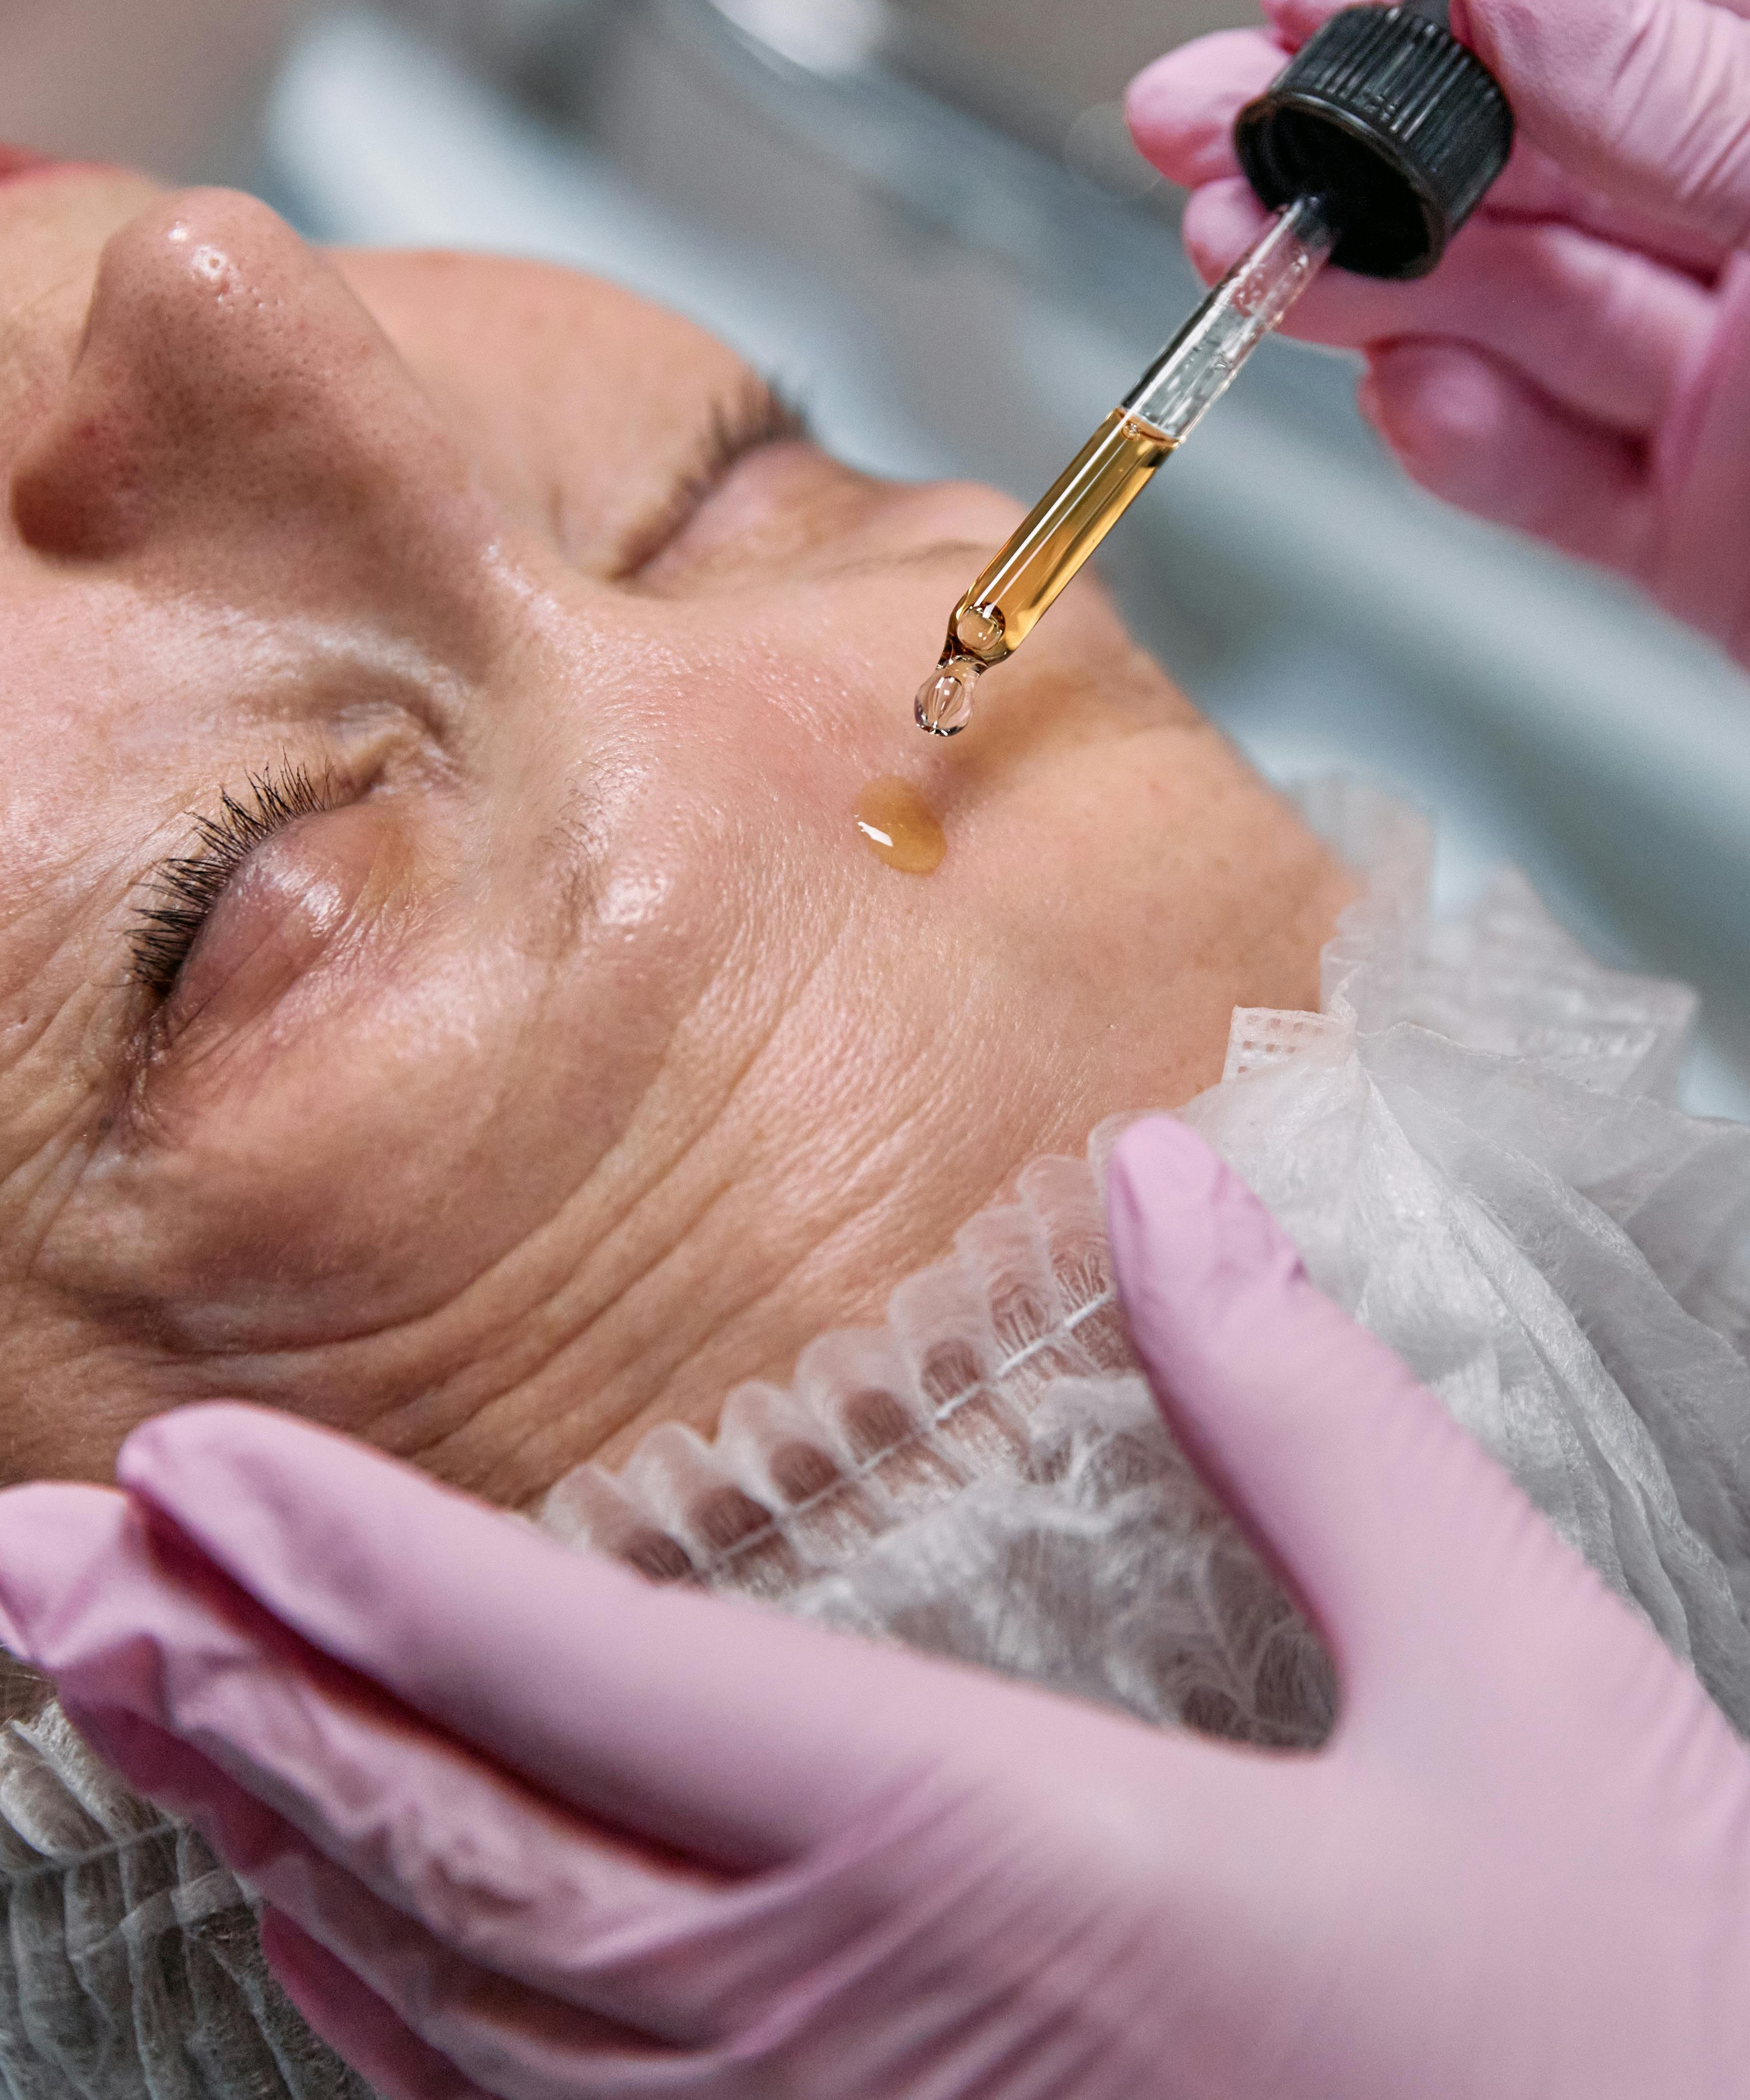
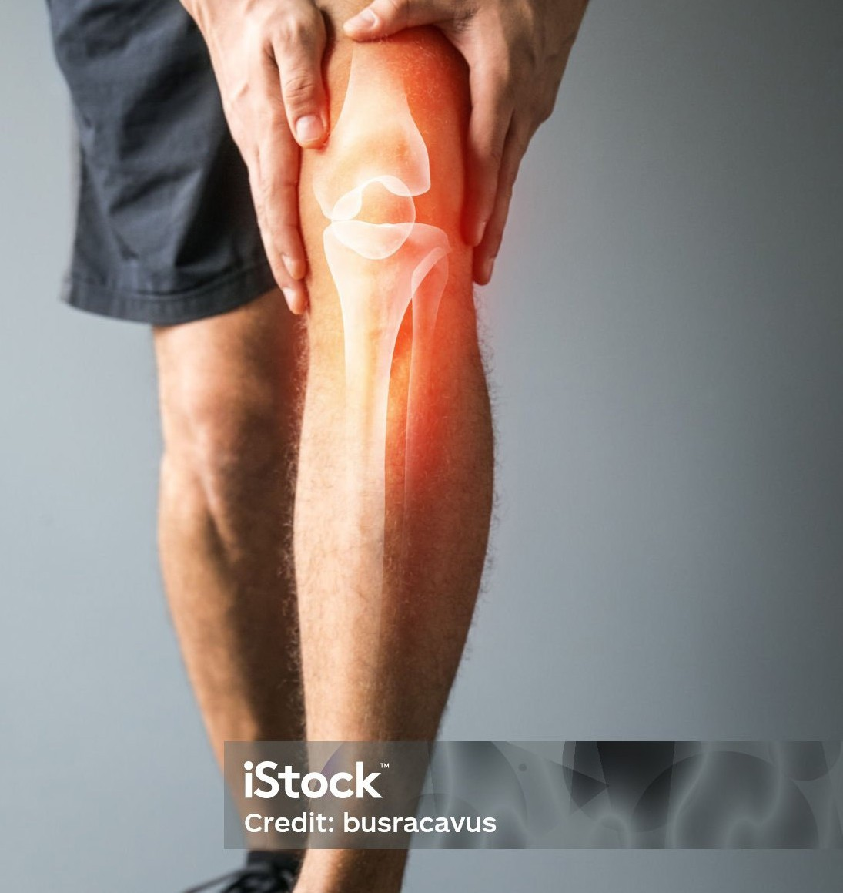
rUk MNuhf;fpak;:
Md;bMf;]pld;l;fs; epiwe;j jpuhl;ir rUkj;ij ,sikahfTk;> MNuhf;fpakhfTk; itj;jpUf;f cjTfpwJ
vYk;G MNuhf;fpak;:
jpuhl;irapy; cs;s itl;lkpd; K vYk;Gfspd; MNuhf;fpaj;jpw;Fk; Kf;fpakhdJ.

Slide 11
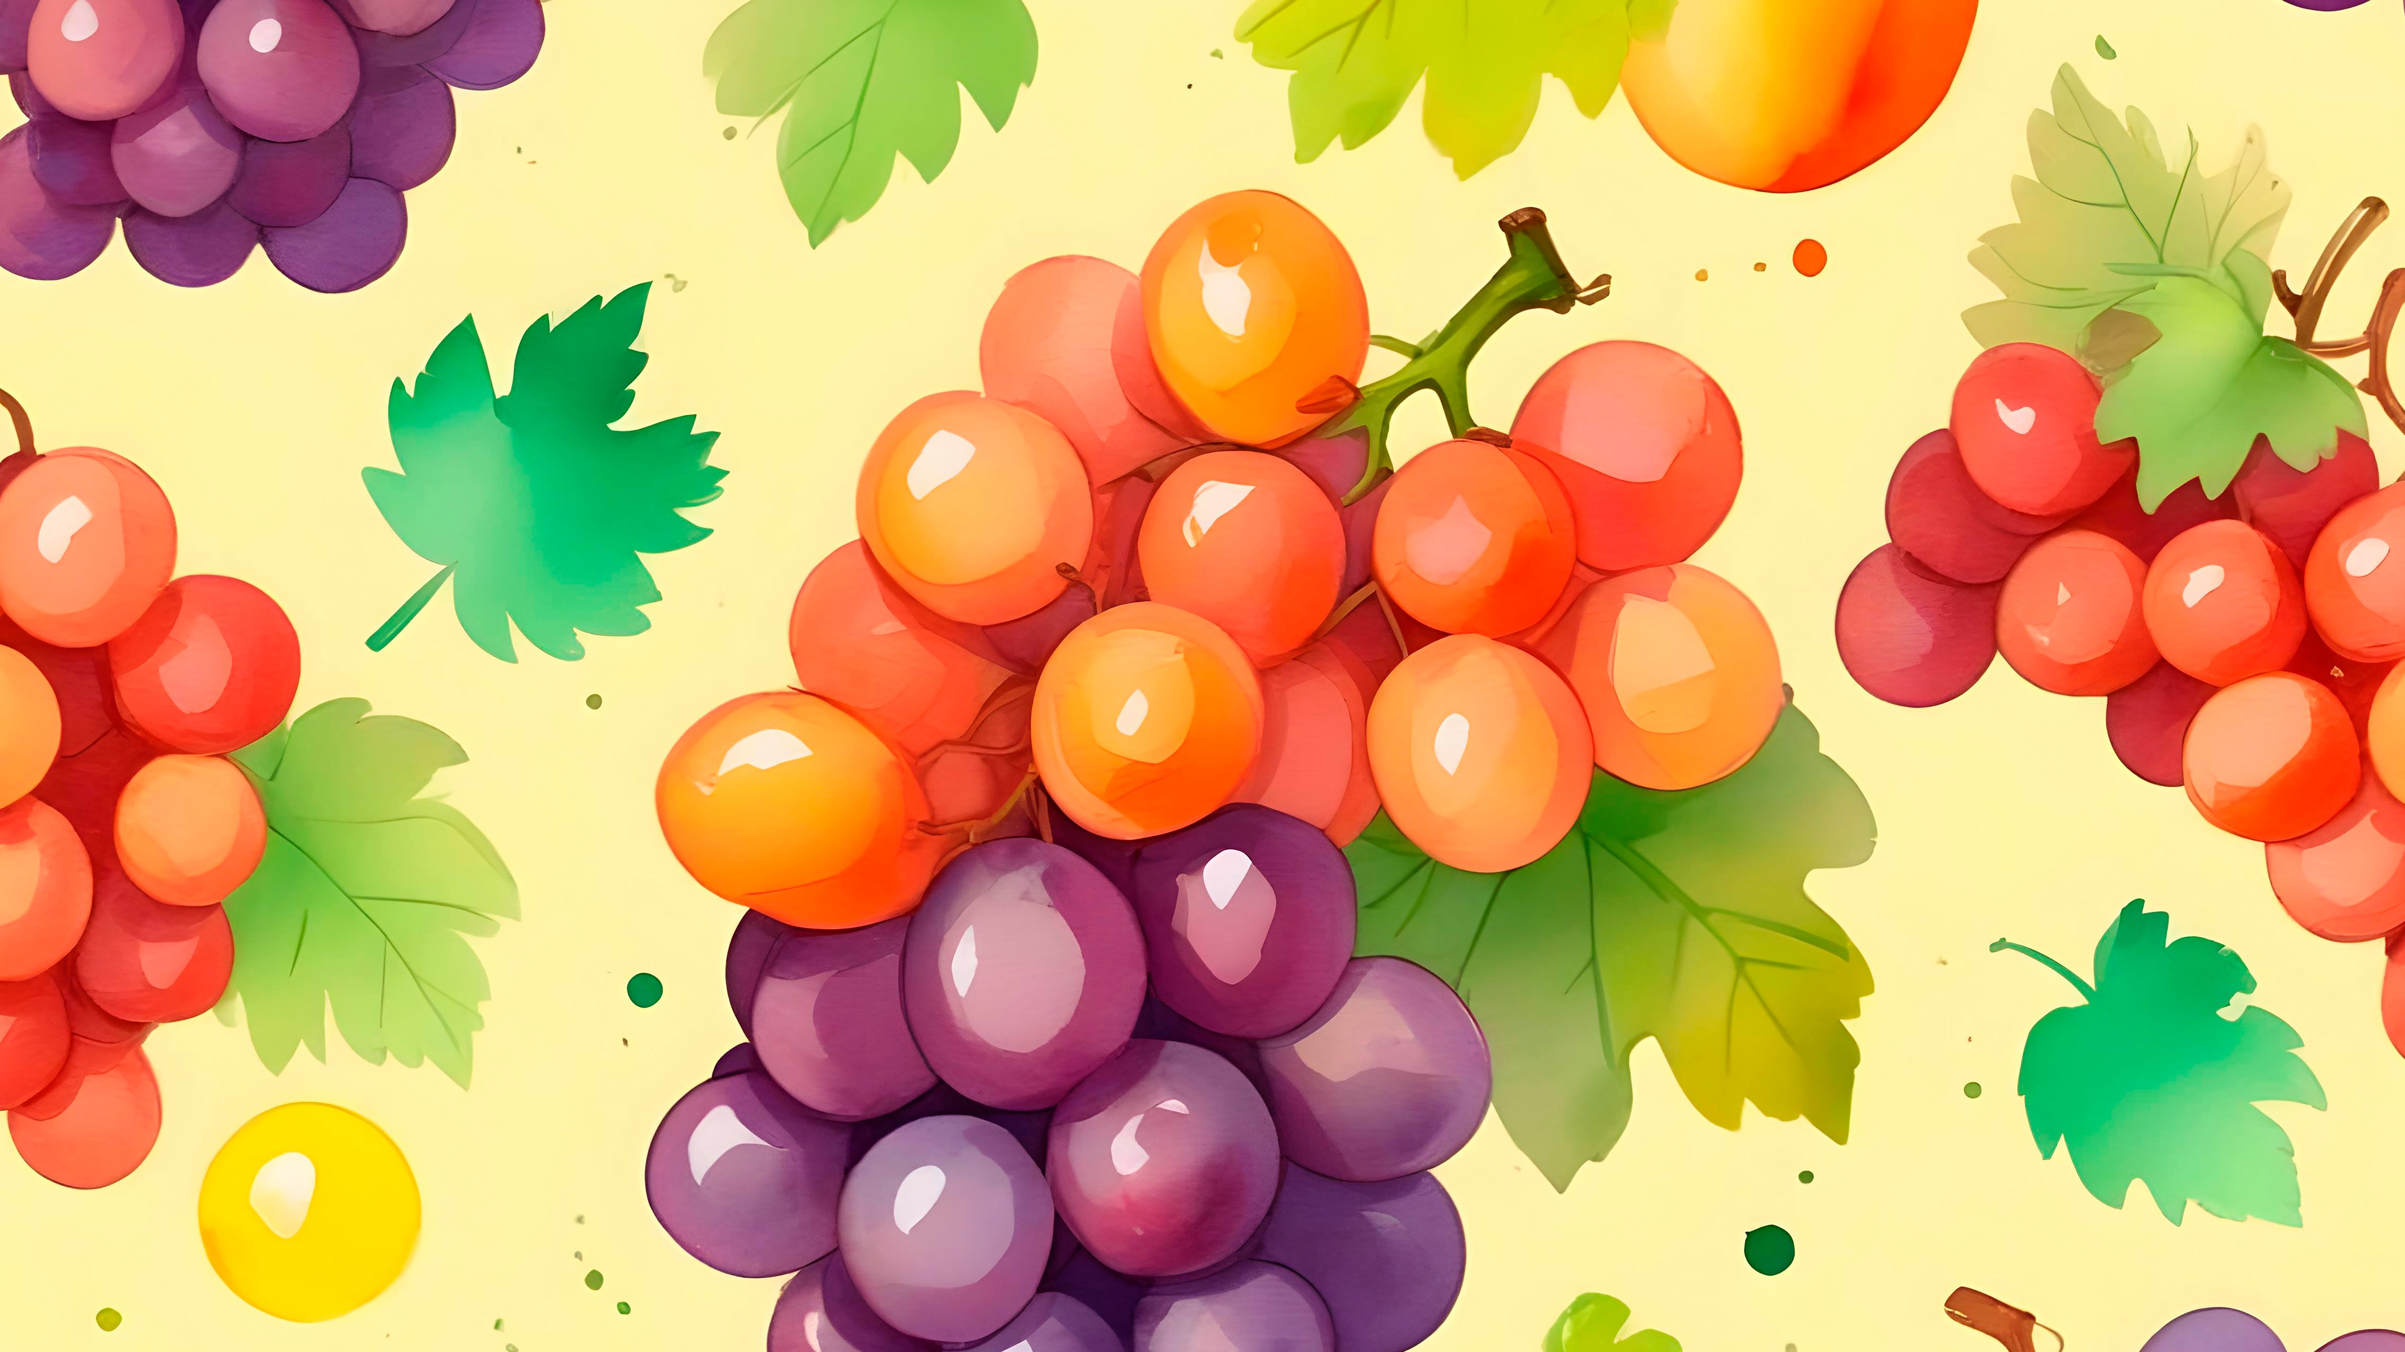
'vd;;dpy;; epiyj;;jpUq;;fs;;> ehDk;; cq;;fspy;; epiyj;;jpUg;;Ngd;;@ nfhbahdJ jpuhl;;rr;;nrbapy;;
epiyj;;jpuhtpl;;lhy;; mJ jhdha;;f;; fdpnfhLf;;fkhl;;lhjJNghy> ePPq;;fSk;; vd;;dpy;; epiyj;;jpuhtpl;;lhy;;> fdpnfhLf;;fkhl;;Bh;;fs;;".
Nahthd;:15:4

