Slide 1

,aw;if nra;jp
/gpskpq;Nfh(Flamingo)

Slide 2
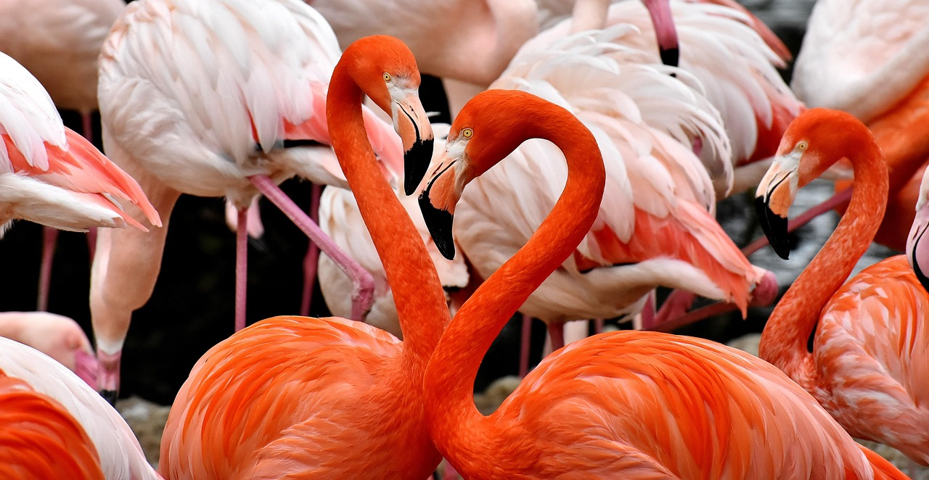
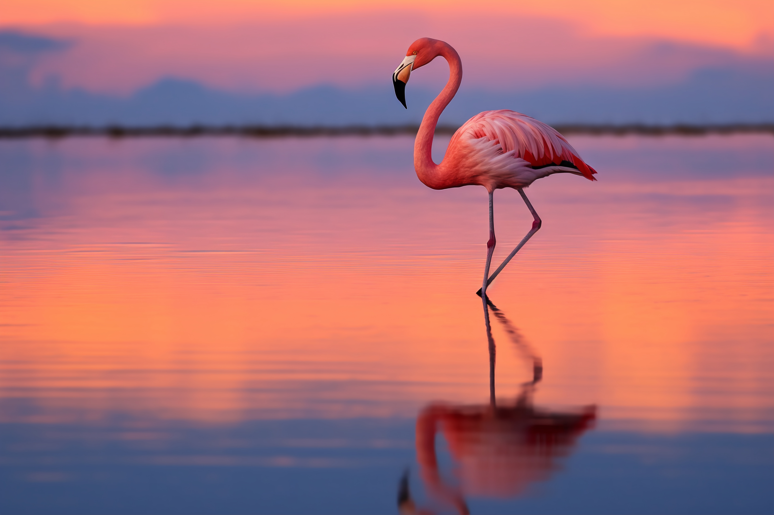
/gpskpq;Nfh(Flamingo):
/gpskpq;Nfh gwitiaj; jkpopy; “g+ehiu" my;yJ “nre;ehiu" vd;W miof;fpwhh;fs;. ,J ehiu FLk;gj;ijr; Nrh;e;j xU gwitahFk;.
,it rpW rpW $l;lq;fshfNth ngUq; FOf;fshfNth thOk;.
NtW ngah;fs;:
g+ehiu
nre;ehiu
nghpa g+ehiu: (Greater Flamingo)
Nfhz%f;Fg; g+ehiu
nrq;fhy; ehiu
gtsf;fhy; ehiu

Slide 3
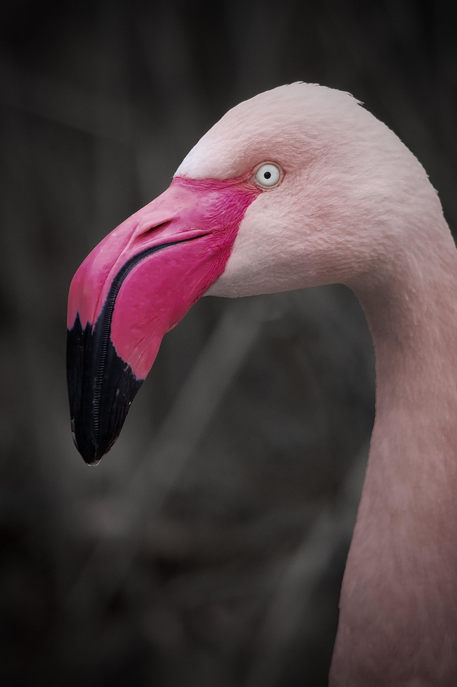
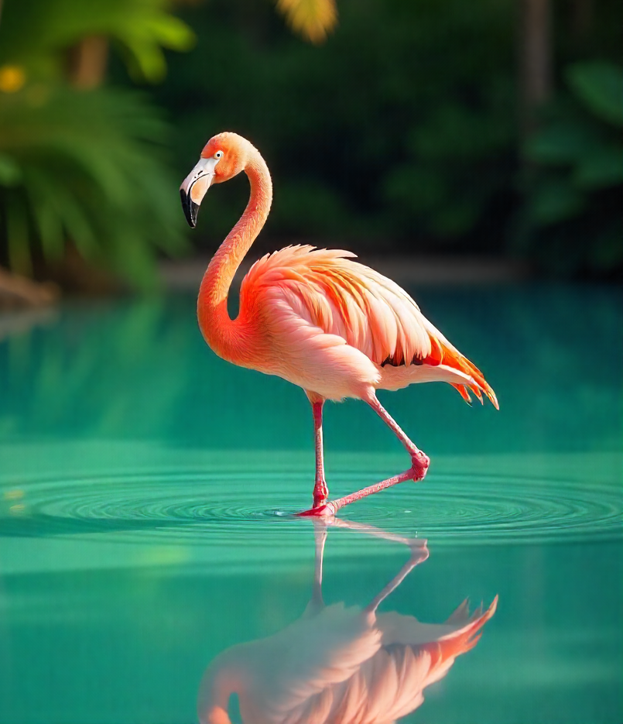
rpwg;G mk;rq;fs;:
tise;J jbkdhf ,Uf;Fk; mjd; mfykhd myF ,tw;wpd; kpfTk; jdpj;Jtkhd mk;rk; MFk;.
g+ehiufspd; fhy;fs; kw;Wk; myFk; ,sQ;rptg;G epwj;jpy; fhzg;gLfpd;wd.
/gpskpq;Nfhf;fs; 20 Kjy; 30 taJ tiu tho;fpd;wd.
3.3 - 4.6 mb cauKk; 3.3 - 9 gTz;Lfs; vilAk; nfhz;lJ.
/gpskpq;Nfhf;fs; nky;ypa fhy;fs;> ePz;l fOj;J> kw;Wk; nghpa ,wf;iffisf; nfhz;bUf;Fk;.
,it ngUk;ghYk; ,sQ;rptg;G epwj;jpy; ,Uf;Fk;.
Neha; gutyhf ,Ue;jhYk;> Gz;fs; nghJthf jhdhfNt FzkilfpwJ. (Neha; vjph;g;G rf;jp mjpfk;)

Slide 4
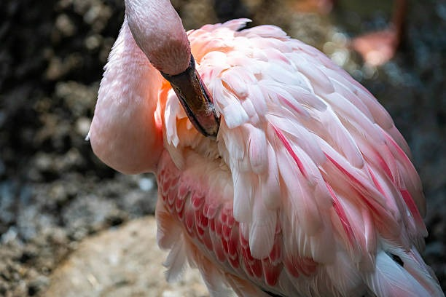
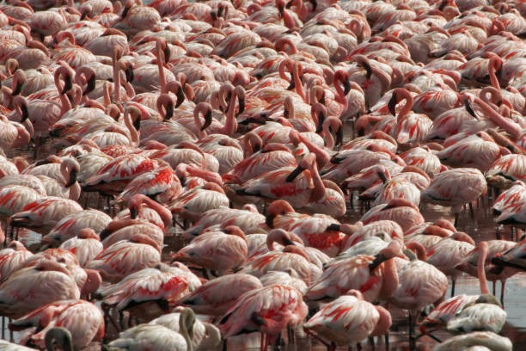
gpskpq;Nfhf;fs; jq;fs; ,wFfis Rj;jk; nra;tjpy; xU ehspy; 15-30% nrytpLfpd;wd.
xU rpwg;G Rug;gpapy; cw;gj;jp nra;ag;gLk; vz;nza; mtw;wpd; myFfs; cjtpAld; ,wFfs; kPJ gug;Gfpd;wd.
gy;yhapuk; g+ehiufs; xd;whf $b ,Ug;gJ ,tw;wpd; jdpj;jd;ik - ,JNt ,tw;Wf;F ghJfhg;Gk; mspf;fpd;wJ.
g+ehiufs; cg;G ePh; kw;Wk; ed;dPh; tho;tplq;fspy;> Fwpg;ghf fiuNahug; gFjpfspy; tho;fpd;wd
,it rj;jkpLtjpy;iy. MdhYk; rpy rkaq;fspy; thj;Jfs; Nghd;W xyp vOg;gf;$bait.

Slide 5
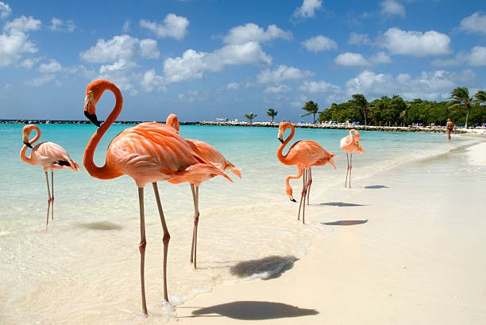
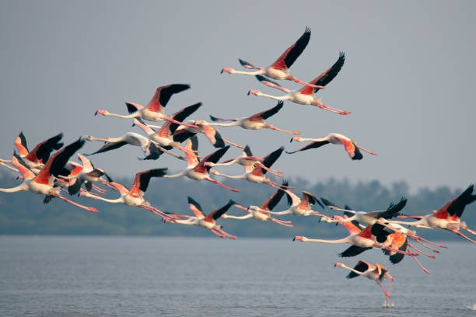
g+ehiuapd; tho;tplk;:
g+ehiufs; NrW gbe;j flw;fiu NkLfspYk;> cg;Gf; fyg;Gs;s mfd;w ePh;j; Njf;fq;fspYk; Mok; ,y;yhjf; Fsq;fspYk; $l;lk; $l;lkhf thOk; ,ay;Gilait.
g+ehiufs; ,e;jpahtpd; gy gFjpfspy; ,lk;ngauhky; tho;git vd;whYk; rpwpjsT cs;ehl;Lf;Fs;NsNa ,lg;ngah;T nra;fpd;wd.
,lk;ngah;tpd; NghJ> ​​gpskpq;Nfhf;fs; xU kzp Neuj;jpw;F 37 iky;fs; tiu gwf;fpwJ.
300 iky;fSf;F Nky; gazk; nra;J jq;fs; Gjpa tho;tplj;ij milthh;fs;.

Slide 6
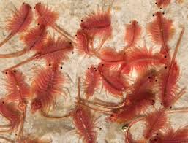
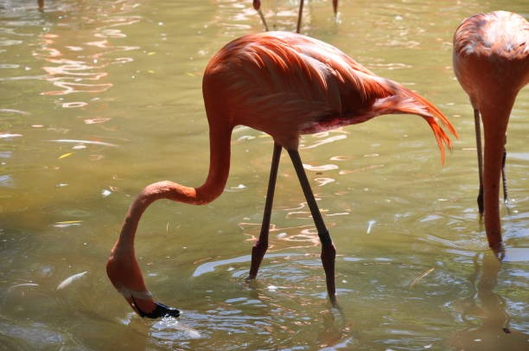
czTfs;:
rpW ez;L> $dpwhy;fs;> g+r;rpfs;> GOf;fs;> epyGOf;fs;> ePh;j;jhtuq;fspd; tpijfs;> mOfpg; gbe;j nghUl;fs; g+ehiuapd; Kf;fpa czTg; nghUs;fshFk;.
mitfspd; ,wFfspd; epwk; mitfspd; cztpd; tpisthFk;. mtw;wpd; cztpy; cs;s epwkpfs; (fNuhl;bdha;Lfs; - Carotenoids) vd miof;fg;gLfpd;wd.
,itfs; /gpskpq;Nfh gwitfspd; epwq;fSf;F fhuzkhfpd;wd

Slide 7
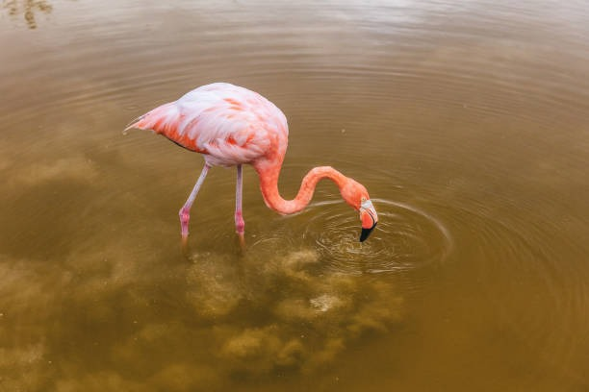
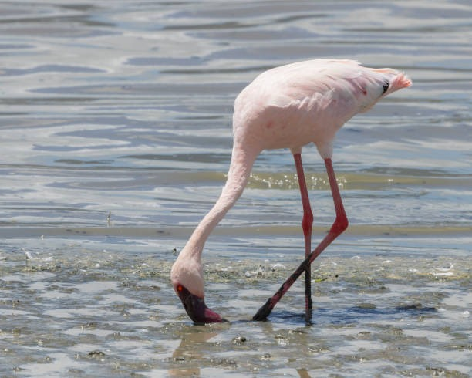
g+ehiuapd; cz;Zk; Kiw:
g+ehiufs; vspjpy; ePe;jf; $bad.
Mokw;w ePhpy; ,wq;fp thpirahf epd;W> jiyia ePUf;Fs; Mo;j;jpj; jdf;Nf chpa tpe;ijahd Nky; myifj; jiuapy; gLk;gb ftpo;j;J itj;J Kd;Nd ,Oj;Jf; nfhz;L Nrw;iwf; fyf;fpa tz;dk; elf;Fk;.
,e;epiyapy; Nky; myF fpz;zk; Nghy; mike;J> Nrw;W ePh; mjpy; Nrfhpf;fg;gLfpwJ.
rijg; gw;Ws;s ehf;F ,e;ePhpDs; xU kj;Jg; Nghy file;jthW> GO Gr;rpfis myRk;.
,jd; rPg;G Nghd;w myF> Xuq;fspy; cs;s ,ilntspfs; topNa ePh; ntspNawp g+r;rpfs; myfpNyNa jq;fptpLk;.
,jd; myF xU tbfl;b Nghy; nray;gLk;.

Slide 8
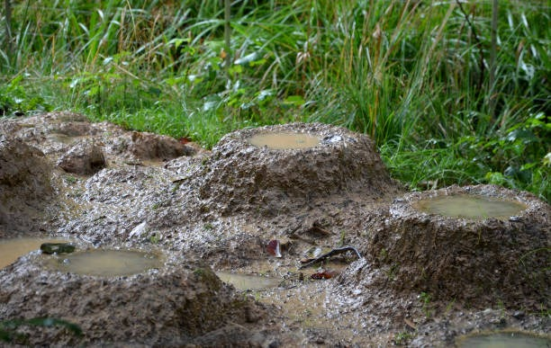
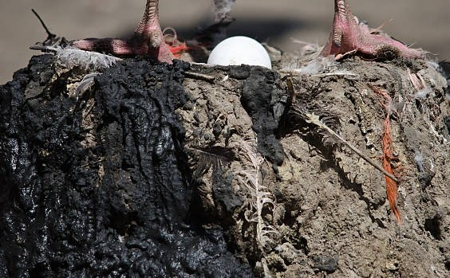
g+ehiuapd; $L:
g+ehiufs; $Lfl;b> Kl;ilapl;L FQ;R nghhpf;fpd;wd.
,tw;wpd; $L Nrw;W kz;izf; Ftpj;J Vw;gLj;jg;gLfpd;wJ.
g+ehiu <ukhd fspkz;zhy; $L fl;Lk;. <ukhd fspkz;izf; caukhff; $g;gp itf;fg;gl;l fpz;zk;Nghy; ,jd; $L ,Uf;Fk;.
#hpa ntg;gj;jhy; cyh;e;J nfl;bahf ,jd; $L mLg;gpy; itj;J Rl;lJ NghyNt Neh;j;jpahf ,Uf;Fk;.
,J Rkhh; 30 nr.kP caukpUf;Fk;. mit kz;ghid Nghd;w tbtpy; $Lfisf; fl;Lk; tof;fj;ijf; nfhz;Ls;sd.

Slide 9
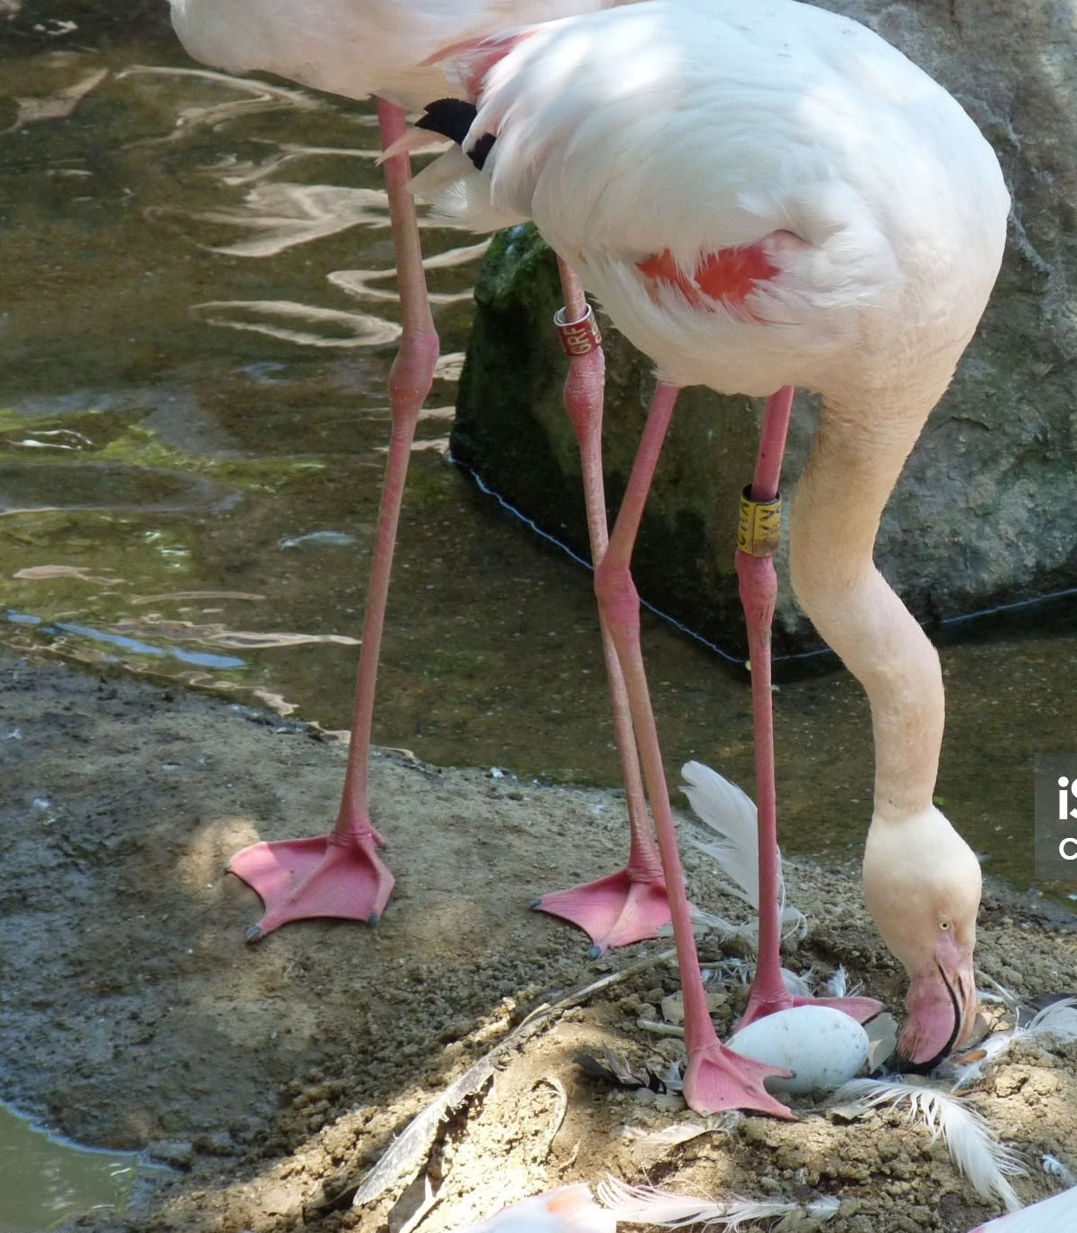
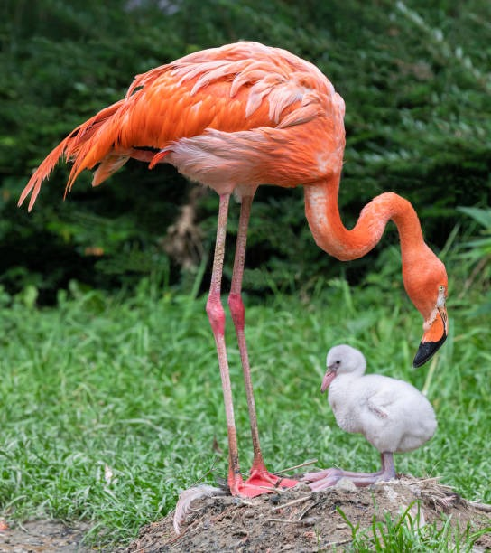
g+ehiuapd; ,dngUf;f Kiw:
gpskpq;Nfhf;fs; kz;zhy; Md $l;by; FQ;R nghhpf;Fk;.
g+ehiufs; xt;nthU Mz;Lk; xU Kl;ilia cw;gj;jp nra;fpwJ.
Rz;zhk;G-nts;is epwj;jpy; Kl;ilia ,Lfpd;wd.
g+ehiu FQ;R gpwf;Fk;NghJ "nts;is gQ;RNghd;w ge;J" Nghy fhzg;gLk; vd;W tpthpf;fg;gLfpwJ.
Muk;gj;jpy; ngw;NwhUld; ,Uf;Fk; FQ;Rfs;> ghJfhg;G kw;Wk; r%fkakhf;fYf;fhfr; rpy thuq;fSf;Fg; gpwF FOthf xd;WNrh;fpd;wd.

Slide 10
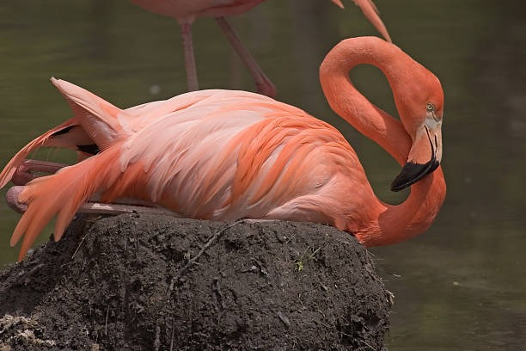
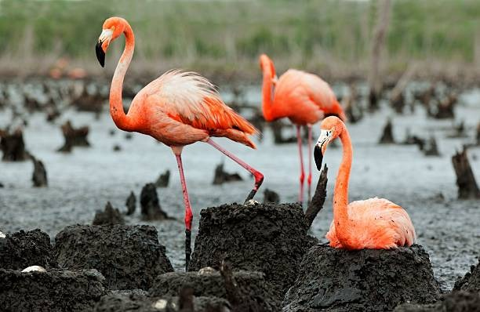
gpskpq;Nfhf;fs; xNu xU JizAld; tho;fpwJ
,dr;Nrh;f;if Kbe;J> $l;bd; cr;rpapYs;s Fopapy; ruhrhpahf xU Kl;ilapLk;.
Kl;ilapl;lgpd; Mz;> ngz; g+ehiufs; ,uz;LNk xd;W khw;wp xd;W mil fhf;Fk;> milfhf;Fk; ehiu ,jd;Nky; fhy;fis klf;fpf; nfhz;L jhd; cl;fhh;e;J milfhf;Fk;.
,UtUk; jq;fs; FQ;Rf;F nfhOg;Gfs; kw;Wk; Gujq;fs; epiwe;j ghy; Nghd;w nghUisf; nfhz;L cztspf;fpwd;wd.

Slide 11
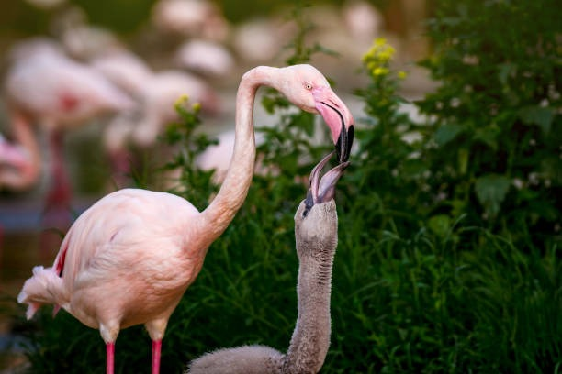
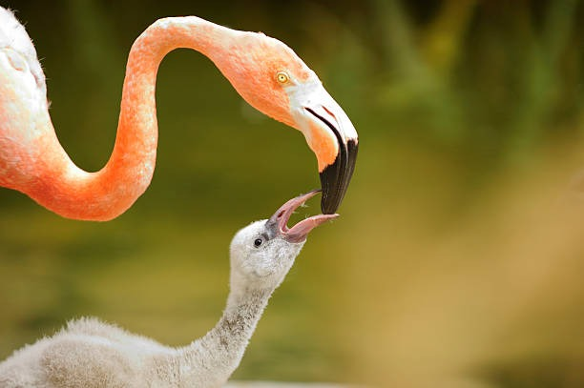
crop milk (FQ;R gwitapd; czT:
Gjpjhfg; gpwe;j FQ;Rfshy; jq;fSf;Fj; jhq;fNs czT Njbf; nfhs;s KbahJ> vdNt ngw;Nwhh;fs; ,UtUk;; epwkpfs; epiwe;j nre;epw “crop milk"-I (gaph; ghy;) FQ;Rfspd; thapy; ff;fpf; nfhLf;fpd;wd.
,e;j ghy;> Gujk; kw;Wk; nfhOg;G epiwe;j xU Cl;lr;rj;J kpf;f jputkhFk;.
Mz; kw;Wk; ngz; /gpskpq;Nfhf;fspd; czTf; Fohapy; (Digestive Tract) cs;s rpwg;G Rug;gpfs; %yk; ,e;j ghy; cw;gj;jp nra;ag;gLfpwJ.
FQ;Rfs; tsu tsu mtw;wpd; myFfs; tise;J> rpy thuq;fspy; jhdhf czit cz;zf; fw;Wf;nfhs;fpd;wd.
gy khjq;fSf;Fg; gpwF> fNuhl;bdha;Lfs; epiwe;j czTfis cl;nfhz;L> mtw;iw tsh;rpij khw;wk; nra;Ak; NghJ mtw;wpd; rpwFfs; ,sQ;rptg;G epwkhf khWfpwJ.

Slide 12
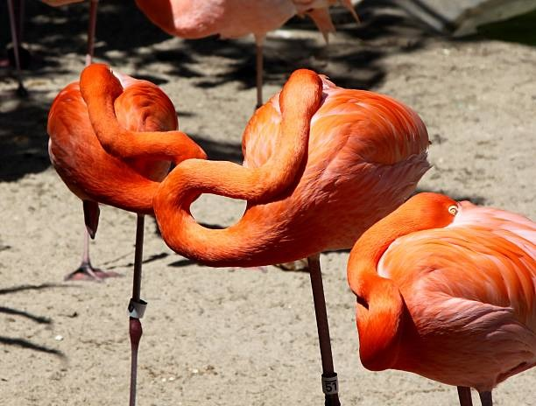
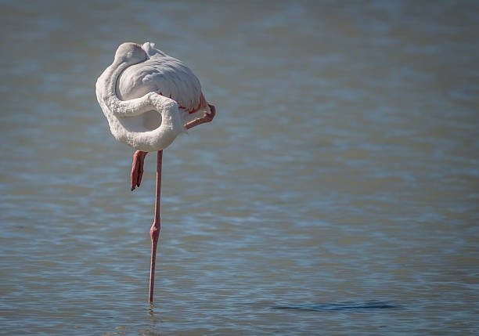
g+ehiuapd; Xa;T Neuk;:
g+ehiu gwitfs; ngUk;ghYk; ePhpy; epd;wgb cwq;Fk; jd;ik nfhz;lit
mitfs; Xa;ntLf;f tpUk;Gk;NghJ> gpskpq;Nfhf;fs; xU fhypy; epw;fpd;wd.
/gpskpq;Nfhf;fs; xU fhypy; epd;W jiyia KJfpy; rha;j;J J}q;Fk;. ,e;j epiy tprpj;jpukhfj; Njhd;wpdhYk;> /gpskpq;Nfhf;fSf;F ,J kpfTk; rhjhuzkhdJ.
thdpiy mDkjpj;jhy;> mit ,uz;L Kjy; %d;W kzp Neuk; tiu njhlh;e;J J}q;Ffpd;wd.
/gpskpq;Nfhf;fs; czT Njb ngUk;ghyhd Neuj;ij Mokw;w ePhpy; nrytpLfpd;wd.

Slide 13
g+ehiuaplkpUe;J fw;Wf;nfhs;s Ntz;ba ghlk;:
/gpskpq;Nfh gwit vg;gb jd; czit Njb> mhpj;J rhg;gpLfpwJ Nghy ehKk; Mtpf;Fhpa czthfpa Ntjj;ij Njb Muha;e;J gbf;f Ntz;Lk;. (Nahthd; 5:39 Ntjthf;fpaq;fis Muha;e;J ghUq;fs;@ mitfshy; cq;fSf;F epj;jpa[Ptd; cz;nld;W vz;ZfpwPh;fNs> vd;idf;Fwpj;Jr; rhl;rpnfhLf;fpwitfSk; mitfNs.)
/gpskpq;Nfh gwitfs; vg;gb Fiwe;j Neuk; cwq;fp mjpf Neuk; tpopj;jpUf;fpwJ Nghy ehKk; ek;Kila n[g tho;tpy; tpopj;jpUe;J n[gpf;f Ntz;Lk;. (kj;NjA 26:41 ePq;fs; Nrhjidf;Fl;glhjgbf;F tpopj;jpUe;J n[gk;gz;Zq;fs;@)
mJ cz;Zk; cztpy; ,Ue;J vLj;Jf;nfhs;Sk; rj;Jfis jd; epwj;jpd; %ykhf ntspg;gLj;JfpwJ. me;j gbNa ehKk; gbj;j rj;jpaj;ij tho;f;ifapy; filgpbj;J NjtDf;fhf gpufhrpf;fpw gps;isfshf ,Uf;f Ntz;Lk;.(kj;NjA 5:14 ePq;fs; cyfj;Jf;F ntspr;rkhapUf;fpwPh;fs;@ kiyapd;Nky; ,Uf;fpw gl;lzk; kiwe;jpUf;fkhl;lhJ.)

Slide 14
/gpskpq;Nfh Mz; gwitAk;> ngz; gwitAk; ,ize;J FQ;Rfis ghJfhf;fpwJ Nghy ngw;Nwhuhfpa ehKk; ek; gps;isfis ,ize;J ghJfhf;f Ntz;Lk;. (vNgrpah; 6:4 gpjhf;fNs> ePq;fSk; cq;fs; gps;isfisf; Nfhgg;gLj;jhky;> fh;j;jUf;Nfw;w rpl;irapYk; NghjidapYk; mth;fis tsh;g;gPh;fshf.)
/gpskpq;Nfh FQ;Rfshy; czit Njb nry;y Kbahj Neuj;jpy; ngw;Nwhh; gwitfs; mjw;F cztspf;fpwJ Nghy rpW tajpy; ek; gps;isfshy; Njtid mwpe;J nfhs;s Kbahj Neuj;jpy; ngw;Nwhuhfpa ehKk; Ntj ghlq;fis; nrhy;ypf; nfhLf;f Ntz;Lk;. (ePjpnkhopfs; 22:6 gps;isahdtd; elf;fNtz;ba topapNy mtid elj;J@ mtd; Kjph;tajpYk; mij tplhjpUg;ghd;.)
/gpskpq;Nfh gwitfs; vg;gb $l;lkhf tho;fpwJ Nghy ehKk; midtNuhLk; ,ize;J Njt md;ig ntspg;gLj;jp mtUila ehkk; kfpikf;fhf tho Ntz;Lk;. (Nuhkh; 12:10 rNfhjurpNefj;jpNy xUth;NknyhUth; gl;rkhapUq;fs;.)

Slide 15


“ePq;fs; vd;dplj;jpy; md;ghapUe;jhy; vd; fw;gidfisf; iff;nfhs;Sq;fs;.”
Nahthd; 14:15
Njtd; gilj;j Nehf;fj;ij /gpskpq;Nfh gwit epiwNtw;WfpwJ> ehKk; Njtd; ek;ik gilj;j Nehf;fj;ij epiwNtw;WNthk;! mtUf;fhf tho;Nthk;! khuehjh! Mnkd;!

