Slide 1
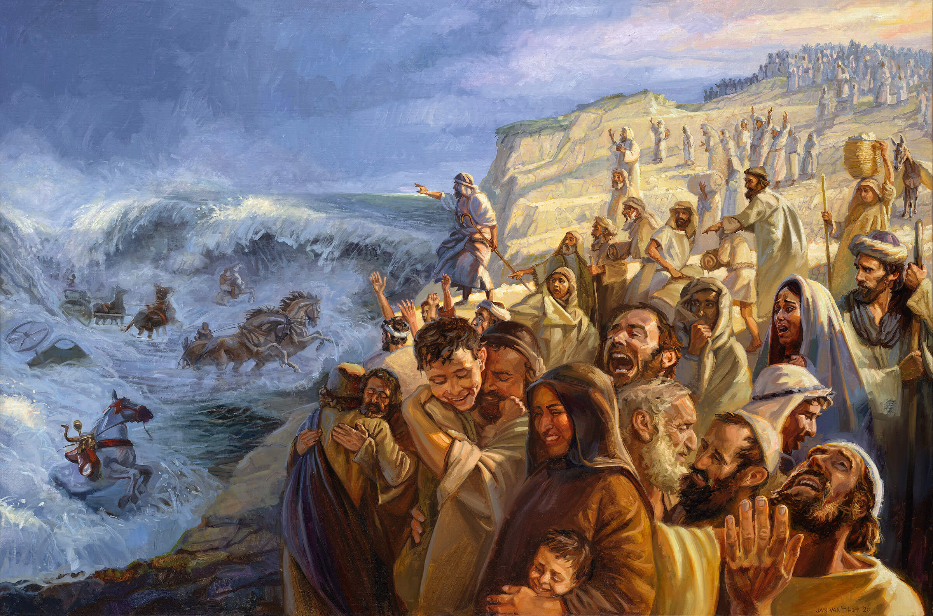
NkhNrapd; ghly;fs;
ahj;jpuhfkk; 15:1-18

Slide 2
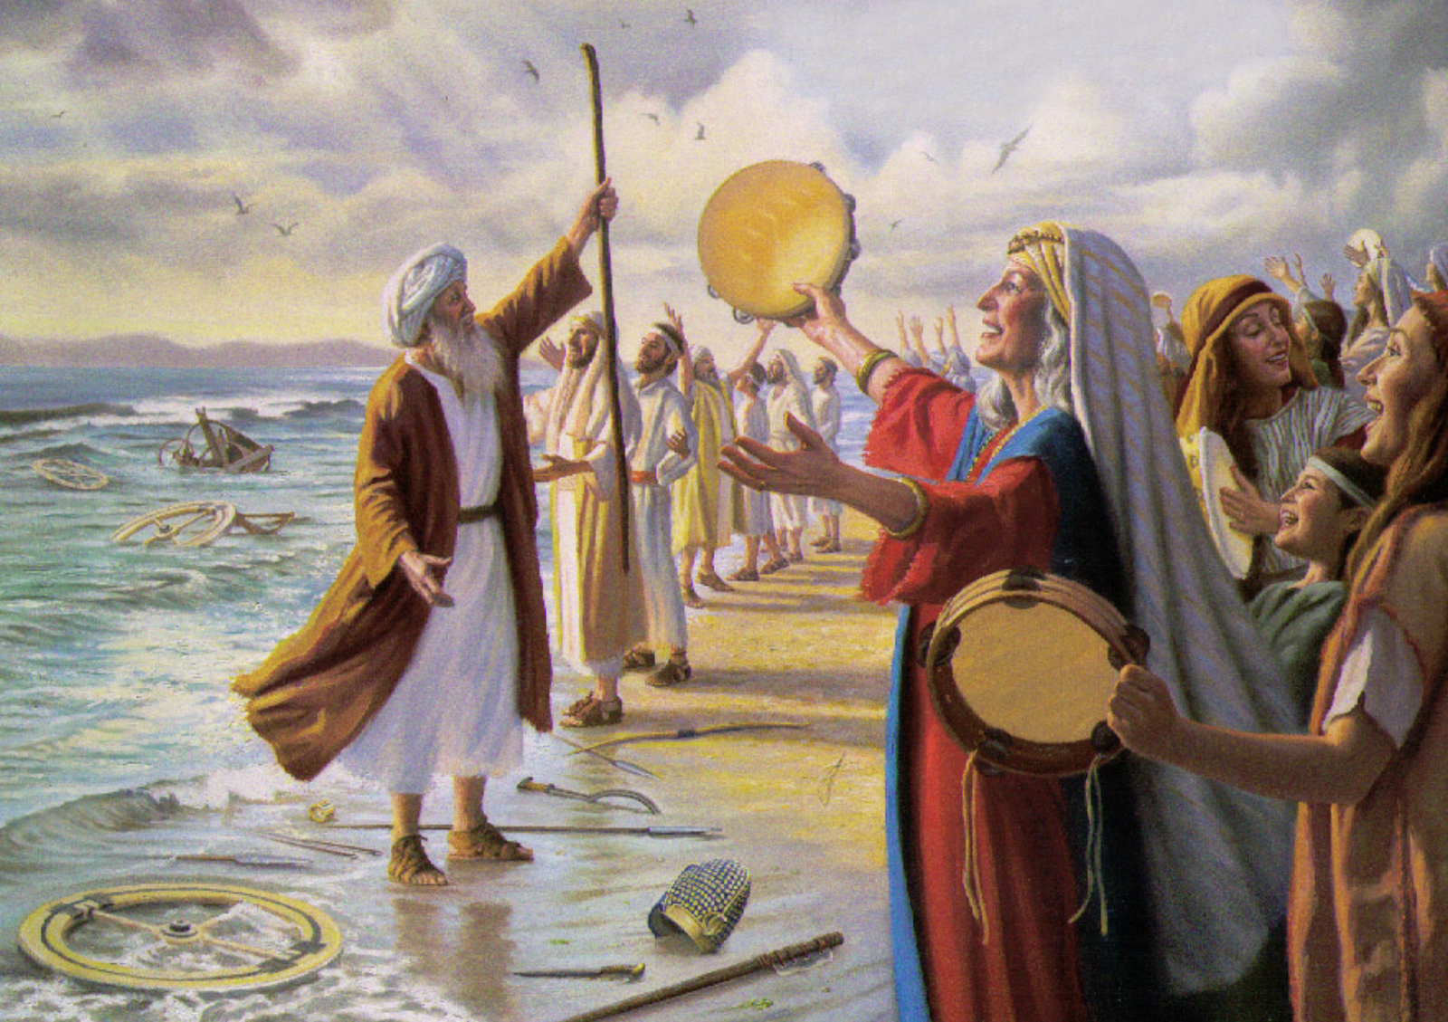
Njtid cau;j;Jjy; (t. 1-3)
mg;nghOJ NkhNrapd; Gj;jpuUk; ,];uNty; Gj;jpuUk; NaNfhthTf;F ghbd ghl;L:
fh;;j;jiug; ghLNtd;@ mth; kfpikaha; ntw;wprpwe;jhh;@ FjpiuiaAk; FjpiutPuidAk; flypNy js;spdhh;..
fh;j;jh; vd; ngyDk; vd; fPjKkhdth;@ mth; vdf;F ,ul;rpg;Gkhdth;@
mtNu vd; Njtd;> mtUf;F thr];jyj;ij Maj;jk;gz;ZNtd;@ mtNu vd; jfg;gDila Njtd;> mtiu cah;j;JNtd;@
fh;j;jNu Aj;jj;jpy; ty;yth;@ fh;j;jh; vd;gJ mtUila ehkk;.

Slide 3
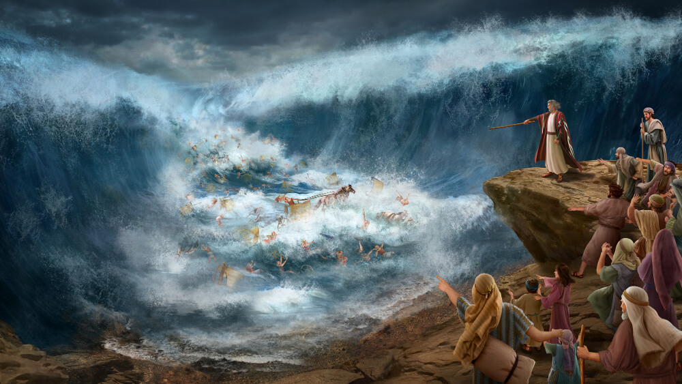
ghu;Nthdpd; kPJ fu;j;jupd; ntw;wp (t. 4-5)
ghh;Nthdpd; ,ujq;fisAk; mtd; NridfisAk; rKj;jpuj;jpNy js;sptpl;lhh;@;
mtDila gpujhd mjpgjpfs; rpte;j rKj;jpuj;jpy; mkpo;e;J Nghdhh;fs;.
Mop mth;fis %bf;nfhz;lJ@
fy;iyg;Nghy Moq;fspy; mkpo;e;JNghdhh;fs;.

Slide 4

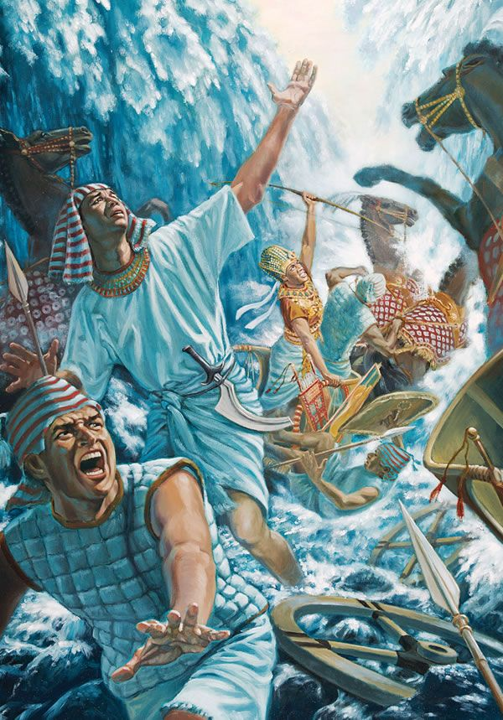
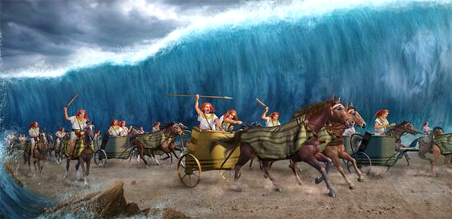
fu;j;jUila kfj;Jtk; epiwe;j kfpik (t. 6-7)
fh;j;jhNt> ck;Kila tyJfuk; gyj;jpdhy; kfj;Jtk; rpwe;jpUf;fpwJ@
fh;j;jhNt> ck;Kila tyJfuk; gifQid nehWf;fptpl;lJ.
ckf;F tpNuhjkha; vOk;gpdth;fis ckJ Kf;fpaj;jpd; kfj;Jtj;jpdhNy eph;%ykhf;fpdPh;@
ck;Kila Nfhghf;fpdpia mDg;gpdPh;> mJ mth;fisj; jhsbiag;Nghyg; gl;rpj;jJ.

Slide 5

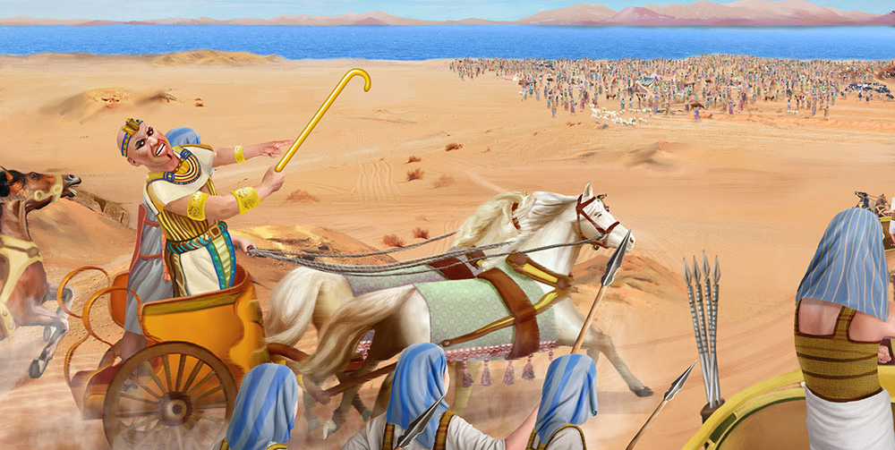
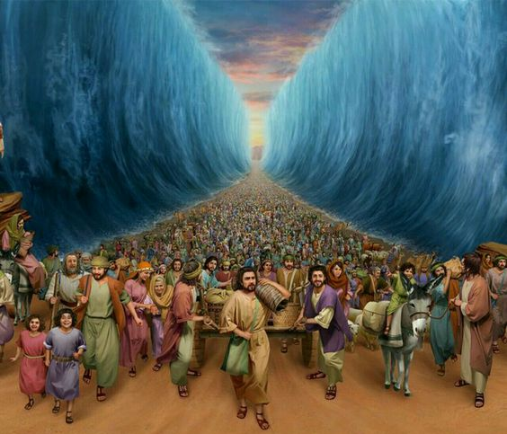
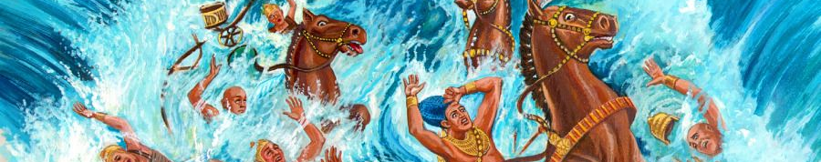
NjtDila rpU\;bg;G> ty;yik kw;Wk; epahaj;jPu;g;G (t. 8-10)
ckJ ehrpapd; Rthrj;jpdhy; [yk; Ftpe;J epd;wJ@ nts;sk; Ftpayhf epkph;e;J epd;wJ@
Mokhd [yk; eLf;flypNy ciwe;JNghapw;W.
njhlUNtd;> gpbg;Ngd;> nfhs;isahbg; gq;fpLNtd;> vd; Mir mth;fsplj;jpy; jph;g;jpahFk;> vd; gl;laj;ij cUTNtd;> vd; if mth;fisr; rq;fhpf;Fk; vd;W gifQd; nrhd;dhd;.
ck;Kila fhw;iw tPrg;gz;zpdPh;> fly; mth;fis %bf;nfhz;lJ@ jpushd jz;zPh;fspy; <ak;Nghy mkpo;e;JNghdhh;fs;.

Slide 6

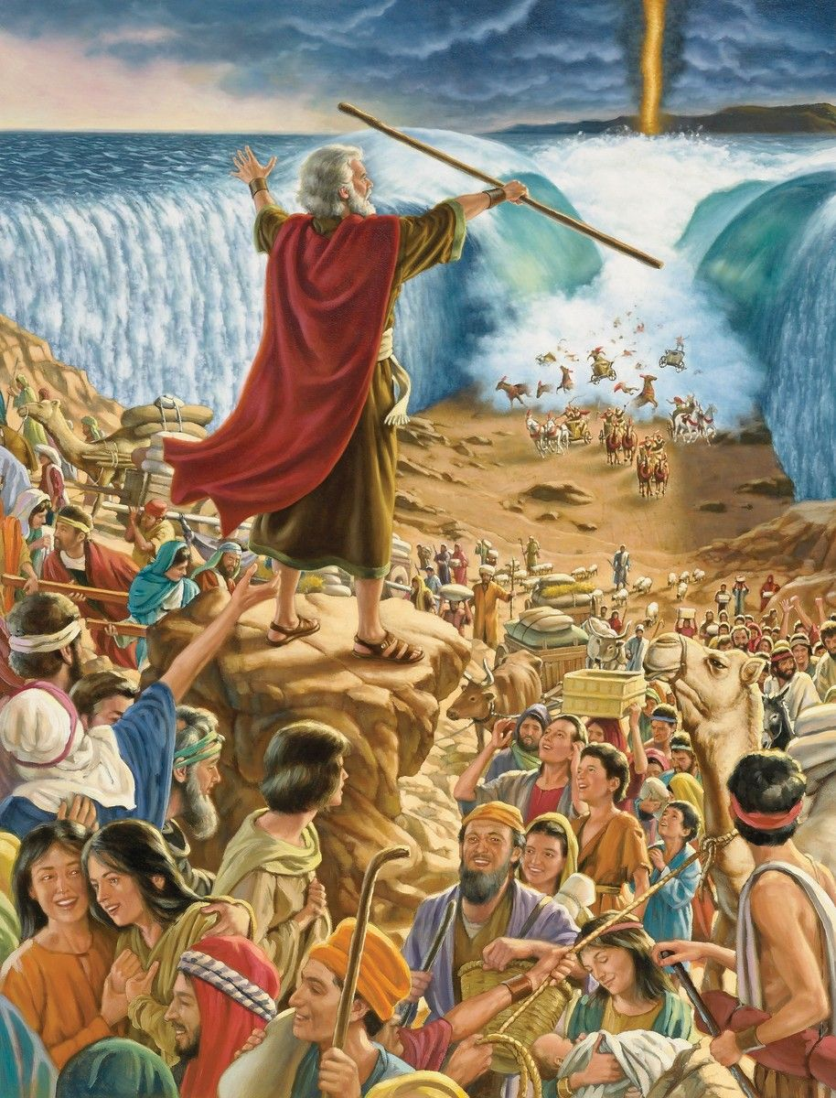
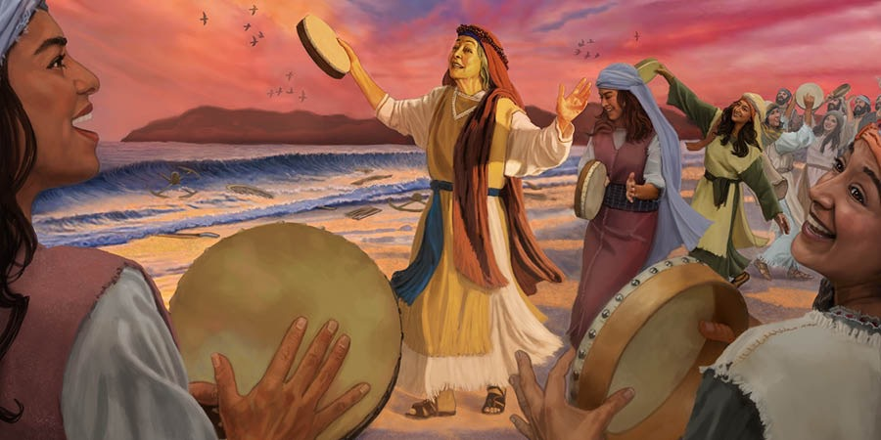
NjtDila jdpj;jd;ik (t. 11)
fh;j;jhNt> Njth;fspy; ckf;F xg;ghdth; ahh;?
ghpRj;jj;jpy; kfj;JtKs;stUk;> Jjpfspy; gag;glj;jf;ftUk;> mw;Gjq;fisr; nra;fpwtUkhfpa ckf;F xg;ghdth; ahh;?

Slide 7

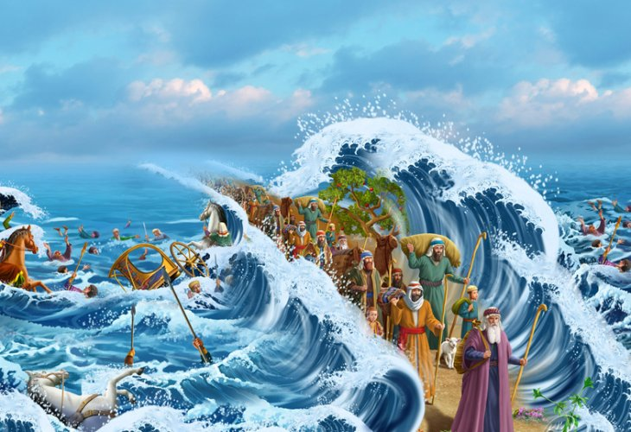
fu;j;jUila md;Gk; nja;tPf vjpupfsplkpUe;J tpLjiyAk; (t. 12-16K)
ePh; ckJ tyJfuj;ij ePl;bdPh;@ G+kp mth;fis tpOq;fpg;Nghl;lJ.
ePh; kPl;Lf;nfhz;l ,e;j [dq;fis ckJ fpUigapdhNy mioj;J te;jPh;@ ck;Kila ghpRj;j thr];jyj;Jf;F Neuhf mth;fis ckJ gyj;jpdhy; topelj;jpdPh;.
[dq;fs; mijf; Nfl;Lj; jj;jspg;ghh;fs;@ ngyp];jpahtpd; Fbfisj; jpfpy; gpbf;Fk;.
VNjhkpd; gpuGf;fs; fyq;Fthh;fs;@ Nkhthgpd; guhf;fpukrhypfis eLf;fk; gpbf;Fk;@ fhdhdpd; Fbfs; ahtUk; fiue;JNghthh;fs;.
gaKk; jpfpYk; mth;fs;Nky; tpOk;. fh;j;jhNt> ckJ [dq;fs; fle;JNghFk;tiuAk;> ePh; kPl;l [dq;fNs fle;JNghFk;tiuAk;> mth;fs; ck;Kila Gaj;jpd; kfj;Jtj;jpdhy; fy;iyg;Nghy mirtw;wpUg;ghh;fs;.

Slide 8
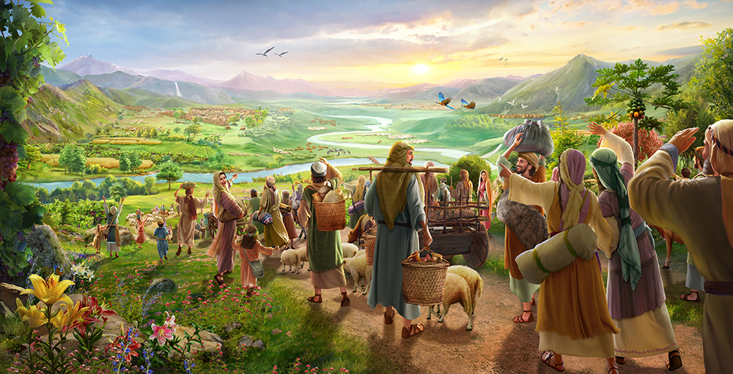
fu;j;ju; ,uh[h>thf;Fg;gz;zg;gz;zg;l;l Njrj;jpy; jk;Kila [dq;fSf;nfd;W jUfpwhu; (ahj;. 16K-18)
fh;j;jhNt> ckJ [dq;fs; fle;JNghFk;tiuAk;> ePh; kPl;l [dq;fNs fle;JNghFk;tiuAk;> mth;fs; ck;Kila Gaj;jpd; kfj;Jtj;jpdhy; fy;iyg;Nghy mirtw;wpUg;ghh;fs;.
ePh; mth;fisf; nfhz;LNgha;> fh;j;juhfpa NjthPh; thrk;gz;Zfpwjw;F epakpj;j ];jhdkhfpa ck;Kila Rje;juj;jpd; gh;tjj;jpYk;> Mz;ltuhfpa NjthPUila fuq;fs; ];jhgpj;j ghpRj;j ];jyj;jpYk; mth;fis ehl;LtPh;.
fh;j;jh; rjhfhyq;fshfpa vd;nwd;iwf;Fk; uh[hpfk; gz;Zthh;.

Slide 9
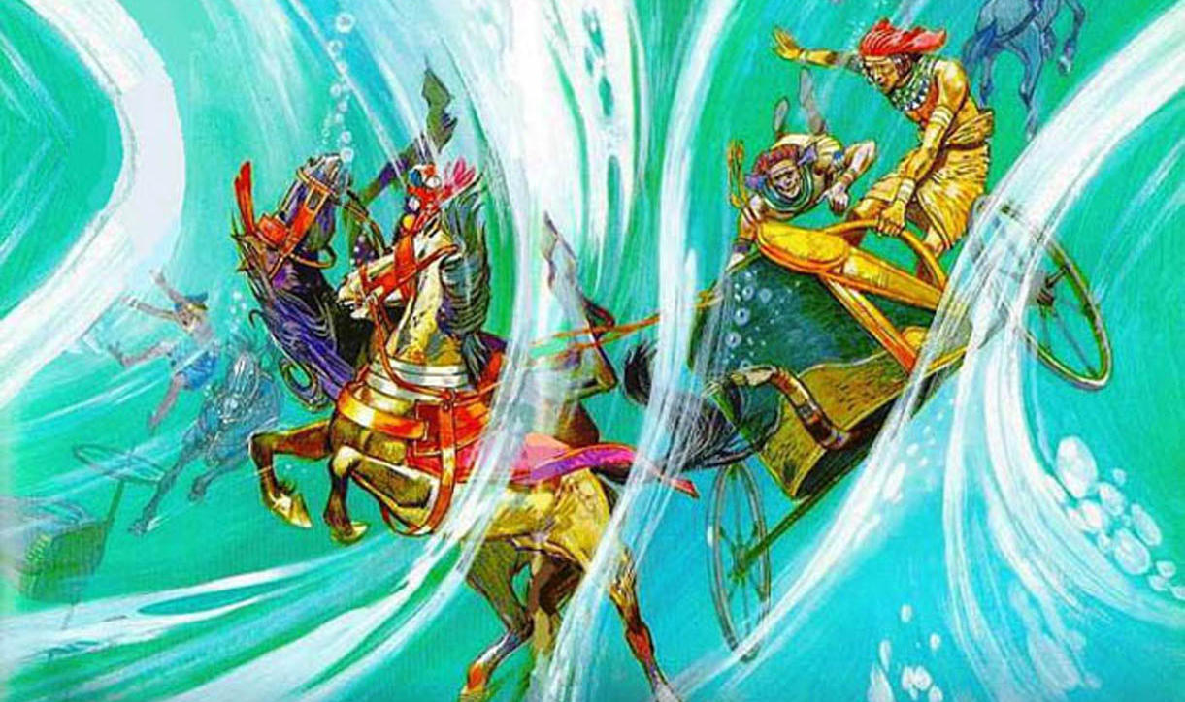
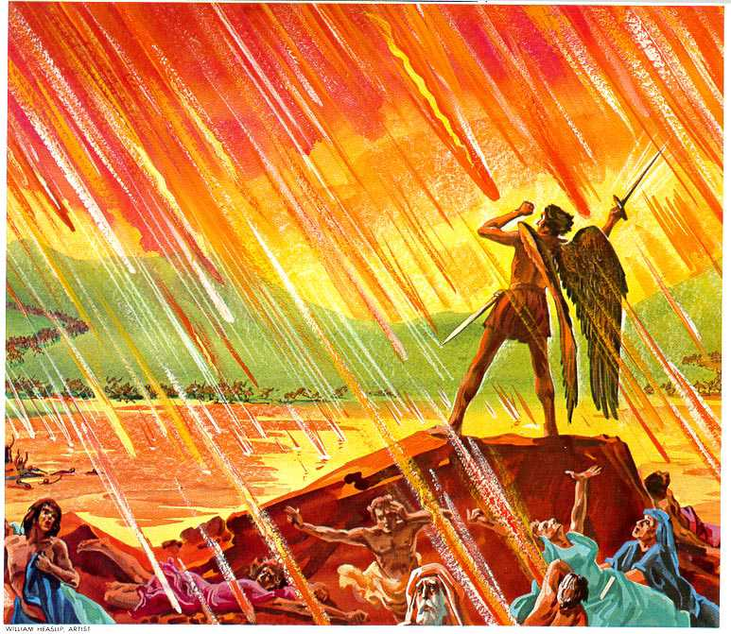
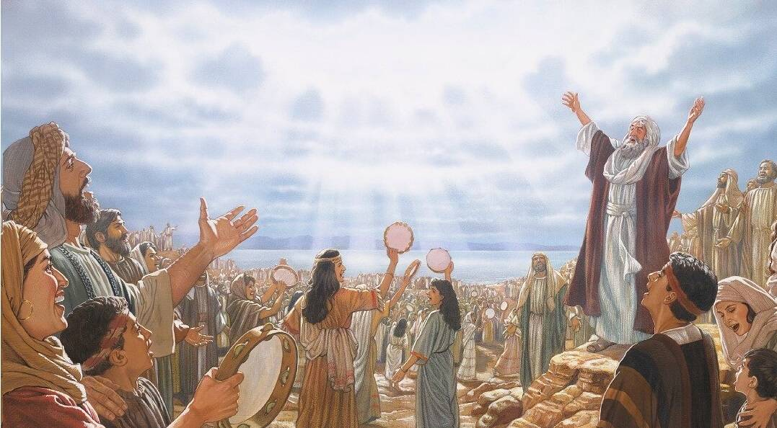
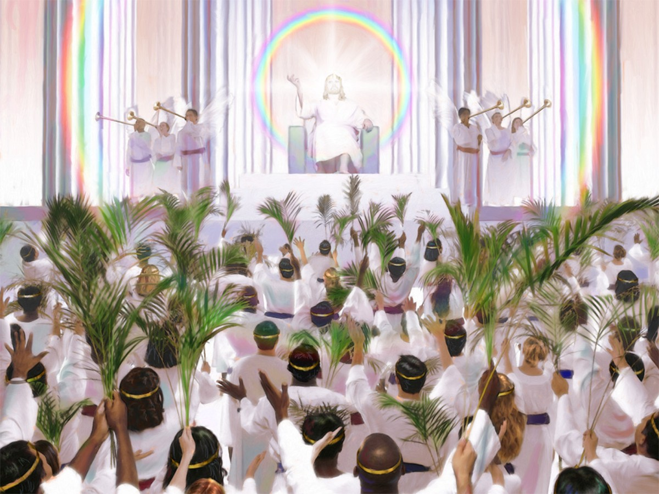
ahj;jpufkk; 15:1-18
ntsp 20:7-10; 15:1-4

