Slide 1
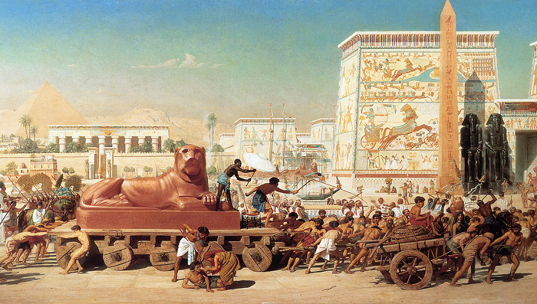
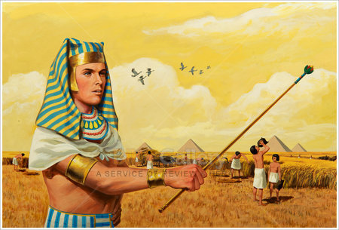
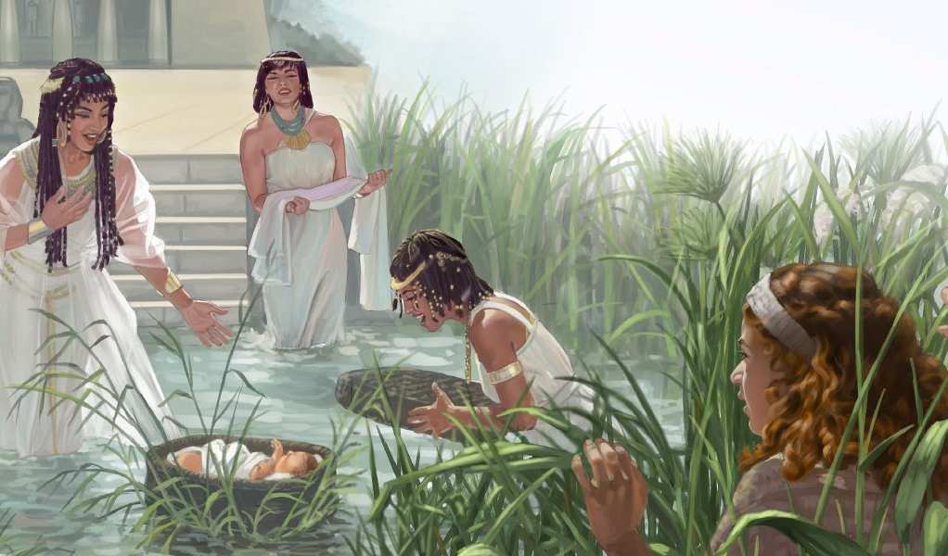
Lesoni 1 ki he ʻaho 5 ʻo Siulai, 2025
FAKAFE‘ĀTUNGIA: KO E PUIPUITUʻA MO E FANAU‘I ʻO MŌSESE

Slide 2
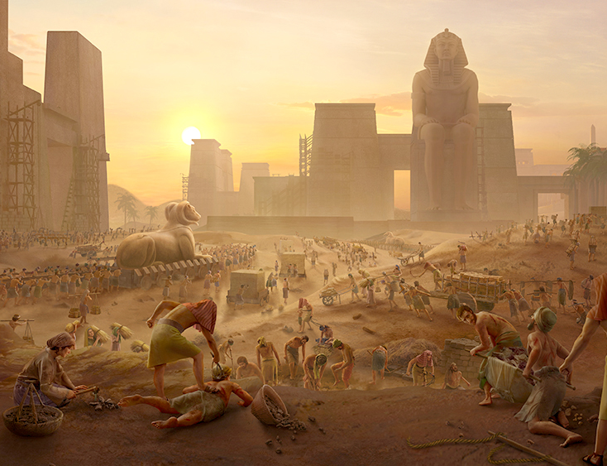
“Pea kuo fuoloa ange naʻe hoko ʻae pekia ʻae tuʻi ʻo ʻIsipite: pea naʻe toʻe ʻae fānau ʻa ʻIsileli, ko e meʻa ʻi honau fakapōpulaʻi, pea naʻa nau tangi, pea naʻe aʻu hake ʻenau tangi ki he ʻOtua ko e meʻa ʻi he fakapōpulaʻi. Pea naʻe ongoʻi ʻe he ʻOtua ʻenau ngaahi toʻe, pea manatuʻi ʻe he ʻOtua ʻene fuakava kia ʻEpalahame, mo ʻAisake, pea mo Sēkope.Pea naʻe ʻafio ʻae ʻOtua ki he fānau ʻa ʻIsileli, pea naʻe tokanga ʻofa ʻae ʻOtua kiate kinautolu.”
‘Ekisotosi 2:23–25

Slide 3

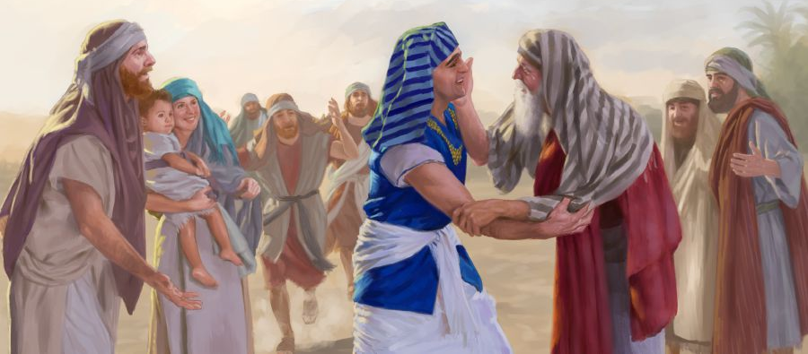
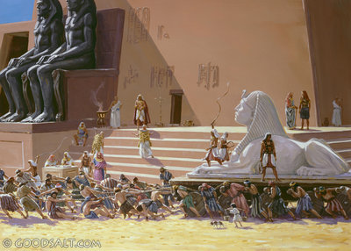

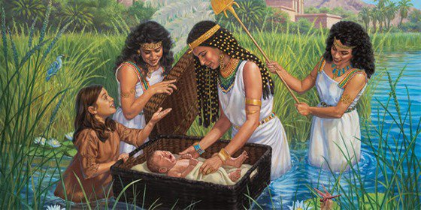




ʻOku kamata ʻa e talanoa ʻa e ʻEkesotosi ʻaki ha kiʻi famili siʻisiʻi naʻa nau nofo ʻi ʻIsipite ʻi he loto ki ai ʻa Felo.
Fakafokifa pe kuo liliu ʻa e tukunga, pea fakamalohiʻi kinautolu ke nau ngaue maʻa honau "kau ʻeiki" ʻi ʻIsipite.
ʻOku fakaʻau ke kovi ange ʻa e tukunga. ʻI he lotolotonga ʻo e mamahi, ʻoku ha mahino ʻa e mateaki ʻa e ongo fefine ko Safila mo Pua, fakataha mo e ʻamanaki lelei ʻoku foaki ʻe he ʻOtua ki Hono kakai: ko Mosese ʻa e kiʻi tamasiʻi fakaʻofoʻofa naʻe fakahaofi mei he vaitafe Naila.
Ko e kakai ʻa e ʻOtua ʻi ʻIsipite(‘Ekisotosi 1:1-14)
ʻEpalahame kia Mosese(Senesi 15:13; Ekisotosi 1:8)
Ko e Ikuna ʻo e Faitotonú . (‘Ekisotosi 1:15-22)
Kuo fanau’I ‘a Mōsese (‘Ekisotosi 2:1-10)
Ko ha liliu ‘o e ngaahi palani. (‘Ekisotosi 2:11-25)

Slide 4

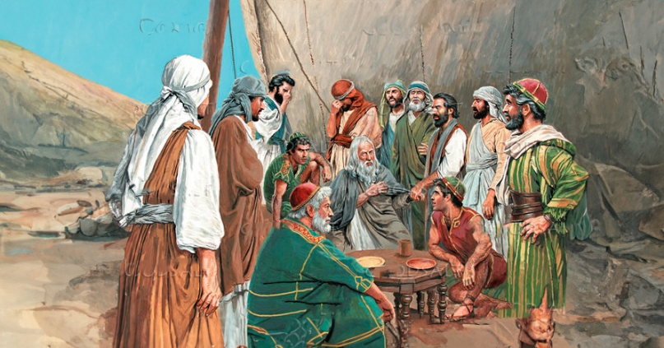
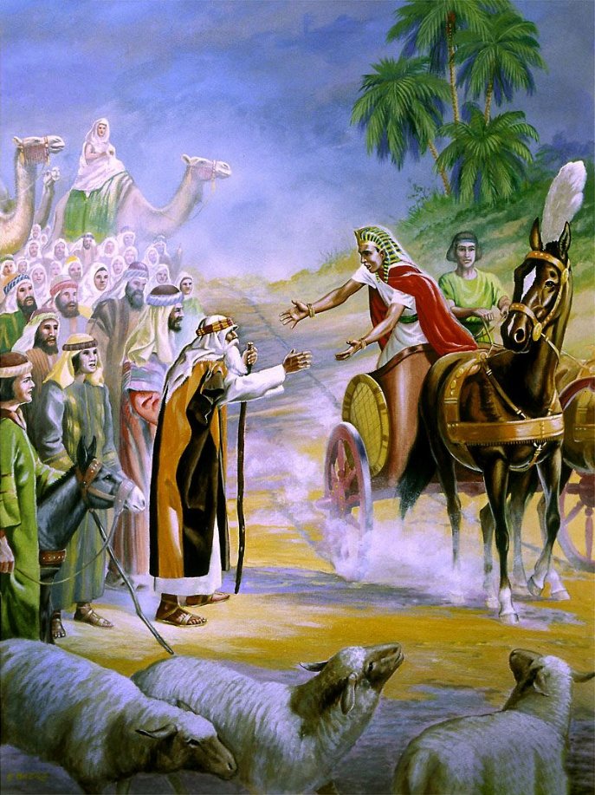
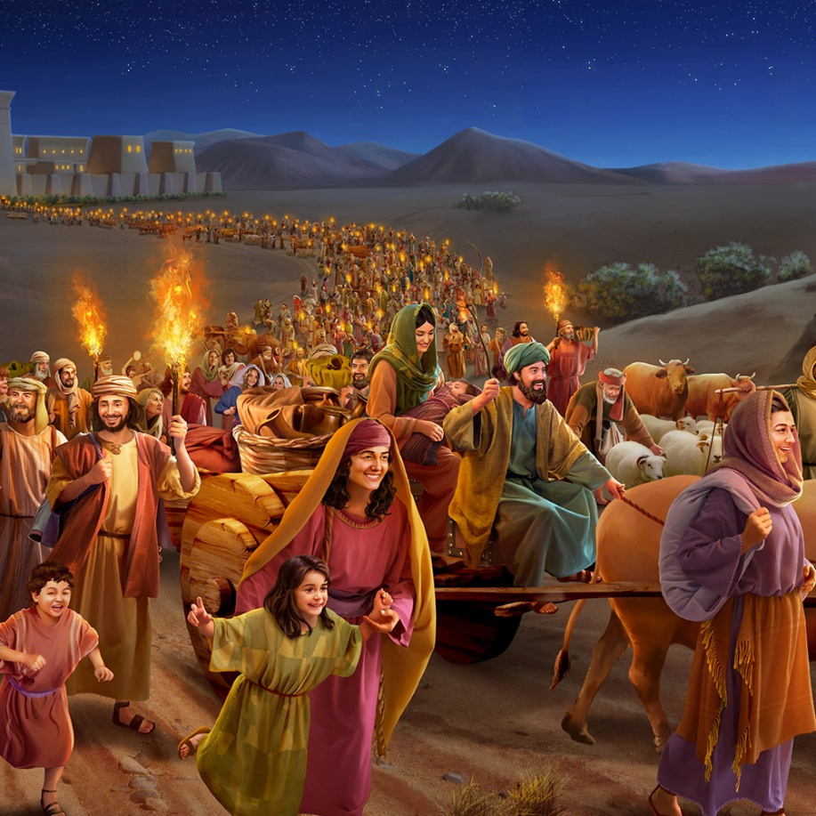
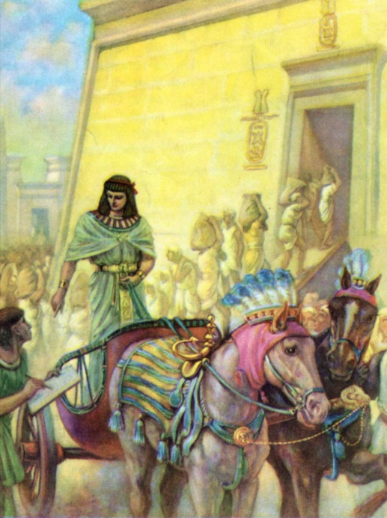
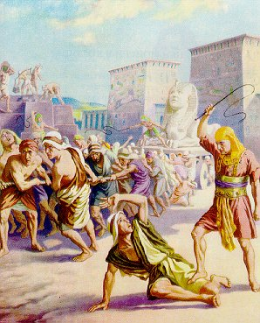
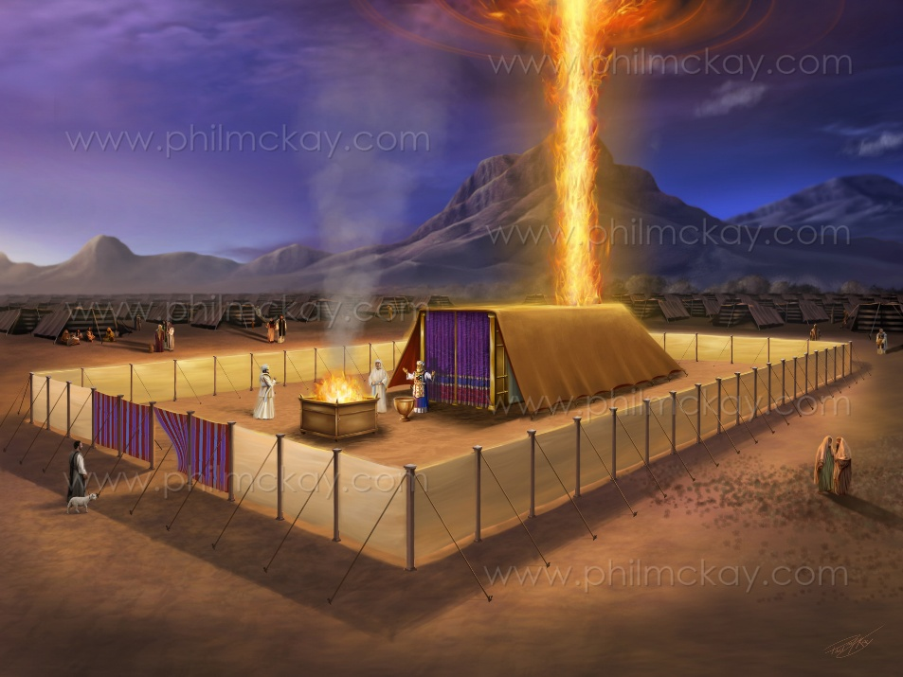
KO E KAKAI 'A E 'OTUA 'I 'ISIPETE .
“Pea ko e ngaahi hingoa eni ʻoe fānau ʻa ʻIsileli, naʻe haʻu ki ʻIsipite; ʻae tangata kotoa pē mo ʻene kau nofoʻanga naʻe haʻu mo Sēkope.” (Ekisotosi 1:1)
ʻOku ui ʻa e tohi hono ua ʻa Mosese ko e ʻEkesotosiʻ ʻi he lea faka-Latina koeʻuhi ko e meʻa ʻoku ʻi ai. Neongo ia, ʻi he lea faka-Hepeluu, ʻoku ui ia ko e ʻShemotʻ (Ngaahi Hingoa), ʻa ia ʻoku maʻu ia mei hono ngaahi lea kamata (ʻEkesotosi 1:1).
Ko e “ngaahi higoa” ko ení ko e hingoa ia ‘o Sēkope mo hono ngaahi fohá. Ko ha ki’i kulupu ‘o e kakai ‘e toko 70 (Sen. 46:26-27; ‘Eki 1:5). ʻI he ʻalu ʻa e taimí, naʻa nau tupu ʻo hoko ko ha kakai ʻoku ʻi ai ʻenau kau tau ʻe toko 600,000 nai ʻa e kau tau ( ʻEke. 12:37 ).
Naʻe hoko ʻa e foha ʻo Sekope, ʻa Siosefa, ko ha faifekau ki ha felo mei he Haʻa Tuʻi hono 17 ʻa ia naʻe hako mei he hako ʻo e kau Haikiso, kae ʻikai ko e kau ʻIsipite. Hili hono ikunaʻi ʻo e kau Hyksos, naʻe ʻasi hake ha haʻa tuʻi foʻou ʻi ʻIsipite ʻa ia naʻe "ʻikai te nau ʻilo ʻa Siosefa" (ʻEkesotosi 1:7-8).
Naʻe ʻomi ʻe he meʻa ni ʻa ʻIsileli ki ha tuʻunga faingataʻa (ʻEkesotosi 1:9-14). Neongo ia, ʻi he fakaʻosinga ʻo e tohi ʻEkesotosi, ʻoku liliu kakato ʻa e ngaahi tukunga: ʻOku lotu tauʻataina ʻa ʻIsileli, ʻi he ʻao tonu ʻo e ʻOtua (ʻEkesotosi 40:38). ʻOku mahino ʻa e popoaki ʻo e tohi: ʻOku puleʻi ʻe he ʻOtua; Te Ne fakahaofi kitautolu, ʻo aʻu ai pe ki he taimi ʻoku ngali taʻemalava ai ʻa e ngaahi tukunga.

Slide 5

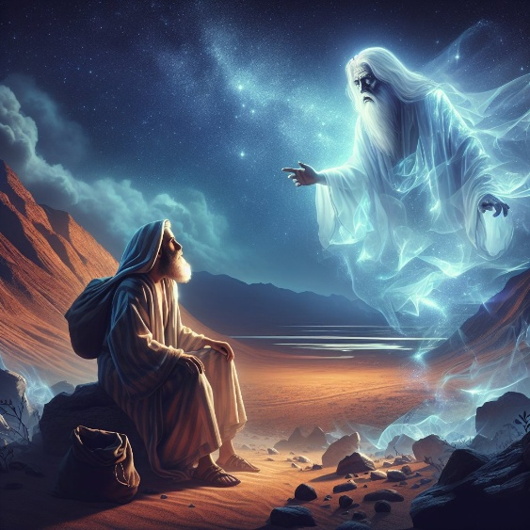
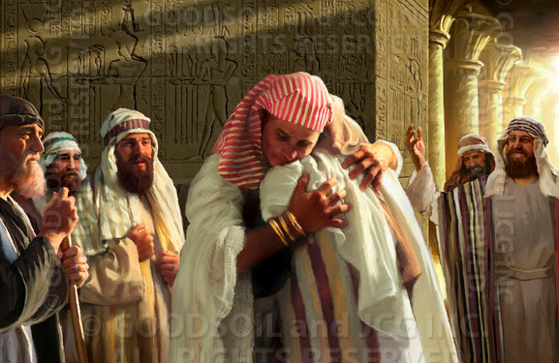
MEIA ʻEPALAHAME KIA MOSESE
“Pea naʻe pehē kia ʻEpalame, “Ke ke ʻilo pau eni, ʻe nofo ʻāunofo ho hako ʻi ha fonua ʻoku ʻikai ʻonautolu, pea te nau tauhi ʻakinautolu; pea te nau fakamamahi ʻakinautolu ʻi he taʻu ʻe fāngeau..’” (Senesi 15:13)
Naʻe talaʻofa ʻa e ʻOtua ke foaki kia ʻEpalahame ʻa e fonua ko Kenani, ka naʻa ne fakatokanga kiate ia ʻe toloi ʻi ha taʻu ʻe 400 hono fakahoko ʻo e talaʻofa ko ʻeni (Senesi 15:13-16).
ʻOku fakaloloa ʻe Mosese mo Paula ʻa e vahaʻataimi ko ʻeni ʻaki ha taʻu ʻe 30, ʻo toe foki ki he uiuiʻi ʻi Halani (ʻEkesotosi 12:40; Kal. 3:17):
Ko e vahaʻa taimi mei he ʻ aʻahi ʻ a ʻ Epalame ki Hālani ki he tūʻuta ʻ a Sēkope ki ʻ Isipité ko e taʻu ʻ e 215.
Mei he tuʻuta ʻa Sekope ʻi ʻIsipite ʻo aʻu ki he ʻEkesotosi: taʻu ʻe 215
Pea naʻe anga - fēfē ʻ a e aʻu ʻ a Sēkope ki ʻ Isipité? ʻI ha founga fakaofo ʻaupito. Neongo ʻa e ngaahi feinga fakatokoua ke tamateʻi ʻa Siosefa, naʻa ne hoko ko e palemia ʻo ʻIsipite. Fakamalo ki hono tuʻunga, naʻa ne lava ai ʻo ʻomi hono famili kotoa.
Ko e fe taimi naʻe hoko kotoa ai ʻeni? ʻOku ʻikai ke tau ʻiloʻi ʻa e ngaahi ʻaho totonu, ka ʻoku tau maʻu ha fakamatala feʻunga ke fokotuʻu kinautolu ʻi he tuʻunga ʻo e hisitolia kuo lekooti (ʻa ia ʻoku ʻi ai foki mo e ngaahi ʻaho ʻoku ʻikai pau).

Slide 6

MEIA ʻEPALAHAME KIA MOSESE
“Pea naʻe hoko ʻo pehē, ʻi hono taʻu ʻe fāngeau ma valungofulu hili ʻae haʻu ʻae fānau ʻa ʻIsileli mei he fonua ʻo ʻIsipite, ʻi hono fā ʻoe taʻu ʻoe pule ʻa Solomone ki ʻIsileli, ʻi he māhina ko Sifi, ʻaia ko hono ua ʻoe māhina, naʻa ne kamata langa ʻae fale ʻo Sihova.” (1 Tu’i 6:1)
ʻOku pehe ʻi he 1 Ngaahi Tuʻi 6:1 naʻe hoko ʻa e ʻEkesotosi ʻi he taʻu ʻe 480 kimuʻa ʻi he taʻu hono ua ʻo e pule ʻa Solomone. Kapau ʻoku tonu mo fakakau ʻa e ʻaho ko ʻeni, ʻe fokotuʻu ai kitautolu ʻi he 1445 BC. Kapau te tau lau ʻeni ko ha ʻfika fuopotopotoʻ mo e meʻa naʻe tupu ai ʻa e mate ʻa Felo, ʻoku ngalingali naʻe hoko ʻa e ʻEkesotosi ʻi he 1450 BC. ʻI hono fakaʻaongaʻi ʻo e fakamatala ko ʻeni, te tau lava ai ʻo ʻiloʻi ʻa e ngaahi meʻa mahuʻinga kehekehe naʻe hoko ʻi he moʻui ʻa Mosese
ʻAhamosi I (1575/1550). Ikunaʻi ʻa e kau Hyksos. Ko e Felo ia naʻe “ʻikai te ne ʻiloʻi ʻa Siosifa” peá ne fakapōpulaʻi ʻa ʻIsileli ( ʻEk . 1:8-12 )
Ko ʻAmenofisi I (1550/1530). Naʻá ne kei fakatangaʻi pē ʻa ʻIsileli (Eki. 1:13-14)
Ko Tutimosi I (1530/1517). Naʻá ne tuʻutuʻuni ke tāmateʻi ʻa e fānau Hepeluú (Eki. 1:15-22)
Naʻe ohi ʻa Mosese (1530/1410) ʻe Hatshepsut, ko e ʻofefine ʻo Thutmose I.
Thutmose II (1517/?). Lolotonga ʻene pule, naʻe hola ʻa Mosese mei ʻIsipite (1490).
Hatshepsut (?/1479). Naʻa ne malolo kimuʻa pea foki mai hono ʻfohaʻ ki ʻIsipite.
Ko Thutmose III (1479/1450) ko e felo ia lolotonga e taimi ʻo e ʻEkesotosi. Ko hono foha lahi tahá naʻá ne tokangaʻi ʻ a e fanga monumanú ka naʻe ʻ ikai te ne ʻ alu hake ki he taloní, he naʻá ne mate lolotonga ʻ a e mahaki fakaʻauha hono 10.
Ko ʻAmenopha II (1450/1424) ko e foha ia ʻo Tutmose III, neongo naʻe ʻikai ko ʻene ʻuluaki foha ia.

Slide 7

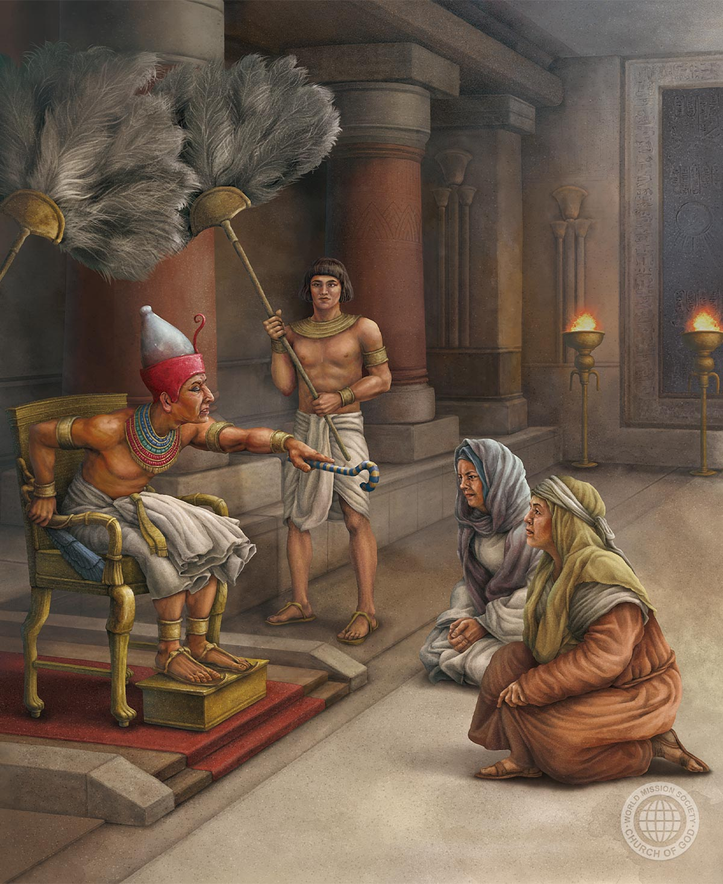
KO E IKUNA ʻO E MATEAKIʻI
“Pea ko e meʻa ʻi he manavahē ʻae kau māʻuli ki he ʻOtua, ko ia naʻa ne fakatupu ai hona fale. ” (Ekisotosi 1:21)
Naʻe fehiʻa lahi ʻa e haʻa tuʻi hono 18 ʻo ʻIsipite ki he kau muli. ʻIkai ngata ai, naʻe feʻunga ʻa e tokolahi ʻo e kau ʻIsileli ke fakaʻaiʻai ha angatuʻu (ʻEkesotosi 1:9-10). Ko hono ola, naʻa nau fakamamahiʻi mamalie kinautolu:
1
Naʻa nau fokotuʻu ha kau komisiona ke fakamalohiʻi kinautolu ke langa ha ngaahi fale (ʻEkesotosi 1:11)
Naʻa nau fakamalohiʻi ʻenau ngaahi fie maʻu, ʻo liliu kinautolu ko e kau ngaue/popula (ʻEkesotosi 1:13-14)
Naʻa nau tuʻutuʻuni ke tamateʻi ʻa e kakai tangata, ʻo fakaʻaongaʻi ʻa e kau maʻuli (ʻEkesotosi 1:15-16)
Fakaʻosi, naʻa nau fakamalohiʻi ke tamateʻi ʻa e fanau tangata (ʻEkesotosi 1:22)
2
3
4
ʻI he lotolotonga ʻo e mamahi ko ʻeni, ʻoku ʻasi makehe ai ʻa e faivelenga ʻa e ongo maʻuli, ʻa Sifila mo Piua, (ʻEkesotosi 1:15-19). Naʻe toʻo ʻe Mosese ʻa e hingoa ʻo Felo, ka ʻoku ne ʻomi honau ngaahi hingoa.
ʻOku toe lekooti foki ai, ke tau ako, ʻa e founga naʻe tapuakiʻi ai kinautolu ʻe he ʻOtua ʻi heʻenau faivelenga (ʻEkesotosi 1:20-21).

Slide 8

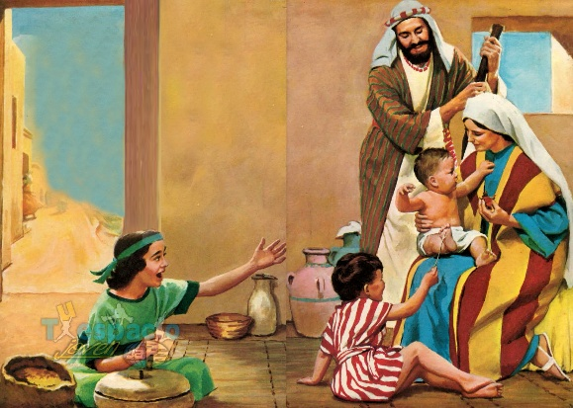
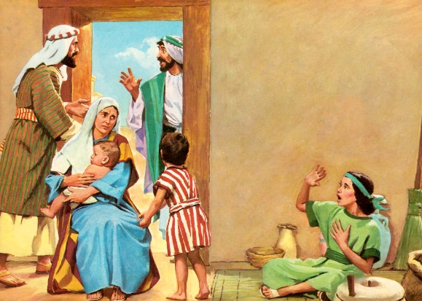
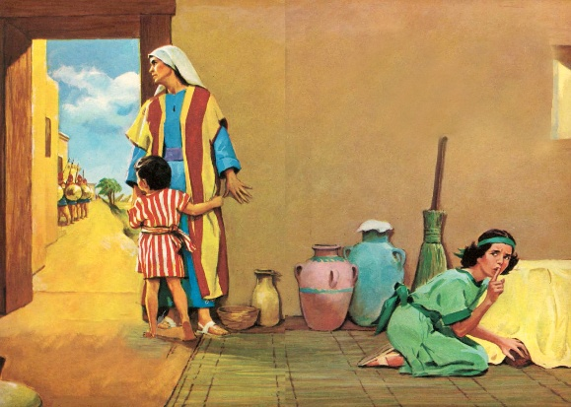
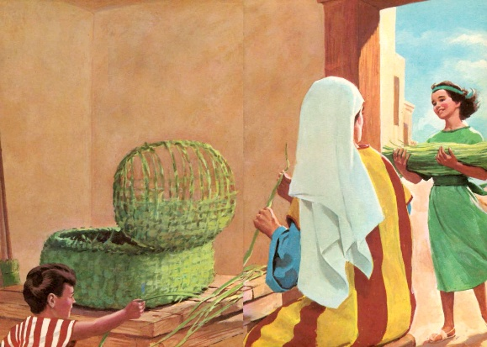
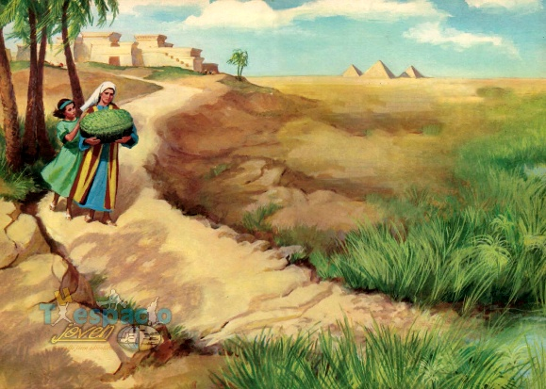
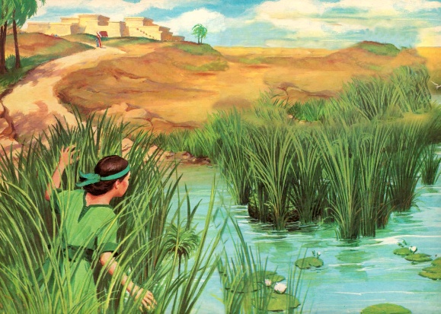
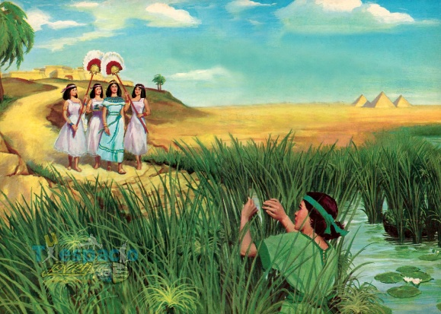
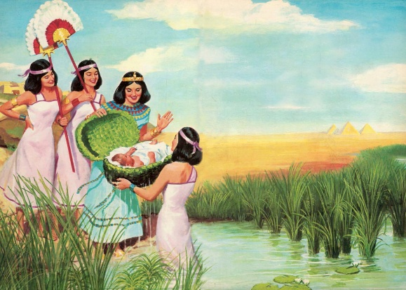
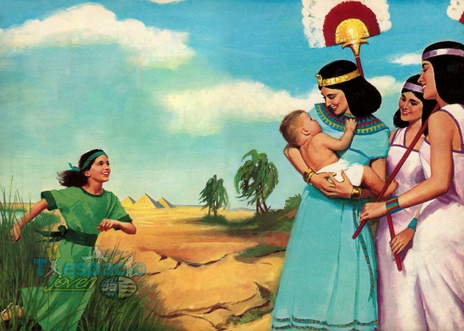
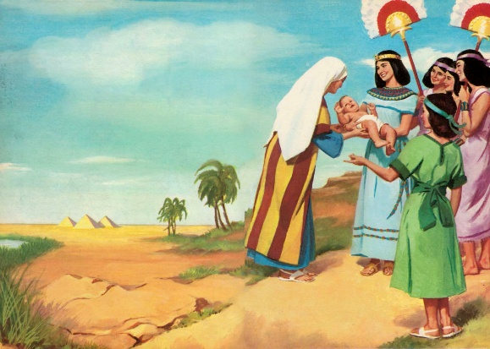
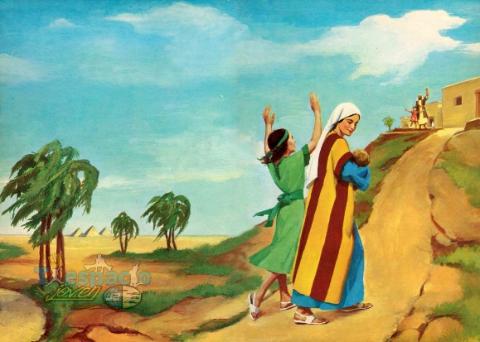
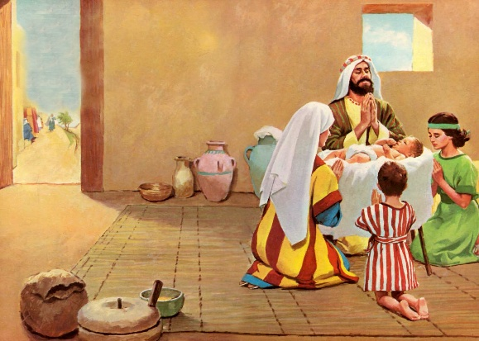
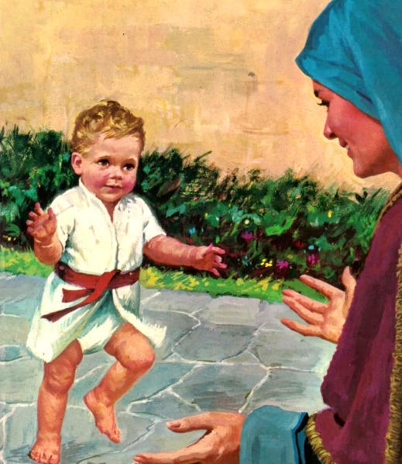
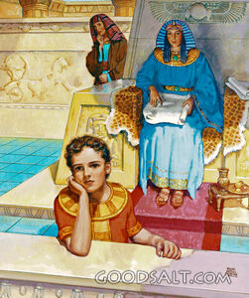
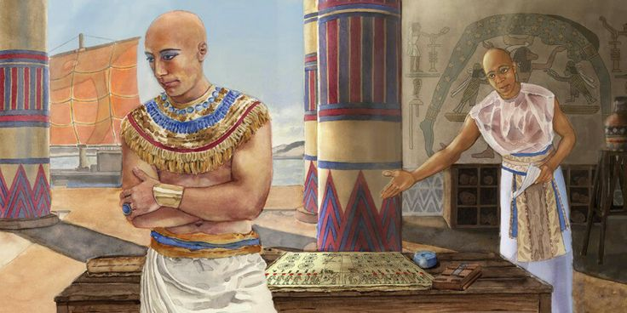
KUO FANAU’I ‘A MŌSESE
"Pea naʻa ne feitama ʻo faʻeleʻi ʻa e tama. ʻI heʻene vakai ko e tamasiʻi lelei ia, naʻa ne fufuuʻi ia ʻi he mahina ʻe tolu"
(ʻEkesotosi 2:2)
ʻOku ʻikai ke fakamatalaʻi ʻe he "fakaʻofoʻofa" ʻa e foha ʻo Sokepeti (ʻEkesotosi 2:2). Ko e foʻi lea faka-Hepelu ko e "tope " (lelei, fakaʻofoʻofa, haohaoa) ko e foʻi lea tatau pe ia ʻoku fakaʻaongaʻi ʻe he ʻOtua ke fakamatalaʻi ʻaki ʻa e haohaoa ʻo ʻEne fakatupu (Senesi 1:31).
Naʻe ʻi ai ha palani makehe ʻa e ʻOtua maʻana. Naʻe ʻi ai ha faʻe naʻe fakatuʻutamaki; naʻe ongo ki ai ha finemui; naʻe lea fakapotopoto ha kiʻi tamasiʻi... pea naʻe fakahaofi ʻa e tokotaha fakahaofi ʻi he kahaʻu mei he mate (ʻEkesotosi 2:3-7).
ʻOku ʻikai ke tau ʻiloʻi ʻa e hingoa naʻe ʻoange kiate ia ʻe heʻene ongomatuʻa, ka ʻoku tau ʻiloʻi ʻa e hingoa naʻe ʻoange kiate ia ʻe heʻene faʻe ohi, ko e ʻofefine ʻo Felo: Hapimosis (foha ʻo e ʻotua Naila). Ka naʻa ne ui pe ia ko e "foha," "mosis ," Mosese (ʻEkesotosI 2:10).
Naʻe fakaʻaongaʻi lelei ʻe heʻene faʻee ʻa e ngaahi taʻu siʻi naʻa ne tokangaʻi ai ia (ʻEkesotosi 2:8-9). Naʻa ne akoʻi ia ke ne hoko ko ha fanau moʻoni ʻa e ʻOtua. Ko ha ngāue mahuʻinga ē ʻ oku fakahoko ʻ e he ngaahi faʻeé ʻ i hono tauhi hake ʻ enau fānaú ʻ i he manavahē ki he ʻ Otuá!

Slide 9

Naʻe fanongo ʻa e ʻOtua ki he ngaahi lotu ʻa e faʻee; Naʻe fakapaleʻi ʻene tui. Naʻa ne kamata ʻi he loto houngaʻia moʻoni ʻa ʻene ngaue malu mo fakafiefia he taimi ni. Naʻa ne fakaʻaongaʻi faivelenga ʻa e faingamalie ke ohi hake ʻene tama maʻa e ʻOtua. Naʻa ne fakapapauʻi naʻe maluʻi ia ʻi ha taumuʻa mahuʻinga, pea naʻa ne ʻiloʻi ʻe vave ni pe hano tuku ia ki heʻene faʻe fakaʻeiʻeiki, ʻa ia ʻe takiekina ai ia ʻi ha ngaahi founga te ne lava ʻo taki mamaʻo ai ia mei he ʻOtua. Naʻe ʻai ʻe he meʻa ni ke ne tokanga mo tokanga ange ʻi hono akoʻi ia ʻi he ako ʻa ʻene fanau kehe. Naʻá ne feinga ke fakahūhū kiate ia ha ʻ apasia ki he ʻ Otuá pea mo ha holi ki he moʻoní mo e fakamaau totonú, pea naʻá ne lotu loto - moʻoni ke maluʻi ia mei ha faʻahinga tākiekina fakatupu maumaú. Naʻa ne fakaʻaliʻali kiate ia ʻa e fakavalevale mo e angahala ʻo e lotu tamapua, pea naʻa ne akoʻi ia ʻi heʻene kei siʻi ke tuʻulutui ʻo lotu ki he ʻOtua moʻui, ʻa ia ko ia toko taha pe te ne lava ʻo fanongo kiate ia mo tokoniʻi ia ʻi he tukunga kotoa pe.
EGW (Kau Peteliake mo e Kau Palofita, peesi 243

Slide 10


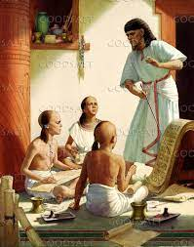
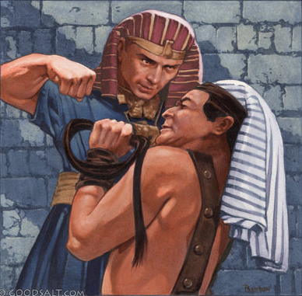
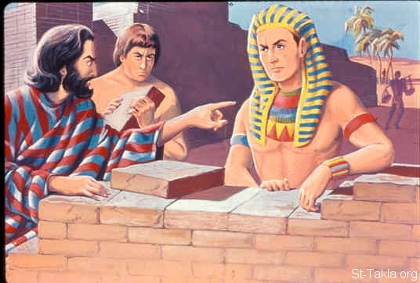
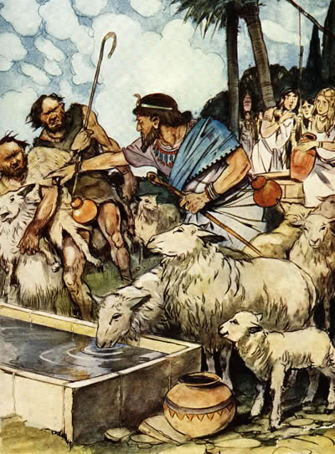
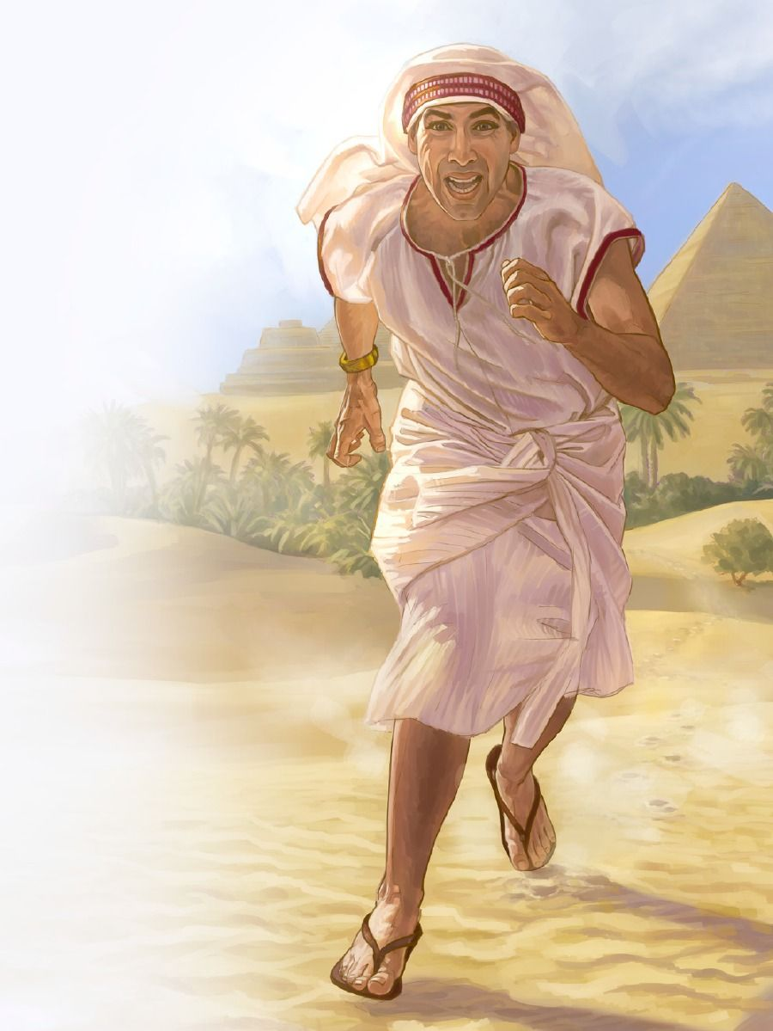
LILIU ‘O E NGAAHI PALANI
"Pea ʻi he fanongo ʻa Felo ki he meʻa ni, naʻa ne feinga ke tamateʻi ʻa Mosese, ka naʻe hola ʻa Mosese meia Felo ʻo nofo ʻi Mitiane, ʻo ne nofo ai ʻi he veʻe vaikeli" (ʻEkesotosi 2:15)
ʻOku fakangatangata pe ʻetau fakamatala fekauʻaki mo e ngaahi taʻu kimuʻa ʻo Mosese. ʻ I he tuʻunga ko ha tokotaha ʻ e malava ke ne fetongi ʻ a e taloní, ngalingali naʻá ne foua ʻ a e ako ʻ a ia naʻe kau ai ʻ a e ʻ ilo fakakautaú mo fakapolitikalé.(EGW , “Peteliake moe Palofita,” p. 245) .
ʻOku tau ʻiloʻi naʻe ʻikai fuoloa pea hoko e taʻu 40 ʻa Mosese, naʻe fanongonongo ʻa Tutmosis II ko e felo koeʻuhi ko ha faʻufaʻu fakapolitikale. Naʻe tui leva ʻ a Mōsese kuo hokosia ʻ a e taimi ke fakatauʻatāinaʻi ai ʻ a hono kakai ʻ Isilelí. Ka naʻa ne kamata ʻene fakatauʻatainaʻi ʻaki hono tamateʻi ha tangata ʻIsipite. Ko ha fehalaaki lahi ʻeni (ʻEkesotosi 2:11-12 ). Naʻa mo hono kakai naʻe ʻikai ke nau lau ia ko honau fakatauʻatainaʻi (ʻEkesotosi 2:13-14 ;Ngaue 7:25 ).
ʻI ha ngaahi ʻaho siʻi pe, naʻa ne hiki mei heʻene hoko ko ha memipa fakaʻapaʻapaʻi ʻo e lotoʻa ʻo Felo ki ha tauhisipi hola (ʻEkesotosi 2:15-22). Neongo ia, naʻe ʻikai ke fakafisingaʻi ʻe he ʻOtua ʻa Mosese; Naʻe hokohoko atu ʻene falala kiate ia, neongo ʻene ngaahi fehalaki.

Slide 11

"Naʻe tuku atu ʻa e palasi fakaʻofoʻofa ʻo Felo mo e taloni ʻo e tuʻi ko ha fakaʻaiʻai kia Mosese; ka naʻa ne ʻiloʻi ko e ngaahi fiefia angahalaʻia ʻoku ne ʻai ke fakangaloʻi ʻe he tangata ʻa e ʻOtua naʻe ʻi hono ngaahi fakamaauʻanga fakaʻeiʻeiki. Naʻa ne sio fakalaka atu ʻi he palasi fakaʻofoʻofa, fakalaka atu ʻi he kalauni ʻo ha tuʻi, ki he ngaahi fakalangilangi maʻolunga ʻe foaki ki he kau maʻoniʻoni ʻo e Fungani Maʻolunga ʻi ha puleʻanga ʻoku ʻikai hano meleʻi ʻe he angahala. Naʻa ne mamata ʻi he tui ki ha kalauni ʻe ʻikai faʻa ʻauha ʻa ia ʻe ʻai ʻe he Tuʻi ʻo e langi ki he laʻe ʻo e tokotaha ikuna. Naʻe tataki ia ʻe he tui ko ʻeni ke ne tafoki mei he kau ʻeiki ʻo e mamani ʻo kau ki he puleʻanga loto fakatokilalo, masiva, mo fehiʻanekinaʻi ʻa ia naʻa nau fili ke talangofua ki he ʻOtua kae ʻikai ke tauhi ʻa e angahala."
EGW (Peteliake mo e Palōfita, p. 246)

