Slide 1
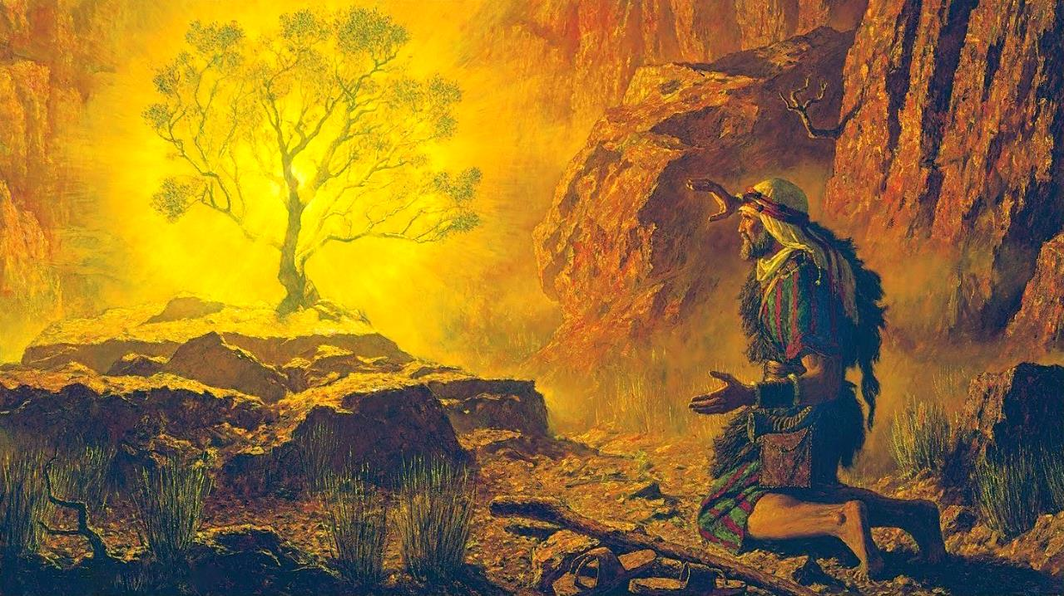
KO E VAO’AKAU VELA
Lesoni 2 ki he ʻaho 12 ʻo Siulai, 2025

Slide 2
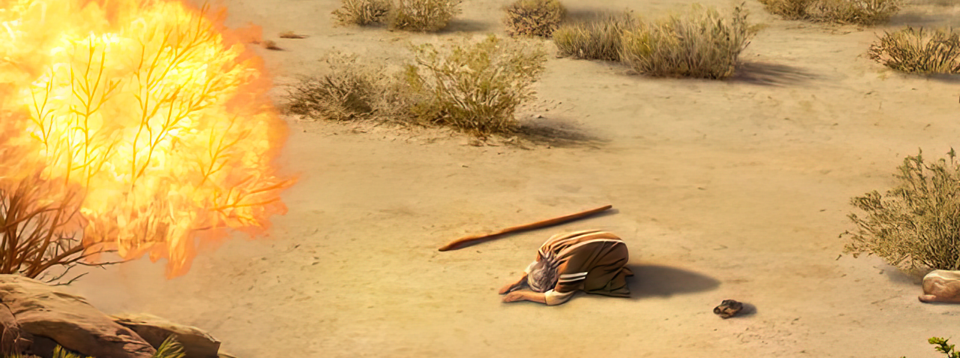
“Pea naʻe pehē ʻe Sihova, “Ko e moʻoni kuo u mamata ki he mamahi ʻa hoku kakai, ʻaia ʻoku ʻi ʻIsipite, pea kuo u ongoʻi ʻenau tangi ko e meʻa ʻi honau kau enginaki ngāue: pea ʻoku ou ʻiloʻi ʻenau ngaahi mamahi: Pea kuo u ʻalu hifo ke fakamoʻui ʻakinautolu mei he nima ʻoe kakai ʻIsipite, pea ke ʻomi ʻakinautolu mei he fonua ko ia ki ha fonua lelei mo lahi, ko e fonua ʻoku mahu tāfea ʻi he huʻahuhu mo e honi” ‘Ekisotosi 3:7, 8

Slide 3

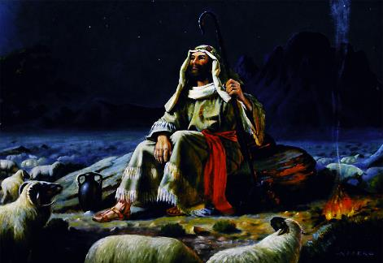
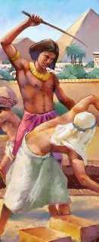
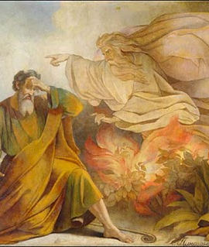







Hili ʻene tō ʻi heʻene feinga ke fakatauʻatāinaʻi e kakai ʻo ʻIsilelí, naʻe nofo ʻa Mōsese ʻi ha taʻu ʻe 40 ʻi he Toafa Mitianí ko ha tauhi-sipi. Lolotonga ‘a e taimi ko iá, neongo na‘á ne hokohoko atu ‘ene vaha‘angatae vāofi mo e ‘Otuá, ka na‘á ne li‘aki ‘a ‘ene fakakaukau ke hoko ko e fakatau‘atāina ‘o ‘Isilelí.
Ka naʻe teʻeki ke liʻaki ʻe he ʻOtuá ʻa e fakakaukau ko iá. Naʻe kei nofo pē ʻa Mōsese, maʻana, ko e fakatauʻatāina kuo filí. He naʻe teʻeki foki ke ngalo ʻiate Ia ʻa e mamahi ʻa Hono kakaí. Ko eni, kuo hokosia ‘a e taimi ke taki ‘a ‘Isileli mei honau nofo pōpula fefeká.
Ko e Ui (ʻEkisoto 3):
Ko e Vaoʻakau Vela (ʻEkisotosi 3:1-6)
Ngaahi Tuʻutuʻuni ʻa e ʻOtuá (ʻEkisotosi 3:7-12)
Ko e Huafa 'o e 'Otua ('Ekisotosi 3:13-22)
Fakahoko ʻa e misioná (ʻEkesōtosi 4):
Ng-Faka‘uhinga mo e Ng-Faka‘uhinga Lahi Ange (‘Ekisotosi 4:1-17)
Ko e Foki ki ‘Isipite (‘Ekisotosi 4:18-31)

Slide 4

KO E UI

Slide 5

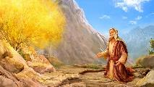
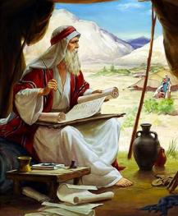
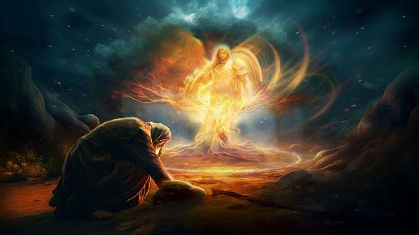
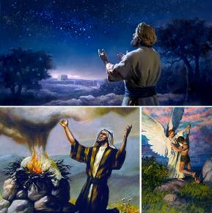
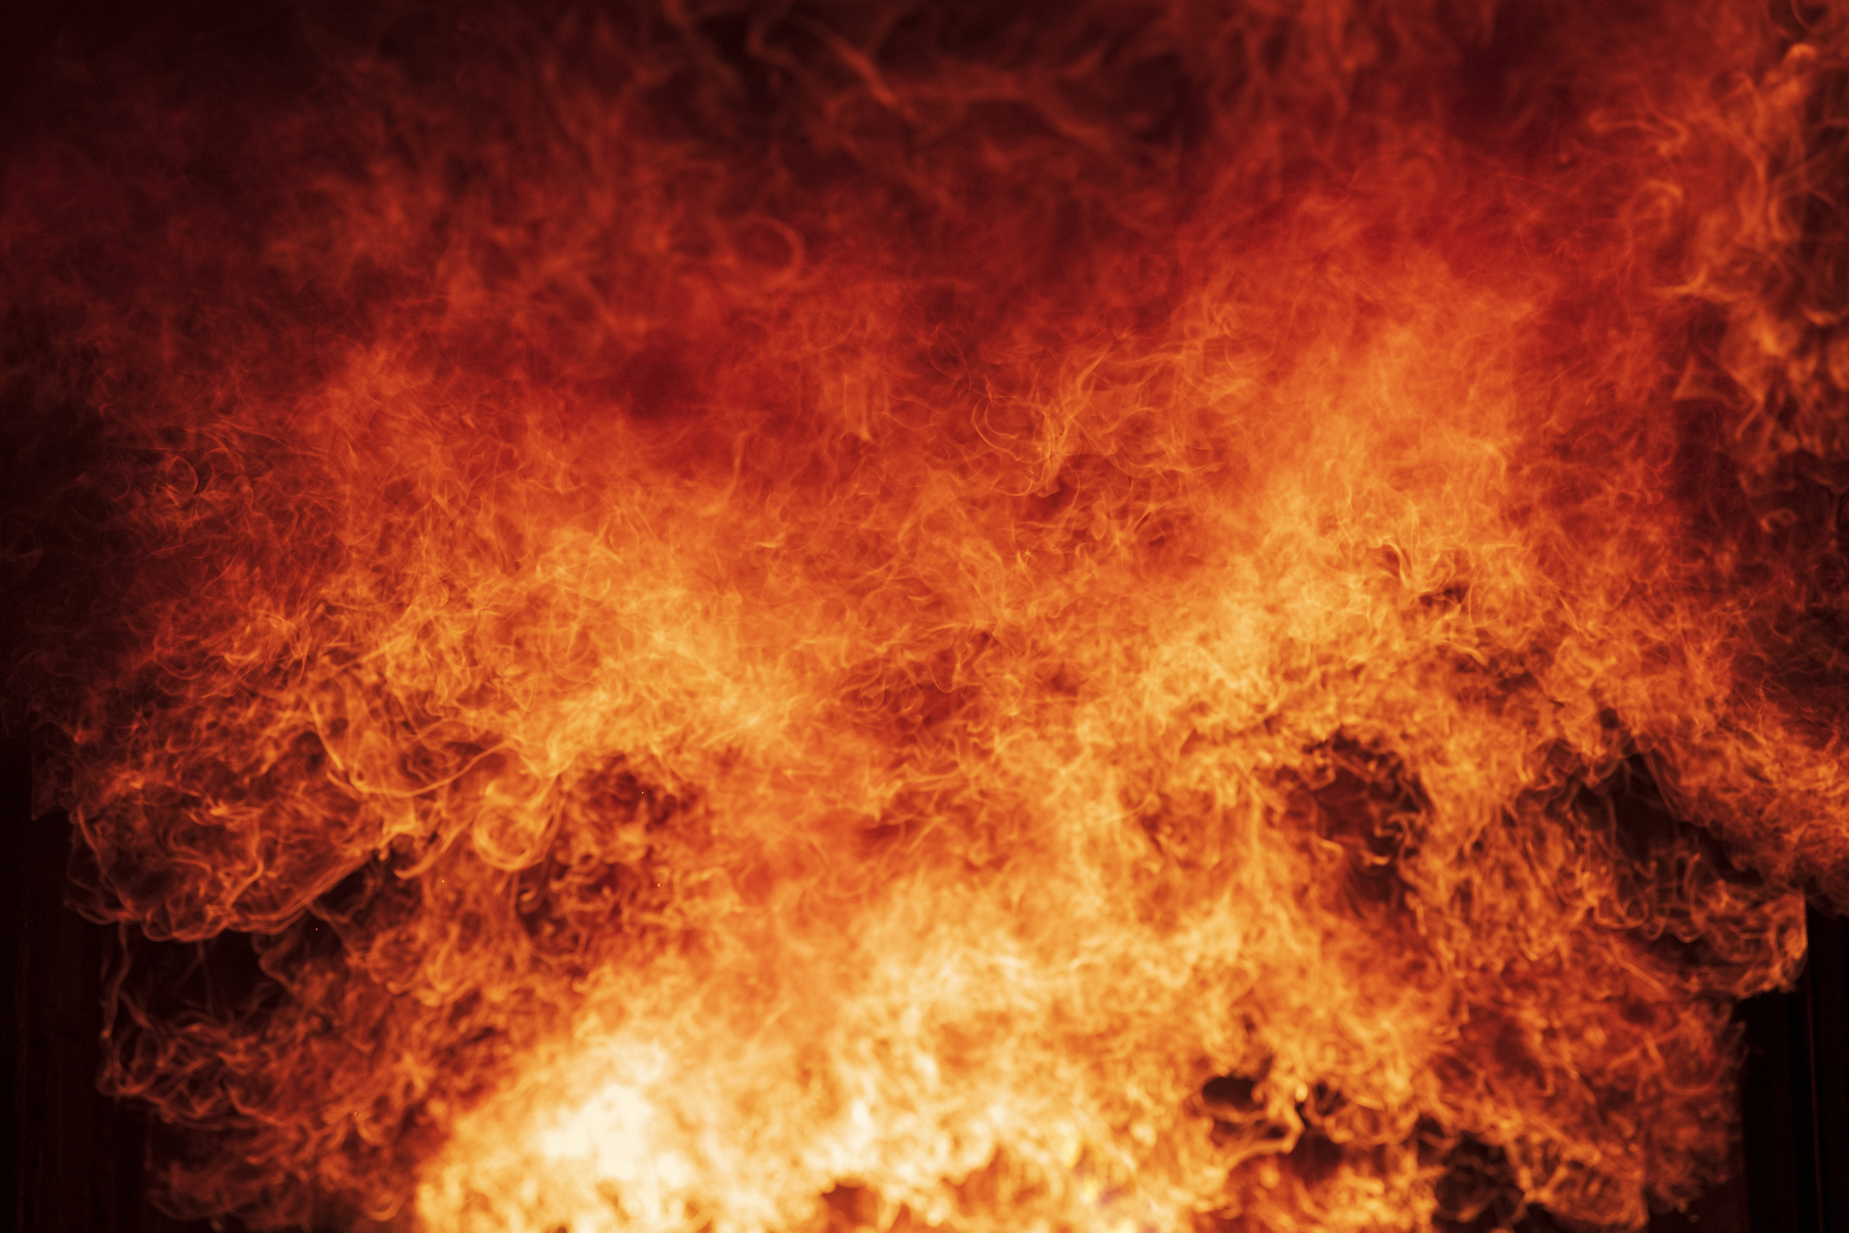
KO E VAO VELA
“Pea naʻe hā mai ʻae ʻāngelo ʻa Sihova kiate ia ʻi he ulo afi ʻi he lotolotonga ʻoe ʻuluʻakau: pea sio ia, pea vakai, naʻe ulo ʻae ʻuluʻakau ʻi he afi, ka naʻe ʻikai ʻosi ai ʻae ʻuluʻakau. (Ekisotosi 3:2)
Ko e ta‘u ‘e 40 na‘e nofo ai ‘a Mōsese ‘i Mitianí ‘e lava ke fakanounou‘i ‘o pehē: na‘á ne mali, ma‘u ha ongo foha, pea hoko ko ha tauhi-sipi ma‘a ‘ene tamai-‘i-he-fonó. Naʻá ne fakatapui foki ʻa e taimi ko iá ke tohi ʻaki ha ongo tohi: Siope mo Sēnesi, ʻa ia ʻoku mahuʻinga ke mahino ʻa e ngaahi kaveinga mahuʻinga ʻo e fakamoʻuí. Ka naʻe liliu e meʻa kotoa pē ʻi ha kiʻi momeniti si’I pe.
‘I Holepi (Mo’unga Sainai), na’e hā ‘a e ‘Angelo ‘a e ‘Otua kia Mosese ‘i ha ‘akau vela (Ekisoto 3:1-3). Ko hai ‘a e ‘Āngelo ko ‘ení? Ko e ‘Otua tonu (Ekisoto 3:4).
Kimu’a pea ne hoko ‘o tangata, na’e hā ‘a Sīsū ‘i ha ngaahi taimi lahi ko e “Angelo ‘a Sihova” (Sen. 22:11-17; Fakamaau 6:11, 16; 13:17-22; Sak. 3:1-2).
‘I he‘ene folofola kia Mōsesé, na‘e fakahaa‘i ai ‘e he ‘Otuá ia ko e ‘Otua ‘o ‘Ēpalahame, ‘Aisake, mo Sēkope. Na’e mahino ‘a e fakakaukau: Kuo hifo mai ‘a e ‘Otua ke fakakakato ‘a e tala’ofa na’e fai ki he kau pēteliake ni pea ke foaki ki ‘Isileli ‘a e fonua ko Kenani (Sen. 12:7; 26:3; 48:3-4).

Slide 6

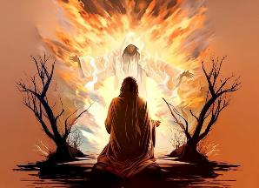
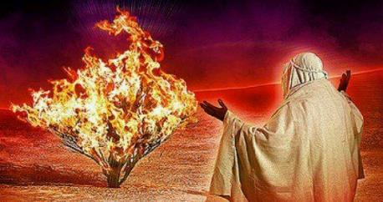
KO E NGAAHI TU'UTU'UNI 'A E 'OTUA
“Pea ko eni, ke ke haʻu, pea te u fekau koe kia Felo, koeʻuhi ke ke ʻomi hoku kakai ko e fānau ʻa ʻIsileli mei ʻIsipite.” (Ekisotosi 3:10)
‘Oku fakahaa’i ‘e he ‘Otua Ia ko e Tokotaha ‘oku malohi, ‘o ne ngaue’aki ‘a e ngaahi veape ngaue: sio, hifo, mo e to’o ki tu’a (‘Ekisotosi. 3:7-8).
SIO: ʻOku ʻikai taʻetokanga ʻa e ʻOtuá ki he mamahí. ʻOkú Ne ʻafio ki he meʻa kotoa pē. ‘Oku ne sio tautefito ki he mamahi mo e fakamaau ta’etotonu ‘oku fai ki hono kakai (2 Tu’i 9:26).
HIFO: ʻOku ʻikai nofo maʻu ʻa e ʻOtuá. ʻOkú Ne ʻalu hifo ke ʻaʻeva ʻi hotau lotolotongá. ‘Oku ne nofo ‘i he lotolotonga ‘o e tangata
(Eki 29:45; Sione 14:16-17)
'AVE KI TU'A: Ko e ‘Otua, ‘i hono taimi, ‘oku ne ngaue ke fakatau’ataina’i kitautolu mei he mamahi pea ke fakahoko ‘ene ngaahi tala’ofa (Sel. 29:11)
Na’e fiema’u foki ‘e he ‘Otua ‘a e ngaahi ngaue pau meia Mosese: ‘Alu ki ‘Isipite ‘o ‘omi hoku kakai mei ai (Eki. 3:10, 12). Naʻe lōmekina ʻaupito ʻa Mōsese ʻe he ngāué. Na‘e ‘ikai te ne toe loto ke ngāue‘aki hono mālohí; naʻe ʻikai ke ne toe ongoʻi te ne malava ke fakahoko e misioná; naʻá ne lava pē ʻo kalanga, “Ko hai au?” ( Eki. 3:11 ). Naʻe liliu ʻene pōlepolé ki he loto fakatōkilaló. Ko hono moʻoní, ko e momeniti ko ʻení naʻá ne mateuteu ai ki heʻene ngāue fakafaifekaú.

Slide 7

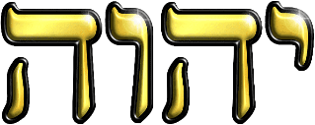
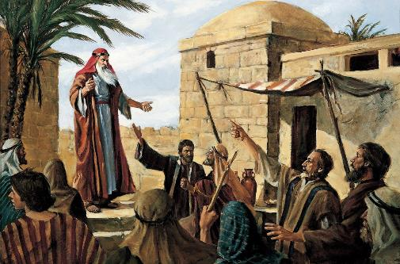
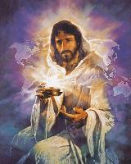
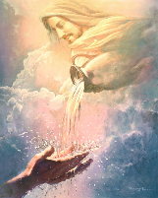
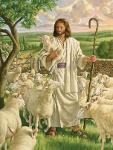
KO E HUAFA 'O E 'OTUA
“Pea pehē ʻe he ʻOtua kia Mōsese, “KO AU, KO E KO AU: pea pehē ʻe ia, Te ke lea pehē ki he fānau ʻa ʻIsileli, ‘Kuo fekau au ʻe he KO AU kiate kimoutolu.’ ” ” (Ekisotosi 3:14)
Ko e ‘otua kotoa pē ‘o ‘Isipite, na’e ‘i ai hono hingoa, ka na’e lotu ‘a ‘Isileli ki he “ ‘Otua Māfimafi” (Ek. 6:3). Hili ha ngaahi senituli ‘o e fakapo’uli ‘a ‘Isipite, na’e fie ‘ilo ‘e ha’a ‘Isileli ‘a e hingoa ‘o honau Fakahaofi (Ek. 3:13).
Koe‘uhi ‘i he taimi ko iá na‘e fehokotaki ai ha hingoa mo e ‘ulungaanga ‘o ha taha, ‘oku fakafe‘iloaki ai ‘e he ‘Otuá ia ‘aki ‘a e taha ‘o hono ngaahi ‘ulungaanga tefitó: ‘ehyeh (ke hoko). ʻOku taʻengata ʻa e ʻOtuá, kuo ʻi ai maʻu pē, ʻoku ʻi ai, pea ʻe ʻi ai maʻu pē. Ko ia ‘a e “KO AU” (Ek. 3:14).
‘I he faai mai ‘a e taimí, na‘e mole ‘a hono pu‘aki ‘o e hingoá ni. Naʻe fakaʻatā ʻeni ʻe he ʻOtuá koeʻuhí he ʻoku ʻikai ko e hingoá ʻa e meʻa ʻoku mahuʻingá, ka ko hono ʻulungāngá. ʻOkú ne feʻunga mo ʻetau ngaahi fie maʻú. Te tau lava ʻo ui Ia ko e “Tauhisipi,” “Fakamoʻui,” “Tokotaha Tokonaki,” “Tamai,” ..., “ʻOfa.”
Ko e meʻa mahuʻingá ʻoku finangalo ʻa e ʻOtuá ke tau ongoʻi ofi, faingofua ke maʻu, fie maʻu, mo ha kaungāmeʻa ofi.

Slide 8
FAKAHOKO 'A E MISIONA

Slide 9

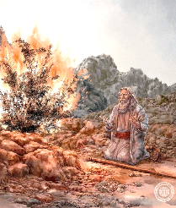
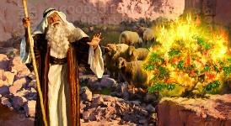
FAKAMOLEMOLE MO E NGAAHI FAKAMOLEMOLE LAHI ANGE .
«Ka naʻe pehē ʻe Mōsese, “Fakamolemoleʻi hoʻo tamaioʻeikí, ʻEiki, fekauʻi mai ha taha kehe.”» (ʻEkisotosi 4:13)
Ki mu‘a ke fakahaa‘i fakahāhā ‘oku ‘ikai te ne loto ke fakahoko ‘a e misiona na‘e tuku ange ‘e he ‘Otuá kiate iá, na‘e ‘omai ‘e Mōsese ha ngaahi ‘uhinga “haohaoa” ‘e fā ki hono fakafisinga‘i iá. Ki he ʻuhinga takitaha, naʻe tali ʻe he ʻOtuá ʻaki ha talaʻofa.
“Ko hai au?”
( ‘Eki. 3:11 )
“Te u ʻiate koe”
( ʻEke. 3:12 ).
Ko e mālohi ke fakahoko ‘a e fekau ‘a e ‘Otuá ‘oku ‘ikai ‘iate kitautolu, ka ‘oku ‘i he mo’oni’i me’a ko ia ‘oku fakaivia kitautolu ‘e he ‘Otuá. Te Ne ʻiate kitautolu ʻo hangē ko ʻEne ʻia Mōsesé.
"Ko hai ho hingoá?"
( ‘Eki. 3:13 )
"Ko au ʻa e tokotaha ʻoku ou ʻi ai" (ʻEkesotosi 3:14)
ʻOku moʻoni, taʻengata, mo fakafoʻituitui ʻa e ʻOtuá; ʻokú ne talaʻofa mo tauhi maʻu pē ʻene ngaahi talaʻofá; taʻefaʻalaua; falala‘anga ma‘u pē.
“ʻE ʻikai te nau tui kiate au, pe fanongo ki hoku leʻó” ( ʻEki. 4:1 ).
“Te nau tui kiate koe koeʻuhi ko e ngaahi fakaʻilonga te ke fai” (ʻEki. 4:8)
Naʻe foaki ʻe he ʻOtuá kia Mōsese ʻa e mālohi ke ne fakahoko ha ngaahi mana, pea naʻá ne ngāue ʻi he loto ʻo e kakaí ke nau tui ki he ngaahi mana ko iá. Na’e tala’ofa foki ‘a Sisu te ne fai ‘a e me’a tatau kiate kitautolu (Ma’ake 16:17-18).
“Kuo teʻeki ai ke u hoko ko ha tangata lea faingofua” ( ʻEki. 4:10 )
“Te u ako kiate koe ʻa e meʻa te ke lea ʻakí”
( ʻEki. 4:12 ).
Ko ia na’a ne fakatupu ‘a e ‘elelo te ne ‘omai kiate kitautolu ‘a e ngaahi lea ‘oku fiema’u ‘i he taimi ‘oku fiema’u (Ek. 4:11; Luke 12:11-12)
Pea faka’osi, na’e folofola ‘a e ‘Otua kia Mosese, “Kuo fe’unga ho’o ngaahi faka’uhinga, te ke lava, pea te ke fai” (Ekisotosi. 4:14-17).

Slide 10


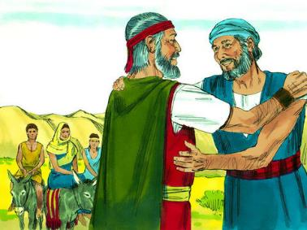
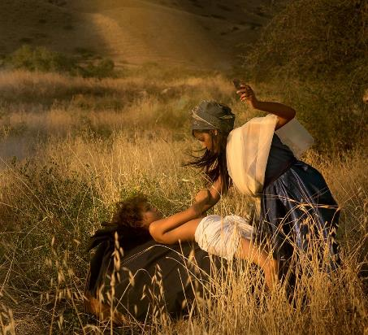
KO E FOKI KI 'ISIPITE
“ʻI ha nofoʻanga ʻi he halá, naʻe fakafetaulaki ʻa e ʻEikí kia Mōsese, ʻo ne teu ke tāmateʻi ia” ( ʻEkesōtosi 4:24 ).
Ko e ʻuluaki sitepu naʻe fai ʻe Mōsese ʻi heʻene foki ki ʻIsipité ko ʻene kole ha ngofua ki heʻene tamai-ʻi-he-fonó ( ʻEki. 4:18 ). ʻI heʻene ʻave hono fāmilí, naʻá ne kamata ʻa e fonongá (ʻEki. 4:20). Ka naʻe hoko ha meʻa fakaʻohovale. ʻI heʻene ʻi he halá, naʻe finangalo ʻa e ʻOtuá ke tāmateʻi ia ( ʻEki. 4:24 ).
Na’e mahino kia Sipola ‘a e me’a na’e hoko, pea ne fai ‘a e ngaahi me’a na’e fiema’u ke faka’ehi’ehi mei he iku’anga fakatupu mate: na’a ne kamu hono foha (Ek.4:25).
Ko Mōsese, ʻ i hono tākiekina ʻ e hono uaifí, naʻe ʻ ikai te ne kamu ʻ a hono fohá. Ko hono ola, naʻa ne maumauʻi ʻa e ngaahi tuʻutuʻuni ʻo e fuakava naʻe fai ʻe he ʻOtua mo ʻEpalahame (Senesi 17:10).
Ko e fakafisi ‘ilo‘ilo pau ke talangofua ki ha fekau faka‘otua mahinó na‘e ta‘efe‘unga ai ‘a Mōsese mei he taki ‘o e kakaí. Naʻe pau ke fakaleleiʻi e tūkunga ko ʻení kimuʻa peá ne toki lava ʻo fakahoko ʻene misioná.

Slide 11

“ʻE maʻu ʻe ha tangata ʻa e mālohi mo e taukei ʻi heʻene tali ʻa e ngaahi fatongia ʻoku hilifaki ʻe he ʻOtuá kiate iá, pea feinga ʻaki hono laumālié kotoa ke fakafeʻungaʻi ia ke ne fua totonu kinautolu.Neongo pe ko e hā hono tuʻunga fakatōkilalo pe fakangatangata ʻene malavá, ʻe aʻusia ʻe he tangata ko iá ʻa e maʻongoʻonga moʻoní ʻa ia, ʻi heʻene falala ki he mālohi fakalangí, ʻokú ne feinga ke fakahoko ʻene ngāué ʻaki ʻa e moʻui fakapotopotó mo ʻene mateakí. na‘á ne tali vēkeveke ‘a e tukuaki‘i lahí, na‘á ne mei fakamo‘oni‘i ‘a ‘ene ta‘efe‘unga kotoa ki ha ngāue peheé.Ko e mo‘oni‘i me‘a ko ia ‘oku ongo‘i ‘e ha tangata ‘a hono vaivaí ko ha fakamo‘oni ia ‘oku ‘ikai si‘i hifo ‘i he ni‘ihi ‘okú ne ‘ilo‘i ‘a e lahi ‘o e ngāue kuo fakanofo kiate iá, pea te ne ‘ai ‘a e ‘Otuá ko hono fale‘i mo hono mālohi.”
EGW ( Ko e Kau Pēteliaké mo e Kau Palōfitá, p. 255
)

