Slide 1
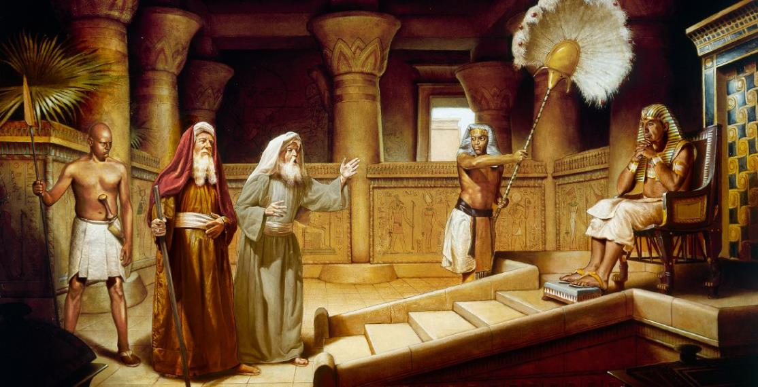
KAMATA’ANGA TOKATĀMAKI
Lesoni 3 ki he ʻaho 19 ʻo Siulai, 2025

Slide 2
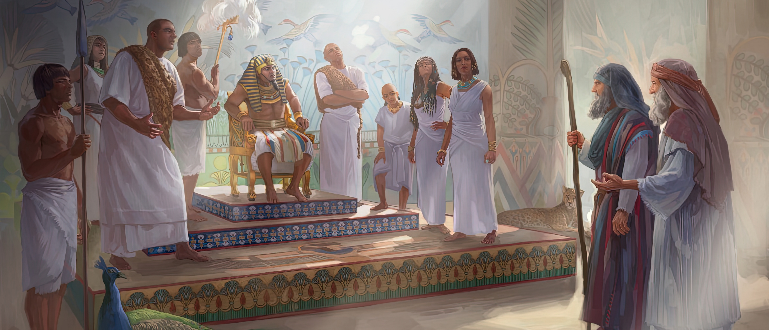
“Pea hili ia naʻe ʻalu ʻa Mōsese mo ʻElone, ʻo tala kia Felo, “ʻOku pehē mai ʻe Sihova, ko e ʻOtua ʻo ʻIsileli, Tukuange ʻa hoku kakai ke ʻalu, koeʻuhi ke nau fai ʻae kātoanga kiate au ʻi he toafa.”Pea pehēange ʻe Felo, “Ko hai ʻa Sihova, koeʻuhi ke u talangofua ai ki hono leʻo ʻo tukuange ʻa ʻIsileli ke ʻalu? ʻOku ʻikai te u ʻiloa ʻa Sihova, pea ʻe ʻikai te u tukuange ʻa ʻIsileli ke ʻalu.” ‘Ekisotosi 5:1,2

Slide 3

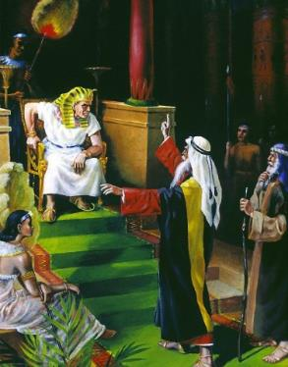
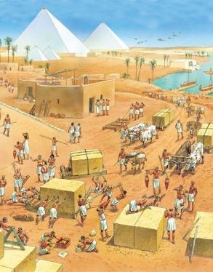
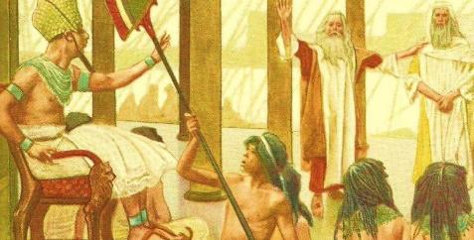




Hangē ko ia na‘e ongo‘i ‘e Mōsesé, ‘e ‘ikai faingofua kia Felo ke ne faka‘atā ‘a ‘Isileli ke mavahe mei ‘Isipite.
Na‘e ‘ikai foki ke hā ngali fakapotopoto ke tukuange pē ha fu‘u kakai ‘aonga tokolahi pehē ke nau tau‘atāina, ‘o fai ‘a e ngaahi ngāue na‘e ‘ikai loto ki ai ‘a e kau ‘Isipité.
Ko ia, ko e ‘amanaki ‘a e kakaí na‘e ‘i he ngaahi mana te ne fakamālohi‘i ‘a Felo ke ne tali fakapapau ki he‘enau kolé.
Naʻe fai ʻa e kolé; naʻe fakafisingaʻi ia; naʻe ʻi ai ha ngaahi tautea; Na‘e ‘ikai ke fai ‘e Mōsese ha mana; ... fakalotosiʻi.
Ko e kole: “Tuku ke ‘alu hoku kakaí.”
Ko e tali ‘a Felo (‘Ekisotosi 5:1-2)
Ko e tali ‘a e kakai (‘Ekisotosi 5:3-21)
Ko e tali ‘a e ‘Otua (‘Ekisotosi 5:22-6:8)
Ko e tali ‘a Mosese (‘Ekisotosi 6:9-13)
Ko e fatongia ‘o Mosese mo ‘Elone (‘Ekisotosi 6:28-7:7)

Slide 4

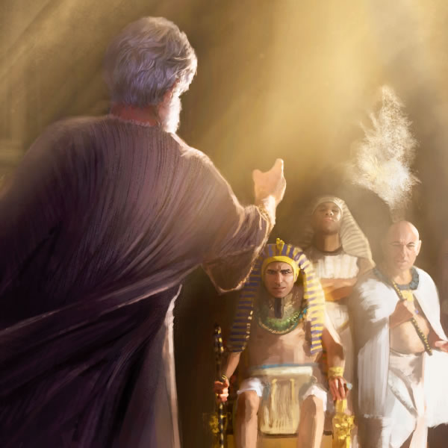
KO E KOLE: "TUKUANGE HOKU KAKAI KE ʻALU"

Slide 5


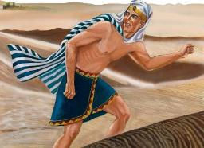
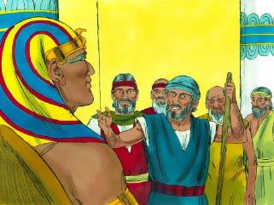
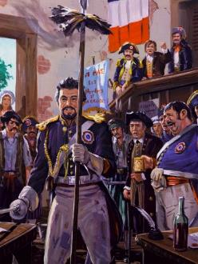
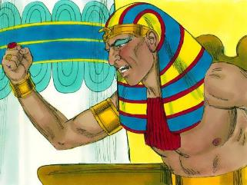
KO E TALI 'A FELO
Naʻe fehuʻi ʻe Felo, ʻKo hai ʻa e ʻEiki ke u fanongo kiate Ia pea tukuange ʻa ʻIsileli? ʻOku ʻikai te u ʻilo ʻa e ʻEiki, pea ʻe ʻikai te u tukuange ʻa ʻIsileli ke ʻalu.ʻ (ʻEkisotosi 5:2)
Naʻe kei siʻi ʻa Thutmose III ʻi he taimi naʻa ne kaka hake ai ki he taloni ʻi he malumalu ʻo e pule ʻa Hatshepsut ke taʻofi ʻa Mosese mei hono fakaha ko e felo. Naʻe hola ʻa Mosese mei ʻIsipite ʻi he taimi naʻe kei taʻu hongofulu tupu ai ʻa Tutimose.
‘I he ta‘u ‘e fāngofulu mei ai, na‘e toe ‘ilo‘i ‘e Mōsese ia ‘i he fakamaau‘angá. Na‘á ne ha‘u ke kole ‘a ‘ene totonu ki he taloní? Hala'atā. Naʻe faingofua pē ʻa e kolé: “Tukuange hoku kakaí ke nau ʻalu” ( ʻEki 5:1 ).
Ko e tali ‘a Tutimosé ko ha pole ia, ‘o ‘ikai kia Mōsese, ka ki he ‘Otuá tonu. Ko hono fakanounou, na’a ne pole’i ‘a e ‘i ai tonu ‘a e ‘Otua (Ekisotosi 5:2).
Ko ‘ene tō’ongá ‘oku ngāue’aki ia ‘ia Fakahā ko ha faka’ilonga ke fakafofonga’i ‘aki ‘a e pule’anga Falanisē lolotonga ‘a e liliu ‘o e senituli 18 (Fakh. 11:8). Hangē ko Feló, na‘e fakahā ‘e he Lepupilika Falaniseé kuo fakangata ‘a e lotú pea fakahā ko ha pule‘anga ta‘etui ‘Otua ia.

Slide 6


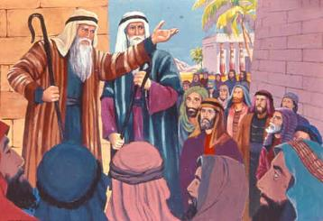
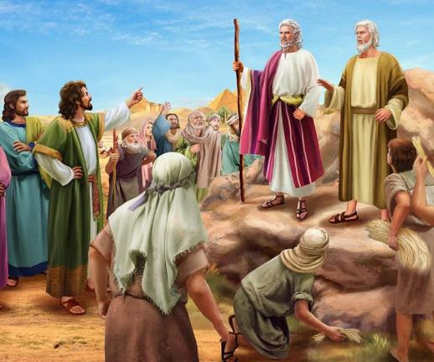
KO E TALI 'A E KAKAI
“Pea nau pehē kiate kinaua, “Ke vakai ʻa Sihova kiate kimoua, pea fakamaauʻi: koeʻuhi kuo mo fakanamukūʻi ʻakimautolu ʻi he ʻao ʻo Felo, pea mo e ʻao ʻo ʻene kau tamaioʻeiki, ke ai ʻae heletā ʻi honau nima ke fakapoongi ʻaki ʻakimautolu.”’” (‘Ekisotosi 5:21)
‘I he fai ‘e Mosese ‘a e ngaahi faka’ilonga na’e ‘oange ‘e he ‘Otua kiate ia ‘i he ‘ao ‘o e kakai, na’a nau tui mo lotu (Ek. 4:29-31). ‘Oku lava ke tau faka‘uta atu ki he vēkeveke ‘enau tatali ki he tali ‘a Felo ki he‘enau kolé.
Naʻe taʻeʻamanekina moʻoni ʻa e talí. Na’e ‘ikai ngata pe ‘i he fakafisi ‘a Felo, ka na’a ne fakamālohi’i kinautolu ke nau fai ‘a e ngāue ‘o ‘ikai ke ‘oange ‘a e ngaahi naunau ‘oku fiema’u, ka na’a ne fiema’u ‘a e ola tatau (Ek. 5:6-8). Ko e hā ‘a e ‘uhinga ki hono hilifaki‘i ha tu‘utu‘uni ta‘efakakaukau‘i pehē?
Naʻe ʻai ʻe Mōsese mo ʻĒlone ʻo fakatatau kia Tutimose ke na “mālōlō [ sāpate ] mei heʻena ngaahi ngāué” ( ʻEk. 5:5 ). Kapau na’a nau ma’u ha taimi ke talanoa ki he lotu mo e tau’ataina, pea te nau ma’u foki ha taimi ke kumi mohuku (Ek. 5:9, 17).
‘I hono ngaohikovi‘i kinautolú, na‘e lāunga ‘a e kau pule ngāué kia Felo, ka na‘e tukunoa‘i kinautolu. Na’a nau tafoki leva ‘o fakafepaki’i ‘a Mosese mo ‘Elone, ‘o tukuaki’i kinaua ki he’ena fakakovi ange hona tu’unga (Ek. 5:20-21).

Slide 7


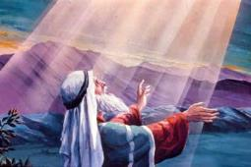
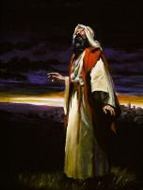
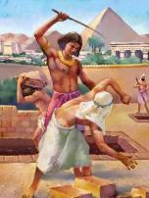
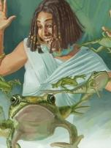
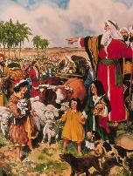
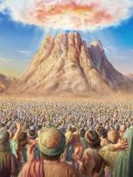
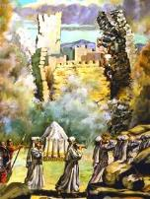
KO E TALI ‘A E ‘OTUA
“Pea naʻe folofola ai ʻa Sihova kia Mōsese, “Ko eni, te ke mamata ki he meʻa te u fai kia Felo: koeʻuhi ʻi he nima mālohi te ne tukuange ʻakinautolu ke ʻalu, pea ʻi he nima mālohi te ne kapusi ʻakinautolu mei he fonua.”’” (‘Ekisotosi 6:1)
Na‘e ‘ita ‘a Felo kia Mōsese. Na‘e ‘ita ‘a e kakaí kia Mōsese. ‘Oku ‘ikai ke ‘ita ‘a Mosese... ka ‘oku ne hoha’a, pea ‘oku ne tafoki ki he ‘Otua mo ‘ene veiveiua: “Ko e ha ‘oku ke fakamamahi’i ai ‘a e kakai ni, ko e ha na’a ke fekau mai ai au?” ( ʻEkisotosi. 5:22 ).
Tau sivisivi’i ‘a e tali ‘a e ‘Otua (Ekisotosi 6:1-8):
Ko e me'a kuo u fai .
Naʻá ku hā ki he kau palōfitá .
Ko e me'a te u fai .
Te u ʻave meiate kinautolu ʻa e fakamamahi ʻa e kakai ʻIsipite .
Te u fakatauʻatāinaʻi kinautolu mei he nofo pōpulá
Naʻa ku fokotuʻu ʻeku fuakava mo kinautolu .
Naʻá ku palōmesi te u foaki kiate kinautolu ʻa e fonua ko Kēnaní .
Kuó u fanongo ki he tangi ʻa e kakaí .
Kuó u manatuʻi ʻeku palōmesí .
Te u ngāueʻaki hoku mālohí
Te u ngaohi kinautolu ko hoku kakai .
Te u hoko ko honau ʻOtua .
Te u foaki kiate kinautolu ʻa e fonua ko Kēnaní .

Slide 8


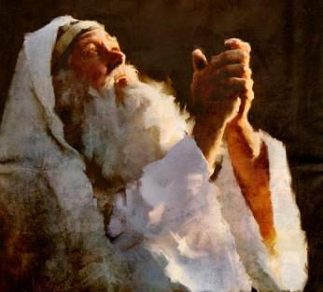
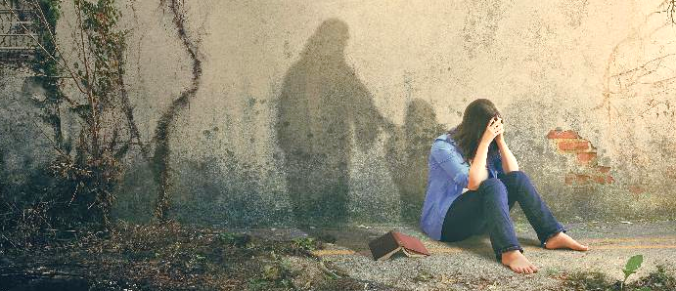
KO E TALI 'A MOSESE
“Pea naʻe lea ʻa Mōsese ʻi he ʻao ʻo Sihova, ʻo pehē, “Vakai, ʻoku ʻikai tokanga ʻae fānau ʻa ʻIsileli kiate au: pea ʻe tokanga fēfeeʻi ʻa Felo kiate au, ko e loungutu taʻekamu ko au?”” (‘Ekisotosi 6:12)
Hili ‘a e ngaahi lea fakalotolahi ‘a e ‘Otua, na’e toe lea ‘a Mosese ki he kakai, ka na’e ‘ikai ke nau fanongo (Ek. 6:9). Naʻe kole leva ʻe he ʻOtuá ke ne toe lea kia Felo ke kole ke tauʻatāina ʻa ʻIsileli (Ek. 6:10-11).
Naʻe fakafisi ʻa Mōsese, peá ne toe lulululu ʻene ngaahi ʻuhinga: Kapau ʻe ʻikai fanongo mai hoku kakaí kiate au, ʻe fanongo fēfē mai ʻa Felo kiate au, ʻi heʻeku lea kovi ʻo hangē ko aú? ( ʻEki 6:12 ).
Naʻe loto-mamahi, loto-mafasia, mo loto-mamahi ʻa Mōsese. Ka, hangē ko e kau tangata lalahi kehe na‘a nau ongo‘i tatau mo iá—hangē ko ‘Ēsafe mo Siopé—na‘e ‘ikai te ne tukulolo ki he loto-mo‘uá. Naʻe mālohi ange ʻene falala ki he ʻOtuá ʻi heʻene ongoʻi lolotongá.
‘I he taimi ‘oku tau a‘usia ai ‘a e loto-si‘í, tau ‘ai ke ‘atautolu ‘a e ngaahi lea ‘a ‘Ēsafé: “Ka ‘oku ou ‘iate koe ma‘u ai pē, he ‘okú ke puke hoku nima to‘omata‘ú: ‘okú ke tataki au ‘aki ho‘o fale‘í, pea ‘amui te ke talitali au ki he lāngilangí. Ko hai ‘oku ou ma‘u ‘i he langí ka ko koe pē? tofiʻa” (Saame 73:23–26 ).

Slide 9

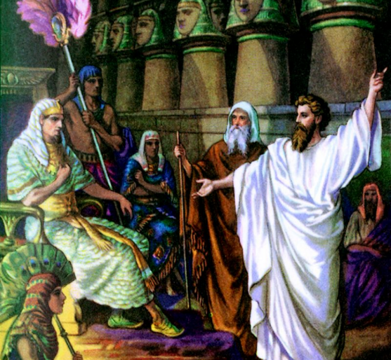
KO E FATONGIA
'O MOSESE
MO ĒLONE

Slide 10

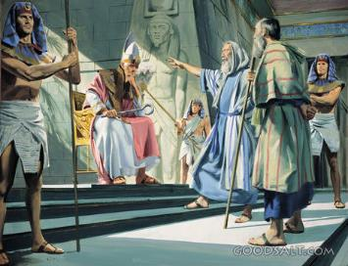
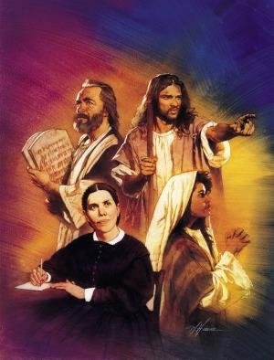
“Pea naʻe folofola ʻa Sihova kia Mōsese, “Vakai, Kuo u ngaohi koe ke ke hangē ko e ʻotua kia Felo: pea ko ʻElone ko ho taʻokete, ko hoʻo fakafofonga ia.” (‘Ekisotosi 7:1)
Hangē ko e “ʻOku ʻikai te u ʻiloʻi ʻa e leá” ko e ʻuhinga manakoa taha ia ʻa Mōsesé. Na‘e a‘u ‘o ne faka‘ita‘i ‘a e ‘Otuá ‘aki ‘a e taha ko ení! Ka ‘oku ‘i ai ‘a e solova‘anga ‘o e ‘Otuá ki he me‘a kotoa pē: ko ‘Ēlone, ko hono tokoua leá, ‘e hoko ia ko e “ngutu” ‘o Mōsesé. Na’e lea ‘a Mosese ki hono tokoua, pea lea ia ki he kakai kehe (Ek. 4:10-16).
Hili ‘a e ngaahi ‘uluaki ta’elavame’a ‘i ‘Isipite, na’e pau ke toe fakamanatu ‘e he ‘Otua kia Mosese ‘a e fatongia ‘o ‘Elone ko hono tokoni mo hono tangata lea (Ek. 7:1-2).
‘I he taimi ko ení, na‘á ne fai ai ha fakahoa ki he fatongia ‘o e kau palōfitá. ‘Oku nau ma‘u ha pōpoaki mei he ‘Otuá pea fakahoko mai ia kiate kitautolu. ‘I he ‘uhinga ko ení, ‘oku fakahoko ai ‘e Mōsese ‘a e fatongia ‘o e ‘Otuá, pea ko ‘Ēlone ‘a e fatongia ‘o e palōfitá.
Hangē ko ia ‘e hoko kimui ki he tokolahi ‘o e kau palōfitá, na’e fakatokanga ‘a e ‘Otuá ‘e ‘ikai ke fanongoa ‘ene pōpoakí, pea kuo pau ke ne ngāue ‘aki ‘a e mālohi lahi (Ek. 7:3).
Hange ko e kau palofita kimui, na'e pau ke lea 'a Mosese ki he kakai mo Felo, "pe 'oku nau fanongo pe tafoki, he 'oku nau angatu'u lahi" (Isik. 2:7). ʻOku moʻoni foki ʻeni kiate kitautolu, he ko kitautolu ʻa e leʻo ongo ʻo e ʻOtuá ʻi he māmani ko ʻení.

Slide 11

“Naʻe ʻamanaki ʻa e kau Hepeluú ke maʻu ʻenau tauʻatāiná ʻo ʻikai ha ʻahiʻahi makehe ʻo ʻenau tuí, ʻo ʻikai ha faingataʻa moʻoni pe mamahi. Ka naʻe teʻeki ke nau mateuteu ki he fakahaofí. Naʻe siʻisiʻi ʻenau tui ki he ʻOtuá pea naʻe ʻikai ke nau loto fiemālie ke kātakiʻi ʻenau ngaahi faingataʻá kae ʻoua kuó Ne vakai ʻoku taau ke ngāue maʻanautolu. a to'o ki ha fonua muli;pea kuo hoko 'a e ngaahi to'onga 'o e ni'ihi 'o hange ko e ngaahi to'onga 'o e kau 'Isipite 'o nau sai'ia ange ke nau nofo 'i 'Isipite.Ko ia, na'e 'ikai ke fakahaofi kinautolu 'e he 'Eiki 'i he 'uluaki fakahaa'i 'o Hono malohi 'i he 'ao 'o Felo Na'a ne orchestrated 'a e ngaahi me'a na'e hoko koe'uhi ke developed 'a e laumalie fakatikitato 'o e tu'i 'o 'Isipite pea Hi mights ke lahi ange. Ko ʻEne fakamaau totonú, Hono mālohí, mo ʻEne ʻofá, te nau fili ke mavahe mei ʻIsipite ʻo foaki kinautolu ki Heʻene ngāué.”
EGW (Kau Pēteliake mo e Kau Palōfitá, p. 236
)

