Slide 1

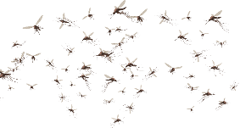
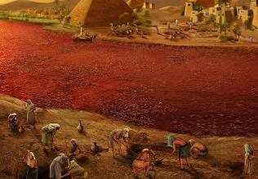
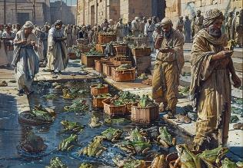
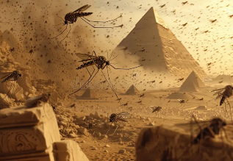
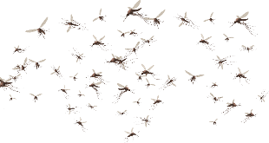
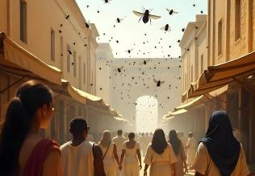
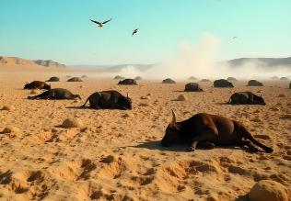
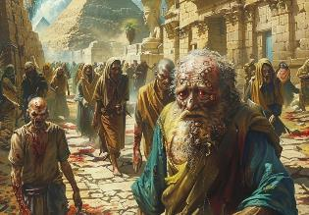
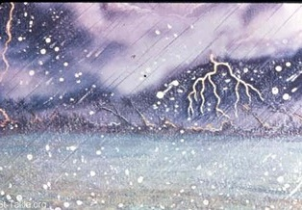
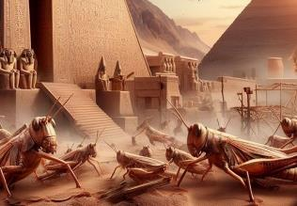
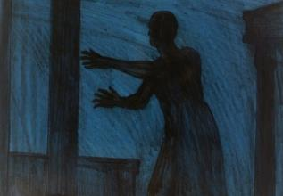
NGAAHI MALAÏA
Lesoni 4 ki he ʻaho 26 ʻo Siulai, 2025

Slide 2
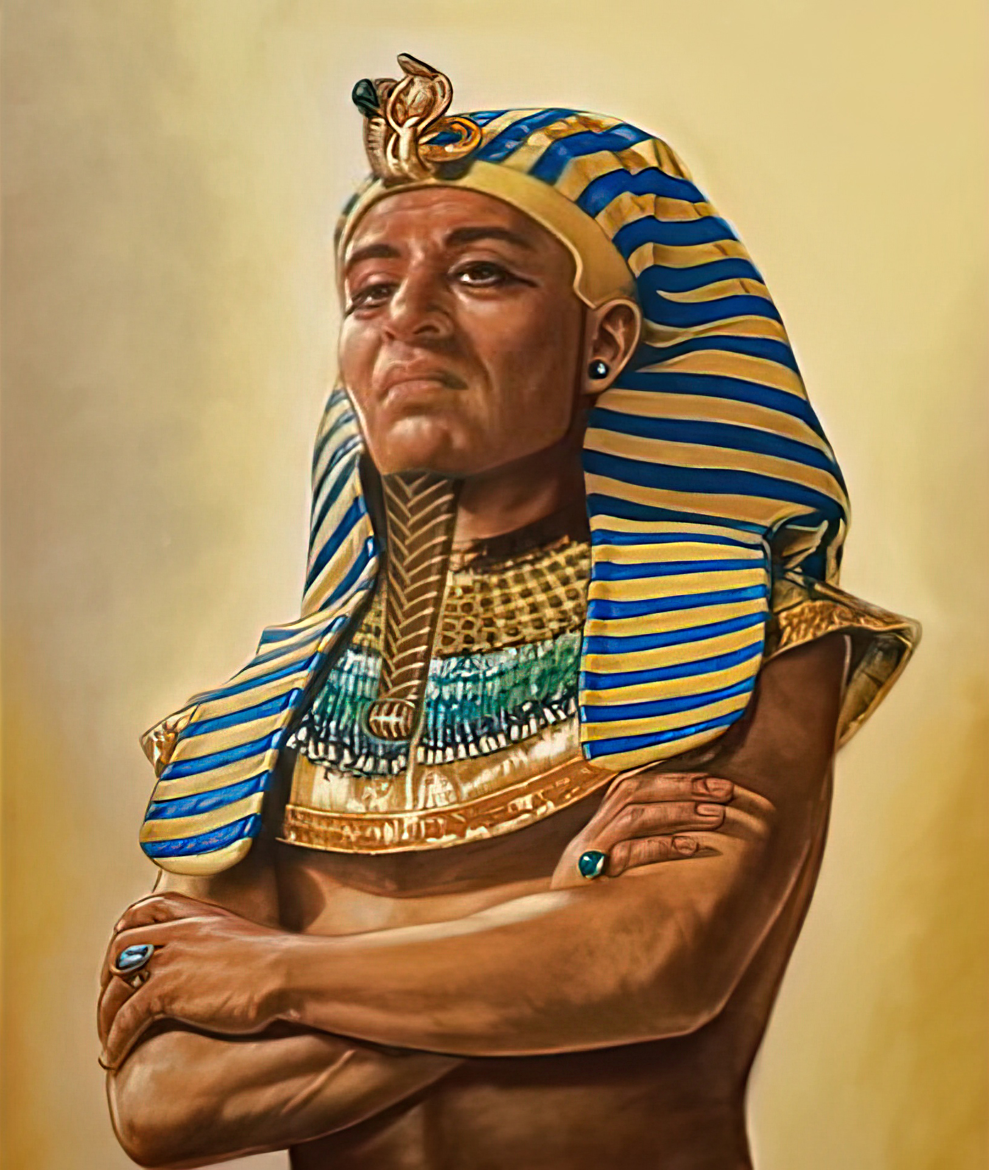
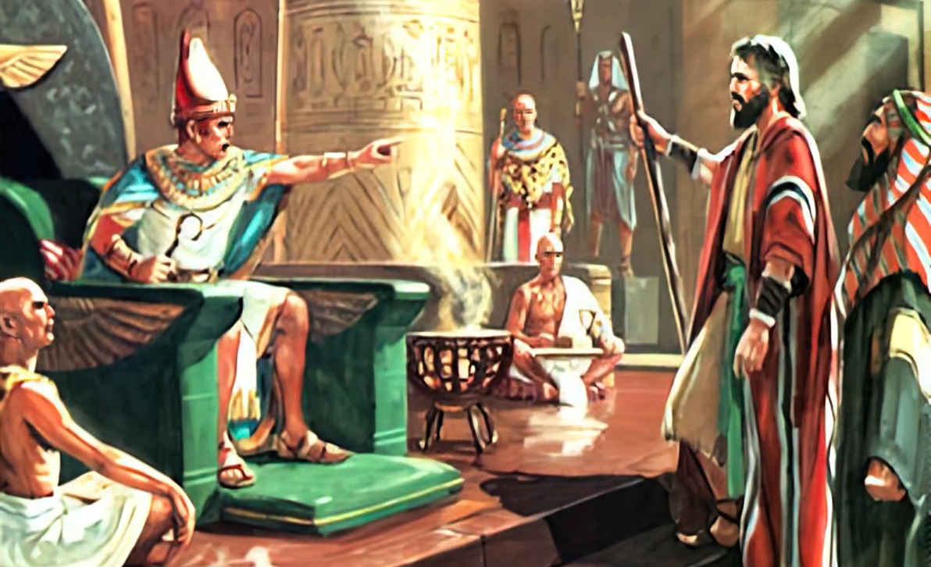
“Pea naʻe fefeka ʻae loto ʻo Felo, pea naʻe ʻikai te ne tuku ʻae fānau ʻa ʻIsileli ke ʻalu: ʻo hangē ko e folofola ʻa Sihova kia Mōsese.”
‘Ekisotosi 9:35

Slide 3

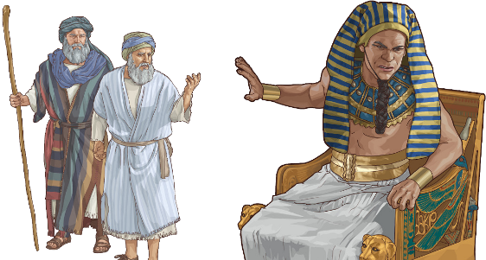
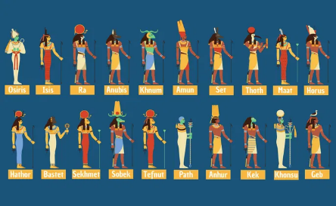
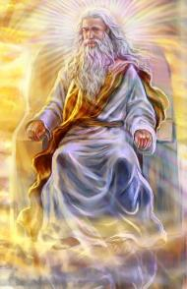




‘I he taimi na‘e fehangahangai ai ‘a e kakai ‘a e ‘Otuá mo ha taú, na‘e fakahinohino‘i kinautolu ‘e he ‘Otuá ke nau ‘uluaki alea‘i ‘a e ngaahi tu‘unga ‘o e melinó. Kapau na’e ‘ikai lava ke fai ha aleapau, pea na’e pau leva ke fai ha ngāue (Teutalonome. 20:10-12).
Ko e anga eni ‘o e feangainga ‘a e ‘Otua mo ‘Isipite. Na‘e ‘osi feinga‘i ha fakalelei‘anga fakamelino, ka na‘e fakafisi ‘a Thutmose ke tali ia. Naʻe hokosia ʻa e taimi ke fai ai ha ngāué.
‘I he tō ‘a e ngaahi mala‘iá, na‘e ‘ikai ha ‘otua ‘i he fu‘u lotu lahi ‘o ‘Isipité ‘e lava ke ne malu‘i ‘a ‘Isipite mei he mālohi ‘o e ‘Otua mo‘oni pē ‘e tahá.
Ko e tomuʻa leá:
  Ngata mālohi (Ekisotosi 7:8-12)
  Ko e loto fefeka (Ekisotosi 7:13)
Ko e ngaahi mala’ia:
  Tolu e tautea vaivai (‘Ekisotosi 7:14-8:19)
  Tolu e tautea mamafa (‘Ekisotosi 8:20-9:12)
  Tolu e tautea fakaauha (‘Ekisotosi 9:13-10:29)

Slide 4

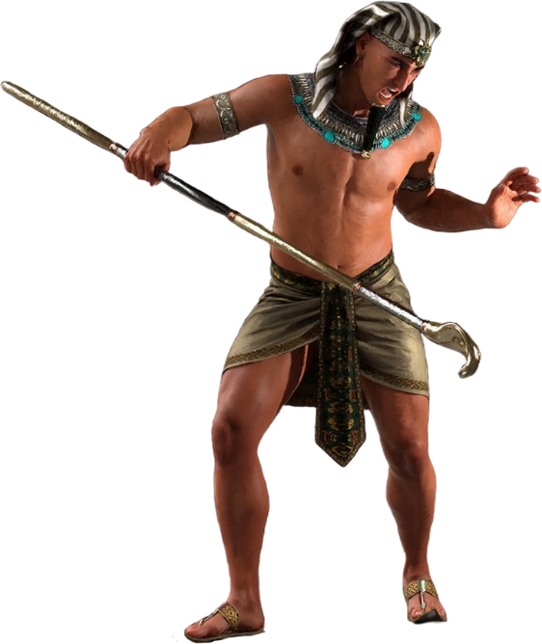
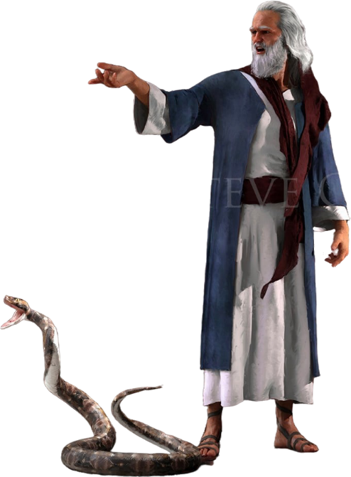
KO E TOMU'A

Slide 5

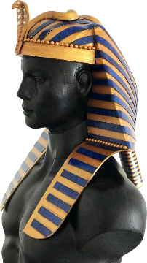
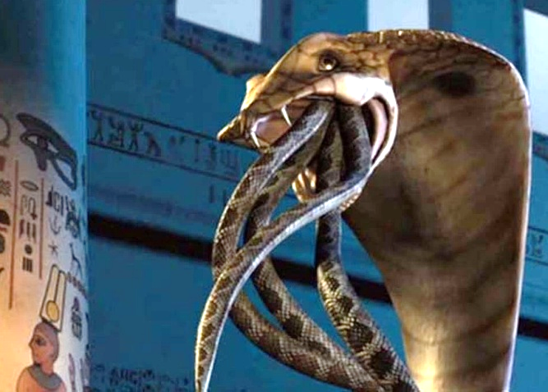
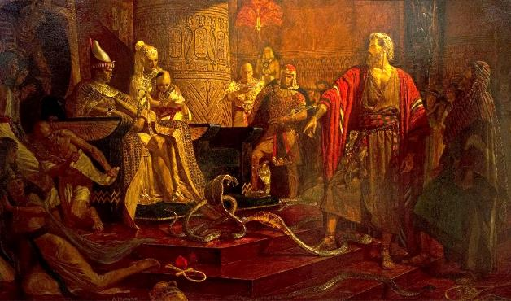
NGATA MĀLOHI
“Na‘a nau taki taha lī ki lalo ‘a ‘ene tokotokó pea na‘e hoko ia ko ha ngata. Ka naʻe folofua ʻe he tokotoko ʻo ʻĒloné honau ngaahi tokotokó.” ( ʻEkisotosi 7:12 )
Na‘e fakahaa‘i ‘e he ‘Otuá ko hono fakatau‘atāina‘i ‘o ‘Isilelí ko ha tau na‘á ne fai fakafo‘ituitui ki he ngaahi ‘otua ‘o ‘Isipité. ( ʻEke. 12:12 ; Nom. 33:4 ).
‘I hono kalauní, ko ha faka‘ilonga ‘o hono mālohí, na‘e tui ai ‘e he feló ha koula faka‘ofo‘ofa ‘okú ne fakafofonga‘i ‘a e ‘otua fefine ko Uadyet .
‘I he’ene liliu ‘a e tokotoko ke ngata, na’e pole’i hangatonu ai ‘e he ‘Otua ‘a e ‘otua fefine ko eni (Ek. 7:10). Te ne malava ke malu‘i ‘a Felo?
Naʻe faʻifaʻitaki ʻa Sētane ki he maná ʻo fakafou ʻi he kau faimaná ( ʻEkes. 7:11 ). Ka ‘oku ‘ikai te ne lava ke fakatupu ‘a e mo‘uí; ko ʻene fanga ngatá naʻe hangē pē ha fanga ngatá. Kaekehe, na’e fakatupu ‘e he ‘Otua ha ngata mo’ui, ‘o ne malava ke keina ‘a e ngaahi me’amo’ui ta’emo’ui (Ekisoto 7:12).
Na‘e fakahaa‘i ai ‘e he ‘Otuá ko Ia, ‘o ‘ikai ko e ngaahi ‘otua ‘Isipité, ‘a e tokotaha ‘okú ne ma‘u ‘a e mālohi mo e mafai fakatu‘í .
.

Slide 6

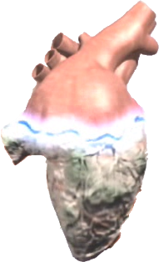
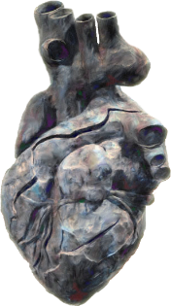


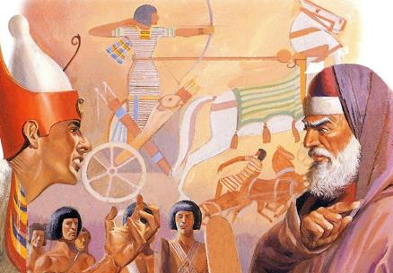

KO E LOTO KUO FAKAFEKA
“Ka naʻe fefeka ʻa e loto ʻo Feló, pea naʻe ʻikai te ne fie fanongo kiate kinaua, ʻo hangē ko e folofola ʻa Sihová” ( ʻEkesōtosi 7:13)
‘I he tohi ‘Ekisotó, ‘oku tu‘o 9 ai ‘a e pehē na‘e fakafefeka ‘e he ‘Otuá ‘a e loto ‘o Feló (‘Eki. 4:21; 7:3; 9:12; 10:1; 10:20; 10:27; 11:10; 14:4; 14:8), pea ‘oku tu‘o 9 ‘a e pehē na‘e fakafefeka ‘e Felo tonu ‘a hono lotó (‘oku pehē ‘e he taha ‘e tahá. (Eke. 7:13; 7:14; 7:22; 8:15; 8:19; 8:32; 9:7; 9:34; 9:35) . Ha'i! Ko hai naʻa ne fakafefeka ʻae loto ʻo Felo?
Hili ‘a e ‘uluaki mala ‘e nimá, ‘oku fakahaa‘i mahino ai na‘e fakafefeka ‘e Felo hono lotó. ‘A ia, na’a ne fakafisi ke tali lelei ‘a e ui ‘a e Laumalie Ma’oni’oni ke tukuange ‘a ‘Isileli ke tau’ataina.
Hili ‘a e mala hono ono, ‘oku fakafefeka ‘e he ‘Otua ‘a e loto (Ek. 9:12). ‘Oku hā ngali na‘e laka atu ‘a Felo ‘i he tu‘unga ‘o e fakatomalá. Kaekehe, ‘i he mala hono fitú, ‘oku toe ‘oange kiate ia ha faingamālie, ka ‘okú ne toe fakafefeka hono lotó (‘Ekisoto 9:34-35 ).
Mei ai, naʻe silaʻi hono ikuʻangá. Naʻe fakafefeka ʻe he ʻOtuá ʻa e loto ʻo Feló koeʻuhí he naʻá ne fakapapauʻi pau ke ʻoua naʻá ne fakatomala.

Slide 7

EGW (Ko e Toe Vakaiʻi mo e Herald , Fepueli 17, 1891)
ʻI hono fakafisingaʻi kotoa pe ʻo e mama, naʻe fakahaaʻi ʻe he ʻEiki ha malohi lahi ange; neongo ia, naʻe fakautuutu ʻa e loto fefeka ʻa e tuʻi ʻi he fakaʻilonga foʻou kotoa pe ʻo e mafimafi mo e naunau ʻo e ʻOtua ʻo e langi, kae ʻoua kuo ʻosi ʻa e fakahaaʻi fakaʻosi ʻo e ʻaloʻofa mei he mahafu tau fakalangi. ʻI he taimi ko ia, naʻe fakafefeka ʻaupito ʻa e tangata ʻi heʻene fakafisi ke tukulolo. Naʻe fakatupulekina ʻe Felo ʻa e loto fefeka pea utu ai ha natula tatau. Naʻe ʻikai lava ʻe he ʻEiki ʻo toe fai ha meʻa ke fakalotoʻi ia, he naʻe fakamalohia ia ʻi heʻene loto fefeka mo filifilimanako, ʻa ia naʻa ne taʻofi ʻa e Laumalie Maʻoniʻoni mei heʻene aʻu ki hono loto. Naʻe tukulolo ʻa Felo ki heʻene taʻetui mo e loto fefeka.

Slide 8

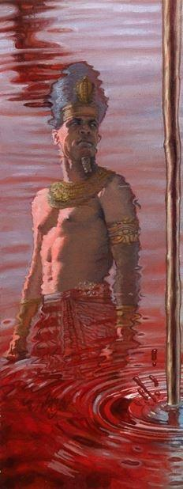
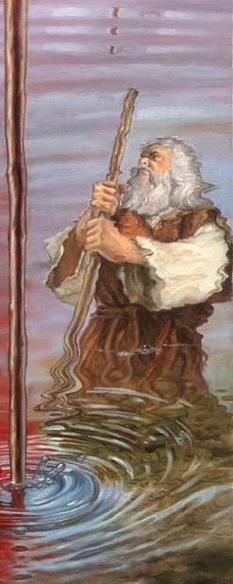
NGAAHI MALA

Slide 9

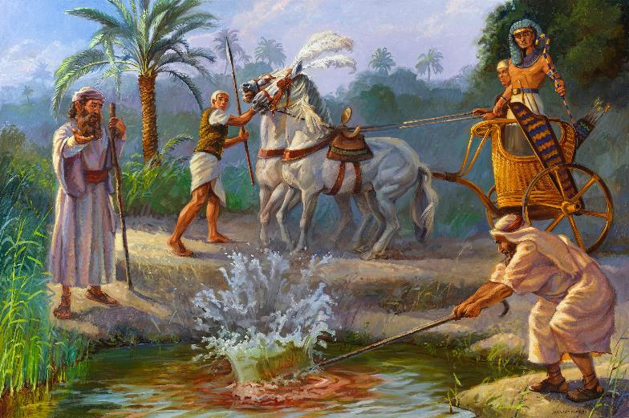
ULUAKI MALA: TOTO
“‌ʻOku pehē mai ʻe Sihova, ʻi he meʻa ni te ke ʻilo ko au ko Sihova: vakai, teu tā ʻae vai ʻaia ʻoku ʻi he vaitafe, ʻaki ʻae tokotoko ʻoku ʻi hoku nima, pea ʻe liliu ia ko e toto.(Ekisotosi 7:17)
Hapi, ko e ‘otua ‘o e Naila .
Ekisotosi 7:14-25 .
Ko e Naila, mo hono ngaahi tāfeá, na‘á ne ‘omai ‘a e mo‘uí ki ‘Isipite. Kae ko ai ʼaē neʼe ina fakatupu te ʼu matapuna ʼo te vai? Na‘e fakatātaa‘i ‘e he kau faimaná ‘a e liliu ‘o e vaí, ka na‘e ‘ikai lava ke nau fakafoki ia .

Slide 10

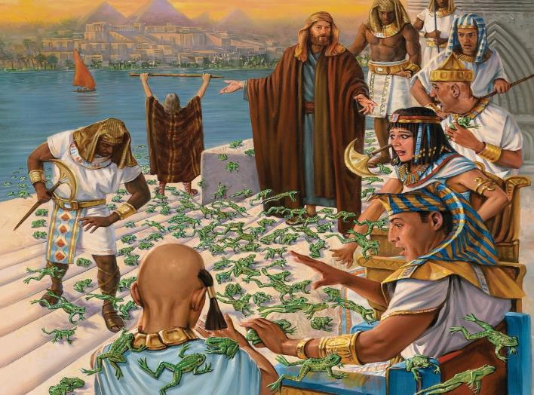
MALA HONO UA : NGAAHI POTO
“Pea folofola leva ʻa e ʻEikí kia Mōsese, “Tala kia ʻĒlone ke mafao atu ho nimá mo ho tokotokó ki he ngaahi vaitafé, mo e ngaahi halanga vaí, mo e ngaahi anovaí, pea ʻai ke ʻalu hake ʻa e fanga potó ki he fonua ko ʻIsipité” ( ʻEkesōtosi 8:5 ).
Heket, ko e ‘otua ‘o e fanga poto .
‘Ekisoto 8:1-15 .
Naʻe toe faʻifaʻitaki ʻa e kau faimaná ki he mahakí, ka naʻe ʻikai ke nau lava ʻo taʻofi ia.

Slide 11
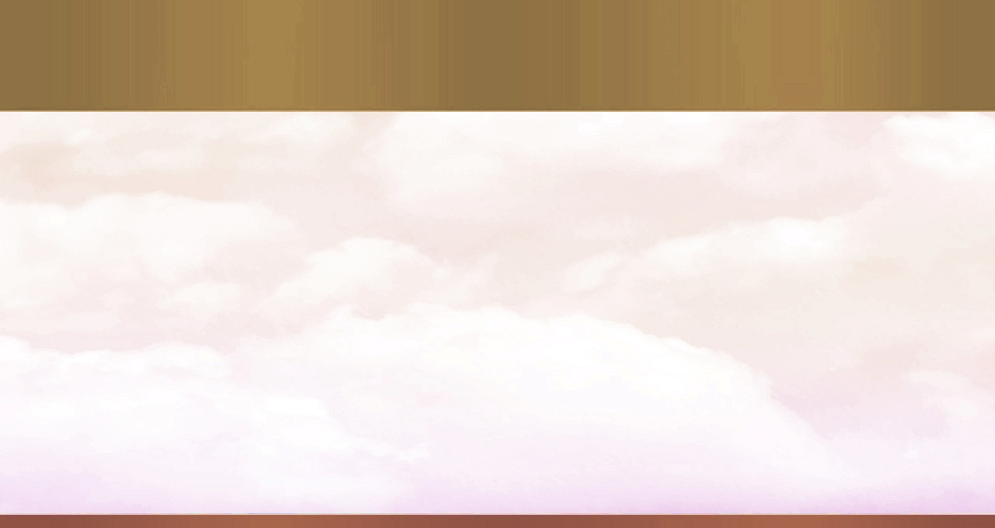
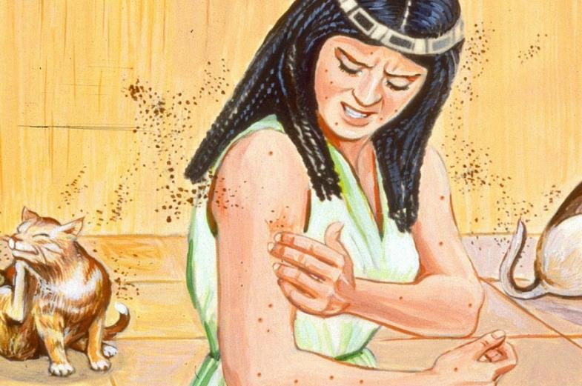
MALA HONO TOLU : KUTU
Pea naʻe folofola ʻa Sihova kia Mōsese, “Tala kia ʻElone, Mafao atu ho tokotoko, ʻo taaʻi ʻaki ia ʻae efu ʻoe fonua, koeʻuhi ke hoko ia ko e fanga kutu ʻi he fonua kotoa pē ʻo ʻIsipite.Ekesotosi 8;16
Geb, ko e ‘otua ‘o e māmaní .
Ekisotosi 8:16-19
Ko hono fakatupu ‘o e mo’ui mei he efu ‘o e kelekele (Sen. 1:24)? Na’e ‘ikai ke toe ‘i ai ha veiveiua ki he tupu’anga ‘o e ngaahi mala: “Ko e tuhu ‘eni ‘o e ‘Otua”
(Ek . 8:19). Pea naʻe faifai pea fakalongolongo ʻa e kau faimaná.

Slide 12
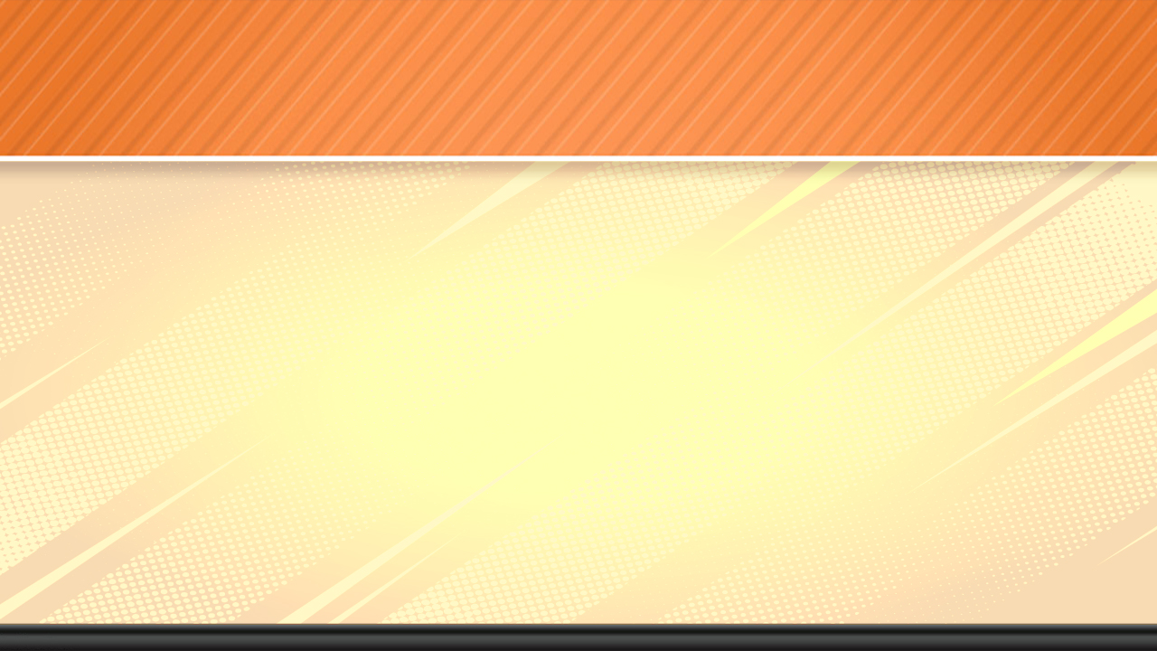
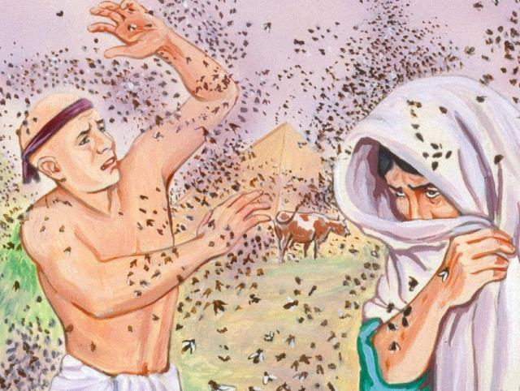
MALA HONO FĀ (MAMAHIA): NGAAHI LANGO
“Pea naʻe fai ia ʻe Sihova: pea naʻe haʻu ʻae fuifui lango fakamamahi ki he fale ʻo Felo, mo e ngaahi fale ʻo ʻene kau tamaioʻeiki, pea ki he fonua kotoa pē ʻo ʻIsipite: pea naʻe maumau ʻae fonua ko e meʻa ʻi he ngaahi fuifui lango.” (Ekisotosi 8:24)
Uatchit, ko e ‘otua fefine ‘o e ngaahi vaotaá .
ʻEkisoto 8:20-32.
.
Ko e ‘uluaki taimi ia na‘e malu‘i ai ‘a e kau ‘Isilelí mei he mahakí. Na‘e taki atu ai ‘a Felo ke ne alea‘i, ka na‘e iku ‘o ‘ikai ke ne tauhi ‘a ‘ene ngata‘anga ‘o e aleapaú.

Slide 13

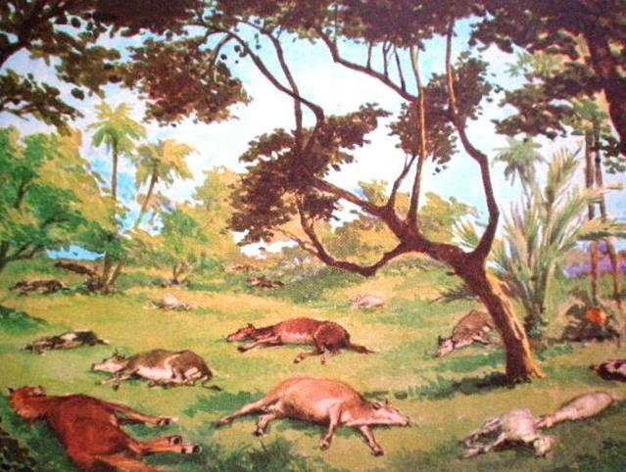
MALA HONO NIMA (MAMAFA): MATE 'A E NGAAHI PULU
“ʻE ʻomi ʻe he nima ʻo Sihová ha mala fakalilifu ki hoʻomou fanga monumanu ʻi he vaó —ki hoʻomou fanga hōsí, fanga ʻasi mo e fanga kāmelí pea ki hoʻomou fanga pulú, fanga sipí mo e fanga kosí” ( ʻEkesōtosi 9:3).
Khnum, ko e ʻotua fakatupu
ʻEkisoto 9:1-7.
Na‘e lahi ‘a e ngaahi ‘otua na‘e ‘ulu monumanu, ko ia na‘e fakamā‘ulalo‘i ai ‘e he mala ko ení ‘a e tokolahi taha ‘o kinautolú.

Slide 14

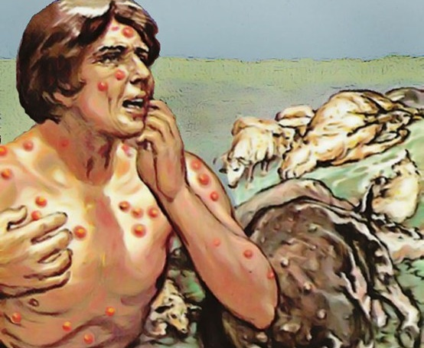
MALA HONO ONO (MALOHI): NGAAHI PALA
“Pea naʻa na toʻo mai ʻae efuefu ʻoe ngotoʻumu, ʻo na tuʻu ʻi he ʻao ʻo Felo: pea laku hake ia ʻe Mōsese ki langi; pea naʻe hoko ia ko e hangatāmaki, pea naʻe tupu ʻae vakafoha ki he tangata mo e manu.” (Ekisotosi 9:10)
Sekhmet, ko e ‘otua fefine ‘o e fakamo‘uí .
Ekisotosi 9: 8-12 .
Na’a mo e kau faimana na’e ‘ikai te nau lava ‘o fakamo’ui kinautolu (Ekisoto 9:11). Na‘e ‘ikai ha veiveiua ‘a Felo fekau‘aki mo e tupu‘anga ‘o e ngaahi mala‘iá. Ka kuo ne tu’utu’uni ke ne fakafisi ke punou ki he ‘Otua, pea na’e tuku ‘e he ‘Otua ke ne utu ‘a e fua ‘o ‘ene angatu’u (Ekisoto 9:12).

Slide 15

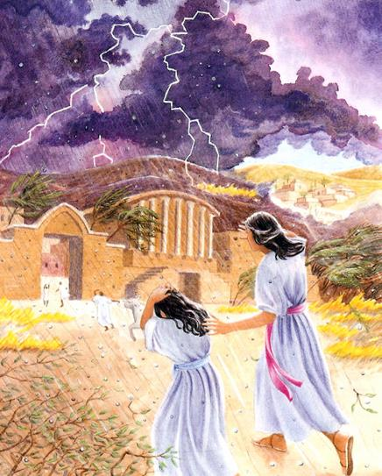
MALA HONO FITU (FAKA'AUHA): 'UHA MAKA
“Vakai, ko e feituʻulaʻā ni ʻapongipongi, Te u pule ke tō ai ʻae ʻuha maka fakamamahi lahi, naʻe ʻikai hano tatau ʻi ʻIsipite, talu hono fokotuʻu ʻo ia ʻo aʻu ki heni” (Ekisotosi 9:18)
Nati, ko e ʻotua fefine ʻo e langí .
ʻEkisotosi 9:13-35.
Na‘e ‘ahi‘ahi‘i ai ‘a e tui ‘a e kau ‘Isipité. Ko kinautolu na’e tui na’a nau fakahaofi ‘a e mo’ui ‘a ‘enau kau tamaio’eiki mo ‘enau fanga monumanu (Ek. 9:20). Na’e ‘ikai tui ‘a Felo, pea neongo na’a ne vete ‘ene angahala, ka na’e ‘ikai fakamātoato ‘ene vete (Ek. 9:27-30).
Seti, ko e 'otua 'o e ngaahi matangi .

Slide 16

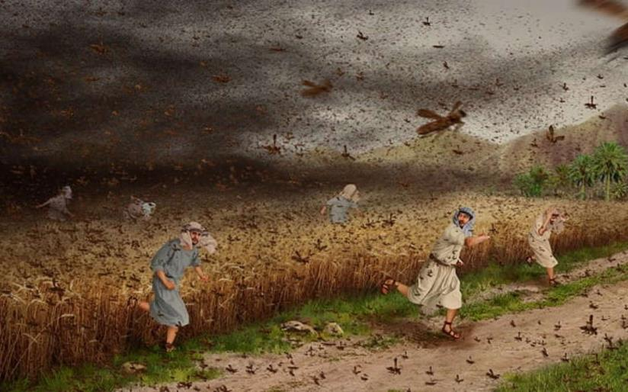
MALA HONO VALU (FAKA'AUHA): NGAAHI HE'E
“Pea kapau te ke taʻofi ʻae tukuange ʻo hoku kakai, vakai, te u ʻomi ʻae fanga heʻe ki ho fonua ʻapongipongi:” (Ekisotosi 10:4)
Nepa, ko e ‘otua ‘o e uite
‘Ekisoto 10:1-20 .
.
‘I he faka’auha ‘o ‘Isipite, na’e kole ‘a e kau ‘Isipite tonu kia Felo ke tukuange ‘a ‘Isileli ke nau ‘alu (Ek. 10:7).

Slide 17

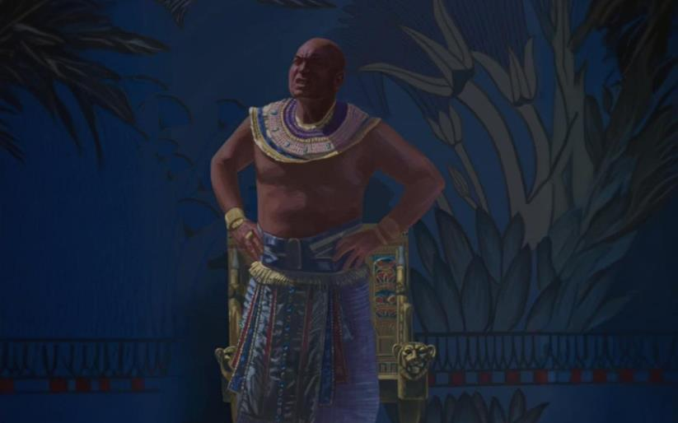
MALA HONO HIVA (FAKA'AUHA): PO'ULI .
“Pea naʻe folofola ʻa Sihova kia Mōsese, “Mafao hake ho nima ki langi, koeʻuhi he hoko ai ʻae fakapoʻuli ki he fonua kotoa pē ʻo ʻIsipite, ʻio, ʻae poʻuli matolu.” (Ekisotosi 10:21)
Ra, ko e ʻotua ʻo e laʻaa
Ekisotosi10:21-29.
Naʻe tuʻu ʻa e moʻui ʻi ʻIsipite ʻi ha ʻaho ʻe tolu (Tuku kehe ʻa Koseni). Naʻe foaki ʻ e he ʻ Otuá ha taimi ke fakalaulauloto ai, ʻ a ia naʻe ʻ ikai ke ngāueʻaongaʻaki kakato ʻ e Felo.

Slide 18
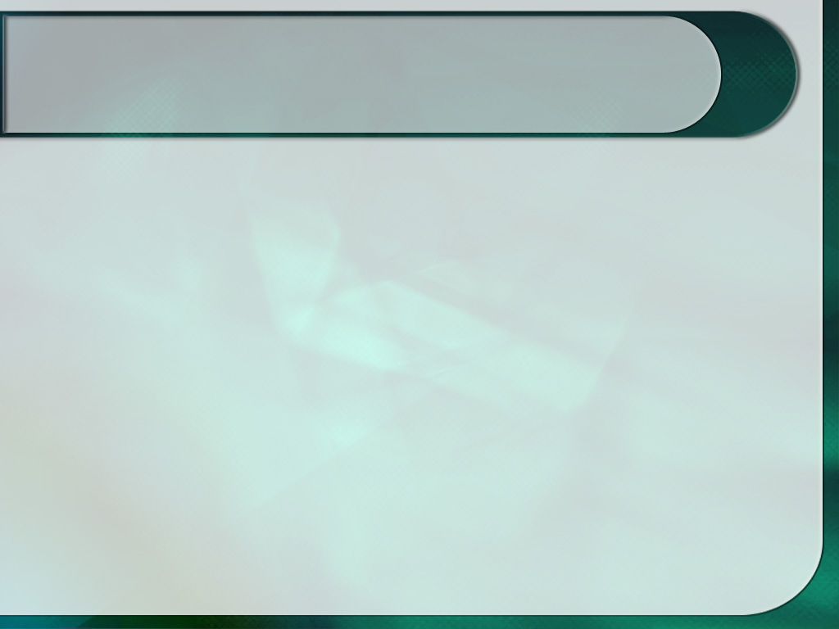
EGW (Kau Pēteliake mo e Kau Palōfitá, p. 263)
“Kimuʻa pea fakahoko ʻa e mala takitaha, naʻe pau ke fakamatalaʻi ʻe Mōsese hono natulá mo e ngaahi nunuʻá, koeʻuhí ke lava ʻe he tuʻí ʻo fakahaofi ia mei ai kapau te ne loto ki ai.Ko e tautea kotoa pē ʻe fakafisingaʻí ʻe muimui atu ʻi ha tautea ʻe taha ʻoku toe mamafa ange, kae ʻoua kuo fakavaivaiʻi hono loto pōlepolé, pea te ne fakamoʻoniʻi ʻa e Tokotaha-Ngaohi ʻo e langí ʻo hangē ko e moʻoni ʻa e ʻOtua ʻo e kau ʻIsipité. faingamalie ke sio ki he ta'e'aonga 'o e poto 'o honau kau tangata malohi, 'a e vaivai 'o e malohi 'o honau ngaahi 'otua, 'i he taimi 'oku fakafepaki'i ai 'a e kakai 'o 'Isipite 'i he'enau tauhi 'aitoli pea fakalongolongo'i 'enau pōlepole 'i he ngaahi tapuaki 'oku nau ma'u mei honau ngaahi 'otua ta'e'uhinga 'e fakalangilangi'i 'a Hono hingoa 'o'ona, ke His powers at he mighty. na‘e taki atu ke nau tafoki mei he‘enau tauhi ‘aitolí pea fai kiate Ia ‘a e lotu ma‘á.”

