Slide 1
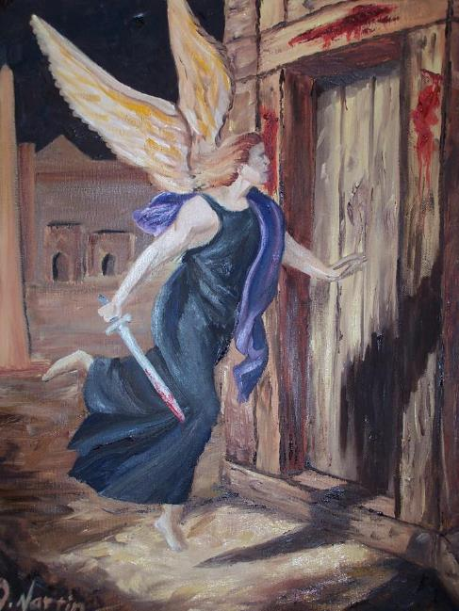
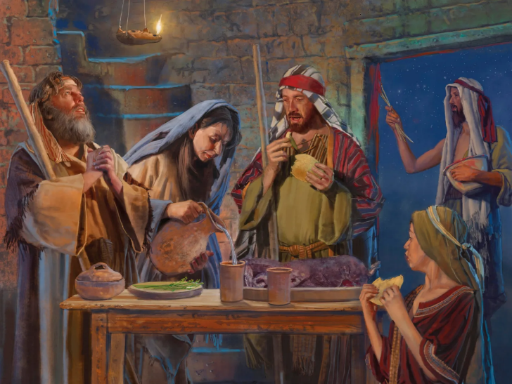
LAKAATU
Lesoni 5 ki he ʻaho 2 ʻo ʻAokosi 2025

Slide 2
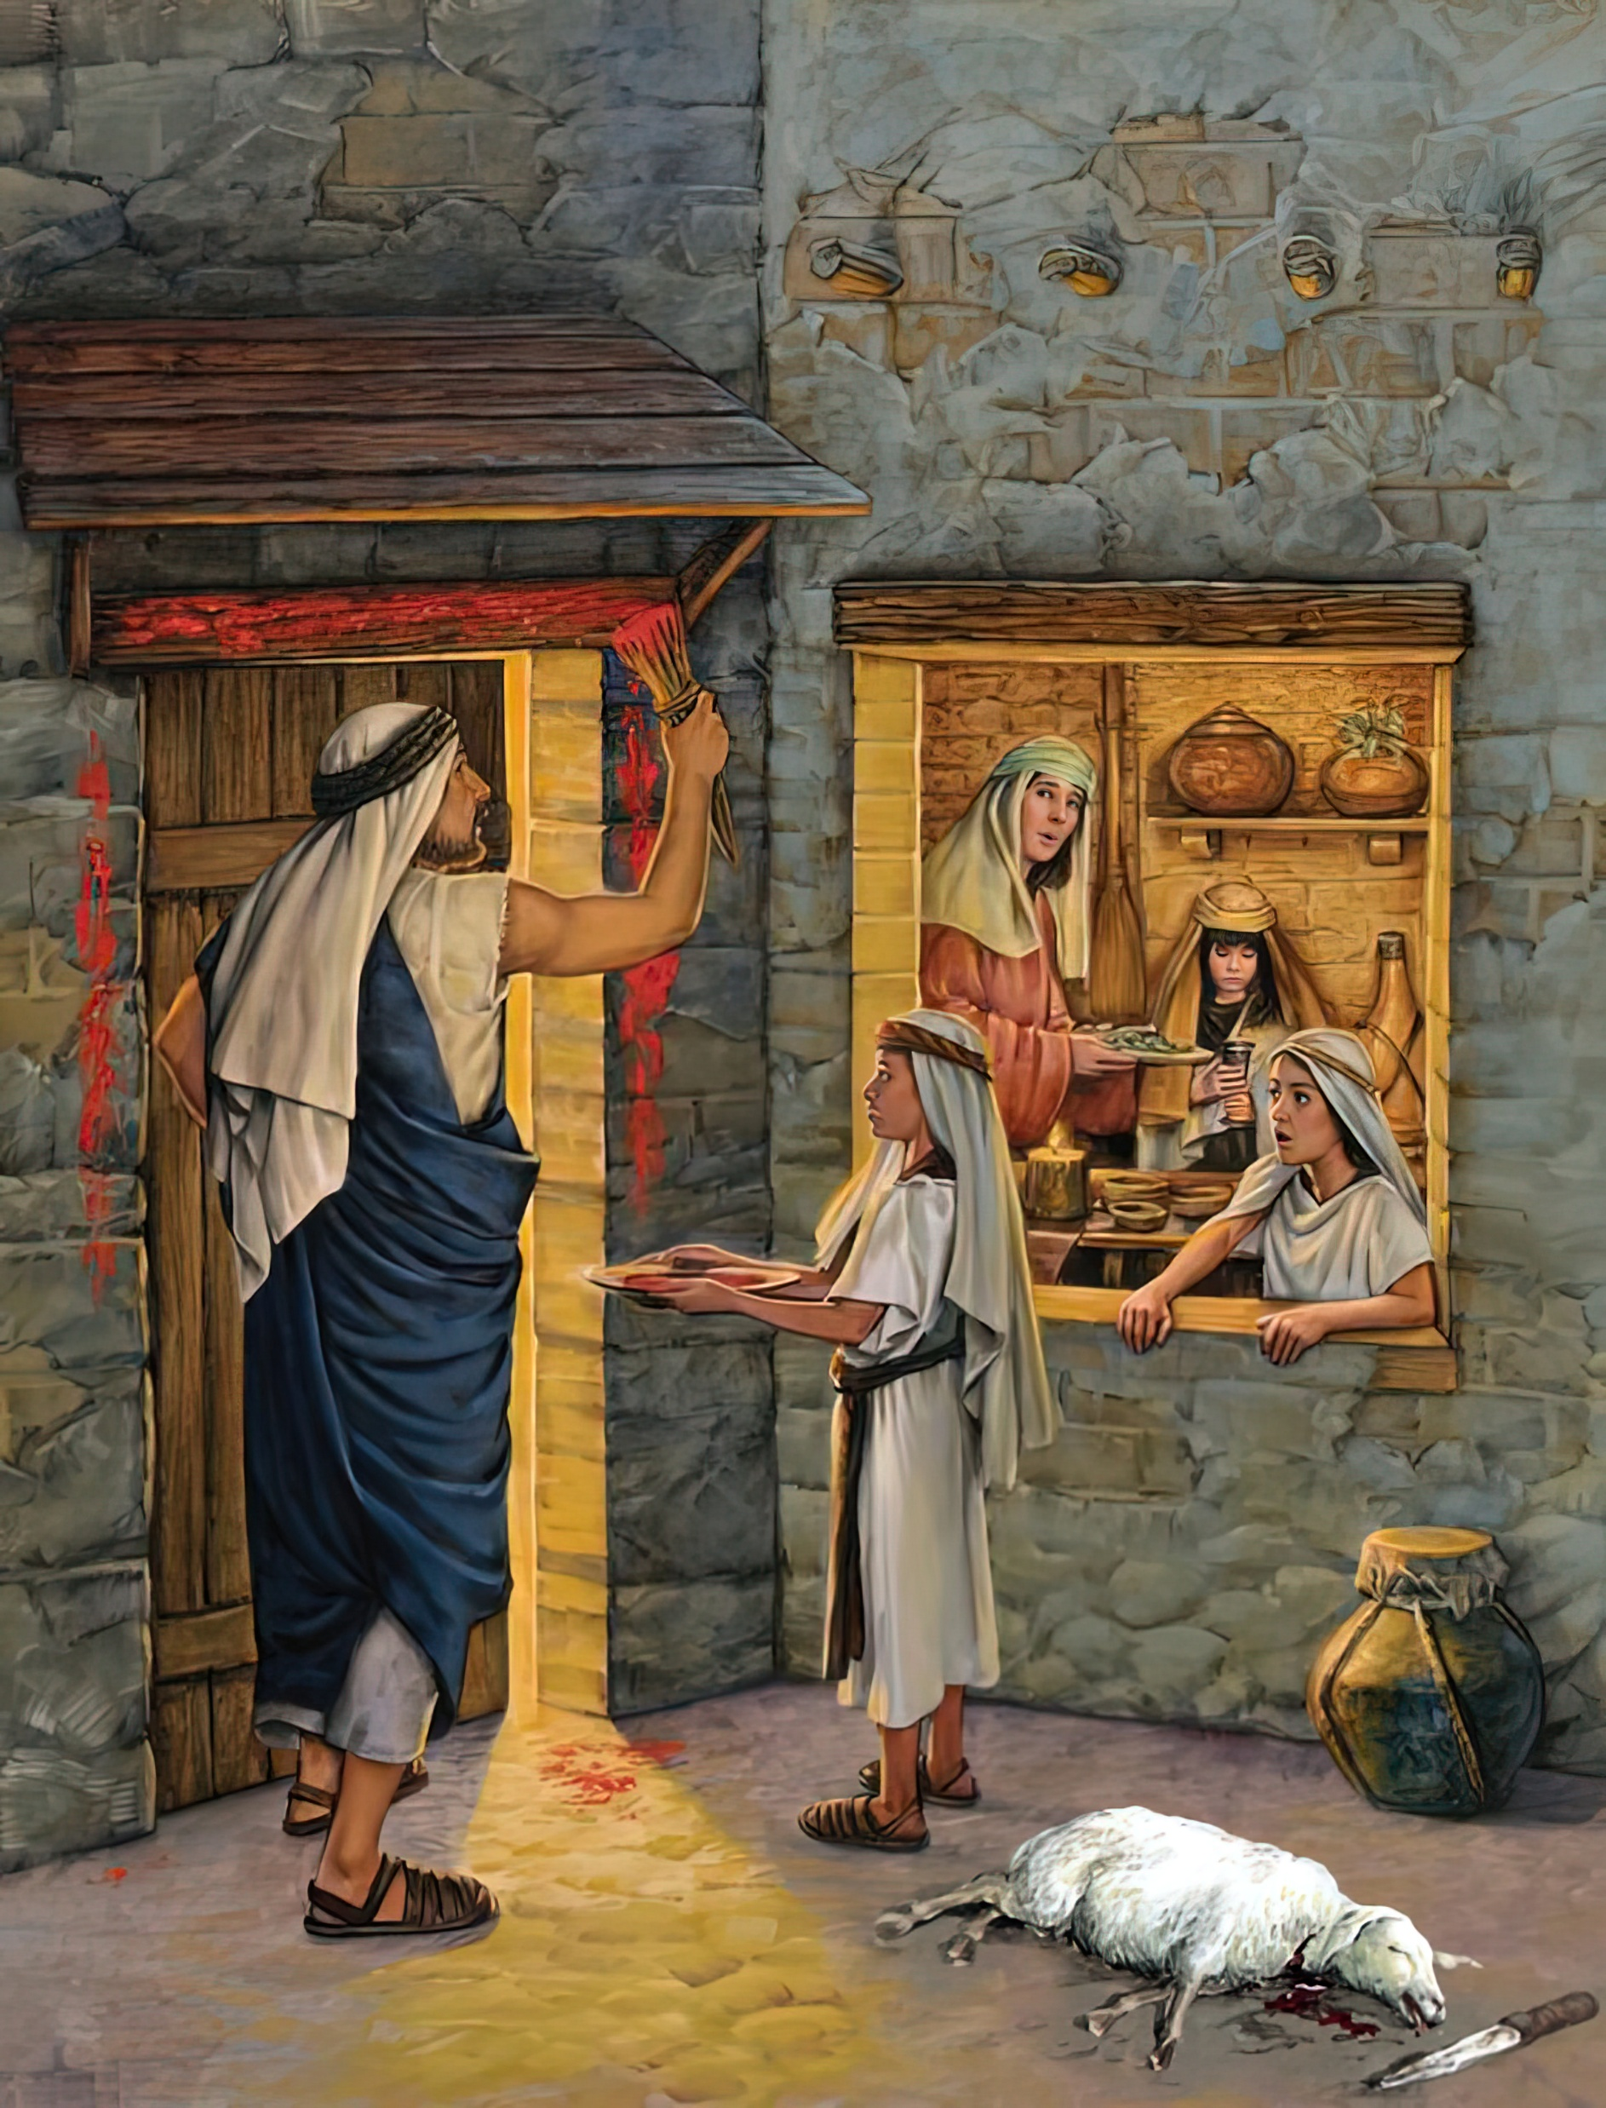
“Pea ʻe hoko ʻo pehē, ʻoka fehuʻi hoʻomou fānau kiate kimoutolu, ‘Ko e hā hono ʻuhinga ʻoe ngāue ni?’ Te mou pehē: ‘Ko e feilaulau ia ʻoe Lakaatu ʻa Sihova, ʻaia naʻa ne laka atu ʻi he ngaahi fale ʻoe fānau ʻa ʻIsileli ʻi ʻIsipite, ʻi heʻene taaʻi ʻae kakai ʻIsipite, ʻo ne fakamoʻui homau fale. ”
‘Ekesotosi 12:26, 27

Slide 3

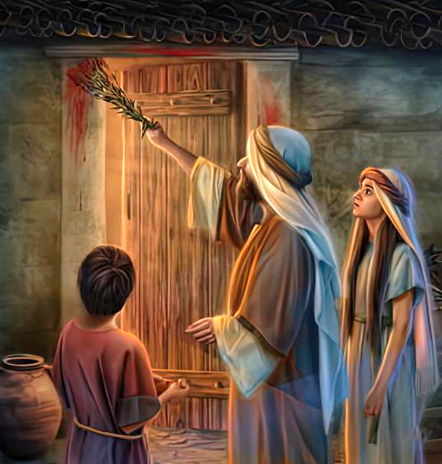
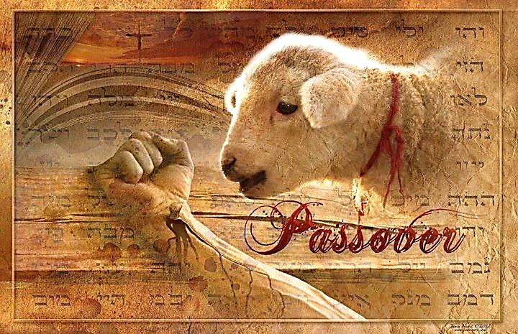
Naʻe taaʻi ʻe he mahaki fakaʻauha hono hongofulu ʻa e famili kotoa pe ʻi ʻIsipite ʻa ia naʻa nau fakafisi ke muimui ki he ngaahi fakahinohino ʻa e ʻOtua. Naʻe ʻikai ke hoko fakafokifa, ka naʻe fanongonongo ia ʻi ha ngaahi ʻaho lahi kimuʻa.
Ko hono moʻoni, ko ha siviʻi ia ʻo e tui. Naʻe ʻikai fie maʻu ke mate ha taha ʻi he po ko ia. Naʻe maʻu ʻe he tokotaha kotoa pe ʻa e faingamalie ke fakahaofi e moʻui ʻa ʻenau ʻuluaki fanau.
Ko e Lami pe naʻe fakahalaiaʻi. Ko ia pe naʻe pau ke mate. Ko hono toto pe te ne ʻai ke fakalaka atu ʻa e Fakaʻauha. Ko e ha hono ʻuhinga? Koeʻuhi he KO KALAISI PE ʻOKU FAKAMOʻUI. Pea naʻe pau ke manatuʻi ʻeni mei he toʻu tangata ki he toʻu tangata... kae ʻoua ke Ne haʻele mai.
Ko e Fakatokanga (ʻEkesotosi 11)
Ko e Teuteu (ʻEkesotosi 12:1-16)
Ko e Toto mo e ʻIsite (ʻEkesotosi 12:17-23)
Manatu mo Akoʻi (ʻEkesotosi 12:24-28)
Ko e Mala hono Hongofulu (ʻEkesotosi 12:29-30)

Slide 4


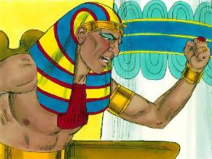
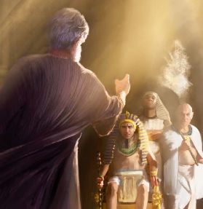
KO E FAKATOKANGA
"Pea naʻe folofola ʻa Sihova kia Mōsese, “ʻOku toe taha pe ʻae tautea te u ʻomi kia Felo mo ʻIsipite; hili ia, te ne tuku ke mou ʻalu ʻi heni: pea ka fekau ia ke mou ʻalu, ko e moʻoni te ne kapusi ʻakimoutolu ke ʻalu kotoa pē ʻi heni." (ʻEkesotosi 11:1 )
Kuo hokosia ʻa e taimi ʻo e fakamaau fakalangi (ʻEkesotosi 12:12):
Hili ha ʻaho ʻe tolu ʻo e fakapoʻuli, naʻe ʻita ʻa Felo kia Mosese pea taʻofi ia ke ʻoua naʻa toe foki ki he palasi
(ʻEkesotosi 10:28).
Ki he hikisia, fielahi mo e ngaohikovia: tautea, mo e fatongia ke fakafoki ʻa e meʻa naʻe fakamalohiʻi
(ʻEkesotosi 11:4-5, 2)
Ki he talangofua ki he ngaahi fekau ʻa e ʻOtua: ke fakalaka ʻi he tautea, pea ke fakatauʻatainaʻi ( ʻEkisoto 11:7-8)
Ka naʻe ʻ ikai lava ke talangofua ʻ a Mōsese ki he tuʻutuʻuni ko ení, he naʻe ʻ i he tuʻunga fakatuʻutāmaki ʻ a e moʻui ʻ a e ʻ uluaki foha ʻ a Feló. ʻI hono fatongia ko e "ʻotua" ʻo Felo (ʻEkesotosi 7:1), naʻe pau ke ne fakatokanga kiate ia ʻa e meʻa naʻe teu ke ne fai (ʻAmosi 3:7).
Ko ʻeni ko Mosese naʻa ne mavahe mei he ʻao ʻo Felo ʻi he ʻita. ʻIta ʻi heʻene loto fefeka mo e ngaahi nunuʻa ʻo ʻene fili. Neongo ʻenau fakaʻapaʻapa kia Mosese, ka naʻe fakafisi ʻa e tokolahi ʻo e kau ʻIsipite ke tokanga ki he fakatokanga (ʻEkesotosi 11:3).

Slide 5


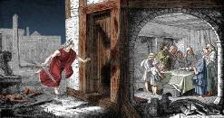
KO E TEUTEU
"Mo lea ki he kakai fakataha kotoa pē ʻo ʻIsileli, ʻo pehē, “ʻI hono hongofulu ʻoe ʻaho ʻoe māhina ni, te nau toʻo kiate kinautolu taki taha ʻe he tangata ha lami, ʻo fakatatau ki he fale ʻoe ngaahi tamai, ko e lami ki he fale:" (ʻEkesotosi 12:3)
Naʻe fakamatalaʻi fakaikiiki ʻe he ʻOtua ʻa e meʻa naʻe pau ke nau fai kae lava ʻa e Fakaʻauha ʻo "fakalaka atu" (Pesach, Lakaatu), pea ʻikai mate ʻa e ʻuluaki fanau:
ʻI he ʻaho 10 naʻe pau ke nau tuku mavahe ha lami taʻe hano mele ki he famili takitaha, pe ki he ngaahi famili kehekehe (ʻEkesotosi 12:3-5).
ʻI he ʻaho 14, ʻi he poʻuli, naʻe pau ke nau feilaulauʻi ia (ʻEkesotoso 12:6)
Naʻe pau ke nau takai ʻa e ngaahi pou matapaa mo e tuʻunga ʻaki ʻa e toto (ʻEkesotosi 12:7)
Na‘e pau ke nau kai ‘a e kakanó kuo tunu kakato, fakataha mo e mā ta‘elēvani mo e ngaahi ‘akau kona . ( ‘Eki. 12:8-10 )
Lolotonga ‘enau kai fakavavevave ia, na’e pau ke nau teunga mo mateuteu ke nau ‘alu
(Eki. 12:11)
‘I he‘enau mavahe mei ‘Isipité, na‘e pau ke nau kei kai mā ta‘elēvani ‘i he ‘aho ‘e fitu .
( ‘Eki. 12:15 )
Naʻe teuteuʻi ʻe he ʻOtua Hono kakai ke mahino kiate kinautolu ʻEne ʻaloʻofa, pea hu kiate Ia (ʻEkesotoso 12:27b).

Slide 6


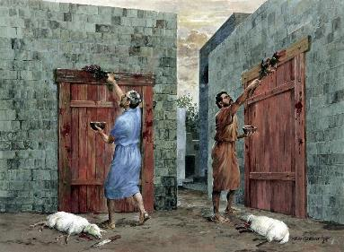
KO E TOTO MO E ʻISITE
“Pea naʻe toki fekau ʻe Mōsese ke haʻu ʻae kau mātuʻa kotoa pē ʻo ʻIsileli, ʻo ne pehē kiate kinautolu, “Vaheʻi ʻo toʻo kiate kimoutolu ʻae lami ʻo fakatatau ki homou ngaahi kau nofoʻanga ʻo tāmateʻi ʻae Lakaatu.” (Ekisotosi 12:21)
ʻI he ʻaho 14, naʻe ʻi ai ha konga mahuʻinga ʻe ua ʻi he katoanga: toto mo e ʻisite.
Naʻe pau ke nau toʻo ʻa e ʻisite mei honau ngaahi ʻapi pea taʻo ʻa e ma taʻe kau ai (ma taʻe fakalevani). Koeʻuhi naʻe tuʻunuku mai ʻa e mavahe, he ʻikai ke nau maʻu ʻa e ʻisite ʻi hono ngaahi kamataʻanga (ʻEkesotoso 12:17–20). Ko e ʻisite ko ʻeni ko ha fakataipe ia ʻo e angahala, pea ʻoku fakataipe ʻe he ma taʻe fakalevani ʻa e moʻui foʻou ʻia Kalaisi Sisu (1 Kolinito 5:6–8;
2 Kolinito 5:17).
Ko e toto ʻa e ʻelemeniti faifakamoʻui. Naʻa ne fakafofongaʻi ʻa e taʻataʻa ʻo Sisuu—ʻa ia naʻa Ne lilingi ʻi he kolosi—koeʻuhi ke "fakalaka atu" ʻa e ʻOtua ʻi hotau fakahalaiaʻi ʻi he Fakamau. (1Sione 1:7 ; 2:1-2).
Ko e hisopo naʻe pau ke afuhi ʻaki ʻa e toto
(ʻEkesotosi 12:22) ko ha fakataipe ia ʻo hono fakamaʻa ʻo e angahala (Saame 51:7).

Slide 7

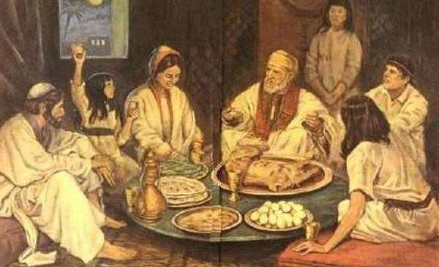
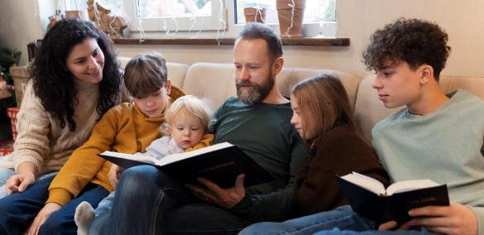
MANATUʻI MO AKOʻI
"Pea ke ke tauhi ʻa e meʻa ni ko e ouau kiate koe mo ho ngaahi foha ʻo taʻengata" (ʻEkesotosi 12:24)
Naʻe akoʻi ʻe he ʻOtua ʻa e ngaahi famili Hepeluu ke fakatolonga honau hisitolia ʻaki hono fakamatalaʻi ia ki heʻenau fanau ʻi he taʻu takitaha (ʻEkesotosi 12:24-27).
Talu mei ai mo e hoko ʻa e Lakaatu ko ha katoanga fakafamili. Ko ha faingamalie ia ki he matuʻa ke nau ʻoatu ai ʻa e ʻilo ki he ʻOtua ki heʻenau fanau.
Naʻe pau ke fakamatalaʻi fakaikiiki ʻa e talanoa ʻo e tauʻataina, pea ʻi he tokotaha ʻuluaki (Teut . 26:5-9).
ʻ Oku ʻ i heni ha lēsoni mātuʻaki makehe maʻatautolu. Kuo pau ke tau ʻoatu ʻetau tui ki heʻetau fanau. Kuo pau ke tau fakaha kiate kinautolu ʻa e meʻa kuo fai ʻe he ʻOtua, ʻo ʻikai ʻi he hisitolia pe, ka ʻi heʻetau moʻui foki. Kuo pau ke tau punou hifo kiate kinautolu ʻo hu (ʻEkesotosi 12:27).

Slide 8


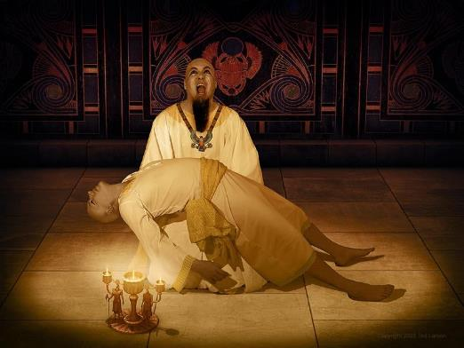
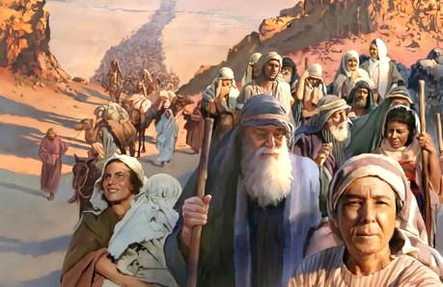
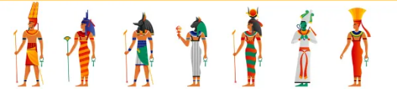
KO E MALA HONO HONGOFULU .
“Pea naʻe hoko ʻo pehē, ʻi heʻene tuʻuapō, naʻe taaʻi ʻe Sihova ʻae ʻuluaki fānau kotoa pē ʻi he fonua ko ʻIsipite, mei he ʻuluaki fānau ʻa Felo naʻe nofo ʻi he nofoʻanga fakatuʻi ʻo aʻu ki he ʻuluaki fānau ʻae pōpula ʻi he fale fakapōpula; pea mo e ʻuluaki tupu kotoa pē ʻoe fanga manu. ” (Ekisotosi 12:29)
Naʻe tuʻutuʻuni ʻe Felo ke tamateʻi ʻa e tamaiki tangata Hepelu kotoa pe ʻo ʻikai ha fakaʻata makehe (ʻEke 1:22). Naʻe fakapapauʻi ʻe he ʻOtua ʻa e mate ʻi ha tuʻunga ʻo e ʻuluaki fanau pe (ʻEke 12:29). ʻI he fale kotoa pe naʻe ʻikai takai ai ʻa e taʻataʻa ʻo e lami, naʻe mate ai ha toko taha (ʻEkesotosi 12:30).
Naʻe to malohi ʻaupito ʻa e ngaahi tautea ʻa e ʻOtua ki he ngaahi ʻotua ʻIsipite, ʻa ia naʻe fakafofongaʻi ʻe Felo (ʻEkesotososi 12:12).
Naʻe ʻ ikai ha ʻ otua ʻ Isipite naʻe hiki hake hono nimá ke tokoni, pea naʻe ʻ ikai lava ke fai ʻ e Felo ha meʻa ke taʻofi ʻ a e fakatamakí.
Hange ko Felo, ʻe lava ke uesia kovi ʻe heʻetau angahala ʻa e niʻihi kehe. Kae hange ko Mosese, ʻe lava ʻe heʻetau faivelenga mo e tuʻu maʻu ʻo fakahaofi ha tokolahi.

Slide 9

“Na‘e fiema‘u ke nau fakamavahe‘i kinautolu mo ‘enau fānaú mei he kau ‘Isipité, pea tānaki kinautolu ki honau ngaahi ‘apí, he kapau ‘e ma‘u ha taha ‘o e kau ‘Isilelí ‘i he ngaahi ‘api ‘o e kau ‘Isipité, te nau tō ‘i he nima ‘o e ‘āngelo faka‘auhá. Naʻe fakahinohinoʻi foki kinautolu ke nau tauhi ʻa e kātoanga ʻo e Laka Atú ko ha ouau, koeʻuhí ʻi he taimi ʻe fehuʻi ai ʻe heʻenau fānaú pe ko e hā hono ʻuhinga ʻo e ngāue peheé, ke nau fakamatala kiate kinautolu ʻa honau tauhi fakaofo ʻi ʻIsipité. Koeʻuhi ʻi he ʻalu atu ʻae ʻāngelo fakaʻauha ʻi he poʻuli ke tāmateʻi ʻae ʻuluaki fānau ʻae tangata, mo e ʻuluaki fānau ʻoe manu, naʻa ne fakalaka ʻi honau ngaahi fale, pea naʻe ʻikai tāmateʻi ha taha ʻoe kau Hepelū naʻe ʻi honau ngaahi pou matapā ʻae fakaʻilonga toto. [...] Na‘a nau [kau ‘Isipite ‘e ni‘ihi] kole ke faka‘atā kinautolu ke nau ha‘u ki he ngaahi fale ‘o e kau ‘Isilelí mo honau ngaahi fāmilí, ‘i he pō fakailifia ko ia ‘a ia ‘e tāmate‘i ai ‘e he ‘āngelo ‘a e ‘Otuá ‘a e ‘uluaki fānau ‘a e kau ‘Isipité. Na‘a nau fakapapau‘i ko honau ngaahi ‘otua na‘a nau lotu ki aí na‘e ‘ikai ha‘anau ‘ilo, pea ‘oku ‘ikai ha‘anau mālohi ke fakamo‘ui pe faka‘auha. Na‘e talitali lelei ‘e he kau ‘Isilelí ‘a e kau ‘Isipite na‘e tuí ki honau ngaahi falé .”
EGW (Ngaahi Meʻafoaki Fakalaumalie, voliume 3, p. 223)

