Slide 1
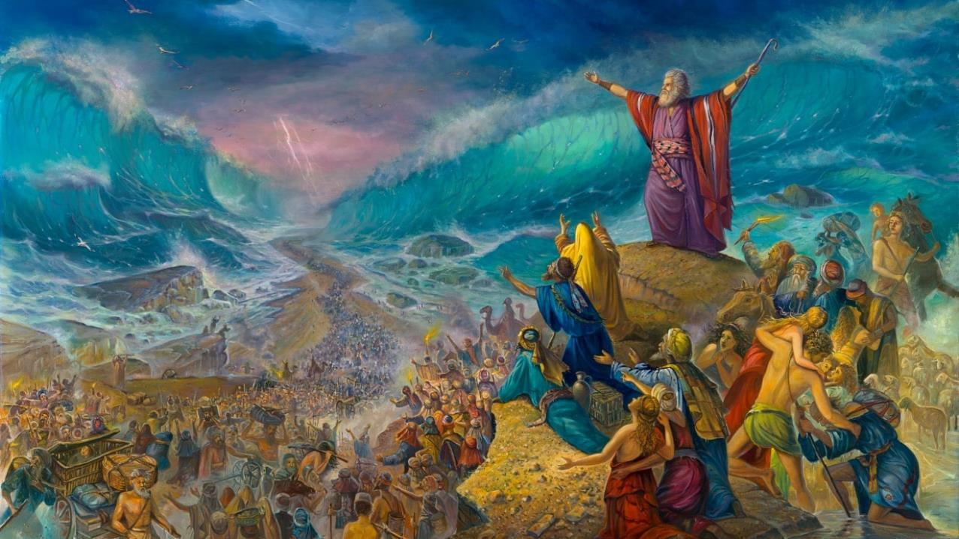
FOU ‘I HE TAHI KULOKULA
Lesoni 6 ki he ʻaho 9 ʻo ʻAokosi, 2025

Slide 2
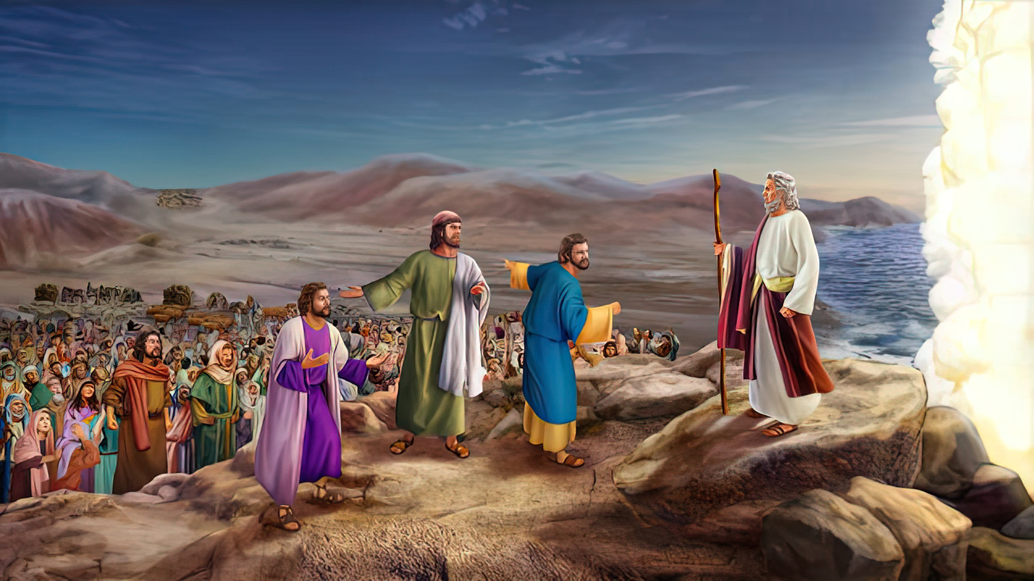
“Pea pehē ʻe Mōsese ki he kakai, “ʻOua te mou manavahē, tuʻu fakalongolongo pe, ʻo mamata ki he fakamoʻui ʻa Sihova, ʻaia te ne fakahā kiate kimoutolu he ʻaho ni: he ko e kakai ʻIsipite kuo mou mamata ki ai he ʻaho ni, ʻe ʻikai te mou toe mamata ki ai ʻo lauikuonga.‌ʻE tau ʻa Sihova maʻamoutolu, pea te mou fakalongo pe. ” ‘Ekisotosi 14:13, 14

Slide 3
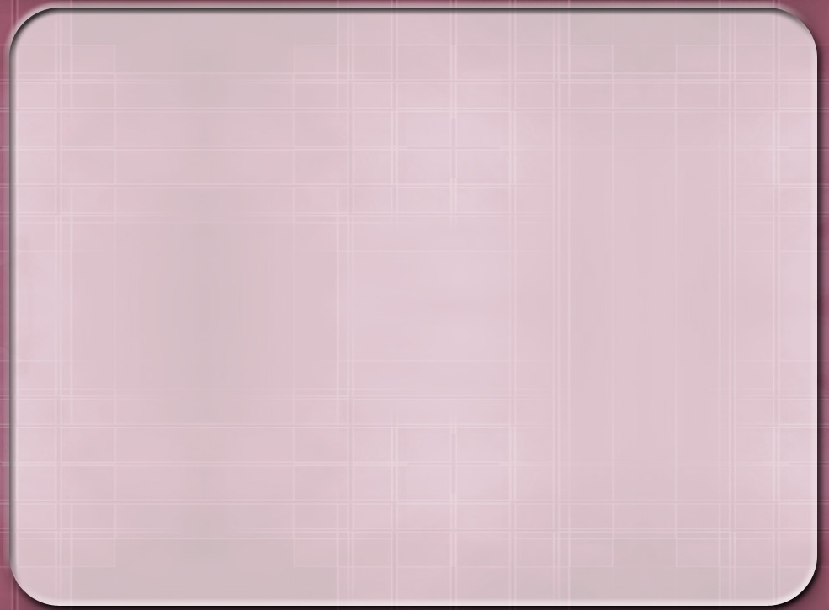
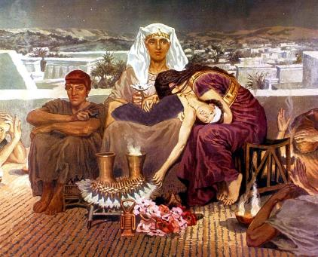
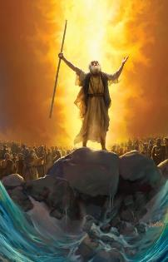
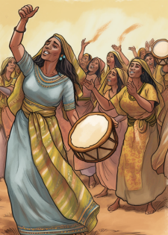



Na’e ‘osi fakatokanga mai ‘a e ‘Otua mei he kamata’anga, ko e ‘ekisoto mei ‘Isipite ‘e kau ai ‘a e mate —pe ko e fakamanamana ‘o e mate —‘o e ‘uluaki foha ‘o Felo (Ekisotosi 4:22-23).
Ke faka‘ehi‘ehi mei he mate ‘a e ‘uluaki fohá pea ke lava ‘o taki kinautolu mei ‘Isipite, na‘e kole ‘e he ‘Otuá kiate kinautolu ha ngāue ‘o e tuí: ko e ouau ‘o e Laka-Atú. Ko ʻeni, ʻi Heʻene tataki kinautolu ki ha hala mate, kuo taimi ke nau fai ʻa e sitepu hono ua ʻo e tuí: ke nau laka atu ki muʻa.
Hili ‘enau kolosi ‘i he Tahi Kulokulá, ‘o faifai pē ‘o fakatau‘atāina‘i mei he pōpula ‘i ‘Isipité, na‘e pā ‘a ‘Isileli ‘i ha hiva fakahīkihiki ki honau Fakatau‘atāiná.
Ko e ʻEkisotosi mei ʻIsipite:
Kātaki ʻo mavahe! (Esoto 12:31-36)
Ko e Fakatapui ʻo e ʻUluaki Fānaú (ʻEkisoto 13:1-16)
Ko e kolosi ʻi he Tahi Kulokulá:
  Maʻu ʻi he Toafa (ʻEkisoto 13:17-14:12)
  Ko ha hala ‘i he tahi (‘Ekisoto 14:13-31)
Ko e katoanga:
  Ko e Hiva ʻa Mosese (ʻEkesotosi 15:1-21)

Slide 4
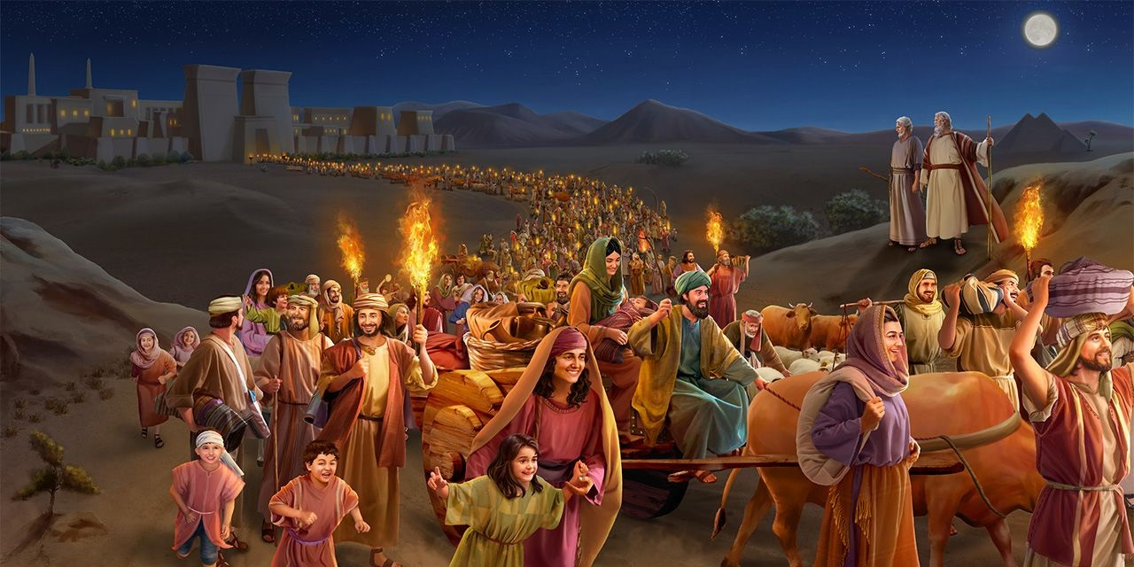
KO E FONONGA MEI ʻISIPITE

Slide 5


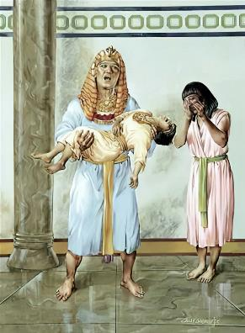
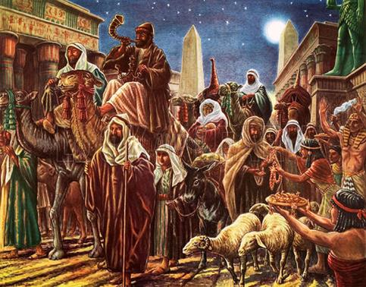
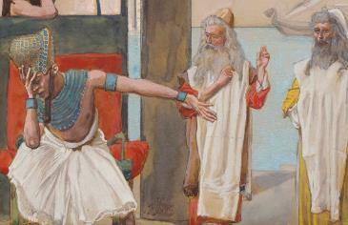
KATAKI ʻO MAVAHE!
"Naʻe poupouʻi ʻe he kau ʻIsipite ʻa e kakai ke nau fakavavevave ʻo mavahe mei he fonua.Naʻa nau pehe mai, "He ka ʻikai, te tau mate kotoa pe!" (ʻEkesotosi 12:33)
Naʻe lala kotoa ʻa ʻIsipite, "he naʻe ʻikai ha fale naʻe ʻikai mate ai ha taha" (ʻEkesotosi12:30). Naʻe fuʻu tomui hono fakangofua ʻe Felo ke mavahe ʻa ʻIsileli.
Naʻe fakahaaʻi ʻe Felo ʻa e ngaahi ongo ʻa hono kakai kotoa ʻaki ʻa e kupuʻi lea "Pea tapuakiʻi foki au" (ʻEkesotosi 12:32): kataki ʻo tuku ke ʻoua naʻa hoko ha toe meʻa kehe kiate kimautolu!
Naʻe ʻikai ko hano fakahaaʻi ia ʻo e fakameʻapangoʻia moʻoni ʻi heʻene faihala, ka ko ha fakaʻamu ke taʻofi ʻa e fakaʻauha.
ʻI he taimi naʻe fie maʻu ai ʻe ʻIsileli ke totongi ʻa e ngaahi taʻu ʻo ʻenau ngaue, naʻe "foaki ʻe he kau ʻIsipite ʻa e meʻa naʻa nau kole" (ʻEkesotosi 12:36). ʻI he founga ni, naʻe fakapapauʻi ai ʻe he ʻOtua ʻe mavahe lelei ʻEne ʻuluaki fanau mei ʻIsipite—pea fonu hono toʻukupu.

Slide 6
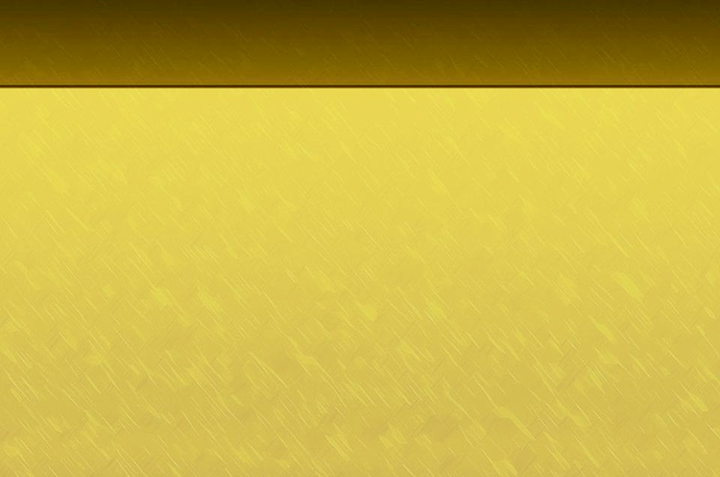
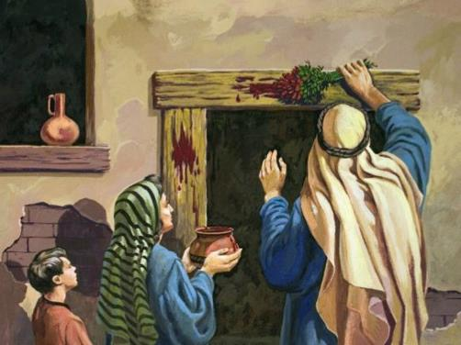
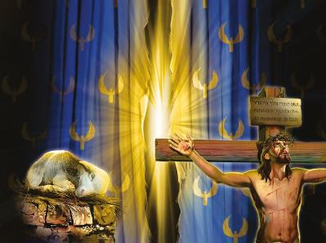
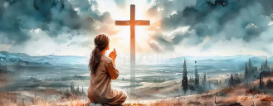
KO E FAKATAPU'I 'O E 'ULUAKI FANAU .
“Fakatapui kiate au ʻae ʻuluaki fānau tangata kotoa pē: ko e ʻuluaki hako ʻoe manava kotoa pē ʻi he lotolotonga ʻoe kakai ʻIsileli ʻoku ʻaʻaku ia, pe ko e tangata pe ko e manu.” (Esotosi 13:2)
Naʻe fakatapui fēfē ʻa e ʻuluaki fānaú?
Naʻe fakatapui kinautolu ʻe he maté. Na‘e pau ke mate ‘a e ‘uluaki foha kotoa pē. Ka na‘e ‘osi fai ha tokonaki ke fetongi ‘a e ‘uluaki fohá, koe‘uhi ke mate ha tokotaha kehe ‘o fetongi ia.
Otua; ka ʻoku ʻi ai ha Tokotaha kuo pekia ʻi hotau tuʻungá. Fakatokanga’i ‘a e fekau’aki: Ko ‘Isileli ko e ‘uluaki foha ia ‘o e ‘Otua (Ek. 4:22); ko e Siasi he ‘aho ni ko e ‘Isileli fakalaumalie (Kal. 6:16); ko ia, kuo pau ke tau mate kotoa pē ke fakatapui ki he .
Ko Sisu, “ko e Lami ‘a e ‘Otua” (Sione. 1:29), na’a ne pekia koe’uhi ko ia te ne ‘ai hono ta’ata’a ‘i he matapa ‘o honau loto ke ‘oua na’a mate ka ke ne ma’u ‘a e MO’UI TA’ENGATA.
Kuo ‘osi fai ‘e he ‘Otuá ‘a ‘ene tafa‘akí. Ko hotau fatongiá ke fakaʻatā ke tau ʻufiʻufi ʻaki hono taʻataʻa huhuʻí.

Slide 7
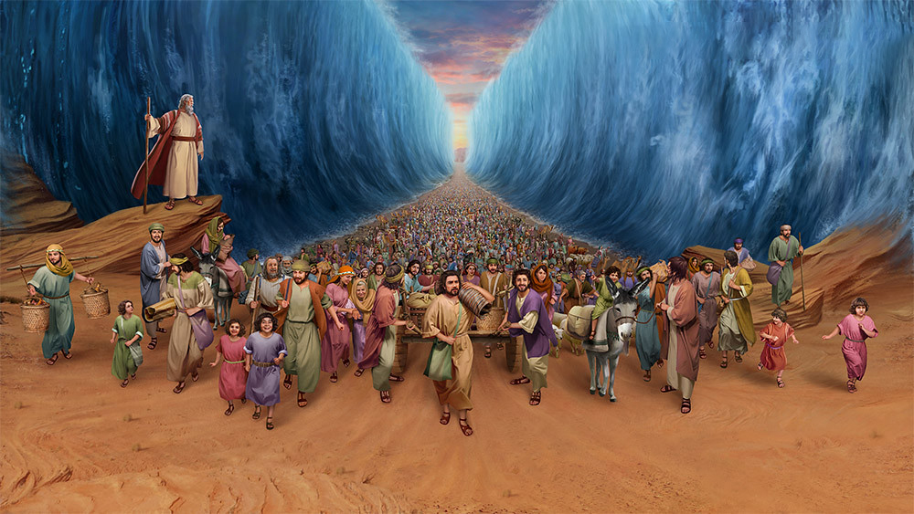
KO E KOLOSI 'I HE TAHI KULOKULA .

Slide 8
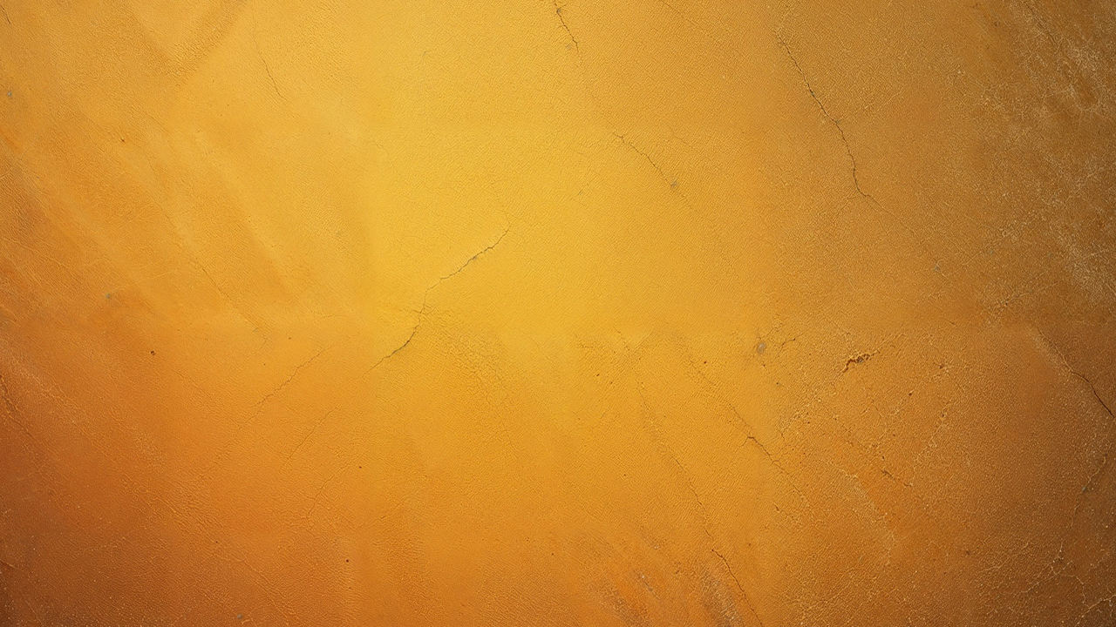
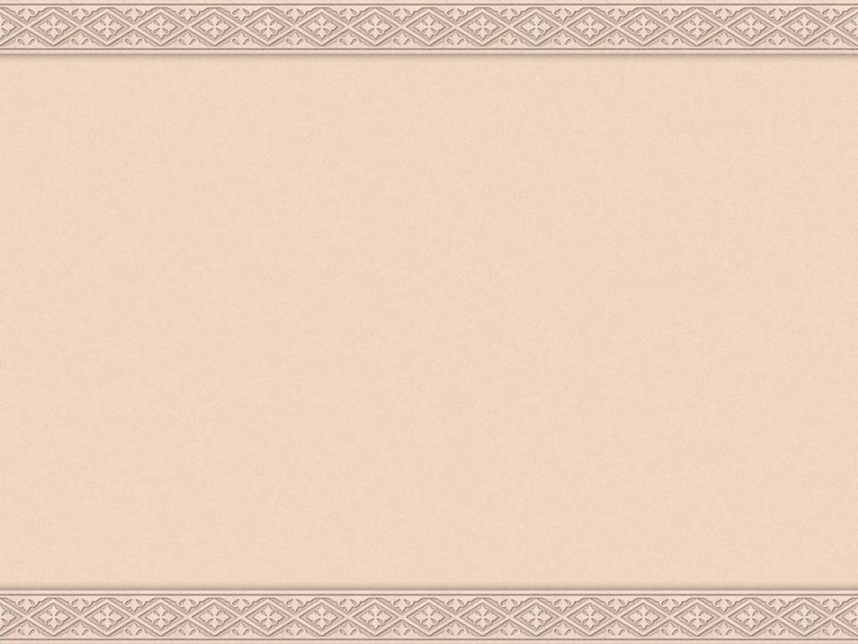
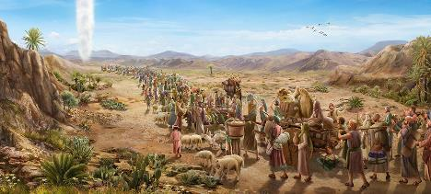
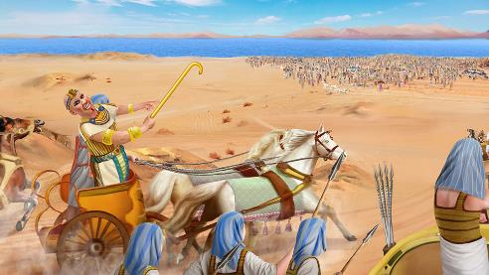
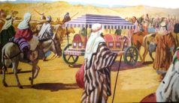
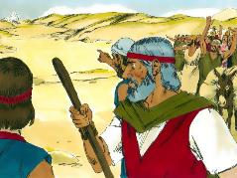
MA'U 'I HE TOAFA .
“‘E fakakaukau ‘a Felo, ‘‘Oku ‘alu takai holo ‘a e kau ‘Isilelí ‘i he fonuá ‘i he puputu‘u, ‘o ‘ātakai‘i kinautolu ‘e he toafá.” (Ekisotosi 14:3)
‘I he fakangofua ‘a Felo, na’e ‘alu atu ‘a ‘Isileli ‘o “teuteu ki he tau” (Ekisotosi 13:18). Ka na’e ‘ikai finangalo ‘a e ‘Otua ke nau fehangahangai mo e tau, ko ia na’a ne taki holo kinautolu (Ekisotosi 13:17).
Lolotonga iá, naʻe fakatomala ʻa Felo ʻi heʻene fakatomala ʻo muimui ʻia ʻIsilelí (ʻEkis. 14:5). Na’e ma’u he taimi ni ‘a ‘Isileli ‘i he toafa, ‘o ‘ikai ha hao’anga ‘e lava ke hao mei ai (Ek. 14:2-3, 9).
Ko e ngāue ʻo e tuí, naʻa nau ʻave mo kinautolu ʻa e ʻaiʻangakai ʻo Siosefá ( ʻEke. 13:19 ). ‘Ikai ngata ai, ka na’e tataki fakaofo kinautolu ‘e he ‘Otua (Ek. 13:21).
Kae kehe, ‘i he sio ki he kau tau ‘a Feló, na‘e holomui faka‘aufuli ‘enau tuí. (Eki. 14:10-12). He vave ē ko e ngalo ʻiate kinautolu ʻa e ngaahi mana ne nau aʻusiá! ‘E lava ke hoko foki eni kiate kitautolu?
"Manatuʻi ʻa e ngaahi meʻa fakaofo kuo ne fai" (1 Kol. 16:12)

Slide 9

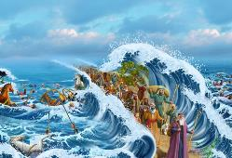
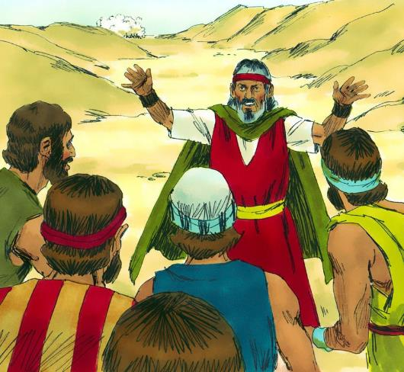
KO HA HALA 'I HE TAHI .
“Pea pehē ʻe Mōsese ki he kakai, “ʻOua te mou manavahē, tuʻu fakalongolongo pe, ʻo mamata ki he fakamoʻui ʻa Sihova, ʻaia te ne fakahā kiate kimoutolu he ʻaho ni: he ko e kakai ʻIsipite kuo mou mamata ki ai he ʻaho ni, ʻe ʻikai te mou toe mamata ki ai ʻo lauikuonga. 14 ‌ʻE tau ʻa Sihova maʻamoutolu, pea te mou fakalongo pe.(Ekisotosi 14:13-14)
‘I he fehangahangai mo e ta’etui ‘a e kakai, na’e fakalotolahi’i kinautolu ‘e Mosese ke nau falala ki he ‘Otua (Ekisotosi.14:13-14)
“‘Oua ‘e manavahē”
Ko e ‘uluaki sitepu ke a‘usia ai ‘a e ikuná ko e falala ki he ‘Otuá .
“Tuʻu maʻu”
Kuo pau ke tau kei kātaki pē ʻi hotau tuʻungá, ʻo ʻikai ke tau lāunga.
“Sio ki he fakamoʻuí”
Kapau te tau tuku ke tataki kitautolu ‘e he ‘Otuá, ‘oku fakapapau‘i ‘a e ikuná.
“‘E tau ‘a Sihova ma‘amoutolu”
‘Oku tau ‘a e ‘Otua ma’atautolu ‘o fakafepaki’i ‘a Setane mo e angahala. Ko Kalevale ‘a e fakamo’oni lahi taha ki he me’a ni.

Slide 10

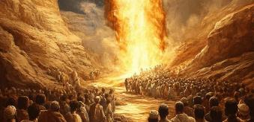
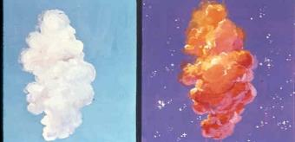
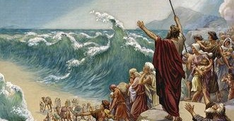
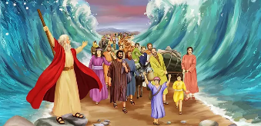
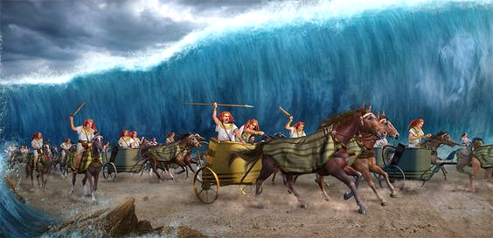
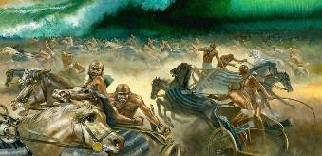
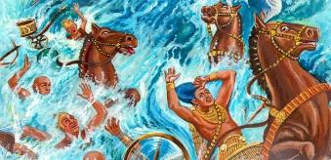
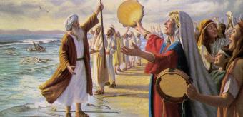
KO HA HALA ʻI TAHI
Naʻe ʻoange ʻe he ʻOtua ki he kakai ha fekau pe ʻe taha: "laka atu" (ʻEkesotosi 14:15). Talu mei he momeniti ko ʻeni, naʻe kamata ʻa e meʻa taʻeʻamanekina (ʻEkesotosi 14:19-31):
Naʻe tuʻu ʻa e ʻangelo ʻa e ʻOtua mo e pou ʻao ʻi he vahaʻa ʻo e ʻapitanga ʻo ʻIsileli mo e ʻapitanga ʻo e kau ʻIsipite
ʻI he lolotonga ʻo e poʻuli, ko e pou ko e fakapoʻuli ki he kau ʻIsipite, pea ko e maama ki he kau ʻIsileli
Naʻe hiki hake ʻe Mosese ʻene tokotoko pea mavaeua ʻa e tahi koeʻuhi ke lava ʻa ʻIsileli ʻo fou atu ʻi he kelekele momoa.
Naʻe hu ʻa ʻIsileli ki tahi, ʻo hoko ʻa e vai ko ha ngaahi ʻa ʻi honau toʻomataʻu mo toʻohema
Naʻe toe hu foki ʻa e kau ʻIsipite ki tahi
ʻ I he mafoa ʻ a e ata, naʻe fakamamahiʻi ʻ e he ʻ Otuá ʻ a e kau ʻ Isipité
ʻI heʻenau feinga ke holomui, naʻe toe foki ʻa e tahi ki hono halanga, ʻo fakaʻauha kotoa ʻa e kau tau.
Naʻe mamata ʻa ʻIsileli mei he matatahi ki he ikuna, pea naʻa nau tui ki he ʻOtua mo Mosese

Slide 11
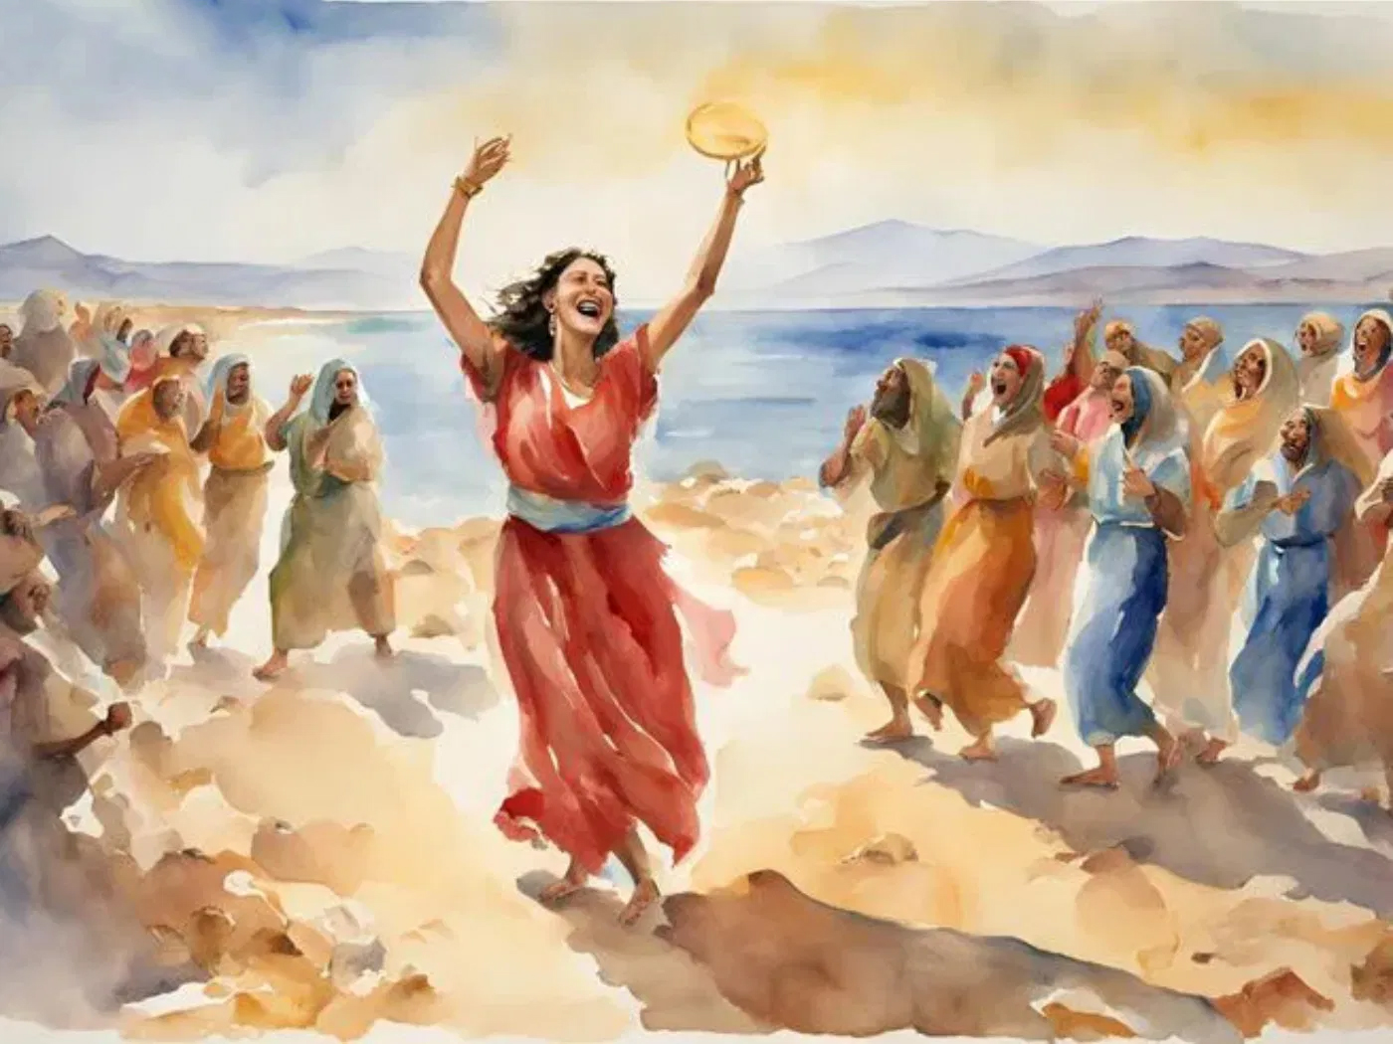
KO E KATOANGA

Slide 12


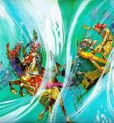
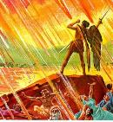
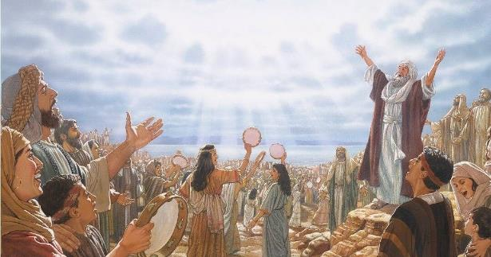
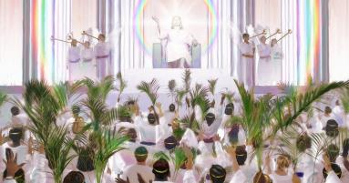
KO E HIVA ʻA MOSESE
"Pea nau hivaʻi ʻa e hiva ʻa Mosese mo e Lami: "ʻOku lahi mo fakaofo hoʻomou ngaahi ngaue. ʻEiki ko e ʻOtua Mafimafi. ʻOku totonu mo moʻoni ho ngaahi hala, ʻe Tuʻi ʻo e ngaahi puleʻanga" (Fakaha 15:3)
ʻI heʻene sio ki he meʻa naʻe hoko, naʻe taki ʻe Mosese ʻa ʻIsileli ʻi ha hiva ʻo e fakafetaʻi, lolotonga ia ʻoku tali ʻe Meliame ha kuaea, fakataha mo e kau fafine (ʻEkesotosi 15:1, 20-21).
ʻOku ʻikai ha lave ʻi he foʻi hiva ko ʻeni ki he meʻa kuo fai ʻe ʻIsileli. ʻOku ʻikai ngata pe ʻi heʻene fakahikihikiʻi ʻa e ʻOtua ʻi heʻene fakaʻauha ʻa e fili (ʻEkesotosi 15:6), ka ʻoku toe fakaʻapaʻapaʻi foki ia ʻi heʻene ngaahi ngaue (ʻEkesotosi 15:11). ʻOku fakaha ʻa e tali ʻa kinautolu ʻoku fanongo ki he meʻa kuo hoko (ʻEkesotosi 15:14).
ʻIkai ngata ai, ko e meʻa ʻoku teʻeki ke fai ʻe he ʻOtua kuo fanongonongo ia: "Te ke ʻomi ia, ʻo to ʻi he moʻunga ʻo ho tofiʻa" (ʻEkesotosi 15:17).
ʻI he taimi kuo fakaha ai ʻa e ngaahi fakamaau ʻa e ʻOtua, pea fakaʻauha ʻa e kovi mo e fakamalohi, ʻe fakahikihikiʻi Ia ʻe he huhuʻi ʻo e ngaahi puleʻanga koeʻuhi ko e ngaahi fakamaau maʻoniʻoni ko ia, ʻo hivaʻi ʻa e hiva ʻa Mosese mo e Lami (Fakaha 15:3).

Slide 13

"ʻI hono fakatauʻatainaʻi hotau laumalie mei he popula ʻo e angahala, kuo fakahoko ai ʻe he ʻOtua maʻatautolu ha fakahaofi ʻoku lahi ange ʻi he kau Hepeluu ʻi he Tahi Kulokula. Hange ko e kau Hepeluu, ʻoku totonu ke tau fakafetaʻi ki he ʻEiki ʻaki ʻa e loto mo e laumalie pea mo e leʻo koeʻuhi ko ʻEne "ngaahi ngaue fakaofo ki he fanau ʻa e tangata." Ko kinautolu ʻoku nofo ʻi he ngaahi ʻaloʻofa lahi ʻa e ʻOtua, pea ʻikai ngalo ʻenau manatuʻi ʻEne ngaahi meʻafoaki maʻulalo ange, te nau ʻai ʻa e nonoʻo ʻo e nekeneka pea hiva ʻi honau loto ki he ʻEiki. ʻOku totonu ke hoko ʻa e ngaahi tapuaki fakaʻaho ʻoku tau maʻu mei he toʻukupu ʻo e ʻOtua, kae mahulu hake ʻi ha toe meʻa ko e pekia ʻa Sisuu ke ʻomi ʻa e fiefia mo hevani ke tau aʻusia maʻu pe."
EGW (Fepakipaki mo e Loto-toʻá, Māʻasi 28)

