Slide 1

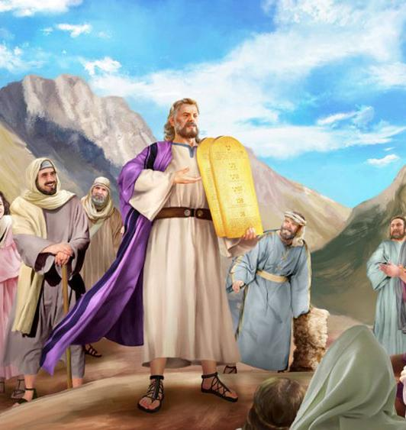
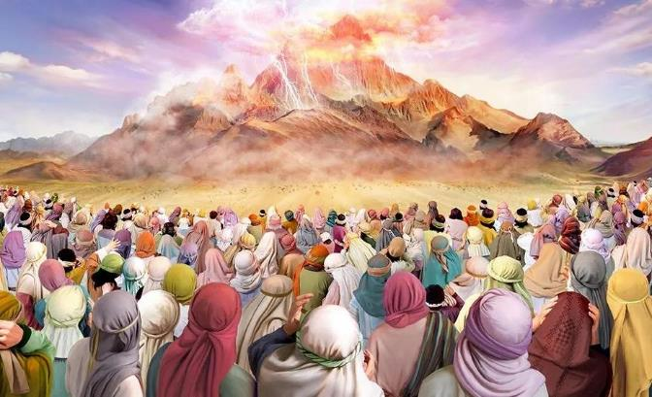
KO E FUAKAVA ʻI SAINAI
Lesoni 8 ki he ʻaho 23 ʻo ʻAkosi 2025

Slide 2
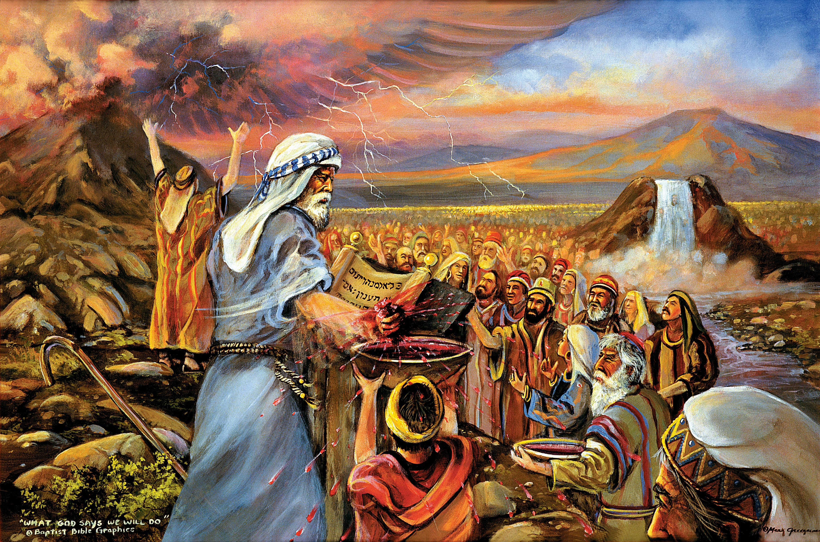
“Kuo mou mamata ki he meʻa naʻaku fai ki he kakai ʻIsipite, mo ʻeku fua ʻakimoutolu ʻi he kapakau ʻoe ʻikale, ʻo ʻomi ʻakimoutolu kiate au.Pea ko ʻeni, kapau te mou tuitala moʻoni ki hoku leʻo, ʻo tauhi ʻeku fuakava, te mou ʻiate au ko e koloa lelei lahi ʻi he kakai kotoa pē: he ʻoku ʻoʻoku ʻa māmani kotoa pē.Pea te mou ʻiate au ko e puleʻanga ʻoe kau taulaʻeiki, mo e kakai māʻoniʻoni. Ko eni ʻae ngaahi lea ke ke lea ʻaki ki he fānau ʻa ʻIsileli.” ‘Ekisotosi 19:4–6

Slide 3

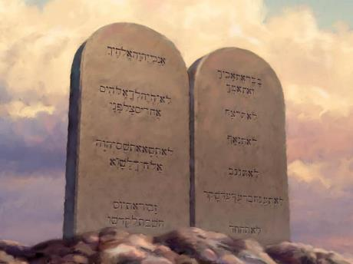
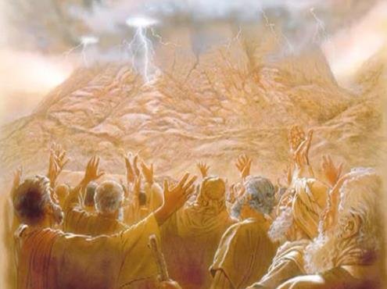








Ko e kolosi ʻ i he Tahi Kulokulá ko ha makamaile ia ki ʻ Isileli. Ko e makamaile hono uá ko hono fanongonongo ʻ o e Laó fakafou ʻ i he fofonga tonu ʻ o e ʻ Otuá.
ʻ I he momeniti ko iá, naʻe fāʻeleʻi ai ʻ a ʻ Isileli ko ha puleʻanga māʻoniʻoní. Naʻa ne maʻu ʻa e ngaahi lao te ne puleʻi ʻene moʻui.
Ka naʻe mahulu hake ia ʻi he ngaahi lao fakalotu, sivile, pe moʻui lelei pe. Ko e Fekau ʻe Hongofulu, ʻa ia ko e fakavaʻe ia ʻo e ngaahi fono kotoa ko ʻeni, ko ha fakafotunga ia ʻo e ʻulungaanga totonu ʻo e ʻOtua, pea ko ia ai, ʻoku ʻikai fakaʻaongaʻi pe ia ki ʻIsileli, ka ki he fanau kotoa pe ʻa e ʻOtua.
Ko hono fakahoko ʻo e Lao:
  The ʻoku nau maʻu ʻa e Lao (ʻEkesotosi 19:1-8)
  Ko e Tokotaha Foaki Fono (ʻEkesotosi 19:9-25)
  Ko e Fekau ʻe Hongofulu (ʻEkesotosi 20:1-17)
Ko e ʻuhinga ʻo e Lao:
  Ko e fatongia ʻo e Lao.
  Ko e Lao ko ha talaʻofa.
  Ko e Lao ko ha ngataʻanga

Slide 4

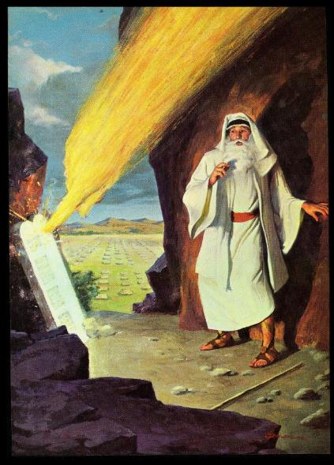
KO HONO FAKAHOKO ʻO E LAO

Slide 5

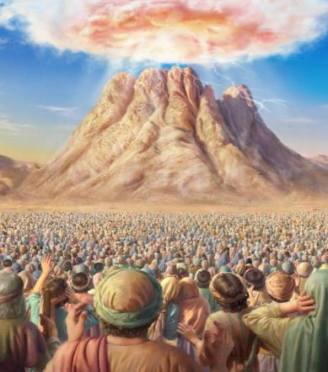
KO KINAUTOLU ʻOKU NAU MAʻU ʻA E LAO
“Kuo mou mamata ki he meʻa naʻaku fai ki he kakai ʻIsipite, mo ʻeku fua ʻakimoutolu ʻi he kapakau ʻoe ʻikale, ʻo ʻomi ʻakimoutolu kiate au.”
(Ekisotosi 19:4)
Ko e ha naʻe ʻomi ai ʻe he ʻOtua ʻa ʻIsileli mei ʻIsipite?
Ke tauhi kiate ia (ʻEkesotosi 5:1; 7:16; 8:1, 20; 9:1, 13; 10:3). ʻI heʻenau fai ia, te nau maʻu ai ha ngaahi lelei lahi (kau ai ʻa e fonua ko Kenani).
ʻI he mahina hono tolu hili ʻenau mavahe mei ʻIsipite, naʻa nau ʻapitanga ofi ki he Moʻunga Sainai. Naʻe fakatoka ai ʻ a e makatuʻunga ki hono fokotuʻu ʻ o e puleʻanga ʻ Isilelí. Naʻe fokotuʻu ʻe he ʻOtua ha fuakava mo kinautolu, pea naʻa nau tali (ʻEkesotosi 19:1-8).
ʻI heʻetau tali ʻa e fuakava, ko e ha e meʻa ʻe hoko ki ai ʻa ʻIsileli (ʻEkesotosi 19:5-6)?
KAKAI MAʻONIʻONI
Te nau fakatapui kinautolu ki he ʻOtua, pea fakaha Hono ʻulungaanga.
PULEʻANGA ʻO E KAU TAULAʻEIKI
Te nau fakafehokotaki ʻa e kakai kehe mo e ʻOtua, pea akoʻi kiate kinautolu ʻene ngaahi fono.
KO HA KOLOA MAKEHE MEI HE ʻ OTUÁ
ʻE ngaohi ʻe he ʻOtua ʻa ʻIsileli ko ha halanga ke fakamamaʻi ai ʻa e mamani ʻaki ʻa e ʻilo fekauʻaki mo Ia

Slide 6

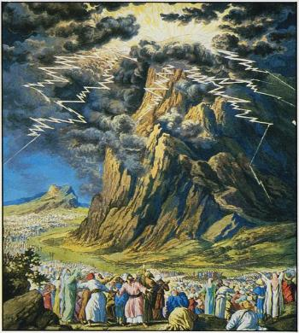
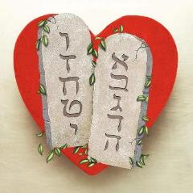
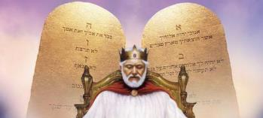
KO E TOKOTAHA FOAKI LAO
“Pea naʻe kohuʻia ʻae moʻunga ko Sainai kotoa pē, koeʻuhi naʻe hāʻele hifo ki ai ʻa Sihova ʻi he afi: pea naʻe ʻalu hake ʻa hono kohu ʻo hangē ko e kohu ʻo ha fuʻu afi, pea naʻe ngalulu lahi ʻae moʻunga kotoa.” (Ekisotosi 19:18)
Ko hono fakahoko ʻo e Lao ʻa e ʻOtua ʻi Sainai ko ha meʻa fakaʻofoʻofa mo fakailifia (Hepelu 12:18-21). ʻOku ʻikai mateuteu ha taha ki ha meʻa pehe. Ko ia ai, naʻe fie maʻu ke tomuʻa fakamaʻa ʻa e kakai pea tauhi ʻa e vamamaʻo totonu koeʻuhi ke ʻoua naʻa fakaʻauha kinautolu ʻe he naunau fakalangi (ʻEkesotosi 19:10-12).
Ko e ha naʻe fie maʻu ai ke fai ha faʻahinga fokotuʻutuʻu pehee?
Ko e ngaahi folofola ko ia naʻe ʻamanaki ke fai ʻe he ʻOtua kiate kinautolu ko hano fakahaaʻi ia ʻo Hono ʻulunganga. Ko e talangofua kiate kinautolu ko e moʻui; ko e talangataʻa kiate kinautolu ko e mate ia. Naʻe fie maʻu ke ʻiloʻi kakato ʻe ʻIsileli ʻa e mamafa mo e mahuʻinga ʻo e "ngaahi lea ʻo e fuakava, ko e Fekau ʻe Hongofulu" (ʻEkesotosi 34:28).
Kuo lēkooti ʻ a e liliu ʻ e ua ʻ o e Lao ko ení: ko e taha ʻ i he kamataʻanga ʻ o e ʻ Ekisotosí, pea ko e taha ko e konga ia ʻ o e ngaahi lea fakaʻosi ʻ a Mōsese ki muʻa ke hū ki Kēnaní.
Neongo ʻe ngali fakailifia ʻi heʻene fakamatalaʻi, ka ʻoku ha mei he Lao ʻa e lelei taha ʻo e ʻulungaanga ʻo e ʻOtua: ʻa e ʻofa (Loma 13:10).

Slide 7
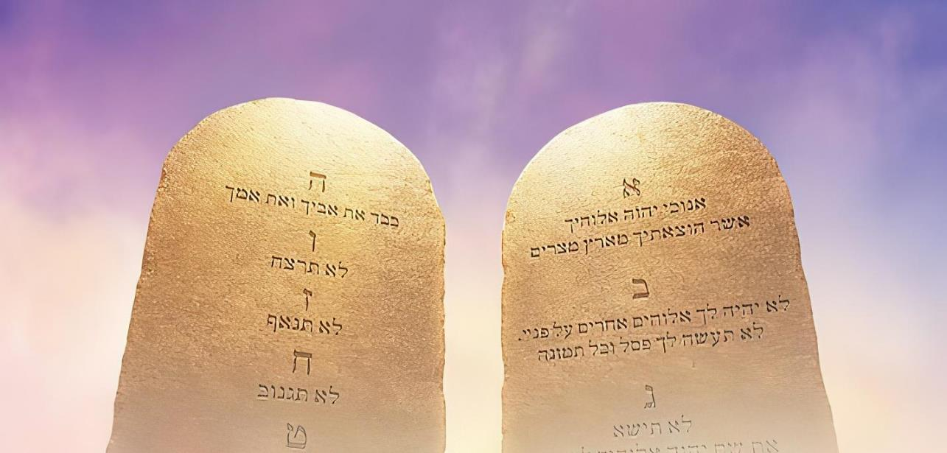

KO E FEKAU ʻE HONGOFULU
"Ko au ko Sihova ko ho ʻOtua, ʻa ia naʻa ku ʻomi koe mei ʻIsipite, mei he fonua ʻo e nofo popula" (ʻEkesotosi 20:2)
ʻOku fakafeʻiloaki ʻe he ʻOtua ʻa e Fono ʻaki hono fakamahinoʻi hono tefitoʻi ngaue: "Kuo u huhuʻi ʻa kimoutolu mei he angahala, ko ia, ko e meʻa ʻeni kuo pau ke mou fai ʻo fai atu mei he taimi ni" (ʻEkesotosi 20:2). Ko e tauhi ʻo e Lao, kiate kitautolu, ko e tali ia ki he Huhuʻi. Ko ha tali ia ʻo e ʻofa ki he ʻofa ʻoku maʻu.
"ko e ʻofa ko hono fakahoko ia ʻo e fono" (Loma 13:10)
ʻOfa ki he ʻOtua (Teu. 6:5; ʻEkes 20:3-11)
ʻOfa ki ho kaungaʻapi (Lev. 19:18; ʻEk 20:12-17)
Fakaʻapaʻapaʻi kitautolu koeʻuhi ke ʻoua naʻa ʻuliʻi ʻe ha holi siokita hotau ʻulungaanga.
Fakaʻapaʻapaʻi Hono ʻaho ʻo e malolo mo e lotu, ʻa ia ko e Sapate
Fakaʻapaʻapaʻi mo fakaʻapaʻapaʻi ʻa e ʻOtua ʻaki hono fakamuʻomuʻa ia ʻi heʻetau moʻui.
Fakaʻapaʻapaʻi ʻa e ʻOtua ʻo ʻikai fetongi ia ʻaki ha faʻahinga tamapua
Fakaʻapaʻapaʻi ʻa e huafa, ongoongo, mo e ʻulungaanga ʻo e ʻOtua
Fakaʻapaʻapaʻi ʻa e matuʻa
Fakaʻapaʻapaʻi ʻa e moʻui
Fakaʻapaʻapaʻi ʻa e nofomali
Fakaʻapaʻapaʻi ʻa e koloa ʻa e kakai
Fakaʻapaʻapaʻi ʻa e ongoongo ʻo e niʻihi kehe

Slide 8

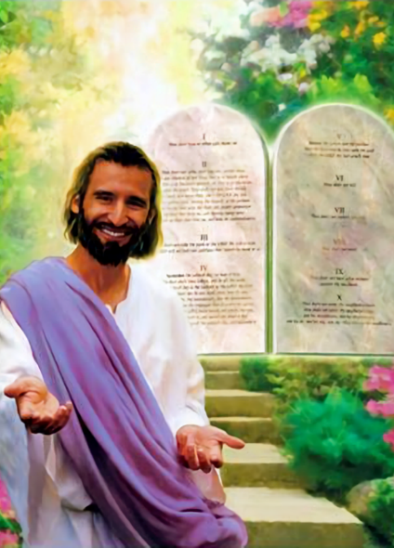

KO E ʻUHINGA ʻO E LAO

Slide 9
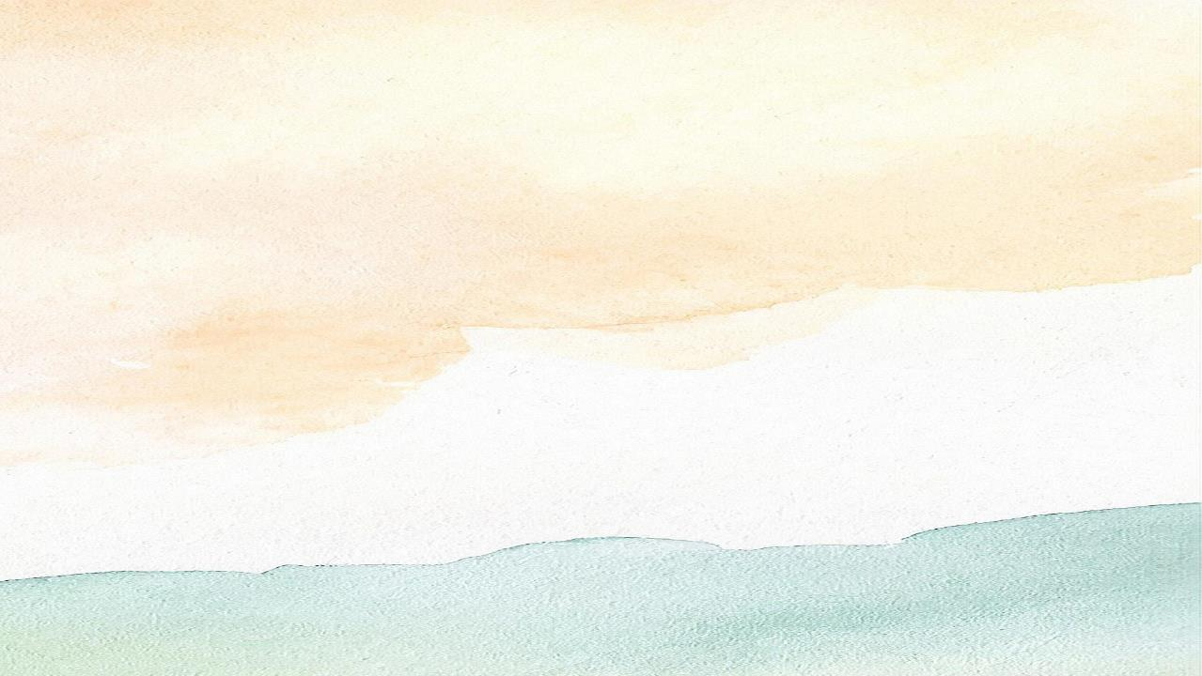

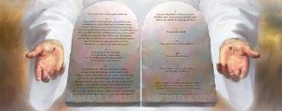
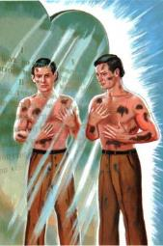
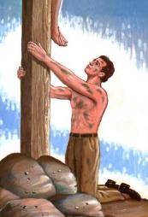
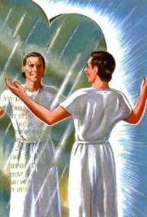
KO E FATONGIA ʻO E LAO
"Ko ia naʻe hoko ʻa e fono ko hotau maluʻi kae ʻoua ke haʻele mai ʻa Kalaisi, koeʻuhi ke fakatonuhiaʻi ʻa kitautolu ʻi he tui" (Kaletia 3:24)
Ko e hā ʻ a e niʻihi ʻ o e ngaahi ngāue ʻ a e Laó?
ʻOku ʻikai kau ʻa e fakamoʻui ʻi hono ngaahi ngaue (Kal. 2:16). ʻOku hange ʻa e Fono ko ha sioʻata ʻoku ha mai ai ʻetau ngaahi angahala (Semisi 1:23-25).
ʻOku ne taʻofi kitautolu mei he kovi (Saame 119:104)
ʻOku ne ʻomi kiate kitautolu ʻa e poto (Tt. 4:6)
ʻOku ne ʻomi kiate kitautolu ʻa e tauʻataina
(Semisi 2:12)
ʻOku ne ʻomi kiate kitautolu ʻa e melino
(Saame 119:165)
ʻOku Ne foaki mai kiate kitautolu ʻa e tuʻumalie (Siosiua 1:8)
ʻOku Ne fakamahinoʻi ʻetau angahala (Loma 7:7)
ʻOku ne tataki kitautolu kia Kalaisi
(Kal. 3:24)
ʻOku ʻikai toʻo ʻa e ʻuli ʻi hono maumauʻi ʻo e sioʻata; ʻoku ʻikai foki ke pehe ʻa e tukunoaʻi ia. Ka ka ne taʻeʻoua ʻa e "sioʻata" [ʻa e fono] he ʻikai ke tau ʻiloʻi kuo ʻuliʻi kitautolu [ʻe he angahala], pea ʻoku tau fie maʻu ʻa e "holoholo" [Kalaisi] ke fakamaʻa kitautolu.
ʻOku mahino ʻa e Tohi Tapu: ʻoku lelei ʻa e Fono (Loma 7:12); ko e meʻa fakafiefia ʻa e fakalaulauloto ki ai (Saame 1:2). "ʻOiaue, ʻoku ou ʻofa lahi ʻi hoʻo fono! ʻOku ou fakalaulauloto ki ai ʻi he ʻaho kotoa" (Saame 119:97).

Slide 10


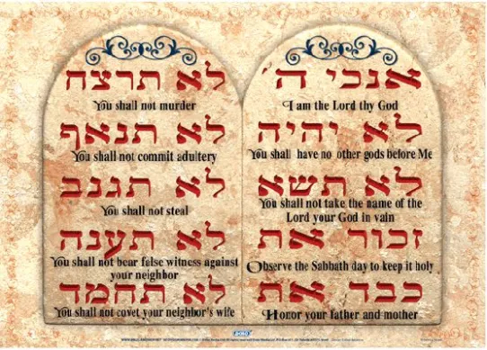
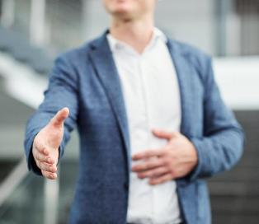
KO E LAO KO HA TALAʻOFA
"Pea naʻa ne fakaha kiate kimoutolu ʻa ʻene fuakava ʻa ia naʻa ne fekau kiate kimoutolu ke mou fai, ko e NGAAHI LEA ʻE HONGOFULU, ʻo ne tohi ia ki he maka lafalafa ʻe ua" (Teutalonome 4:13,ʻuluaki lea faka-Hepelu)
ʻI he lea faka-Hepeluu, ko e tuʻo tolu ʻoku lave ki ai ʻa e Fekau ʻe Hongofulu, ʻoku ui kinautolu ko e "ngaahi lea ʻe hongofulu" (ʻEkesotosi 34:28; Teu. 4:13; Teu. 10:4).
Tau fakakaukau ki he meʻa ni. Ko e ha ʻetau ʻuhinga ʻi heʻetau pehe ki ha taha, "ʻOku ou fai kiate koe ʻeku lea"?
Ko hono moʻoní, ʻoku ʻikai ke mau ʻoatu ha meʻa kiate koe; 'oku mau fai atu ha palōmesi kiate koe. 'Oku mau fakapapau'i atu 'oku mau 'alu ke fai ha me'a pau.
Ko ia ai, ʻe lava ke liliu ʻa e tefitoʻi lea faka-Hepelu ko e "dabar" ko e "lea" pe "talaʻofa."
Sipinga: "Kuo teʻeki ai ke tonounou ha foʻi lea [tapale] ʻe taha ʻi heʻene talaʻofa lelei kotoa pe [tapale], ʻa ia naʻa Ne talaʻofa ʻo fakafou ʻi Heʻene tamaioʻeiki ko Mosese" (1 Ngaahi Tuʻi 8:56).
Ko e Fekau ʻe Hongofulu ko ha ngaahi talaʻofa ia ʻe hongofulu ʻoku fai mai ʻe he ʻOtua kiate kitautolu, ʻoku fakataumuʻa ke tataki kitautolu ʻi he hala totonu.

Slide 11

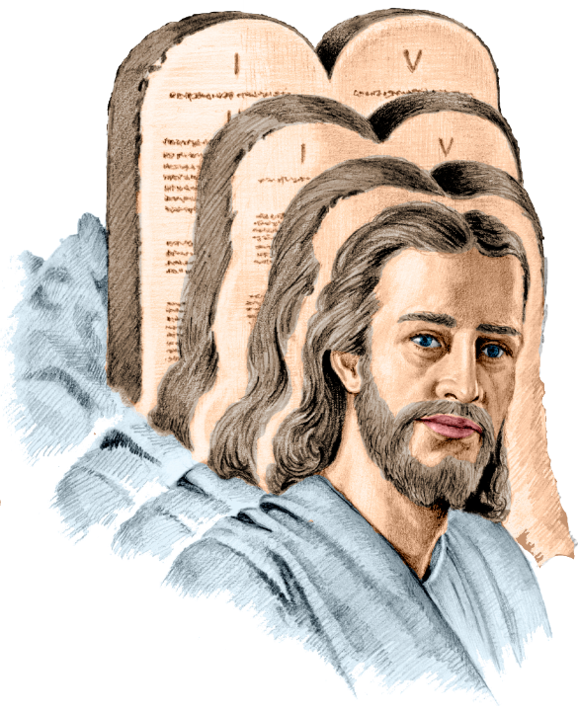
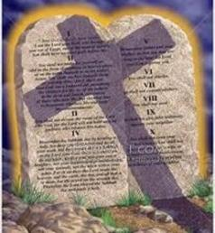
KO E LAO KO HA NGATAʻANGA
"He ko Kalaisi ʻa e ngataʻanga ʻo e fono, ko e maʻoniʻoni ki he kakai kotoa pe ʻoku tui" (Loma 10:4)
Ko e foʻi lea ko e "ngataʻanga" naʻe fakaʻaongaʻi ʻe Paula ki he fono ʻi he Loma 10:4 ko e "telos." Ko e ha ʻa e ʻuhinga ʻo e foʻi lea ko ʻeni?
Ko e ‘uhinga tefitó ko e: poini ‘oku fakahaa‘i ko ha fakangatangata pe taumu‘a. ‘I he faka‘uhinga (ngaahi ‘uhinga fika ua): ko e faka‘osinga, ko e fakangata, ko e ola, ko e taumu‘a. Ko hono ‘uhinga paú kuo pau ke fakapapau‘i ia ‘e he sētesi ‘oku ngāue‘aki aí.
Kapau te tau liliu ‘eni ko e “Ko Kalaisi ‘a e faka’osinga ‘o e lao,” ‘oku ‘ikai ke toe ‘i ai ha lao talu mei he pekia ‘a Sisu. Ko ia ai, ‘oku ‘ikai ha angahala. ‘E fakafepaki’i ‘e Paula ia ‘a ia tonu (Lom. 7:7).
Kapau te tau liliu "Ko Kalaisi ʻa e meʻa ʻoku tuhu ki ai ʻa e fono," ʻoku tuʻu maʻu pe ʻa Paula, koeʻuhi he ʻoku kei ngaue pe ʻa e fono, pea ʻoku ne tataki kitautolu kia Kalaisi (Loma 3:31; Kal. 3:24).

Slide 12

EGW (Kau Pēteliake mo e Kau Palōfitá, p. 305)
“Naʻe ʻikai ke lea ʻaki ʻa e fono ʻi he taimi ko ʻeni ke ʻaonga pe ki he kakai Hepeluu. Naʻe fakaʻapaʻapaʻi kinautolu ʻe he ʻOtua ʻaki hono fokotuʻu kinautolu ko e kau maluʻi mo tauhi ʻEne fono, ka naʻe pau ke tauhi ia ko ha falala toputapu maʻa e mamani kotoa. ʻOku fakafeʻungaʻi ʻa e ngaahi akonaki ʻo e Decalogue ki he faʻahinga kotoa ʻo e tangata, pea naʻe foaki ia ki he fakahinohino mo e puleʻi ʻo e kakai kotoa pe. ʻOku ʻi ai ha ngaahi akonaki ʻe hongofulu, nounou, fakaʻauliliki, mo fakamafaiʻi, ʻoku ne fakamatalaʻi ʻa e fatongia ʻo e tangata ki he ʻOtua pea ki hono kainga; pea ʻoku makatuʻunga kotoa ia ʻi he tefitoʻi moʻoni mahuʻinga maʻongoʻonga ʻo e ʻofa."

