Slide 1
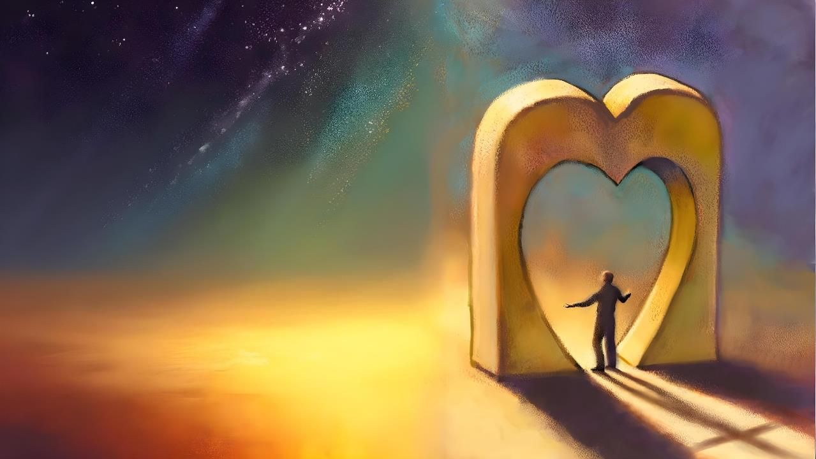
MO‘UI ‘I HE FONO
Lesoni 9 ki he ʻaho 30 ʻo ʻAokosi 2025

Slide 2
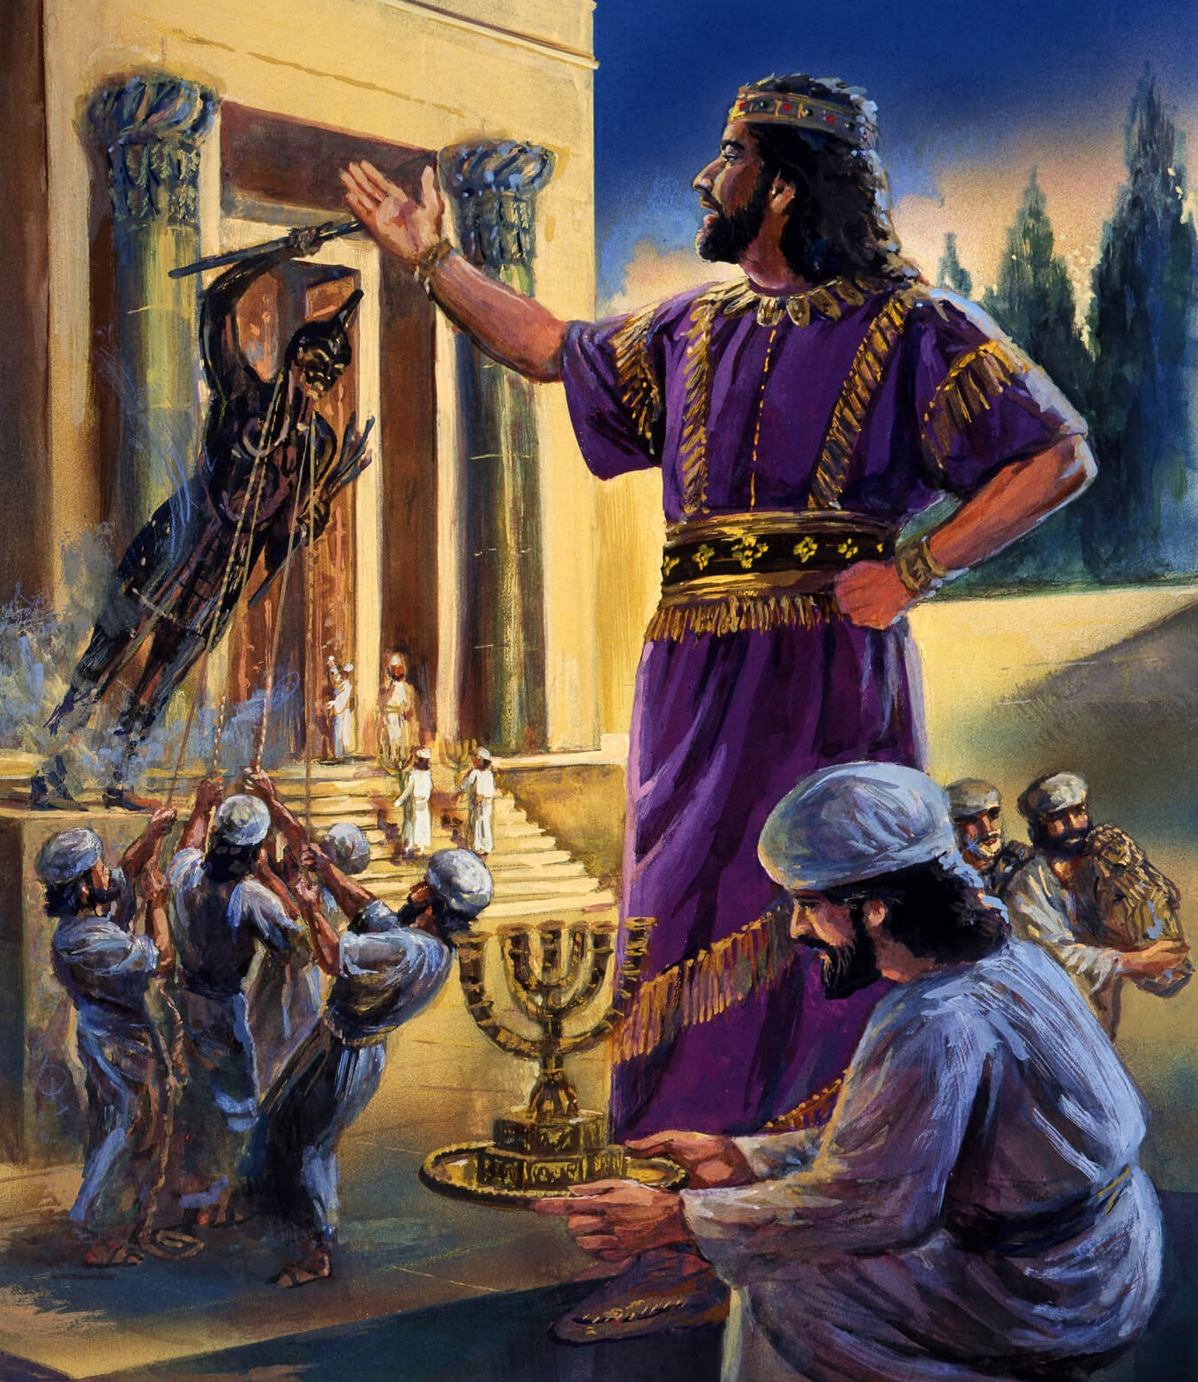
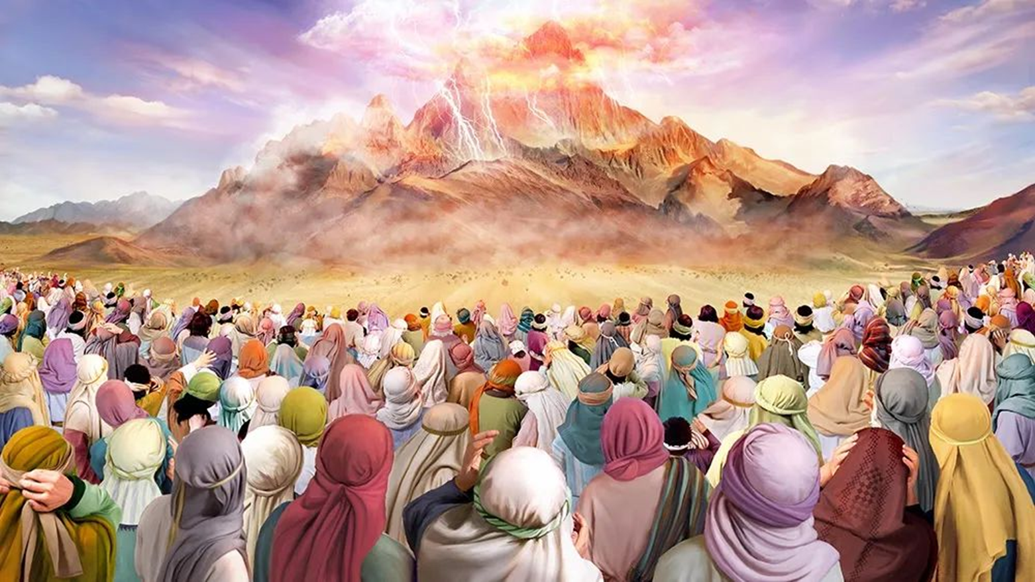
“Pea naʻe folofola ʻa Sihova kia Mōsese, “Ke ke lea ki he fānau ʻa ʻIsileli, ʻo pehē, Kuo mou mamata ki heʻeku lea kiate kimoutolu mei langi.‌ʻOua naʻa mou ngaohi ke fakalahi ʻaki au ha ngaahi ʻotua siliva, pea ʻoua naʻa mou ngaohi kiate kimoutolu ʻae ngaahi ʻotua koula.” ‘Ekisotosi 20:22,23

Slide 3

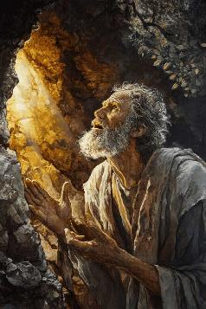
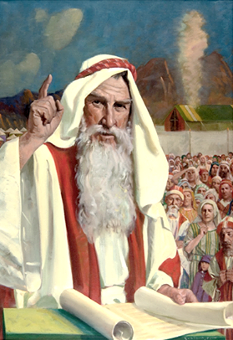
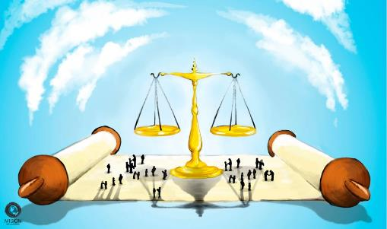


Hili hono fanongonongo ʻo e Tala, naʻe kole ʻe he kakai kia Mosese ke hoko ko e fakaʻava ʻi he vahaʻa ʻo e ʻOtua mo kinautolu (ʻEkesotosi 20:19). Mei he momeniti ko iá ʻ o faai mai ai, naʻe ʻ oange ʻ e he ʻ Otuá ʻ a e ngaahi laó kia Mōsese, pea naʻá ne ʻ oatu ia ki he kakaí.
Naʻe fakataumuʻa ʻa e ngaahi lao ko ʻeni, ʻa ia naʻe ui ko e "tuʻutuʻuni ʻo e fuakava," ke puleʻi ʻa e moʻui ʻa e kakai ʻo ʻIsileli pea mo ʻetau moʻui foki (mo e ngaahi liliu ʻoku fie maʻu ki hotau tuʻunga lolotonga).
Ko hono fakanounou, ko hono fakaʻaongaʻi ia ʻo e Fekau ʻe Hongofulu ki he ngaahi meʻa pau ʻo e moʻui fakaʻaho.
Founga ke mo’ui ‘aki ‘a e lao:
  Founga ke Mapuleʻi ʻa e Fakamamahi (ʻEke 21:1-32)
  Founga ke Moʻui ʻi he Sosaieti (ʻEke 21:33-23:19)
  Founga ke Maʻu ai ʻa e Ikuna (ʻEke 23:20-33)
Founga ke mahino ai ‘a e lao:
  Ko e lao ʻo e sauni.
  Pale mo e tautea.

Slide 4
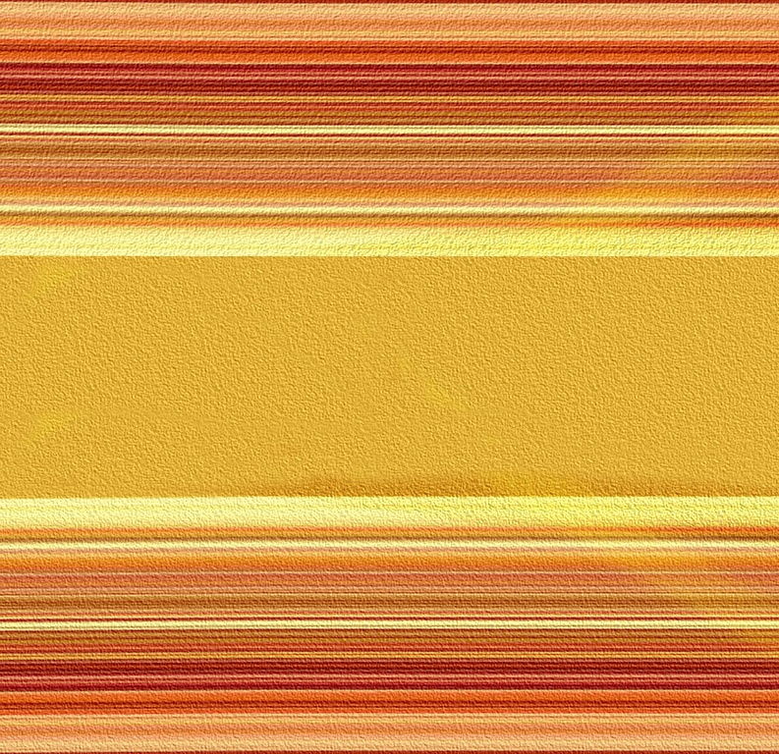
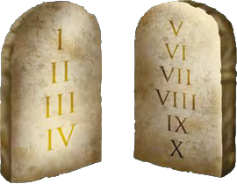

FOUNGA KE MOʻUI ʻAKI ʻA E FONO

Slide 5
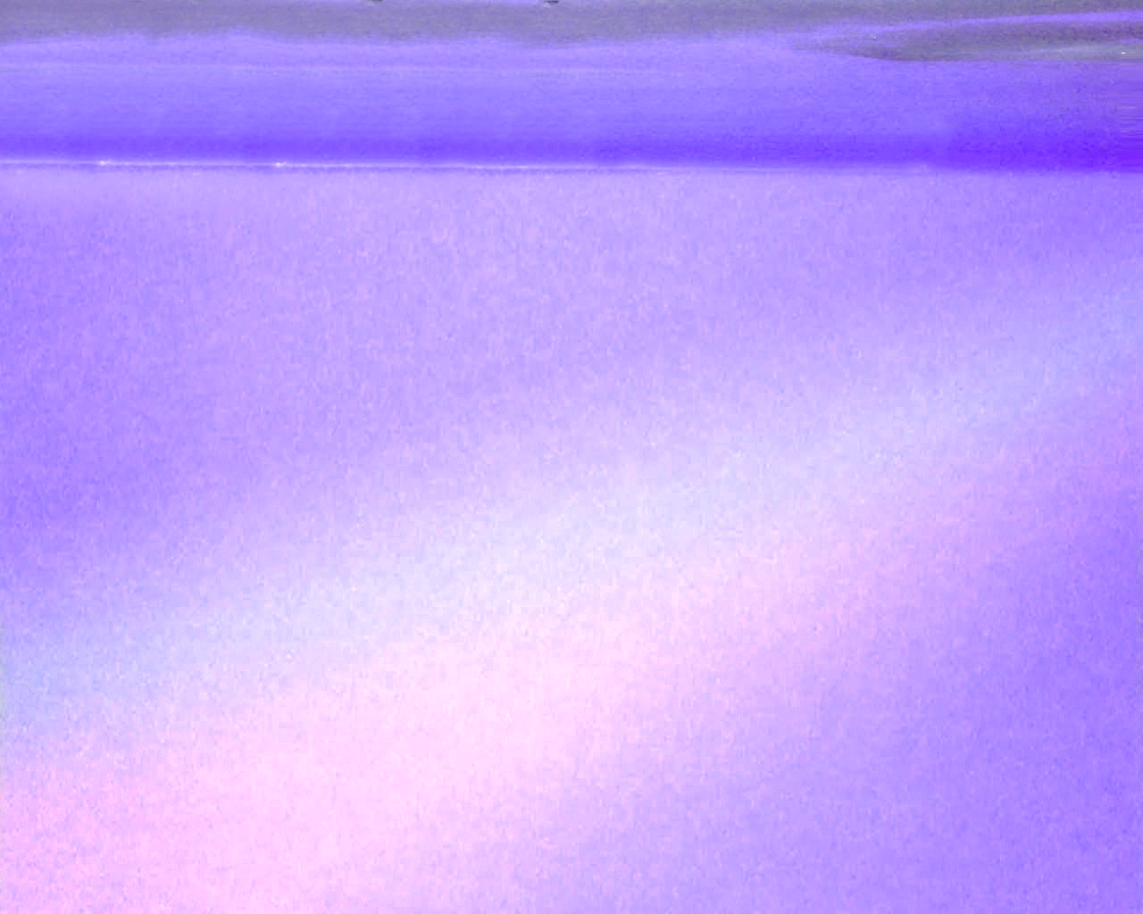
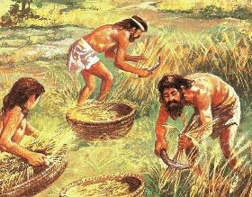
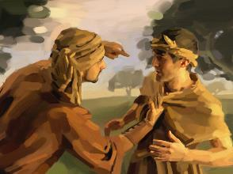
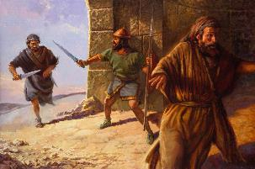
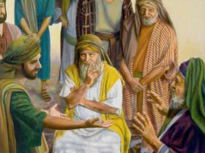
FOUNGA KE MAPULEʻI AI ʻA E FETAʻAKI
““Ko ia ʻoku ne tali ha tangata, pea mate ai ia, ʻe tāmateʻi moʻoni ia.” (Ekisotosi 21:12)
ʻOku kamata ʻaki ʻa e tuʻutuʻuni ʻo e fuakava ʻa e tafaʻaki mahuʻinga ʻe tolu ʻo e sosaieti Hepeluu:
Nofo popula (ʻEkesotosi 21:2-11)
  Naʻe tukuange ʻa e kakai tangata hili ʻa e taʻu hono fitu.
  Kapau naʻe ʻikai ke nau mali, naʻe tauʻataina foki mo e kakai fefine.
  ʻE lava ke kei popula pe ha tangata kapau te ne loto ki ai.
Ko e tautea mate (ʻEkesotosi 21:12-17)
  Ki he tokotaha fakapoo fakataumuʻa
  Kiate ia ʻoku ne fakamamahiʻi pe kapeʻi ʻene matuʻa
  Ki he tokotaha puke fakamalohi
Ngaahi Lavea (ʻEkesotosi 21:18-32)
  Tufakanga ʻo e totongi huhuʻi fakapaʻanga
  Kapau ʻe hoko ha fakatotama, ʻe hilifaki ʻe he fakamaau mo e fefine (mo hono husepaniti) ʻa e moʻua.
ʻOku feinga ʻa e ngaahi lao kotoa ko ʻeni ke taʻofi ʻa e ngaohikovia mo e fetaʻaki ʻi he vahaʻa ʻo e kakai.

Slide 6

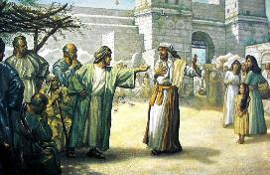
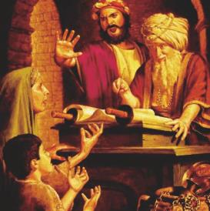
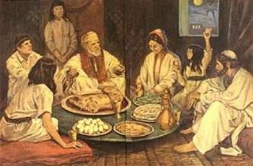
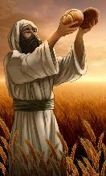
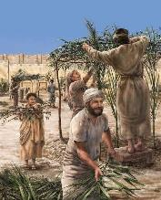
FOUNGA KE MOʻUI AI ʻI HE SOSAIETI
““Pea kapau ʻe fakatauveleʻi ʻe ha tangata ha taʻahine ʻoku teʻeki poloʻi pea na mohe, ko e moʻoni te ne vahe koloa maʻana, pea hoko ko hono mali. ” (‘Ekisotosi 22:16)
Naʻe ʻikai fiemalie ʻa e ʻOtua ke tuku mai pe kiate kitautolu ʻa e ngaahi lao "tefito" pea tuku ke tau fakaʻaongaʻi kinautolu ʻo fakatatau ki heʻetau fie maʻu. Naʻa ne tokanga ke ʻomai ha ngaahi sipinga pau koeʻuhi ke tau lava ʻo fakaʻaongaʻi totonu kinautolu.
ʻOku kau ʻi he ngaahi sipinga ko ʻeni ʻa e ʻohofi ʻo e monumanu ki he monumanu (ʻEkesotosi 21:35-36 ); no mo e nofo totongi (ʻEkesotosi. 22:14-15 ); fetuʻutaki kimuʻa ʻi he mali (ʻEkesotosi 22:16 )
ʻOku fai ha fakamamafa makehe ki hono maluʻi ʻo e vaivai mo e fakamavahevaheʻi, kae ʻikai ʻoange kiate kinautolu ʻa e ngaahi lelei taʻetotonu—ʻa ia ko e ʻikai fakakeheʻi ʻa e fakamaau totonu ke ʻaonga pe maumauʻi kinautolu (ʻEkesotosi. 22:21-23; 23:2-3, 6).
ʻI he hoko ko ha fuakava ʻi he vahaʻa ʻo e ʻOtua mo Hono kakai, naʻe kau foki ʻi he ngaahi fono ko ʻeni ʻa e founga ʻoku totonu ke tau fetuʻutaki ai mo Ia. Makehe mei he maloloʻanga ʻo e Sapate, naʻe ʻi ai ʻa e fatongia ke tauhi ʻa e ngaahi katoanga ʻoku ne fakamanatu mai kiate kitautolu ʻetau fakatauʻatainaʻi mei he angahala, maluʻi fakalangi, pea mo e kahaʻu naunauʻia ʻoku fakatatali mai kiate kitautolu.

Slide 7

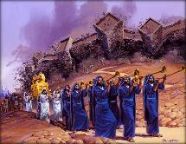
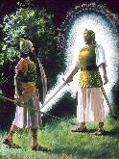
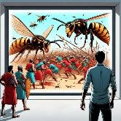
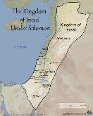
FOUNGA KE MAʻU AI ʻA E IKUNA
ʻOku fakaha ʻe he ʻOtua ki ʻIsileli ʻa e meʻa ke fai
Fanongo ki hono
(23:21-22leʻo, koeʻuhi ke hoko ʻa e ʻOtua ko e fili ʻo hono ngaahi fili )
Tauhi pe ki he ʻOtua, koeʻuhi ke Ne toʻo atu ʻa e mahaki kotoa pe (23:24-26)
ʻOua naʻa fai ha felotoi mo e kau Kenani, koeʻuhi ke ʻoua naʻa nau hu ki honau ngaahi ʻotua (23:32-33)
ʻOku fakaha ʻe he ʻOtua ki ʻIsileli ʻa e meʻa te Ne fai
Te Ne fekauʻi mai ʻEne ʻangelo ke maluʻi mo ʻomi kinautolu ki he [maluʻi] (23:20)
ʻE muʻomuʻa ʻa e ʻangelo ʻiate kinautolu ʻo ʻomi kinautolu ki Kenani (23:23)
Te Ne ʻoatu ʻa e ilifia ki he kakai (23:27)
Te ne fekau atu ʻa e pi ke tuli kinautolu ki tuʻa (23:28)
Te ne kapusi mamalie kinautolu ki tuʻa (23:29-30)
Te ne tukuange kinautolu ki ʻIsileli kae ʻoua kuo nau pule mei he Meteleniane ki ʻIufaletesi (23:31)
"Vakai, ʻoku ou fekau ha ʻangelo ke muʻomuʻa ʻiate koe ke leʻohi koe ʻi he hala, pea ke ʻomi koe ki he potu kuo u teuteu" (ʻEkesotosi 23:20)
Ko e ha naʻe ʻikai foaki ai ʻe he ʻOtua kia ʻEpalahame ʻa e fonua ʻo e kau Kenani? "He ʻoku teʻeki ai ke kakato ʻa e angahala ʻa e kau ʻAmoli" (Senesi 15:16).
Hili ha senituli ʻe fa ʻo e ʻaloʻofa, naʻe ʻikai liliu ʻe he kau Kenani ʻenau ngaahi founga. Kuo taimi ke foaki ʻa e fonua ki ʻIsileli... melino! (ʻEkesotosi 13:17)
Kapau naʻe ʻomi kinautolu ʻe he ʻOtua mei ʻIsipite ʻo ʻikai fie maʻu ke nau tau, fakamavaeuaʻi ua ʻa e tahi, fafanga kinautolu ʻi he mana, pea tataki kinautolu ʻaki ʻEne ʻAngelo... he ʻikai nai te Ne lava ʻo foaki kiate kinautolu ʻa Kenani taʻe fie maʻu ke nau tauʻi ia?

Slide 8
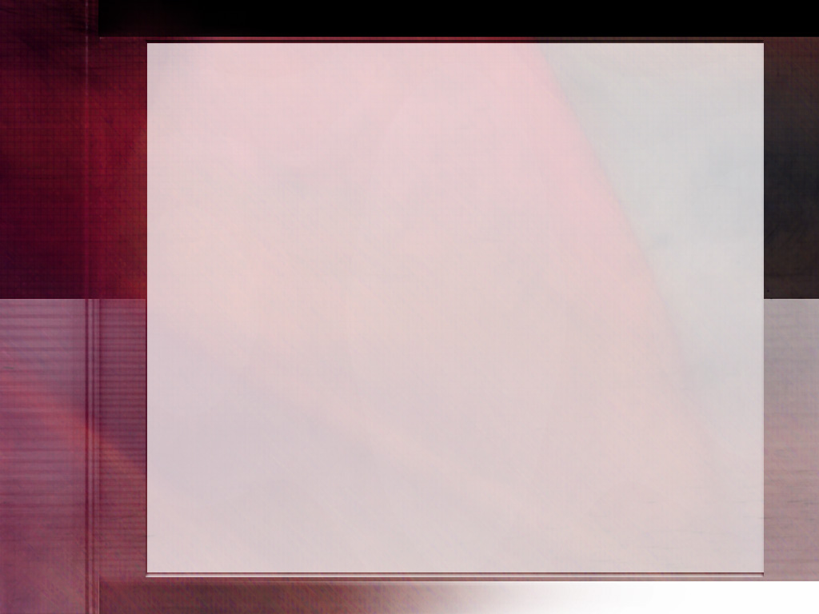
"Kuo fakatolonga mai ʻa e fono ʻa e ʻOtuá ʻi he ngaahi kuongá ko e tuʻunga moʻui māʻolunga taha ia ʻo e angamaʻá. ʻOku ʻikai lava ʻe he ngaahi faʻu fakasaienisi pe fakakaukau ʻa e ngaahi ʻatamai lelei ʻo ʻiloʻi ha fatongia mahuʻinga ʻe taha ʻoku ʻikai kau ki ai ʻa e lao ko ʻeni.
Ko e fono ʻa e ʻOtua ko e malu ia ʻo e moʻui mo e koloa pea mo e melino mo e fiefia. Naʻe foaki mai ia ke fakapapauʻi ʻetau lelei lolotonga mo taʻengata."
EGW (Ko e Sio ki ʻOlunga. 7 ʻOkatopa)

Slide 9

FOUNGA KE MAHINO AI ʻA E LAO

Slide 10
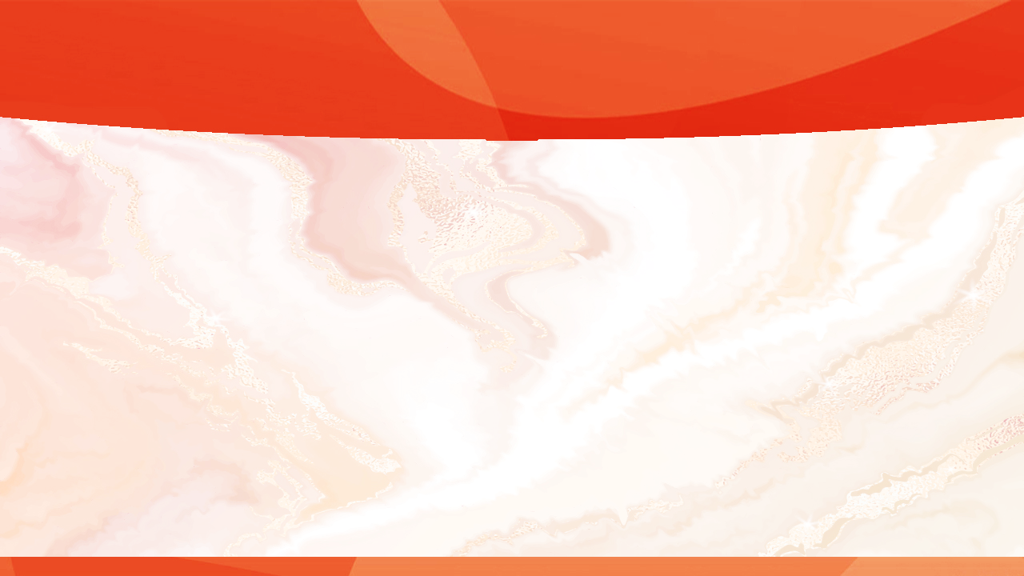
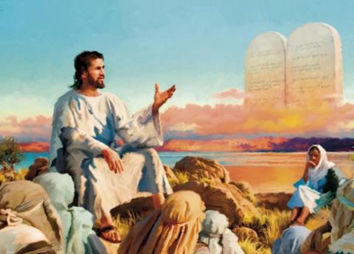

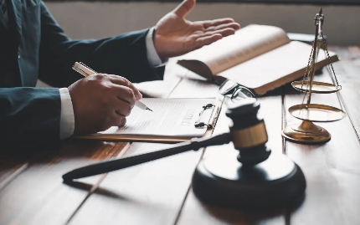
KO E LAO ʻO E SAUNI
“Ko e mata ki he mata, ko e nifo ki he nifo, ko e nima ki he nima, ko e vaʻe ki he vaʻe,,” (Ekisotosi 21:24)
ʻI he taimi naʻe fai ai ʻe Sisu ʻa e Malanga ʻi he Moʻunga, naʻa ne fakangata ʻa e fono ʻo e sauni (Matiu 5:38-42) ... Pe naʻe ʻikai?
Ko e kupuʻi lea "kuo mou fanongo naʻe leaʻaki... ka ʻoku ou tala atu kiate kimoutolu" naʻe ʻikai ke ne fakataʻeʻaongaʻi ha fono (naʻe fakaʻaongaʻi ʻe Sisu ʻa e kupuʻi lea tatau ki he "ʻoua naʻa ke fakapo" pe "ʻoua naʻa ke tono," ka naʻe ʻikai ke ne teitei fakataumuʻa ke fakataʻeʻaongaʻi kinautolu). Ko hono moʻoní, naʻe fakalahi maʻu pē ʻ e Sīsū ʻ a e Laó, fakaleleiʻi ia, pea ʻ oange ki ai ʻ a hono ʻ uhinga moʻoní.
Naʻe ʻikai teitei hoko ʻa e taumuʻa moʻoni ʻo e fono ʻo e sauni ke mole ʻa e mata pe nima ʻo ha taha koeʻuhi ko haʻane fakalaveaʻi ha taha kehe.
Naʻe faʻu ʻa e lao ko ʻeni ʻi he taumuʻa ke taʻofi ʻa e sauni, fakangata ʻa e fekeʻikeʻi toto, mo e sauni taʻe tomuʻa fakatotoloʻi. Naʻe pau ke fakafuofuaʻi ʻe he kau fakamaau ʻa e ngaahi maumau, pea fokotuʻu leva ʻa e totongi paʻanga feʻunga. Naʻe hoko ʻa e founga ko ʻeni ke taʻofi ʻa e kakai mei hono toʻo ʻa e fakamaau totonu ki honau nima. Naʻe fiemaʻu ke fai ʻ a e fakamaau totonú, ka naʻe fehoanaki ia mo e Lao ʻ a e ʻ Otuá.

Slide 11
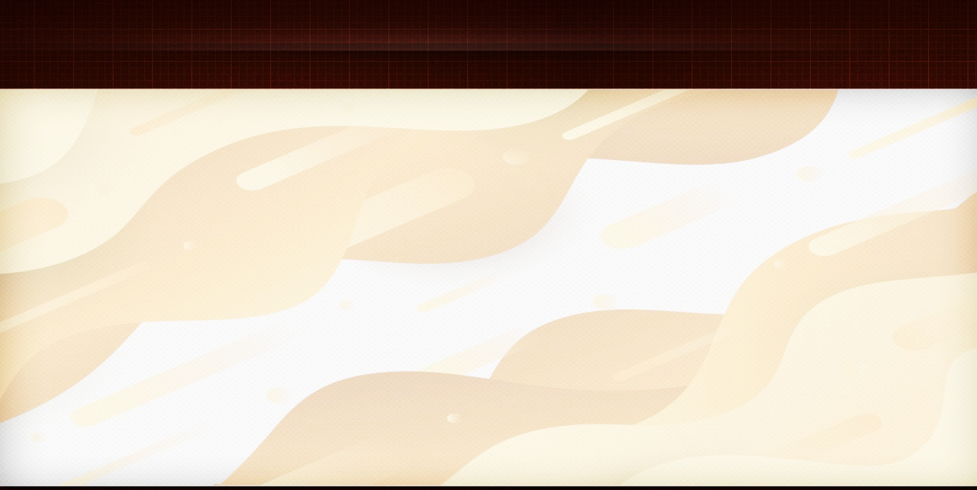
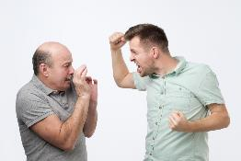

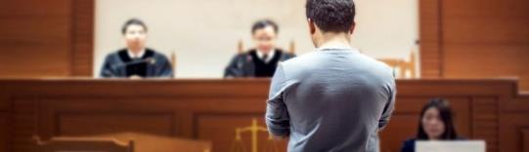
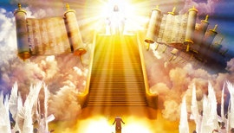
PALE MO E TAUTEA
“Ka ʻo kapau ʻoku ʻikai fai ia ʻi he ʻiloʻi totonu, ka ʻoku tuku ʻe he ʻOtua ke hoko, te nau hola ki he potu te u fili" (ʻEkesotosi 21:13)
Ko e holi ki he sauní ʻ oku aka loloto ia ʻ iate kitautolu. Pea ʻoku ʻikai tatau maʻu pe ia mo e fehalaaki kuo tau maʻu: "Kapau naʻa ne fai ʻeni kiate au, te u fai ha meʻa lahi ange kiate ia."
ʻOku fakaafeʻi kitautolu ʻe Sisu ke tau fai ʻa e fehangahangai ʻo e meʻa ʻoku tau holi ki ai: ke totongi ʻaki ʻa e lelei ʻa e kovi (Matiu 5:44). Ko e fe leva ʻa e fakamaau totonu? Ko hai te ne totongi ki he tokotaha faihala ʻa e meʻa ʻoku totonu ke ne maʻu?
ʻOku ʻikai talamai ʻe he ʻOtua he ʻikai tauteaʻi ʻa e tokotaha ʻoku ne fakamamahiʻi, pe ʻe sauni ha faʻahinga ngaue. Ka ʻoku Ne talamai mahino kiate kitautolu ko Ia ʻa e sauni (Loma 12:19-21).
Neongo ʻoku tali ʻa e sauni fakafoʻituitui ʻi he tuʻutuʻuni ʻo e fuakava, ka naʻe taʻofi ia ʻaki hono fokotuʻu ha faʻunga fakamaauʻanga ke taʻofi ʻa e ngaohikovia (ʻEkesotosi 21:12-13, 22; 22:8-9).
ʻOku ʻikai lava ʻe ha taha ʻo fakahoko ʻi he taimi tatau ʻa e fatongia ʻo e fakamaau, sula mo e tokotaha tautea. Kapau kuo pau ke hilifaki ha tautea, kuo pau ke fakahoko ia ʻi ha founga fakamaauʻanga totonu. Pea ʻe hoko ʻa Kalaisi ko e Fakamaau maʻolunga mo fakaʻosi.

Slide 12
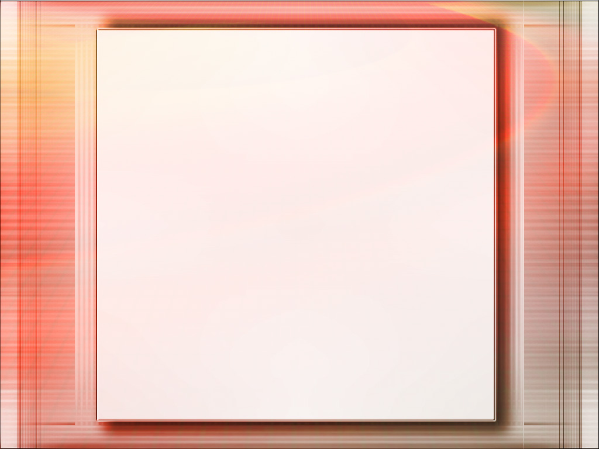
“ʻ I he tuʻunga ko e Tupuʻanga ʻ o e meʻa kotoa pē, ko e ʻ Otuá ʻ a e pule ki he meʻa kotoa pē, pea ʻ okú Ne haʻisia ke fakamālohiʻi ʻ Ene laó ʻ i he kotoa ʻ o e ʻ univēsí. Ka siʻisiʻi ange ʻa e fie maʻu mei Heʻene ngaahi fakatupu ʻi he talangofua ki Heʻene fono, ʻe hoko ia ko hano liʻaki kinautolu ki he fakaʻauha. Kapau he ʻikai ke tau tauteaʻi ʻa e maumauʻi ʻo ʻEne fono, ʻe puputuʻu ai ʻa e ʻunivesi. Ko e fono ʻo e angamaʻa ko e ʻa vahevahe ia ʻa e ʻOtua ʻi he vahaʻa ʻo e fakafofonga ʻo e tangata mo e angahala. Ko ia kuo fokotuʻu ai ʻe he poto taʻefakangatangata ki he tangata ʻa e faikehekehe ʻi he vahaʻa ʻo e totonu mo e hala, ʻi he vahaʻa ʻo e angahala mo e maʻoniʻoni.”
EGW (Ko e Ngaahi Fakaʻilonga ʻo e Taimi , 5 Sune 1901)

