Slide 1
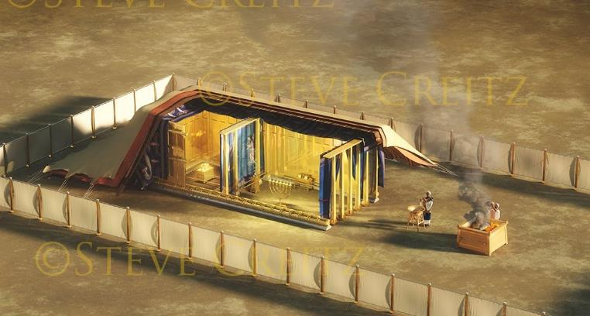
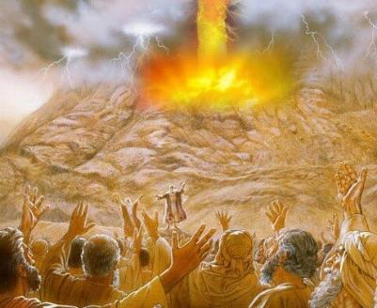
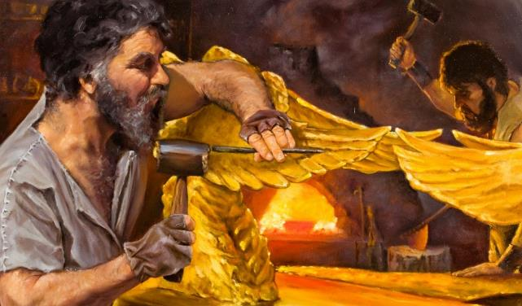
Lesoni 10 ki he ʻaho 6 ʻo Sepitema 2025
KO E FUAKAVA MO HONO FOKOTU‘UTU‘U

Slide 2
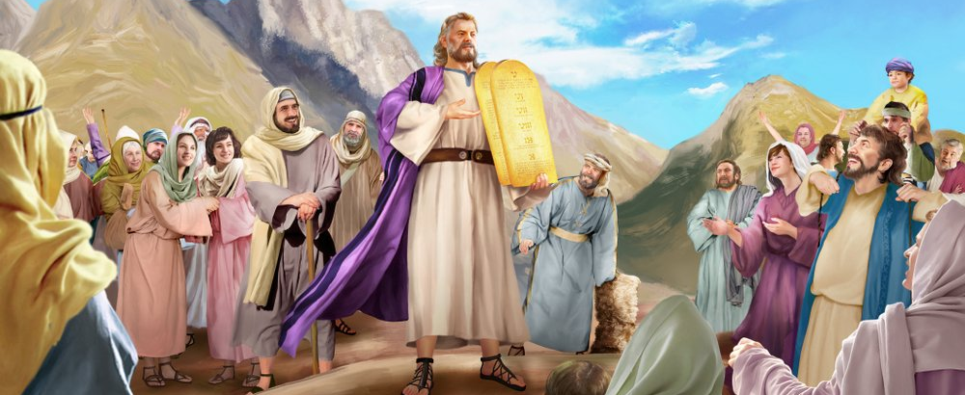
“Pea naʻe haʻu ʻa Mōsese ʻo ne tala ki he kakai ʻae ngaahi folofola kotoa pē ʻa Sihova, mo e ngaahi fono kotoa pē; pea tali lea taha pe ʻae kakai kotoa pē, ʻonau pehē, “Ko e ngaahi lea kotoa pē kuo folofolaʻaki ʻe Sihova te mau fai.”Ekesotosi 24:3

Slide 3

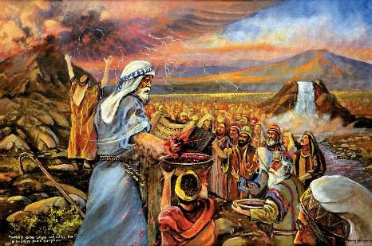
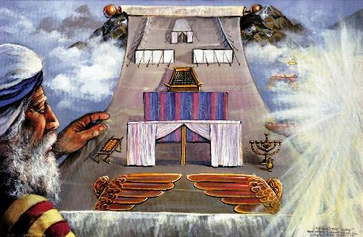


Hili hono fanongonongo leʻolahi ʻ a e Fekau ʻ e Hongofulú pea ʻ oange kia Mōsese ha ngaahi lao tefito, naʻe fiemaʻu ʻ e he ʻ Otuá ke fai ha fuakava mo ʻ Isileli.
Naʻe faingofua pe ʻa e fuakava: Te u hoko ko ho ʻOtua, te u maluʻi mo tapuakiʻi koe; Mou talangofua ki heʻeku ngaahi fono.
Hili hono hiki ʻ a e fuakavá ʻ i ha takainga tohí, naʻe pau ke fakamoʻoniʻi ia ʻ e he ongo faʻahí fakatouʻosi. Naʻe fakamoʻoniʻi ia ʻe he kakai, ʻo pehe te nau tauhi ia. Naʻe anga - fēfē hono fakamoʻoniʻi ia ʻ e he ʻ Otuá? ʻAki ʻa e toto; mo ha katoanga; pea mo ha sipinga ke tokoni ke mahino kiate kinautolu ʻa e fuakava.
Ko e Fuakava:
  Ko e taʻataʻa ʻo e fuakava (ʻEkesotosi 24:1-6, 8)
  Ko hono fakahoko ʻo e fuakava (ʻEkesotosi 24:7)
  Ko e Maʻu Meʻatokoni ʻo e Fuakava (ʻEkesotosi24:9-18)
  Ko e sipinga:
  Ko e taumuʻa ʻo e sipinga (ʻEkesotosi 25:1-9)
  Ko e Teuteu ʻo e Sipinga (ʻEkesotosi 31:1-18)

Slide 4
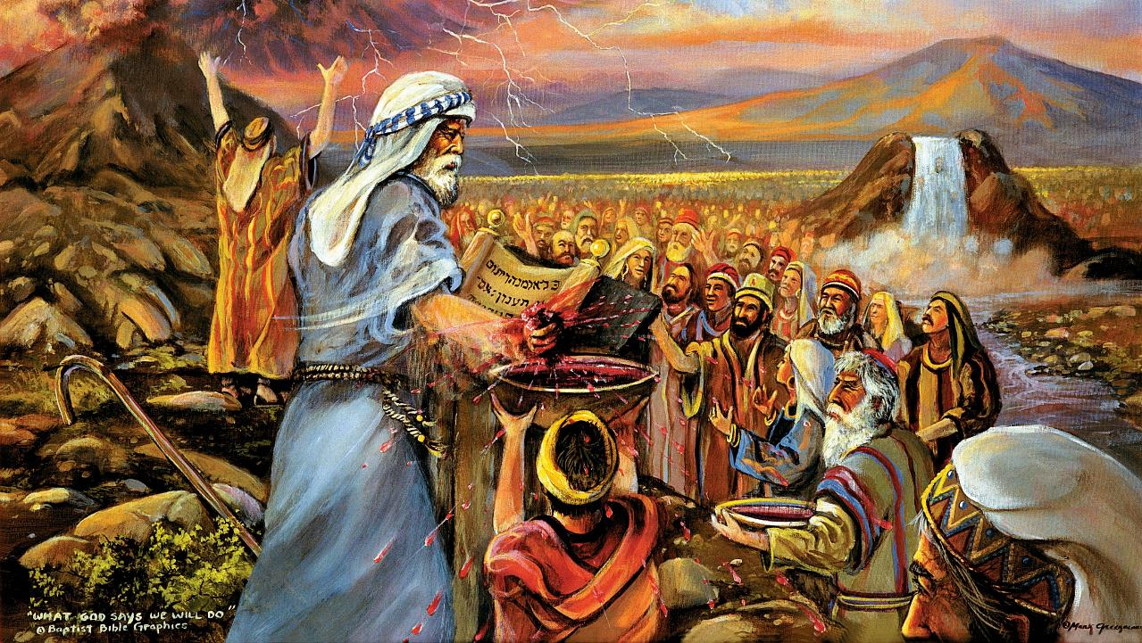
KO E FUAKAVA

Slide 5

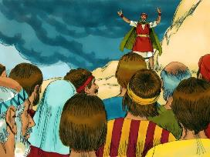
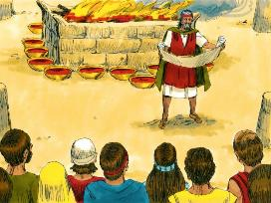
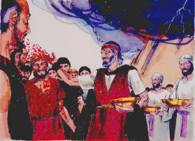
KO E TAʻATAʻA ʻO E FUAKAVA
Pea naʻe toʻo ʻe Mōsese ʻae toto, ʻo ne luluku ia ki he kakai, ʻo ne pehē, “Vakai, ko e toto ʻoe fuakava, ʻaia kuo fai ʻe Sihova mo kimoutolu ʻi he ngaahi folofola ni kotoa pē.” (Ekesotosi 24:8)
Naʻe fakahoko fefe ʻa e fuakava?
Naʻe lau ʻa e fuakava (ʻEkesotosi 24:3a)
Naʻe tali ʻio ʻe he kakai (ʻEkesotosi 24:3b)
Naʻe hiki ia ʻi ha tohi (ʻEkesotosi 24:4a)
Naʻe langa ha ʻesi-feilaulau (ʻEkisotosi 24:4e)
Naʻe fokotuʻu ha ngaahi pou ʻe 12 (ʻEkesotosi 24:4c)
Naʻe fai ʻa e ngaahi feilaulau tutu (ʻEkesotosi 24:5)
Naʻe afuhi ʻa e vaeua ʻo e toto ʻi he ʻolita (ʻEkesotosi 24:6)
Naʻe toe lau ʻa e fuakava (ʻEkesotosi 24:7a)
Naʻe toe tali ʻio ʻa e kakai (ʻEkesotosi 24:7b)
Naʻe afuhi ʻa e vaeua ʻe taha ʻo e toto ki he kakai (ʻEkesotosi 24:8a)
Naʻe fakaha ʻe Mosese ko e "toto ia ʻo e fuakava" (ʻEkesotosi 24:8b; Matiu 26:28)
Naʻe fai ha maʻu meʻatokoni ke fakamoʻoniʻi ʻa e fuakava (ʻEkesotosi 24:9-11)
Naʻe ʻafioʻi ʻe he ʻOtua ʻa ʻIsileli ko ha kakai (kolomu ʻe 12); Naʻa ne fakamahuʻingaʻi ʻaupito ʻa e toʻu tupu; pea naʻa Ne fakatukupaaʻi ia ki he tokotaha takitaha fakafoʻituitui (afuhi Hono taʻataʻa kiate kinautolu).
ʻOku finangalo ʻa e ʻOtua ke tau fetuʻutaki fakafoʻituitui pea mo ha kolo ʻo e kakai tui.

Slide 6

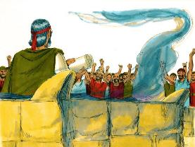
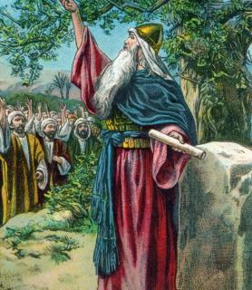


KO HONO FAKAHOKO ʻO E FUAKAVA
“Pea toʻo ʻe ia ʻae tohi ʻoe fuakava, ʻo ne lau ia ke ongoʻi ʻe he kakai: pea naʻa nau tala, ‘Ko e meʻa kotoa pē kuo folofola ki ai ʻa Sihova te mau fai, pea te mau talangofua”” (Ekisotosi 24:7)
Naʻe tukupa ʻa e kakai ʻi he loto fakamatoato kakato ke tauhi ʻa e fuakava. Naʻe taimi nounou pe ʻa e tukupa ko ʻeni (ʻEkesotosi 32:8).
Naʻe tukupa foki ʻa e toʻu tangata hono hoko ke tauhi ʻa e fuakava (Sosiua 24:18b). Ka naʻe fakatokanga mahino ange ʻa Sosiua kiate kinautolu: "ʻE ʻikai te mou faʻa tauhi ʻa e ʻEiki" (Sosiua 24:19).
Ko e hā ʻ okú ne taʻofi kitautolu mei he talangofua ki he ʻ Otuá, neongo ʻ etau ngaahi taumuʻa leleí?
ʻOku fakanatula pe ʻetau talangataʻa (Loma 7:18), pea ʻoku ʻikai ke tau lava ʻo fai ha meʻa ke liliu ai ʻetau hehema (Loma 7:24).
Ka ʻo kapau te tau fakaʻata Ia, ʻe lava ʻe he ʻOtua ʻo liliu hotau natula (ʻIsi. 36:26-27). ʻOku Ne fakamaʻa, toʻo, foaki, mo fokotuʻu ke tau lava ʻo talangofua kiate Ia. Ko Ia pe ʻoku ne ngaohi kitautolu ke tau malohi (2 Kolinito 12:10).

Slide 7

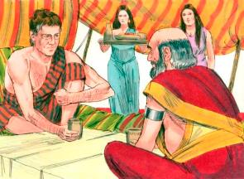
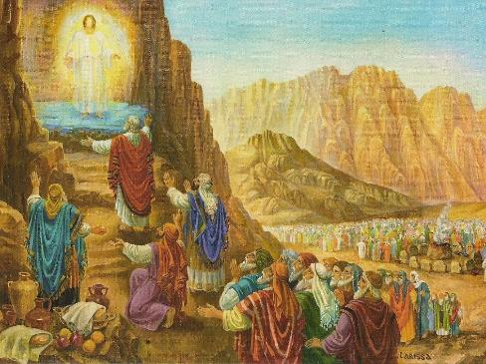
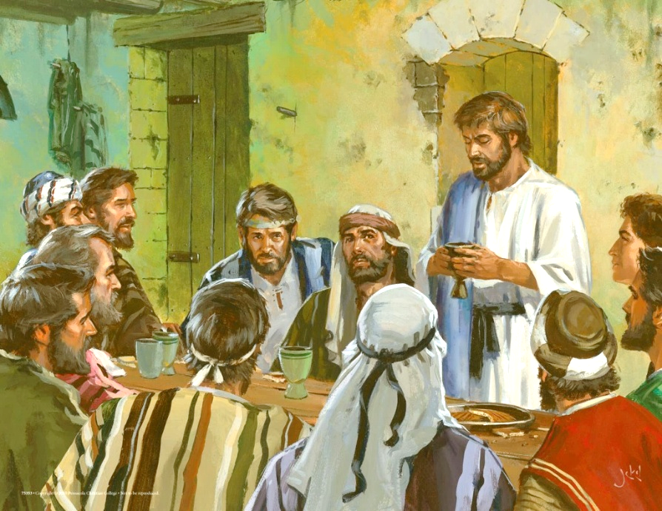
KO E MAʻU MEʻATOKONI ʻO E FUAKAVA
“Pea naʻe toki ʻalu hake ʻa Mosese mo ʻElone, mo Netapi mo ʻApiu, mo e toko fitungofulu ʻo e kaumatuʻa ʻo ʻIsileli; […] pea naʻa nau mamata ki he ʻOtua, pea naʻa nau kai mo inu" (ʻEkesotosi 24:9, 11b)
Hange ko ia ʻoku tau sio ki ai ʻi he sipinga ʻa Sekope mo Lepani, ʻi he Hahake ʻo e kuonga muʻa naʻe kau ai ʻa e maʻu meʻatokoni ʻa e ongo tafaʻaki fakatouʻosi (Senesi 31:44-54).
ʻI Sainai, naʻe foaki ʻe he ʻOtua ha "kai fuakava" ki he kakai ʻe toko 74: Mosese, ʻElone, Netapi, ʻApiu, mo e kaumatuʻa ʻe toko 70, ʻo fakafofongaʻi ʻa e kakai kotoa pe (ʻEkesotosi 24:9-11).
ʻI he taimi naʻe fokotuʻu ai ʻe Sisu ʻa e fuakava foʻou, naʻa Ne toe fai ia ʻaki ʻEne maʻu meʻatokoni mo e kau ʻaposetolo ʻe toko 12 (Matiu 26:26-28).
Ko e taimi kotoa pe ʻoku tau maʻu ai ʻa e ʻOhomohe ʻa e ʻEiki, ʻoku tau fakafoʻou ai ʻetau fuakava mo e ʻOtua. ʻI heʻetau maʻu ʻa e maa mo e uaine, ʻoku tau fakafiefiaʻi ai ʻa e fakamolemole mo e fakamoʻui ʻoku tau maʻu ʻia Sisu (1 Kolinito 11:26).
Neongo ʻenau fakafisingaʻi fakaʻosi ʻa e fakamoʻui, ka naʻe ʻikai ke taʻofi ʻa Netapi, pe ʻApiu, pe Siutasi mei he "maʻu meʻatokoni ʻo e fuakava" ko ʻeni.

Slide 8
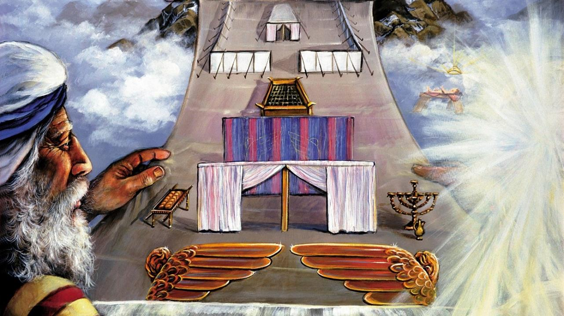
KO E SIPINGA

Slide 9

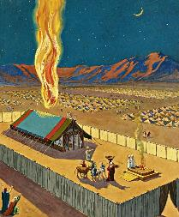
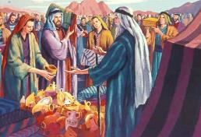
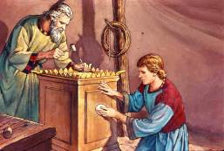
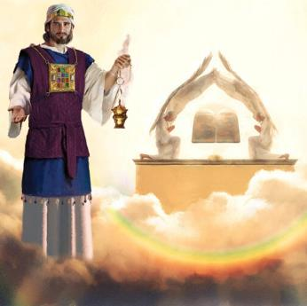
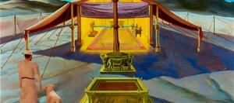
KO E TAUMUʻA ʻO E SIPINGA
“Pea tuku ke nau ngaohi kiate au ʻae Potu Toputapu; koeʻuhi ke u nofo ʻiate kinautolu.” (‘Ekesotosi 25:8)
Naʻe fakapapauʻi ʻe he ʻOtua ke ʻalu ʻo nofo ʻi he lotolotonga ʻo e kakai ko ha fakapapauʻi te ne fakahoko ʻene konga ʻo e fuakava.
Ka ʻe ʻuhinga ʻa e ʻi ai ʻa e ʻOtua ki he mate he taimi pe ko ia kiate kinautolu kotoa (ʻEkesotosi 33:20). Ko ia ai, naʻa ne fekau kiate kinautolu ke langa ha potu toputapu ʻa ia te ne lava ʻo fakaha ai ʻene ʻi ai. Naʻe fakahaaʻi ʻa e ʻi ai ko ʻeni ʻi ha ngaahi fakataipe, koeʻuhi he ʻoku ʻikai ʻafio fakatuʻasino ʻa e ʻOtua ʻi ha temipale ʻi he mamani (Ngaue 17:24 ).
Naʻe fakaʻaliʻali kia Mōsese ʻ a e faʻifaʻitakiʻangá pea ʻ oange ki ai ʻ a e ngaahi fakahinohino pau ki hono faʻu. Naʻe kole ki he kakai ke nau tokoni ʻi he ngaahi naunau naʻe fie maʻu
(ʻEkesotosi 25:2-7).
Ko e potu toputapu mo e temipale naʻe langa ʻe Solomone ko ha sipinga ia ʻo e potu toputapu naʻe langa ʻi he Langi (Hepelu 8:1-2; 1Tuʻi 8:27, 30).
ʻI he taimi naʻe hu ai ha ʻIsileli ki he potu toputapu, naʻa ne hu ki he ʻao ʻo e ʻOtua... kae ʻoua kuo mavaeua ʻa e veili ʻi he taimi naʻe pekia ai ʻa Sisuu.

Slide 10

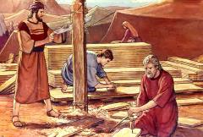
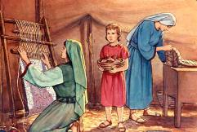
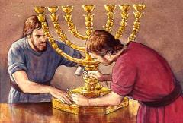
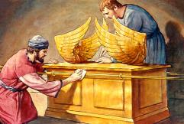
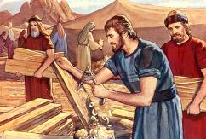
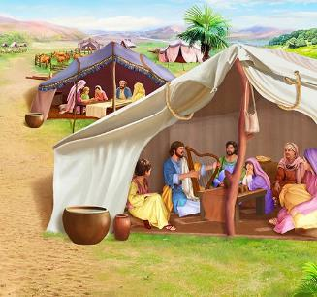
KO HONO TEUTEUʻI ʻO E SIPINGA
““Vakai, kuo u ui ʻa Pesalili ko e foha ʻo Uli, ko e foha ʻo Hua, ʻi he faʻahinga ʻo Siuta: Pea kuo u fakafonu ia ʻi he laumālie ʻoe ʻOtua, ʻi he poto, pea ʻi he loto-matala, mo e faʻa ʻilo, pea ʻi he ngaahi ngāue fakatufunga kotoa pē,” (‘Ekesotosi 31:2-3)
Neongo naʻe ʻoange ʻe he ʻOtua kia Mosese ha ngaahi fakahinohino fakaikiiki fekauʻaki mo e langa, ka naʻe ʻikai ke Ne fakaha kiate ia ʻa e fakaikiiki kotoa pe. ʻOku totonu ke fotunga fefe ʻa e ipu palasa, selupimi, mite ʻa e kau taulaʻeiki, mo e ala meʻa pehee? Naʻe ʻoange ʻe he meʻa ni ki he Laumalie Maʻoniʻoni ʻa e faingamalie ke ngaue mo e ngaahi meʻafoaki ʻa e kau tufunga.
Ki he ngaahi fakaikiiki ko ʻeni, naʻe fakakoloaʻi ʻe he Laumalie Maʻoniʻoni ʻa e ngaahi meʻafoaki makehe:
Pesaleli, ʻa ia naʻa ne tataki ʻa e ngaue kotoa (ʻEkesotosi 31:2)
ʻAholiape, ʻa ia ko hono tokoni lahi (ʻEkesotosi 31:6a)
Ko e kakai kehe naʻa nau tokoni ʻi he ngaue (ʻEkesotosi 31:6e)
ʻI he lotolotonga ʻo e ngaahi fakahinohino ki hono langa ʻo e potu tapu, ʻoku ʻi ai ha fakamatala makehe ki he Sapate (ʻEkesotosi 31:12-17). Ko e ha e kaunga ʻa e Sapate ki he ngaahi meʻa ni kotoa?
Ko e maʻoniʻoni ʻa e kii. Kuo pau ke tau maʻoniʻoni ʻo hange ko Ia kae lava ke tau ofi ki he ʻOtua Maʻoniʻoni. Ko e Sapate ko e fakaʻilonga ia ʻo e maʻoniʻoni ko ia (ʻEkesotosi 31:13; ʻIsikeli 20:12, 20).
Notes:
Exodus 31:2
See, I have called by name Bezalel the son of Uri, the son of Hur, of the tribe of Judah;
Exodus 31:6a
And behold, I have set with him Aholiab the son of Ahisamach , of the tribe of Dan;
Exodus 31:6b
and I have put wisdom in the minds of every wise-hearted person, so that they may do all that I have commanded you;
Exodus 31:12-17 And the LORD spake unto Moses, saying, (13) Thou shalt speak unto the children of Israel, saying, Ye shall surely keep my sabbaths: for it is a sign between me and you throughout your generations, that ye may know that I am the LORD that sanctifies you. (14) Therefore ye shall keep the sabbath day, for it is holy unto you: whoso profaneth it shall surely be put to death: for whosoever doeth any work in it, that soul shall be cut off from among his people. (15) Six days shall work be done: but the seventh day is a sabbath of rest holy to the LORD: whosoever doeth any work on the sabbath day shall surely be put to death. (16) Therefore shall the children of Israel keep the sabbath, to observe the sabbath throughout their generations for a perpetual covenant. (17) It is a sign between me and the children of Israel for ever: for in six days the LORD made heaven and earth, and on the seventh day he rested, and was refreshed.

Slide 11

"ʻI hono langa ʻo e potu toputapu ko ha nofoʻanga ʻo e ʻOtua, naʻe fakahinohinoʻi ai ʻa Mosese ke ne ngaohi ʻa e ngaahi meʻa kotoa pe ʻo fakatatau ki he sipinga ʻo e ngaahi meʻa ʻi he langi. Naʻe ui ia ʻe he ʻOtua ki he moʻunga, ʻo fakaha kiate ia ʻa e ngaahi meʻa fakalangi, pea naʻe ngaohi ʻa e fale fehikitaki mo e meʻa kotoa pe naʻe kau ki ai ʻi honau tatau.
Ko ia naʻa Ne fakaha ai ki ʻIsileli, ʻa ia naʻa Ne finangalo ke hoko ko Hono nofoʻanga, ʻa Hono ʻulungaanga naunauʻia. […] Ka naʻe ʻikai ke nau lava ʻo aʻusia ʻa e tuʻunga lelei ko ʻeni. Naʻe ongo kiate kinautolu ʻa e fakaha ʻi Sainai ʻi heʻenau fie maʻu mo e ʻikai ke nau lava ʻo fai ha meʻa."
EGW (Ako p. 35-36)

