Slide 1
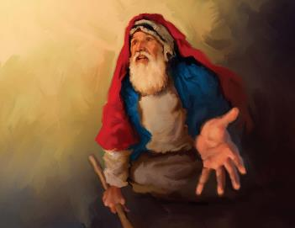
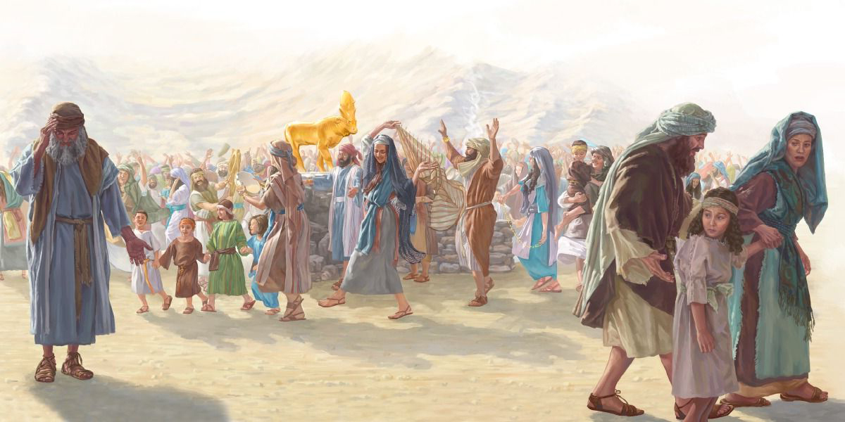
FAKAHOLOMUI mo e FAKALALOA
Lesoni 11 ki he ʻaho 13 ʻo Sepitema, 2025

Slide 2
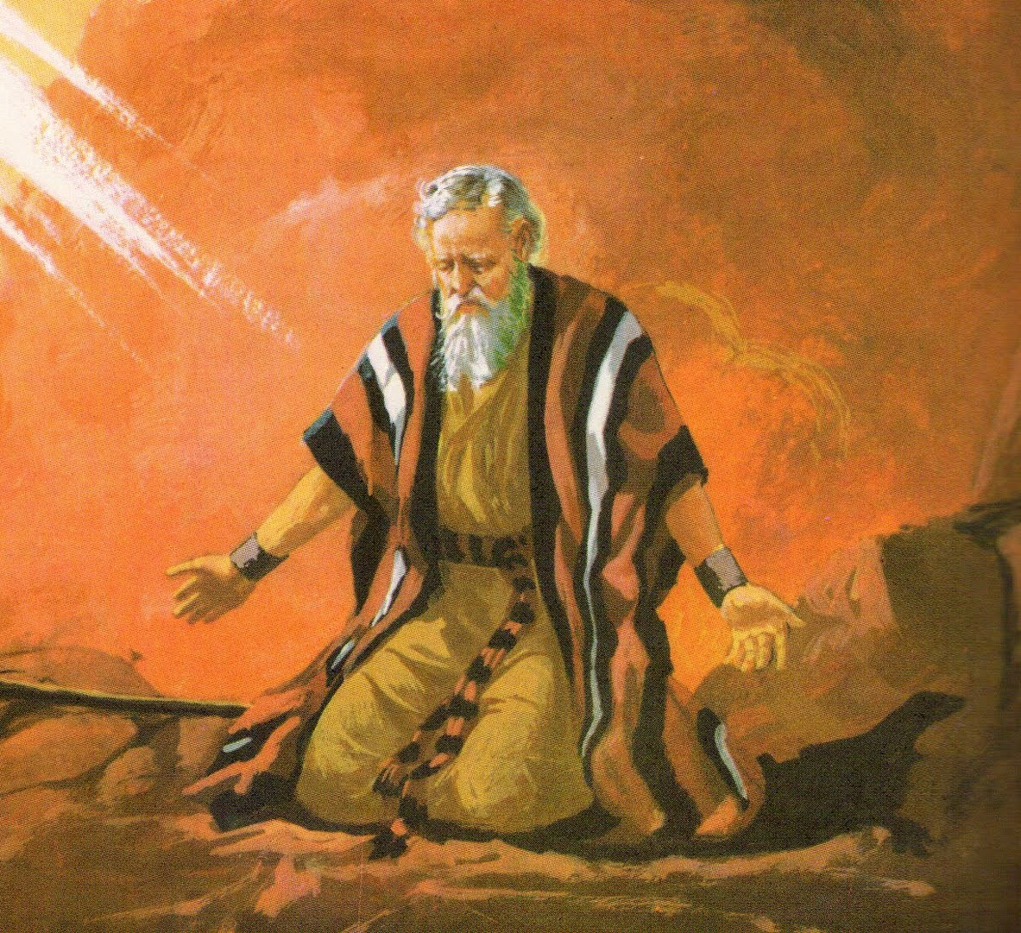
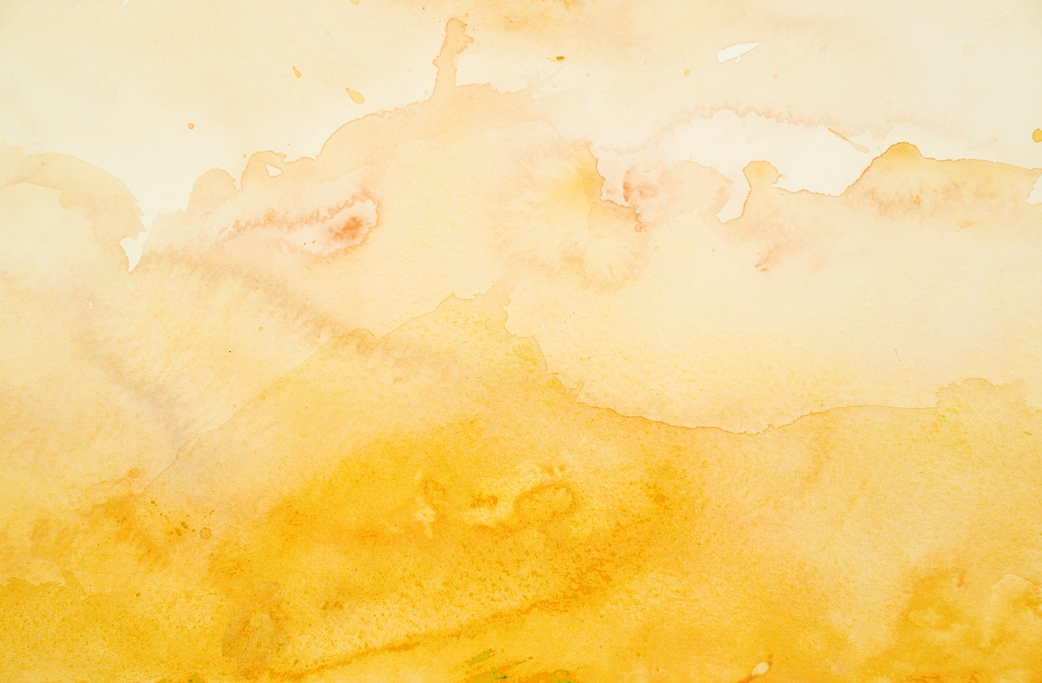
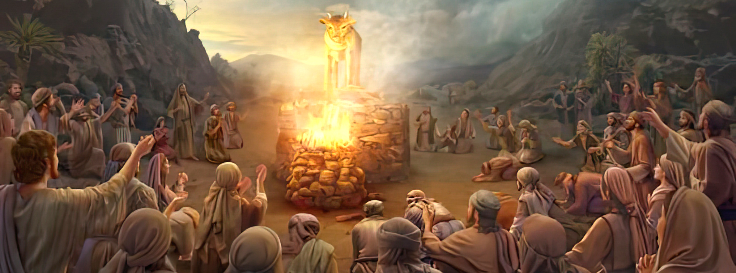
“Pea naʻe toe ʻalu ʻa Mōsese kia Sihova, ʻo ne pehē, “ʻOiauē, kuo fai ʻae angahala lahi ʻe he kakai ni, pea kuo ngaohi honau ngaahi ʻotua koula.Ka ko eni, kapau ʻe lelei te ke fakamolemole ʻenau angahala; pea kapau ʻe ʻikai, ʻoku ou kole kiate koe, tāmateʻi au mei hoʻo tohi ʻaia kuo ke tohi.”
‘Ekisotosi 32:31, 32

Slide 3

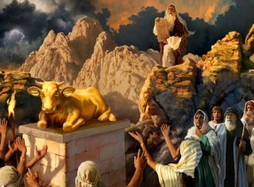
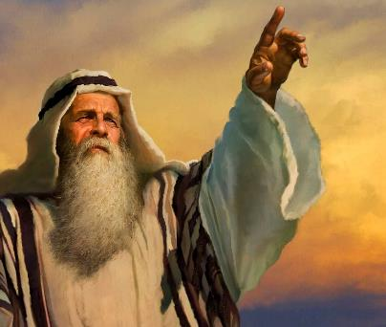


“Kuo nau vave ke tafoki mei he me’a na’a ku fekau’i kinautolu” (Eki. 32:8 ).
Hili ha taimi nounou mei hono maʻu ʻo e Fekau ʻe Hongofulú, pea toe fakahā kiate kinautolu ke ʻoua naʻa nau ngaohi ʻaitoli (Ek. 20:23), naʻe ngaohi ʻe ʻIsileli ha ʻuhikiʻi pulu koula ke nau lotu ki ai.
‘I he fehangahangai mo e hē ko eni, na’e kole ‘e he ‘Otua kia Mosese ha ngofua ke ne faka’auha ‘a ‘Isileli ‘o ngaohi ia ko e pule’anga fo’ou (Ek. 32:10). Neongo ‘a e hē mei he mo‘oní ‘a e kakaí, na‘e tu‘o ua ‘a e hufekina ‘e Mōsese ‘i he ‘ao ‘o e ‘Otuá ke kole ‘a e fakamolemole na‘e ‘ikai taau mo kinautolú.
Hē mei he moʻoní:
  Ko e vaivai ‘o ‘Ēloné (‘Ekisotosi 32:1-5)
  Ko e Kātoanga ʻo e ʻUluʻi Pulú (ʻEkisotosi 32:6)
  Ko e fakamele‘i ‘o e tauhi ‘aitoli (‘Ekisotosi 32:7-8)
Fakafetaʻi:
  “Tafoki mei ho‘o houhau kakahá!” (Ekisotosi 32:9-29)
  “Tamateʻi au mei he tohi kuó ke tohí!” (Ekisotosi 32:30-32)

Slide 4

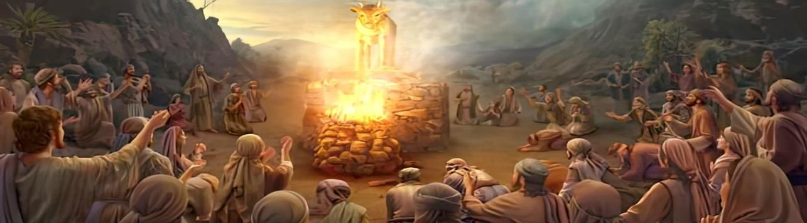
HE MEI HE MO‘ONI

Slide 5

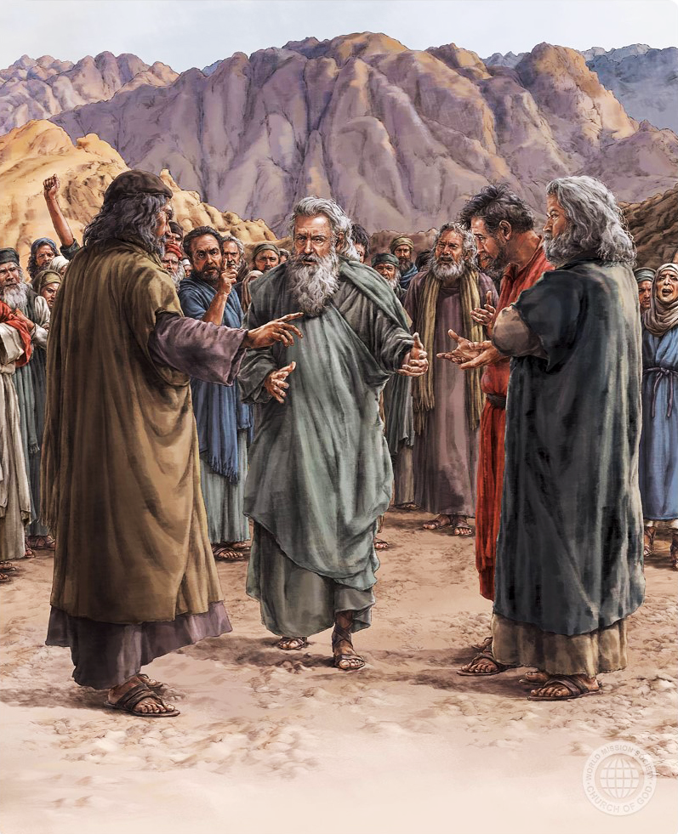
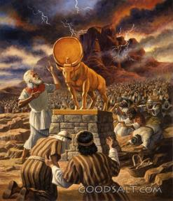
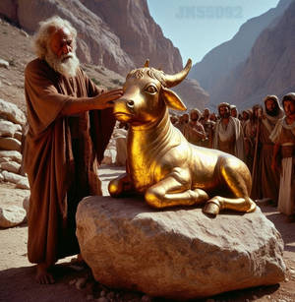
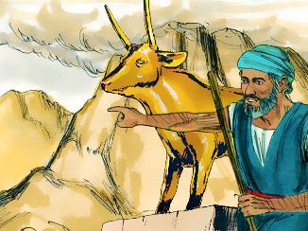
KO E VAIVAI’ANGA 'O 'ELONE
“Pea kuo mamata ki ai ʻa ʻElone, pea fokotuʻu ʻe ia ʻae feilaulauʻanga ʻi hono ʻao: pea naʻe fakahā ʻe ʻElone, ʻo pehē, “ʻE fai ʻae kātoanga kia Sihova ʻapongipongi.”” (Ekesotosi 32:5)
Neongo ko e lea faka-Hepelū elohim ko e tokolahi ia ‘o e “‘otua,” ka ‘oku fa’a ngāue’aki ia ke ‘uhinga ki he ‘Otua pē taha: “Ko Sihova au ko homou ‘Otua [elohim], ‘a ia na’a ku ‘omi kimoutolu mei he fonua ko ‘Isipite” (Ek. 20:2).
‘I he ‘ikai ke ‘i ai ‘a Mosese, na’e kole ‘a e kakai kia ‘Elone ke ne ngaohi ha ‘elohimi ‘oku hā mai ‘a ia te nau lava ‘o lotu ki ai. ( ʻEke. 32:1 ). Na’e ‘ikai fuoloa kuo ngalo ‘iate kinautolu ‘a e ngaahi fekau na’a nau ma’u pea mo ‘enau tukupā ke talangofua ki ai (Ek. 24:7).
Ko e ‘uluaki veiveiua ‘a ‘Elone ‘i he’ene feinga ke alea mo e kakai (Ek. 32:2) na’a ne taki ai ‘a e hē mei he mo’oni kae ‘ikai ke ne ta’ofi ia.
‘I he ‘ikai ke ne fakamanatu kiate kinautolu ‘a e tapui ‘o e ngaohi ‘aitoli, na’e ngaohi ‘e ‘Elone ha ki’i pulu koula kiate kinautolu, pea ne fakahā, “Ko homou ‘otua [elohim] ‘eni ‘e ‘Isileli, ‘a ia na’a ne ‘omi kimoutolu mei he fonua ko ‘Isipite!” (Eki. 32:4 ).

Slide 6
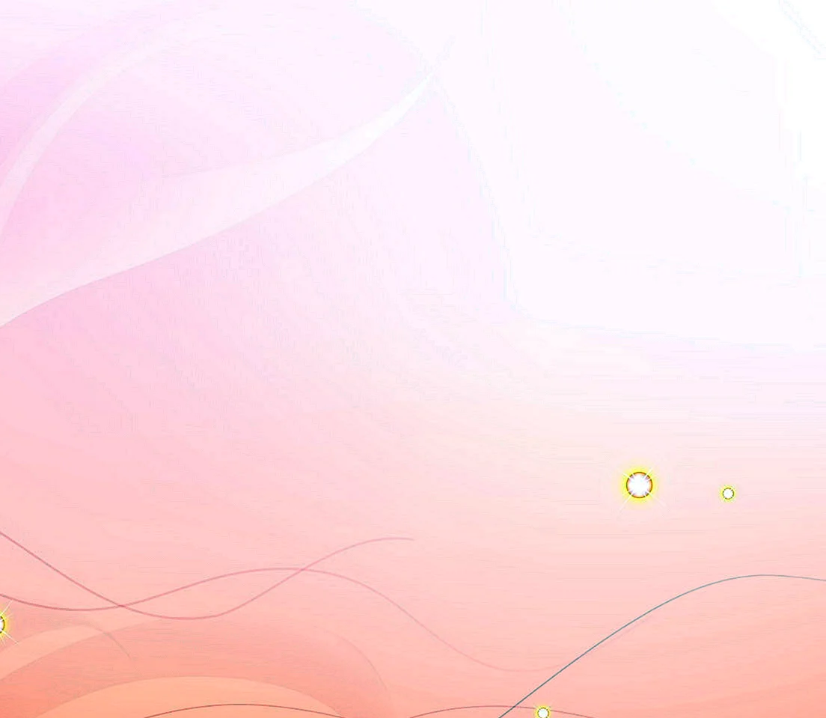
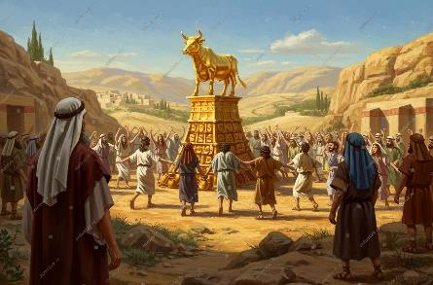
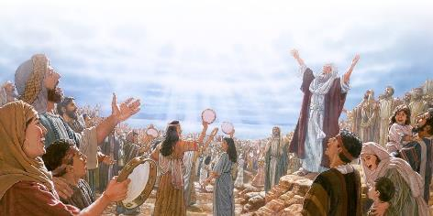

KO E KATOANGA 'O E PULU
“Ko ia naʻe tuʻu hengihengi hake ʻa e kakaí ʻi he ʻaho hono hokó, ʻo nau feilaulau tutu, mo ʻatu ʻa e ngaahi feilaulau feʻofaʻakí: hili iá naʻa nau nofo hifo ke kai mo inu, pea nau tuʻu hake ʻo fakafiefia” ( ʻEkesōtosi 32:6 ).
‘I hono ngaohi ‘e ha’a ‘Isileli ha ‘aitoli ‘i he fōtunga ‘o e ki’i pulu, na’a nau fakasi’isi’i ai ‘a e ‘Otua Māfimafi ki he ‘imisi ‘o ha monumanu, ‘o nau lotu ki he me’amo’ui kae ‘ikai ki he Fakatupu (Lom. 1:23).
Naʻa nau fakakaukau taʻeʻuhinga ʻe lava ʻe ha ʻimisi tongitongi ʻo tataki kinautolu. Naʻe aʻu nai ʻ o nau fakakaukau naʻe hoko ʻ a e ʻ elohim tonu ko ha kiʻi pulu! (ʻEkesotosi 32:24)
Ko hono moʻoni, naʻa nau tafoki mei he hu ki he ʻOtua ki he lotu ki he kau tevolo (Teu. 32:17). Lolotonga ʻ enau lotu ki he ʻ Otuá, naʻa nau tupulaki fakaeʻulungāanga, he naʻa nau hoko ʻ o hangē ko e ʻ Otuá.
ʻ I he lotu ki he kau tēmenioó, naʻe kamata ai ke nau tukuhifo kinautolu, he naʻa nau hangē ko e kau tēmenioó naʻa nau lotu ki aí.
ʻI he taimi ʻoku ʻikai ke tau foaki ai hotau loto ki he Tupuʻanga, ka tau tauhi ki ha tamapua kehe (pea ʻoku tokolahi), ʻe vave pe haʻatau taki kitautolu ki he maʻulalo fakaeangamaʻa.

Slide 7

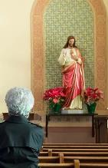



KO E KOVI ʻO E TAUHI TAMAPUA
"Pea naʻe folofola ʻa Sihova kia Mosese, "ʻAlu hifo, koeʻuhi ko ho kakai, ʻa ia naʻa ke ʻomi mei ʻIsipite, kuo kovi ia." (ʻEkesotosi 32:7)
Ke punou hifo ʻi he ʻao ʻo ha ʻimisi (neongo ʻoku ne fakafofongaʻi ʻa e ʻOtua tonu, Kalaisi, pe ko ʻEne kau maʻoniʻoni) ko e talangataʻa ia ki he Fono ʻa e ʻOtua (ʻEkesotosi 20:3-6) pea ko ia ai, ke hu ki he angahala mo e ʻauha.
Ko e ha ʻa e tauhi tamapua ʻo e senituli 21? Ko e tauhi tamapua ko e lotu ia ki ha meʻa ʻoku ne fetongi ʻa e ʻOtua. Ko e tamapua ko ha faʻahinga meʻa pe ia ʻoku ne maʻu ʻetau fakakaukau, ʻofa, taimi, mo e ʻatamai ʻo lahi ange ʻi he ʻOtua, pea ʻoku ne fakapopulaʻi ʻetau fakakaukau.
Ko e ha ʻa e ngaahi tamapua ʻoku tau hu ki ai? Te ke lava ʻo faʻu haʻo lisi pe ʻaʻau. Ko ha ngaahi fokotuʻu: hikisia, paʻanga, malohi, fehokotaki fe’auaki, meʻakai, ngaue, mitia fakasosiale...
Ko e ha ʻoku kau ki ai ʻa e lotu ki he ngaahi tamapua ko ʻeni? Ko hotau angaʻitangatá, founga fakakaukaú, ngaahi ongoʻí, pea naʻa mo ʻ etau moʻui fakasōsialé ʻ oku liliu ia. ʻOku tau fakafetongi ʻetau fetuʻutaki moʻoni mo e ʻOtua ki ha ngaahi fengaueʻaki taʻeʻaonga mo taʻeʻuhinga he ʻikai ke ne lava ʻo fakahaofi kitautolu.

Slide 8

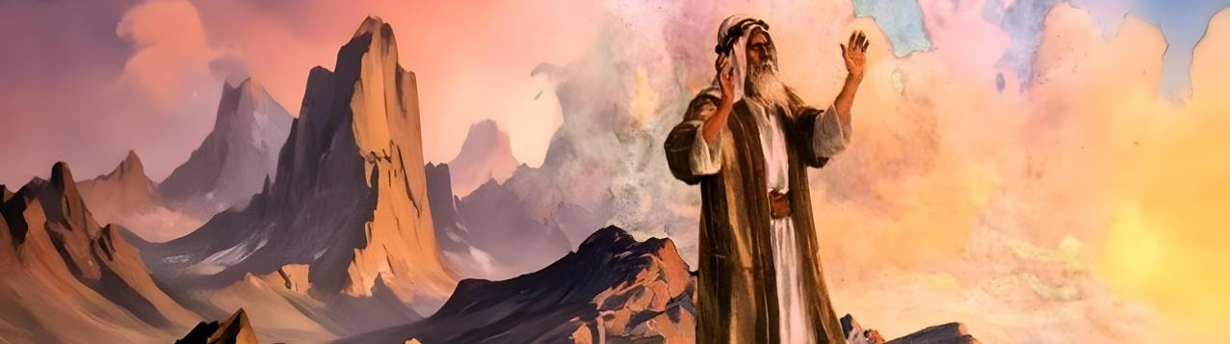
TAUKAPO

Slide 9

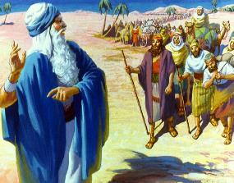
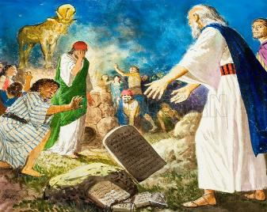
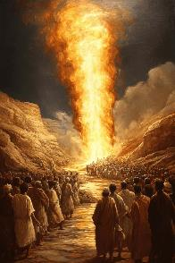
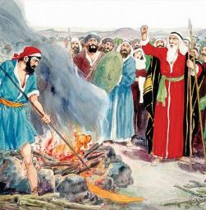
"TAFOKI MEI HOʻO ʻITA KAKAHA!"
"Ko e hā ka lea ai ʻae kakai ʻIsipite, ʻo pehē, naʻa ne ʻomi kovi ʻakinautolu kituaʻā, ke tāmateʻi ʻakinautolu ʻi he ngaahi moʻunga, pea ke fakaʻauha ʻakinautolu mei he funga ʻo māmani? Tafoki mei ho houhau lahi, pea lolou ʻi he kovi ni ki ho kakai." (ʻEkesotosi 32:12)
Naʻe tala ʻe he ʻOtua kia Mosese "Koeʻuhi ko ho kakai, ʻa ia naʻa ke ʻomi mei ʻIsipite, kuo nau kovi ʻaupito." (ʻEkesotosi 32:7).
Naʻe tali lelei ʻe Mosese: "ʻOku ʻikai ko hoku kakai ʻa kinautolu, ka ko ho kakai; naʻe ʻikai ko au naʻa ku ʻomi kinautolu ki tuʻa, ka ko koe" (ʻEkesotosi 32:11). Naʻe kole ange ʻe he ʻOtua ke ne fakaʻauha ʻa ʻIsileli (ʻEkesotosi 32:10), ka naʻe fakafisi ʻa Mosese ke fakangofua ia.
Na’e totonu ‘a e houhau ‘o e ‘Otua, ka na’e ‘ilo ‘e Mosese “ ‘oku ikuna ‘a e ‘alo’ofa ‘i he fakamaau” (Semisi 2:13). Hili ‘ene hufekina ma’a ‘Isileli, pea ‘i he’ene falala kuo fakanonga ‘e he ‘Otua ‘a ‘ene houhau, na’a ne (‘ita) hifo mei he mo’unga (Ek. 32:12-15). ‘I he’ene sio ki he hē mei he mo’oní, na’á ne maumau’i ai ‘a e faka’ilonga ‘o e fuakavá: ko e ngaahi lau’i maka (Ek. 32:19).
Hili ‘ene fanongo ki he ngaahi faka’uhinga vaivai ‘a hono tokoua, na’e ngaue fakapapau ‘a Mosese ke ta’ofi ‘a e fe’au’auhi (Ek. 32:20-28).

Slide 10

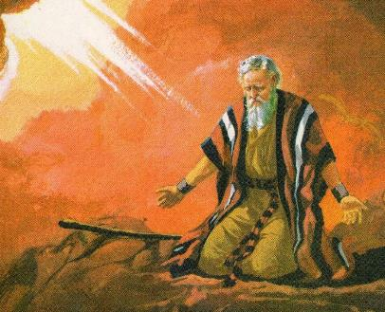
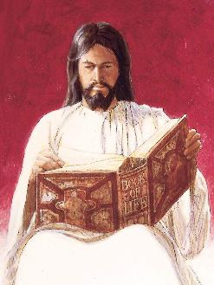

“TAMATE’I AU MEI HE TOHI KUO KE TOHI!”
Ka ko eni, kapau ʻe lelei te ke fakamolemole ʻenau angahala; pea kapau ʻe ʻikai, ʻoku ou kole kiate koe, tāmateʻi au mei hoʻo tohi ʻaia kuo ke tohi.”Ekisotosi 32:32
ʻI heʻene ʻuluaki fakalaloá, naʻe taʻofi ai ʻe Mōsese ʻa hono fakaʻauha ʻo e kakaí. Ka na’e mahino ‘e ‘ikai ke toe lava ‘e he ‘Otua ‘o tapuaki’i kinautolu hili ‘a e angahala ko ‘eni. Ko ia ai, na’a ne tu’utu’uni ke ne fai ha hufekina hono ua (Ekisotosi. 32:30).
Na’e loto pe ‘a Mosese ke mole ‘ene fakamo’ui ‘a’ana ‘o kapau ‘e ‘ikai ke fakamolemole’i ‘a e kakai (Ek. 32:31-32). Kaekehe, na'e 'ikai ko ha fakamolemole angamaheni 'eni na'e kole 'e Mosese, he na'e 'ikai ke ne ngaue'aki 'a e fo'i lea faka-Hepelū angamaheni ki he "fakamolemole." Na'a ne kole ke "fua" 'e he 'Otua 'a e angahala 'a e kakai.
Na’e fakahu’unga ‘eni, ‘e to’o ‘e he ‘Otua ‘a e angahala kiate ia, pea te ne fua ia, ‘o totongi hono totongi: ko e mate (Isaia. 53:6; Lom. 6:23). Ko e me’a tofu pe ‘eni na’e fai ‘e Sisu ‘i he kolosi. Na’a ne to’o kiate ia ‘etau ngaahi angahala koe’uhi ke ne mate ‘i he mate na’e taau mo kitautolu (1 Pita 2:24).

Slide 11

EGW (Kau Pēteliake mo e Kau Palōfita, p. 315)
“Lolotonga e vahaʻataimi ko ʻeni ʻo e tatalí, naʻe ʻi ai ha taimi ke nau fakalaulauloto ai ki he fono ʻa e ʻOtuá ʻa ia ne nau fanongo ki aí, pea ke teuteuʻi honau lotó ke maʻu ʻa e ngaahi fakahā lahi ange te Ne fai kiate kinautolú. ‘eni, pea na‘e ‘ikai fuoloa kuo nau hoko ‘o ta‘etokanga, ta‘etokanga, mo maumau-lao [...]
‘I he‘enau ongo‘i ‘enau ta‘elavame‘á ‘i he ‘ikai ke ‘i ai honau takí, na‘a nau foki ai ki he‘enau ngaahi tui ta‘e‘uhinga motu‘á. [...] Na‘e faka‘amu ‘a e kakaí ki ha ‘īmisi ke fakafofonga‘i ‘a e ‘Otuá, pea ke ‘alu mu‘omu‘a ‘iate kinautolu ‘i he tu‘unga ‘o Mōsesé.”

