Slide 1
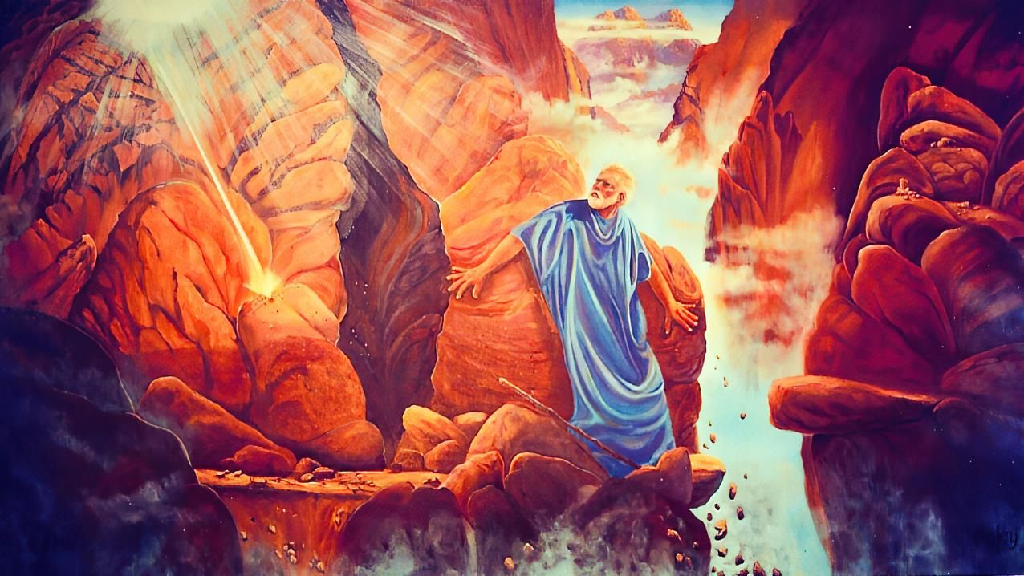
“KĀTAKI, FAKAHAA‘I KIATE AU HO‘O NĀUNAU”
Lesoni 12 ki he ʻaho 20 ʻo Sepitema, 2025

Slide 2
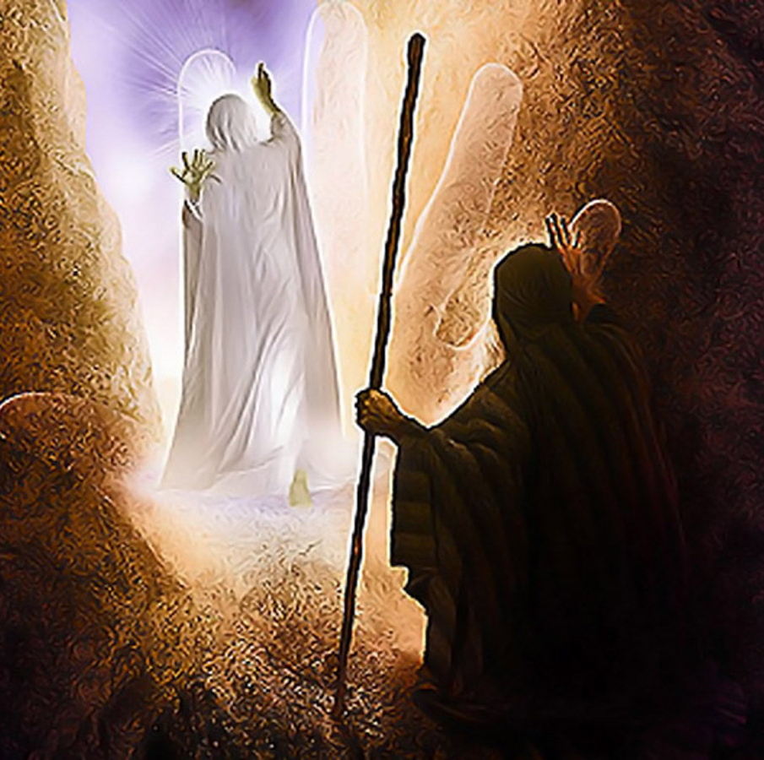
“Pea naʻe hāʻele ange ʻa Sihova ʻi hono ʻao, ʻo ne folofola, “Ko Sihova, Ko Sihova ko e ʻOtua, ʻoku ʻaloʻofa, mo ʻofa mataʻatā, ʻoku kātaki fuoloa, pea mohu ʻi he angalelei mo e moʻoni.ʻOku ne fakahā ʻae ʻaloʻofa ki he ngaahi toko afe, ʻi he fakamolemole ʻae hia, mo e talangataʻa, mo e angahala, pea ʻe ʻikai ʻaupito fakatonuhiaʻi ʻae halaia; ʻoku ʻaʻahi ʻaki ki he fānau ʻae hia ʻae mātuʻa, pea ki he hako ʻo ʻenau fānau, ʻo aʻu ki hono tolu mo hono fā ʻoe toʻutangata.”
‘Ekisōtosi 34:6, 7,

Slide 3

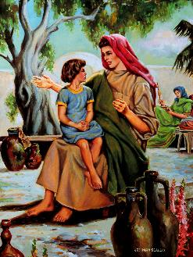
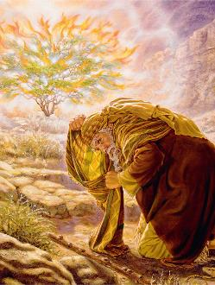

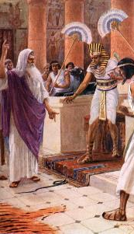
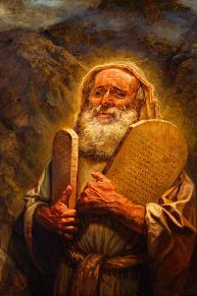

'Oku 'ikai ha veiveiua ki ai. Na‘e hoko ‘a e ‘Otuá mo Mōsese ko e ongo kaume‘a ofi.
Naʻe ʻikai ke hoko ʻeni ʻi ha pō pē ʻe taha. Ko ha founga māmālie ia. Naʻe kamata ia ʻi hono ngaahi taʻu siʻí, ʻi he taimi naʻe lea ai ʻene faʻeé kiate ia fekauʻaki mo e ʻOtua fakaofo ʻokú na tauhí.
Na’e toe mālohi ange ‘ena feohi fakakaungāme’á lolotonga ‘a e ngaahi fetaulaki kehekehe na’á na fai ‘i he mo’unga ko Sainaí, pea na’e hokohoko atu ‘ene tupulakí ‘o a’u ki he ‘aho na’e ui ai ‘e he ‘Otuá ‘a Mōsese ke ne mālōloó.
ʻOku lekooti ʻi he vahe 33 mo e 34 ʻo ʻEkisotó ha momeniti makehe ʻi he fetuʻutaki mālohi ko ʻení: ko e kole ʻa Mōsese ke mamata ki he nāunau ʻo e ʻOtuá.
Ko e 'Otua mo Mosese:
Fe'iloaki mo e 'Otua ('Ekisoto 33:7-11)
Ko Hono ‘Ilo‘i Lelei Ange ‘a e ‘Otuá ( ‘Ekisoto 33:​12-​17 )
Ko e langilangi 'o e 'Otua:
Ko e holi ke ‘ilo ‘a e langilangi ‘o e ‘Otua (‘Ekisoto 33:18-23)
Ko e visone ‘o e langilangi ‘o e ‘Otua (‘Ekisoto 34:1-28)
Ko e ola 'o e mamata ki he langilangi 'o e 'Otua(Ekisoto 34:29-35)

Slide 4

‘OTUA
MO
MOSESE

Slide 5

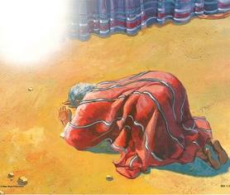
FETAUTAKI MO E 'OTUA .
Na‘e faifai pē ‘o fakalalahi ‘a e vaha‘angatae ‘i he vaha‘a ‘o e ‘Otuá mo Mōsesé .
Naʻe ui ia ʻe he ʻOtuá mei he vao velá .
Naʻe mamata ʻa Mōsese ki hono ikunaʻi ʻe he ʻOtuá ʻa e ngaahi ʻotua ʻo ʻIsipité .
Na‘á ne sio tonu ‘i hono vaeua ‘a e Tahi Kulokulá ke fakatau‘atāina‘i ‘a ‘Isileli .
Naʻá ne mamata ki hono tataki ʻe he ʻOtuá ʻa ʻIsileli ki Sainai .
Naʻá na fakamoleki fakataha ha ʻaho kakato ʻe 40 ʻi he moʻungá .
Naʻe hokohoko atu ʻena fetuʻutakí ʻo tupulaki ʻi he ʻaho kotoa pē ʻo lahi ange .
Na‘e fakamānava‘i ‘e he ‘Otuá ‘a Mōsese ke ne tohi ‘a Siope mo Sēnesi .
“Pea ʻi he hū ʻa Mōsese ki he fale fehikitaki, naʻe ʻalu hifo ʻae pou ʻao, pea tuʻu ia ʻi he matapā ʻoe fale fehikitaki, pea aleaʻa Sihova mo Mōsese.” (‘Ekisotosi 33:9)
Na’e fetaulaki ‘a Mosese mo e ‘Otua ‘i he Tapanekale, ‘a ia na’a ne talanoa ai mo Ia mata ki he mata (Eki. 33:7-11).
Ko e fakamahino: ko e lea “mata ki he mata” na’e ‘ikai ke ‘uhinga ia na’a na fesiofaki fakasino, ka na’e ‘uhinga ia na’a na fai ha talanoa ‘oku vai (neongo na’e ‘ikai ‘aupito ke sio ‘a Mosese ki he fofonga ‘o e ‘Otua).
Naʻe hoko ʻa Mōsese ko ha tamaioʻeiki faivelenga ʻa e ʻOtuá ( Hep. 3:5 ), ko ha maama taʻe-faʻa-mate ʻi he fakapoʻulí, pea ko ha palōfita faʻifaʻitakiʻanga.

Slide 6

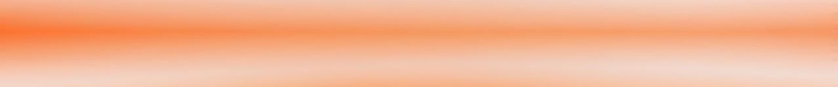
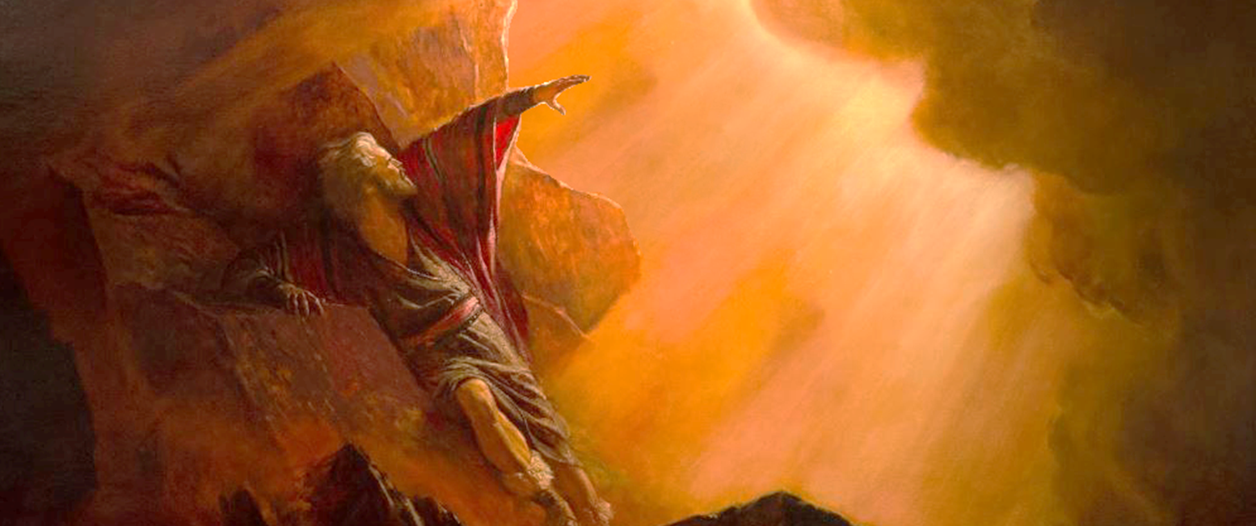
HOKO KE ‘ILO‘I LELEI ANGE ‘A E ‘OTUA .
“Pea ko ʻeni, ʻoku ou kole kiate koe, kapau kuo u maʻu ʻae ʻofa ʻi ho ʻao, ke ke fakahā ni kiate au ho hala, koeʻuhi ke u ʻilo koe, pea te u ʻilo ai ʻae ʻofa ʻi ho ʻao: pea ke ʻafioʻi ko e puleʻanga ni ko ho kakai.” (Ekisotosi 33:13)
‘I he taimi na’e talaange ai ‘e he ‘Otua kia Mosese ‘e ‘ikai te ne ‘alu mo e kakai ki Kenani (Eki. 33:1-3), na’e hoko ai ha talanoa malie (Eki. 33:12-17):
‘Otua
Mosese
‘Otua
Mosese
Mosese
‘Otua
Ko hoku kaume'a koe pea 'oku ke ma'u 'eku manako .
Kapau ʻoku pehē moʻoni, akoʻi mai ho halá, koeʻuhí ke u ʻiloʻi koe .
‘E ‘alu mo kimoutolu ‘a hoku ‘Afio‘anga, pea te u ‘oatu ‘a e mālōlō kiate kimoutolu .
Kapau 'oku 'ikai ke 'alu ho'o 'Afio mo kimautolu, 'oua na'a ke fekau'i hake kimautolu mei heni .
Kapau ʻe ʻikai te ke haʻu mo kimautolu, ʻe ʻilo fēfē ʻe ha taha ʻokú ke hōifua ʻiate au?
teu fai 'a e me'a 'oku ke kole mai,'oku ke ma'u 'eku manako pea 'oku ou lau koe ko hoku kaume'a
Naʻe ʻosi ʻaho ʻe 40 ʻa Mōsese mo e ʻOtuá, ʻo ne maʻu ʻa e Fekau ʻe Hongofulú mo e ngaahi fakahinohino ki hono langa ʻo e potu toputapú. Pea ko eni naʻa ne toe ʻi he ʻao ʻoe ʻOtua, ʻo hufekina ʻae kakai. Naʻe hangē naʻá ne ʻiloʻi lelei ʻaupito ʻa e ʻOtuá, he naʻá ne lea maheni ʻaupito mo Ia. Ko e hā leva ‘a e ‘uhinga na’e fiema’u ai ke ne ‘ilo’i Ia (Ek. 33:13)? Ko e hā ha ʻuhinga ʻoku fie maʻu foki ai ke ke ʻiloʻi Ia?

Slide 7

KO E KOLOLIA .
'O E 'OTUA .

Slide 8


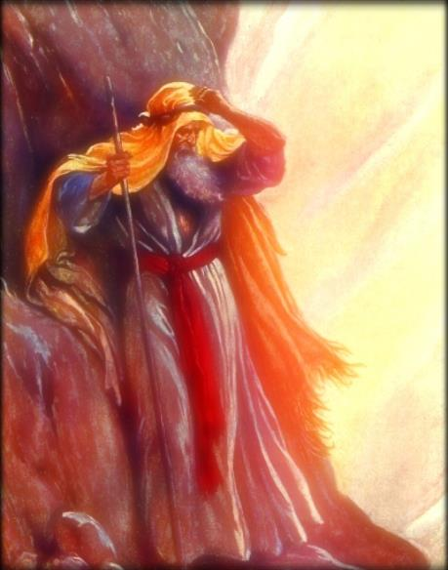
KO E HOLI KE 'ILO 'A E LANGILANGI 'O E 'OTUA .
“Pea pehē ʻe Mōsese, ‘Ko ʻeni ke ke fakahā mai ho nāunaú.’ ” ( ʻEkesōtosi 33:18 )
Naʻe kole ʻe Mōsese: Fakahaaʻi mai ho nāunaú (ʻEki. 33:18)
Naʻe tali ʻe he ʻOtuá: Te u fakahā kiate koe ʻeku leleí (Eki. 33:19)
Ko e langilangi ‘o e ‘Otua ko ‘ene lelei, ‘a ia ko hono ‘ulungaanga .
Ko e me’a na’e fakahaa’i kiate ia ‘e he ‘Otua ko hono ‘ulungaanga (Eki. 34:6-7)
ʻOku tānaki mai ʻe Ellen G. White ʻo pehē ko e nāunau ʻo e ʻOtuá ʻoku ʻi hono fakaivia ʻene fānaú; ʻuma ki he kau angahala fakatomalá; pea mo hono tokonaki ʻo e meʻa kotoa pē ʻoku fie maʻu ki honau liliú.
Ko ia, ko hotau “kololia” ke ho’ata ‘a e ‘ulungaanga ‘o e ‘Otua ‘i he’etau mo’ui (2 Kol. 1:12; 3:18).
‘I he’etau sio ki he Kolosi, ‘oku tau ma’u ai ‘a e fakahā lahi taha ‘o e langilangi ‘o e ‘Otua, mo ‘ene lelei, mo hono ‘ulungaanga.

Slide 9

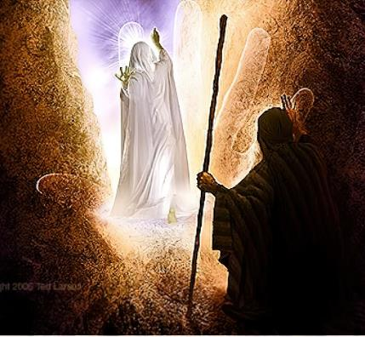
KO E VISONE KI HE LANGILANGI 'O E 'OTUA .
“Pea na’a ne ‘alu atu ‘i he ‘ao ‘o Mosese, ‘o ne talaki, ‘KO SIHOVA,KO SIHOVA, ko e ‘Otua manava’ofa mo angalelei, ‘oku tuai ki he houhau, ‘oku fonu ‘i he ‘ofa mo e faitotonu’ ” (Ekisotosi 34:6)
Na’e fakahaa’i ‘e he ‘Otua ‘a hono langilangi kia Mosese ‘i he taimi hono fitu ‘o ‘ene ‘alu hake ki Mo’unga Sainai. Ko e hā ‘a e ngaahi taimi pea ko e hā ‘a e taumu‘a na‘e ‘oatu ai ‘e Mōsese ia ‘i he ‘ao ‘o e ‘Otuá?
1
2
3
4
5
6
7
Ke maʻu ʻa e ngaahi makatuʻunga ʻo e fuakava (Ek. 19:3-7).)
Ke ‘oatu ‘a e tali ‘a e kakai pea ma’u ‘a e ngaahi fakahinohino ki he teofani ‘i Sainai (Ek. 19:8-14)
Ke ma‘u ha ngaahi fakahinohino fo‘ou ( ‘Ek. 19:20-25 ).)
Ke maʻu ʻa e ngaahi fono fakafetongi ( ʻEk. 20:21 ; 24:3 ).)
Ke ma'u 'a e Fekau 'e Hongofulu na'e tohi 'e he tuhu 'o e 'Otua, pea mo e sipinga 'o e Fale Tapu (Ek. 24:12, 18; 32:15)
Ke hufekina ‘a e angahala ‘a e kafi koula (Ek 32:30)
Koe’uhi ke lava ‘e he ‘Otua ‘o fakahaa’i kiate ia ‘a hono langilangi, pea ne ma’u ‘a e ngaahi maka fo’ou ‘oku ‘i ai ‘a e Fekau ‘e Hongofulu (Ek. 34:1-5)
Na’e fakamo’oni’i ‘a e visone ‘o e langilangi ‘o e ‘Otua, ko e talaki ‘e ia pe ‘a e ‘ulungaanga ‘o e ‘Otua (Ekisotosi 34:6-7). ‘I he ki’i sio ko ‘eni ‘o e ‘ofa ‘a e ‘Otua, na’e lotu ai ‘a Mosese (Ekisotosi 34:8; 1 Sione 4:19). Na‘e faifai pē ‘o toe fakapapau‘i ‘e he ‘Otuá ‘ene fuakava mo ‘Isilelí pea fakamolemole‘i ‘a e me‘a na‘e hoko ‘i he fo‘i pulú.

Slide 10

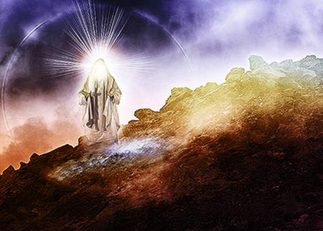
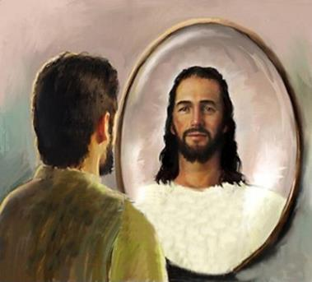
KO E OLA 'O E SIO KI HE LANGILANGI 'O E 'OTUA
“ʻI he ʻalu hifo ʻa Mōsese mei he Moʻunga Sainaí mo e ongo maka ʻo e fono ʻo e fuakavá ʻi hono nimá, naʻe ʻikai te ne ʻiloʻi ʻoku ulo hono fofongá koeʻuhí ko ʻene folofola mo e ʻEikí.” (Ekisotosi 34:29)
Na‘e tu‘o lahi ‘a e talanoa ‘a Mōsese mo e ‘Otuá “mata ki he mata” ki mu‘a, pea ‘o a‘u ki he taimi ko iá, na‘e te‘eki ai ke ulo hono fofongá. Ko e hā naʻe liliu ʻi he taimi ko ʻení? ‘Ikai ngata ai, fakatokanga’i ange, na’e kei hokohoko atu pe ‘a e liliu ‘i he taimi loloa (Ek . 34:34-35).
Ko ʻeni kuo ʻiloʻi lelei ange ʻe Mōsese ʻa e ʻOtuá. Naʻe aʻu ʻene feohi fakakaungāmeʻá ki he tuʻunga matuʻotuʻá. Naʻá ne fakalaulauloto ki he nāunau ʻo e ʻOtuá, pea kuo liliu ia ʻe he nāunau ko iá.
‘I he’ene toe fakalea ‘a e konga ko ‘eni, ‘oku fakaafe’i kitautolu ‘e Paula ke tau fa’ifa’itaki kia Mosese ‘o fakalaulauloto ki he langilangi ‘o e ‘Otua ke liliu ‘o hange ko ia (2 Kol. 3:12-18).
Ko Mōsese ko ha sīpinga ia ʻokú ne fakahaaʻi ʻa e meʻa ʻe lava ke fai ʻe he ʻOtuá maʻatautolú ʻi heʻetau fakaʻatā ia ke ne liliu hotau ʻulungāngá mo fakafuo kitautolu ki hono ʻīmisi fakalangí.

Slide 11

EGW (ʻI he Ngaahi Feituʻu Fakalangí, ʻAokosi 22)
"ʻOku ke pehe naʻe valokiʻi ʻe he ʻOtua ʻa Mosese ʻi heʻene loto-toʻa? ʻIkai ʻaupito. Naʻe ʻikai fai ʻe Mosese ʻa e kole ko ʻeni ko ʻene fieʻilo pe. Naʻe ʻi ai ʻene taumuʻa ʻi heʻene fakakaukau. Naʻa ne ʻiloʻi he ʻikai ke ne lava ʻo fakahoko lelei ʻa e ngaue ʻa e ʻOtua ʻi hono malohi pe ʻoʻona. Naʻe mahino kiate ia kapau te ne lava ʻo maʻu ha visone mahino ki he naunau ʻo e ʻOtua, ʻe fakaivia ia ke hoko atu hono misiona mahuʻinga, ʻo ʻikai fakafalala ki he ngaahi meʻa ʻoku ne malava, ka ki he malohi ʻo e ʻEiki ko e ʻOtua Mafimafi. Naʻe fakataumuʻa kotoa Hono sino ki he ʻOtua; naʻa ne fakaʻamu ke ʻilo lahi ange kiate Ia koeʻuhi ke ne lava ʻo ongoʻi ʻa e ofi mai ʻa e ʻOtua ʻi he faingataʻa pe puputuʻu kotoa pe. Ko e kole ʻ a Mōsese ke sio ki he lāngilangi ʻ o e ʻ Otuá naʻe ʻ ikai makatuʻunga ia ʻ i he siokitá. Ko ʻ ene taumuʻá pē tahá ke fakalāngilangiʻi lelei ange ʻ a hono Tokotaha - Fakatupú."

