Slide 1
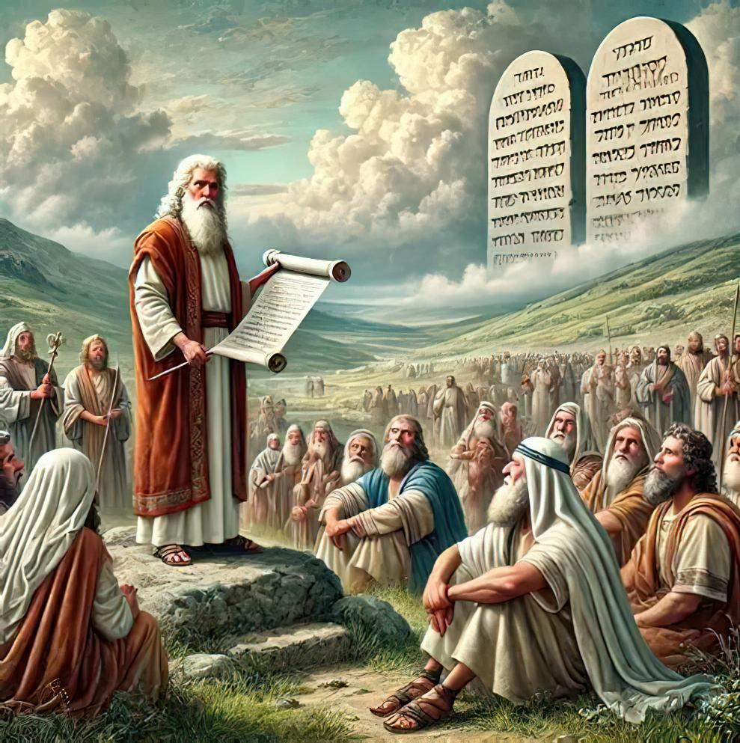
MĀTEAKI TAUPOTU TAHA: LOTU ʻI HA FEITUʻU ʻO E TAU
Lesoni 7 ki he ʻaho 15 ʻo Novema 2025

Slide 2


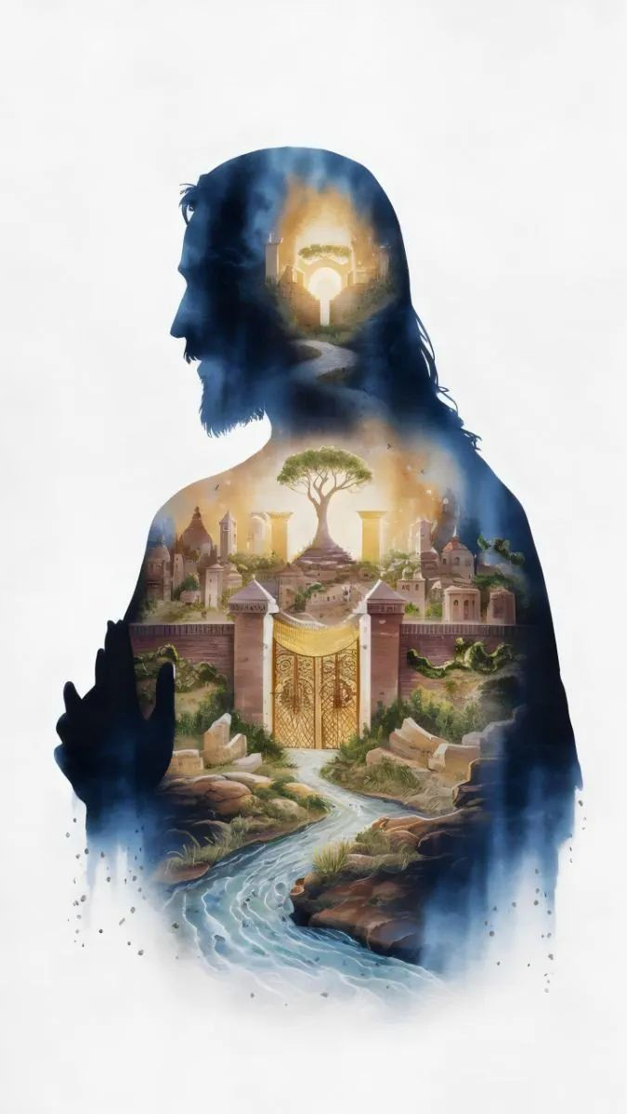
“Ka mou fuofua kumi ʻae puleʻanga ʻoe ʻOtua, mo ʻene māʻoniʻoni; pea ʻe fakalahi ʻaki ʻae ngaahi meʻa ni kotoa pē kiate kimoutolu. ”
Mātiu 6:33

Slide 3

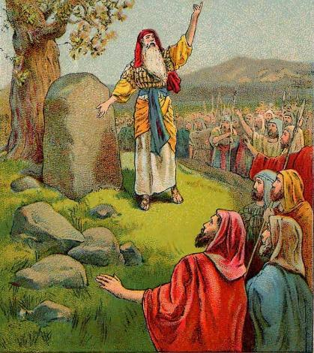
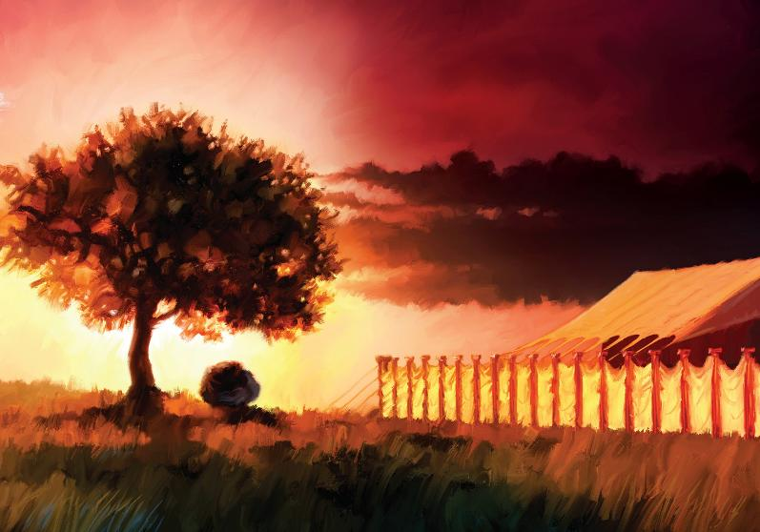








ʻI he kolosi fakaofo ʻi Soatani, naʻe ilifia ʻa e ngaahi tuʻi Kenani kotoa pe (Sosiua 5:1). Naʻe teuteuʻi ʻa e kelekele ke ikunaʻi he taimi pe ko ia.
Neongo ia, naʻe ʻikai ko e meʻa ʻeni naʻe fakamuʻomuʻa ʻe ʻIsileli. Naʻe pau ke nau tomuʻa kumi ki he fetuʻutaki mo e ʻOtua.
ʻI he lotolotonga ʻo e ikuna, naʻa nau fakakaukau foki ke kiʻi malolo ʻo toe fakatapui kinautolu ki he ʻEiki ʻi ha fakataha lahi ʻi he vahaʻa ʻo e ʻotu moʻunga ʻo ʻIpale mo Kelisimi.
ʻ I he meimei fakaʻosi ʻ a e ikuna, naʻa nau aʻusia ai ha makamaile foʻou ʻ o e lotú: naʻa nau langa ʻ a e Potu Toputapu ʻ i Sailo.
Lotu kimu’a pea Ikuna’i:
Ko e fakafoʻou ʻo e fuakava (Sosiua 5:1-9)
Ko e ʻUluaki Lakaatu ʻi Kenani (Sosiua 5:10-12)
Lotu ‘I he lotolotonga ‘o e ngaahi mo’unga:
Ko ha ʻolita ki he lotu (Sosiua 8:30-31)
Manatuʻi ʻa e fono (Sosiua 8:32-35)
Ko ha feitu’u makehe ke lotu ai:
Ko Hono Fokotuʻu ʻo e Potu Tapu (Sosiua 18:1)

Slide 4

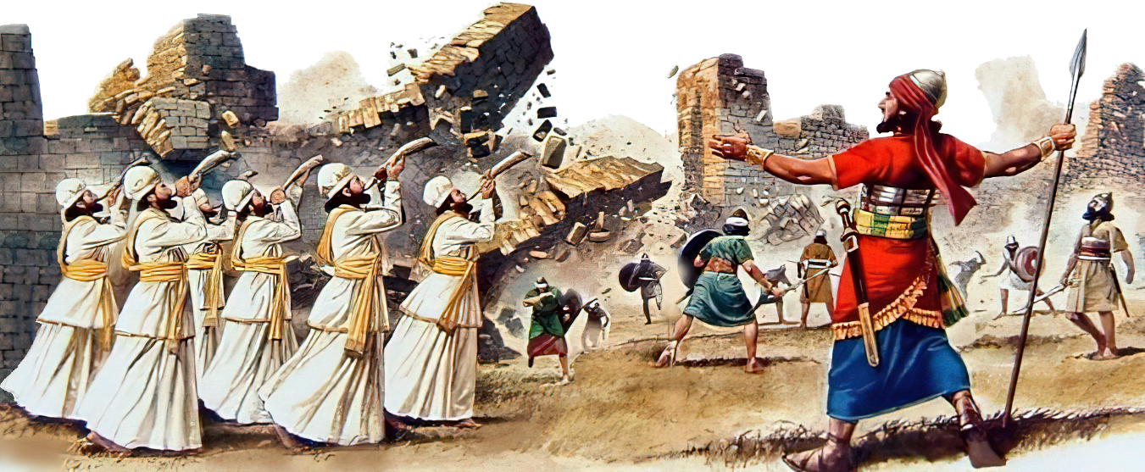
LOTU KIMUʻA PEA IKUNAʻI

Slide 5

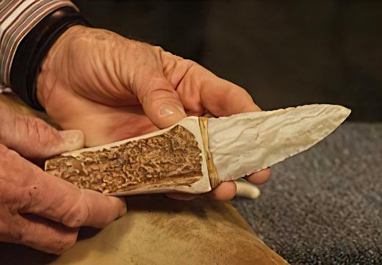
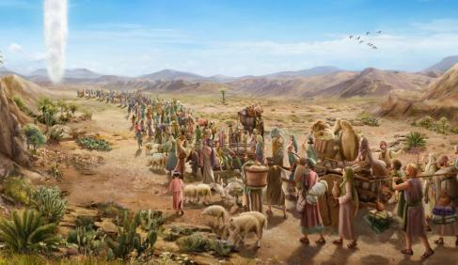

KO E FAKAFOʻOU ʻO E FUAKAVA
“Pea ʻi he kuonga ko ia naʻe folofola ʻa Sihova kia Siosiua, “Ngaohi maʻau ʻae ngaahi hele māsila, pea toe kamuʻi ʻae fānau ʻa ʻIsileli ko hono liunga ua.” (Sosiua 5:2 )
Ko Kilikali ʻa e hingoa naʻe ʻoange ki he ʻapitanga ʻo e kau ʻIsileli, ko e senita pule lolotonga e konga kimuʻa ʻo e ikuna. Ko e ha hono mahuʻinga ʻo e hingoa ko ʻeni (Sosiua 5:9)?
Neongo kuo laka hake ʻ i he taʻu ʻ e 40 talu mei heʻenau mavahe mei ʻ Isipité, naʻe teʻeki ai ke hū ʻ a ʻ Isileli ki he Fonua ʻ o e Talaʻofá. Ko ʻeni, naʻe molomoloki ai honau vaʻe. Kuo taimi ke toʻo atu ʻa e "manuki ʻo ʻIsipite" pea fakafoʻou ʻa e fuakava mo e ʻOtua.
Kimuʻa pea kai ʻa e ʻuluaki Lakaatu, naʻe kamu ʻa e kakai tangata ʻIsileli, he naʻe ʻikai lava ke maʻu ia ʻe ha taha taʻekamu (ʻEkesotosi 12:48). Ka koeʻuhi ko ʻenau fakafisi ke hu ki Kenani ʻi he fuofua taimi, naʻe maumauʻi ai ʻa e fuakava, pea naʻe ʻikai kamu ha ʻIsileli ʻi he feituʻu maomaonganoa (Sosiua 5:5).
Ke fakafoʻou ʻa e fuakava, naʻe fie maʻu ke toe fakahoko ʻa e fakaʻilonga fakatuʻasino ko ia (Senesi 17:10). Naʻe fakamuʻomuʻa ʻe he ngaue ko ʻeni ʻa e meʻa naʻe mahuʻinga Kiate kitautolu, ko ha sipinga ia ke muimui ki ai: "Ka ke fuofua kumi ʻa hono puleʻanga mo ʻene maʻoniʻoni, pea ʻe foaki ʻa e ngaahi meʻa ni kotoa pe kiate kimoutolu foki." (Matiu 6:33).

Slide 6

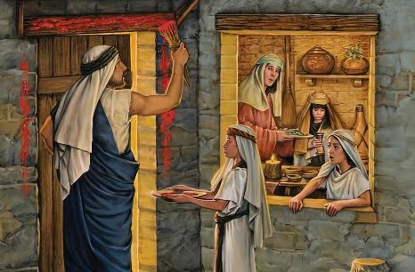
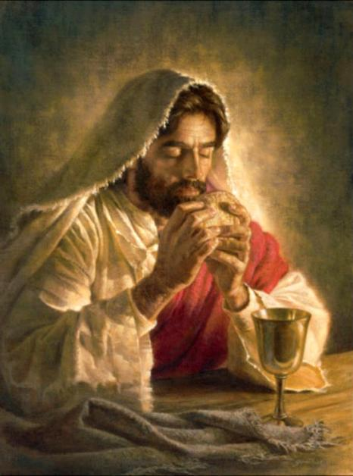
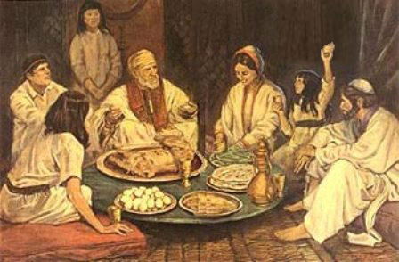
KO E ʻULUAKI LAKA ATU ʻI KENANI
“Pea naʻe ʻapitanga ʻae fānau ʻa ʻIsileli ʻi Kilikali, ʻonau fai ʻa e kātoanga ʻoe Lakaatu ʻi hono hongofulu ma fā ʻoe ʻaho ʻoe māhina ʻi he efiafi ʻi he ngaahi tafangafanga ʻo Seliko.” (Sosiua 5:10)
Mei ʻIsipite ki Kenani, naʻe muimui ʻa ʻIsileli ʻi ha founga "fakaʻofoʻofa", ʻo toutou fakahoko ʻa e ngaahi meʻa naʻe hoko ʻi he fakahokohoko ʻe taha:
ʻIsipite
Kamu mo e Lakaatu
Ko e kolosi ʻi he Tahi Kulokula
Toafa
Ko e kolosi ʻi Soatani
Kamu mo e Lakaatu
Kenani
Ko e ʻuluaki Lakaatu ko ha fakaʻilonga ia ʻo e fakatauʻatainaʻi mei ʻIsipite. Ko e Pāsová hono uá, naʻe kātoangaʻi ʻ e he toʻutangata foʻoú, ko ha fakaʻilonga ia ʻ o ʻ enau maʻu ʻ a e Fonua ʻ o e Talaʻofá.
Taimi nounou pe kimuʻa pea tutuki Ia, naʻe ʻoange ʻe Sisu ha ʻuhinga foʻou ki he ouau ko ʻeni, mo ha ngaahi fakaʻilonga foʻou: naʻe hoko ʻa e lami ko e maa, pea hoko ʻa e toto ko e uaine.
ʻOku nau hoko he taimi ni ko e fakataipe ʻo e sino mo e taʻataʻa ʻo hotau Huhuʻi, ʻa ia ʻoku ne ʻomi kitautolu mei ʻIsipite (ʻa ia ko ʻetau angahala), pea ʻomi kitautolu ki he Fonua ʻo e Talaʻofa (1 Kolinito 11:23-26).

Slide 7

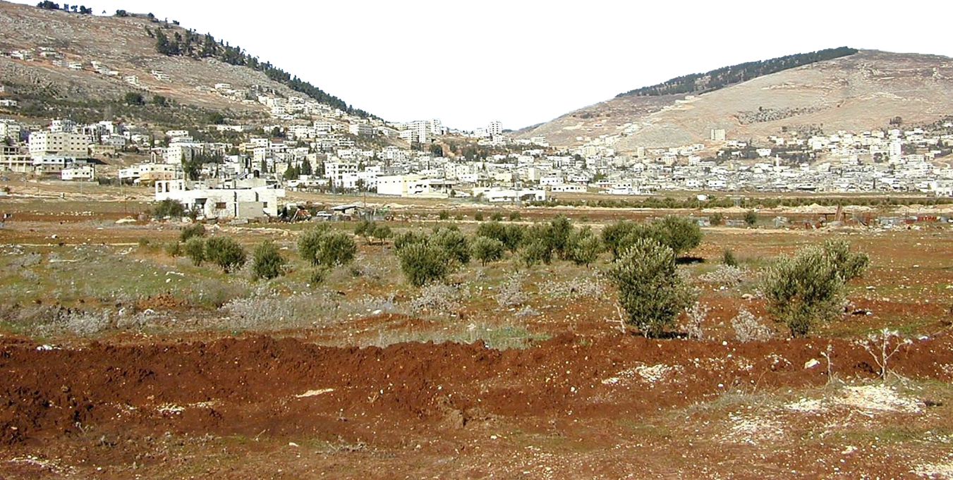
LOTU ʻI HE LOTOLOTONGA ʻO E NGAAHI MOʻUNGA

Slide 8

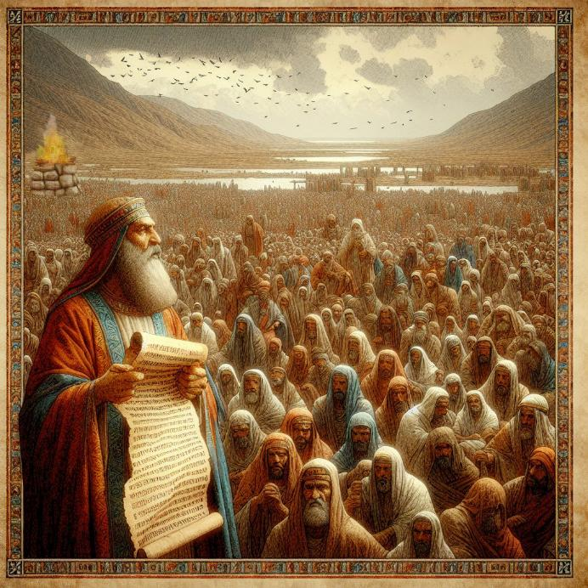
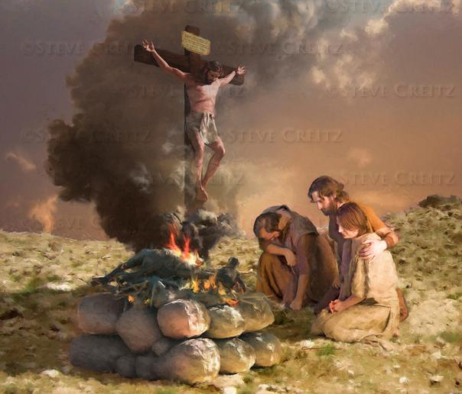
KO HA ʻOLITA KI HE LOTU
“Pea naʻe fokotuʻu ʻe Siosiua ʻae feilaulauʻanga kia Sihova ko e ʻOtua ʻo ʻIsileli ʻi he moʻunga ko Ipale” (Sosiua 8:30)
Naʻe fekau ʻe Mosese ʻi heʻene hu ki Kenani, ke langa ha ʻolita ʻi he Moʻunga ʻIpale, pea ke ʻoatu ʻa e fakafetaʻi ki he ʻOtua (Teu. 27:5-7). Ko e ha ʻi he Moʻunga ʻIpale kae ʻikai ʻi Kelisimi?
Ko e ʻolita mo e ngaahi fono naʻe pau ke tohi ʻi ha maka fakamanatu pea lau ki he kakai naʻe fekauʻaki ia mo e ngaahi tapuaki mo e fakamalaʻia. (Teu. 27:12-13). Naʻe foaki ʻa e tapuaki kia Kelisimi, pea fakamalaʻia ʻa ʻIpale.
Naʻe hoko ʻa Sisu ko e malaʻia kiate kitautolu, koeʻuhi ke tau lava ʻo maʻu ʻa e tapuaki (Kal. 3:13-14). Ko e ʻolita ko ʻeni, kiate kitautolu, ko ha ʻimisi mahino ia ʻo e feilaulau ʻa Sisu maʻatautolu.
ʻI he lotolotonga ʻo e ikuna, naʻe feinga ʻa ʻIsileli ke toe fakatapui kinautolu ki he ʻOtua. Ko ha fakaafe eni kiate kitautolu ke tau faʻifaʻitaki ki heʻenau faʻifaʻitakiʻangá, ʻ o toe fakatapui kitautolu ki he ʻ Otuá, ʻ o ʻ ikai fakafoʻituitui pē, kae toe pehē foki ki he tuʻunga ko e kakai fili ʻ a e ʻ Otuá.

Slide 9

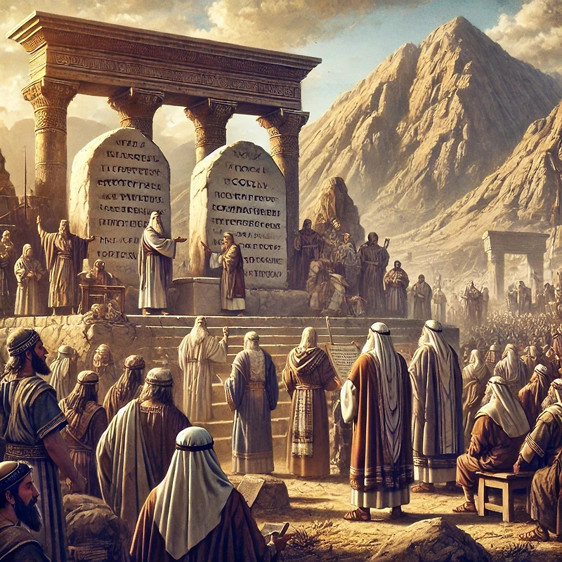
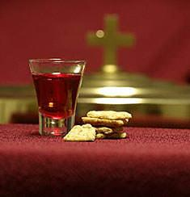
MANATUʻI ʻA E LAO
“Pea naʻe tohi ʻe ia ʻi ai ki he ngaahi maka hono hiki ʻoe fono ʻa Mōsese, ʻaia naʻa ne tohi ʻi he ʻao ʻoe fānau ʻa ʻIsileli.” (Sosiua 8:32)
Hili hono langa ʻ a e ʻ ōlitá ʻ i he Moʻunga ʻ Īpale, naʻe fokotuʻu ʻ e Siosiua ha ngaahi foʻi maka ʻ o palasitaʻi kinautolu ʻ aki ʻ a e lamí. Naʻa ne tohi leva kiate kinautolu ha tatau ʻo e fono [Teutalonome, ʻa ia naʻe kau ai ʻa e Fekau ʻe Hongofulu mo e ngaahi fono kehekehe, fakataha mo e ngaahi tapuaki mo e fakamalaʻia] (Siosua 8:32; Teu. 27:2-3).
Fakaʻosi, naʻe lau ʻa e fono ki he kakai, ʻo vahevahe ki ha konga ʻe ua taha ʻi he tafaʻaki moʻunga takitaha (Sosiua 8:33-35). ʻI he founga ni, naʻe fakafoʻou ai ʻa e fuakava ʻi he vahaʻa ʻo e ʻOtua mo hono kakai.
Ko ha uiuiʻi foki ʻeni kiate kitautolu. ʻI heʻetau hoko ko e toenga ʻo e kakai ʻo e ʻOtua, kuo pau ke tau toutou fakafoʻou ʻetau fuakava mo Ia, ʻo manatuʻi ʻa e founga kuo Ne tataki ai kitautolu ki he mamaʻo ko ʻeni pea mo e ngaahi tapuaki kuo Ne foaki mai kiate kitautolu.
Makehe mei heʻetau fakafoʻou fakafoʻituitui, ʻoku toe ʻomi foki ʻe he Lotu Maʻoniʻoni ʻa e momeniti makehe ko ia ʻo e fakafoʻou ʻi heʻetau hoko ko e kakai ʻo e ʻOtua.

Slide 10
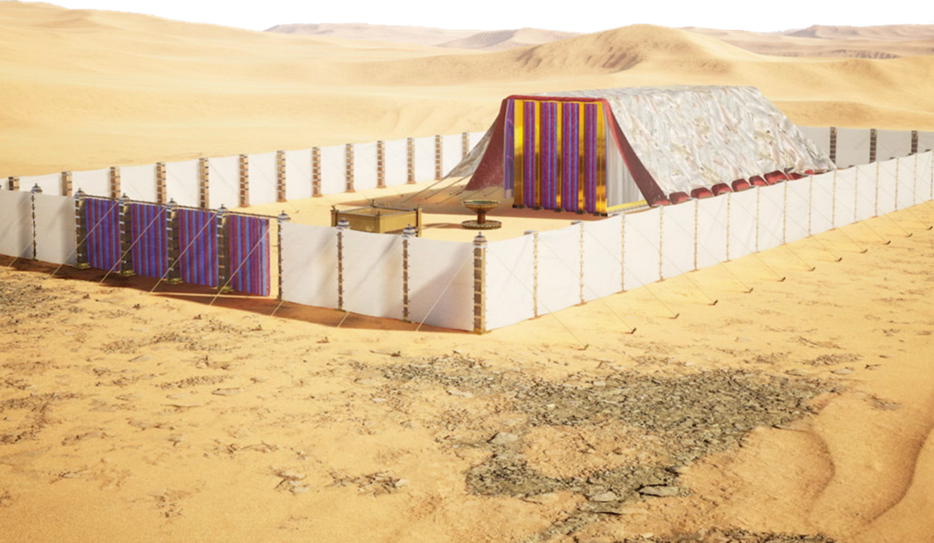
KO HA FEITUʻU MAKEHE KE LOTU AI

Slide 11

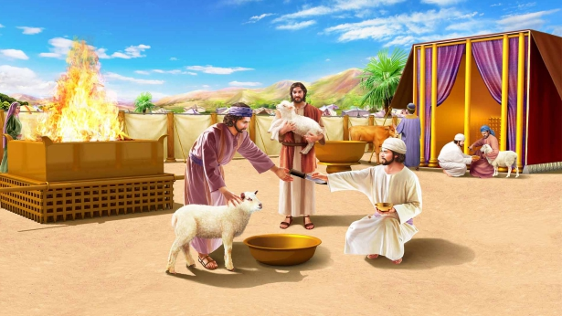
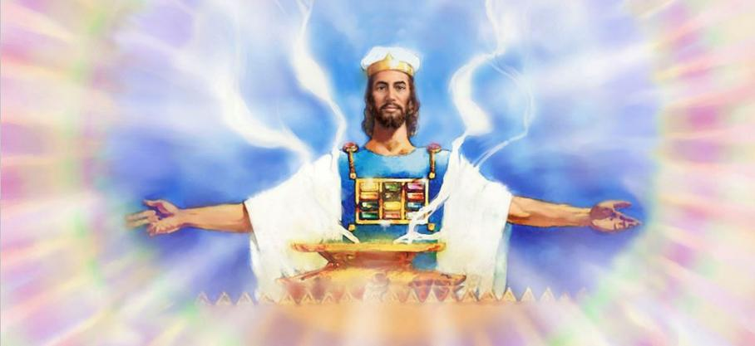
FOKOTUʻU HAKE ʻO E HUFANGAʻANGA
“Pea ko e kakai kotoa pē ʻoe fānau ʻa ʻIsileli naʻa nau fakakātoa ʻakinautolu ʻi Sailo, ʻonau fokotuʻu ʻi ai ʻae fale fehikitaki ʻoe kakai. Pea naʻe fakavaivai ʻae fonua ʻi honau ʻao.” (Sosiua 18:1)
Naʻe ikunaʻi ʻe ʻIsileli ʻa e fonua. Naʻe vahevahe ʻa e vahefonua ki he ngaahi matakali tuʻu - ki - muʻa taha, neongo naʻe teʻeki ai ke maʻu ʻe he matakali ʻe fitu honau ʻinasi. Ko e kau tau ʻ a Lupeni, Kata, mo e vaeua matakali ʻ o Manasé naʻe pau ke ʻ ave kinautolu ki honau ngaahi tofiʻa ʻ i he tafaʻaki ʻ e taha ʻ o Soataní.
Kimuʻa pea mavahevahe ʻa e ngaahi faʻahinga, naʻe fakahoko ha ngaue makehe mo mahuʻinga: ko hono langa ʻo e Tapanekale, ʻa ia ko e uho ʻo e lotu ʻa ʻIsileli (Sosiua 18:1).
Ko e Potu Toputapú, ʻ i he tuʻunga ko e nofoʻanga hā mai ʻ o e ʻ Otuá, ko e feituʻu ia ʻ o e fāʻūtaha ʻ a ia naʻe ’i ai ʻ a e tokotaha kotoa pē ʻ i he lotú. Ka ne taʻeʻoua ʻ a e ʻ i ai ʻ a e ʻ Otuá, naʻe taʻeʻuhinga ʻ a hono maʻu ʻ o e fonuá.
Ko e ‘aho ni, ‘i he kei ‘i ai ‘a e kau tangata lalahi fakaonopooni mo e hili ‘o e kuonga ke ikuna’i, ‘oku mahu’inga ‘aupito ke tau tukutaha ‘etau tokanga ki he Fale Tapu ‘o Langi, ‘a ia ‘oku hufekina ai ‘e Sisu ma’atautolu.

Slide 12

"Naʻe teʻeki ai ke ʻosi ha ngaahi uike lahi talu mei hono ʻoange ʻe Mosese ʻa e tohi kotoa ʻo Teutalonome ʻi he ngaahi malanga ki he kakai, ka ko ʻeni naʻe toe lau ʻe Siosiua ʻa e fono."Naʻe ʻikai ko e kakai tangata pe ʻo ʻIsileli, ka naʻe fanongo ʻa e "kakai fefine kotoa pe mo e tamaiki iki" ki hono lau ʻo e fono; he naʻe mahuʻinga ke nau ʻiloʻi mo fai honau fatongia foki. […]
Ko e vahe mo e veesi kotoa pe ʻo e Tohi Tapu ko ha fetuʻutaki ia mei he ʻOtua ki he tangata. ʻOku totonu ke tau nonoʻo hono ngaahi akonaki ko ha ngaahi fakaʻilonga ʻi hotau nima pea mo ha ngaahi meʻa ʻi muʻa ʻi hotau mata. Kapau ʻ e ako mo talangofua ki ai, te ne tataki ʻ a e kakai ʻ a e ʻ Otuá, ʻ o hangē ko hono tataki ʻ a e kau ʻ Isilelí, ʻ e he pou ʻ ao ʻ i he ʻ ahó pea mo e pou afi ʻ i he poʻulí.
EGW (Ko e Kau Pēteliaké mo e Kau Palōfitá, p500-504)

