Slide 1

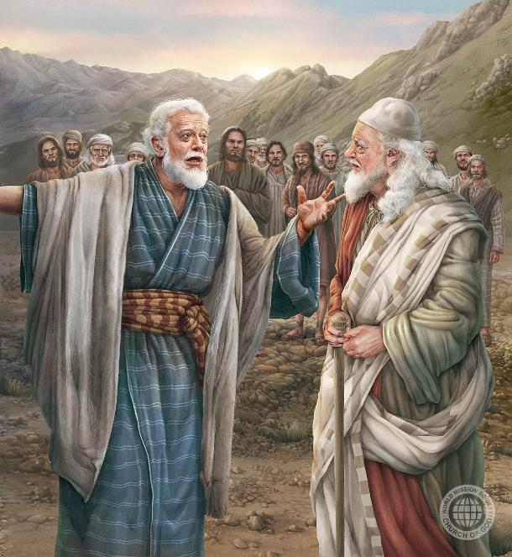
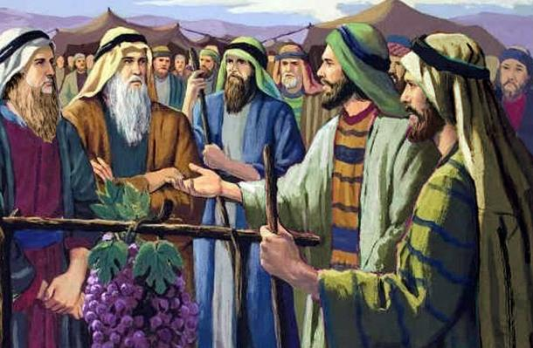
KAU SAIENITI ʻO E TUI: SIOSIUA MO KĒLEPI
Lesoni 8 ki he ʻaho 22 ʻo Novema 2025

Slide 2
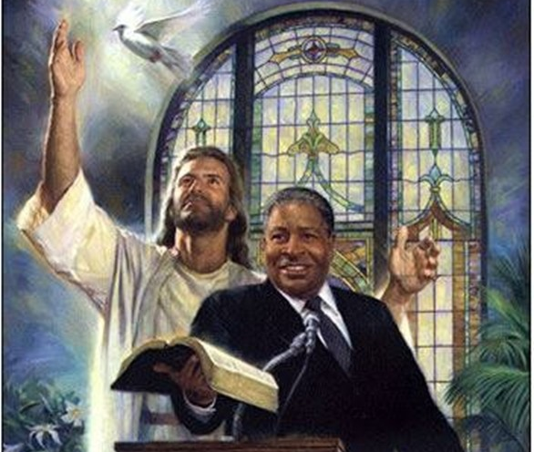
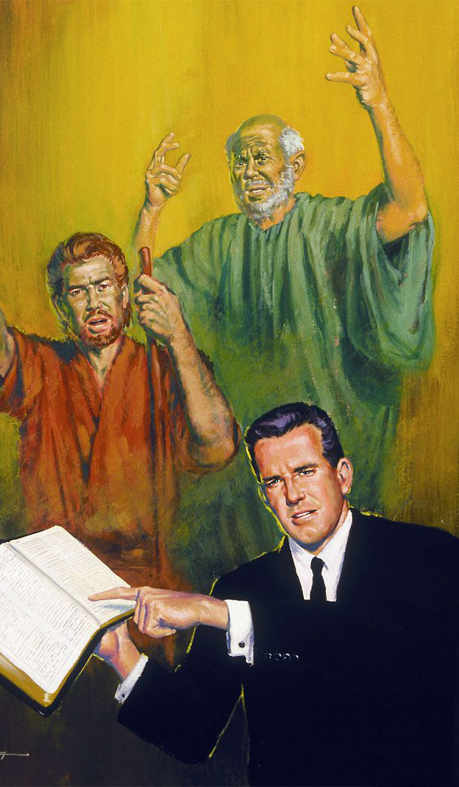
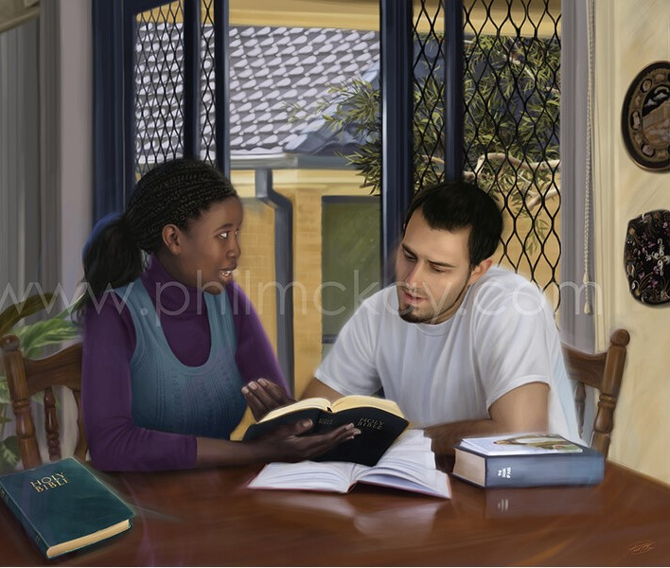
“Manatuʻi ʻa homou kau fakahinohino, ʻakinautolu naʻe leaʻaki ʻae folofola ʻae ʻOtua kiate kimoutolu, pea faʻifaʻitaki ki heʻenau tui, ʻo fakatokanga ki he ngataʻanga ʻo ʻenau ʻulungāanga.”
(Hepelū 13:7)

Slide 3

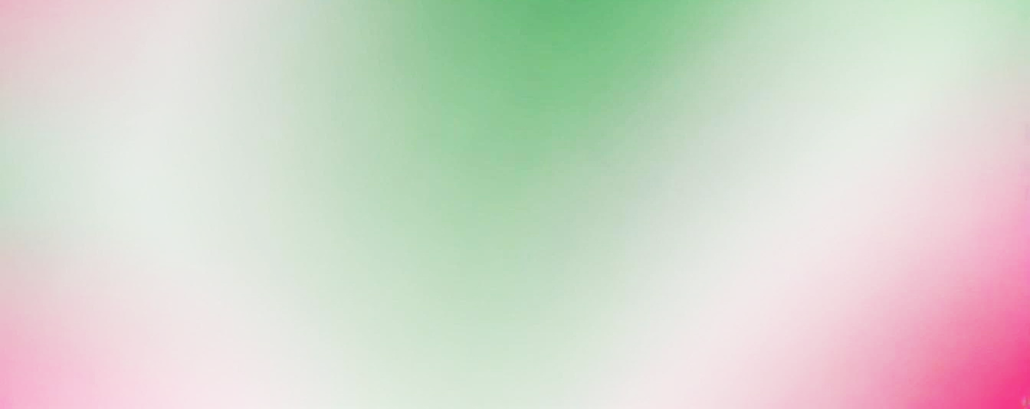
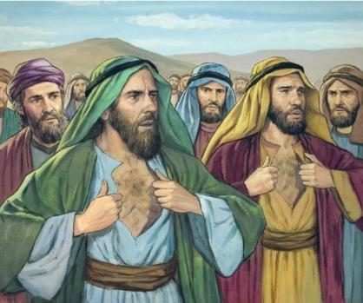




ti, Katieli, Kati, Amieli, Setuli, Napi mo KeueOku mou iloi a e toko hongofulu ko eni: Samua, Safati, Ikali, Pali?
Naʻe kau ʻi heʻene "ongoongoa" ʻa e taʻefalala ki he malohi ʻo e ʻOtua, pea ʻomi ai ʻene pekia mo ha toʻu tangata kakato. (Nomipa 14:36-37).
Ka mahalo kuo ke ʻosi fanongo ʻi he ongo meʻa ko ʻeni: Sosiua mo Kelepi. Naʻa nau tuʻu maʻu, tui ki he ngaahi talaʻofa ʻa e ʻOtua, pea moʻui ke mamata ki hono fakahoko (Nomipa 14:38).
ʻ E lava fēfē ke tau faʻifaʻitaki ki heʻenau tuí pea hoko ʻ o falala kakato ʻ e lava ke fai ʻ e he ʻ Otuá ʻ a e meʻa taʻemalava ke faí, ʻ o hangē pē ko ia naʻa nau faí?
Ko e tui ‘a Kēlepi:
malava ʻa e meʻa ʻoku ʻikai malavá.
Ko e tuí ʻi he ngāué.
Ko hono paasi ʻo e māmá.
Ko e tui ʻa Siosiua.
Founga ke maʻu ai ʻa e tuí.

Slide 4

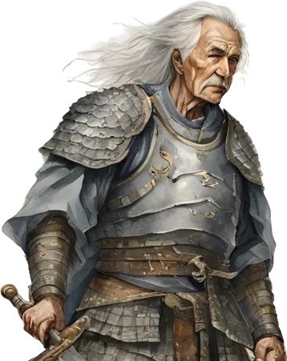
KO E TUI ʻA KELEPI

Slide 5
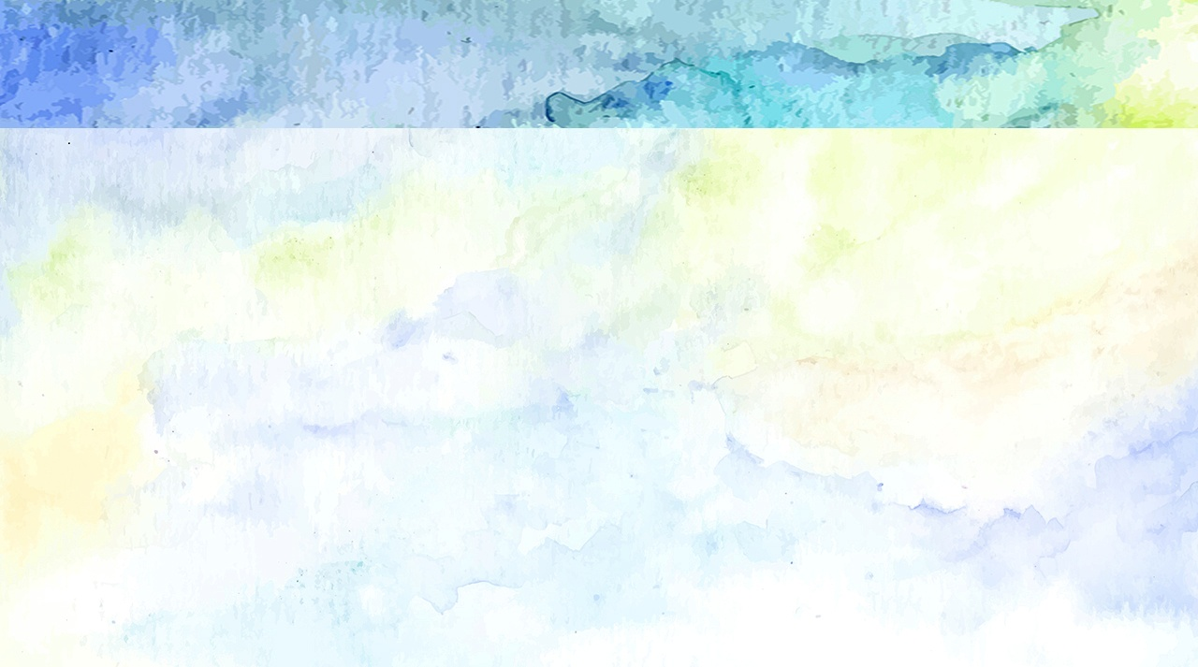
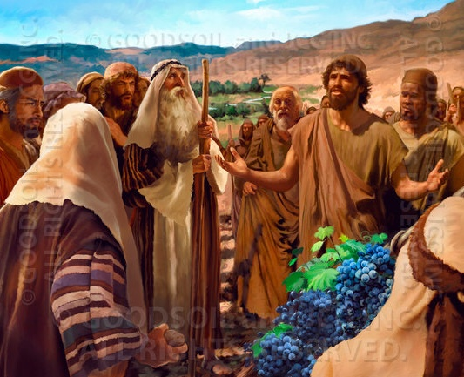
KE MALAVA ʻA E MEʻA ʻOKU ʻIKAI MALAVA
“Ka ko hoku ngaahi kāinga naʻe ʻalu hake mo au naʻa nau ngaohi ke vai ʻo ʻosi ʻae loto ʻoe kakai: ka naʻaku tuli tāupau kia Sihova ko hoku ʻOtua.” (Siosiua 14:8)
ʻOku ʻuhinga ʻa e hingoa "Kelepi" ko e "kulii." Hange ko ia naʻe fakahaaʻi ʻe heʻene moʻui, naʻe ʻikai ke ne maʻu ʻa e hingoa ko ia ko ha foʻi lea tukuhifo ka koeʻuhi ko ʻene mateakiʻi taʻeueʻia. Naʻa Ne faivelenga ʻi he feituʻu naʻe taʻefaitotonu ai ʻa e niʻihi kehe. Naʻá ne mateaki ai pē ki he ʻ Otuá ʻ i he feituʻu naʻe holomui ai ʻ a e niʻihi kehé.
Naʻe mamata ʻa Kelepi ki hono ikunaʻi ʻo e ngaahi kolo pea "kai ʻe he kau saieniti ʻa e ngaahi kolo ʻo hange ko e maa" (Nomipa 13:28-33; 14:6-9).
Fakataha mo Siosiua (na’e ki’i si’i ange ‘iate ia), na’a ne tu’u ma’u ‘i he’ene fakakaukau, na’a mo e taimi na’e loto ai ‘a e fu’u kakai ke tolomaka’i kinaua (Nomipa 14:10).
‘Oku fakalototo‘a‘i kitautolu ‘e he‘ene fa‘ifa‘itaki‘angá ke tau tauhi ma‘u ‘etau tui mālohi ki he ‘Otuá, ‘a ia ‘okú ne lava ‘o ‘ai ke malava ‘a e me‘a ‘oku ta‘emalava kiate kitautolú.

Slide 6
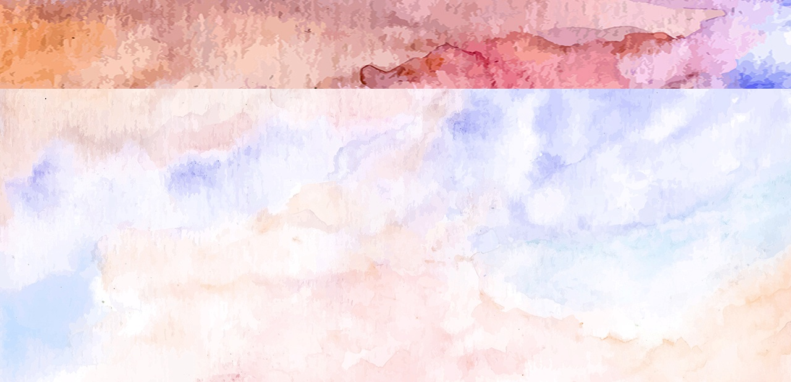
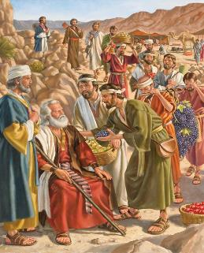
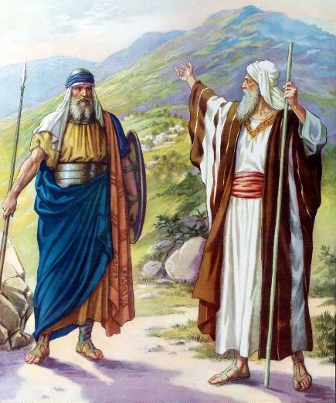

TUI 'I HE NGAUE
“Pea ko eni, foaki mai kiate au ʻae moʻunga ni, ʻaia naʻe folofola ki ai ʻa SIHOVA ʻi he ʻaho ko ia; he naʻa ke fanongo ʻi he ʻaho ko ia, koeʻuhi ʻoku ʻi ai ʻae kau ʻAnaki, pea ko ʻenau ngaahi kolo naʻe fuʻu lahi, pea ʻāʻi: kapau ʻe ʻiate au ʻa SIHOVA, pea te u toki mafai ke kapusi ʻakinautolu, ʻo hangē ko e folofola ʻa SIHOVA” (Siosiua 14:12)
Fakatatau kia Kelepi tonu, ‘i he taimi na’e kole ai ‘e Mosese ha fakamatala, “Na’a ku ‘omi kiate ia ha fakamatala ‘o fakatatau ki he’eku ngaahi tui” (Siosiua 14:7 ), pea “na’a ku muimui loto kotoa kia Sihova ko hoku ‘Otua” (Siosiua 14:8). Koeʻuhí ko ʻene faivelengá, naʻe talaʻofa ai te ne maʻu ʻa e feituʻu naʻe ʻai ai hono vaʻé lolotonga ʻa e siví (Siosiua 14:9).
Na‘e ta‘u 40 ‘a Kēlepi ‘i he taimi na‘e fekau‘i atu ai ia ko ha sipai. Hili ha taʻu ʻe nima ʻo e ikunaʻí, kuó ne hoko he taimí ni ko ha motuʻa ʻo e taʻu 85 (Siosiua 14:10 ). Naʻe kei mālohi pē hono sinó mo hono ʻatamaí, pea naʻe kei tatau pē ʻene ngaahi fakakaukaú (Siosiua 14:11).
Kuo hokosia e taimi ke taukaveʻi ai ʻa e talaʻofá mo fakamoʻoniʻi naʻe ʻikai ke taʻeʻaonga ʻene ngaahi leá. ‘I he tokoni ‘a e ‘Otua, na’a ne ‘alu ke keina ‘a e kau tangata lalahi pea ikuna’i honau ngaahi kolo (Siosiua. 14:12-14).

Slide 7
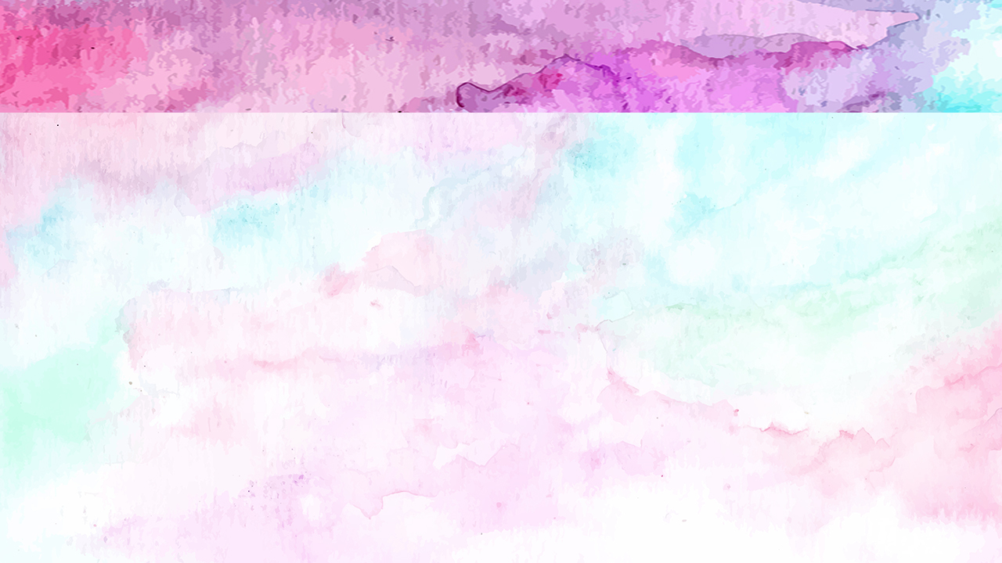
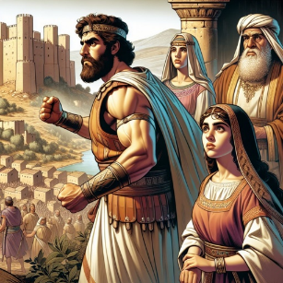
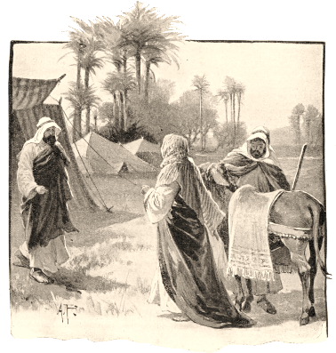
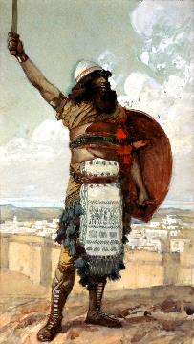
KO HONO PAASI ʻO E AMA
“Pea naʻe pehē ʻe Kelepi, “Ko ia ʻoku ne taaʻi ʻa Kesa-Sefa, pea lavaʻi ia, te u ʻatu kiate ia hoku ʻofefine ko ʻAkesa ke na mali” (Siosiua 15:16)
ʻ I he taimi naʻá ne ikunaʻi ai ʻ a e konga ʻ o e feituʻu ngāue ʻ a ia naʻe totonu ke ne maʻú, naʻe fakakaukau ai ʻ a Kēlepi ki he tofiʻa te ne tuku maí. ʻ E hokohoko atu ʻ a hono hakó ke falala ki he ʻ Otuá ʻ o hangē ko ia naʻá ne faí?
Naʻa ne fakamoʻoniʻi ʻe lava ke falalaʻanga ʻa e ʻOtua, pea ʻoku ne fie maʻu ʻeni ke kumi ha taha ʻoku ne maʻu ʻa e tui tatau, koeʻuhi ke ne lava ʻo ʻoatu ʻa e ama kiate kinautolu.
ʻI he ʻuhinga ko ʻeni, naʻa ne palomesi ai ʻa e nima ʻo hono ʻofefine ki he tokotaha naʻa ne ikunaʻi ʻa Kiliati-sefa, ʻa ia naʻe ui foki ko Tepili (Siosiua 15:15-16).
Ko hono ʻilamutu ko ʻOtiniela ʻa e tangata malohi naʻa ne ikunaʻi ʻa e kolo, pea hoko ko e ʻuluaki fakamaau ʻo ʻIsileli (Sosiua 15:17; Fakamaau 3:9-11).
Hili ʻene mali mo ʻAkisa, ko e ʻofefine ʻo Kelepi, naʻa ne fakalotoʻi ʻene tamai ke fakaʻata ia ke ne fakalahi ʻa e feituʻu naʻe ikunaʻi (Siosiua 15:18-19), ʻo fakamoʻoniʻi ai ko e ʻea taau ia kia Kelepi.

Slide 8

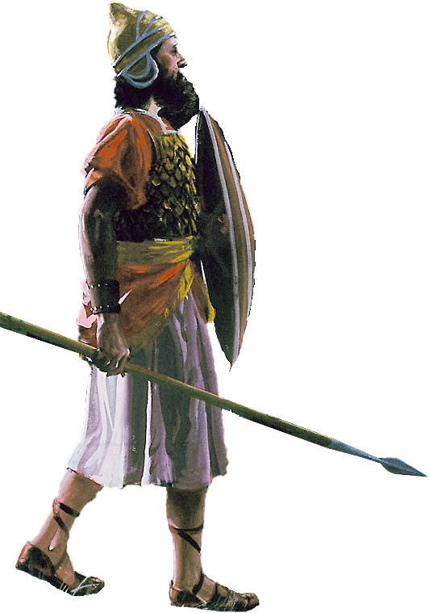
KO E TUI ʻA SIOSIUA

Slide 9
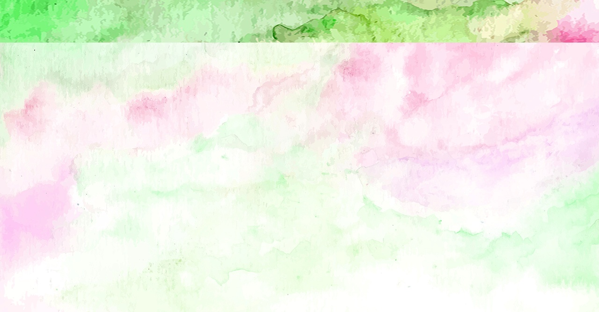
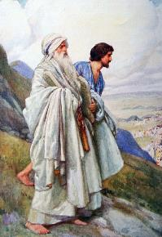
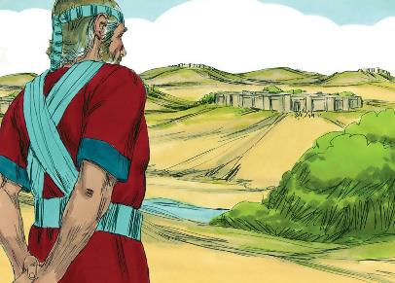
“Pea hili ʻenau fakaʻosi hono vahe ʻoe fonua ko e ngaahi tofiʻa ʻi honau ngaahi ngataʻanga, naʻe ʻatu ʻe he fānau ʻa ʻIsileli ʻae tofiʻa kia Siosiua ko e foha ʻo Nuni ʻiate kinautolu:” (Siosiua 19:49)
ʻI heʻene kei talavou, naʻe fili ʻe Mosese ʻa Siosiua ko hono tokoni. Naʻa ne fakamoʻoniʻi ʻene talangofua, loto-toʻa, faivelenga, faʻa tokoni, mo ʻofa ʻi he ngaahi meʻa ʻa e ʻOtua (ʻEkesotosi 33:11).
ʻI he hokosia ʻa e taimi ke maʻu ai hono vahefonua ʻoʻona, naʻa ne tatali kae ʻoua kuo maʻu ʻe he ngaahi faʻahinga kotoa honau tofiʻa, pea naʻa ne fili "ʻa e konga naʻe toe" [Timnati-sela] (Siosiua 19:50), ko ha kolo ofi ki Sailo, ʻa ia naʻe langa ai ʻa e Potu Toputapu.
ʻOku tau ako mei heʻene talanoa:
ʻOku ʻikai tukunoaʻi ʻe he tui ʻa e ngaahi moʻoniʻi meʻa; ʻoku ne ʻomi pe ha tafaʻaki kehe ʻo e mahino
ʻOku ui kitautolu ke tau falala mo tukulolo ki he ngaahi palani ʻa e ʻOtua kae ʻikai ke tau launga
ʻOku maʻu ʻe kinautolu ʻoku nofo maʻu kakato ʻi he ʻEiki ʻa e ngaahi tapuaki
Kuo pau ke moʻui ʻaki ʻa e moʻui ʻi hono ngaahi tafaʻaki kotoa pe ʻo fakatatau ki he ngaahi palani kuo fokotuʻu ʻe he ʻOtua
ʻOku mahuʻinga ke moʻui ofi ki he ʻOtua
(Saame 84:10)

Slide 10

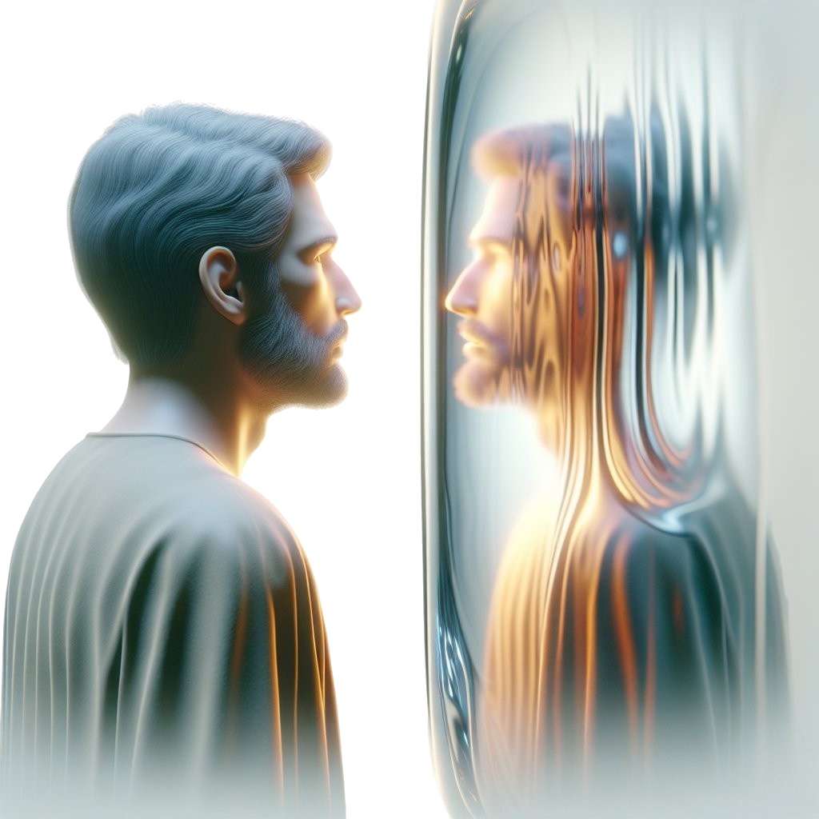
FOUNGA KE MAʻU AI ʻA E TUI

Slide 11
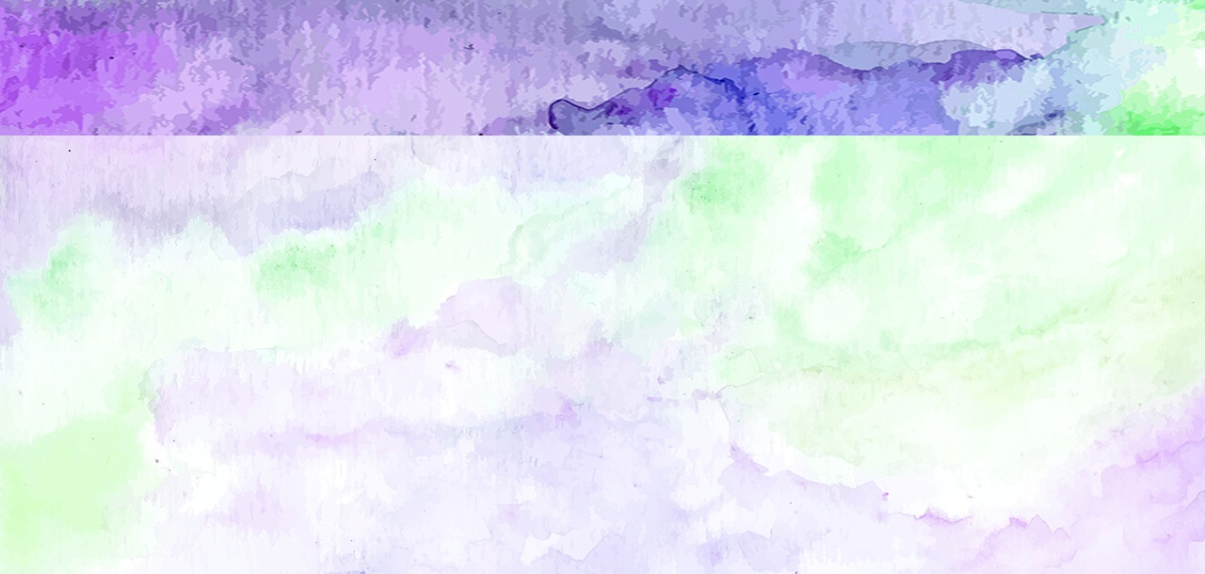
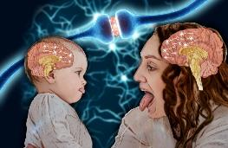
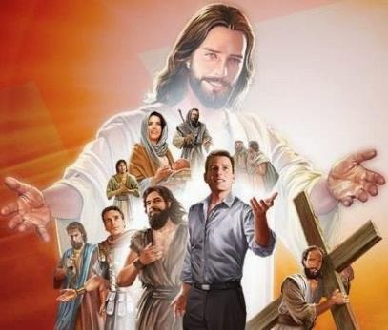

“Ko ia, ko e meʻa ʻi he kāpui ʻakitautolu ʻe he ʻao ʻoe kau fakamoʻoni tokolahi pehē, ke tau siʻaki foki ʻae meʻa mamafa kotoa pē, mo e angahala ʻoku tau moʻuangofua ki ai, pea tau feleleʻi ʻi he fakakukafi ʻae fakapuepue kuo tofi ʻi hotau ʻao. 2 ‌ʻO sio pe kia Sisu ko e kamataʻanga mo e ngataʻanga ʻoe tui; ʻaia ne ne kātaki ʻae pekia ʻi he ʻakau, mo ne taʻetokanga ki he fakamā, ko e meʻa ʻi he fiefia naʻe tuku ʻi hono ʻao, pea kuo nofo eni ʻi he nima toʻomataʻu ʻoe ʻafioʻanga ʻoe ʻOtua..” (Hepelu 12:1-2)
ʻOku fakahehema hotau ʻulunganga ke tapua mei ai ʻa e meʻa ʻoku tau sio ki ai. ʻOku ʻi ai foki mo e ngaahi meʻa ʻoku ui ko e "sioʻata neurons" ʻoku ne fakanenefuʻi ʻa e faikehekehe ʻi hono siofi ha meʻa mo hono fai ia.
ʻOku fakaafeʻi kitautolu ʻe he Tohi Tapu ke tau mamata ki he sipinga ʻa e kau moʻungaʻi tangata maʻongoʻonga ʻo e tui, ʻo tokanga makehe kia Sisu, ko e faʻifaʻitakiʻanga maʻolunga taha (Hepelu 12:1-2).
ʻI heʻetau ako ki he moʻui ʻa e kakai tui hange ko Kelepi mo Sosiua, ʻoku tau ako ai ke falala ki he ʻOtua ʻo hange ko ia naʻa na fai; ke nau loto fakatokilalo ʻo hange ko kinautolu; ke fakamoʻoniʻi ʻa e moʻoni ʻi he loto-toʻa, ʻo hange ko ia naʻa nau fai.
Ka ʻe lava fefe ke liliu kitautolu? ʻOku mahino ʻa e Tohi Tapu: ʻaki hono fakaʻata ʻa e Laumalie Maʻoniʻoni ke ngaue ʻiate kitautolu (2 Kolinito 3:18). Ko ha ngaue longomoʻui ʻeni. Kuo pau ke tau fili ke liliu, pea hange ko Kelepi, ʻo ngaue. ʻOku ui kitautolu ke tau hoko ko ha ngaahi feilaulau moʻui maʻa e ʻOtua (Loma 12:1-2).

Slide 12
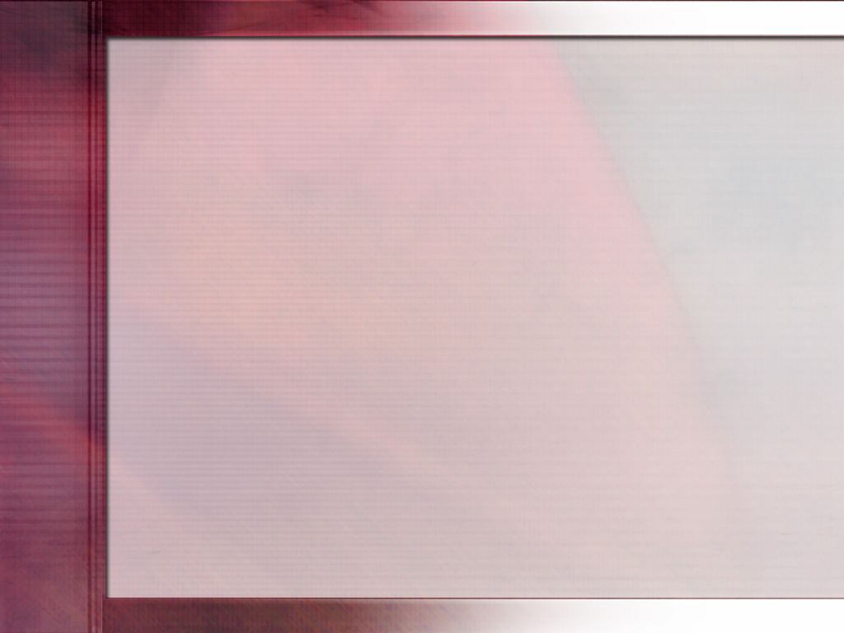
“ʻOku tau fie maʻu he ʻaho ni ha kau tangata anganofo kakato, kau tangata ʻoku muimui kakato ki he ʻEiki, kau tangata ʻoku ʻikai ke nau faʻa fakalongolongo ʻi he taimi ʻoku totonu ke nau lea ai, ʻoku nau tuʻu maʻu ʻo hange ha ukamea ki he tefitoʻi moʻoni, ʻoku ʻikai ke nau feinga ke fakangalingali, ka ʻoku nau ʻaʻeva ʻi he loto fakatokilalo mo e ʻOtua, kau tangata faʻa kataki, angaʻofa, faʻa tokoni, mo anga fakaʻapaʻapa, ʻa ia ʻoku mahino kiate kinautolu ko e saienisi ʻo e lotu ke ngaue ʻaki ʻa e tui mo fakahaaʻi ʻa e ngaahi ngaue te ne fakaha ki hono fakalangilangiʻi ʻo e Ko e ʻOtua mo e lelei ʻa Hono kakai.... ʻOku fie maʻu ʻa e ului kakato ʻi he kamataʻanga ke muimui ʻia Sisuu, pea toutou fakahoko ʻa e ului ko ʻeni ʻi he ʻaho kotoa pe.
Ko e tui ʻa Kelepi ki he ʻOtua naʻa ne ʻoange kiate ia ha loto-toʻa, naʻa ne taʻofi ia mei he manavahe ki he tangata, pea ʻai ke ne lava ʻo tuʻu loto-toʻa mo taʻeueʻia ʻi hono taukapoʻi ʻo e totonu. ʻE lava ke maʻu ʻe he sotia moʻoni kotoa pe ʻo e kolosi ʻa e malohi mo e loto-toʻa ke ikunaʻi ʻa e ngaahi faingataʻa ʻoku ngali he ʻikai lava ke ikunaʻi, ʻo fakafou ʻi he falala ki he malohi tatau, ʻa e Seniale maʻongoʻonga ʻo e ngaahi kau tau ʻo e langi.
EGW ( Ngaahi Foha mo e Ngaahi ʻOfefine ʻo e ʻOtuá , Siulai 19)

