Slide 1
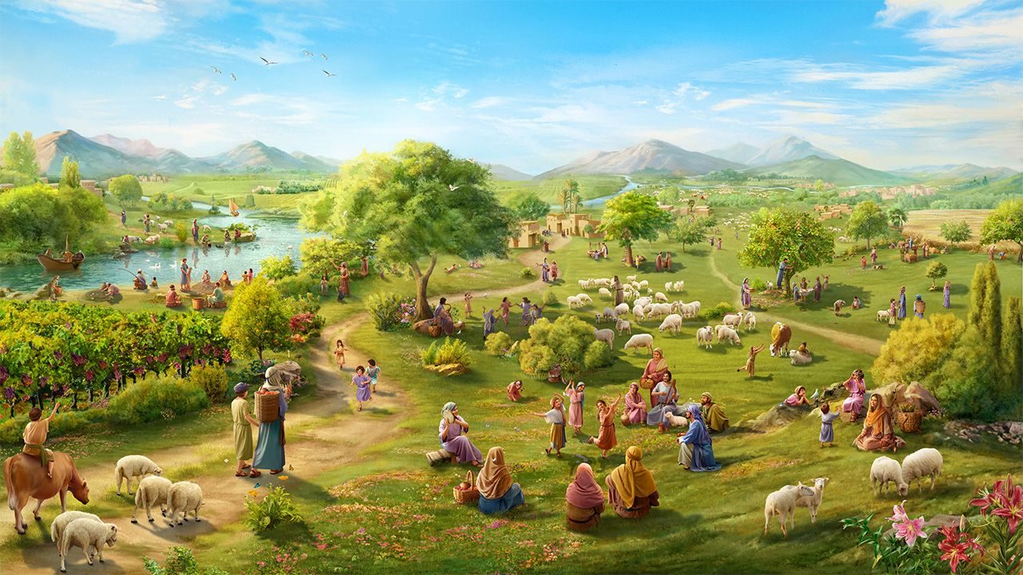
KO E KAU ʻEA-HOKO ʻO E NGAAHI TALA’OFA, KAU PŌPULA ʻO E ʻAMANAKI LELEI
Lesoni 9 ki he ʻaho 29 ʻo Novema 2025

Slide 2
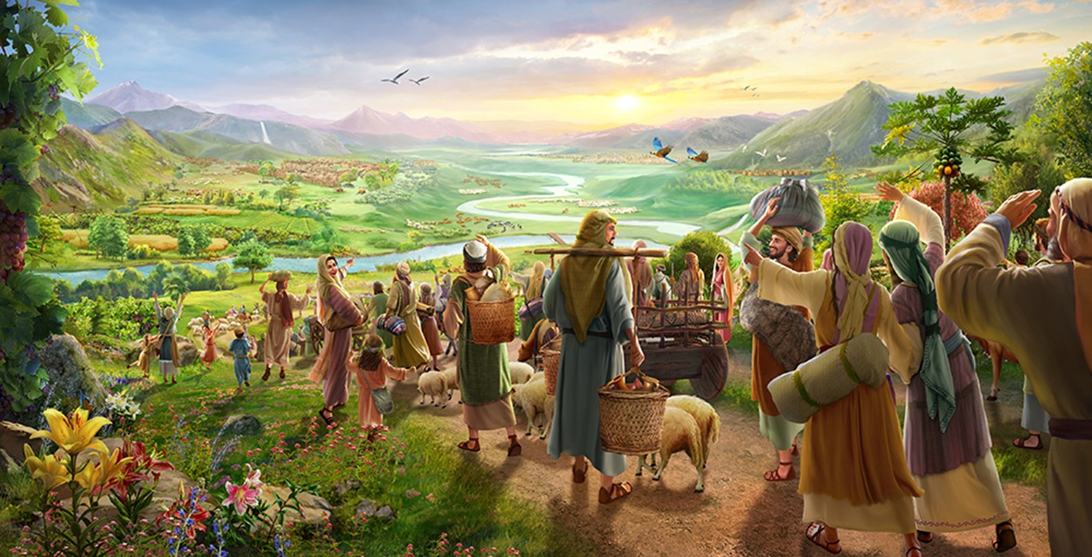
“Mou foki mai ki he hūfanga mālohi, ʻakimoutolu ʻoku pōpula ka e ʻamanaki lelei:ko e moʻoni ʻoku ou fakahā he ʻaho ni, te u totongi ke liunga ua kiate koe:” (Sakalaia 9:12)

Slide 3
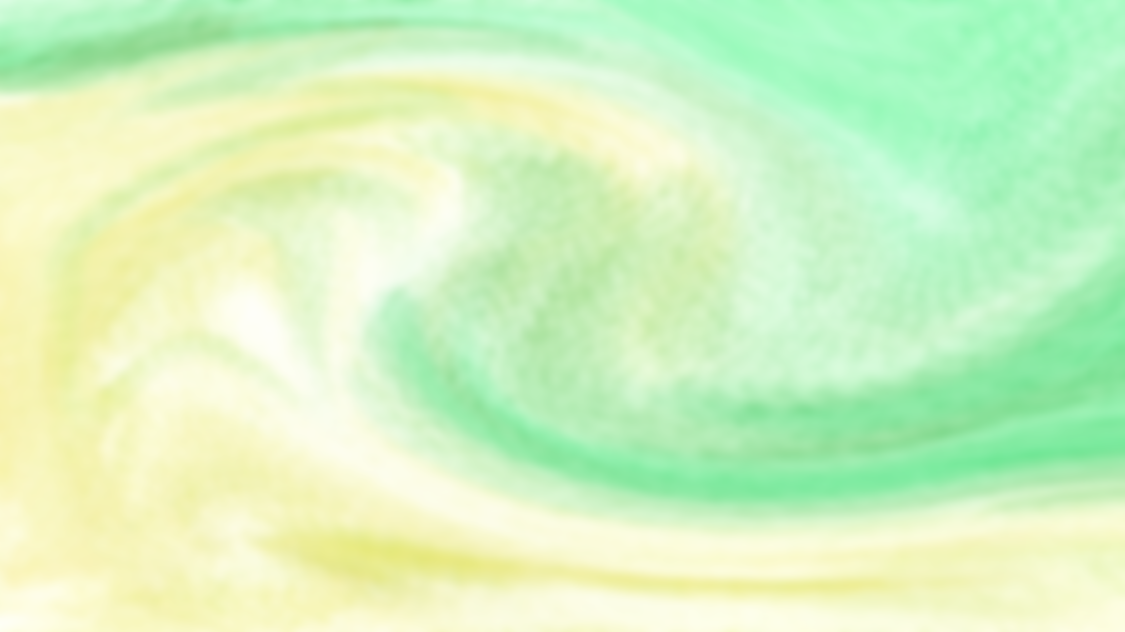
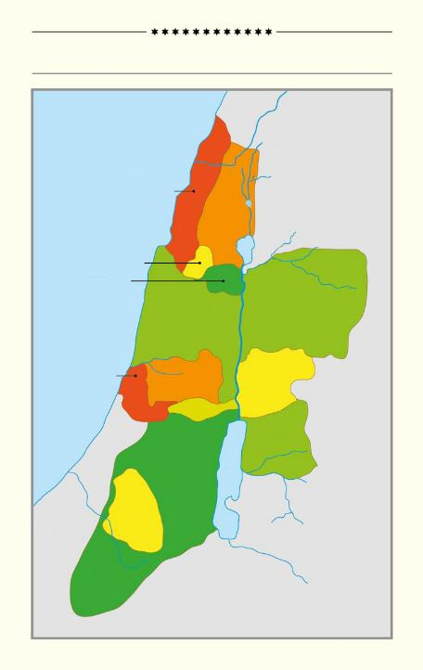
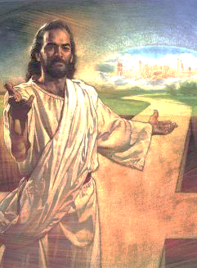
Ko e konga lahi ʻ o e tohi ʻ a Siosiuá, vahe 13 ki he 21, ʻ oku fekauʻaki ia mo hono tufaki ʻ o e fonua ko Kēnaní ki he lotolotonga ʻ o e ngaahi matakali kehekehe ʻ o ʻ Isilelí.
KO E FAʻAHINGA ʻE 12 ʻO ʻISILELI
Tahi Meteleniane
ʻI he vahaʻa ʻo e ngaahi fakamatala ki he ngaahi feituʻu, kakai, mo e ngaahi faʻahinga, ʻoku tau lava ʻo sio ai ki ha fonua kuo ʻosi hoko ko e tofiʻa ʻo ʻIsileli, ka ʻi he taimi tatau, naʻe teʻeki ai ke nau maʻu kakato.
ASA
NAFETALAI
ʻOku fakapapauʻi mai ʻe he pekia ʻa Sisuu kuo tau maʻu he taimi ni ʻa e fonua naʻe mole ʻe ʻAtama mo ʻIvi. Neongo ia, ʻoku tau kei "popula pe ʻi he ʻamanaki lelei" ke maʻu ia.
SEPULONI
‘ISAKA
MANASE
MANASE
Ko e kelekele naʻe mole
Ko e fonua ʻoku foaki ʻe he ʻOtua
Ikunaʻi ʻa e fonua
Tauhi ʻa e meʻaʻofa
Ko e kelekele na’e toe ma’u
TANI
A
IFALEMI
KATA
PENISIMANI
LUPENI
B
SIUTA
C
SIMIONE
B'
A'

Slide 4

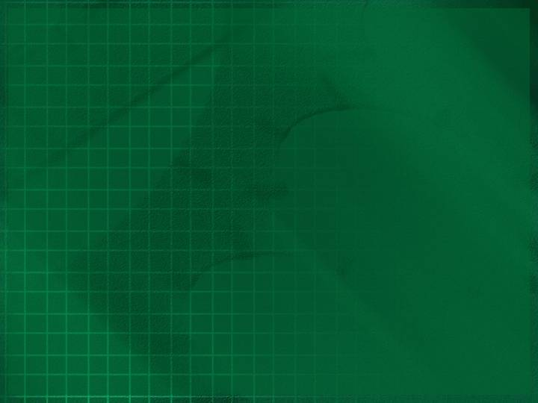
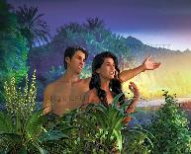
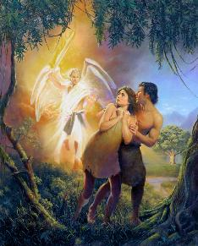
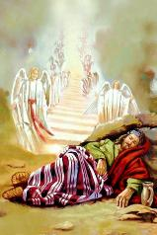
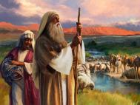

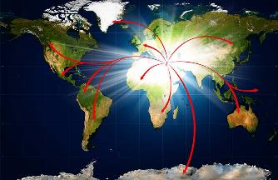
KO E FONUA NAʻE MOLE
“Ko ia naʻe fekau atu ia ʻe SIHOVA ko e ʻOtua mei he ngoue ʻo ʻIteni, ke ne ngāue ki he kelekele ʻaia naʻe toʻo ia mei ai.” (Senesi 3:23)
Naʻe fakanofo ʻe he ʻOtua ʻa ʻAtama mo ʻIvi ko e ongo pule ʻo e mamani ko ʻeni (Senesi 1:27-28), pea tuku kinaua ʻi he Ngoue ko ʻIteni (Senesi 2:8).
ʻI he taimi naʻa nau talangataʻa ai ki he ʻOtua, naʻe kapusi kinautolu mei ai (Senesi 3:23). Kuo mole meiate kinautolu ʻa e pule ki he Mamani.
Ka naʻe ʻi ai ha palani ʻa e ʻOtua maʻa e faʻahinga ʻo e tangata ke toe fakafoki mai ʻa e fonua naʻe mole. ʻI he konga ʻuluaki, naʻa Ne foaki kia ʻEpalahame, ʻAisake, mo Sekope ha kiʻi konga kelekele: Kenani (Senesi 13:14-15).
Naʻe faifai pe pea aʻu atu ʻa e koloa ki he mamani kotoa, ʻi he aʻu atu ʻa e ʻilo ki he ʻOtua ki he kakai mo e puleʻanga kotoa pe (ʻIsaia 11:9).
Naʻe iku ʻa e talangataʻa ʻa ʻIsileli ki ha liliu ʻi he ngaahi ʻuluaki palani. Naʻe fokotuʻu hake ʻe he ʻOtua ʻa e fanau ʻa ʻEpalahame mei he ngaahi maka ke maʻu ʻene ngaahi talaʻofa: ʻa kitautolu (Luke 3:8; Hepelu 6:11-12).

Slide 5

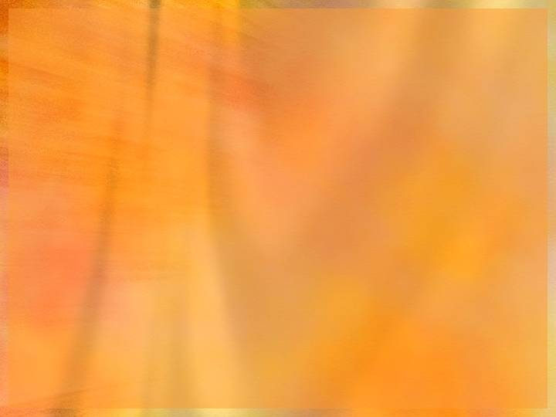
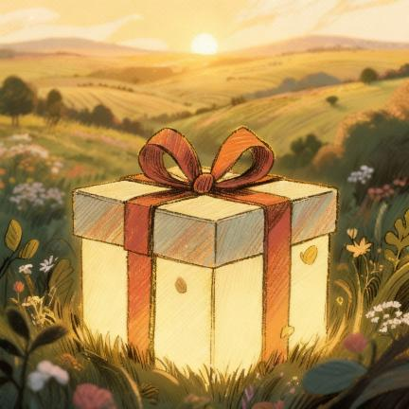
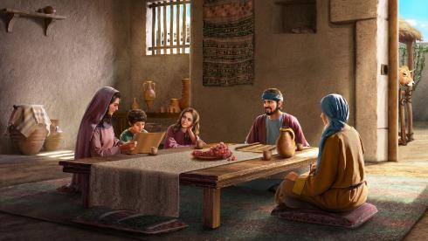
KO E FONUA ʻOKU FOAKI ʻE HE ʻOTUA
“‌ʻOku ʻo Sihova ʻae fonua kotoa pē, mo hono mahu ʻo ia;ʻa māmani, mo kinautolu ʻoku nofo ʻi ai.”
(Saame 24:1)
Hange pe ko e ʻikai fai ʻe ʻAtama mo ʻIvi ha meʻa ke tuha ai mo e Ngoue ko ʻIteni, naʻe ʻikai fai ʻe ʻEpalahame mo hono hako ha meʻa ke tuha ai mo e Fonua ʻo e Talaʻofa. Ko ha meʻaʻofa ia mei he ʻOtua.
ʻE lava ke tau fakafehoanaki ʻa e meʻaʻofa ko ʻeni ki ha fale totongi. Neongo naʻe lava ke nofo ʻa ʻIsileli ʻi Kenani, ka naʻe kei maʻu pe ʻe he ʻOtua ʻa e fonua (Saame 24:1).
Ko e tokotaha ʻoku ʻaʻana ʻa e fale ʻoku ne tokangaʻi hono tokangaʻi ʻo e ʻato, paipa, etc. ʻ I he tuʻunga meimei tatau, ko e ʻ Otuá ʻ a e tokotaha naʻá ne tokonaki mai ʻ a e ʻ uhá, maluʻi ʻ a e ngoué, mo e ala meʻa peheé, koeʻuhi ke lava ʻ a ʻ Isileli ʻ o nofo loto - falala ʻ i he fonua naʻe foaki ange ʻ e he ʻ Otuá kiate kinautolú.
Hange ko ia ʻi ʻIteni, naʻe ʻi ai ʻa e totongi ke "totongi": talangofua (Lev. 20:22). Ko e meʻa moʻoni ia ʻo e va fetuʻutaki: ʻofa ki he ʻOtua mo fiefia ʻi Heʻene ngaahi tapuaki.
ʻAneafi, ʻo hange ko e ʻaho ni, ʻoku kei hoko pe ia ko ha meʻa ʻo e tui (Hepelu 11:9-13).

Slide 6
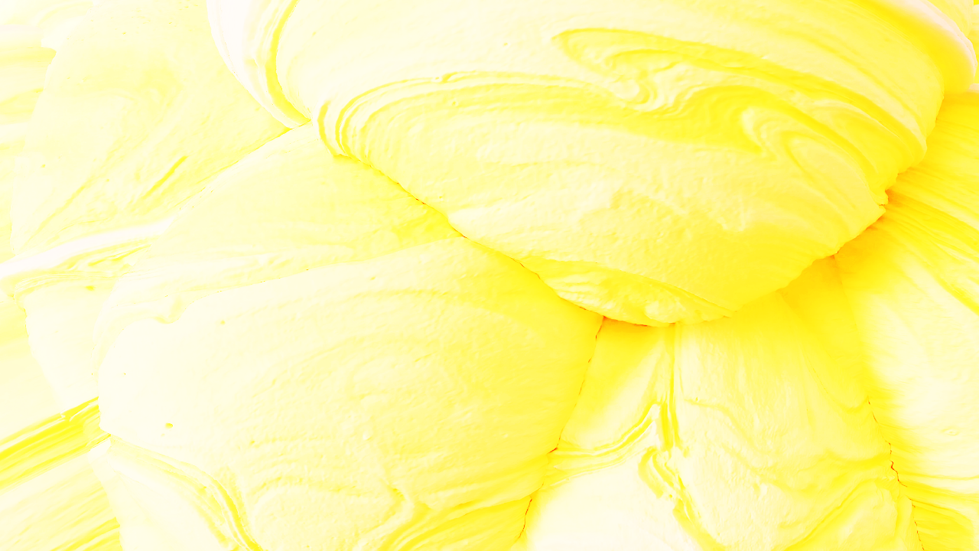
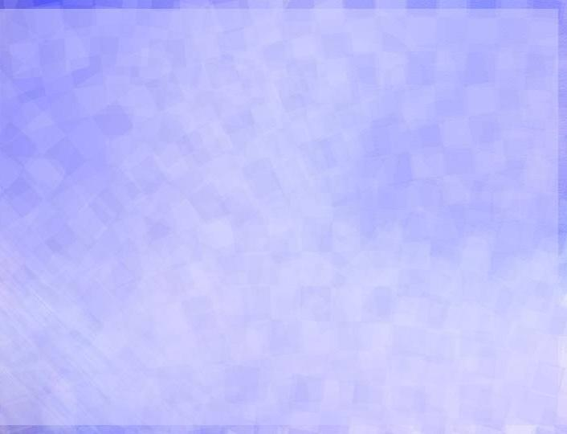
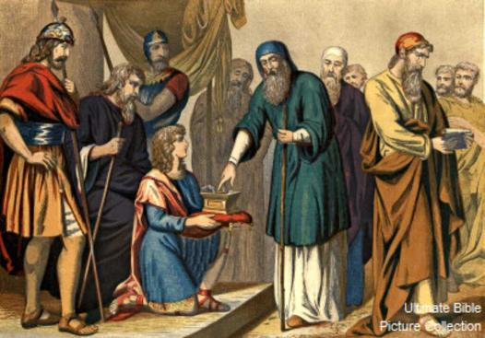
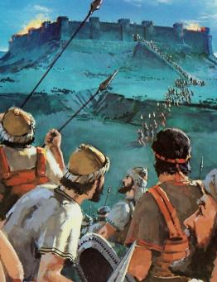
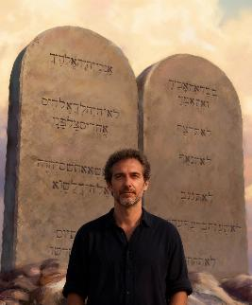
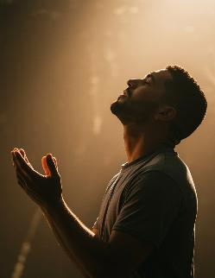
IKUNAʻI ʻA E FONUA
“Pea ko eni, vahevahe ʻae fonua ni ki he faʻahinga ʻe hiva mo hono vaeuaʻanga ʻoe faʻahinga ʻo Manase” (Siosiua 13:7)
ʻI he taimi naʻe motuʻa ai ʻa Sosiua, naʻe fekauʻi ia ʻe he ʻOtua ke vahevahe ʻa e fonua ki he ngaahi faʻahinga ʻo ʻIsileli, kau ai ʻa e ngaahi feituʻu naʻe teʻeki ikunaʻi (Siosiua 13:1-7).
Naʻa nau maʻu ʻa e kelekele, ka naʻe kei pau pe ke nau feinga ke maʻu ia. ʻOku ʻikai ngaue tauʻataina ʻa e ʻOtua mei he tangata; ʻOku Ne finangalo ke tau fai ʻetau tafaʻaki.
Neongo naʻa nau tau ke ikuna, ka naʻe ʻikai ko ʻenau lavameʻa ʻanautolu pe, ka ko e lelei ʻa e ʻOtua (Teu. 9:5). Hange ko ʻIsileli, he ʻikai ke tau lava ʻo fai ha meʻa ke maʻu ai ʻa e fakamoʻui mo maʻu ʻa e ngaahi talaʻofa (ʻEfeso 2:8-9; Kal. 3:29). Ka ʻo kapau naʻa nau tau... Ko e ha ʻoku totonu ke tau fai he ʻaho ni?
ʻI he taimi pe ʻoku fakamoʻui ai, ʻoku fie maʻu ʻe he ʻOtua ha meʻa ʻe ua mei hono kau ʻea: talangofua (Filipai. 2:12); mo e loto houngaʻia (Hepelu 12:28).

Slide 7

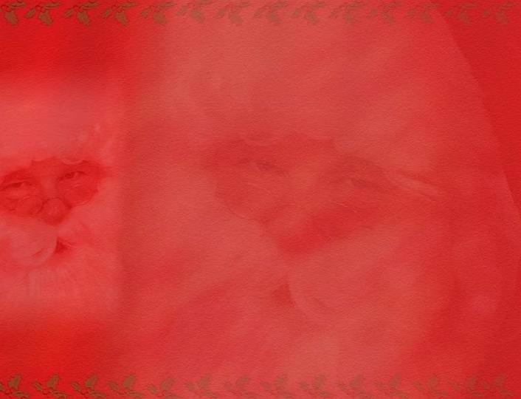
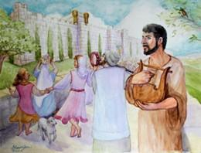
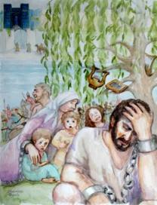
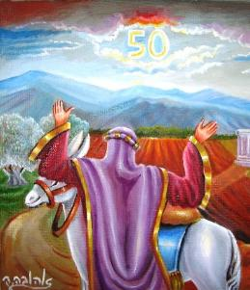
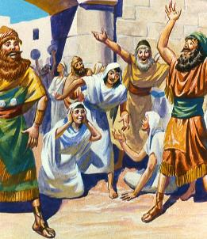
TAUHI ʻA E MEʻAʻOFA
“ʻE ʻikai fakatau ʻae fonua ʻo taʻengata: he ʻoku ʻoʻoku ʻae fonua; he ko e kau muli mo e ʻāunofo ʻakimoutolu kiate au.” (Levitiko 25:23)
ʻI hono maʻu pe ʻo e tofiʻa, naʻe ʻi ai ha ngaahi lao makehe naʻa ne puleʻi hono fakaʻaongaʻi ʻo e kelekele: ko e taʻu sapate mo e siupeli.
Ko e taʻu Sapate, ko ha fakalahi lahi ia ʻo e Sapate, naʻe fakaʻata ai ʻa e fonua ke malolo (Lev 25:2-5). Ko e ʻikai ke tauhi ʻa e fono ko ʻeni ko e taha ia ʻo e ngaahi ʻuhinga ʻo e fakaheeʻi (2Fkmatlme’ahokohoko 36:20-21).
Naʻe kau ʻi he siupeli ʻa e fakafoki ʻo e kelekele ki honau muʻaki kau maʻu, ʻo fakaʻehiʻehi mei he ngaahi tuʻunga kehekehe fakasosiale (Levitiko 25:10, 23, 40-41).
Ko hono moʻoni, ko e tefitoʻi taumuʻa ʻeni ʻo e ongoongolelei: ke tamateʻi ʻa e faikehekehe ʻi he vahaʻa ʻo e koloaʻia mo e masiva, ʻa e pule ngaue mo e tokotaha ngaue, monuʻia mo e masiva, ʻo tau tuʻunga tatau kotoa ʻaki ʻetau ʻiloʻi ʻetau fie maʻu kakato ʻa e ʻaloʻofa ʻa e ʻOtua.

Slide 8

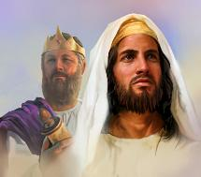
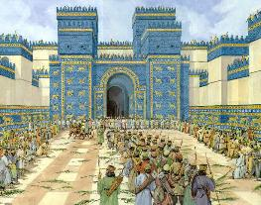
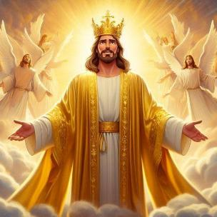
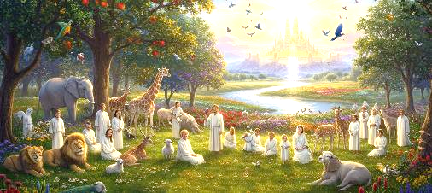
KO E KELEKELE NAʻE TOE MAʻU
“Pea te nau nofo ʻi he fonua, ʻaia kuo u foaki ki heʻeku tamaioʻeiki ko Sēkope, ʻaia naʻe nofo ai ʻa hoʻomou ngaahi tamai; pea te nau nofo ʻi ai, ʻio, ʻakinautolu, mo ʻenau fānau, mo e hako ʻo ʻenau fānau ʻo taʻengata; pea ko ʻeku tamaioʻeiki ko Tevita, ʻe pule ia kiate kinautolu ʻo taʻengata.” (‘Isikeli 37:25)
Koeʻuhi ko ʻenau talangataʻa, naʻe taʻaki fuʻu ʻa ʻIsileli mei honau fonua pea li ki Papilone. Ka naʻe ʻ ikai liʻaki kinautolu ʻ e he ʻ Otuá.
Naʻa ne palomesi ke fakafoki mai kinautolu, ʻoange kiate kinautolu ʻa e fonua ʻo taʻengata, pea fokotuʻu ʻa Tevita ko e tuʻi kiate kinautolu (ʻIsi. 37:25). Ka naʻe ʻ ikai ke maʻu ʻ e ʻ Isileli ʻ a e fonua ko iá ʻ o taʻengata, pea naʻe mate ʻ a Tēvita ʻ i ha taimi fuoloa. Ko e hā leva ʻ a e ʻ uhinga ʻ o e kikite ko ení?
ʻ Oku fanongonongo heni ʻ a Sīsū, ko e Tuʻi moʻoni ʻ a ia ʻ oku pule taʻengata. Ko Ia ʻoku ne fakapapauʻi mai kiate kitautolu ha tofiʻa taʻengata ʻi hono taʻataʻa.
Ko Ia ʻa e fakahoko ʻo e ngaahi talaʻofa kotoa pe (Loma 15:8; 2 Kolinito 1:20). ʻOku tau maʻu ʻiate Ia ʻa e ngaahi tapuaki he taimi ni pea ʻi he kahaʻu, ʻa e tofiʻa kuo talaʻofa mai (1 Pita 1:3-4). Kuo vavé ni ke tuʻu hotau vaʻé ʻ i he Fonua ʻ o e Talaʻofá.

Slide 9
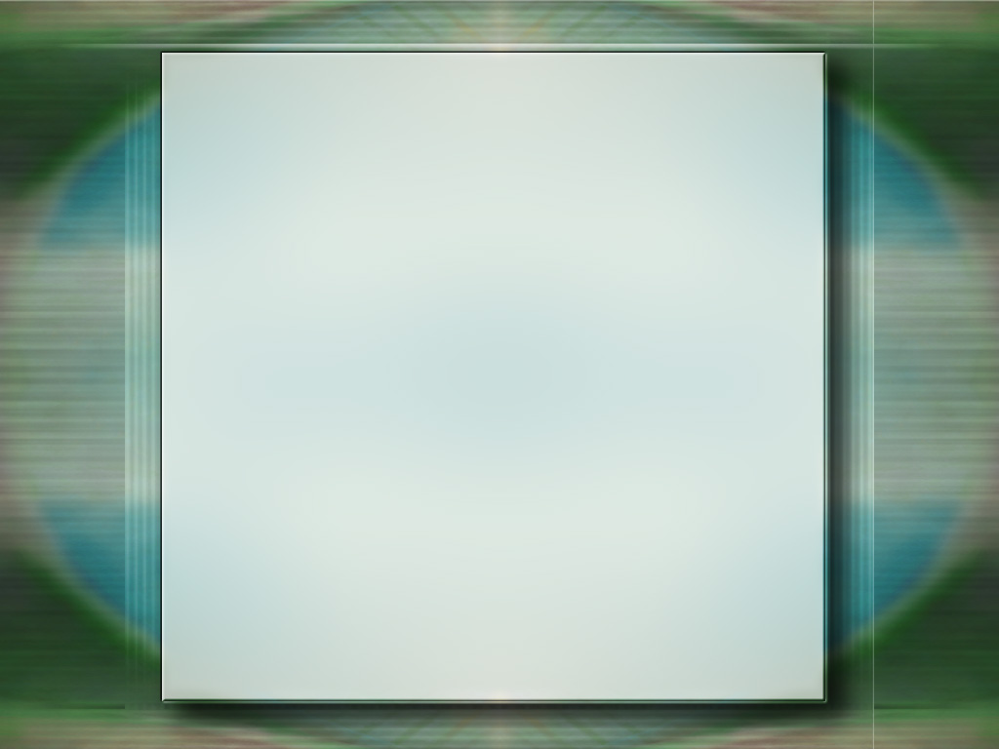
“Tuʻunga ʻi he talangataʻa ki he ʻOtua, naʻe mole ai ʻa ʻIteni kia ʻAtama mo ʻIvi, pea koeʻuhi ko e angahala naʻe fakamalaʻiaʻi ai ʻa e mamani kotoa. Ka ʻo kapau naʻe muimui ʻa e kakai ʻa e ʻOtua ki Heʻene fakahinohino, ʻe toe fakafoki honau kelekele ki he moʻui mo e fakaʻofoʻofa. Naʻe ʻoange tonu pe ʻe he ʻOtua kiate kinautolu ʻa e ngaahi fakahinohino fekauʻaki mo e anga fakafonua ʻo e kelekele, pea naʻe pau ke nau fengaueʻaki mo Ia ʻi hono toe fakafoki mai. Ko ia ai, ko e fonua kotoa, ʻ i he malumalu ʻ o e pule ʻ a e ʻ Otuá, ʻ e hoko ia ko ha lēsoni fakataumuʻa ʻ o e moʻoni fakalaumālié. Hange ko e talangofua ki Heʻene ngaahi fono fakanatula ʻoku totonu ke maʻu ʻe he mamani ʻa hono ngaahi koloa, ʻoku pehe pe ʻa e talangofua ki Heʻene fono fakaeangamaʻa ke fakafotunga mei he loto ʻo e kakai ʻa e ngaahi ʻulungaanga ʻo Hono ʻulungaanga.”
EGW (Ko e Ngaahi Lesoni Fakataumuʻa ʻa Kalaisi, p. 289)

