Slide 1
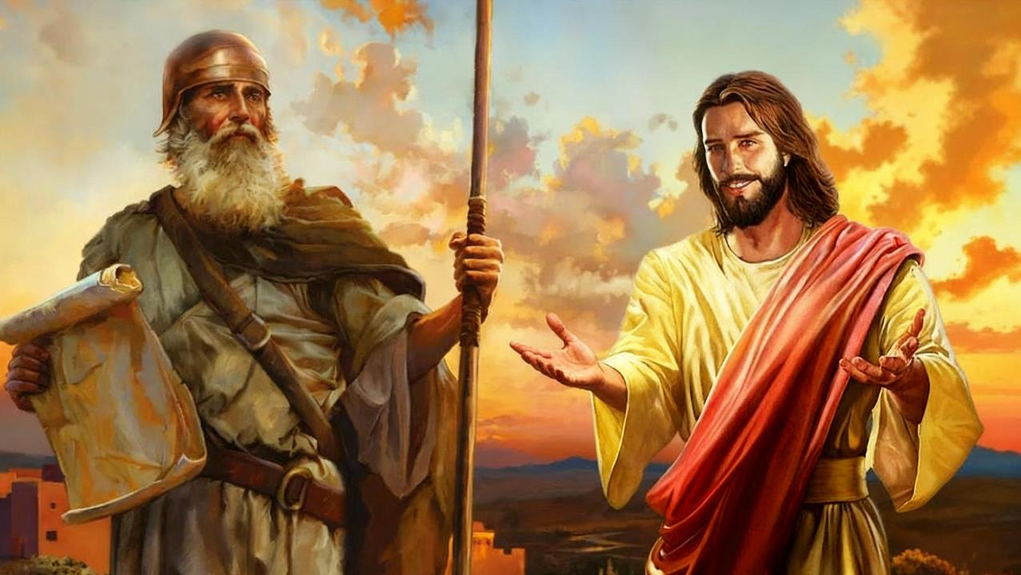
KO SOSIUA MOʻONI
Lesoni 10 ki he ʻaho 6 ʻo Tisema 2025

Slide 2
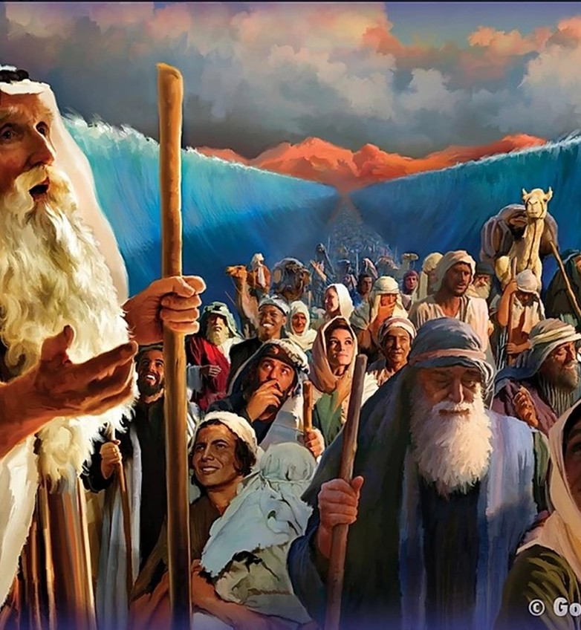
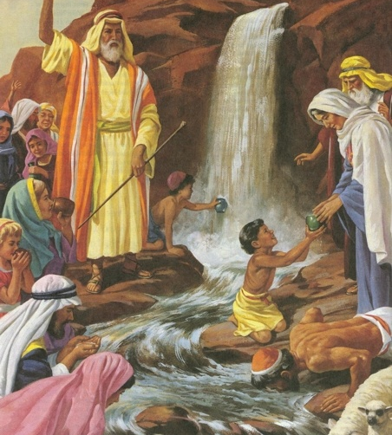
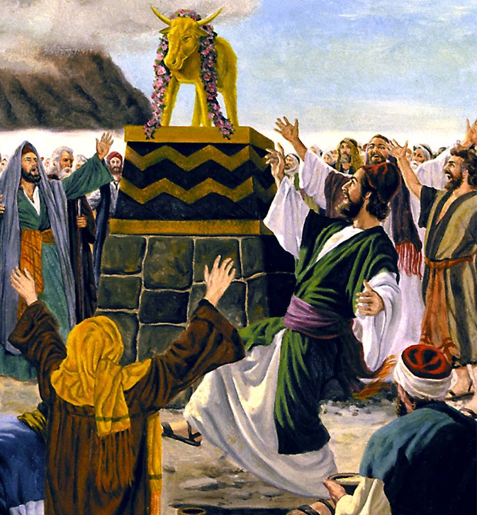
“Pea naʻe hoko ʻae ngaahi meʻa ni kotoa pē kiate kinautolu ko e ngaahi fakaʻilonga: pea kuo tohi ia ko hotau akonakiʻi, ʻakitautolu kuo hoko ki ai hono ngataʻanga ʻoe kuonga.” (1 Kolinitō 10:11)

Slide 3

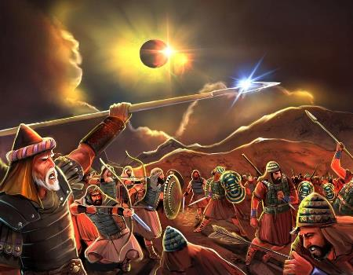
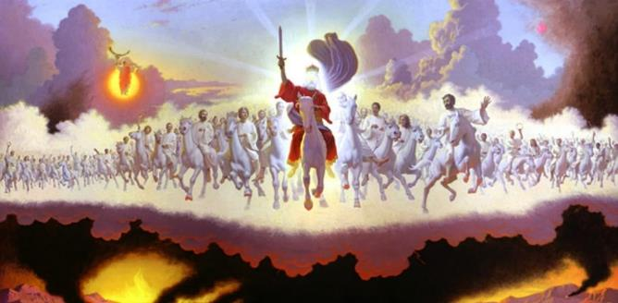







‘Oku lava ke tau lau ‘a e mo’ui ‘a Siosiua, ‘a ia ‘oku fakamatala’i ‘i he Penitātusi pea mo e tohi ‘a Siosiua tonu, ‘i ha founga kehekehe (pea fakakakato) ‘e ua: ko e hisitōlia mo e fakataipe.
Koeʻuhi ke lava ʻo fakaʻuhingaʻi totonu ʻa e fakatata ʻo Sosiua, kuo pau ke tau ʻuluaki ʻiloʻi ʻa e ngaahi lao ʻoku ne puleʻi ʻa e fakataipe fakatohitapu: ʻa e ngaahi faʻahinga mo e ngaahi fakataipe.
Ko ʻene fai pe ʻeni, te tau fakatotoloʻi ʻa e fakataipe ʻo Sosiua ʻi he toenga ʻo e Tohi Tapu ke maʻu ʻa e ngaahi popoaki kuo tuku mai ʻe he ʻOtua kiate kitautolu ʻi Heʻene Folofola fekauʻaki mo e "fakataipe ʻo Sosiua".
Fakataipe ʻo e Tohi Tapu:
  Ko e ha ‘a e fakataipe?
  Ngaahi kalasi fakataipe
Ko e fakataipe ʻo Sosiua:
  Ko Siosiua ko e fakataipe
  Ko e fakatātā ‘o Sosiua
  Ko Sosiua ko e taipe ia 'o e Siasi

Slide 4

FAKATAIPE ʻO E TOHI TAPU

Slide 5


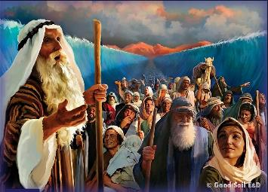
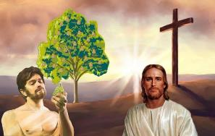
KO E HA ʻA E FAKATAIPE?
“Pea naʻe hoko ʻae ngaahi meʻa ni kotoa pē kiate kinautolu ko e ngaahi fakaʻilonga: pea kuo tohi ia ko hotau akonakiʻi, ʻakitautolu kuo hoko ki ai hono ngataʻanga ʻoe kuonga.” (1 Kolinitō 10:11)
ʻOku fakaʻaongaʻi ʻe Paula – mo e kau faʻu tohi Tohi Tapu kehe – ʻa e foʻi lea ko e "taipe" ke ʻuhinga ki ha tokotaha fakahisitolia pe meʻa naʻe hoko ʻoku ne fakafofongaʻi ha meʻa pe ha taha mei hono taimi mo e/pe kahaʻu (ʻoku ui ko e "antitype").
Hange ko ʻeni, ʻoku lau ʻa e Loma 5:14 ʻo kau kia ʻAtama ko ha fakataipe ["fakatataa" ʻi he NKJ] "ʻo ia ʻe haʻele mai," ʻa ia ko Sisu ko e fakataipe.
Ko e faʻahinga
Tevita (Saame 22:1)
Tu’uaki Sīpinga totonu
Ko ha Tevita foʻou (Selemaia 23:5)
Ko e Sīpinga totonu
Ko Sīsū (Matiu. 27:46)
Ko e faʻahinga
Ngaahi Feilaulau (Lev. 1:3-5)
Tu’uaki Sīpinga totonu
Tamaioʻeiki faingataʻaʻia (ʻIsaia 53:5-7)
Ko e Sīpinga totonu
Pekia ʻa Sisu (Sione 19:16-18)
ʻI he ngaahi meʻa lahi, ʻoku tau maʻu ai ʻi he Fuakava Motuʻa ha fakaʻilonga ko ha kakai pau pe ngaahi meʻa ʻe hoko ko ha fakataipe ia ʻo ha meʻa ʻe hoko mai. Tau vakai ki ha sīpinga ʻe ua:

Slide 6

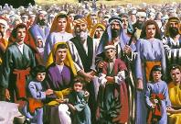
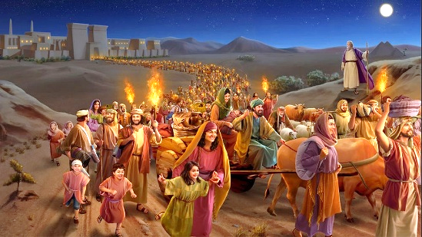
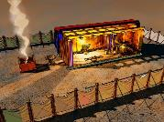
NGAAHI KALASI FAKATAIPE
“Pea naʻe ʻi ai ia ʻo aʻu ki he mate ʻa Helota: ke fakamoʻoni ʻaia naʻe folofolaʻaki ʻe he ʻEiki ʻi he palōfita, ʻo pehē, “Kuo u ui mai hoku foha mei ʻIsipite.”” (Matiu 2:15)
ʻOku tuhu ʻa e ngaahi fakataipe ʻi he Fuakava Motuʻa ki ha faʻahinga kehekehe ʻe tolu ʻo e fakataipe ʻi he Fuakava Foʻou: Kalaisi; ʻa e Siasi; pea mo e kuonga fakaʻosi.
SĪPINGA MOE SĪPINGA TOTONU
‘Isileli
Ko ʻEkesotosi
Ko e Falefehikitaki
Kalaisi
Siasi
Kuonga Fakaosi
Kalaisi
Siasi
Kuonga Fakaosi
Kalaisi
Siasi
Kuonga Fakaosi
Naʻe ʻave ia ki ʻIsipite
Matiu 2:13-15
Ko e ʻIsileli foʻou
Kalētia 6:16
Ko e toko 144,000
Fakaha 7:4
ʻAho ʻe 40 ʻi he Toafa
Matiu 3:16-4:2
Papitaiso mo poupouʻi ʻe Kalaisi
1 Kolinito 10:1-6
ʻEkesotosi mei he ngaahi siasi he mei he moʻoni
Fakaha 18:4
Naʻe hange ia ha temipale ʻi homau lotolotonga
Sione 1:14; 2:21-22
Ko e temipale kitautolu ʻo e ʻOtua
1 Kolinito 3:16-17
Ko e Selusalema Foʻou, ko hotau temipale
Fakaha 21:2-3
SĪPINGA
SĪPINGA TOTONU

Slide 7

KO E FAKATAIPE ʻO SIOSIUA

Slide 8


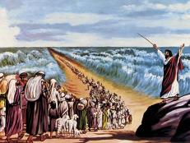
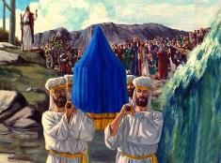
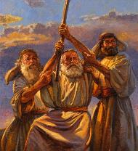
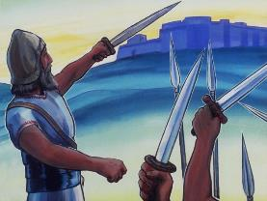
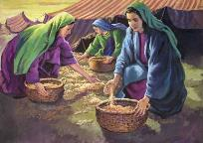
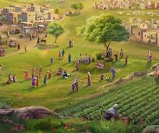
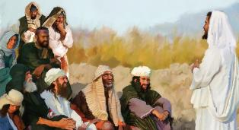
KO E FAKATAIPE ʻO SIOSIUA
“ʻE fokotuʻu ʻe Sihova ko ho ʻOtua ha palōfita kiate koe, ʻi ho ngaahi kāinga, ʻo hangē ko au; ke mou tokanga kiate ia.” (Teutalonome 18:15)
Naʻe fakahoko fakakonga ʻe Siosiua ʻa e kikite ʻa Mosese fekauʻaki mo ha palofita hono ua te ne tataki ʻa e kakai (Teutalonome 18:15-19).
Hange ko Mosese, naʻe maʻu ʻe Sosiua ha ngaahi popoaki fakahangatonu mei he ʻOtua; naʻa ne katoangaʻi ʻa e Lakaatu; naʻa ne kolosi ʻi he vai; naʻa ne mamata ki he ʻAngelo ʻa e ʻEiki; naʻe ikuna ʻe hono nima naʻe mafao mai; Naʻa ne fakaafeʻi ʻa e kakai ke nau kei faivelenga hili ʻEne pekia
Neongo naʻe kamata ke to ʻa e mana kia Mosese, ka naʻe ngata ia ʻi he malumalu ʻo Sosiua. ʻ Ikai ko ia pē, naʻe fakahoko ʻ e Siosiua ʻ a e ngaahi fakahinohino fekauʻaki mo hono vahevahe ʻ o e fonuá mo e ngaahi kolo hūfangaʻanga naʻe ʻ oange ʻ e Mōsesé.
Ka naʻe mahino ki he kakai naʻe mahulu atu ʻa e kikite ʻa Mosese ʻia Sosiua (Sione 1:21). Ko ia ai, ʻoku fakatou hoko ʻa Mosese mo Sosiua ko e ngaahi sipinga ʻo e fakataipe moʻoni ʻa ia naʻa na ʻiloʻi kakato ʻa e kikite naʻe fai kia Mosese fekauʻaki mo e "Palofita": Sisu (Ngaue 3:22-26).

Slide 9


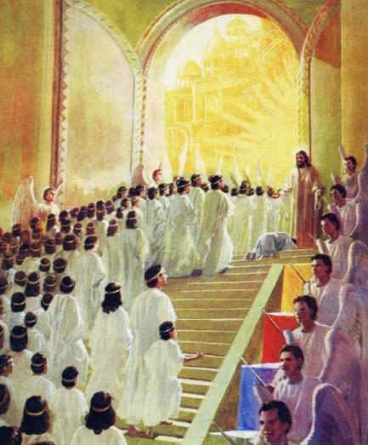
KO E FAKATAIPE ʻO SIOSIUA
“‌ʻOku pehē ʻe Sihova, “ʻI he kuonga tuʻutuʻumālie kuo u fanongo kiate koe, pea ʻi he ʻaho fakamoʻui kuo u tokoni kiate koe:pea te u maluʻi koe, pea foaki koe ko e fuakava ʻoe kakai,
ke fokotuʻumaʻu ʻa māmani, ke ngaohi ke toe kakai ʻae ngaahi ʻapi liʻaki;” (Isaia 49:8)
Ko e taumuʻa ʻ o e ngaahi tau naʻe taki ʻ e Siosiuá ke fokotuʻu ʻ a e kau ʻ Isilelí ʻ i he Fonua ʻ o e Talaʻofá. ʻOku fakahaaʻi ʻe ʻIsaia ʻa e ngaue ʻa e Misaia ʻo pehe ʻoku kau ai hono vahe ʻo e "ngaahi tofiʻa lala [ki hono kakai]" (ʻIsaia 49:8, ) ʻo fakaʻaongaʻi ʻa e foʻi lea tatau mo e tohi ʻa Sosiua.
Ko e ha ʻa e ʻuhinga ʻoku ha mai ai ʻa e moʻui mo e ngaue ʻa Sosiua (ko ha fakataipe) ʻi he moʻui mo e ngaue ʻa Sisuu (ko e fakataipe)?
Hili hono papitaiso ia ʻi Soatani, naʻe fakafepakiʻi ʻe Sisu ʻa e
Ko e ngaahi malohi ʻo e kovi
Naʻe kamata ʻene ngaue hili ha ʻaho ʻe 40 ʻi he toafa
Naʻa Ne ikunaʻi ʻa e fili ʻi he kolosi
ʻ Okú ne ʻ omai kiate kitautolu ʻ a e ikuna ʻ i hotau ngaahi fili fakalaumālié
ʻOku Ne foaki mai ʻa e fiemalie moʻoni kiate kitautolu
ʻ Okú ne vaheʻi mai kiate kitautolu ha tofiʻa taʻefaʻaʻauha

Slide 10

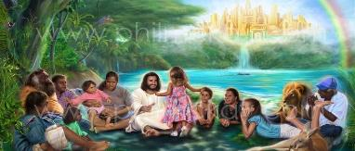
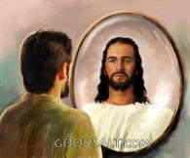
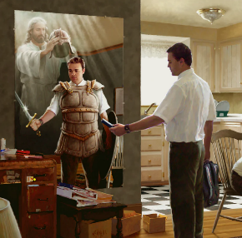

HOKO ʻA SOSIUA KO HA FAKATAIPE ʻO E SIASI
“He ʻoku ʻikai ko ʻetau fangatua mo e kakano mo e toto, ka ki he ngaahi pule, mo e ngaahi mālohi, mo e kau pule ʻoe fakapoʻuli ʻoe māmani, mo e kau laumālie kovi ʻi he ngaahi potu ʻi ʻolunga.” (Efesō 6:12)
SIOSIUA MO E SIASI
ʻOku ʻi ai ha tau ke tau he ʻaho ni, ʻa ia ʻoku taki ai kitautolu ʻe hotau "Sosiua", ʻa ia ʻoku ne fakanaunau kitautolu ʻaki ʻa e teunga tau ʻoku fie maʻu (ʻEfeso 6:10-12).
ʻIkai ngata ai, kuo ne ʻosi vaheʻi mai kiate kitautolu ha tofiʻa, pea fakafonu kitautolu ʻaki ʻa e ngaahi tapuaki fakalaumalie (ʻEfeso 1:3, 11)
SIOSIUA MO E KUONGA FAKAʻOSI
Ka ko hono fakahoko kakato ʻo e fakataipe ʻo Sosiua ʻe hoko ia ʻi he ngataʻanga, ʻi he taimi ʻe fakaʻauha ai ʻa e kau tau kotoa pe ʻo e kovi, pea tau maʻu kakato hotau tofiʻa: ko ha fonua ʻe lava ke tau nofo ai ʻi he falala (Fakaha 20:7-9; ʻIsikeli 28:26)
Kae ʻoua kuo hokosia ʻa e taimi ko ia, tau tupulaki muʻa ʻi he ʻaloʻofa ʻo hange ko ia naʻe fai ʻe Sosiua, ʻo fakaʻata ʻa e ʻOtua ke liliu kitautolu ke tau hoko ʻo hange ko Ia ʻi he ʻaho takitaha

Slide 11

"ʻOku ʻi ai ha ʻEikitau ʻo e ʻIsileli ʻo e ʻOtua, ʻi heʻenau fononga ki he Kenani fakalangi, naʻe ʻikai fie maʻu ha akoʻi fakaetangata ke teuteuʻi Ia ki Hono misiona ko ha taki fakalangi; ka naʻe fakahaohaoaʻi Ia ʻi he ngaahi mamahi; pea "ko e meʻa ʻi Heʻene katakiʻi ʻi hono ʻahiʻahiʻi, ʻoku Ne faʻa tokoni kiate kinautolu ʻoku ʻahiʻahiʻi." Hepelu 2:10, 18. Naʻe ʻikai fakahaaʻi ʻe hotau Huhuʻi ha vaivai pe taʻehaohaoa fakaetangata; ka naʻa Ne pekia ke tau hu ki he Fonua ʻo e Talaʻofa."
EGW (Kau Pēteliake mo e Kau Palōfitá, p. 480)

