Slide 1
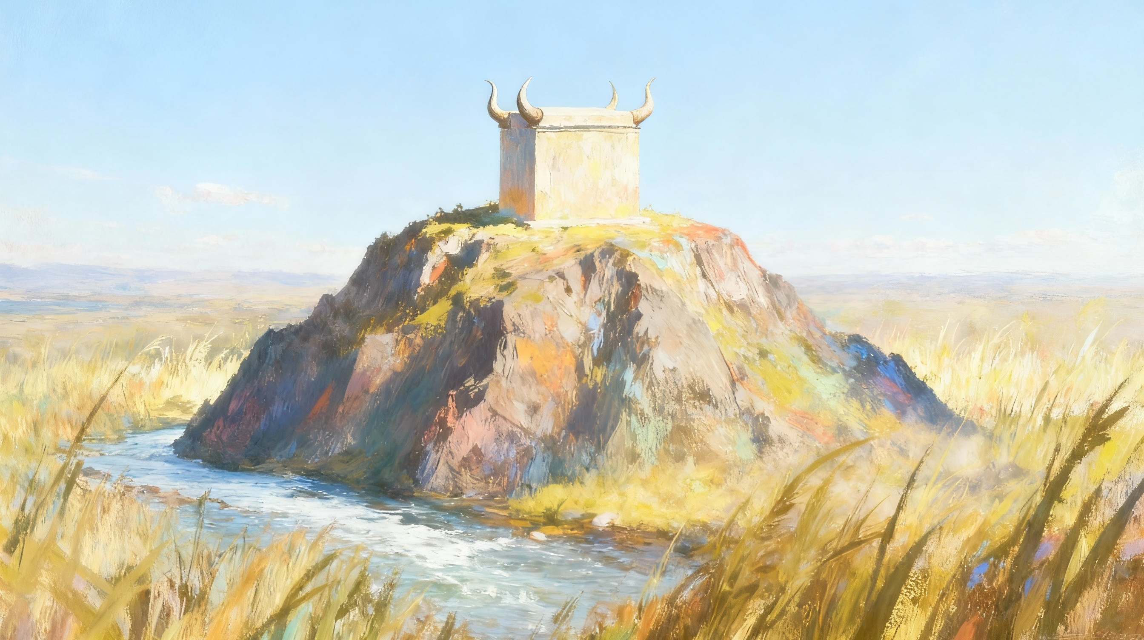
MO’UI ʻI HE FONUA
Lesoni 11 ki he ʻaho 13 ʻo Tisema 2025

Slide 2
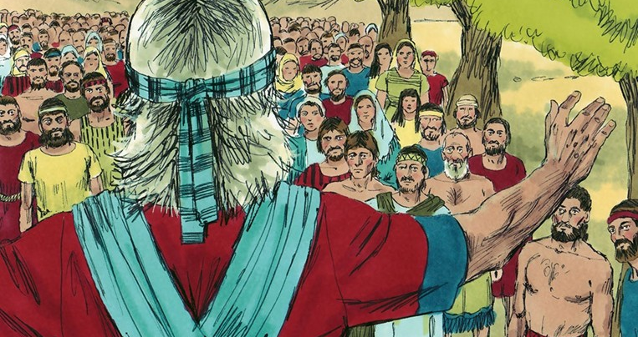

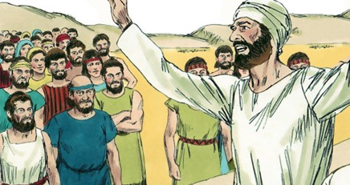
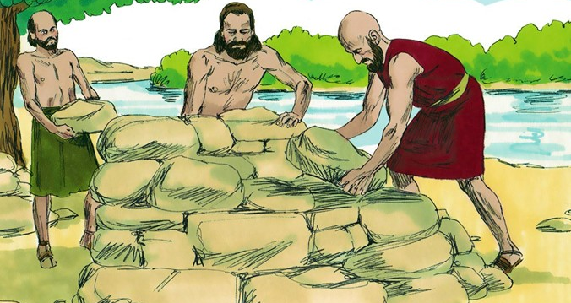
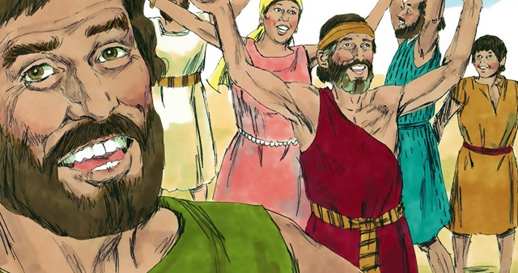
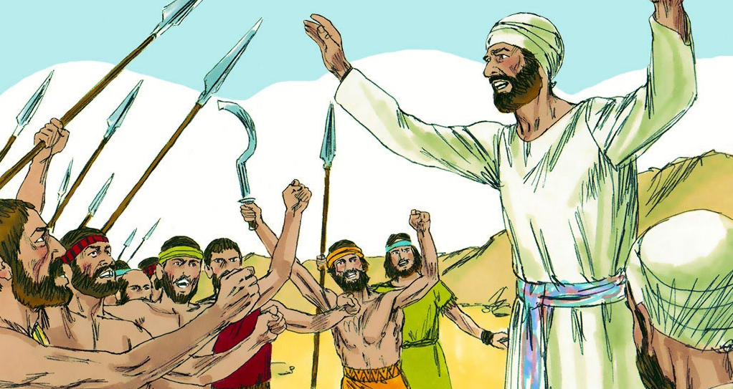
“ʻOku tekeʻi atu ʻae houhau ʻe he tali fakavaivai:ka ʻoku fakatupu ʻae ʻita ʻi he lea fakamamahi.” (Lea Fakatātā 15:1)

Slide 3

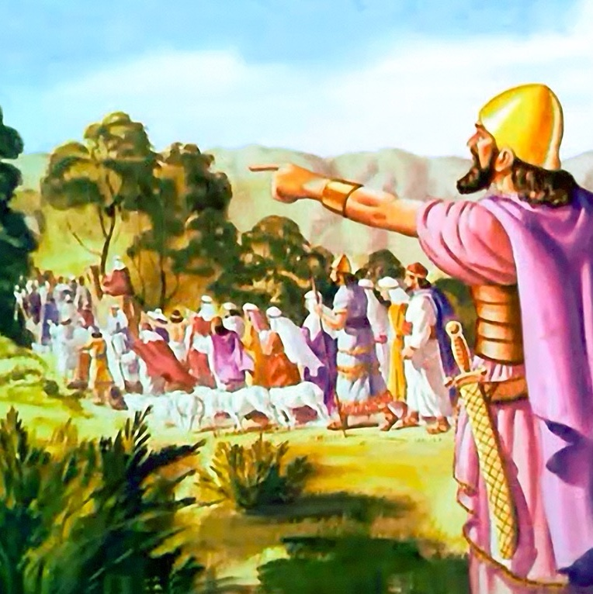
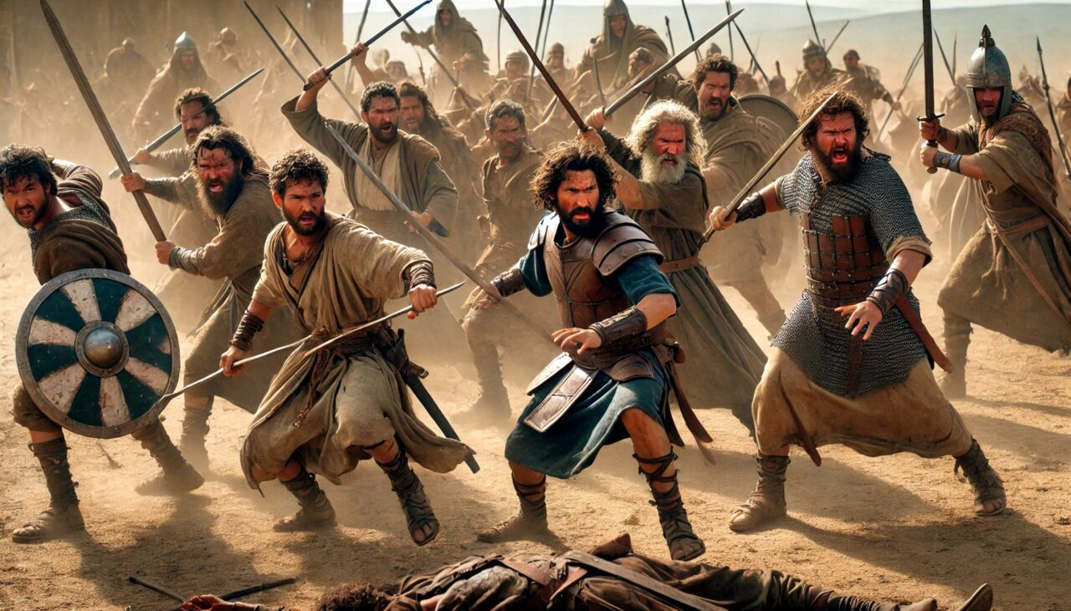

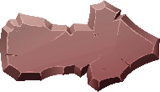


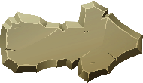
Hili ha ngaahi taʻu lahi ʻ o e taú, naʻe ikunaʻi ai ʻ e ʻ Isileli ʻ a Kēnaní, neongo naʻe teʻeki ai ke kapusi kotoa ʻ a hono kakaí.
Ko e faʻahinga ʻe ua mo e konga naʻa nau maʻu ʻa e feituʻu fakahahake (Lupeni, Kata mo e faʻahinga vaeua ʻo Manase), pea naʻa nau kolosi ʻi Soatani ke tokoni ʻi hono ikunaʻi, naʻa nau fakahoko faivelenga ʻenau tukupaa.
Naʻe faifai pea hokosia ʻa e taimi ke mavae ai. Hili hono tāpuakiʻi kinautolu mo faleʻi kinautolu ke hokohoko atu ʻ i he hala ʻ o e ʻ Otuá, naʻe tukuange kinaua ʻ e Siosiua. Ka naʻe ʻufiʻufi ʻa e lea fakamavae ʻe ha fetaʻemahinoʻaki mafatukituki ʻa ia naʻe mei faingofua ke ne fakaʻauha ʻa e uouangataha ʻa e kakai ʻIsilelí.
Ko e Lea Fakamavae (Siosiua 22:1-8)
Ko e ʻuhinga ʻo e fepaki (Siosiua 22:10-12)
Ko e ngaahi tukuakiʻi (Siosiua 22:13-20)
Ko e tali ʻofa (Siosiua 22:21-29)
Fakalelei (Siosiua 22:30-34)

Slide 4


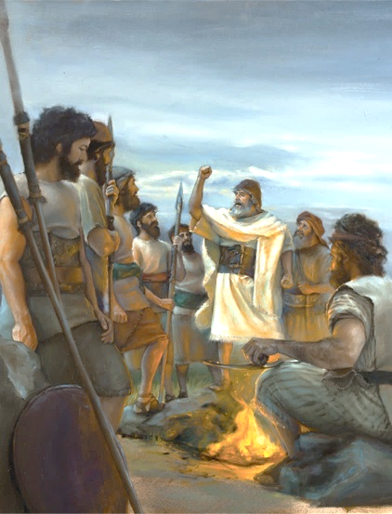
KO E LEA FAKAMAVAE
“Ka mou faʻa vakai ʻo fai ki he fekau mo e fono, ʻaia naʻe fakapapau ʻe Mōsese ko e tamaioʻeiki ʻa Sihova kiate kimoutolu, ke mou ʻofa kia Sihova ko homou ʻOtua, pea ke ʻaʻeva ʻi hono ngaahi hala, pea ke tauhi ʻene ngaahi fekau, pea ke mou pikitai kiate ia, pea ke mou tauhi ia ʻaki homou loto kotoa, pea mo homou laumālie kotoa.””(Siosiua 22:5)
Koeʻuhi ʻe fakatupu ʻe Soatani ha fakamavahevaheʻi ʻi he vahaʻa ʻo e ngaahi faʻahinga, naʻe fai ʻe Sosiua ha faleʻi fakapotopoto ki he faʻahinga ʻe ua mo e konga koeʻuhi ke nau lava ʻo faivelenga ai pe (Siosiua 22:5):
Ke ʻofa ki he ʻEiki ko ho ʻOtua
Ke ʻaʻeva ʻi he talangofua kiate ia
Ke tauhi ʻene ngaahi fekau
Ke pikitai kiate ia
Ke tauhi kiate ia ʻaki ho loto mo e laumalie kotoa
Ko e ʻofa ʻa e tefitoʻi moʻoni ʻoku totonu ke ne tataki kitautolu ki he ʻOtua. ʻOku tau ʻofa kiate Ia koeʻuhi he naʻa Ne tomuʻa ʻofa ʻiate kitautolu (1 Sione 4:19)
Ko e founga eni ʻ oku fakahaaʻi ai ʻ e Siosiua ʻ a e ʻ ulungaanga ʻ oku ʻ amanekina mei he faʻahinga ʻ oku nau fili ke ʻ aʻeva mo e ʻ Otuá
Ko e talangofua ko e ola fakanatula ia ʻo ha loto houngaʻia ʻoku mahino kiate ia ʻa e meʻa kuo fai ʻe he ʻOtua
Kuo pau ke tau pikitai ki he ʻ Otuá ʻ o ʻ ikai fakaʻatā ha faʻahinga fakahohaʻasi ke ne maumauʻi ʻ a e haʻi ko iá
ʻOku tau maʻu ʻetau taumuʻa moʻoní, fiemālie, mo e moʻui mahutafea ʻ i he taimi ʻ oku tau tauhi loto - lelei ai ki hotau Tokotaha - Fakatupú ʻaki ʻa e ʻofá

Slide 5


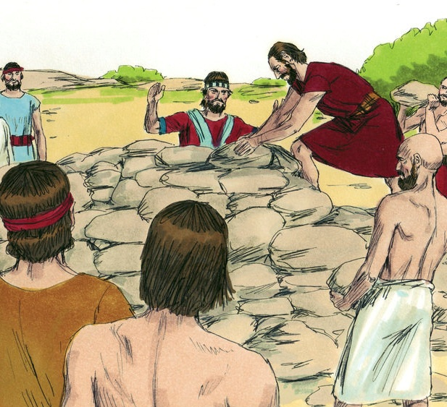
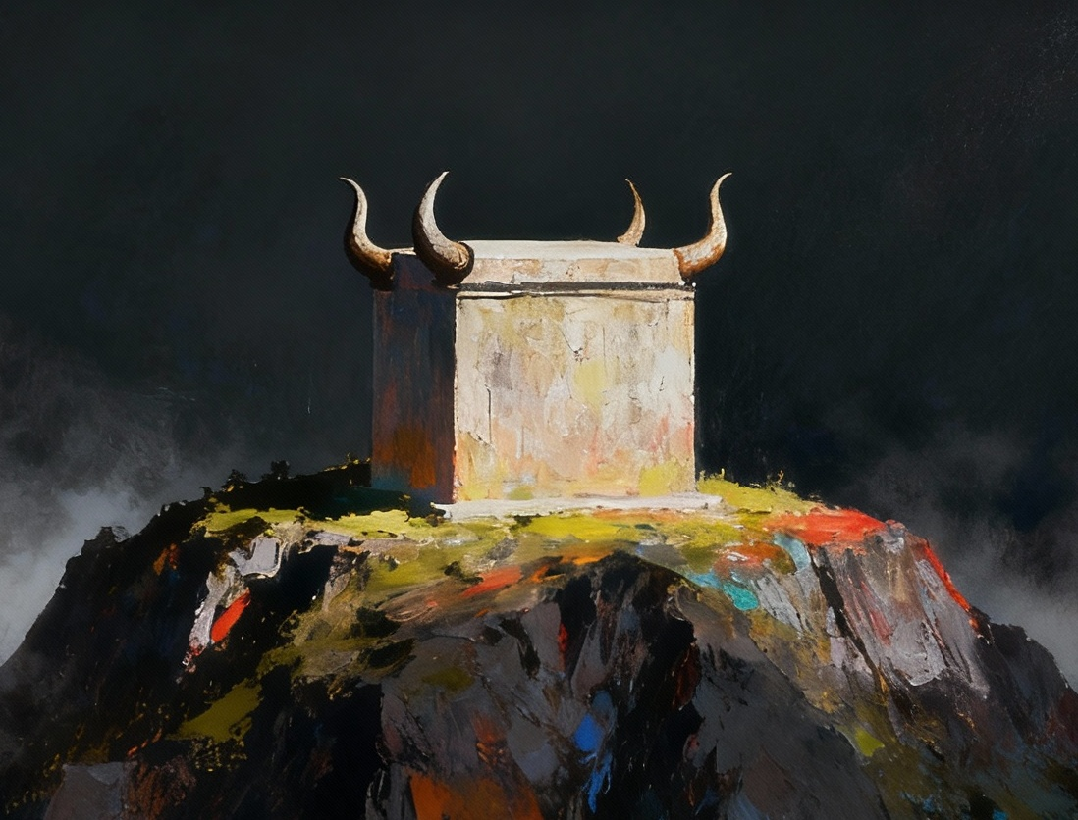
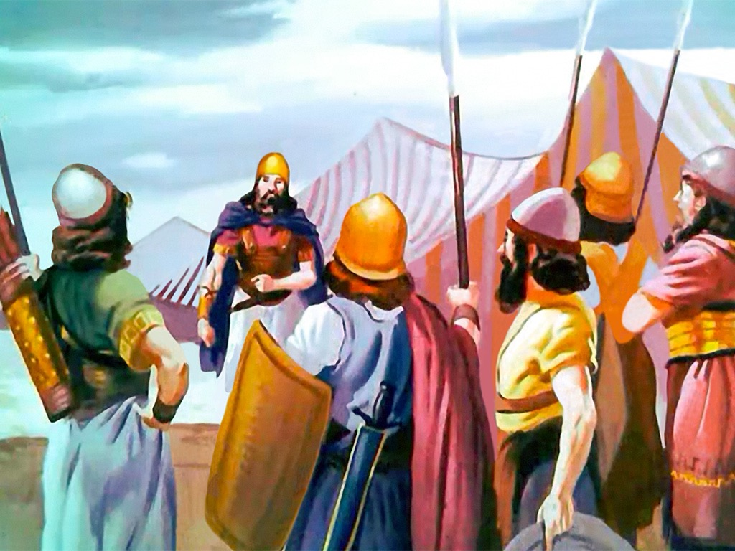
KO E ʻUHINGA ʻO E FEPAKI
“Pea ʻi heʻenau hoko ki he veʻe Sioatani, ʻaia ʻoku ʻi he fonua ko Kēnani, naʻe fokotuʻu ʻi ai ʻe he fānau ʻa Lupeni mo e fānau ʻa Kata mo hono vaeuaʻanga ʻoe faʻahinga ʻo Manase ʻae ʻesifeilaulau ofi ki Sioatani, ʻae ʻesifeilaulau lahi ke vakai ki ai.” (Sosiua 22:10)
Ofi ki he feituʻu naʻe fokotuʻu ai ʻe Sosiua ha fakamanatu ʻo e kolosi fakaofo ʻi Soataní, naʻe langa ʻe he matakali ʻe ua mo e kongá ha ʻōlita ʻo tatau mo e ʻōlita ʻo e Potu Toputapú (Sosiua 22:10, 28)
Naʻe fakaʻuhingaʻi ʻa e ngaue ko ʻeni ko ha maumauʻi ʻo e fono naʻe tapui ai ʻa e feilaulau ʻi ha feituʻu kehe mei he ʻesi-feilaulau tutu ʻi he Potu Tapu (Lev 17:8-9)
Naʻe fakakaukau ʻa e toenga ʻo e kau ʻIsileli ke fakaʻauha ʻa e angahala ko ʻeni ʻaki hono ʻohofi honau ngaahi tokoua (Sosiua 22:12). Ka naʻe kau mai ʻ a e ʻ Otuá ke taʻofi ha tau fakalotofonua fakatoto. Naʻa Ne fokotuʻu hake ha kakai naʻa nau fili ke ʻoua naʻa nau fakamaau taʻe ʻi ai ha fakamoʻoni kotoa; naʻa nau foaki ʻa e lelei ʻo e veiveiua; pea naʻa nau fakakaukau ke ʻoange ki honau ngaahi tokoua ʻa e faingamalie ke nau fakamatalaʻi kinautolu (Sosiua 22:13-14)
Ko ʻene fehalaaki pe ko e ʻikai ke ne fakaha ki hono ngaahi tokoua ʻa ʻene ngaahi taumuʻa... ka ʻoku ʻikai ko ha angahala ia

Slide 6

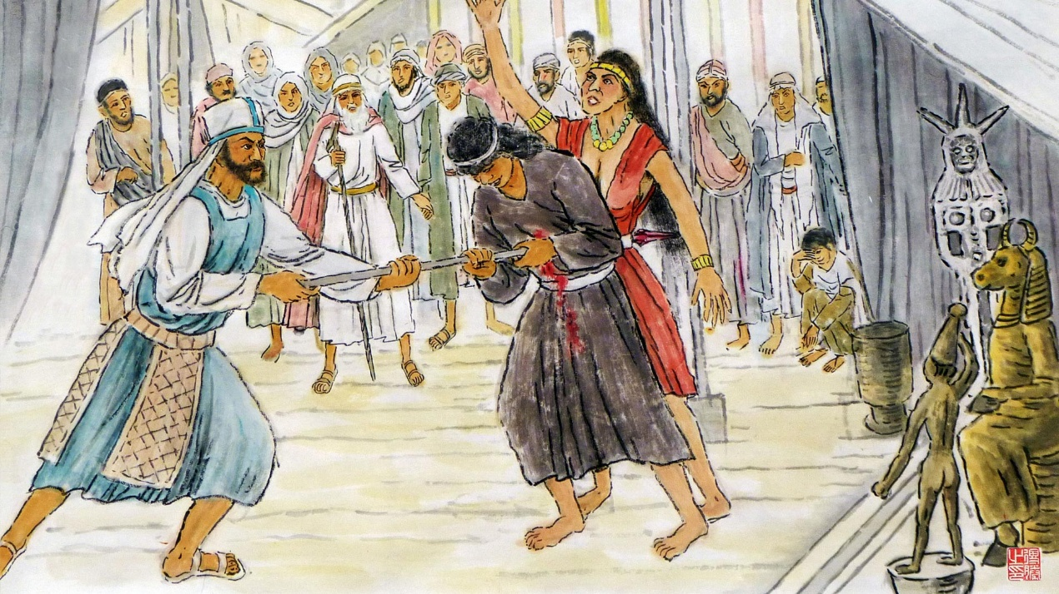
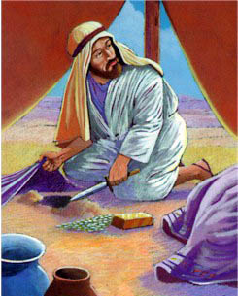
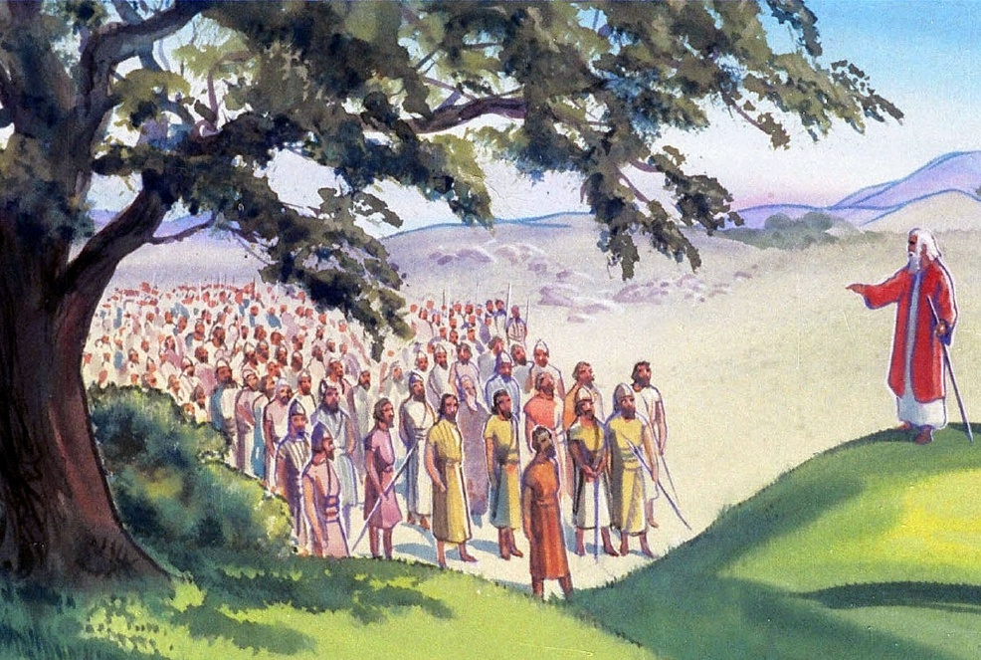
KO E NGAAHI TUKUAKIʻI
" ‌ʻOku pehē mai ʻe he fakataha kotoa pē ʻa Sihova, “Ko e hā ʻae meʻa hala ni kuo mou fai ki he ʻOtua ʻo ʻIsileli, ke tafoki he ʻaho ni mei he muimui ʻia Sihova, ʻi hoʻomou langa kiate kimoutolu ha feilaulauʻanga, koeʻuhi ke mou fai angatuʻu he ʻaho ni kia Sihova? " (Sosiua 22:16)
Ko e ha naʻe fili ai ʻa Fineasi ke ne taki ʻa e komiti fakatotolo
(Sosiua 22:13-14)?
Naʻe taʻetuku ʻa Finiasi, ko e foha ʻo e taulaʻeiki lahi, ʻi hono taʻofi ʻa e angahala ʻi Peali-Peola (Nomipa 25:7-8). ʻI heʻene lea, naʻa ne fakafehokotaki ʻa e angahala ko ʻeni ki he angahala ʻa ʻAkeni pea fakatatau ia ki he angahala naʻe fai ʻe he faʻahinga ʻe ua mo e konga (Sosiua 22:16-20)
Naʻe ʻ uhinga lelei ʻ aupito ʻ a e lea ʻ a Fineasí. Kapau naʻe fai ha ngaahi feilaulau ʻi he ʻolita foʻou ne toki fokotuʻu, ʻe tauteaʻi kotoa ʻe he ʻOtua ʻa ʻIsileli koeʻuhi ko ia (Sosiua 22:18)
Neongo ia, naʻa ne ʻoange kiate kinautolu ʻa e faingamalie ke fakatonutonu ʻa e fehalaaki ko ʻeni, kimuʻa pea nau fai ʻa e angahala: naʻa ne ʻoange kiate kinautolu ʻa e faingamalie ke nau foki ki he tafaʻaki ʻo Soatani ʻa ia naʻe tuʻu ai ʻa e Potu Tapu (Sosiua 22:19)

Slide 7


KO E TALI ʻOFA
“‌ʻEmau langa homau feilaulauʻanga ke tafoki mei heʻemau muimui ʻia Sihova, pea kapau ko e meʻa ke fai ki ai ʻemau ngaahi feilaulau tutu, pe ko e feilaulau meʻakai, pea ke ʻatu ʻi ai ʻae ngaahi feilaulau fakalelei, tuku ke totongi ia ʻe Sihova pe;.” (Sosiua 22:23)
Ko e faʻahinga ʻo Lupeni mo Kata, pea mo e vaeua ʻo e faʻahinga ʻo Manase, ʻi he taimi naʻe tukuakiʻi ai, naʻa nau ngaue ʻi ha faʻifaʻitakiʻanga lelei:
Naʻa nau fanongo fakalongolongo pe ki he ngaahi tukuakiʻi
Naʻa nau ui ʻa e ʻOtua ko ʻenau fakamoʻoni
Naʻa nau tali ke tauteaʻi kinautolu kapau naʻa nau faiangahala
Naʻa nau fakahaaʻi ʻenau ngaahi taumuʻa moʻoni
ʻI he taimi naʻe ʻikai ke ʻilo ai ʻe he kau ʻIsileli ʻa e ngaahi taumuʻa ʻa honau ngaahi tokoua ki hono langa ʻo e ʻolita, naʻa nau pehe: angatuʻu, holi ke mavahevahe, mo e tautea fakalangi.
Ko hono moʻoni: ko ha holi ke kei fakataha mo honau ngaahi tokoua pea fakaʻehiʻehi mei ha mavahevahe ʻi he kahaʻu ʻi he tafaʻaki ʻo e kau ʻIsileli (Sosiua 22:24-26)
Neongo naʻe mei ongoʻi ʻita ʻa e ngaahi matakali naʻe tukuakiʻi ʻi he ngaahi tukuakiʻi pea nau tali fefeka ʻi hono maluʻi kinautolu, koeʻuhi ko ʻenau tali fakakaumeʻa, naʻe fakaʻehiʻehi mei he tau.

Slide 8

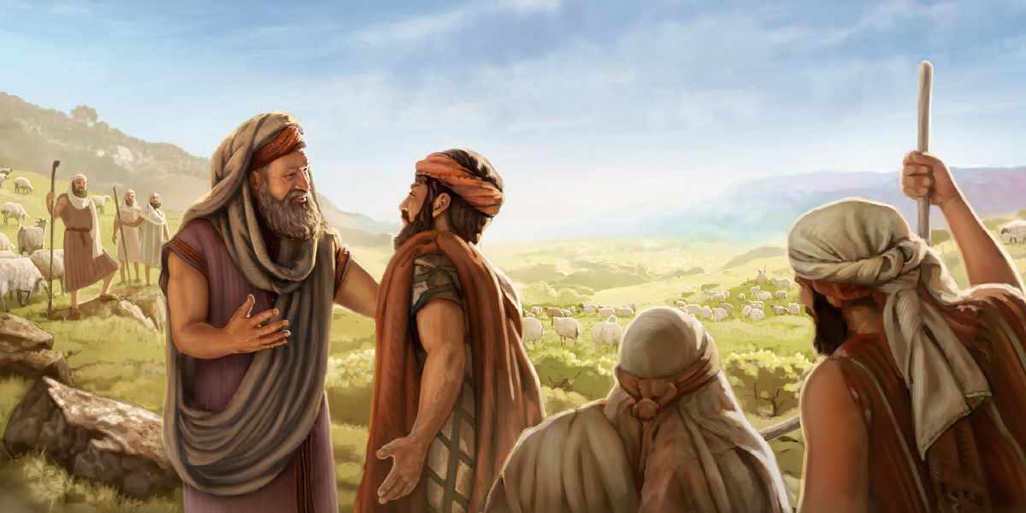
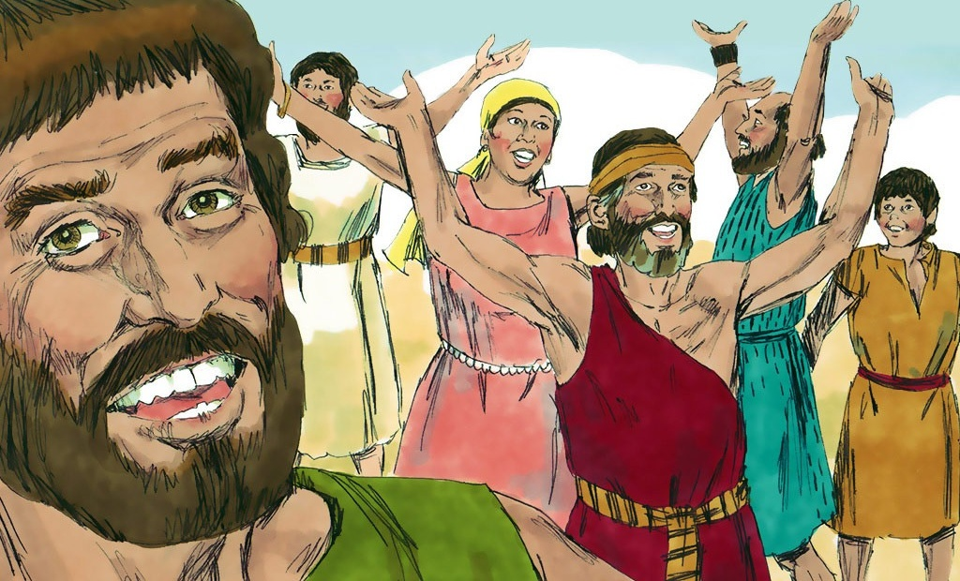
FAKALELEI
“Pea naʻe fiemālie ai ʻae fānau ʻa ʻIsileli; pea naʻe fakafetaʻi ki he ʻOtua ʻe he fānau ʻa ʻIsileli, pea naʻe ʻikai tenau loto ke ʻalu ke tauʻi ʻakinautolu, ke fakaʻauha ʻae fonua naʻe nofo ai ʻae fānau ʻa Lupeni, mo Kata.” (Sosiua 22:33)
ʻI heʻenau vakai naʻe taʻemakatuʻunga ʻa e tukuakiʻi, naʻe fiemalie ʻa Fineasi mo e kau fakafofonga ʻIsileli (Sosiua 22:30-31). ʻI heʻenau tafaʻaki, ʻi he taimi naʻe ʻilo ai ʻe he kakai ʻIsileli ʻa e moʻoni, naʻa nau fiefia mo fakafetaʻi ki he ʻOtua (Sosiua 22:32-33)
ʻI heʻenau faʻifaʻitakiʻanga, te tau lava ʻo sio ai ki he ngaahi sitepu ʻoku fie maʻu ke toe fakafoki mai ʻa e melino ʻi he ngaahi tukunga tatau ʻi he fekauʻaki mo e famili, siasi, mo e kolo:
ʻOua naʻa ke fakavavevave ki ha aofangatuku
Talanoa ki he ngaahi palopalema kimuʻa pea toki fai ha meʻa
Loto fiemalie ke fai ha ngaahi feilaulau ke maʻu ʻa e uouangataha
Fai ha tali fakaʻapaʻapa ki he ngaahi tukuakiʻi
Fiefia mo tapuakiʻi ʻa e ʻOtua ʻi he taimi ʻoku toe fakafoki mai ai ʻa e melino
Ko hono fakahoko ʻetau ngaahi fakakaukau

Slide 9

“Naʻe ʻai leva ʻe he fānau ʻa Kata mo Lūpení ʻi honau ʻōlitá ha tohi ʻo fakahaaʻi ai ʻa e taumuʻa naʻe fokotuʻu ai iá; pea na‘a nau pehē, “‘E hoko ia ko ha fakamo‘oni ‘i hota vaha‘á ko Sihova ‘a e ‘Otuá.” Ko ia na‘a nau feinga ai ke ta‘ofi ‘a e mahino hala ‘i he kaha‘ú pea ke to‘o atu ‘a e me‘a ‘e hoko nai ko ha tupu‘anga ‘o e ‘ahi‘ahí.
Ko e hā hono lahi ʻo e ngaahi faingataʻa lahi ʻoku tupu mei ha taʻefemahinoʻaki faingofua, naʻa mo kinautolu ʻoku fakaʻaiʻai ʻe he ngaahi taumuʻa taau tahá; pea kapau ‘e ‘ikai ke ngāue‘aki ‘a e anga-faka‘apa‘apá mo e kātakí, ko e hā ‘a e ngaahi ola mamafa mo na‘a mo e fakatupu mate ‘e hoko mai nai [...]
Naʻe ʻikai ke toe maʻu ha taha mei ha tuʻunga hala ʻaki ha fakaanga mo ha fakaanga; ka ʻoku pehē ʻoku tekeʻi mamaʻo ange ʻa e tokolahi mei he hala totonú pea taki atu ke nau fakafefeka honau lotó ki he fakapapaú. Ko ha laumālie ‘o e anga-‘ofá, ko ha tō‘onga anga-faka‘apa‘apa, mo kātaki ‘e lava ke ne fakahaofi ‘a e kau halá pea fufū ha ngaahi angahala lahi .”
EGW (Ko e Kau Pēteliaké mo e Kau Palōfitá, p 519)

