Slide 1
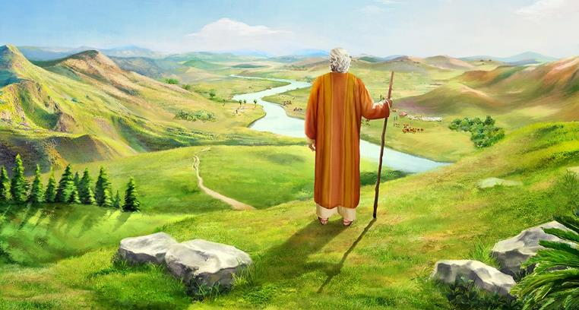
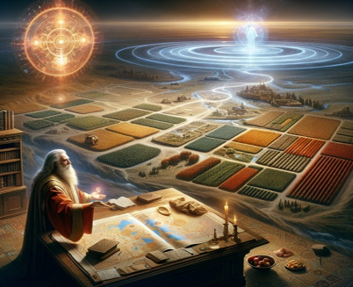
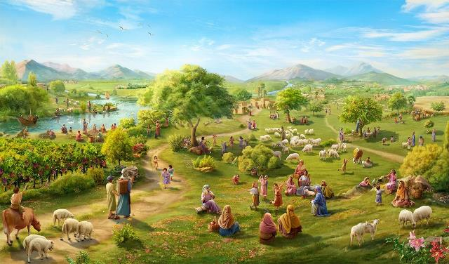
‘OKU FAITOTONU
‘A E
‘OTUA!
Lesoni 12 ki he ʻaho 20 ʻo Tisema 2025

Slide 2

“Naʻe ʻikai liʻaki ha meʻa ʻe taha ʻi he meʻa lelei kotoa pē naʻe folofola ki ai ʻa Sihova ki he fale ʻo ʻIsileli; naʻe hoko kotoa pē.” (Siosiua 21:45)

Slide 3

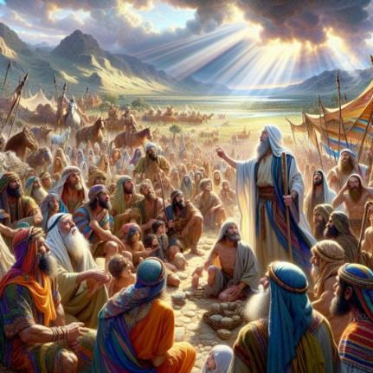
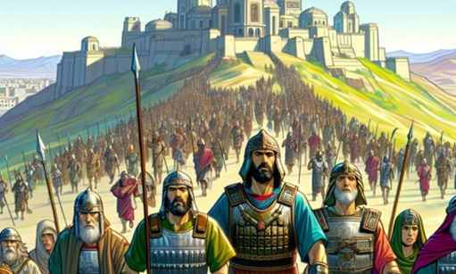
Naʻe ʻosi motuʻa ʻa Siosiua, pea naʻe kei ʻi ai pe ʻa e ngaahi feituʻu ke ikunaʻi. Naʻa ne fakatahatahaʻi ʻa e kau taki foʻou ke poupouʻi kinautolu ke hokohoko atu ʻa e ikuna.
Naʻe ʻikai ʻiate kinautolu ʻa e malava ko ia ke ikuna, ka naʻe ʻi he ʻOtua. Ko ia naʻá ne fakamanatu kia kinautolu ʻ a e faitōnunga kuo ʻ osi fakahāhā ʻ e he ʻ Otuá pea fakapapauʻi ange kiate kinautolu te Ne hokohoko atu ʻ a e faitōnunga.
Ka naʻa ne toe ʻoange foki kiate kinautolu ʻa e ngaahi fakatuʻutamaki. Ko hono moʻoni, naʻe taha pe ʻa e fakatuʻutamaki, ʻa ia kuo pau ke tau fehangahangai mo ia he ʻaho ni: ko e taʻofi ʻetau faivelenga ki he ʻOtua; fakafoki ʻa e faitotonu ʻa e ʻOtua mo e taʻefaitotonu ʻi heʻetau tafaʻaki.
Ko e faitotonu ʻa e ʻOtuá (Siosiua 21:43-45)
Ko e me'a kuo fai 'e he 'Otua mo e me'a te Ne fai (Sosiua 23:1-5)
Ko e pale ma‘á e faitōnungá (Siosiua 23:6-10)
Ko e me‘a kuo pau ke tau faí (Siosiua 23:11-14)
Ko e tautea ki he ta’efaitōnunga (Siosiua 23:15-16)

Slide 4


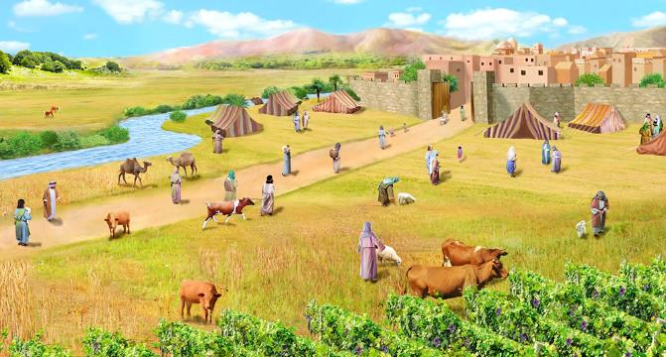
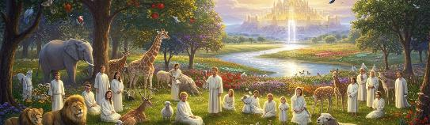
KO E FAITOTONU 'A E 'OTUA .
“Naʻe ʻikai liʻaki ha meʻa ʻe taha ʻi he meʻa lelei kotoa pē naʻe folofola ki ai ʻa Sihova ki he fale ʻo ʻIsileli; naʻe hoko kotoa pē.” (Siosiua 21:45)
Na’e ‘osi foaki ‘e he ‘Otua ki ‘Isileli ‘a e “fonua kotoa” (Sios. 21:43) pea kuo ne tukuange ki honau nima “honau ngaahi fili kotoa pe” (Sios. 21:44), ko ia “na’e fakakakato ‘a e tokotaha kotoa pe” (Sios. 21:45)
Ko hono toutou ngāue’aki ‘o e fo’i lea “kotoa” ‘oku ne fakamamafa’i ‘a e faitotonu ‘a e ‘Otua ‘i hono fakahoko ‘ene ngaahi tala’ofa. Kuo ikunaʻi hono ngaahi filí ʻe he ʻOtuá. Naʻa nau lava ʻo nofoʻi ʻa e fonuá koeʻuhí he naʻe maʻu ia ʻe he ʻOtuá. Na‘e lava ke nau fakapapau‘i ‘e ‘osi ‘enau kapusi ‘a e kau Kēnani na‘a nau kei nofo ‘i he fonuá koe‘uhi na‘e tauhi ‘e he ‘Otuá ‘ene ngaahi tala‘ofá ‘o a‘u mai ki he taimí ni pea ‘e hokohoko atu ‘ene tauhi ia ‘i he kaha‘ú.
‘Oku ola lelei ‘a e me‘á ni kotoa ki he‘etau leleí. ‘Oku kei faitotonu pe ‘a e ‘Otua.(Teut. 7:9; Saame 117:2; Tangilaulau 3:22-23). Kuo ne tala’ofa te ne fakamo’ui kitautolu pea te ne foaki mai ‘a e Mamani ko hotau tofi’a, pea te ne fakakakato ‘a e tala’ofa ko eni (Filipai 1:6; 1 Pita 1:5; Saame 37:29).

Slide 5

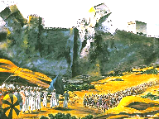
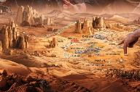
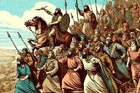
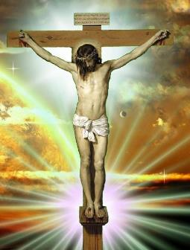
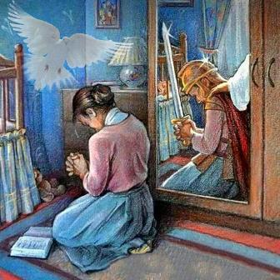
KO E ME'A KUO FAI 'E HE 'OTUA MO E ME'A TE NE FAI
“Pea kuo mou mamata ki he ngaahi meʻa kotoa pē kuo fai ʻe Sihova ko homou ʻOtua ki he ngaahi puleʻanga ni koeʻuhi ko kimoutolu; he ko Sihova ko homou ʻOtua, ko ia ia kuo ne tau koeʻuhi ko kimoutolu.” (Siosiua 23:3)
ʻI heʻene lea ki he kau mātuʻá, ʻoku kamata ʻaki ʻe Siosiua ʻene talaange kiate kinautolu ʻa e meʻa kuo ʻosi fai ʻe he ʻOtuá mo e meʻa naʻá Ne kei teu ke faí:
Kuó ne tauʻi ʻa e ngaahi puleʻangá
( Sios. 23:3 )
Kuó ne vahevahe ʻa e fonuá ki he ngaahi matakalí ( Sios. 23:4 )
Te ne kapusi ʻa e ngaahi puleʻanga ʻoku toé (Sios. 23:5)
Ko e me’a kotoa ko eni (ko e me’a kuo ‘osi fai mo e me’a na’e kei fai) na’e mo’ulaloa ia ki ha tu’unga ‘e taha ‘i he tafa’aki ‘o ‘Isileli: ko e talangofua (Siosiua 23:6)
Ko e hisitōlia ʻo ʻIsilelí ko ha lēsoni ia kiate kitautolu he ʻahó ni. Kuo ‘osi ikuna ‘a e ‘Otua ‘i he angahala pea kuo ne ‘omi kiate kitautolu ‘a e fakapapau ‘o e fakamo’ui ‘i he feilaulau ‘a Sisu (Kol. 2:15).
‘Oku ‘atautolu pe ke tau hoko atu ‘a e tau, pea ke tau falala ki he Laumalie Ma’oni’oni kae lava ke tau mo’ui ikuna (2 Kol. 10:3-5; ‘Efeso 6:11-18).

Slide 6

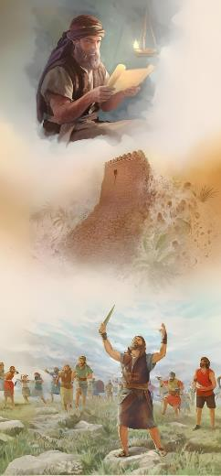
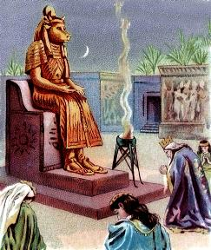
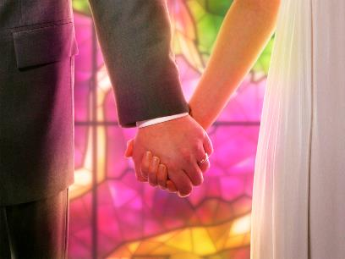
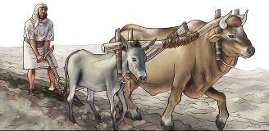
KO E PALE ʻO E ANGATONU
“ʻE tuli ʻe homou tokotaha ʻae toko afe: he ko Sihova ko homou ʻOtua, ko ia ia ʻoku tau maʻamoutolu ʻo hangē ko ʻene fakahā kiate kimoutolu.” (Siosiua 23:10)
Ko e pale ki he faitotonu ‘a ‘Isileli, ko e ikuna kakato mo faka’aufuli ‘a honau ngaahi fili kotoa pe (Siosiua 23:6, 10)
‘I he tu‘unga ‘o e ikuna‘i ‘o Kēnaní, na‘e pau ke fakahaa‘i ‘a e faitōnunga ki he ‘Otuá ‘i ha founga pau ‘aupito ‘e tolu:
'Oua 'e mali mo e kakai 'o e fonua
( Siosiua 23:7 )
ʻOua naʻa mou lave ki he hingoa honau ngaahi ʻOtuá
( Siosiua 23:7 )
‘O ‘ikai ke nau lotu ki honau ngaahi ‘otua (Siosiua 23:7)
Na‘e pau ke nau tauhi ma‘u ‘a e ma‘a fakalaumālié. Kapau te nau mali mo e kau nofo aí, te nau kamata lea ‘o kau ki honau ngaahi ‘otuá, pea ‘e iku ‘o nau lotu kiate kinautolu. Naʻe kamata pehē ʻa e hē mei he moʻoní ʻa Solomoné (1 Tuʻi 11:4)
Ko ia ai, ‘oku fale’i kitautolu kau Kalisitiane ke tau muimui ki he ngaahi fokotu’u tatau, pea ‘oua ‘e mali mo e kau ta’etui (2 Kol. 6:14-16)

Slide 7


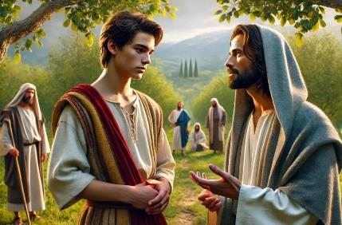
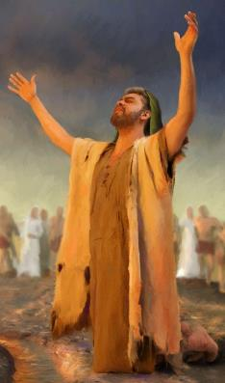
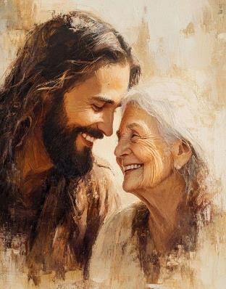
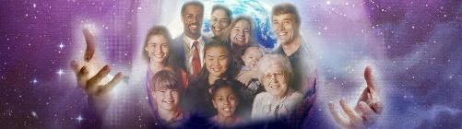
KO E ME'A KUOPAU KE TAU FAI
“Ko ia mou vakai lahi kiate kimoutolu ke mou ʻofa kia Sihova ko homou ʻOtua.” (Siosiua 23:11)
‘Oku lava ke tau pehē ta’e toe veiveiua ko e poini tefito ‘o e lea ‘a Siosiuá ‘oku ma’u ia ‘i he veesi 11: ke ‘ofa ki he ‘Otuá.
Naʻe pau ke fakahaaʻi ʻe ʻIsileli ʻenau ʻofá ʻaki ʻenau ʻikai ʻofa ki he ngaahi ʻotua kehé, ʻa ia ʻe iku ai ki ha maumau lahi kiate kinautolu (Sios. 23:12-13)
‘Ikai ngata ai, ‘oku fokotu’u mai ‘e Siosiua ha fakalotolahi ke tauhi ‘a e ‘ofa ko ia: ko e faitotonu ‘a e ‘Otua (Sios. 23:14)
‘Oku tau ma’u ‘i he ‘aho ni ha fakalotolahi ‘oku toe lahi ange: ko e fa’ifa’itaki’anga ‘a Sisu (Sione 13:34) .
ʻOku fakaʻamu ʻa e ʻOtuá ke hū ki ha fetuʻutaki vāofi mo fakafoʻituitui mo e tokotaha kotoa pē ʻokú ne tali ʻEne ʻofá .
Ko hono olá, ko ʻEne ʻofa ki he tokotaha kotoa pē ʻokú ne faʻu ʻa e faʻunga ki hono fakahaaʻi ʻo ʻetau ʻofa loto-fiemālié mo e feʻofaʻakí.

Slide 8

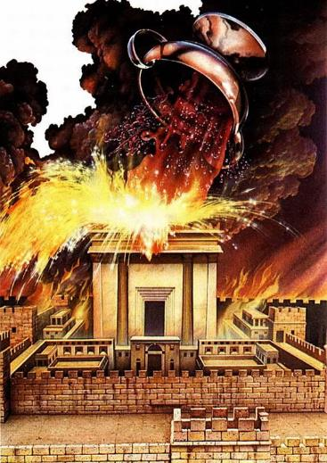
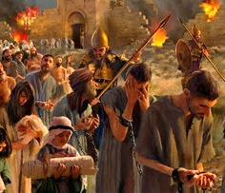
KO E TAUTEA KI HE TAʻEANGATONU
“Ko ia ʻe hoko ʻo pehē, ʻo hangē kuo hoko kiate kimoutolu ʻae ngaahi meʻa lelei ʻaia naʻe talaʻofa ʻe Sihova ko homou ʻOtua kiate kimoutolu; ʻe pehē ʻae ʻomi kiate kimoutolu ʻe Sihova ʻae ngaahi meʻa kovi, kaeʻoua ke ʻosi ʻene fakaʻauha ʻakimoutolu mei he fonua lelei ni ʻaia kuo foaki ʻe Sihova ko homou ʻOtua kiate kimoutolu.” (Siosiua 23:15)
Naʻe fakaʻosi ʻe Siosiua ʻene lea ʻaki ha ngaahi lea fefeka ʻo e fakatokanga fekauʻaki mo e ngaahi nunuʻa ʻo e talangataʻa: katakiʻi ʻa e houhau ʻo e ʻOtua (Siosiua 23:15-16)
Pea pehe ki he Fonua ʻo e Talaʻofa pea naʻa ne ʻiloʻi kakato ʻa e ngaahi nunuʻa ʻo hono fakatupunga ʻa e houhau ʻa Yahweh ʻaki hono maumauʻi ʻa e fuakava.
Ko e ʻofa tatau pe naʻa ne tataki ʻa e ʻOtua ke foaki Hono ʻAlo maʻatautolu, ko e ʻofa tatau pe ia ʻoku fakahaaʻi ia ʻi he houhau kiate kinautolu ʻoku pikitai fefeka ki he angahala (Sione 3:16; Loma 2:5)
Naʻe ʻikai lava ʻa ʻIsileli pea faingataʻaʻia ʻi hono tautea. ʻOku tau maʻu he ʻaho ni ʻa e faingamalie ke hiki ha talanoa kehe: ke faivelenga mo nofo maʻu ʻi Heʻene ʻofa (Sione 15:9)

Slide 9
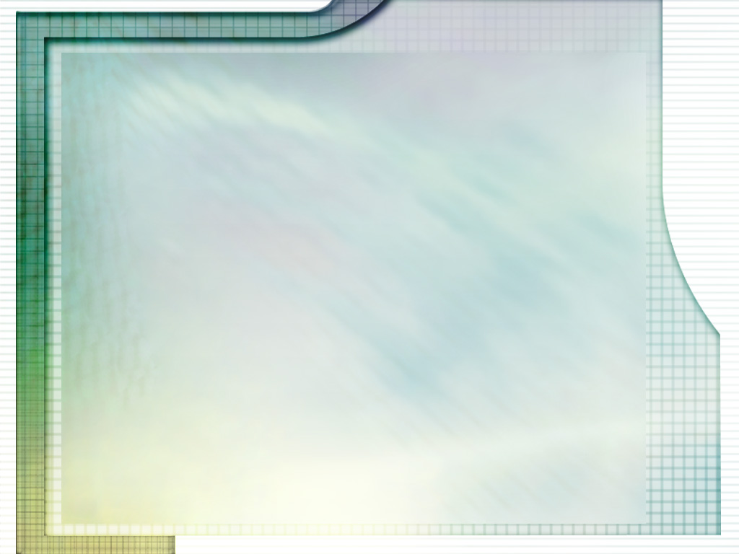
“ʻOku makatuʻunga kotoa hoʻo fiefia, melino, nekeneka, mo e lavameʻa ʻi he moʻui ni ʻi he tui moʻoni mo falala ki he ʻOtua. ʻE ueʻi ʻe he tui ko ʻeni ʻa e talangofua moʻoni ki he ngaahi fekau ʻa e ʻOtua. Ko hoʻo ʻilo mo e tui ki he ʻOtua ʻa e taʻofi malohi taha mei he ngaue kovi kotoa pe, pea ko e taumuʻa ia ki he lelei kotoa pe.
Tui kia Sisu ko ha taha ʻoku Ne fakamolemoleʻi hoʻo ngaahi angahala, ko ha taha ʻoku Ne fie maʻu ke ke fiefia ʻi he ngaahi nofoʻanga kuo Ne haʻele mai ke teuteu maʻau. ʻOku Ne finangalo ke ke nofo ʻi Hono ʻao; ke maʻu ʻa e moʻui taʻengata mo ha kalauni ʻo e naunau.”
EGW (Ngaahi Popoaki ki he Toʻu Tupu, p. 410)

