Slide 1
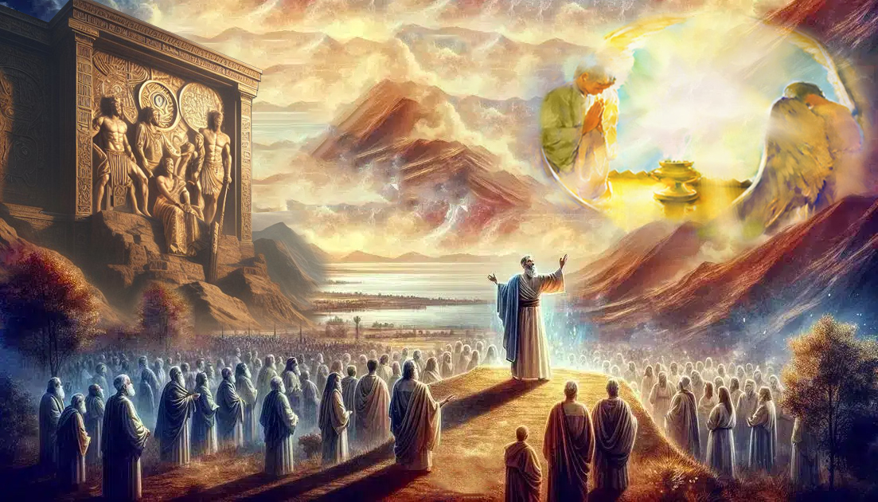
FILI ‘I HE 'AHO NI!
Lesoni 13 ki he ʻaho 27 ʻo Tīsema, 2025

Slide 2
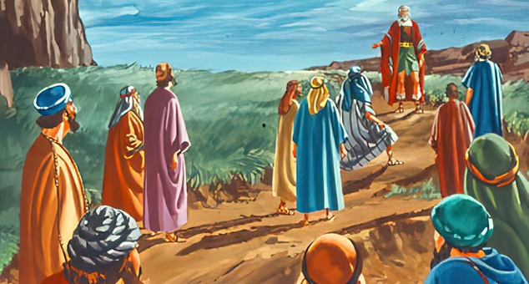
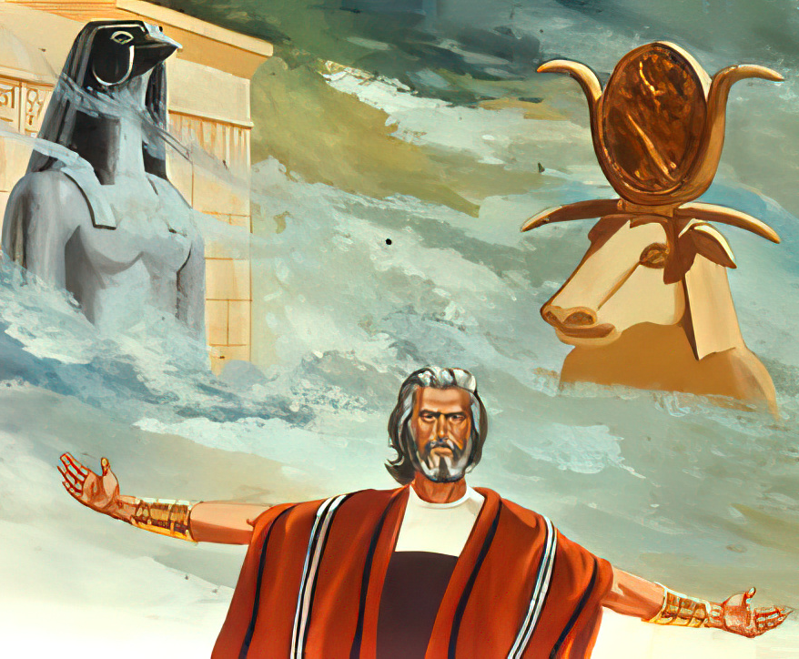
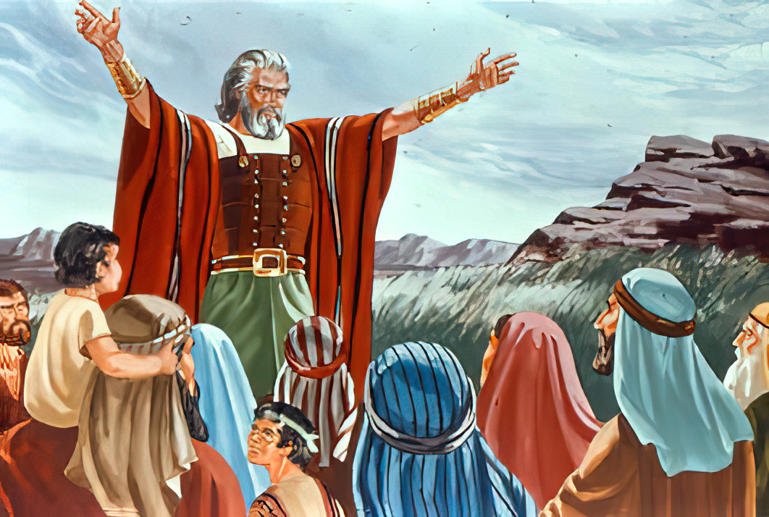
“Pea kapau ʻoku matamata kovi kiate kimoutolu ke tauhi ʻa Sihova, mou fili he ʻaho ni ʻaia te mou tauhi; . . . . ka ko au mo hoku fale te mau tauhi ʻa Sihova.”
(Siosiua 24:15)

Slide 3

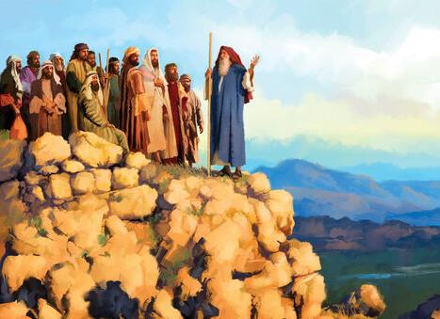
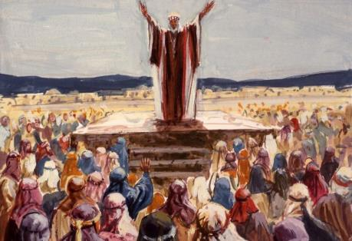
Naʻe ongoʻi ʻe Siosiua kuo ofi hono ngataʻangá. Naʻá ne fai ʻa e tau leleí.Naʻá ne ʻosi ʻi he lová. Naʻá ne tauhi ʻa e tuí. Naʻá ne lava ʻo tatali ʻi he loto falala, ʻo hangē ko Paulá, ki hono kalauni ʻo e māʻoniʻoní (2 Tim. 4:7-8) .
Ka, ʻ i he hangē ko Kēlepi, naʻe kei pau pē ke ne fakapapauʻi ʻ e toʻo hake ʻ e he niʻihi kehé ʻ a e tuhulu pea tataki ʻ a e kakai ʻ a e ʻ Otuá ʻ i he hala totonú
ʻI he ʻuhinga ko ia, naʻa ne fakatahatahaʻi ai ʻa e kakai ʻi Sikemi ke fakafoʻou ʻa e fuakava ʻo e faivelenga, pea ke naʻinaʻi kiate kinautolu ke nau fili ha moʻui ʻo e ngaue maʻa e ʻOtua.
Ko e talanoa na’e tohi ‘e he ‘Otua (Siosiua 24:1-13)
Ko e ui ki he angatonu (Siosiua 24:14-15)
Ko e fili ‘a e kakai (Siosiua 24:16-21)
Ko hono fakafo'ou 'o e fuakava (Siosiua 24:22-28)
Ko e hoko atu ‘o e talanoa (Siosiua 24:29-33)

Slide 4


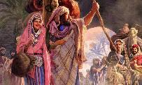
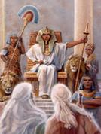
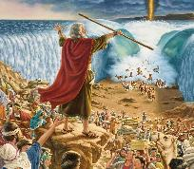
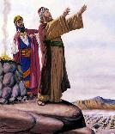
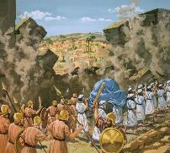
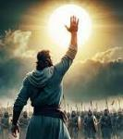
KO E TALANOA NA'E TOHI 'E HE 'OTUA
“Pea kuo u foaki kiate kimoutolu ʻae fonua ʻaia naʻe ʻikai te mou ngāue ke maʻu, mo e ngaahi kolo naʻe ʻikai te mou langa, pea ʻoku mou nofo ʻi ai; ko e ngaahi ngoue vaine, mo e ngaahi ngoue ʻolive ʻaia naʻe ʻikai te mou tō ʻoku mou kai mei ai.” (Siosiua 24:13)
Ko e feituʻu naʻe fili ʻe Siosiua ki heʻene lea fakaʻosí ko ha feituʻu fakahisitōlia ia: ko Sikemi ( Siosiua 24:1 )
1. Ko e fuofua feituʻu ia ʻi Kēnani naʻe ʻapitanga ai ʻa ʻĒpalahamé ( Sēnesi 12:6 )
2. Ko e fuofua feituʻu ia ʻi Kenani naʻe ʻapitanga ai ʻa Sēkope (Sēnesi 33:18)
3. Ko e koloa pe ia na’e ma’u ‘e Sekope (Sēnesi 33:19)
4. Na’e tanu ai ‘e Sekope ‘a e ngaahi ‘Otua muli na’e kei ma’u ‘e hono famili (Sēnesi 35:4)
Naʻe kamata ʻaki ʻe Siosiua ʻene fakamatala kiate kinautolu fekauʻaki mo e "ngaahi ʻotua kehe" naʻe hu ki ai ʻa Tela, ko ʻenau kui (Siosiua 24:2). Mei ai, naʻa ne fakamanatu kiate kinautolu ʻa e meʻa kotoa pe kuo fai ʻe he ʻOtua: Naʻa ku toʻo; Naʻa ku haʻu; Naʻa ku fakautuutu ange; Naʻa ku fekau; Naʻa ku taaʻi; Naʻa ku ʻomi ki tuʻa; Naʻa ku ʻomi koe ki loto; Naʻa ku fakahaofi kinautolu; Naʻa ku fakaʻauha kinautolu; Naʻe ʻikai ke u fanongo kia Pelami; Naʻa ku fakahaofi koe; Naʻa ku tukuange kinautolu; Naʻa ku fekau atu ʻa e lango; Naʻa ku foaki kiate kimoutolu ʻa e fonua (Siosiua 24:3-13)
ʻI he fakamatala ko ʻeni, ʻoku ʻalu tahataha atu ʻa e ngaahi toʻu tangata ʻo ʻikai ha filifilimanako. ʻOku kau kotoa pe. Ko kinautolu naʻe fanongo kia Sosiua naʻa nau haʻu "mei he tafaʻaki ʻe taha ʻo e vaitafe"; naʻa nau ʻalu hifo ki ʻIsipite; naʻa nau ʻalu mo ha fuʻu malohi lahi; naʻa nau kolosi ʻi tahi; naʻa nau maʻu ʻa Transjordan; naʻa nau maʻu ʻa Kenani. Ko e meʻa naʻe fai ʻe he ʻOtua ki heʻenau ngaahi kui, ʻoku Ne fai ia kiate kinautolu, pea te Ne fai kiate kitautolu he ʻaho ni

Slide 5

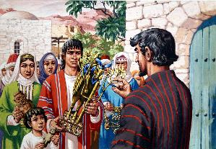
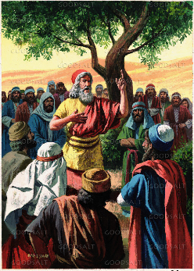
KO E UI KI HE ANGATONU
“Pea kapau ʻoku matamata kovi kiate kimoutolu ke tauhi ʻa Sihova, mou fili he ʻaho ni ʻaia te mou tauhi; pe ko e ngaahi ʻotua ʻaia naʻe tauhi ʻe hoʻomou ngaahi tamai, ʻaia naʻe ʻi he kauvai ʻe taha ʻoe vai lahi, pe ki he ngaahi ʻotua ʻoe kau ʻAmoli, ʻae fonua ʻonautolu ʻoku mou nofo ai: ka ko au mo hoku fale te mau tauhi ʻa Sihova. .” (Siosiua 24:15)
Hangē ko hono fakaafe’i ‘e Sēkope hono fāmilí ke nau tanu honau ngaahi ‘otuá kimu’a pea nau toki fakafo’ou ‘enau fuakava mo e ‘Otuá ‘i Pēteli, ‘oku fakaafe’i foki ‘e Siosiua ‘a e kakaí ke nau li’aki honau ngaahi ‘otuá kimu’a pea nau toki fakafo’ou ‘enau fuakava mo e ‘Otuá (Sios. 24:14)
Na’e pau ke nau manavahē ki he ‘Otua mo tauhi kiate ia “ ‘i he loto mo’oni mo e mo’oni” (Sios. 24:14a). Ko e hā ‘oku fakahu‘unga ki ai ‘a e me‘á ni?
Ke manavahē ki he ʻOtuá
Ke fakahaaʻi ha fakaʻapaʻapa loloto kiate Ia ʻoku taʻefakangatangata ʻene lahi ange ʻiate aú, pea ke tali Ia ko hoku Tuʻi mo hoku ʻEiki .
Ke tauhi ‘a e ‘Otuá ‘i he loto-mo‘oni [angatonu]
Ko ha ngāue tokoni taʻe-mele (ko e founga ʻeni naʻe fakaʻuhingaʻi ai ʻa e monumanu ʻoku feʻunga pē ke tāmateʻí kapau ʻoku “taʻe-mele” [kakato])
Ke tauhi ‘a e ‘Otuá ‘i he mo‘oni
Ke faitōnunga, falalaʻanga, mateaki, taʻe mavahevahe, mo tuʻumaʻu. Ke fakaʻata ʻi heʻeku moʻuí ʻeku houngaʻia ki he ʻOtuá ʻi he meʻa kuó Ne fai ʻiate aú.

Slide 6

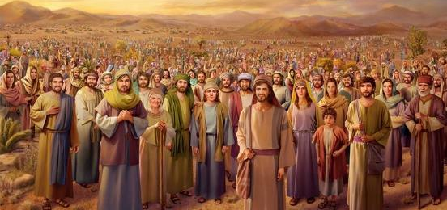
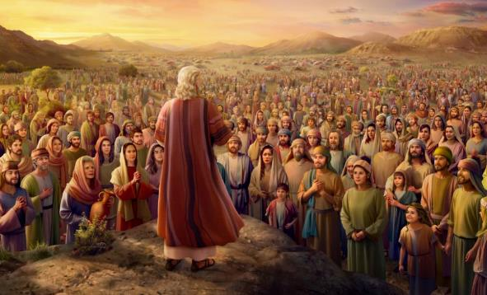
KO E FILI 'O E KAKAI
“Pea naʻe lea ʻae kakai ʻo pehē, “Ke taʻofi ʻe he ʻOtua ke ʻoua ʻaupito naʻa mau liʻaki ʻa Sihova, ke tauhi ʻae ngaahi ʻotua kehe!’” (Siosiua 24:16)
Ko e hā e tali ki he ui ʻa Siosiuá (Sios. 24:16)? Na’e pehē ‘e he kakai kotoa ‘oku ‘ikai ki honau ngaahi ‘otua, pea nau tali ‘oku taha pē ‘enau ‘Otua: “ko hotau ‘Otua,” ko e tokotaha tatau pē na’a ne tataki kinautolu ‘enau ngaahi kui mo kinautolu fakatou’osi ‘o a’u ki he momeniti ko ia (Sios. 24:17-18)
Kae ‘ikai ke fakamālō’ia’i ‘e Siosiua ‘a e kakai ‘i he’enau tu’utu’uni, ka na’e fai ‘e Siosiua ha tali ta’e’amanekina: “’Oku ‘ikai te mou taau ke tauhi ‘a Sihova” (Sios. 24:19). Ko ha fakalotosi‘i ē!
Na’e fanongo ‘a Siosiua ki he fai ‘e he’ene ongo matu’a ‘a e palōmesi tatau (Ek. 19:8), pea na’a ne sio ki he’ena toutou maumau’i ia ‘i he ta’u ‘e 40.
Naʻe aʻusia ʻe he tali fefeka ko ʻení ʻa hono taumuʻá. Naʻe fakapapauʻi ʻe he toʻutangata foʻoú ke ʻoua naʻa nau toe fai ʻa e ngaahi fehālaaki tatau (Sios. 24:21)

Slide 7

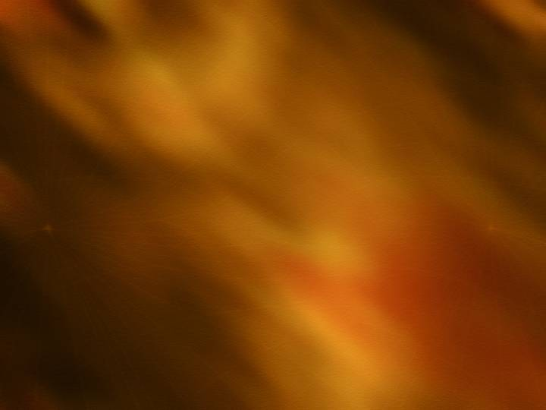
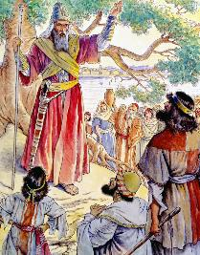
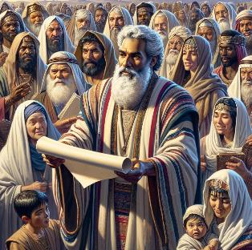
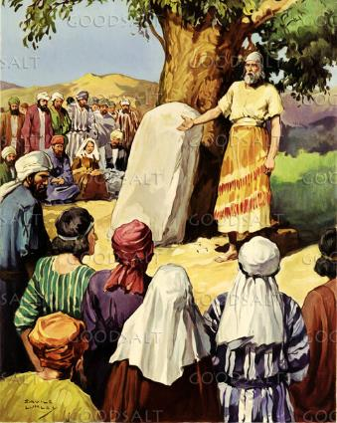
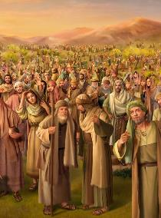
KO E FAKAFO'OU 'O E FUAKAVA
“Ko ia naʻe fai ai ʻe Siosiua ʻae fuakava mo e kakai ʻi he ʻaho ko ia, ʻo ne fokotuʻu ʻae fekau maʻanautolu mo e tuʻutuʻuni ʻi Sikemi.” (Siosiua 24:25)
Ke faka’osi ‘ene lea, na’e kole ‘e Siosiua ke nau to’o ‘a e ngaahi ‘otua ‘oku “ ‘iate kimoutolu,” pea ke fakafoki honau loto ki he ‘Otua (Sios. 24:23)
Ko hono tu’o tolu, na’e tukupā ‘a e kakai te nau tauhi ki he ‘Otua (Sios. 24:24). Naʻe fakamoʻoniʻi ʻa e fuakavá, pea hangē ko Mōsesé, naʻe “ʻoange ʻe Siosiua kiate kinautolu ʻa e ngaahi tuʻutuʻuni mo e ngaahi lao” ( Sios. 24:25 )
Neongo ʻoku makatuʻunga ʻa e fuakava mo e ʻOtuá ʻi ha vahaʻangatae moʻui mo Ia pea ʻoku ʻikai lava ke fakahaaʻi kakato ia ʻo fakafou ʻi ha ngaahi tuʻutuʻuni pē, ka naʻe mahino kia Siosiua naʻe fie maʻu ke tuku ha ngaahi fakamanatu mahino ʻe tokoni kiate kinautolu ke nau nofo maʻu ʻi he fuakavá .
Na’a ne ‘ai ‘a e fuakava ke tohi, pea ne fokotu’u ha maka fakamanatu: ko ha maka ke hoko ko e fakamo’oni ki he tukupā na’a nau fai (Sios. 24:26-27)

Slide 8

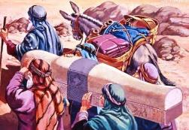
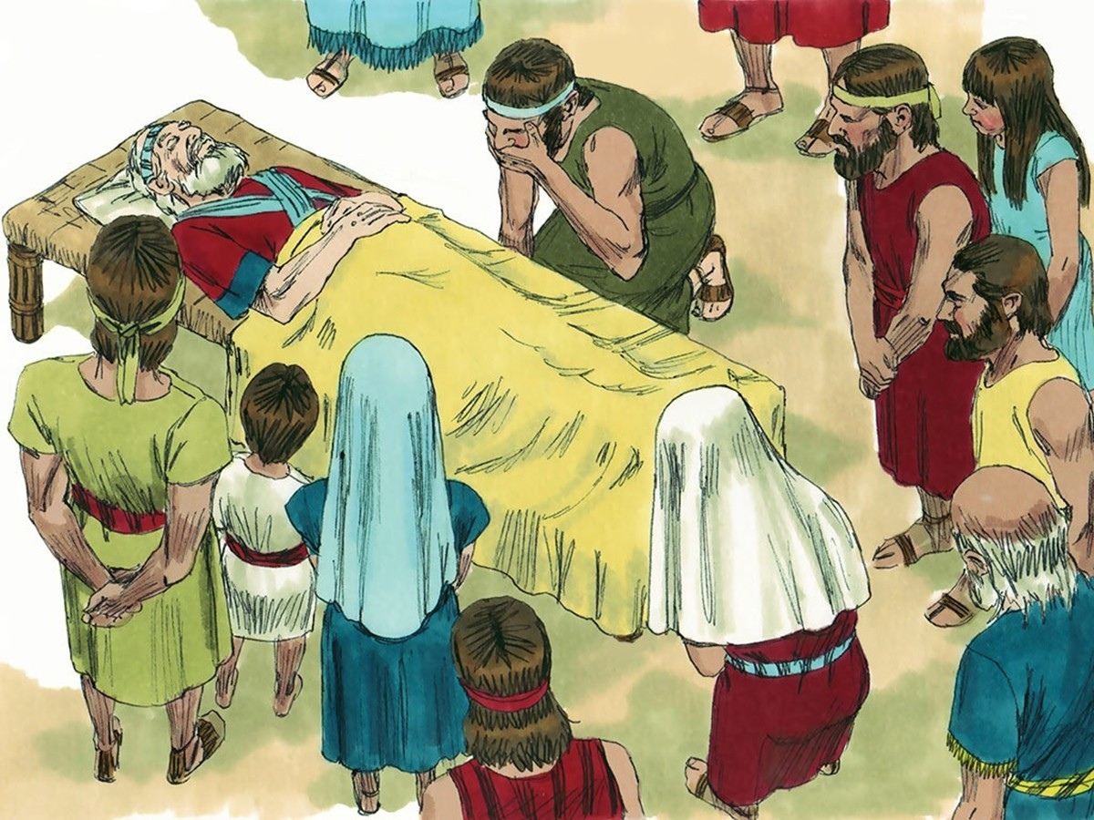
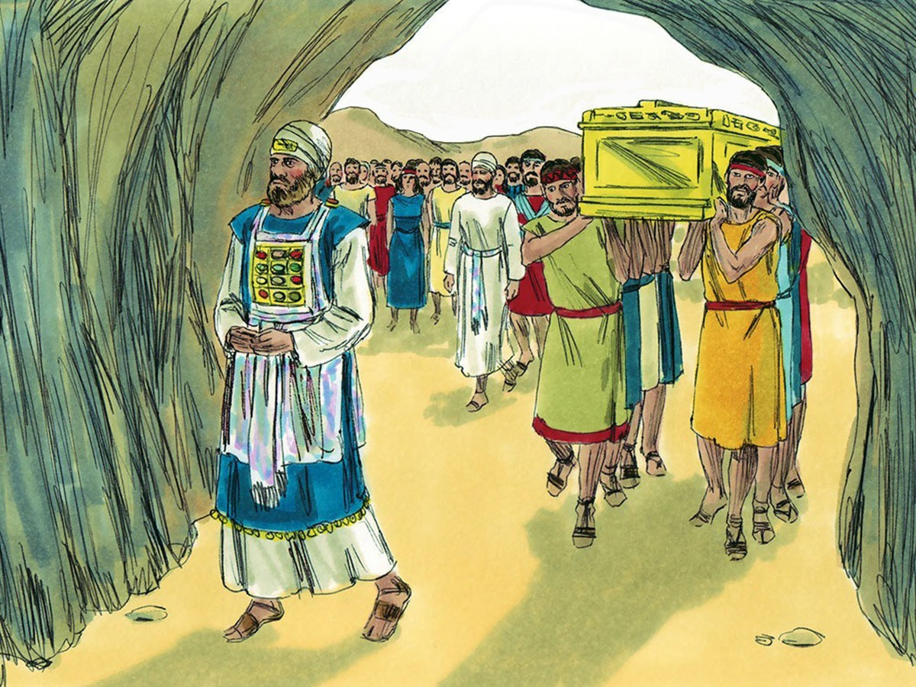
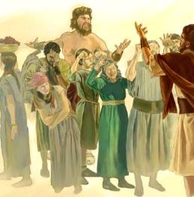
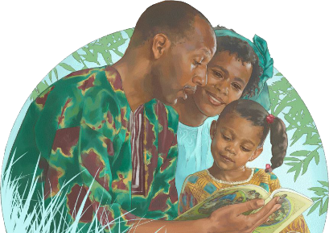
KO E HOKOHOKO 'O E TALANOA
“Pea naʻe tauhi ʻe ʻIsileli ʻa Sihova ʻi he ʻaho kotoa pē ʻo Siosiua, mo e ʻaho kotoa pē ʻoe kau mātuʻa naʻa nau moʻui kimui ʻia Siosiua, ʻakinautolu naʻa nau ʻilo ʻae ngaahi ngāue kotoa pē ʻa Sihova, ʻaia naʻa ne fai maʻa ʻIsileli.” (Siosiua 24:31)
ʻOku fakaʻosi ʻa e tohi ʻa Siosiuá ʻaki ha tanu ʻe tolu. Ko e taha ʻo kinautolu, naʻe kikiteʻi ʻi he taʻu ʻe laungeau kimuʻá, ko hono tanu ʻo Siosifa ʻi he tofiʻa ʻo Sēkopé (Sen. 50:24-26; Sios. 24:32)
Ko e to‘utangata angatu‘u na‘e ha‘u mei ‘Isipité na‘e tanu ia ‘i he toafá. Ka ko e to‘utangata fo‘oú na‘e pau ke tanu “‘i honau tofi‘á,” fakataha mo e fa‘ahinga na‘a nau nofo‘aki faitōnunga ‘i ha to‘utangata ta‘efaitōnunga: ko Siosiua mo ‘Eliesa ( Sios. 24:29-30, 33 )
Naʻe kei faivelenga pē ʻa e toʻutangata foʻou ko ʻení (Sios. 24:31 )Kae fēfē ‘a e to‘utangata hokó (Fkm. 2:10-11)?
Kuo pau ke fai ʻe he toʻu tangata takitaha ʻene fuakava mo e ʻOtuá. ʻE lava ke tokoniʻi kinautolu ʻe he tui ʻa ʻenau mātuʻá ke nau fai ʻa e fili ʻoku totonú. Ka ko e tu‘utu‘uní ‘oku ‘anautolu ia. Tau fai ‘etau tu’utu’uni he ‘aho ni: “Ko au mo hoku fale, te mau tauhi kia Sihova” (Sios. 24:15 )

Slide 9

“ʻOku ʻamanaki ʻemau Seniale, ʻa ia kuo teʻeki ai ke ne ikuna ʻi ha taú, ha ngāue loto fiemālie mo faitotonu mei he tokotaha kotoa pē kuo kau ki he taú ʻi Hono fuká. ʻI he fakakikihi fakaʻosi ʻoku lolotonga hoko he taimí ni ʻi he vahaʻa ʻo e ngaahi kongakau ki he leleí mo e ngaahi kau tau ʻo e koví ʻokú Ne ʻamanaki ki he kakai kotoa pē, ʻa e kau tangata angamahení pea pehē ki he kau faifekaú, ke nau kau mai. fatongia ‘oku hilifaki kiate kinautolu tāutaha.”
EGW (Ngaahi Fakamoʻoni maʻá e Siasí, vol. 9, p. 116)

