Slide 1

UOUANGATAHA ʻI HE LOTO FAKATOKILALO
Lesoni 4 ki he ʻaho 24 ʻo Sanuali 2026

Slide 2
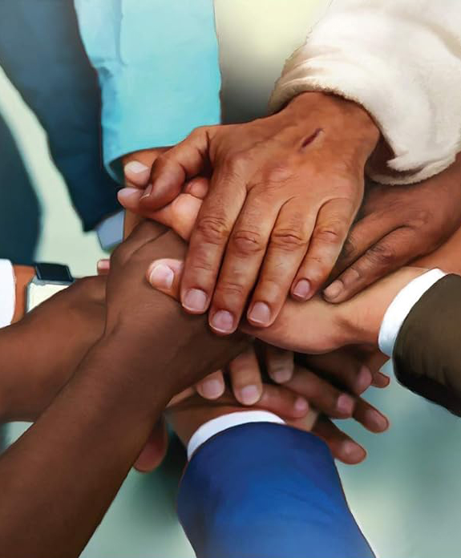
“Mou fakakakato ʻeku fiefia, ke mou felototatau pe, ʻo maʻu ʻae ʻofa pe taha, ke mou ʻulungāanga taha pe, mo uouangataha pe.”
Filipai 2:2

Slide 3







Kuo toki fakalototoʻaʻi pē ʻ e Paula ʻ a e kau tui ʻ i Filipaí ke nau tuʻu maʻu ʻ i he fehangahangai mo e ngaahi pole ʻ o e moʻui faka - Kalisitiané. Kuo Ne kole ange ke nau tōʻonga ʻ i ha founga ʻ oku taau mo e kau tangataʻifonua fakahēvaní, ʻ o fakamamafaʻi ʻ a e fāʻūtahá.
ʻI he kupuʻi lea "ko ia", ʻoku kamata ai ʻe Paula ha konga foʻou ʻa ia ʻoku ne ʻomi ai kiate kitautolu ʻa e ngaahi ki ke mahino ʻa e founga ke aʻusia ai ʻa e uouangataha haohaoa ko ia: ʻaki ʻene faʻifaʻitaki ki he sipinga ʻa Sisuu.
Ko e tupuʻanga ʻo e mavahevahe (Filipai 2:1-3a)
Uouangataha ʻi he loto fakatokilalo (Filipai 2:3b-4)
Fakakaukau ʻo hange ko Sisuu (Filipai 2:5)
Ko e toʻonga fakakaukau ʻa Sisuu (Filipai 2:6-8)

Slide 4



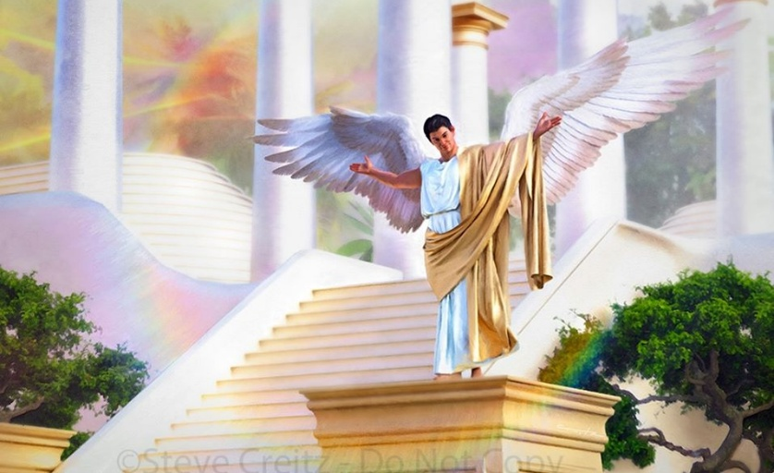

KO E TUPUʻANGA ʻO E MAVAHEVAHE
"ʻOua naʻa fai ha meʻa koeʻuhi ko e siokita pe ko e fielahi taʻeʻaonga" (Filipai 2:3a)
Kimuʻa pea ne ʻai hono tuhu ki he feituʻu mamahi, ʻo fakamahinoʻi ʻa e ngaahi ʻuhinga ʻo e mavahevahe naʻe fakatokangaʻi ʻe he kakai Filipai, ko e ha ʻa e ngaahi ʻuluaki faleʻi naʻa ne fai kiate kinautolu ke nau maʻu ʻa e uouangataha, ʻo fakakakato ʻene fiefia (Filipai 2:1-2)?
Fakafiemalie ʻia Kalaisi
Fakafiemalie ʻi he ʻofa
Fetuʻutaki ʻa e Laumalie
ʻOfa moʻoni
ʻAloʻofa
Uouangataha ʻo e ongo mo e ʻofa
ʻ Okú ne fakalototoʻaʻi kinautolu ke nau ako mo faʻifaʻitaki ki he sīpinga moʻui ʻ a Kalaisí
Ko ʻ enau ʻ ofa kia Kalaisí ʻ oku ngāueʻaki ai ha mālohi fakaueʻiloto ki honau ʻ atamaí
Kuo pau ke nau tukulolo ki he puleʻi ʻo e Laumalie
ʻ Oku totonu ke tapua atu ʻ a e ngaahi ongoʻi ongongofua mo māfana ʻ o e ʻ ofa fakaetangatá
Tuku ke nau fakahaaʻi ʻa e ʻi ai ʻa e ʻofa moʻoní ʻo fakafou ʻi he ngaahi ngāue fakafoʻituitui ʻo e ʻaloʻofá.
ʻOku hanga ʻe he feʻofaʻakí ʻo ʻai ke tatau ʻa e ngaahi fakakaukaú pea iku ki he ngāue uouangatahá .
Ko e ngaahi me’a kotoa ko ‘eni na’a nau toki lava pe ‘o kapau te nau tuku ki tafa’aki ‘a e me’a na’a ne fakamavahe’i kinautolu: ko e feke’ike’i mo e fakakikihi (Filipai 2:3a).
Naʻe fakatou ʻi ai ʻa e ongo palopalema ko ʻeni ʻi he angatuʻu ʻa Lusifaa, pea ʻoku kau ia ʻi he ngaahi palopalema mamafa taha ʻi he ngaahi va fetuʻutaki (Kaletia 5:26; Semisi 3:16)

Slide 5



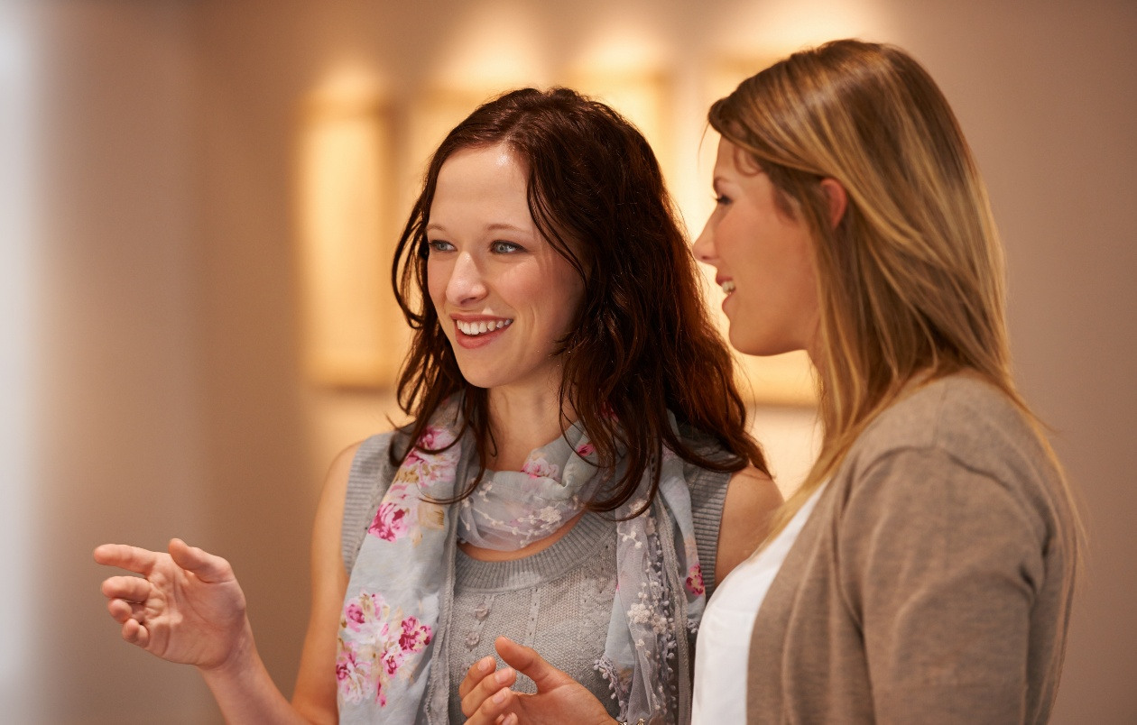
UOUANGATAHA ʻI HE LOTO FAKATOKILALO
“… ʻi he loto fakatokilalo, fakamahuʻingaʻi ʻa e niʻihi kehe ʻo maʻolunga ange ʻiate kimoutolu, ʻo ʻoua naʻa mou tokanga ki hoʻomou ngaahi fie maʻu pe ʻaʻautolu ka ko kimoutolu takitaha ki he lelei ʻa e niʻihi kehe." (Filipai 2:3b-4)
Ko e founga ʻo e uouangataha ʻoku fokotuʻu mai ʻe Paula ʻoku ʻikai ko ha meʻa mei tuʻa, ka ko ha toʻonga fakakaukau ʻi loto: loto fakatokilalo. Makehe mei heʻene hoko ko ha ʻulungaanga ʻo Sisuu, naʻa Ne poupouʻi ʻEne kau fanongo ke nau loto fakatokilalo (Matiu 11:29; 18:4; 23:12).
Ke maʻu ʻa e loto fakatokilalo ko ʻeni, ʻoku fokotuʻu mai ʻe Paula ke tau fakakaukau ʻoku mahuʻinga ange ʻa e niʻihi kehe ʻiate kitautolu (Filipai 2:3). Ka ʻoku ʻikai nai ke tau tuʻunga tatau kotoa pe ʻi he ʻao ʻo e ʻOtua? ʻIkai ʻoku totonu ke ʻi ai ʻa e tuʻunga tatau kae lava ke maʻu ʻa e uouangataha?
ʻOku ʻikai ke pehe ʻe Paula ʻoku tau maʻulalo ange ʻi he niʻihi kehe, ka ʻoku totonu ke tau fakakaukau ʻoku tau pehe. Hange ko e fekumi ʻa e tamaioʻeiki ki he lelei ʻa hono ʻeiki, ʻoku totonu ke tau fekumi ki he lelei ʻa kinautolu ʻoku tau pehe ʻoku maʻolunga ange ʻiate kitautolu (Filipai 2:4)
Ke malava ke tokoniʻi ʻ a e niʻihi kehé, kuo pau ke tau ako ke fanongo kiate kinautolu pea mahinoʻi ʻenau fakakaukaú. ʻOku ʻikai ha veiveiua ko e ngaue kotoa ʻeni ʻa e Laumalie Maʻoniʻoni.

Slide 6

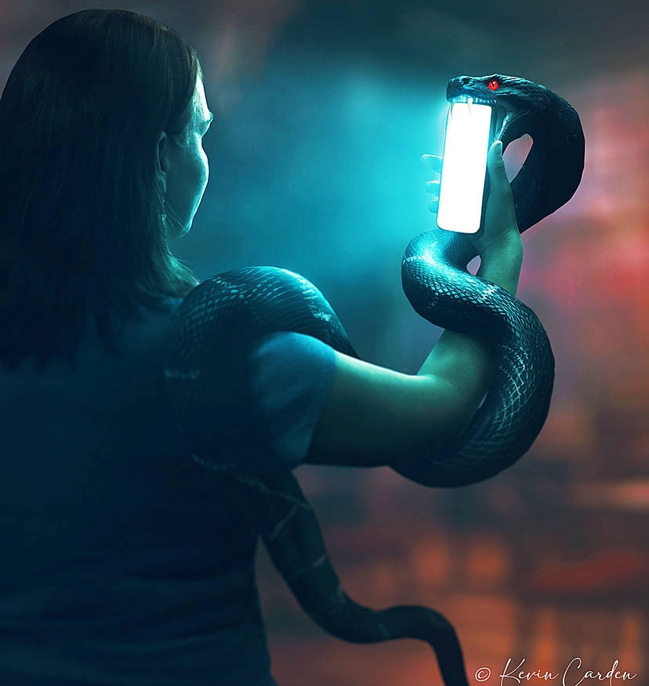

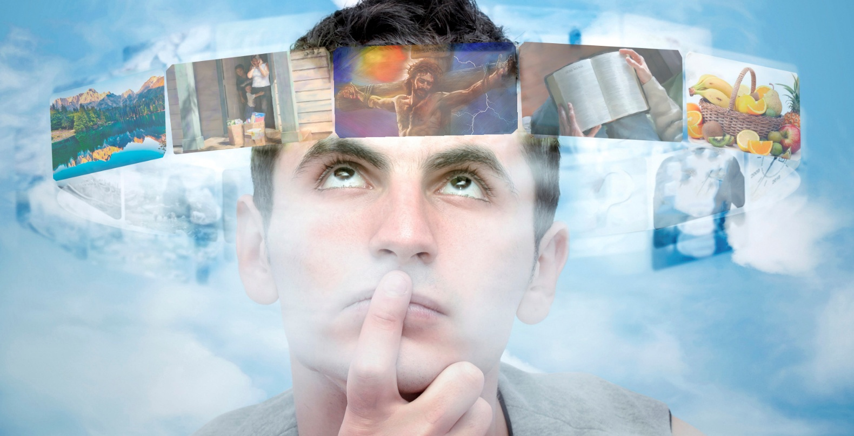
FAKAKAUKAU ʻO HANGE KO SISUU
"Tuku ke ʻiate kimoutolu ʻa e fakakaukau ko ʻeni, ʻa ia naʻe ʻia Kalaisi Sisu foki" (Filipai 2:5 )
ʻ Oku anga - fēfē hono fakafuo ʻ etau ngaahi fakakaukaú? ʻI he "ngaahi hala ʻo e laumalie," ʻa ia ko hotau ngaahi ongo. Ko e meʻa kotoa pe ʻoku tau lau, mamata pe fanongo ki ai ʻoku ne fakafotunga kitautolu ʻi ha faʻahinga founga. Pea ko e moʻoni, ʻ oku ʻ ohofi ʻ e Sētane hotau ngaahi ongoʻangá ke fakafuo hotau ʻ atamaí ki heʻene founga fakakaukaú tonu.
ʻOku fuʻu totuʻa ʻa Paula. ʻOku ʻikai ngata pe ʻi Heʻene fakaafeʻi kitautolu ke tau tokangaʻi ʻetau ngaahi fakakaukau, ka ʻoku Ne kole mai ke tau fakakaukau ʻo hange ko e fakakaukau ʻa Kalaisi (Filipai 4:8; 2:5).
Mahalo te tau lava, ʻi heʻetau feinga lahi, ʻo aʻusia ʻa e ʻuluaki. Ka ko hono liliu hotau ʻatamai ke muimui ki he fakakaukau ʻa Sisuu ʻe toki lava pe ke fai ia ʻiate kitautolu ʻe he Laumalie Maʻoniʻoni.
ʻOku ʻuhinga ʻeni koeʻuhi he ʻoku fakakakano ʻetau ngaahi mahalo, pea kaka hotau loto (Selemaia 17:9). ʻE liliu ʻe he Laumalie hotau ʻatamai fakakakano ke hoko ko ha ʻatamai fakalaumalie, ʻo hange ko Kalaisi (Loma 8:1, 5)

Slide 7

EGW (Kau Pēteliake mo e Kau Palōfitá, p. 436)
"Ka ʻoku ʻi ai ʻetau ngāue ke fai ke tekeʻi ʻaki ʻa e ʻahiʻahí. Kuo pau ke maluʻi lelei ʻe kinautolu ʻoku ʻikai ke nau moʻulaloa ki he ngaahi filioʻi ʻa Setane ʻa e ngaahi hala ʻo e laumalie; Kuo pau ke nau fakaʻehiʻehi mei hono lau, sio, pe fanongo ki he meʻa te ne fokotuʻu mai ha ngaahi fakakaukau taʻemaʻa. ʻOku ʻikai totonu ke tuku ʻa e ʻatamai ke he noa pe ʻi he kaveinga kotoa pe ʻe fokotuʻu mai ʻe he fili ʻo e ngaahi laumalie."

Slide 8

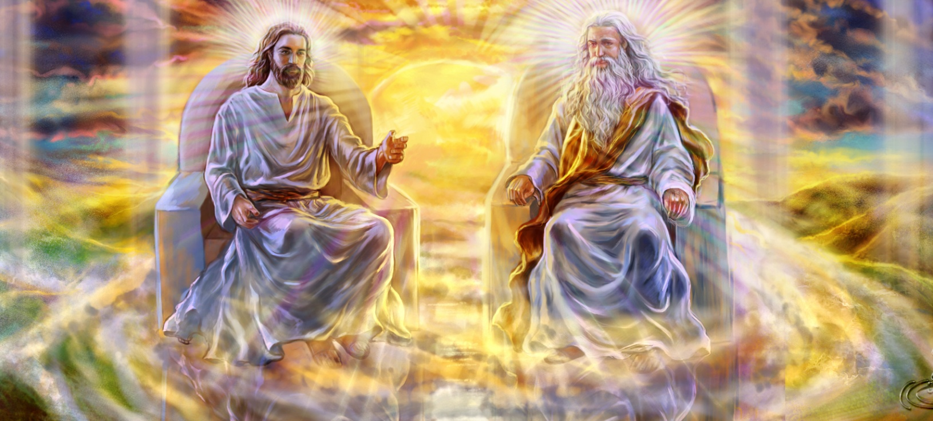


KO E 'ULUNGAANGA 'O SISU (1)
“ʻa ia, ʻi he anga ʻo e ʻOtuá, naʻe ʻikai te ne lau ko e kaihaʻa ke tatau mo e ʻOtuá” ( Filipai 2:6 ).
ʻOku fakamamafaʻi ʻe Paula ʻa e ngaahi ʻulungaanga ʻe tolu ʻo Sisuu:
Naʻa ne fakaʻikaiʻi ʻa hono ngaahi totonu fakalangi (Filipai 2:6)
Naʻa Ne hoko ko e tangata ke tauhi kiate kitautolu (Filipai 2:7)
Naʻa Ne talangofua ʻi he loto fakatokilalo ʻi he meʻa kotoa pe, ʻo aʻu ki heʻene mate (Filipai 2:8)
ʻI Heʻene hoko ko e Tupuʻanga, naʻa Ne hoko ai ko ha meʻa fakatupu. Naʻa Ne tali hono ngaohikovia mo pekia ʻi he kolosi kae lava ke huhuʻi kitautolu.
Neongo ʻene tuʻunga tatau mo e ongo Tokotaha kehe ʻo e Toluʻi ʻOtua, ka naʻe haohaoa maʻu pe ʻa e tukulolo ʻa Sisu ki he finangalo ʻo e Tamai. Naʻe ʻikai ha momeniti ia naʻa ne fakafisi ai ke tukulolo.
ʻI heʻetau fakakaukau ki he meʻá ni, ʻe lava pē ke tau punou hifo ʻo hū ki hotau Fakamoʻui fakaofó.
Ko Ia hotau faʻifaʻitakiʻangá. Kuo pau ke tau loto fiemālie ke fakavaivaiʻi kitautolu mo feilaulauʻi kitautolu koeʻuhí ko e lelei ʻa e niʻihi kehé.

Slide 9


KO E 'ULUNGAANGA 'O SISU (2)
“Pea ʻoku ʻikai ha fakakikihi ʻoku lahi ʻa e misiteli ʻo e anga fakaʻotuá: naʻe fakahā ʻa e ʻOtuá ʻi he kakanó, naʻe fakatonuhiaʻi ia ʻi he Laumālié, naʻe mamata ki ai ʻa e kau ʻāngeló, naʻe malangaʻaki ia ʻi he Senitaile, naʻe tui ki ai ʻi māmani, naʻe maʻu hake ʻi he nāunaú” (1 Tīmote 3:16)
ʻE hoko ʻa e afeitaulalo fakaofo ʻa Kalaisi ʻi heʻene hoko ko ha tangata ko ha kaveinga ke ako ki ai ʻa kinautolu kuo huhuʻi ʻo aʻu ki ʻitaniti.
ʻOku taʻeʻamanekina ʻa e hoko ʻa e Tokotaha taʻefakangatangata mo taʻengata ko ha tangata fakangatangata, ʻo moʻulaloa ki he mate. Ko e meʻa ʻeni ʻoku ui ʻe Paula "ko e meʻa lilo ʻo e anga faka-ʻOtua" (1 Timote 3:16).
Naʻe ʻalu ʻa Sisu mei he tuʻunga maʻolunga fakamamani lahi ki he nofo popula fakaʻaufuli. Ko e fehangahangai moʻoni ʻeni ʻo e meʻa naʻe fakaʻamu ki ai ʻa Lusifaa, ʻa ia ʻi heʻene hoko ko ha tamaioʻeiki, naʻa ne fie maʻu ʻa e tuʻunga maʻolunga fakamamani lahi.
ʻOku ui kitautolu ʻe he sipinga ko ʻeni ke tau siʻaki ʻetau siokita mo ʻetau holi ke tokoniʻi kitautolu, pea fetongi kinautolu ʻaki ʻa e loto fakatokilalo mo ha loto fiemalie ke tokoniʻi e niʻihi kehe.

Slide 10

"ʻOku fakangofua ʻe he ʻOtua ʻa e faʻahinga kotoa ʻo e tangata ke ne fakaʻaongaʻi hono tuʻunga fakafoʻituitui. ʻOku ʻikai ke ne loto ke fakauku hifo ʻe ha taha hono ʻatamai ʻi he ʻatamai ʻo ha taha matelie. Ko kinautolu ʻoku holi ke liliu honau ʻatamai mo e ʻulungaanga, ʻoku ʻikai totonu ke nau sio ki he tangata, ka ki he Sipinga fakalangi. ʻOku fakaafeʻi mai ʻe he ʻOtua, "Tuku ke ʻiate kimoutolu ʻa e fakakaukau ko ʻeni, ʻa ia naʻe ʻia Kalaisi Sisu foki." ʻOku totonu ke maʻu ʻe he tangata ʻa e fakakaukau ʻa Kalaisi ʻi he ului mo e liliu."
EGW (Koeʻuhi ke u ʻIloʻi Ia, 8 Me)

