Slide 1
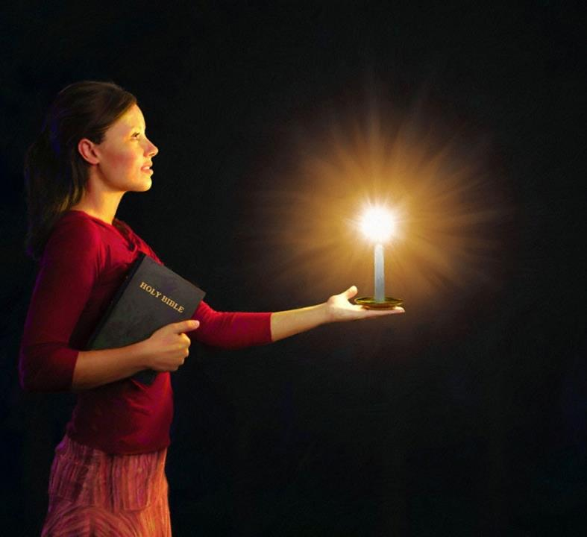
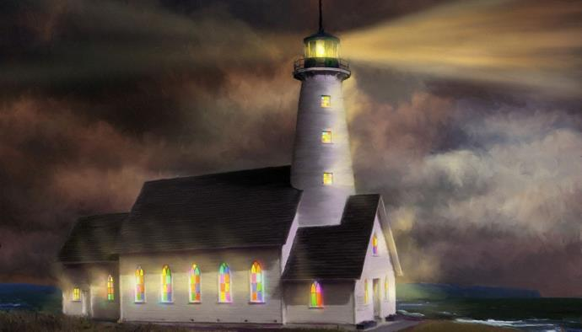
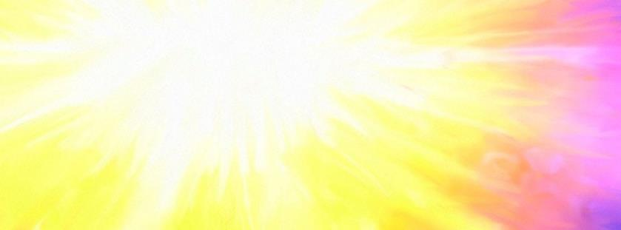
Lesoni 5 ki he ʻaho 31 ʻo Sānuali, 2026
ULO ʻO HANGE HA MAAMA ʻI HE POʻULI

Slide 2

“Fai ʻae ngaahi meʻa kotoa pē ʻo taʻelāunga mo e taʻefakakikihi:Koeʻuhi ke mou taʻehalaia mo taʻekovi, ko e fānau taʻevalokiʻia ʻae ʻOtua, ʻi he lotolotonga ʻoe kakai anga pikopiko mo fefeka, ʻakinautolu ʻoku mou ulo atu ki ai, ʻo hangē ko e ngaahi maama ʻo māmani; ”
Filipai 2:14, 15

Slide 3
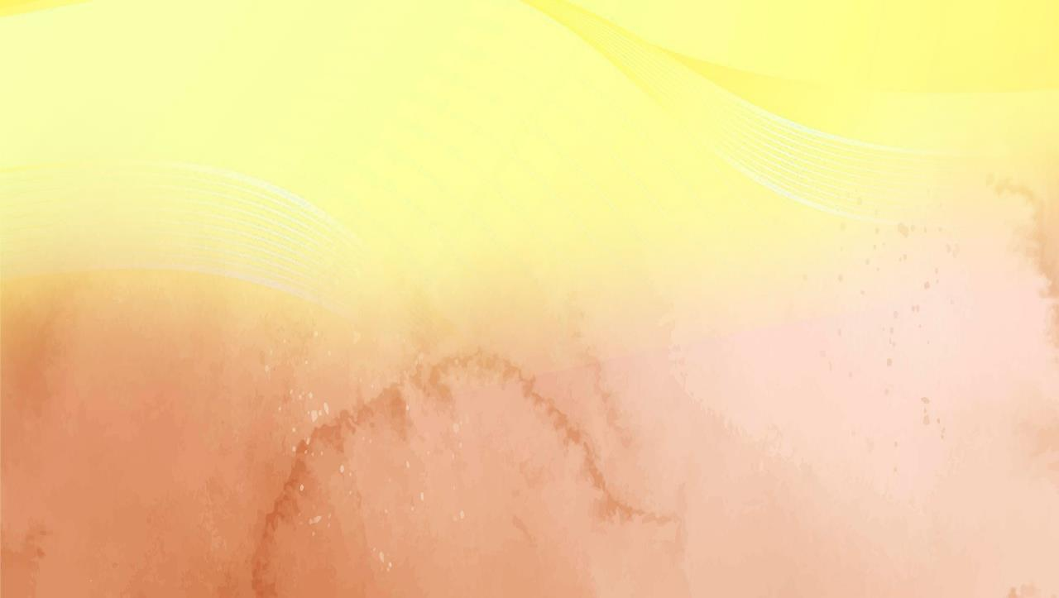
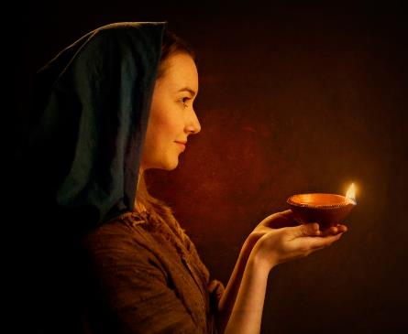



"Ke pehe foki mo hoʻomou mama ke ulo atu ʻi he ʻao ʻo e kakai, koeʻuhi ke nau mamata ki hoʻomou ngaahi ngaue lelei, pea fakamaloʻia ʻa hoʻomou Tamai ʻi he langi" (Matiu 5:16)
ʻI he Filipai 2:12-18 te tau lava ʻo lau ʻa e liliu ʻa Paula ʻo e fekau ko ʻeni ʻa Sisuu.
ʻ I he moʻui ʻ i ha māmani ʻ a ia ʻ oku molomoloki maʻu pē ai ʻ a e Lao ʻ a e ʻ Otuá, ko kitautolu kau Kalisitiané, ʻ a ia ʻ oku tau holi ke tauhi ki he ʻ Otuá ʻ aki ʻ a e moʻui ʻ o fakatatau ki ai, ko e ngaahi maama ia ʻ oku ulo atu ʻ i he fakapoʻulí.
Kakai ʻiloa ʻi he mamani:
Ko ha ʻata ʻo e ʻOtua (Filipai 2:12-13)
Ko ha maama ʻi mamani (Filipai 2:14-16)
Ko ha feilaulau moʻui (Filipai 2:17-18)
Ngaahi sīpinga ʻo e māmá:
Timote (Filipai 2:19-24)
Epafalotaito (Filipai 2:25-30)

Slide 4
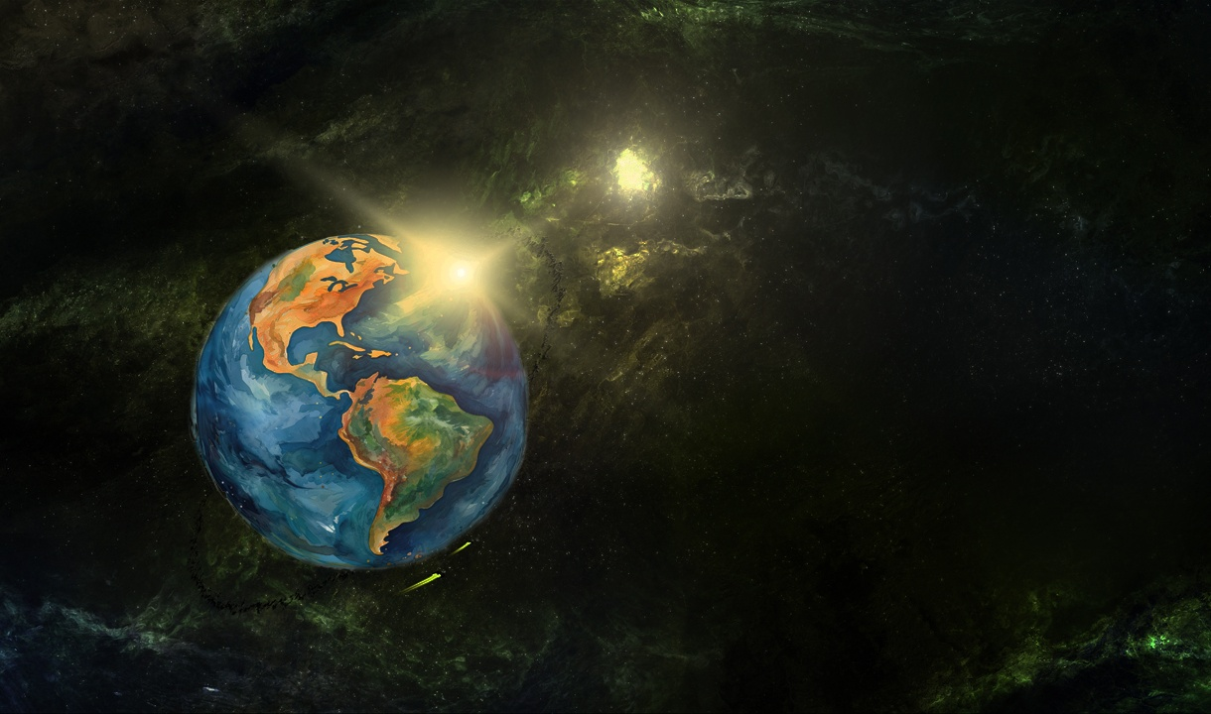
NGAAHI MAAMA 'I HE MAMANI

Slide 5
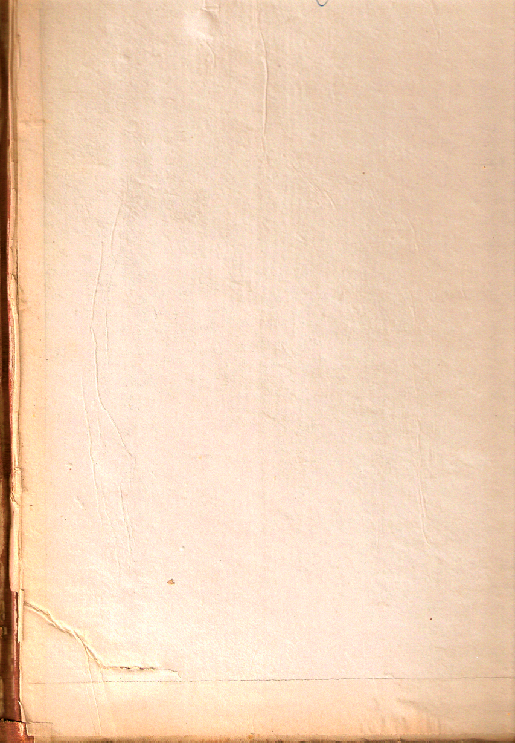
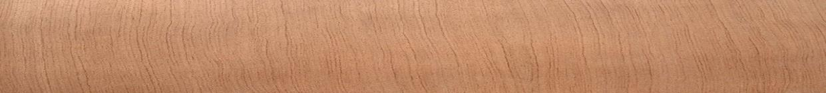


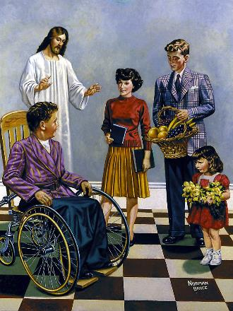
KO E FAKA'ATA 'A E 'OTUA .
“He ko e ʻOtua ia ʻoku ne ngāue ʻiate kimoutolu ʻi hono finangalo lelei ke mou loto mo fai ki ai. ” (Filipai 2:13)
Hili hono fakaikiiki pōto‘i ‘a hono fakamā‘ulalo‘i mo hakeaki‘i ‘o Sīsuú, ‘oku tānaki atu ‘e Paula ‘a e kupu‘i lea “ko ia.” ‘A ia, koe’uhi na’e fakavaivai’i ‘e Sisu ia pea hakeaki’i ia koe’uhi ke “mo’oni ‘e he ‘elelo kotoa pe ko Sisu Kalaisi ko e ‘Eiki, ke fakalangilangi’i ai ‘a e ‘Otua ko e Tamai” (Filipai 2:11), kuo pau ke fai ‘e he kau tui Filipai (pea, ‘i hono fakalahi atu, ko kitautolu kotoa pe) ha me’a ki ai.
Ko hotau ‘uluaki ngāue ke ngāue’i hotau fakamo’ui “mo e manavahē mo e tetetete” (Filipai 2:12). Kapau ko e ‘Otua ‘oku ne fakamo’ui kitautolu (Taitusi 2:11), ko e ha ‘oku totonu ai ke tau tokanga ki ai?
Ko e manavaheé mo e teteteté ko e ongo kupu‘i lea ia ‘oku ngāue‘aki ko e ongo ‘uhinga tatau ki he tauhi ki he ‘Otuá. ( Saame 2:11 ). Ko ia ai, ‘oku fakamamafa’i ‘e Paula, ko e ‘Otua ‘oku ne fakatupu ‘iate kitautolu ‘a e holi ke fai lelei, pea ‘oku ne ‘omai ‘a e ivi ke tau ‘ai ia ke mo’oni. (Filipai 2:13 ).

Slide 6




KO HA MAAMA 'I MAMANI
“Koeʻuhi ke mou taʻehalaia mo taʻekovi, ko e fānau taʻevalokiʻia ʻae ʻOtua, ʻi he lotolotonga ʻoe kakai anga pikopiko mo fefeka, ʻakinautolu ʻoku mou ulo atu ki ai, ʻo hangē ko e ngaahi maama ʻo māmani;.” (Filipai 2:15)
ʻOku fokotuʻu mai ʻe Paula ha tafaʻaki ʻe tolu te ne ʻai ʻa e kau tuí ke nau ulo ʻi he māmaní:
Tauhi ma‘u ‘a e fā‘ūtahá (Filipai 2:14)
ʻI he taimi ʻoku tau ngaue fakataha ai, ʻoku ʻikai totonu ke ʻi ai ha ngutu lau, fakaanga,feʻauʻauhi, pe fakakikihi ʻiate kitautolu.
ʻUlungaanga taʻehalaia (Filipai 2:15)
Ko e talangofua ki heʻetau Tamaí ʻi he faingofuá ʻoku kehe ʻaupito ia mei he kovi mo e fakamovetevete ʻoku ʻi ai ʻo takatakai ʻiate kitautolú.
Faivelenga ki he Folofola ʻa e ʻOtua (Filipai 2:16)
Ko ‘etau ngaahi ngāué mo ‘etau fakakaukaú kuo pau ke fehoanaki ia mo e me‘a ‘oku ako‘i ‘e he Tohi Tapú
Ko e feituʻu ko ia ʻoku lahi taha ai ʻa e fakapoʻuli, ʻoku ulo ngingila taha ʻa e mama. ʻI ha mamani ʻoku fakafisingaʻi maʻu ai pe ʻa e ʻOtua, kuo pau ke ulo atu ʻa kitautolu kau Kalisitiane ʻaki ʻa e maama ʻo Kalaisi.

Slide 7




KO HA FEILAULAU MOʻUI
“ʻIo, pea kapau ʻe felingiʻaki au mo e feilaulau mo e ngāue ʻa hoʻomou tui, ʻoku ou fiefia, mo nekeneka, fakataha mo kimoutolu kotoa pē. .” (Filipai 2:17)
Neongo naʻe ʻ amanaki ʻ a Paula ke fakatauʻatāinaʻi ia, naʻe ʻ i ai ha malava ke fakahalaiaʻi ia. ʻOku ne fokotuʻu mai ʻa e meʻa ko ʻeni ʻoku malava ke "lilingi atu ʻo hange ko e feilaulau inu" (Filipai 2:17)
Naʻe kau ʻi he feilaulau inu ʻa hono lilingi ha huhuʻa ʻi he feilaulau naʻe fai (ʻEkesotosi 29:39-40). ʻI he meʻa ko ʻeni, ko e feilaulau naʻe fehuʻia ko e kau Filipai.
ʻE mate nai ʻa e kau Filipai? ʻIkai ʻaupito. Naʻe kau ʻi heʻenau feilaulau ʻa e "ngaue ʻo hoʻomou tui." Ko ha feilaulau moʻui ia, ko ha feilaulau kuo pau ke tau ʻoatu kotoa ki he ʻOtua (Loma 12:1).
Naʻe ʻikai tokanga ʻa Paula ia ki he mate koeʻuhi he ʻe hanga ʻe heʻene fakamoʻoni ʻo ʻoange ha malohi lahi ange ki he kakai tui kuo nau ʻosi hoko ko e kau fakamoʻoni faivelenga ʻo e Ongoongolelei, ʻo lea ki ai ʻi he loto-toʻa, mo ʻulungaanga ko e fanau moʻui taau ʻa e ʻOtua.

Slide 8
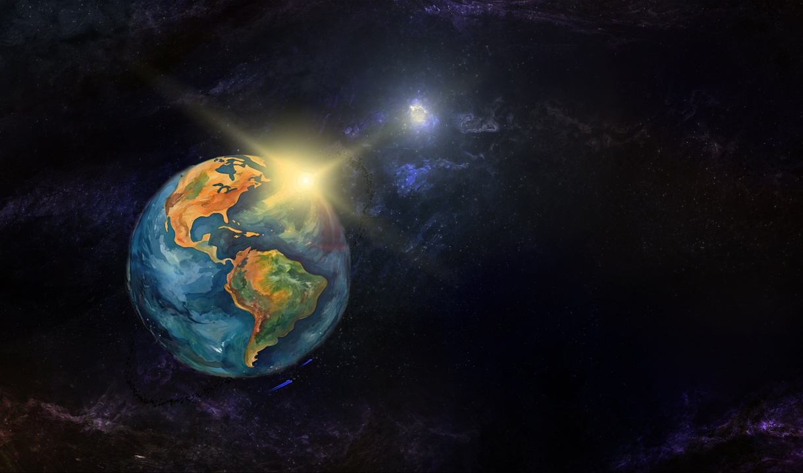
NGAAHI SIPINGA ʻO E MAMA

Slide 9

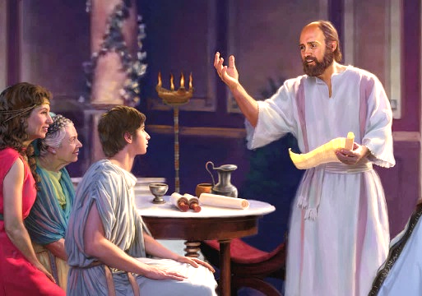


TIMOTE
“Ka ʻoku mou ʻilo ʻae fakamoʻoni ʻoʻona, koeʻuhi, ʻo hangē ko e foha mo e tamai, kuo pehē ʻene ngāue mo au ʻi he ongoongolelei.” (Filipai 2:22)
Ko Tīmote ko ha tokotaha ngāue mālohi mo Paula pea ko e tokotaha faʻu ʻo e ngaahi ʻipiseli ʻe ono (2 Kolinito, Filipai , Kolose, 1 Tesalonaika, 2 Tesalonaika, Filimone). Ko Paula tonu na’a ne fili ia ke ne hoko ko e ‘evangelio (Ngaue 16:1-3). Ko e hā naʻe sio ki ai ʻa Paula naʻe makehe fekauʻaki mo e talavou ko ʻení?
‘Uluakí, ko e tokotaha kotoa pē na‘a nau “lea lelei kiate ia.” Na’e fakapapau’i ‘ene fe’unga ki he ngaue fakafaifekau ‘aki ‘a e ngaahi lea fakapalofita (1 Tim. 1:18). ʻI heʻene kei talavoú, naʻe lau ia ʻe Paula ko ha foha, (1 Tim. 1:2; 4:12). Ko hono tafa’aki, na’e fai ‘e Timote kia Paula ‘a e faka’apa’apa mo e ‘ofa ‘oku ma’u ‘e ha foha ki he’ene tamai (Fil. 2:22).
Na’e lau ia ‘e Paula ko e tokotaha ngaue ola lelei ‘o hange ko ia (1 Kol. 6:10). Naʻá ne tuku kiate ia ʻa e tokangaʻi ʻo ha ngaahi siasi ʻe niʻihi, hangē ko Kolinitoó (1 Kol. 4:17); Filipai ( Fili. 2:19 ); mo Tesalonaika ( 1 Tes. 3:2 ). Na’a ne mamahi’ia foki ‘i he nofo pilisone ‘o hange ko Paula (Hep. 13:23).

Slide 10

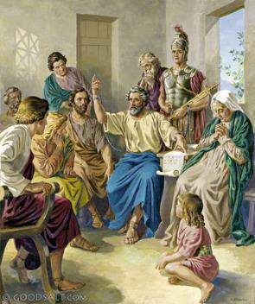


“Ka naʻaku mahalo, ʻe lelei ʻeku fekau atu kiate kimoutolu ʻa Epafalotaito, ko hoku tokoua, mo e kaunga ngāue, mo e kaunga tau, ka ko hoʻomou faifekau, pea ko ia naʻa ne tauhi ki heʻeku ngaahi masiva. ” (Filipai 2:25)
EPAFALOTAITO
‘I he ‘ilo ‘e he kakai Filipai ‘oku tuku pōpula ‘a Paula ‘i Loma, na’a nau fakakaukau ke ‘ave ha tokoni kiate ia ke feau ‘ene ngaahi fiema’u (totongi ‘api, me’atokoni, kofu, etc.) Ko ‘Epafalotaito na’a ne tokanga’i ‘a hono ‘omi ‘o e tokoni ko ‘eni ki he ‘aposetolo (Fil. 4:18; 2:25).
Naʻe ʻikai ke ʻave pē ʻe ʻEpafalotaito ha ngaahi tokoni, ka naʻá ne ʻalu fakataha mo Paula, tokoniʻi ia ʻi heʻene ngaahi fie maʻú, pea fengāueʻaki mo ia ʻi hono fakamafola ʻo e ongoongoleleí.
ʻI heʻene faivelenga ki he ongoongoleleí, naʻá ne fakatuʻutāmakiʻi ai ʻene moʻuí ʻo ne puke lahi ai (Fil. 2:27, 30). ‘I he fanongo ‘a e kau Filipaí ki he me‘á ni, na‘a nau hoha‘a kiate ia. Ko e tefito’i ‘uhinga ia na’e fakakaukau ai ‘a Paula ke fekau’i ia ke ne ‘ave ‘a e ‘ipiseli kiate kinautolu (Fil . 2:26, 28).
‘Oku kole ‘e Paula “pea mou faka’apa’apa’i ‘a e kakai ‘oku hange ko ia” (Fil. 2:29 ) ‘Oku ‘ikai ha veiveiua ko ‘Epafalotaito ko ha Kalisitiane faitōnunga ia.

Slide 11

“Lolotonga ‘a e tautapa ‘a Sisu, ko hotau Fakafepaki, ma’atautolu ‘i langi, ‘oku ngaue ‘a e Laumalie Ma’oni’oni ‘iate kitautolu, ke tau loto mo fai ‘a ‘ene finangalo lelei. ʻOku mahuʻingaʻia ʻa e langi kotoa pē ʻi he fakamoʻui ʻo e laumālié. Pea ko e hā leva ha ʻuhinga ke tau veiveiua ai ʻe tokoniʻi kitautolu ʻe he ʻEikí pea ʻokú ne tokoniʻi kitautolu? Ko kitautolu ‘oku tau ako‘i ‘a e kakaí kuo pau ke tau ma‘u tonu ha fehokotaki mahu‘inga mo e ‘Otuá. ‘I he Laumalie mo e Folofola ‘oku totonu ke tau hoko ki he kakai ko e matavai, he ‘oku ‘iate kitautolu ‘a Kalaisi ko e matavai ‘oku mapuna hake ki he mo’ui ta’engata. ʻE lava ke ʻahiʻahiʻi ʻe he loto mamahí mo e mamahí ʻetau kātakí mo ʻetau tuí; ka ko e ngingila ‘o e ‘afio‘anga ‘o e Ta‘ehāmaí ‘oku ‘iate kitautolu, pea kuo pau ke tau fufū kitautolu ‘i mui ‘ia Sīsū.”
EGW (Te Ke Maʻu ʻa e Mālohí, Tīsema 8)

