Slide 1

KO E TANGATAʻI FONUA FAKALANGI
Lesoni 7 ki he ʻaho 14 ʻo Fepueli 2026

Slide 2
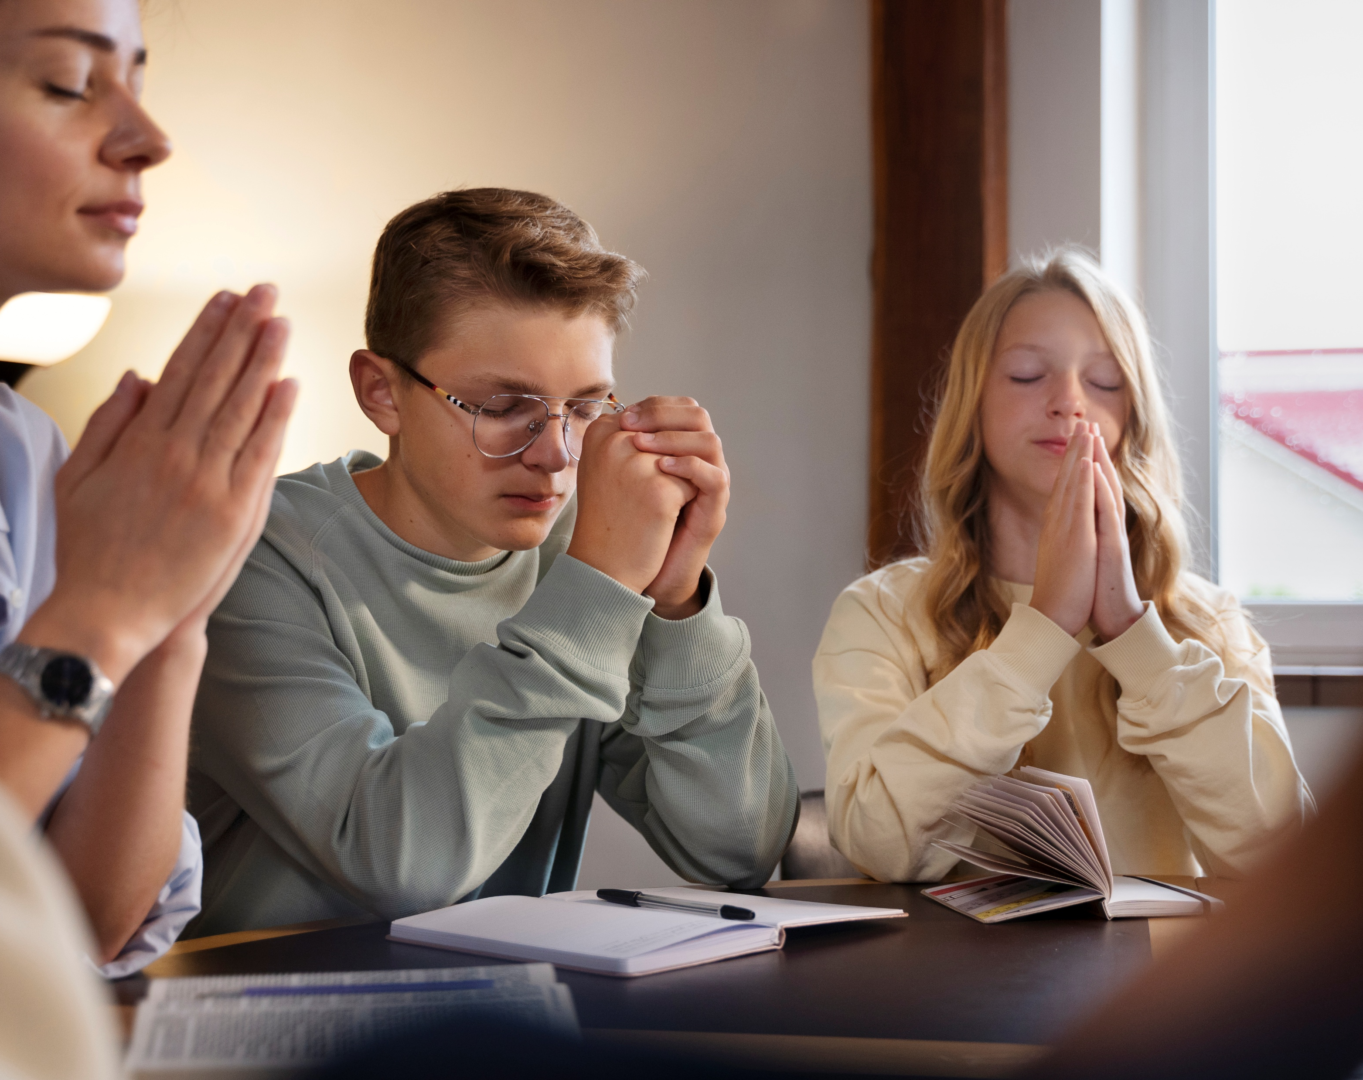
“‌ʻOua naʻa tokanga mamahi ki ha meʻa ʻe taha; kae fakahā atu hoʻomou holi ʻi he meʻa kotoa pē, ki he ʻOtua, ʻi he lotu mo e lotu tāumaʻu mo e fakafetaʻi.”
Filipai 4:6

Slide 3


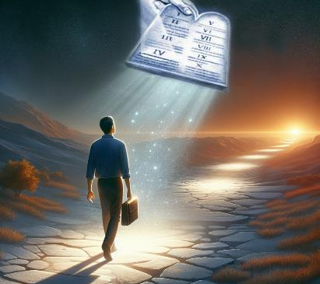


ʻ I he kotoa ʻ o ʻ ene ngaahi tohí, ʻ oku fakamahinoʻi ai ʻ e Paula ʻ oku ʻ ikai ko e kau tangataʻifonua kitautolu ʻ o e māmani ko ení. ʻI heʻetau tali ʻa Sisu ko hotau Fakamoʻui, ʻoku fanauʻi foʻou ai kitautolu. ʻI he fanauʻi foʻou ko ʻeni, ʻoku tau hoko ai ko e kau tangataʻifonua ʻo e Langi.
Neongo ʻoku tau fakaʻapaʻapaʻi mo moʻulaloa ki he ngaahi lao mo e ngaahi tuʻunga ʻo e māmani ko ʻení, ko ʻetau tōʻonga moʻuí, ko hono moʻoní, ʻoku lahi ange, ʻo ha ʻulungaanga māʻolunga ange ʻaupito.
Tangataʻifonua ‘o Hevani:
Faʻifaʻitaki ki he kau angatonu (Filipai 3:17-19)
tangataʻifonua kakato (Filipai 3:20-21)
Kae ʻoua kuo tau aʻu ki ai:
Uouangataha mo e fiefia (Filipai 4:1-6)
Ngaahi fakakaukau maʻa (Filipai 4:7-9)
Fiemālie (Filipai 4:10-13, 19)

Slide 4

TANGATAʻIFONUA ʻO HEVANI

Slide 5
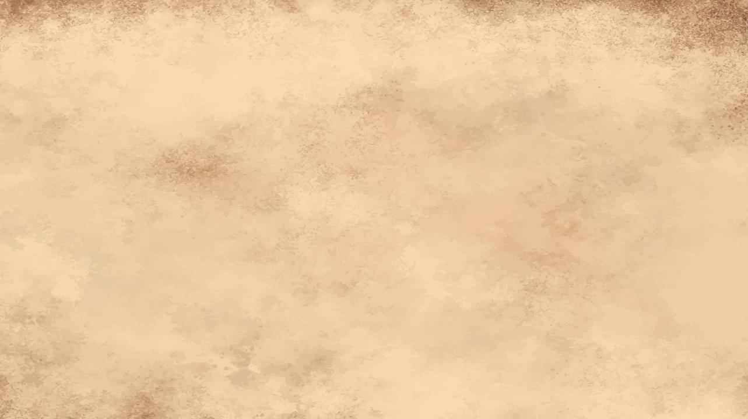

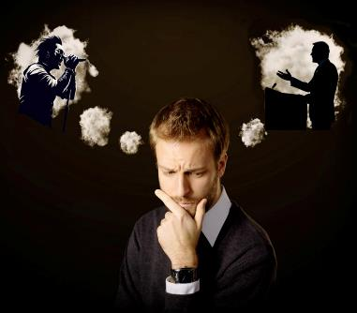
FAʻIFAʻITAKI KI HE KAU FAITŌNUNGÁ
“E kāinga, ke mou kaunga faʻifaʻitaki kiate au, pea vakai kiate kinautolu ʻoku ʻaʻeva ʻo taau mo ʻemau faʻifaʻitakiʻanga kiate kimoutolu.” (Filipai 3:17)
ʻOku tau maʻu kotoa pe ha kakai kuo nau fakafotunga ʻetau moʻui pe fakakaukau ʻi ha faʻahinga founga. Mahalo ko ha tokotaha ʻati, ko ha tokotaha sipoti, ko ha tokotaha musika, ko ha tokotaha hiva. Mahalo ko ha faifekau, ko ha tangata malanga, ko ha tokoua pe tuofefine faivelenga.
Kuo tokoniʻi nai kitautolu ʻe he kakai "faʻifaʻitakiʻanga" ko ʻeni ke tau tupulaki fakafoʻituitui, pe tataki kitautolu ʻi he ngaahi hala naʻe ʻikai totonu ke tau ʻahiʻahiʻi?
ʻOku fakaafeʻi kitautolu ʻe Paula ke tau faʻifaʻitaki kiate kinautolu ʻoku langaki hake mo fakalotolahiʻi kitautolu ʻe heʻenau ngaahi sipinga ke tau hoko ʻo lelei ange (Filipai 3:17). ʻOku ne toe fakatokanga mai foki ʻoku ʻi ai ha kakai ʻoku ʻikai taau ke faʻifaʻitaki ki ai (Filipai 3:18-19).
Ko e ha ʻoku ne ʻai ʻa e faikehekehe? ʻ Oku fakakaukau pē ʻ a e niʻihi ki he ngaahi meʻa fakaemāmaní, lolotonga ia ko e niʻihi ʻ oku tukutaha ʻ enau ngaahi fakakaukaú kia Sīsū. ʻOku hoko leva ʻa e kau faʻifaʻitakiʻanga lelei ko e kau faʻifaʻitaki kia Kalaisi (1 Kolinito 11:1).

Slide 6

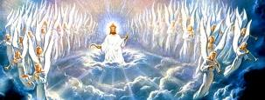

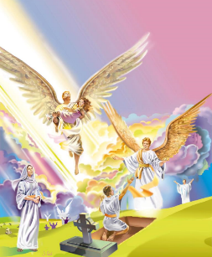
TANGATAʻIFONUA KAKATO
“He ʻoku ʻi he langi hotau kolo; ʻaia ʻoku tau ʻamanaki mei ai foki ʻae Fakamoʻui, ko e ʻEiki, ko Sisu Kalaisi.” (Filipai 3:20)
Tau fehangahangai mo ia. ʻOku ʻi ai ha palopalema ʻa kitautolu kau Kalisitiane: ko e tangataʻi fonua ʻe ua. Ko e kau tangataʻifonua kitautolu ʻo e mamani mo e kau tangataʻifonua ʻo e langi. ʻOku fakatupu ʻe he meʻa ni ha ngaahi fepakipaki lahi kiate kitautolu (Loma 7:22-23).
ʻE fakalaumalie, taʻe-faʻa-mate, mo taʻe-faʻa-ʻauha hotau sino (1 Kolinito 15:42-44, 50-54)
ʻE fakalangilangiʻi kitautolu (Kolose 3:4;
Filipai 3:21)
Te tau maʻu ha sino fakamatelie, pea ʻe mamata hotau mata tonu ki he ʻOtua. (Siope 19:25-27)
Ko e fe taimi te tau aʻusia ai ʻa e tangataʻifonua kakato? Ko fē ʻ a fē ʻ e tuku ai ʻ etau hoko ko e kau tangataʻifonua ʻ o e māmani angahalaʻia ko ení? ʻI he Haʻele ʻAngaua Mai (Fili. 3:20).
Ko e ha ʻe hoko ʻi he taimi ʻoku tau toetuʻu ai, (pe liliu), pea ʻikai ha malohi ʻo e mate kiate kitautolu?

Slide 7

KAE ʻOUA KUO TAU AʻU KI AI

Slide 8



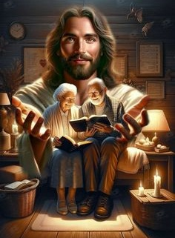
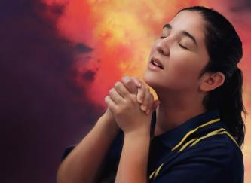
UOUANGATAHA MO E FIEFIA
“Fiefia maʻuaipē ʻi he ʻEiki: ʻoku ou toe pehē, Fiefia.” (Filipai 4:4)
ʻ I hono fakaʻosiʻosi ʻ ene tohí, ʻ oku lalanga ai ʻ e Paula ʻ a e ngaahi talamonū fakafoʻituituí ʻ aki ʻ a e faleʻi ʻ aonga. ʻOku ne kole kia Siniteke [hoa faivelenga] mo Kelemeni ke na tokoniʻi ʻa ʻIuotia mo Siniteke ke na nofo uouangataha. ʻOku ne pehe fekauʻaki mo kinautolu kotoa, ko e kaunga-ngaue ʻo Paula: "ʻa ia ʻoku ʻi he tohi ʻo e moʻui" (Filipai 4:2-3).
Ko e faleʻi ko ení te tau puputuʻu nai ai: "Fiefia maʻu ai pē [...] ʻOua naʻa mou hohaʻa ki ha meʻa" (Fili. 4:4, 6). ʻE lava fefe ke hoko ʻeni ʻi ha mamani ʻoku fonu ʻi he ngaahi palopalema mo e ngaahi faingataʻa?
ʻOku malava ʻeni koeʻuhi he ʻoku tau fiefia "ʻi he ʻEiki" (Fili. 4:4a). ʻOku tau tuku atu ʻetau loto hohaʻa kiate Ia, ʻo falala te Ne lava ʻo katakiʻi ia maʻatautolu(Matiu 6:31-34; 1 Pita 5:7).
Pea ʻ oku anga - fēfē ʻ etau lī atu ʻ etau loto - moʻuá kia Sīsū? ʻI he lotu (Filipai 4:6).

Slide 9



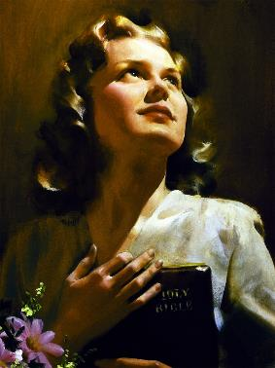
NGAAHI FAKAKAUKAU MAʻA
“E kāinga, ko hono fakaʻosi eni, ke ʻilonga ʻae ngaahi meʻa ʻoku moʻoni, ke ʻilonga ʻae ngaahi meʻa ʻoku matamatalelei, ke ʻilonga ʻae ngaahi meʻa ʻoku totonu, ke ʻilonga ʻae ngaahi meʻa ʻoku māʻoniʻoni, ke ʻilonga ʻae ngaahi meʻa ʻoku fakaʻofoʻofa, ke ʻilonga ʻae ngaahi meʻa ʻoku ongoongolelei; kapau ʻoku ai ha lelei, pe ha meʻa ke fakamālōʻia, tokanga ki he ngaahi meʻa ko ia. ” (Filipai 4:8)
ʻI he meʻa ʻoku moʻoni
Ko e moʻoni
ʻOku feʻunga pe
ʻI hono fotunga haohaoa taha
ʻI he angaʻofa
ʻI he meʻa ʻoku ʻi ai ʻa e hingoa lelei
Ko e ola ʻo hono tuku atu ʻetau loto hohaʻa kia Sisu mo e fiefia ko e melino (Filipai 4:7). Ko ha melino he ʻikai lava ʻe mamani ʻo foaki pe toʻo (Sione 14:27; 16:33).
Fakatatau kia Paula, ʻe hoko ʻa e melino ko ʻeni ko ha maluʻi ko ha maluʻi ki heʻetau ngaahi ongo mo ʻetau ngaahi fakakaukau (Filipai 4:7b). Koeʻuhi ke ola lelei ʻa e maluʻi ko ʻeni, ko e ha e ngaahi meʻa ʻoku totonu ke tau fakakaukau ki ai (Filipai 4:8)?
Ko hono fakanounou: "kapau ʻoku ʻi ai ha meʻa ʻoku lelei pe feʻunga mo hono vikivikiʻi—fakakaukau ki he ngaahi meʻa pehee." (Filipai 4:8b).

Slide 10






FIEMALIE
"Pea ʻe feau ʻe hoku ʻOtua ʻa hoʻomou ngaahi fie maʻu kotoa pe, ʻo fakatatau ki he ngaahi koloa ʻo hono naunau ʻia Kalaisi Sisu" (Filipai 4:19)
ʻOku tau fiefia; ʻoku ʻikai ha meʻa te ne fakahohaʻasi kitautolu; ʻoku tau maʻu ʻa e melino; ʻOku maʻa ʻetau ngaahi fakakaukau. ʻOku tau maʻu ha moʻui haohaoa mo lavameʻa...
pe ko kitautolu?
ʻOku tau falala ʻe ʻikai foaki mai ʻe he ʻOtua ha meʻa lahi ange pe siʻi ange ʻi he meʻa ʻoku ʻaonga kiate kitautolu (Lea-Fakatata 30:8-9).
ʻI he taimi ʻoku tau moʻui ai ʻi he loto falala ko ʻeni, ʻoku tau fakapapauʻi "ʻoku ou faʻa fai ʻeni kotoa pe ʻiate ia ʻoku ne foaki kiate au ʻa e malohi" (Filipai 4:13).
Te tau lava ʻo tuʻumalie; Mahalo ʻoku ʻi ai haʻatau ngaahi fie maʻu pe palopalema. Kapau ʻoku tau hange ko Paula, ʻo fakapapauʻi kakato ʻoku tataki ʻe he ʻOtua ʻetau moʻui, te tau falala maʻu pe kiate Ia ʻo tatau ai pe pe ko e ha hotau tukunga
(Filipai 4:11-12, 19).

Slide 11

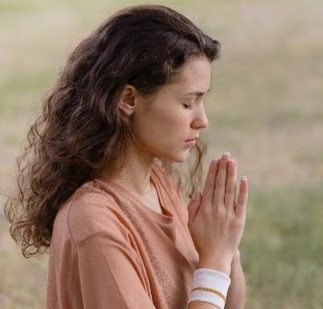
FIEMALIE
“Ka ʻe taufetuku ʻe hoku ʻOtua ki hoʻomou masiva kotoa pē, ʻo fakatatau ki heʻene koloa ʻi he nāunau ʻia Kalaisi Sisu.” (Filipai 4:19)
Ko e ha e meʻa ʻoku hoko ʻi he taimi ʻoku ʻikai ke tau maʻu ai ʻa e meʻa ʻoku tau pehe ʻoku tau fie maʻu?
Tau kole ia ki he ʻEiki, pea kapau ʻoku fakatatau ki Hono finangalo, te Ne foaki mai ia kiate kitautolu (Semisi 4:2b; 1 Sione 5:14-15)
ʻOku ʻikai ke tau ʻiloʻi maʻu pe pe ʻoku fakatatau ʻa e meʻa ʻoku tau kole ki Hono finangalo, ka ʻoku ʻi ai ha ngaahi kole pau ʻoku tau fakapapauʻi ʻoku fakatatau maʻu pe ki Hono finangalo:
Fakamoʻui ki ha taha ʻoku tau ʻofa ai pe kaungameʻa (1 Timote 2:3, 4)
Loto-toʻa ke vahevahe ʻetau tui (Fakaha 22:17)
Fakamolemole ʻi he taimi ʻoku tau vete ai mo siʻaki ʻetau fehalaaki (1 Sione 1:9)
Malohi ke talangofua ki he ngaahi fekau ʻa e ʻOtua (Hepelu 13:20, 21)
ʻOfa kiate kinautolu ʻoku fehiʻa mo ngaohikovia kitautolu (Matiu 5:44)
Poto ki he ngaahi tukunga faingataʻa (Semisi 1:5)
Mahino ʻa e moʻoni ʻi he Folofola ʻa e ʻOtua (Sione 8:32)

Slide 12

"ʻOku totonu ke tau moʻui maʻa e maama ka hoko. ʻOku fuʻu fakamamahi ke moʻui taʻeʻaonga mo taʻeʻaonga. ʻOku tau fie maʻu ha taumuʻa ʻi he moʻui—ke moʻui ʻi ha taumuʻa. ʻE tokoniʻi kitautolu kotoa ʻe he ʻOtua ke tau feilaulauʻi kitautolu, siʻisiʻi ange ʻetau tokanga kiate kita, fakangaloʻi lahi ange ʻetau tokanga mo e siokita; pea ke fai lelei, ʻo ʻikai koeʻuhi ko e langilangi ʻoku tau ʻamanaki ke maʻu heni, ka koeʻuhi ko e taumuʻa ʻeni ʻo ʻetau moʻui pea te ne tali ʻa e ngataʻanga ʻo ʻetau moʻui."
EGW (Ko Hotau Uiuiʻi Maʻolunga, 24 ʻAokosi )

