Slide 1

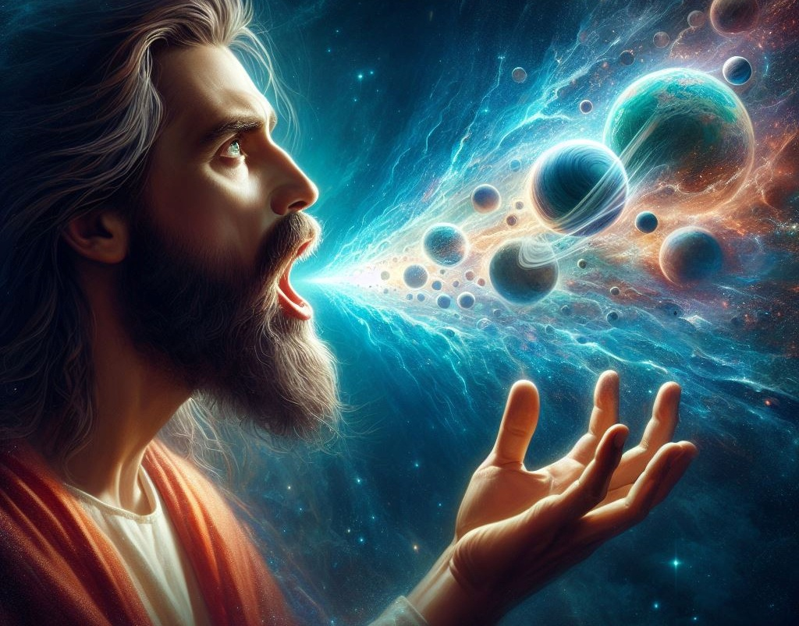
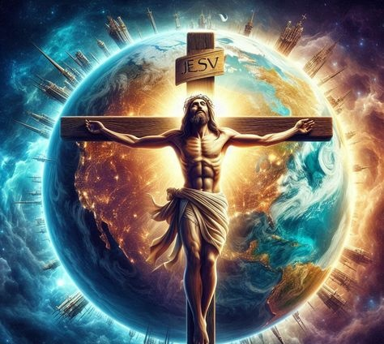
Lesoni 8 ki he ʻaho 21 ʻo Fepueli 2026
KO E LAULŌTAHA ʻO KALAISI

Slide 2
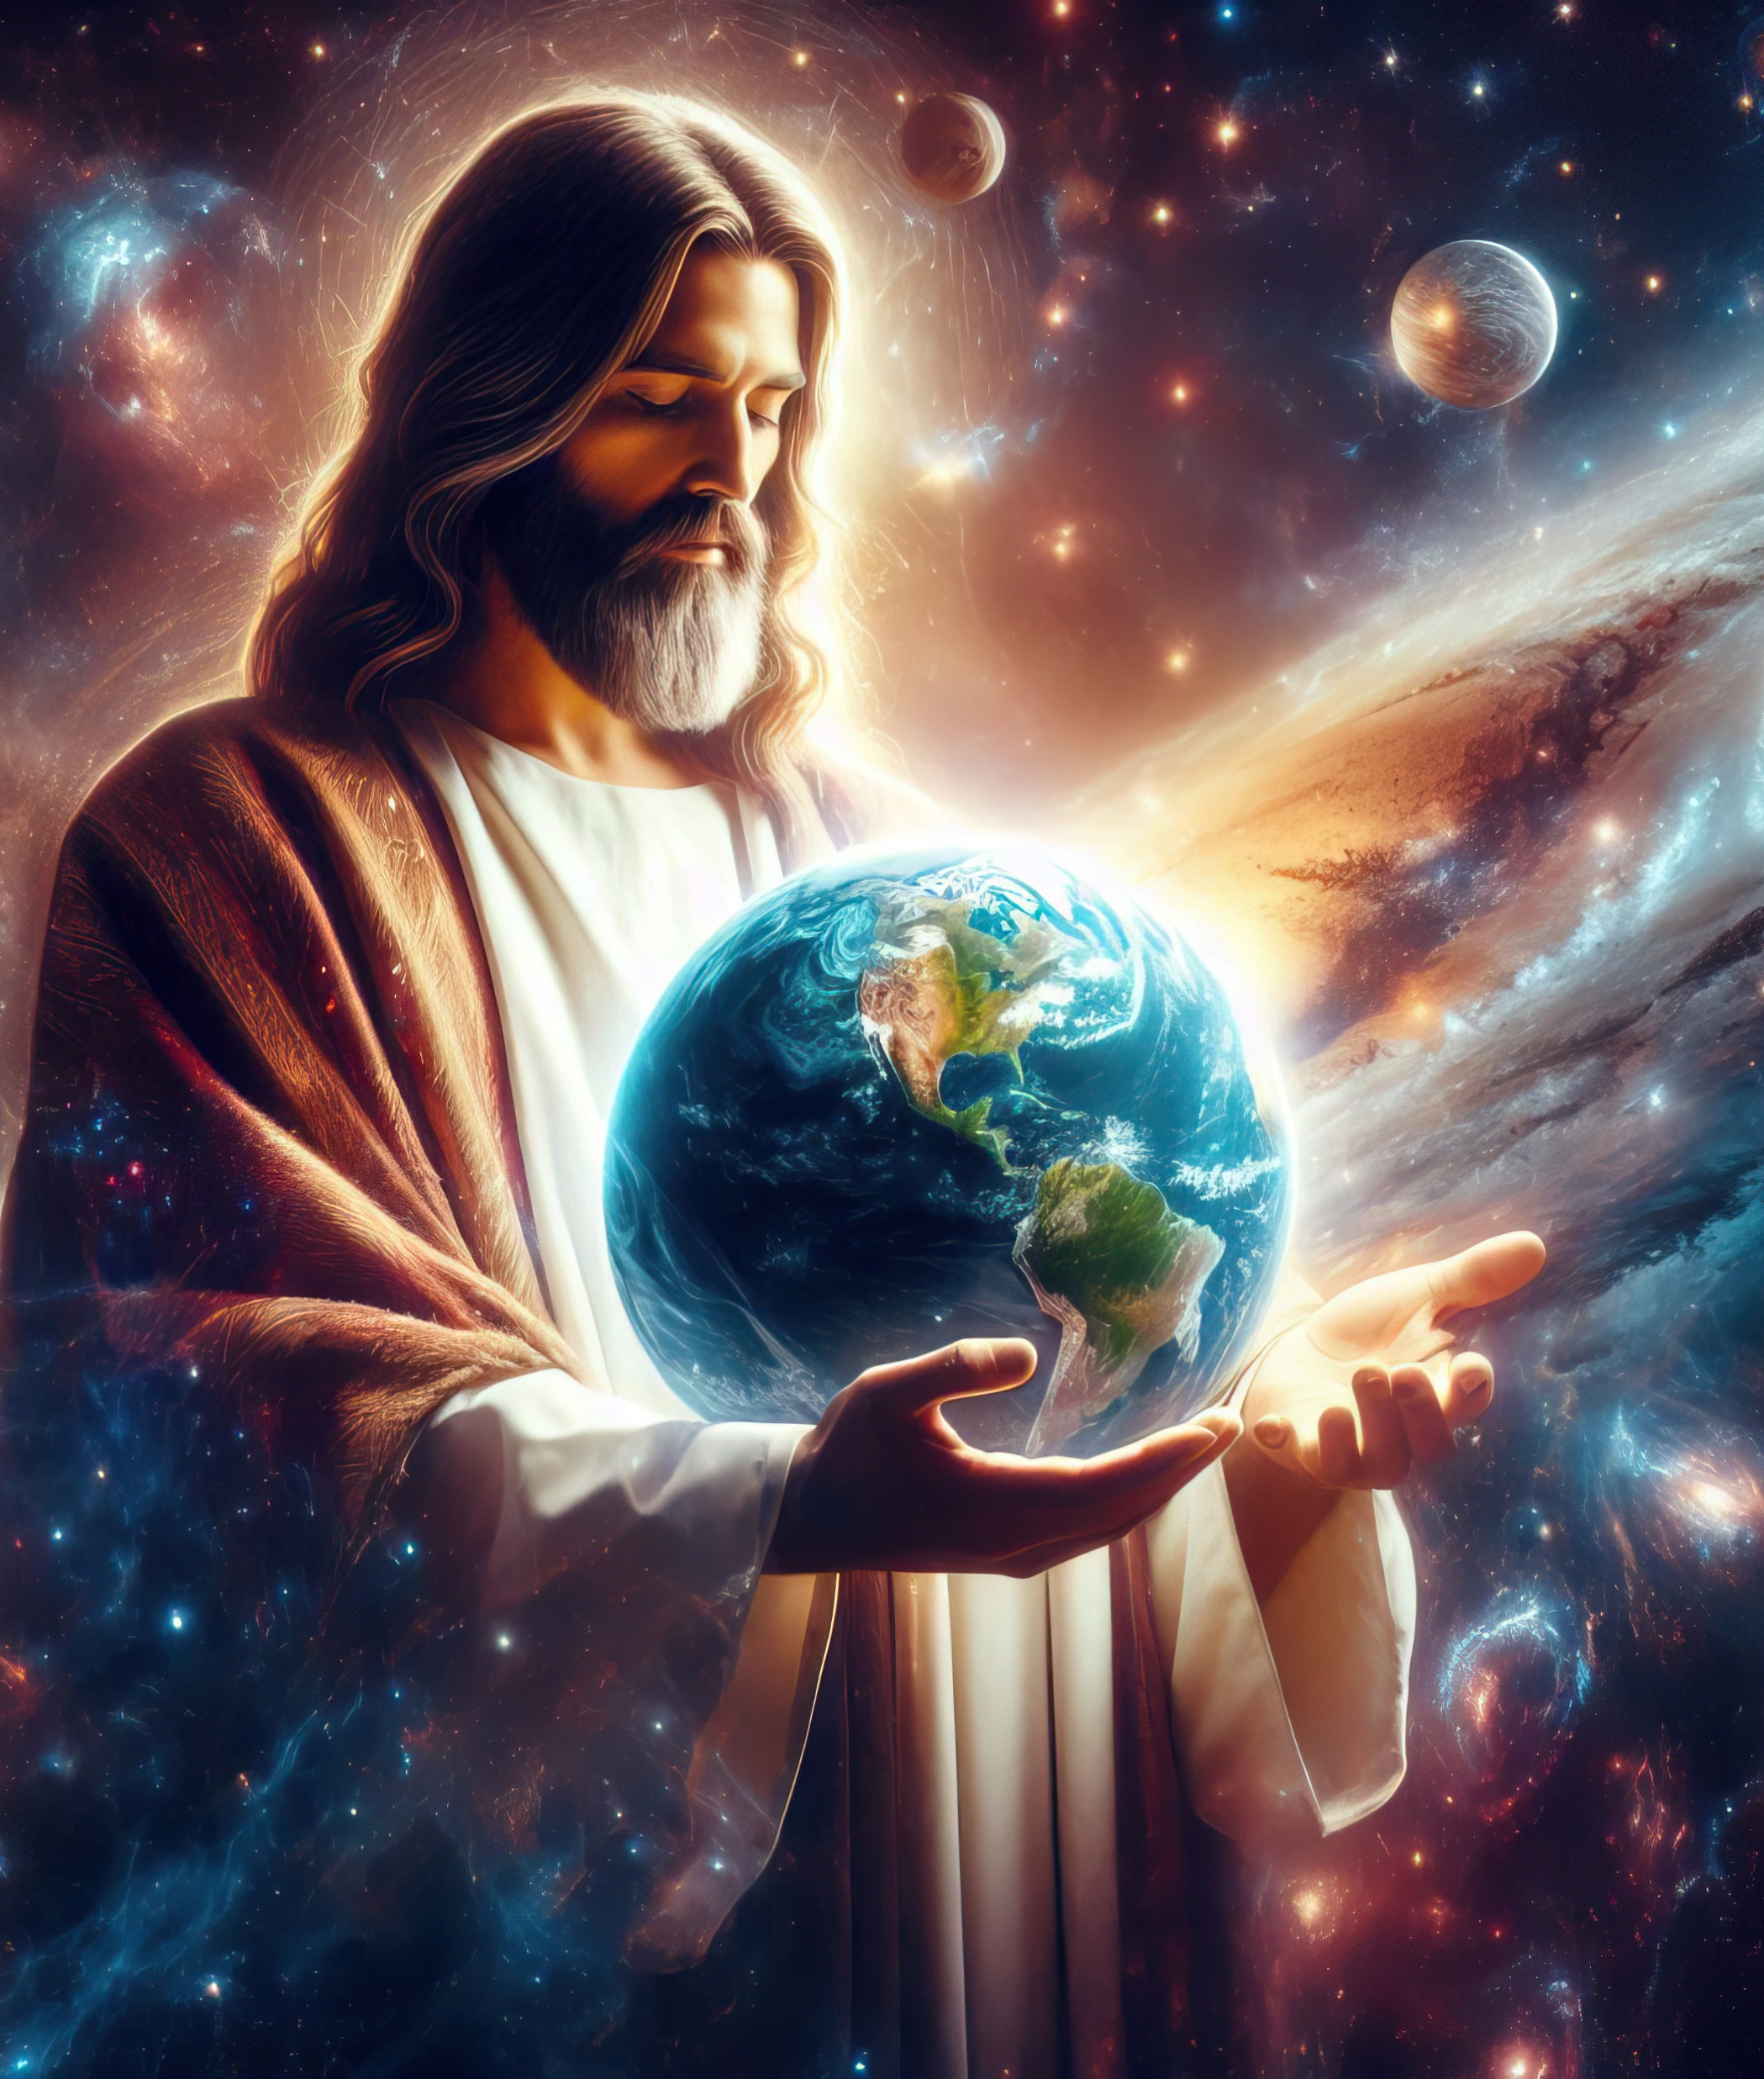
“ʻAia ko hono tatau ʻoe ʻOtua taʻehāmai, ko e ʻuluaki fānau ʻi he meʻa fakatupu kotoa pē:He naʻe fakatupu ʻe ia ʻae ngaahi meʻa kotoa pē, ʻaia ʻoku ʻi he langi, pea mo ia ʻoku ʻi māmani, ʻae meʻa hā mai mo e taʻehāmai, pe ko e ngaahi nofoʻa fakaʻeiʻeiki, pe ko e ngaahi ʻeikiʻanga, pe ko e ngaahi pule, pe ko e ngaahi mālohi: naʻe fakatupu ʻe ia ʻae ngaahi meʻa kotoa pē, pea naʻe maʻana ia:Pea ʻoku ki muʻa ia ʻi he ngaahi meʻa kotoa pē, pea ʻoku tuʻumaʻu ʻiate ia ʻae ngaahi meʻa kotoa pē.”
Kolose 1:15–17

Slide 3


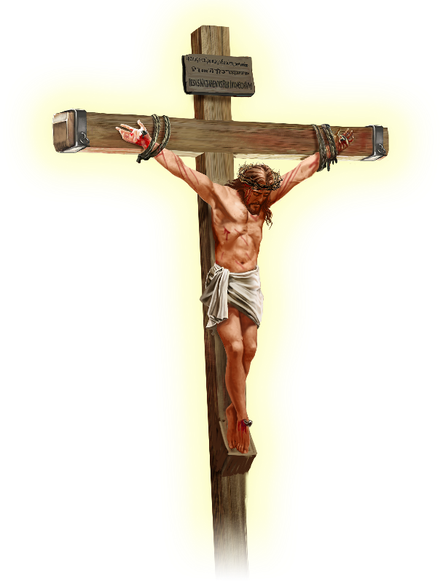






ʻOku fakaha ʻe Paula kuo ʻomi ʻe Sisu ʻa e melino ki he ʻunivesi kotoa, "pe ko e ngaahi meʻa ʻi mamani pe ko e ngaahi meʻa ʻi he langi" (Kolose 1:20 )
Ki muʻa ke aʻu ki he fakamatala ko ení, ʻ oku tala mai ʻ e he ʻ apositoló pe ko hai moʻoni ʻ a Sīsuú. ʻOku ʻikai ko ha faiako maʻongoʻonga, pe ko ha filosefa, pe ko ha palofita, pe ko ha tangata malanga, pe ko ha talafekau ʻo e ongoongo lelei.
Ko Sisu Kalaisi ko e...
Ko e ʻimisi ʻo e ʻOtua (Kolose 1:15a)
Ko e ʻuluaki fanau (Kolose 1:15b-17)
Ko e ʻulu ʻo e Siasi (Kolose 1:18a)
Ko e kamataʻanga (Kolose 1:18b)
Ko e Fakalelei (Kolose 1:19-20)

Slide 4
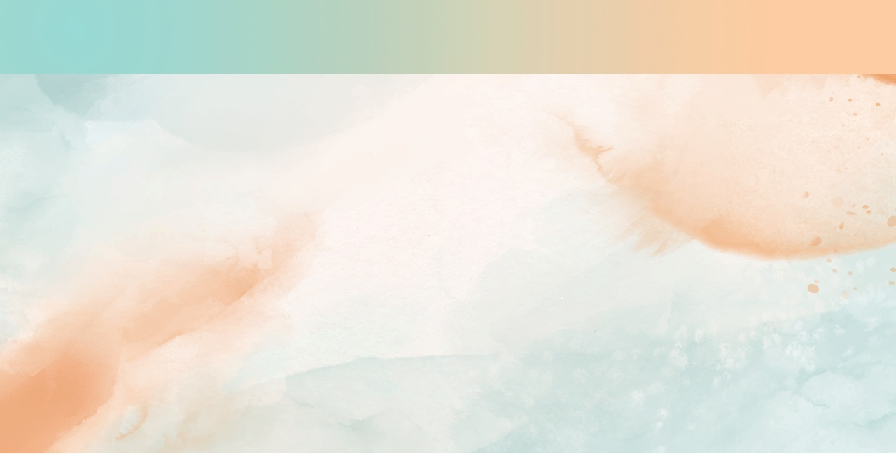
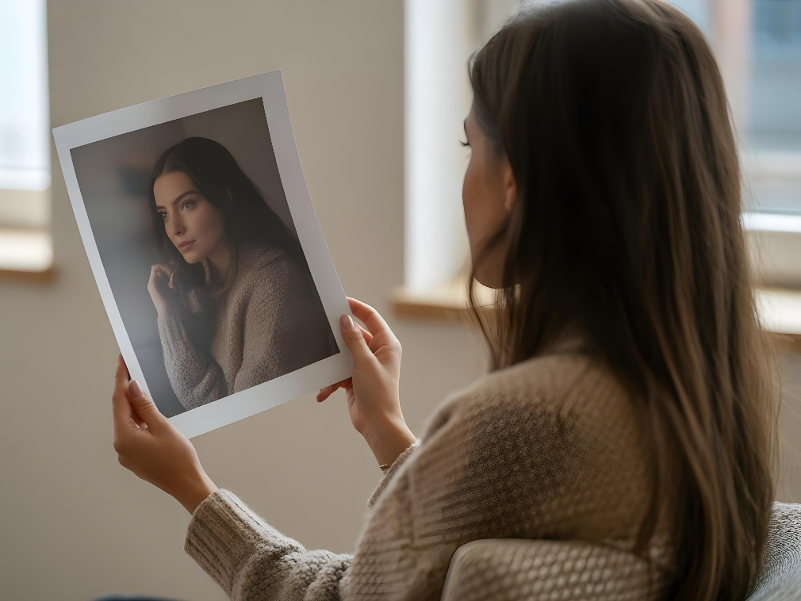
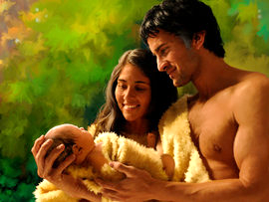


KO E ʻIMISI ʻO E ʻOTUA
“‌ʻAia ko hono tatau ʻoe ʻOtua taʻehāmai, ko e ʻuluaki fānau”(Kolose 1:15a)
ʻE lava ke hoko ʻa e ʻimisi ko ha tatau ʻo e moʻoni (ko ha laʻita, ko ha ʻimisi fakamanatu), pe ko ha faʻahinga meʻa faʻu (ko ha ta fakatata). Ka ʻoku mahulu atu ʻa e fakakaukau fakatohitapu ki he ʻimisi ai.
Naʻe fakatupu ʻe he ʻOtua ʻa ʻAtama mo ʻIvi ʻi hono tatau (Senesi 1:27), pea naʻe fanauʻi ʻe ʻAtama ha foha ʻi hono tatau pe ʻoʻona (Senesi 5:3). ʻOku ʻikai ko ha tatau ʻeni ʻo e meʻa moʻoni, faʻifaʻitakiʻanga, pe faʻufaʻu ʻo ʻenau fakakaukau. ʻOku nau faitatau fakaesino, fakaʻatamai, mo fakasosiale...
‘Oku pehē ‘e Paula, ko e lao faka-ouaú, ko e ‘ata pē, “‘o ‘ikai ko e ‘īmisi tonu ‘o e ngaahi me‘á” (Hep. 10:1), ‘o fakahu‘unga ai ‘a e “‘īmisi = mo‘oni.”
Ko e fehu’i: Na’e tatau nai ‘a Sisu mo e ‘Otua, pe tatau mo e ‘Otua? Tānaki atu ki hono toutou tuku kiate ia ‘a e huafa faka‘otua ko e “Ko au,” na‘e pehē mahino ‘e Sīsū: “Ko au mo e Tamaí ‘okú ma taha” ( Sione 10:30 ); “Ko ia kuó ne mamata kiate aú kuó ne mamata ki he Tamaí” ( Sione 14:9 ).

Slide 5

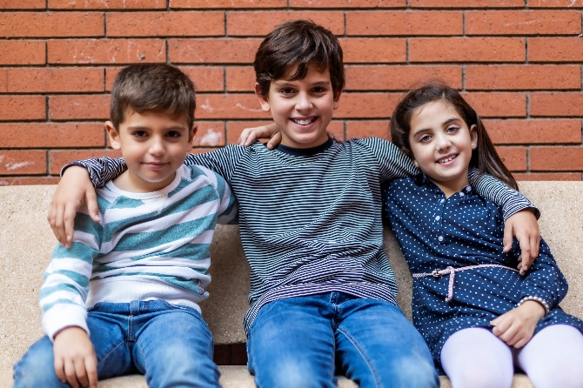


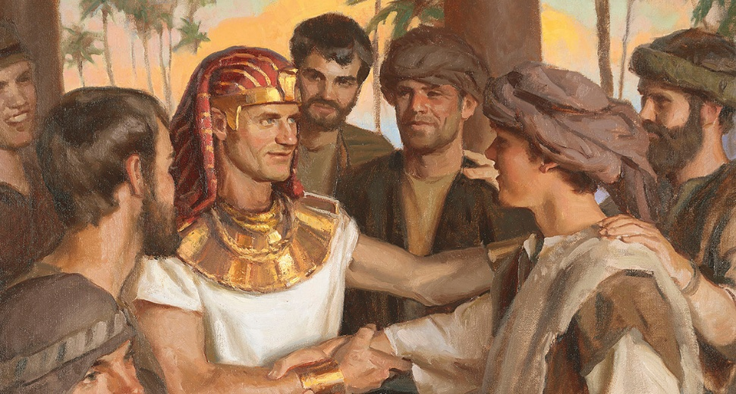
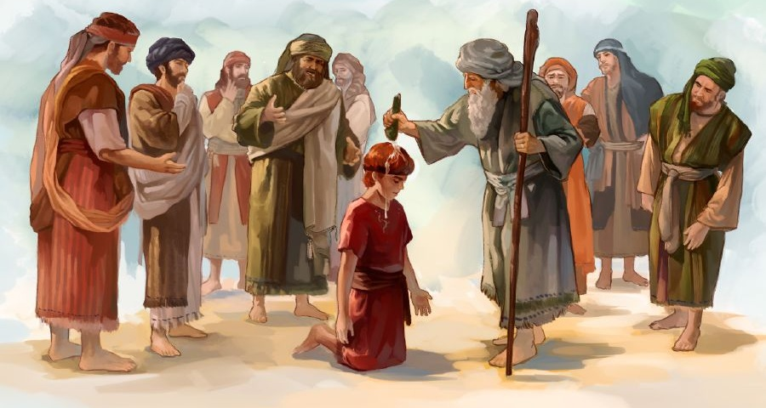

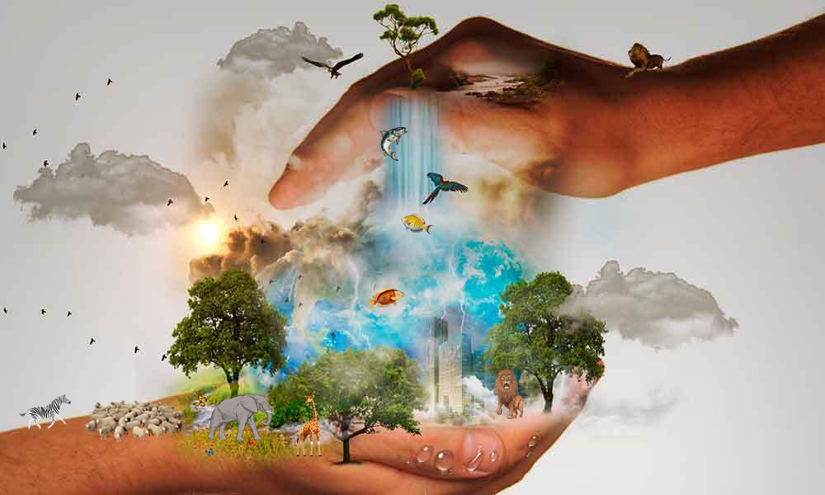
KO E 'ULUAKI FANAU
“Pea ʻoku ki muʻa ia ʻi he ngaahi meʻa kotoa pē, pea ʻoku tuʻumaʻu ʻiate ia ʻae ngaahi meʻa kotoa pē.” (Kolose 1:17)
ʻOku ʻuhinga ʻa e “ʻUluaki Fānaú” ki he ʻuluaki fakatupú. Ko ia ai, ‘oku ako’i ‘e he ni’ihi ko Sisu ‘a e ‘uluaki fakatupu ‘e he ‘Otua (Kol. 1:15). Ka, hangē ko e fo‘i lea “‘īmisí,” ko e fo‘i lea “‘uluaki fānaú” ‘oku ‘i ai hono ‘uhinga fakatohitapu ‘oku lahi ange.
Ko ʻAisake ʻa e ʻuluaki fohá kae ʻikai ko ʻIsimeʻeli; Ko Sēkope ‘a e ‘uluaki fohá ‘o fetongi ‘a ‘Īsoa; Ko Siosifa ʻa e ʻuluaki fohá kae ʻikai ko Lūpeni; Ko Tevita ‘a e ‘uluaki foha kae ‘ikai ko ‘Eliapi (Saame 89:27). Na‘a nau ‘uluaki fanau kotoa koe‘uhi na‘a nau ma‘u ‘a e tu‘unga mā‘olunga ‘i honau fanga tokouá, ‘o ‘ikai koe‘uhi na‘e ‘uluaki fanau‘i kinautolu.
‘Oku lave ‘a Paula ki he tu’unga ma’olunga ko ‘eni ‘ia Kolose. Ke faka’ehi’ehi mei ha veiveiua ki hono natula, ‘oku ne faka’uhinga’i ‘a e ongo ‘ulungaanga faka’otua ‘e ua kiate Ia: ko e fakatupu ‘o e me’a kotoa pe ‘oku ‘i ai (Kol. 1:16; ‘Ais. 45:18); pea mo hono me’atokoni (Kol. 1:17; Same 119:91).

Slide 6



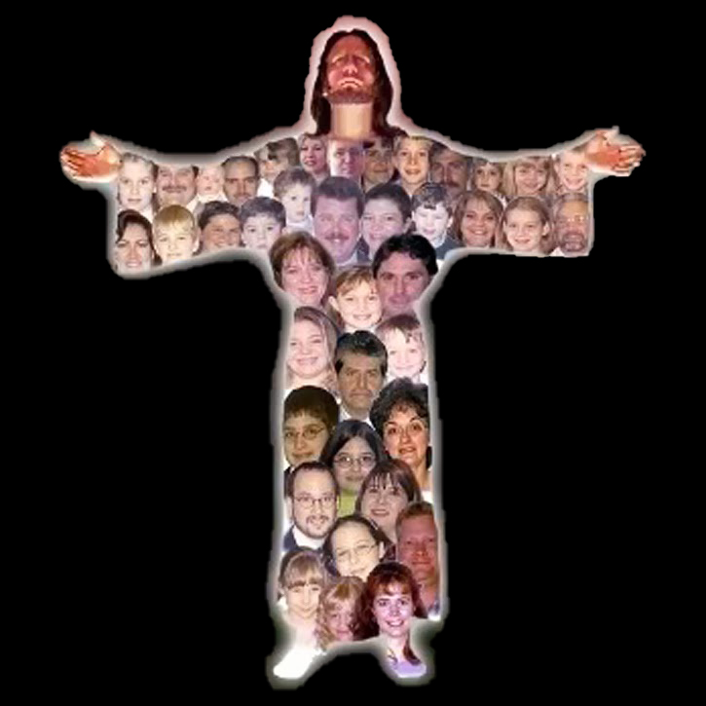
KO E 'ULU 'O E SIASI
“Pea ko e ʻulu ia ʻo e sinó, ʻa ia ko e siasí” (Kolose 1:18a)
‘I he ngaahi lea ‘e ni‘ihi (hangē ko e lea faka-Katalaní pe faka-Pilitāniá) ‘oku toe liliu ai ‘a e fo‘i lea “‘ulu” ko e “pule” pe “puleako,” koe‘uhi ko e ‘uhinga fakaefakatātā ia ‘o e “‘ulu.” ‘Oku pehē foki ‘a e me‘á ni ‘i he lea faka-Hepeluú. Hangē ko ʻení, ʻoku totonu ke liliu ʻa e “fakanofo maʻanautolu ha ʻulu ʻe taha” (Hosea 1:11) ko e “te nau fakanofo ha taki ʻe taha” .
‘Oku fiema‘u kotoa kitautolu (1 Kol. 12:15)
‘Oku taki taha ‘i ai pe ‘ene ngaue (1 Kol. 12:17)
He'ikai ke tau manuki'i ha taha (1 Kol. 12:21)
ʻOku ʻikai ha kakai tui "maʻulalo ange" (1 Kolinito 12:22-24)
ʻOku tau fetauhiʻaki
(1 Kolinito 12:25-26)
Ko e ‘uhinga foki eni ‘oku ngāue’aki ‘e Paula ‘a e lea ni ‘i he’ene faka’aonga’i ia kia Kalaisi (Kol. 1:18a).
Ka ‘oku toe tānaki atu ‘e Paula ha ‘uhinga fakaefakatātā ki he sinó. Kapau ko Kalaisi ʻa e ʻulú, ko kitautolu —ʻa e siasí —ko e sinó. Mei he fakakaukau ko eni ‘oku ‘asi mai ai:

Slide 7


KO E KAMATAʻANGA
“Ko ia ʻa e kamataʻanga mo e ʻuluaki fanau mei he mate, koeʻuhi ke ne maʻu ʻa e pule ʻi he meʻa kotoa pe." (Kolose 1:18b)
Ko e fo‘i lea ‘oku liliu ko e “kamata‘angá” ko e archē (ἀρχή), ko ha fo‘i lea faka-Kalisi ‘oku ‘uhinga ki he kamata‘angá, tupu‘angá, ‘uluaki tupu‘angá pe tefito‘i mo‘oní, ka ‘oku toe ‘uhinga ia ki he pule, mālohi, mafai pe pule‘anga, ‘o fakatu‘unga lahi ‘i he tu‘unga-leá.
‘Oku lava ke tau pehē, ko e lea ko eni, ‘i hono ngāue’aki kia Kalaisi, ‘e lava ke ne ma’u ‘a e ngaahi ‘uhinga kotoa ko eni (Kol. 1:18). Ko Sīsū ‘a e tupu‘anga ‘o e me‘a kotoa pē [ko e ‘īmisi ‘o e ‘Otuá], ko e ‘uhinga na‘e fakatupu ai ‘a e me‘a kotoa pē [ko e ‘uluaki ‘o e fakatupú], ko e pule mā‘olunga tahá [ko e ‘ulú]. ‘Oku ‘oange ‘e he me‘á ni kotoa kiate ia ‘a e tu‘unga mā‘olungá.
‘Oku fakahū heni ‘e Paula ‘a e hingoa “ko e ‘uluaki foha mei he pekia” (neongo na’e ‘ikai ko Sīsū ‘a e ‘uluaki toetu’u, ka ko Mosese). Ko ‘ene ikuna ‘i he mate ‘oku toe ‘uhinga ia ki he’ene ikuna ‘i he angahala pea mo hono mafai ke toe fakatupu kitautolu ‘i hono ‘imisi.

Slide 8

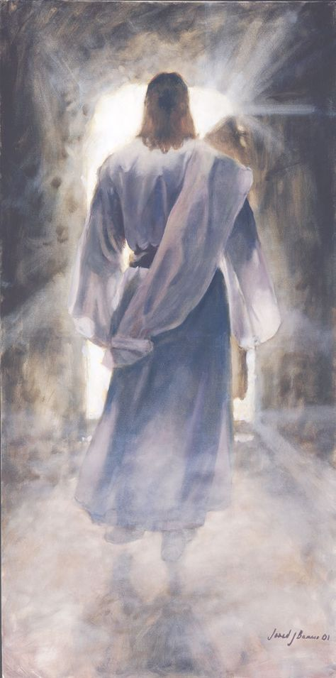



KO E FAKALELEI
“Pea ʻi he fakamelino ʻaki ʻae taʻataʻa ʻi hono tutuki ki he ʻakau, ke fakalelei ai ʻae ngaahi meʻa kotoa pē kiate ia; ʻiate ia, pe ko ha ngaahi meʻa ʻi māmani, pe ko e ngaahi meʻa ʻi he langi. ” (Kolose 1:20)
Ko e meʻa naʻe fai ʻe Sīsuú naʻe iku ia ke ne ʻuluaki ʻi he meʻa kotoa pē. Fakatatau kia Paula, ʻoku taau ʻa Kalaisi mo e ngaahi hingoa fakalakanga kotoa ko ʻení “he naʻe finangalo ʻa e ʻOtuá ke nofo ʻiate ia ʻa hono fonu kotoa pē” ( Kolose 1:19 ). Ko hono fakalea ʻe tahá, ko Sīsuú ko e ʻOtua kakato ia pea ko e tangata kakato. “Kuo mau mamata ki hono nāunaú, […] ʻoku fonu ʻi he ʻaloʻofá mo e moʻoní”
( Sione 1:14 ).
‘I he’ene pekia ‘i he kolosi pea toetu’u, na’e fakakakato ai ‘e Sisu ‘a e ngaahi fiema’u ‘oku fiema’u ke fakalelei’i ‘aki ‘a e tangata mo e ‘Otua (Kolose 1:20).
ʻE lava ke mahino kiate kitautolu kuo ne fakalelei mo e ʻOtua "ʻa e ngaahi meʻa ʻi he mamani." Ka kuo anga - fēfē ʻ ene fakalelei kiate ia ʻ a e faʻahinga ʻ oku ʻ i hēvaní?
Kuo malava ‘e he ‘univēsí kotoa ke sio lelei ki he natula ‘o e koví. Ko ia, ‘oku fakatonuhia’i ai ‘a e ‘ulungaanga ‘o e ‘Otua ‘i Hevani mo Mamani fakatou’osi.

Slide 9

“Ko Sīsū ‘a e faka‘ei‘eiki ‘o e langí, ko e ‘eikitau ‘ofeina ‘o e kau ‘āngeló, ‘a ia na‘á ne fiefia ke fai ‘a Hono finangaló. Naʻá Ne taha mo e ʻOtuá, “ʻi he fatafata ʻo e Tamaí” ( Sione 1:18 ), ka neongo ia naʻá Ne fakakaukau ʻoku ʻikai ko ha meʻa ia ke fakaʻamu ke tatau mo e ʻOtuá lolotonga ia ʻoku mole ʻa e tangatá ʻi he angahalá mo e mamahí. Naʻá Ne hifo mei Hono taloní, naʻá Ne tuku Hono kalauní mo e tokotoko fakatuʻí, peá Ne fakakofuʻi Hono fakaʻotuá ʻaki ʻa e tangatá. Naʻá Ne fakavaivaiʻi Ia ʻo aʻu ki he pekia ʻi he kolosí, koeʻuhí ke hakeakiʻi ʻa e tangatá ki ha nofoʻanga mo Ia ʻi Hono taloní. [...] ʻI he ʻofá ʻokú Ne haʻu ai ke fakahā ʻa e Tamaí, ke fakalelei ʻa e tangatá mo e ʻOtuá.”
EGW (Ngaahi Pōpoaki Filifili, Voliume 1, p. 321)

