Slide 1
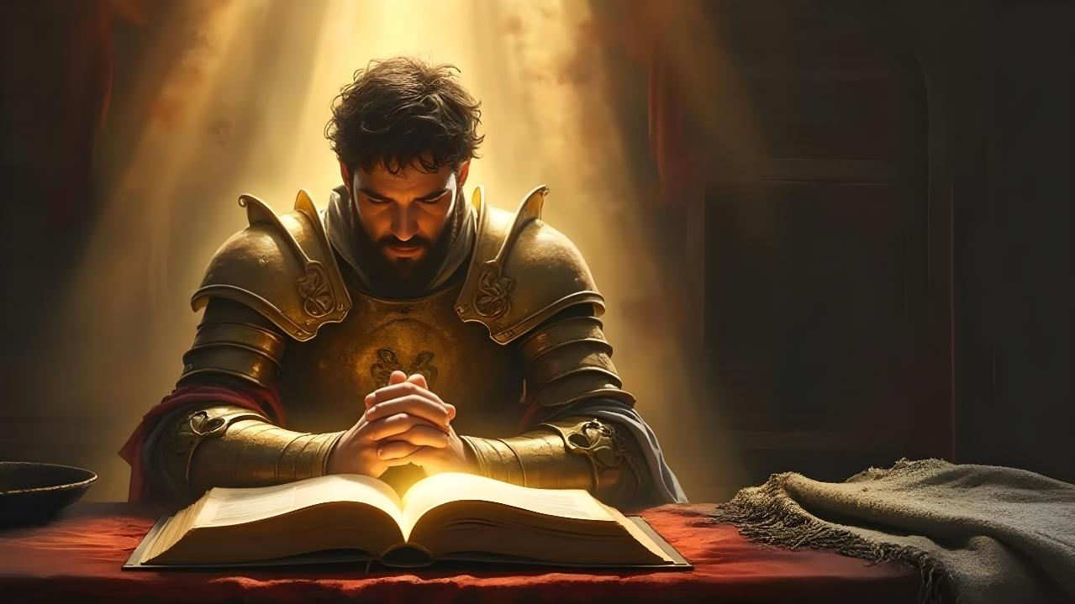
KAU TAU ‘O E LOTU
Lesoni 6 ki he ʻaho 9 ʻo Me 2026

Slide 2

“‌ʻOku ou ʻofa kia Sihova, koeʻuhi kuo ne ongoʻi hoku leʻo mo ʻeku lotu tāumaʻu. Koeʻuhi kuo ne fakatokangaʻi hono fofonga kiate au,
ko ia te u ui ai ki heʻene ʻafio ʻi hoku ngaahi ʻaho.” (Saame 116:1, 2)

Slide 3


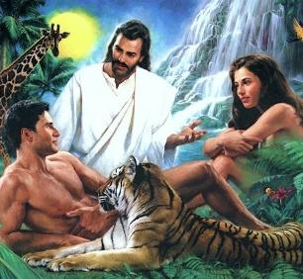

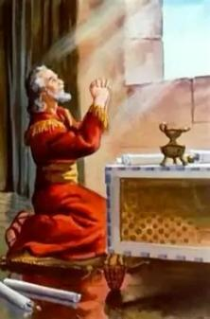
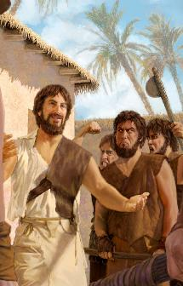
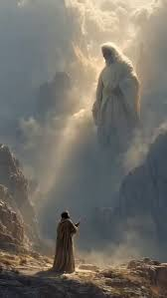


Ko e ngaahi me’amo’ui kotoa pe, kau ai ‘a e tangata, na’e fakatupu ia ‘e he ‘Otua ‘o ‘i ai ‘a e malava ke nau fetu’utaki ‘iate kinautolu, pea mo Ia.
Me’apango, na’e mole mei he tangata ‘a e malava ke fetu’utaki hangatonu mo e ‘Otua ‘i he taimi na’e faiangahala ai ‘a ‘Atama mo ‘Ivi.
Ka naʻe tuku mai ʻe he ʻOtuá ha meʻaʻofa maʻatautolu. Ko ha “telefoni” ʻokú ne fakaʻatā ke tau hokohoko atu ʻetau fetuʻutaki mo Iá: ko e lotú.
Ko Taniela, ʻĪnoke, mo Mōsese ko ha ngaahi sīpinga ia ʻo e founga ʻe lava ke tau fakaʻaongaʻi ai ʻa e meʻaʻofa mālohi ko ʻení.
Taniela:
  Ko e lotu he taimi fakatu'utamaki
  Lotu ʻi he tuʻunga totonú
Inoke:
  Ko e mo'ui lotu
Mosese:
  Talanoa mo e 'Otua
  Ko e lotu fakalaloa

Slide 4

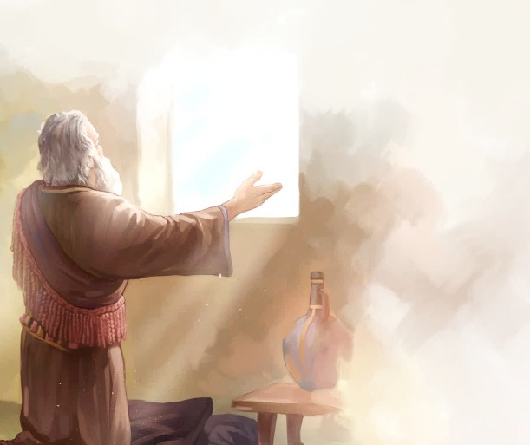
TANIELA

Slide 5

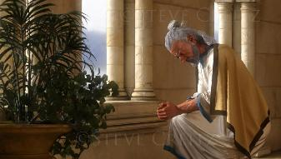
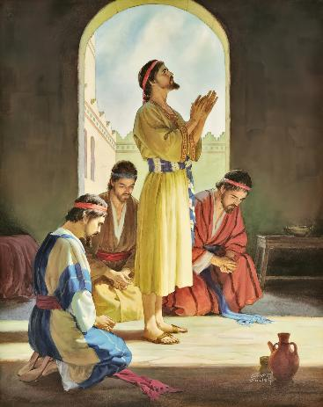
















LOTU HE TAIMI FAKATU'UTAMAKI
“Pea ne u hanga hoku mata kia Sihova ko e ʻOtua, ke kumi ʻi he lotu mo e ngaahi kole mo e ʻaukai mo e ʻai ʻae tauangaʻa mo e efuefu.” (Taniela 9:3)
Koeʻuhi ko ʻene falala ki he ʻOtua, naʻe maʻu ai ʻe Taniela ʻa e poto, malava ke fakaʻuhingaʻi ʻa e ngaahi misi, mo e poto (Taniela 1:8, 17, 20). ʻI he taimi naʻe ʻi ha tuʻunga fakatuʻutamaki ai ʻene moʻui mo e moʻui ʻa hono ngaahi kaungameʻa, naʻa ne tafoki ki he ʻOtua ʻi he lotu (Taniela 2:17-23).
Hili ha moʻui ʻo e lotu, ko e ha e ngaahi ʻulungaanga naʻe maʻu ʻe Taniela (Taniela 6:3-5)?
PULE LELEI
ANGATONU
FAKAOFOOFA
IKAI LAVA KE VELA
FALALAʻANGA
FAKALANGILANGI
FAIVELENGA MO MATEAKI
IKAI HA TAHA
NGAAHI TOʻONGA KOVI

Slide 6

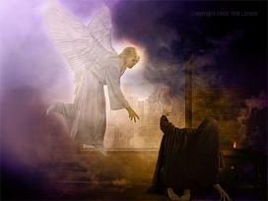
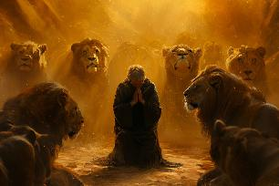
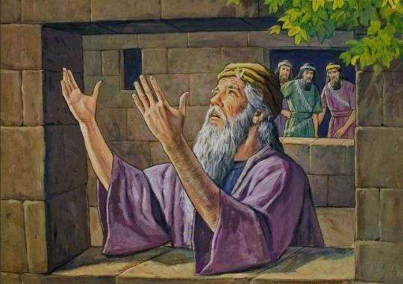
KO E LOTU ʻI HE NGAAHI TAIMI FAKATUʻUTAMAKI
“Pea ne u hanga hoku mata kia Sihova ko e ʻOtua, ke kumi ʻi he lotu mo e ngaahi kole mo e ʻaukai mo e ʻai ʻae tauangaʻa mo e efuefu.” (Taniela 9:3)
Naʻe tokanga ʻa Langi ki he lotu ʻa Taniela (Taniela 9:20-23; 10:12). ʻE toki lava pe ke fakalaveaʻi ia ʻe hono ngaahi fili ʻi hono maumauʻi ʻo e haʻi ko ʻeni (Taniela 6:5-7).
ʻI he fehangahangai mo e fakamanamana foʻou ko ʻeni ʻo e mate, naʻe tauhi ʻe Taniela ʻene toʻonga lotu (Taniela 6:10):
Naʻa ne lotu maʻu pee, ʻo lotu tuʻo tolu ʻi he ʻaho
Naʻe ʻikai lava ke ʻiloʻi, ʻo fakaava hono matapa sioʻata ki Selusalema
Naʻe ʻi ai ʻene ngaahi toʻonga moʻui pau; Naʻa ne lotu ʻi hono tuʻulutui
Naʻe fakatefito ia ʻi he fakafetaʻi mo e tautapa

Slide 7

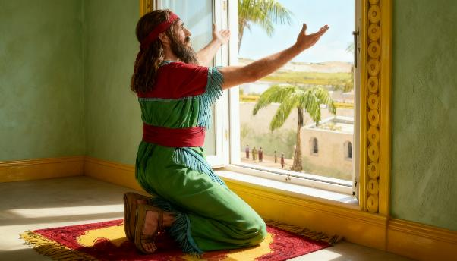


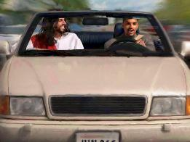
LOTU ʻI HE TUʻUNGA TOTONU
“Pea ʻi he ʻilo ʻe Taniela, kuo tohi ʻae fono, naʻa ne hū ki hono fale, pea ko e ngaahi matapā sioʻata ʻi hono fale mohe naʻe ava ki Selūsalema, pea naʻa ne tōmapeʻe ʻo tūʻulutui ʻo liunga tolu ʻi he ʻaho, pea ne lotu mo fakafetaʻi ʻi he ʻao ʻo hono ʻOtua, ʻo hangē ko ʻene faʻa fai ʻi muʻa.” (Taniela 6:10)
ʻI he taimi ʻ oku tau lotu aí, ʻoku tau lea ai ki he ʻOtuá ʻ o hangē pē ʻ oku tau talanoa ki ha kaumeʻa. Neongo ia, ʻoku ʻikai tatau ʻa e ʻOtua mo kitautolu. Ko e Tuʻi Ia ʻo e ʻUnivesi.
ʻI he ʻ uhinga ko ení, ko e tōʻonga ʻ a Tanielá ke ne tuʻulutui ʻi Hono ʻ ao ʻ o lotu, ʻ o fakahaaʻi Ko Hono Hau Ia.
Koeʻuhi ʻ e lava ke tau lotu ki he ʻ Otuá ʻi ha faʻahinga tuʻunga pē pea ʻi ha faʻahinga taimi pē, ʻoku ʻ ikai malava maʻu pē pe fiemaʻu ke fai pehē ʻ i he founga ko ení.
ʻOku hanga ʻe he kuikui hotau mata ʻo fakaʻata kitautolu ke tau tokanga lahi ange ki he lotu, ka ʻoku ʻi ai ha ngaahi tukunga ʻe niʻihi ʻoku ʻikai malava ia (luelue, fakaʻuli, mo e ala meʻa pehee)
Ko e meʻa mahuʻingá ke fai ʻ etau ngaahi lotú fakataha mo e fakaʻapaʻapa ʻ oku tuha mo e ʻ Otuá.

Slide 8

LOTU ʻI HE TUʻUNGA TOTONU
“Pea ʻi he ʻilo ʻe Taniela, kuo tohi ʻae fono, naʻa ne hū ki hono fale, pea ko e ngaahi matapā sioʻata ʻi hono fale mohe naʻe ava ki Selūsalema, pea naʻa ne tōmapeʻe ʻo tūʻulutui ʻo liunga tolu ʻi he ʻaho, pea ne lotu mo fakafetaʻi ʻi he ʻao ʻo hono ʻOtua, ʻo hangē ko ʻene faʻa fai ʻi muʻa.” (Taniela 6:10)
ʻ Oku tau maʻu ʻ i he Tohi Tapú ʻ a e ngaahi faʻifaʻitakiʻanga ʻ o e kakai naʻa nau lotu ʻ i he ngaahi founga kehekehe, ʻ o fakatatau ki honau ngaahi tuʻunga makehé.
Naʻe lotu ʻa Sihosafate ʻo tuʻu ʻi he ʻao ʻo e kakaí (2Fkmtl. 20:5)
Naʻe tangutu ʻa Tevita ʻi he ʻao ʻo e ʻOtua ke fakafetaʻi .
(2S. 7:18)
Naʻe lotu ʻa Solomone ʻo tūʻulutui, ʻo hiki hake hono ongo nimá .
(1 Tuʻi 8:54)
Naʻe punou ʻa e kakaí ki he kelekelé ʻo lotu .
( Nehe. 8:6 )
Naʻe lotu ʻa Tēvita ʻo punou ʻi hono mohengá .
( 1 Tu‘i 1:47 )
Naʻe tuʻu ʻa Nehemaia ʻo lotu fakalongolongo ʻi he ʻao ʻo e tuʻí
(Nehe. 2:1-4)
Tatau ai pe pe ko e ha ʻetau tuʻu, ʻoku naʻinaʻi mai ʻa e Tohi Tapu ke tau lotu taʻetuku (1 Tesalonika 5:17), vilitaki (Kolose 4:2) pea maʻu ai pe (Loma 12:12).

Slide 9

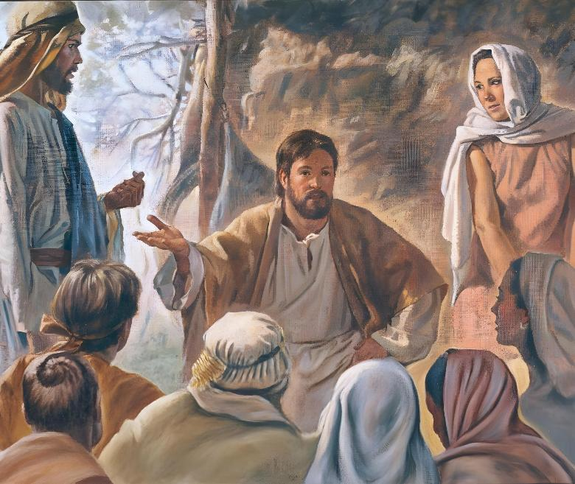
ʻINOKE

Slide 10

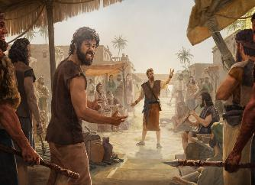
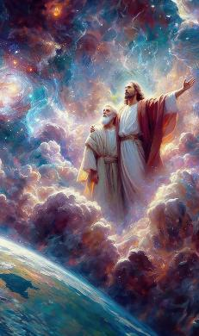
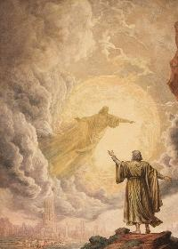
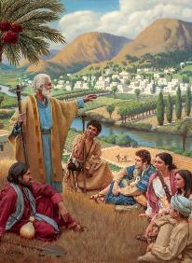
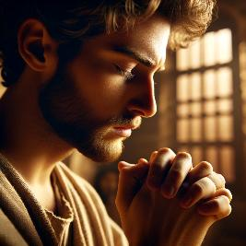
KO HA MOʻUI ʻO E LOTU
“Pea naʻe ʻaʻeva ʻa ʻInoke mo e ʻOtua pea naʻe ʻikai ia; he naʻe ʻave ia ʻe he ʻOtua.” (Senesi 5:24)
Naʻe moʻui ʻa ʻInoke ʻi he ngaahi taimi faingataʻa, ʻi he taimi naʻe fakautuutu ai ʻa e faiangahala ʻa e kakai kimuʻa. ʻI hono faʻeleʻi hono foha, naʻe tupulaki ʻene mahino ki he ʻOtua, pea toe lahi ange ʻene fetuʻutaki mo Ia (Senesi 5:21-24).
Ko e lotú ko ha meʻa mahuʻinga ia ʻ i he vahaʻangatae ko iá. Ko e lahi ange mo e fakavavevave ange ʻene ngaue, ko e lahi ange ia ʻene ngaahi lotu maʻu pe mo fakamatoato. ʻ I he taimi ʻ e niʻihi, naʻá ne mavahe ai ki he ngaahi feituʻu maomaonganoa ke feohi lahi ange ai mo e ʻ Otuá. Neongo ia, naʻa ne foki maʻu pe ki he kakai ke vahevahe ʻene ʻilo ki he ʻOtua mo kinautolu.
ʻOku fanongo mai ʻa e ʻOtua kiate kitautolu ʻi he femoʻuekina ʻo e moʻui fakaʻaho pea ʻi he longonoa ʻo e maloloo. ʻOku ʻikai ha feituʻu ʻi he mamani ʻe taʻe lava ke Ne ʻafioʻi mo fanongo mai kiate kitautolu. Te tau lava ʻo fakahaaʻi ʻetau lotu ʻi he lea (ʻa ia ʻoku ne tokoniʻi kitautolu ke tau tokanga), pe te tau lava ʻo fai fakalongolongo pe (ʻa ia ʻoku tokoni ke tau fakahaaʻi ʻetau ngaahi fakakaukau). Ko e meʻa mahuʻinga ke ʻoua naʻa tuku ʻa e fetuʻutaki mo e ʻOtua ʻi he lotu.

Slide 11

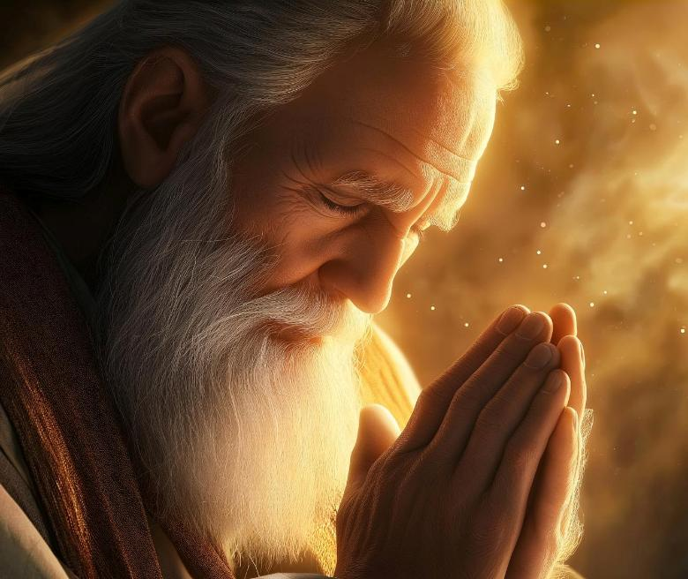
MOSESE

Slide 12


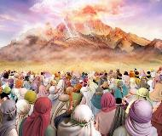
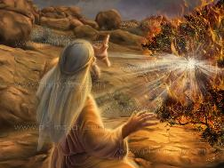
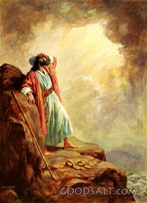
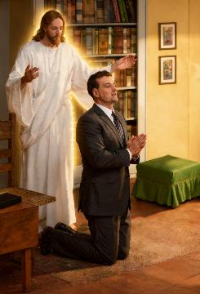
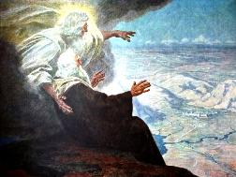
TALANOA KI HE ʻOTUA
“Pea talu ai pe, kuo ʻikai tuʻu hake ha palōfita ʻi ʻIsileli ʻo hangē ko Mōsese, ʻaia naʻe ʻafioʻi ʻe Sihova ko e mata ki he mata, ” (Teutalonome 34:10)
ʻI he fanongo ʻa e kakai ʻo ʻIsileli ki he leʻo ʻo e ʻOtua mei Sainai, naʻa nau kole ke ʻoua naʻa Ne toe folofola hangatonu kiate kinautolu, koeʻuhi naʻa nau manavasiʻi ke mate koeʻuhi ko Hono leʻo (ʻEkesotosi 20:18-19).
Naʻe ʻikai ko e meʻa ʻeni naʻe hoko kia Mosese, ʻa ia naʻa ne fefolofolai mo e ʻOtua ko e mata ki he mata (Teu. 34:10). ʻI he taʻu ʻe 40 (mei he ʻakau vela ʻo aʻu ki heʻene pekia), naʻe fetalanoaʻaki fakatautaha maʻu pe ʻa Mosese mo e ʻOtua (ʻEkesotosi 33:9-11).
ʻOku lekooti ʻe he Tohi Tapu ha ngaahi vahaʻataimi ʻaho ʻe fangofulu ʻa ia naʻe ʻoange ai ʻe he ʻOtua kia Mosese ha ngaahi fakahinohino pau ki hono langa ʻo e tapanekale mo fakahoko kiate ia ha ngaahi fono kehekehe. Lolotonga e ngaahi fetalanoaʻaki ko ʻeni, naʻe toe taukapo foki ʻa Mosese maʻa e kakai.
ʻOku ʻikai ke tau maʻu ʻa e faingamalie ke talanoa mata ki he mata ki he ʻOtua, ka ʻoku fakafonu ʻe he lotu ʻa e ava ko ia ʻaki hono fakaʻata kitautolu ke tau fetuʻutaki hangatonu mo Ia.

Slide 13
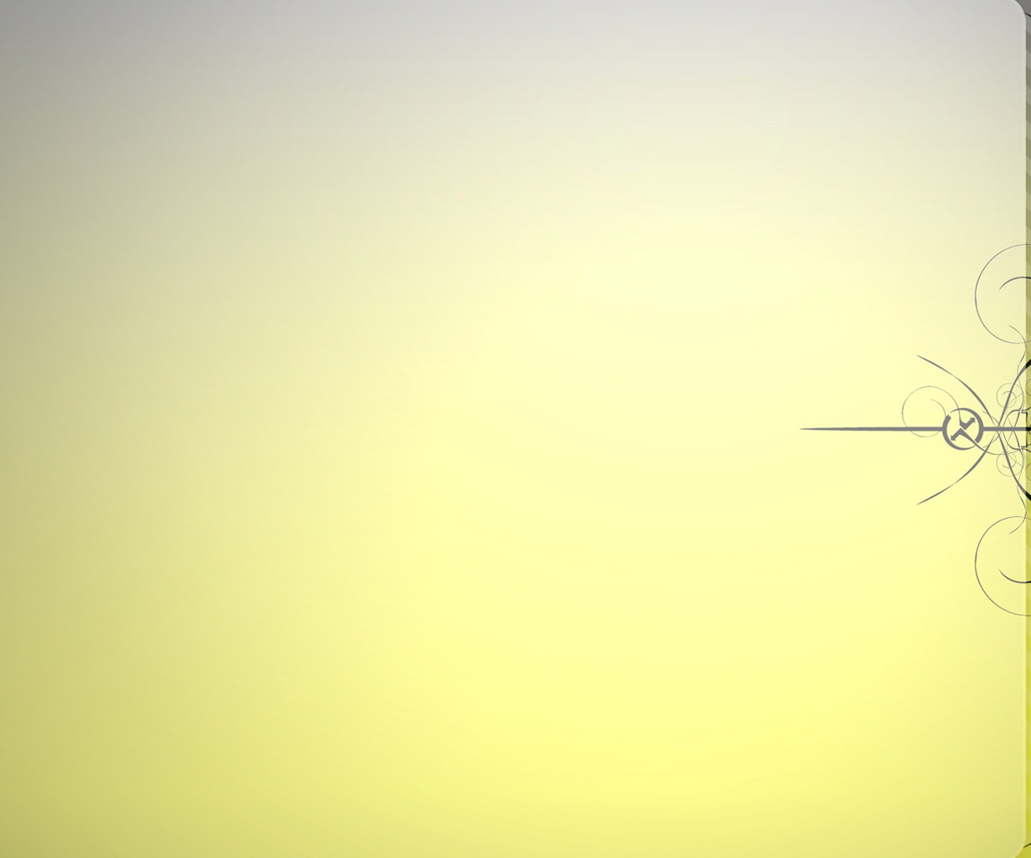


LOTU TAUKAPO
“Pea naʻe houhau lahi ʻa Sihova kia ʻElone ke fakaʻauha ia: pea naʻaku lotua ʻa ʻElone foki ʻi he kuonga ko ia..” (Teutalonome 9:20)
Ko e lotu hufekina ko e lotu ia ʻoku tau lotu ai maʻa e kakai kehe (Semisi 5:16; Matiu 5:44; 1 Timote 2:1-4).
Naʻe taukapo ʻa Mosese ki he ʻOtua maʻa e niʻihi kehe ʻi ha ngaahi meʻa kehekehe pea ʻi ha ngaahi ʻuhinga kehekehe:
MAʻA E KAU MEMIPA HONAU FAMILI
⁕ Koeʻuhi ko e angahala ʻa ʻElone
(Teu. 9:20)
⁕ Koeʻuhi ko e launga ʻa Mele
(Nm. 12:10-13)
MAʻA E KAKAI
⁕ ‘I he taimi na‘a nau fieinua aí .
( ‘Eki. 15:24-25 )
⁕ ‘I he taimi na‘a nau fiekaia aí (Nm. 11:11-13)
⁕ ‘I he‘enau faiangahalá .
(‘Eki. 32:3032)
Ko e hā na‘á ne ue‘i ‘a Mōsese ke lotu ma‘á e ni‘ihi kehé?
ʻOku totonu ke ueʻi kitautolu ʻe he meʻa tatau: ko e ʻofa kiate kinautolu ʻoku tau lotu maʻanautolú.

Slide 14

“ʻOku totonu ke tau lotu ʻi he siakale ʻo e famili, pea ko e mahuʻinga taha kuo pau ke ʻoua naʻa tau liʻaki ʻa e lotu lilo, he ko e moʻui ʻeni ʻo e laumalie. ʻOku faingataʻa ke tupulaki ʻa e laumalie lolotonga ia ʻoku liʻaki ʻa e lotu. ʻOku ʻikai feʻunga ʻataʻata pe ʻa e lotu fakafamili pe ʻi he kakai. ʻI he tuenoa, tuku ke fakaava ʻa e laumalie ki he fofonga ʻo e ʻOtua. Ko e lotu lilo ke fanongo pe ki ai ʻa e ʻOtua ʻoku fanongo ki he lotu. ʻOku ʻikai ha telinga fie ʻilo te ne tali ʻa e kavenga ʻo e ngaahi kole pehee. ʻI he lotu lilo, ʻoku tauʻataina ʻa e laumalie mei he ngaahi ivi takiekina ʻoku ne ʻatakaiʻi, ʻataʻata mei he fiefia. ʻE kakapa atu ia ki he ʻOtua ʻi he mokomoko kae fakamatoato. ʻE fakafiefia mo tuʻuloa ʻa e ivi takiekina ʻoku haʻu meiate Ia ʻoku ʻafio ʻi he lilo, ʻa ia ʻoku fakaava hono telinga ke fanongo ki he lotu ʻoku haʻu mei he loto."
EGW (Ngaahi Sitepu kia Kalaisi, p. 98)

