Slide 1

Lesoni 3 ki he ʻaho 18 ʻo Siulai, 2026
UOUONGATAHA ʻIA KALAISI

Slide 2

“Pea ko eni, ʻe kāinga, ʻoku ou kole kiate kimoutolu, ʻi he huafa ʻo hotau ʻEiki ko Sisu Kalaisi, ke lea taha pe ʻakimoutolu kotoa pē, pea ke ʻoua naʻa ʻiate kimoutolu ʻae ngaahi mavahevahe; ka mou māʻopoʻopo lelei ʻo loto taha pe, pea fakakaukau taha pe.” (1Kolinito 1:10)

Slide 3





Hili ʻ ene fakafeʻiloaki ki he kau Kolinitoó mo fakahīkihikiʻi kinautolu ʻ i heʻenau tupu fakalaumālié, naʻe hoko atu ʻ a Paula ʻ o lea ki he ʻ uluaki ʻ o e ngaahi palopalema ʻ okú ne uesia ʻ a e siasi ko iá: ko e siʻi ʻ a e fāʻūtaha.
ʻI he kotoa ʻo e ngaahi tohi ki he kakai Kolinitoo, mo e niʻihi kehe naʻe tohi ʻe Paula, ʻoku tau sio ai ki he founga ʻo ʻene ʻomi kiate kitautolu ʻa e ngaahi fakahinohino ke fakaleleiʻi ʻaki ʻa e palopalema ko ʻeni, ʻa ia ʻe lava ke ne uesia ʻa e ngaahi siasi he ʻaho ni.
ʻOku mahino ʻa e poini ʻe taha mei he kamataʻanga: he ʻikai lava ke aʻusia ʻa e uouangataha ʻi he siasi ʻi he feinga ʻa e tangata. Ko e tokangataha pē kia Sīsū ʻ e lava ke tau maʻu ai ʻ a e fāʻūtahá.
Ngaahi palopalema ʻoku ne fakatupu ʻa e mavahevahe:
  Vahevahe mo e fakakikihi
Founga ke tauhi maʻu ai ʻa e uouongataha:
  Uouongataha ʻia Sisu
  Poto mo e matuʻotuʻa
  Ngaue tokoni mo e loto fakatōkilalo
  Fakaʻapaʻapa ki he kau taki

Slide 4
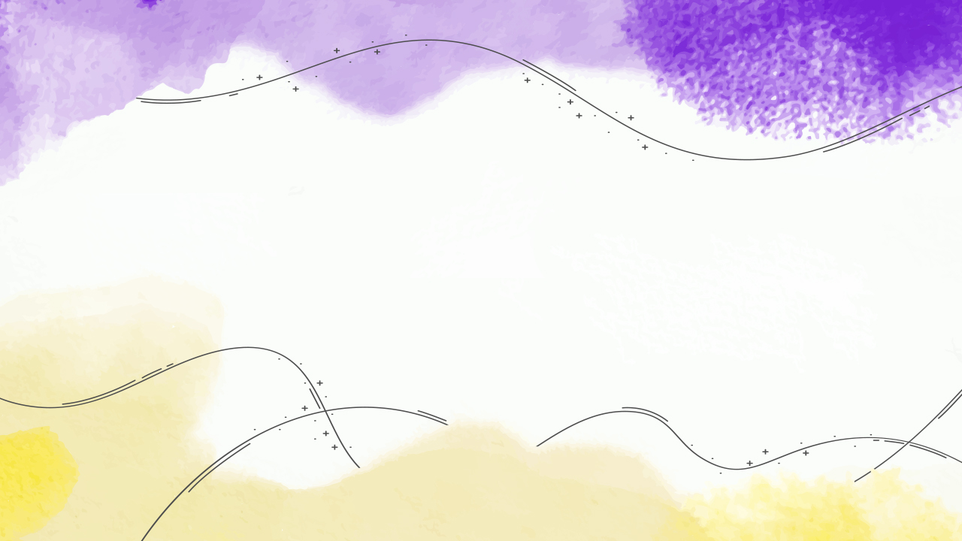
NGAAHI PALOPALEMA ʻOKÚ NE FAKATUPUNGA ʻA E MAVAHEVAHE

Slide 5





NGAAHI VAHEVAHE MO E NGAAHI FAKAKIKIHI
“0 Pea ko eni, ʻe kāinga, ʻoku ou kole kiate kimoutolu, ʻi he huafa ʻo hotau ʻEiki ko Sisu Kalaisi, ke lea taha pe ʻakimoutolu kotoa pē, pea ke ʻoua naʻa ʻiate kimoutolu ʻae ngaahi mavahevahe; ka mou māʻopoʻopo lelei ʻo loto taha pe, pea fakakaukau taha pe. .”
(1 Kolinito 1:10)
Ko e ha ʻa e ngaahi vahevahe naʻe ʻi he siasi ʻo Kolinitoo (1 Kolinito 1:12)?
Naʻe fou atu ʻa e kau taki kehekehe ʻi Kolinitoo, pea naʻe ʻi ai ʻa e tokotaha malanga naʻe saiʻia taha ai ʻa e tokotaha tui takitaha (Paula, ʻApolosi, Pita...) Naʻe aʻu ʻeni ki ha tuʻunga ʻo e fakakikihi ʻiate kinautolu (1 Kolinito 1:11)
Naʻe ʻikai ke nau fakatokangaʻi naʻa nau malangaʻi kotoa ha popoaki tatau, ka naʻa nau tokanga taha ki he ngaahi tafaʻaki taʻemahuʻinga (1 Kolinito 3:5-8)
Naʻe uesia mamalie ʻa e moʻui ʻa e siasi (1 Kolinito 3:3). Naʻe hanga ʻe he ʻikai ke uouongataha ʻo fakakeheʻi ʻa hono katoangaʻi ʻo e ʻOhomohe ʻa e ʻEiki (1 Kolinito 11:33), pea naʻe aʻu ʻo nau fefakaʻilo ʻi he fakamaauʻanga (1 Kolinito 6:1).

Slide 6
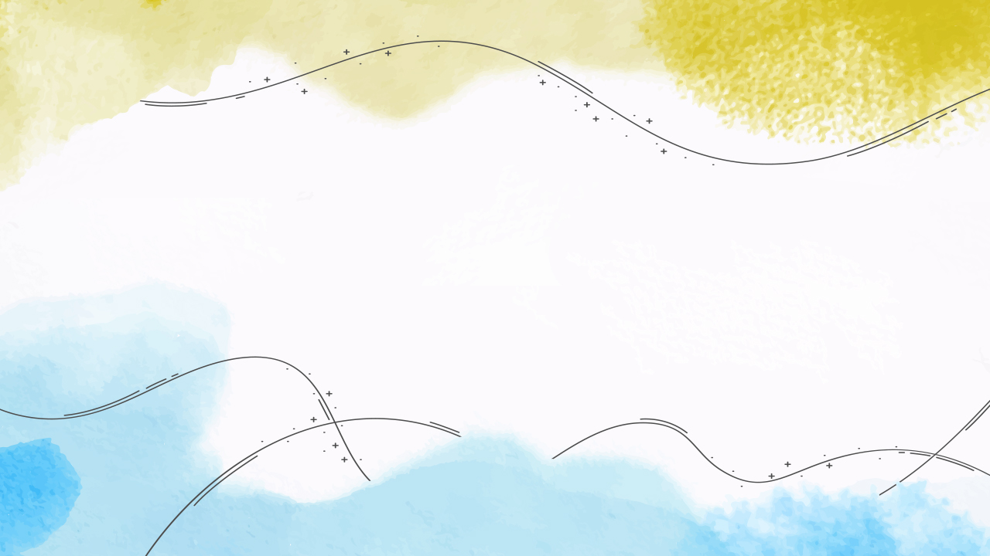
FOUNGA KE TAUHI MAʻU AI ʻA E UOUONGATAHA

Slide 7


UOUONGATAHA ʻIA SISU
“‌ʻOku moʻoni ʻae ʻOtua, ʻaia naʻe ui ʻakimoutolu ki he feohi mo hono ʻAlo ko Sisu Kalaisi ko hotau ʻEiki.” ( 1 Kolinito 1:9 )
“Kuo mavahevahe koā ʻa Kalaisi, pe naʻe kalusefai ʻa Paula koeʻuhi ko kimoutolu, pe naʻe papitaiso kimoutolu ʻi he hingoa ʻo Paula?” ( 1 Kolinitō 1:13 ). ‘I he ngaahi fehu‘i ko ení, ‘oku loto ‘a Paula ke nau fakakaukauloto.
Ko e uouangataha ‘e toki lava pe ia ‘i he’etau ma’u ‘a Sisu ko hotau ‘Eiki. ʻOku ʻikai maʻu ʻa e fāʻūtahá ʻi he pipiki ki he ngaahi fakakaukau pe ngaahi fakakaukau ʻa ha tokoua pe tuofefine, pe ʻi hono fokotuʻu ha ngaahi kulupu tāpuni.
Ka ko e uouangataha ‘ia Sisu ‘oku ‘ikai ko e uniformity. ʻOku ʻikai fakahuʻunga ia ʻoku tau fakakaukau tatau kotoa ki he meʻa kotoa pē, pe ʻoku tau ngāue kotoa ʻi he founga tatau.
Ko e fanga ki’i kehekehe ‘o e fakakaukau, ko e ngaahi me’a’ofa kehekehe ‘oku ma’u ‘e he tokotaha takitaha, ‘i he taimi ‘oku nau fakatefito ai ‘ia Kalaisi, ‘o ‘ikai ke ne fakatupu ‘a e ta’efe’unga, ka ‘oku ne fakatupu ‘a e uouangataha (1 Kol. 12:12-13, 25, 27).
Ko e uouangataha 'i he siasi 'oku toki ma'u pe ia 'i he mate ki he self pea mo'ui ma'a Sisu.

Slide 8

POTO MO E MATU'OTU'A
“Pea naʻe ʻikai teu faʻa lea kiate kimoutolu, ʻe kāinga, ʻo hangē ki he fakalaumālie, kae hangē ki he fakakakano, ʻio, ʻo hangē ko e kau valevale ʻia Kalaisi..” (1 Kolinito 3:1)
ʻOku ui ʻe Paula ʻa e kau Kalisitiane taʻematuʻotuʻa, "fanau ʻia Kalaisi," "fakakakano" (1 Kolinito 3:1) Ko e faʻahinga Kalisitiane ko ʻeni ʻoku tokanga lahi ange ki he kakai kae ʻikai kia Sisuu.
ʻOku ʻikai matuʻotuʻa
ʻOku nau hange ko e fanau (1 Kolinito 3:1)
ʻOku nau kai huʻakau (1 Kolinito 3:2)
ʻOku nau fakakakano (1 Kolinito 3:3)
ʻOku takiekina kinautolu ʻe he fakakaukau ʻa e niʻihi kehe (1 Kolinito 3:4)
Matuʻotuʻa
Ko e kakai lalahi kinautolu
(1 Kolinito 14:20)
ʻOku nau kai ʻa e meʻakai fefeka (Hepelu 5:14)
ʻOku nau fakalaumalie (1 Kolinito 2:13)
ʻOku nau maʻu ʻa e faʻa ʻiloʻilo fakalaumalie (1 Kolinito 2:14)
ʻI he taimi ʻoku fuʻu mahuʻinga ai ʻa e kau taki ʻe niʻihi ʻo uesia ai ha niʻihi kehe, ʻoku faʻu leva ha ngaahi kulupu ʻoku nau fakamavahevaheʻi ʻa e siasi. Ko e ola ʻeni ʻo e taʻematuʻotuʻa. Ko ia ai, ʻoku fakaafeʻi kitautolu ʻe Paula ke tau matuʻotuʻa ʻia Kalaisi (1 Kolinito 2:6).

Slide 9
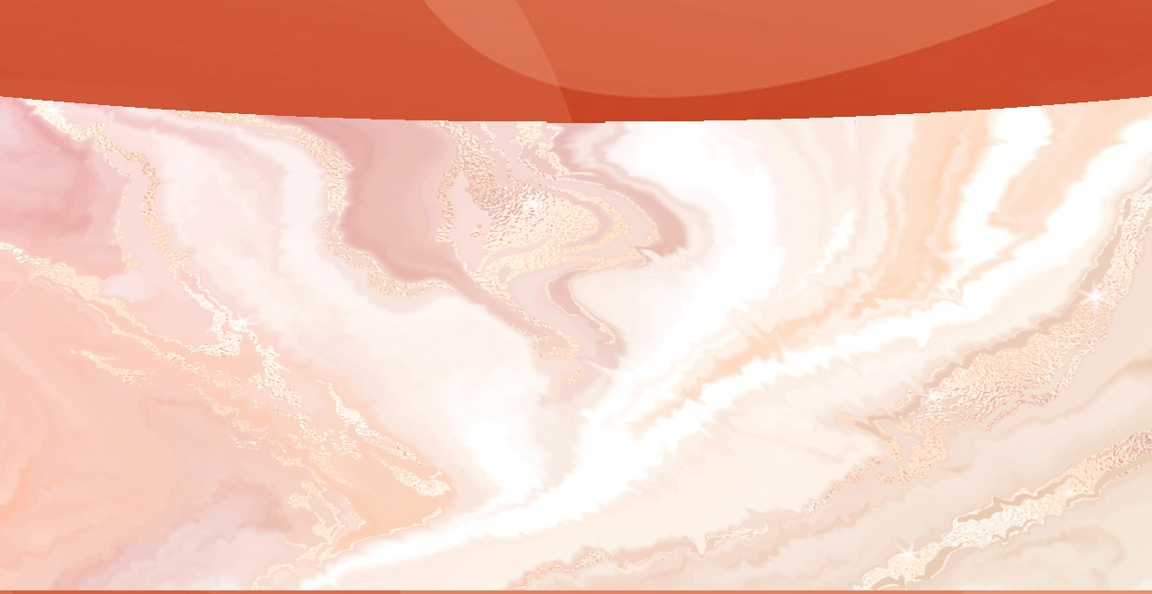


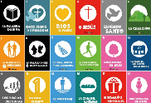


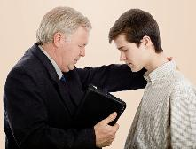
NGAUE TOKONI MO E LOTO FAKATOKILALO
“Ko ia ke pehē ʻae lau ʻe he tangata kiate kimautolu, ʻo taau mo e kau tamaioʻeiki ʻa Kalaisi, mo e kau tauhi ʻoe ngaahi meʻa fakalilolilo ʻae ʻOtua.” (1 Kolinito 4:1)
Hangē pē ko e ʻ ahó ni, ʻ i he ʻ uluaki senitulí naʻe māvahevahe ai ʻ a e kakaí ʻ i he ngaahi tui fakapolitikale, fakafilōsofia, fakalotú mo e ngaahi tui kehe.ʻE lava fefe ke tau taʻofi ʻa e founga fakakaukau ko ʻeni mei heʻene hu ki he siasi ʻo fakatupu ʻa e mavahevahe?
ʻOku ʻi ai ha fatongia mahuʻinga ʻo e toʻonga fakakaukau ʻa e taki. Kuo pau ke mahino ki he kau taki ʻo e Siasi honau fatongia ko e kau tauhi. ʻOku ʻikai ko kinautolu ʻoku ʻaʻana ʻa e siasi; ʻoku nau tokangaʻi pe ia maʻa Kalaisi.
Ko e taki ʻo e siasi ko Sisu, ʻoku taki ia ʻe he niʻihi kehe kotoa ko e "kau tamaioʻeiki ʻa Kalaisi" (1 Kolinito 4:1).
Ko e tamaioʻeiki ʻoku pule kuo pau ke ne fai ʻa e meʻa ʻoku fai ʻe hono ʻEiki: loto fiemalie maʻu pe ke foaki ia ʻi he loto fakatokilalo ki he ngaue ʻa e niʻihi kehe (Fili. 2:3-8).
Ko e ha ʻa e uouangataha ʻi he siasi kapau ʻe fai pehe ʻa e tokotaha kotoa pe – ʻo ʻikai ko e kau taki pe, ka ko e memipa kotoa pe – ʻi he founga ko ʻeni?

Slide 10





FAKAʻAPAʻAPA KI HE KAU TAKI
“Ko eni foki, ʻoku ʻamanaki ki he kau tauhi, ke nau fai totonu.” (1 Kolinito 4:2)
ʻOku ʻikai ʻuhinga ʻa e ʻi ai ʻa e ngaahi feʻauʻauhi mo e ngaahi faʻahi ʻoku nau ʻatakaiʻi ʻa e kau taki ʻoku totonu ke tau fakafisingaʻi kinautolu. ʻI he tafaʻaki ʻe taha, naʻe poupouʻi mo taukapoʻi ʻe Paula ʻa e ngaue fakafaifekau ʻa ʻApolo mo ʻene ngaue ʻi Kolinito (1 Kolinito 3:5-6; 4:6; 16:12)
ʻI he taimi ʻoku ngaue faivelenga ai ʻa e kau taki, ʻoku taau ke fakalangilangiʻi kinautolu (1 Kolinito 4:2; 1 Timote 5:17). Ka naʻa mo e taimi ʻoku ʻikai ke nau maʻu ai ʻa e fakalangilangi ko ia, ʻoku nau kei faivelenga pe koeʻuhi he ʻoku nau ʻiloʻi ko e ʻOtua tonu pe, kae ʻikai ko e tangata, ʻoku totonu ke ne fakamauʻi kinautolu (1 Kolinito 4:3-4)
ʻOku molomolomuivaʻe ʻa e kau taki Kalisitiane ʻia Sisu ʻaki ʻenau loto fiemalie ke mamahi maʻa honau ngaahi tokoua mo e tuofafine, pea aʻu ki heʻenau mate koeʻuhi ko ʻenau ngaue fakafaifekau (1 Kolinito 4:11-13; 2 Kolinito 11:23-28)
Ko Frank mo Walter Bond ʻa e ongo fuofua faifekau ʻi Sipeini. Naʻe pekia ʻa Walter koeʻuhi ko ʻene tui kia Seini ʻi he 1914
ʻOku ʻikai ui ʻa e kau taki pe kaingalotu ke nau ke pe fakakikihi, ka ke nau uouangataha ʻi hono fakahikihikiʻi ʻo Sisu mo malangaʻi ʻa e popoaki ʻo e kolosi.

Slide 11

“He ʻikai ha meʻa te ne lava ʻo fakahaohaoaʻi ha uouangataha haohaoa ʻi he siasi ka ko e laumalie pe ʻo e faʻa kataki faka-Kalaisi. ʻE lava ʻe Setane ʻo tutuuʻi ʻa e fekeʻikeʻi; Ko Kalaisi toko taha pē ʻ e lava ke ne fakatahatahaʻi ʻ a e ngaahi ʻ elemēniti ʻ oku taʻefelotoi.... ʻI he taimi ʻoku mou ʻofa taupotu taha ai ki he ʻOtua ʻi hoʻomou hoko ko e kau ngaue fakafoʻituitui ʻo e siasi pea mo homou kaungaʻapi ʻo hange pe ko kimoutolu, he ʻikai leva ke ʻi ai ha feinga lahi ke mou uouangataha, ʻe taha ʻia Kalaisi, ʻe tapuniʻi ʻa e telinga ke lipooti, pea he ʻikai ke lauʻikoviʻi ʻe ha taha hono kaungaʻapi. ʻE mataʻikoloa ʻaki ʻe he kaingalotu ʻo e siasi ʻa e ʻofa mo e uouangataha pea nau hoko ko ha famili maʻongoʻonga pe ʻe taha. Pea te tau toki ʻave leva ʻa e ngaahi tohi fakamoʻoni ki he mamani te nau fakamoʻoniʻi kuo fekauʻi mai ʻe he ʻOtua Hono ʻAlo ki he mamani.”
EGW (Ko e Fakafotunga ʻo Kalaisi 5 Siulai)

