Slide 1

ANGAHALA ʻI HE SIASI
Lesoni 4 ki he ʻaho 25 ʻo Siulai 2026

Slide 2
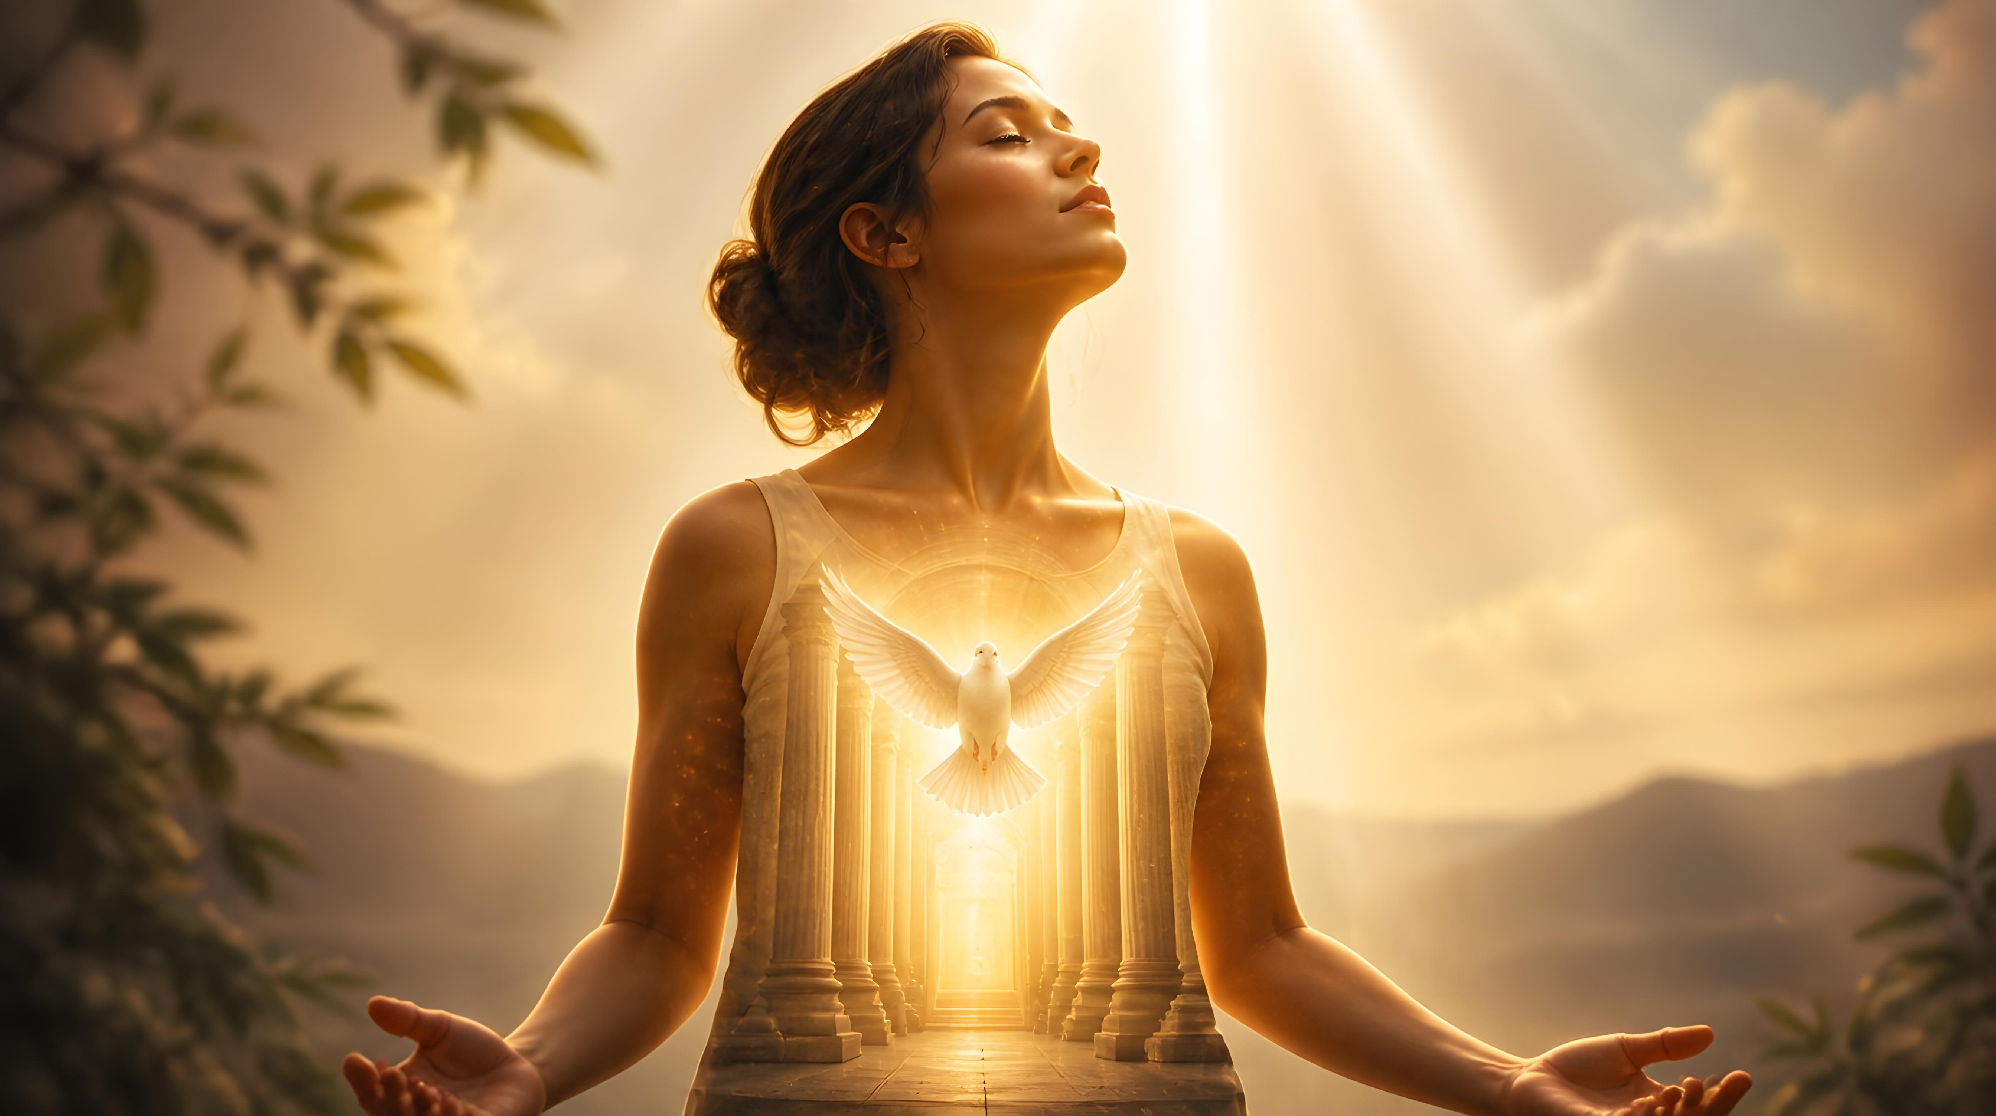
“Ko e hā? ʻIkai ʻoku mou ʻilo, ko homou sino ko e fale tapu ʻoe Laumālie Māʻoniʻoni, ʻoku ʻiate kimoutolu, ʻaia ʻoku mou maʻu mei he ʻOtua, pea ʻoku ʻikai ʻamoutolu ʻakimoutolu? He kuo fakatauʻakimoutolu ʻaki ʻae totongi: ko ia ke fakaongolelei ʻae ʻOtua ʻi homou sino, pea ʻi homou laumālie, ʻaia ʻoku ʻoe ʻOtua.”
(1 Kolinitō 6:19,20)

Slide 3




ʻOku fakamoleki ʻe Paula ʻa e vahe nima ki he fitu ʻo e 1 Kolinito ʻi heʻene feinga ke toʻo atu ha angahala naʻe aka loloto ʻi he siasi ʻo Kolinitoo: ʻa e angaʻuli fakasekisuale.
Ko e angahala pau ko ení naʻe toe fakalahi ia ʻ e he ngaahi angahala kehe hangē ko e ngaahi hia mo e ngaahi kākā naʻe fai ʻ i he lotolotonga ʻ o e fanga tokouá tonu, ʻ a ia naʻe ʻ omai ki he ʻ ao ʻ o e ngaahi fakamaauʻanga fakapuleʻangá.
ʻI hono fakaʻaongaʻi ʻo e lea mahino mo fakahangatonu, ʻoku ʻikai ngata pe ʻi hono fakamahinoʻi ʻe Paula ʻa e angahala, ka ʻoku ne toe fokotuʻu mai ha ngaahi founga ke fakaleleiʻi ʻaki ia, pea ke fakaʻehiʻehi mei heʻene toe to ki ai.
Angahala ʻi he siasi
Ko e angahala kuo loto ki ai
Fakaʻauha ʻo e angahala
Ko e fekuki mo e ngaahi palopalema fakalotofonua
Founga ke fakaʻehiʻehi ai mei he angahala ʻi he lotu
Ngaahi Temipale ʻo e Laumalie Maʻoniʻoni
Ko e fehokotaki fakasino fakalao

Slide 4

KO E ANGAHALA 'I HE SIASI

Slide 5



KO E ANGAHALA KUO LOTO
“Pea ʻoku mou anga fakafiefielahi, kae ʻikai te mou mamahi muʻa, koeʻuhi ko ia kuo ne fai ʻae meʻa ni?” (1 Kolinitō 5:2)
ʻI he siasi ʻo Kolinitoo naʻe ʻi ai ʻa e "angaʻuli ʻiate kimoutolu, pea mo e faʻahinga ʻoku ʻikai tali ʻe he kau pangani" (1 Kolinito 5:1).
Ko e ʻi ai ha fetuʻutaki fakamalaʻia ʻi he siasi ko ha meʻa mamafa ʻaupito. Ka naʻe toe kovi ange ʻa e tukunga koeʻuhi he naʻe ʻikai ke nau fakatupu ha fehiʻa ʻi he lotolotonga ʻo e kaingalotu, ka naʻa nau laukau ke katakiʻi ʻa e angahala ko ʻeni (1 Kolinito 5:2).
Naʻe faʻuʻaki tefito ʻa e siasi ʻaki ʻa e kau Senitaile. Naʻe tala ange ʻe honau konisēnisi kiate kinautolu ʻoku ʻikai totonu ke kātakiʻi ʻa e hia fakamalaʻiá. ʻIkai ngata ai, naʻe fakamalohia ʻe heʻenau ʻilo ki he Folofola ʻa e fakakaukau ko ʻeni (Levitiko 18:8)
Kapau naʻa nau mahino ko e va fetuʻutaki ko ʻeni ko e angahala... ko e ha naʻa nau laukau ai (1 Kolinito 5:6)? Naʻe ʻi ai nai ha ivi takiekina ʻo e famili naʻe kau ki ai ʻi he siasi? Naʻa nau pōlepole ʻ i heʻenau hoko ko ha siasi ʻ oku kātakiʻi ʻ a e kau angahalá? …?

Slide 6
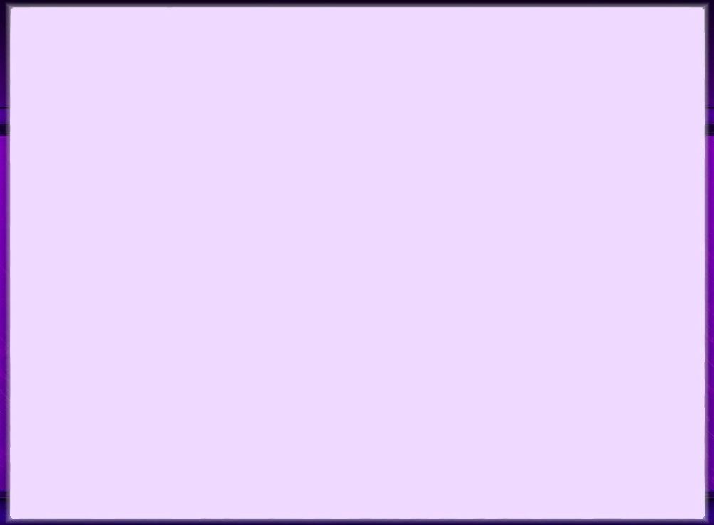
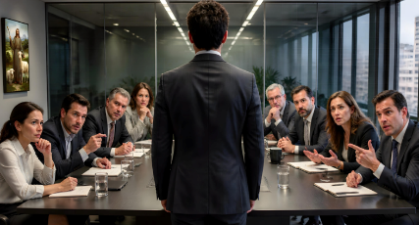



FAKAʻAUHA ʻO E ANGAHALA
“Ka ko kinautolu ʻoku ʻi tuaʻā ʻoku fakamaauʻi ʻe he ʻOtua. Ko ia ke “tukuange ʻiate kimoutolu ʻae tangata angahala ko ia.”.”
(1 Kolinito 5:13)
Naʻe ʻosi "ʻilo ʻe he kakai" ʻa e hia fakamalaʻia (1 Kolinito 5:1), ko ia naʻe pau ke fai ha ngaahi meʻa fakavavevave ke taʻofi ʻa e maumau ki he ongoongo ʻo e siasi. Ko e hā ʻ a e ngaahi meʻa ʻ oku totonu ke faí?
Ke fai ha fakamaau ʻoku ne fakapapauʻi, pe ʻikai fakapapauʻi, ʻa e halaia ʻa e tokotaha
(1 Kolinito 5:3)
ʻOua naʻa ke feohi mo e tokotaha angahala, pe kai mo ia, kehe pe ke ne vilitaki ke lau ia ko ha memipa ʻo e siasi, ʻo ʻikai loto ke liʻaki ʻene angahala (1 Kolinito 5:11)
Ke kapusi ʻa e tokotaha faiangahala pea tukuange ia "kia Setane," koeʻuhi ʻi heʻene tauhi ʻa e angahala ko ʻeni, kuo ne fili loto fiemalie ai ke tuku ia ki he haʻamonga ʻa Setane (1 Kolinito 5:2b, 5a, 13b)
Kuo pau ke ʻi ai maʻu pe ha taumuʻa huhuʻi ʻo e fakatonutonu faka-Siasi (tatau ai pe pe ko e ha hono mamafa ʻo e angahala). Kuo pau ke fakamahinoʻi ʻa e fehalaaki ʻa e tokotaha koeʻuhi ke nau lava ʻo ʻiloʻi ia, fakatomala, pea "moʻui ʻi he ʻaho ʻo e ʻEiki ko Sisuu"
(1 Kolinito 5:5).

Slide 7
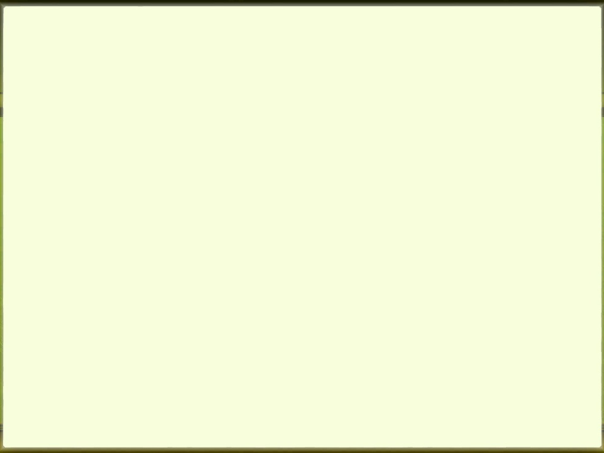


FEKUKI MO E NGAAHI PALOPALEMA ʻI LOTO
“ʻO kapau ʻoku ai ha meʻa ki ha tokotaha, ke fakamaau ia ʻi he ʻao ʻoe taʻeangatonu, kae ʻikai ʻi he ʻao ʻoe kāinga māʻoniʻoni?” (1 Kolinito 6:1)
Hili hono fakamatalaʻi ʻe Paula ʻa e founga ke fakaleleiʻi ʻaki ʻa e angahala ʻi he siasi, naʻa ne valokiʻi kinautolu ʻi he ʻikai ke nau muimui ki he ngaahi fakahinohino totonu pea mo hono tuku ʻa e ngaahi fakakikihi ʻi he vahaʻa ʻo e kakai tui ki he ngaahi fakamaauʻanga fakamamani (1 Kolinito 6:1-6). Ka ʻoku toe lahi ange ʻa Paula ʻo ʻohofi ʻa e tefito ʻo e palopalema.
ʻUluaki, ʻoku ʻikai totonu ke ʻi ai ha taʻefelotoi ʻi he kaingalotu ʻo e siasi (1 Kolinito 6:7a) pea ko e moʻoni, ʻoku ʻikai totonu ke faihala pe kakaaʻi ʻe he kaingalotu ha memipa kehe (1 Kolinito 6:8).
Ua, kuo pau ke loto fiemalie ʻa e ngaahi tokoua ke fakamolemoleʻi ʻa e faihala (1 Kolinito 6:7b).
Tolu, kapau ʻoku ʻikai ke ʻi ai ha felotoi ʻi he vahaʻa ʻo e kaingalotu, kuo pau ke fakamaauʻi pe fakalaloa ʻa e siasi ʻiate kinautolu (1 Kolinito 6:2).
Tuku kehe kapau ko ha hia (Loma 13:1-5), ʻoku totonu ke fakaleleiʻi ʻa e ngaahi palopalema fakalotofonua ʻo e siasi.

Slide 8
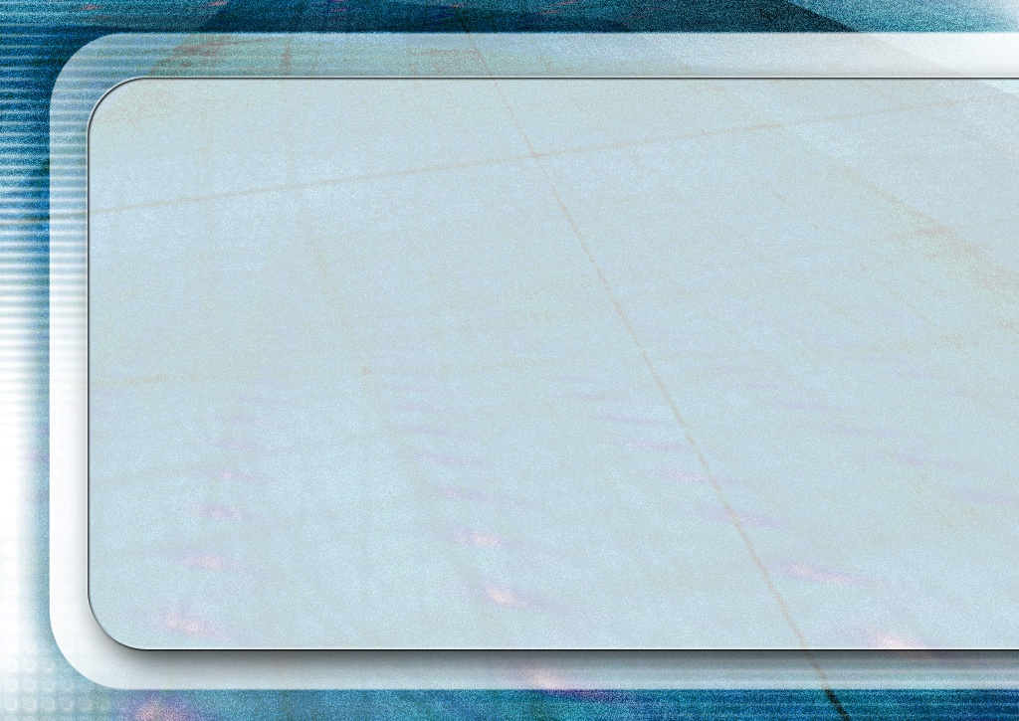
“Ko ʻetau ngaue ke ʻiloʻi ʻetau ngaahi tonounou mo e ngaahi angahala makehe, ʻa ia ʻoku ne fakatupu ʻa e fakapoʻuli mo e vaivai fakalaumalie, pea tamateʻi ʻetau ʻuluaki ʻofa. Ko e ngaahi meʻa fakamamani nai ia? Ko e siokita ia? Ko e ʻofa nai ia ʻi he fakaʻapaʻapaʻi kita? ʻOku feinga nai ke muʻomuʻa? Ko e angahala nai ʻo e holi fakakakano ʻoku fuʻu longomoʻui? Ko e angahala nai ia ʻa e kau Nikolaitani, ʻo liliu ʻa e ʻaloʻofa ʻa e ʻOtua ki he holi fakakakano? Ko hono fakaʻaongaʻi hala mo ngaohikovia nai ʻo e maama maʻongoʻonga mo e ngaahi faingamalie mo e ngaahi faingamalie, ʻo taukaveʻi ʻoku ʻi ai ʻa e poto mo e ʻilo fakalotu, lolotonga ia ʻoku ʻikai tatau mo angaʻuli ʻa e moʻui mo e ʻulungaanga? Ko e ha pe ha meʻa kuo fakaʻaongaʻi mo tanumaki kae ʻoua kuo malohi mo puleʻi, feinga fakapapau ke ikunaʻi, telia naʻa ke he.”
EGW (Te Mou Maʻu ʻa e Malohi, ʻaho 18 ʻo Tisema)

Slide 9
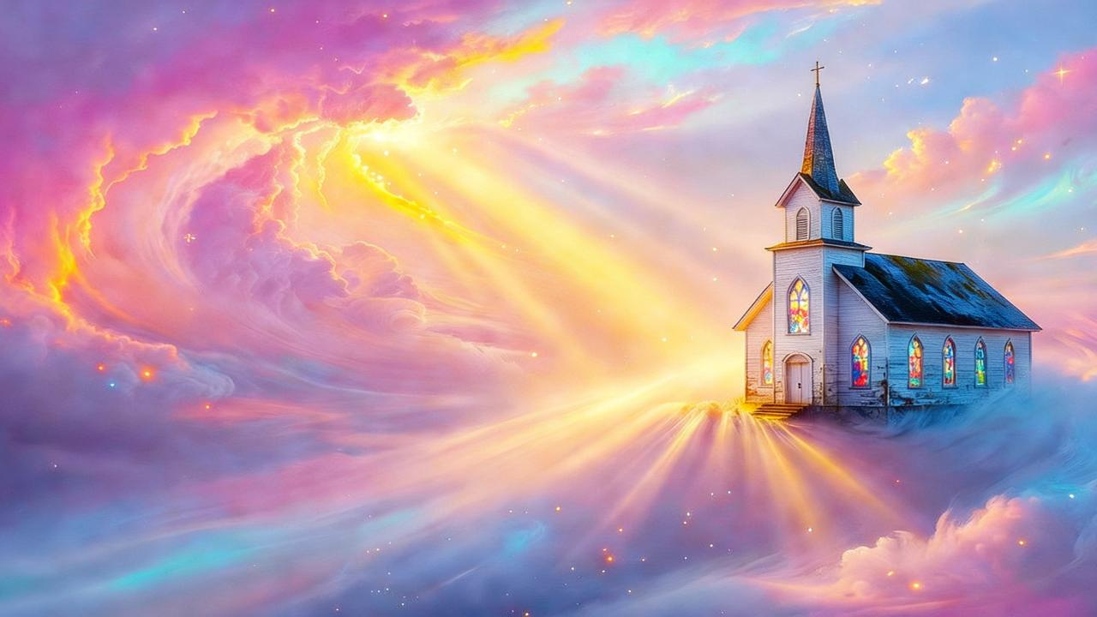
FOUNGA KE FAKAʻEHIʻEHI AI MEI HE ANGAHALA ʻI HE LOTU

Slide 10




NGAAHI TEMIPALE ʻO E LAUMALIE MAʻONIʻONI
“Ko e hā? ʻIkai ʻoku mou ʻilo, ko homou sino ko e fale tapu ʻoe Laumālie Māʻoniʻoni, ʻoku ʻiate kimoutolu, ʻaia ʻoku mou maʻu mei he ʻOtua, pea ʻoku ʻikai ʻamoutolu ʻakimoutolu?”
(1 Kolinitō 6:19)
Hili ‘ene lea ki he ‘isiu ‘o e ngaahi hopo, ‘oku toe foki ‘a Paula ki he kaveinga tefito: ko e fe’auaki ‘i he loto siasi. Ko e hā na‘e ‘i ai aí?
‘Oku ui ‘a e kau Kalisitiane ki he ma’oni’oni (1 Kol. 6:11), pea ‘oku totonu ke tuku ki tu’a heni ‘a e angahala kotoa pe. Kae neʼe fakakikihi ʼihi, ʼuhi ko tanatou ʼu agahala neʼe kua ʼosi fakamolemoleʼi, neʼe feala ke nātou fai he meʼa pe ʼe nātou loto kiai ʼaki tonatou sino. Ko e ‘uhinga ia ‘oku fakamahino mai ai ‘e Paula, “ko e sino ‘oku ‘ikai teu’aki ki he fe’auaki” (1 Kol. 6:12-13)
Ko ʻene fakakikihí: ko hotau sinó ko e ngaahi mēmipa ia ʻo Kalaisi. He’ikai ke tau lava ‘o to’o ha memipa ‘o Kalaisi ‘o fakataha’i ia mo ha fefine fe’auaki pe fe’auaki (1 Kol. 6:15-18).
Faka’osí, ‘oku ne taki kitautolu ke tau fakakaukau ki ha me’a mahu’inga: ko hotau sinó ko e temipale ia ‘o e Laumālie Mā’oni’oní, pea ko ia ai, ‘oku ‘ikai ko ‘etau koloa ia, ka ‘oku ‘a e ‘Otuá ia (1 Kol. 6:19). Na’e fakatau kitautolu ‘e he ‘Otua ‘aki ‘a e ta’ata’a mahu’inga ‘o hono ‘Alo, ko ia kuo pau ke tau fakalangilangi’i ‘a e ‘Otua ‘i hotau sino mo hotau laumalie fakatou’osi (1 Kol. 6:20).

Slide 11


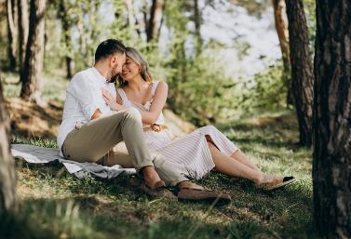


FE'AUAKI FAKALAO
“Ka koeʻuhi telia ʻae feʻauaki, ke maʻu ʻe he tangata taki taha hono uaifi ʻoʻona, pea ke maʻu ʻe he fefine taki taha hono husepāniti ʻoʻona. .” (1 Kolinitō 7:2)
‘I he tali ‘e Paula ‘a e ngaahi fehu’i ‘e ni’ihi na’e ‘ohake ‘e he siasi ‘i Kolinito, ‘oku tokoni ai ke mahino kiate kitautolu ‘a e founga te tau lava ai ‘o hola mei he fe’auaki (1 Kol. 7:1)
Ko hono tefitó: ʻoku totonu ke fiefia ʻa e kakai malí ʻi he fehokotaki fakasino fakalaó mo honau hoá; ‘oku ‘ikai totonu ke fehokotaki fakasino ‘a e kakai ta‘emalí mo ha taha.
‘Oku ‘ikai totonu ke fakafisi ‘a e ongo hoá ke fai ha fehokotaki fakasino ke faka‘ehi‘ehi mei hono faka‘ai‘ai ‘a e tokotaha ‘e tahá ki ha fe‘auaki ‘e ala hoko (1 Kol. 7:3-5).
Ko e kakai ta’emali ‘oku nau ma’u ‘a e me’a’ofa ‘o e mapule’i ‘oku nau lava ‘o ngaue’aki lelei ange ‘a e ngaahi faingamalie ke nau tauhi ki he ‘Otua ‘o ‘ikai ha fakangatangata mei he ngaahi tokanga’i ‘o e famili (1 Kol. 7:6-8, 32-34)
Ko e kakai ta'emali 'oku 'ikai ke nau ma'u 'a e me'a'ofa 'o e mapule'i 'oku totonu ke nau feinga ke mali ke faka'ehi'ehi mei he ngaahi 'ahi'ahi (1 Kol. 7:9)

Slide 12

“ʻI he ngāue maʻá e kau halá, tuku ke fakahangatonu ʻa e mata kotoa pē kia Kalaisi. [...] Tuku ke nau lea ki he hala ʻo e ʻaloʻofa fakamolemole ʻa e Fakamoʻuí. Tuku ke nau fakalotolahiʻi ʻa e tokotaha angahalá ke fakatomala, pea tui kiate Ia ʻokú Ne lava ʻo fakamolemolé. [...]
Tuku ke tali ‘e he siasi ‘a e fakatomala ‘a e angahala ‘aki ‘a e loto hounga’ia. Tuku ke taki atu ʻa e tokotaha fakatomalá mei he fakapoʻuli ʻo e taʻetuí ki he maama ʻo e tuí mo e māʻoniʻoní. Ke tuku hono nima teteteté ki he nima ʻofa ʻo Sīsuú. Ko e fakamolemole peheé ʻoku fakamoʻoniʻi ia ʻi he langí.
EGW (Ko e Holi ʻo e Ngaahi Kuongá, p. 806)

