Slide 1
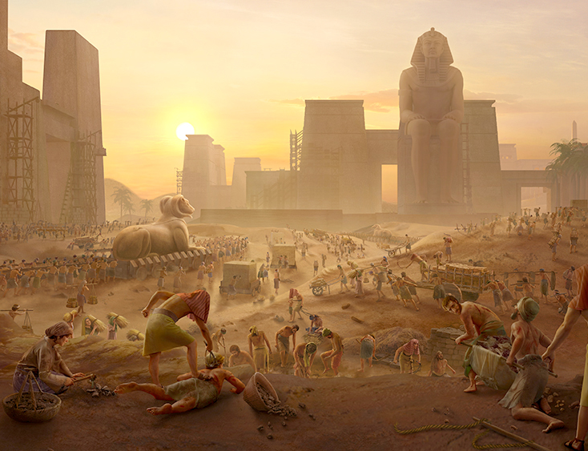
“Pea naʻe toʻe ʻae fānau ʻa ʻIsileli, ko e meʻa ʻi honau fakapōpulaʻi, pea naʻa nau tangi, pea naʻe aʻu hake ʻenau tangi ki he ʻOtua ko e meʻa ʻi he fakapōpulaʻi.Pea naʻe ongoʻi ʻe he ʻOtua ʻenau ngaahi toʻe, pea manatuʻi ʻe he ʻOtua ʻene fuakava kia ʻEpalahame, mo ʻAisake, pea mo SēkopePPea naʻe ʻafio ʻae ʻOtua ki he fānau ʻa ʻIsileli, pea naʻe tokanga ʻofa ʻae ʻOtua kiate kinautolu.”
‘Ekisotosi 2:23–25

Slide 2
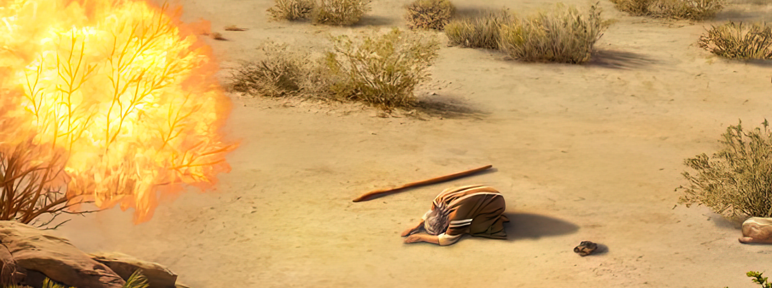
“Pea naʻe pehē ʻe Sihova, “Ko e moʻoni kuo u mamata ki he mamahi ʻa hoku kakai, ʻaia ʻoku ʻi ʻIsipite, pea kuo u ongoʻi ʻenau tangi ko e meʻa ʻi honau kau enginaki ngāue: pea ʻoku ou ʻiloʻi ʻenau ngaahi mamahi: 8 Pea kuo u ʻalu hifo ke fakamoʻui ʻakinautolu mei he nima ʻoe kakai ʻIsipite, pea ke ʻomi ʻakinautolu mei he fonua ko ia ki ha fonua lelei mo lahi, ko e fonua ʻoku mahu tāfea ʻi he huʻahuhu mo e honi; ” ‘ ‘Ekisotosi 3:7, 8

Slide 3
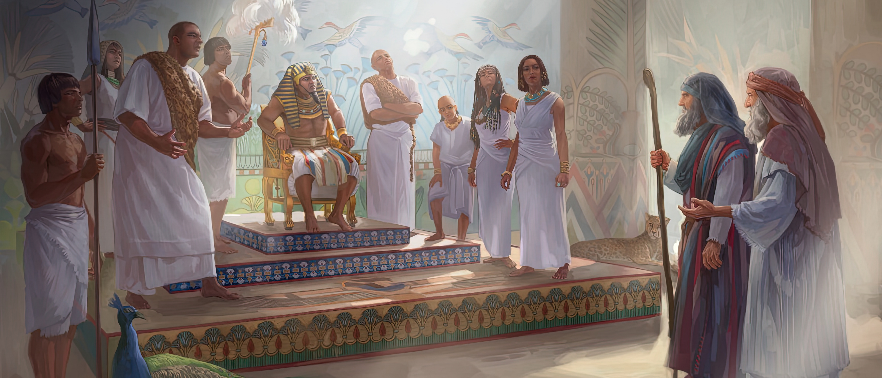
“Pea hili ia naʻe ʻalu ʻa Mōsese mo ʻElone, ʻo tala kia Felo, “ʻOku pehē mai ʻe Sihova, ko e ʻOtua ʻo ʻIsileli, Tukuange ʻa hoku kakai ke ʻalu, koeʻuhi ke nau fai ʻae kātoanga kiate au ʻi he toafa.”Pea pehēange ʻe Felo, “Ko hai ʻa Sihova, koeʻuhi ke u talangofua ai ki hono leʻo ʻo tukuange ʻa ʻIsileli ke ʻalu? ʻOku ʻikai te u ʻiloa ʻa Sihova, pea ʻe ʻikai te u tukuange ʻa ʻIsileli ke ʻalu.”” ‘Ekisotosi 5:1, 2

Slide 4
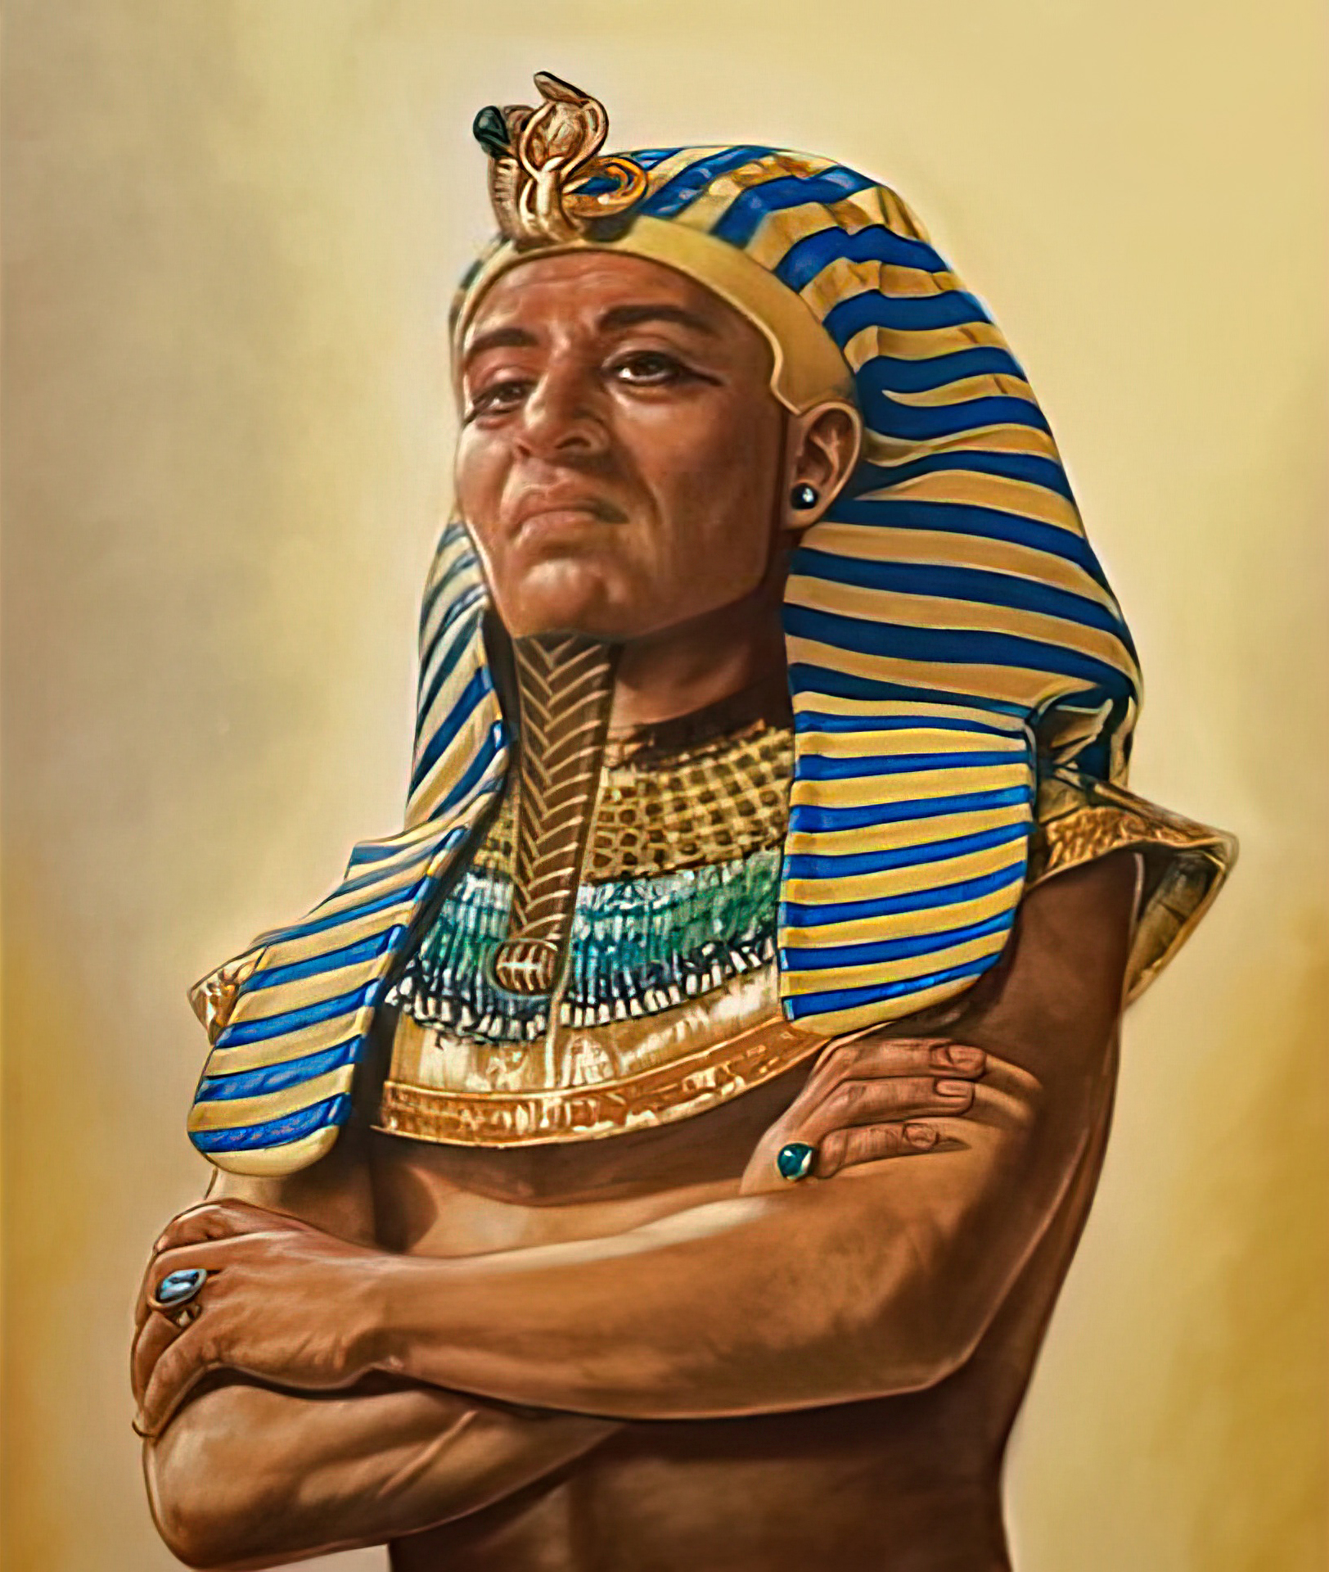
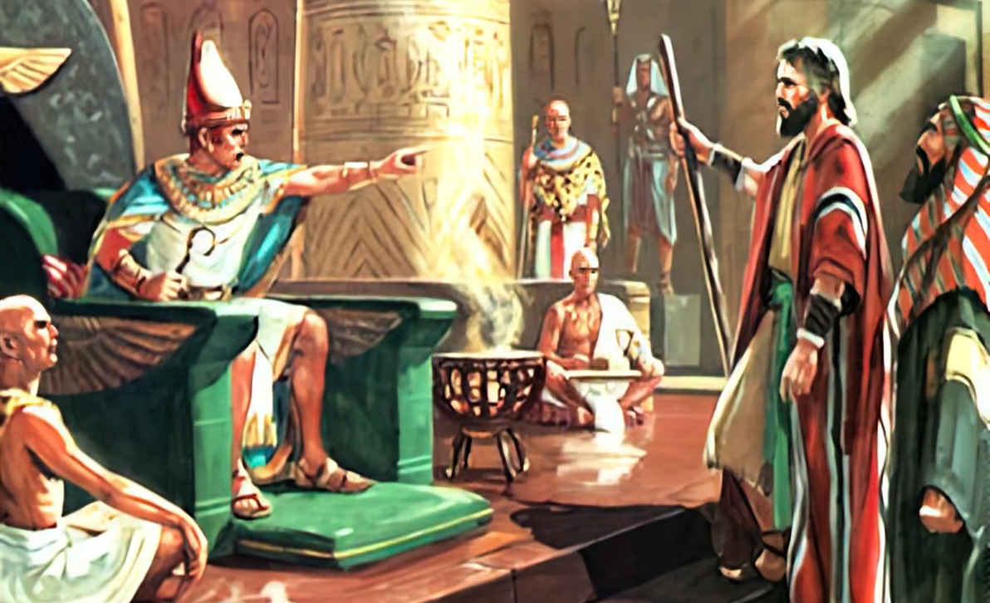
“Pea naʻe fefeka ʻae loto ʻo Felo, pea naʻe ʻikai te ne tuku ʻae fānau ʻa ʻIsileli ke ʻalu: ʻo hangē ko e folofola ʻa Sihova kia Mōsese.”
‘Ekisotosi 9:35,

Slide 5
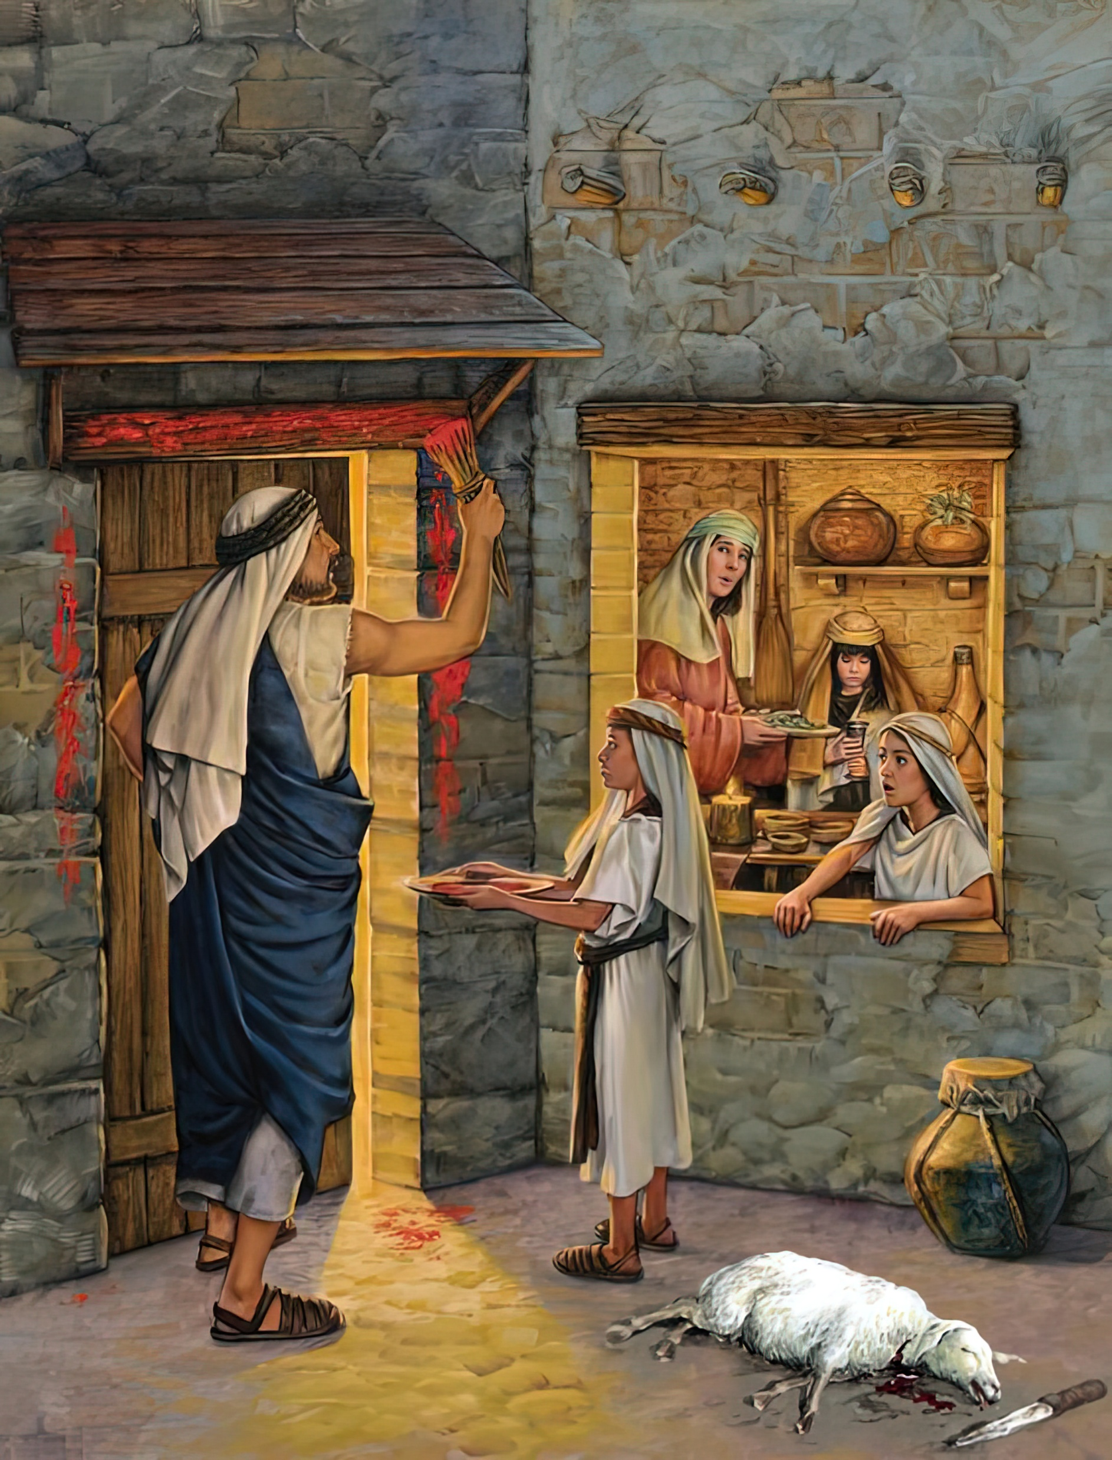
“Pea ʻe hoko ʻo pehē, ʻoka fehuʻi hoʻomou fānau kiate kimoutolu, ‘Ko e hā hono ʻuhinga ʻoe ngāue ni?’ Te mou pehē: ‘Ko e feilaulau ia ʻoe Lakaatu ʻa Sihova, ʻaia naʻa ne laka atu ʻi he ngaahi fale ʻoe fānau ʻa ʻIsileli ʻi ʻIsipite, ʻi heʻene taaʻi ʻae kakai ʻIsipite, ʻo ne fakamoʻui homau fale.”
Ekisotosi 12:26, 27

Slide 6
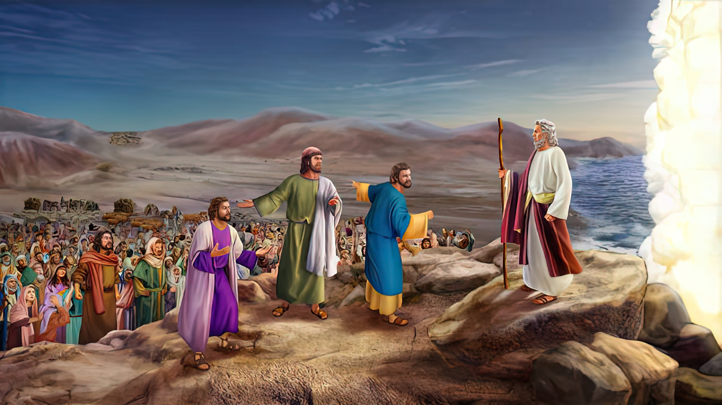
“Pea pehē ʻe Mōsese ki he kakai, “ʻOua te mou manavahē, tuʻu fakalongolongo pe, ʻo mamata ki he fakamoʻui ʻa Sihova, ʻaia te ne fakahā kiate kimoutolu he ʻaho ni: he ko e kakai ʻIsipite kuo mou mamata ki ai he ʻaho ni, ʻe ʻikai te mou toe mamata ki ai ʻo lauikuonga.‌ʻE tau ʻa Sihova maʻamoutolu, pea te mou fakalongo pe.”’Ekisotosi 14:13, 14

Slide 7
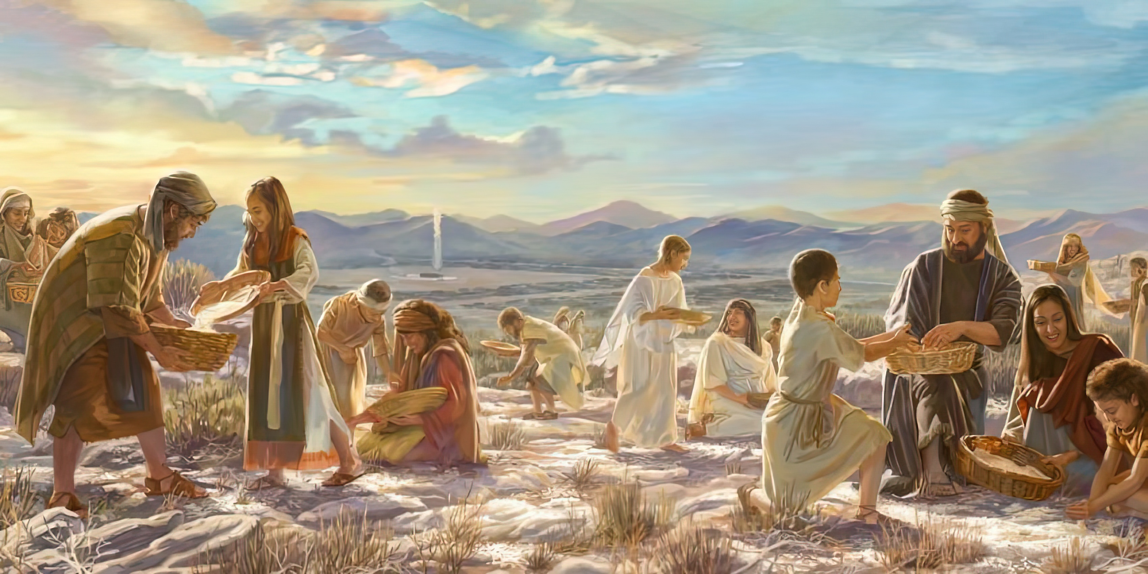

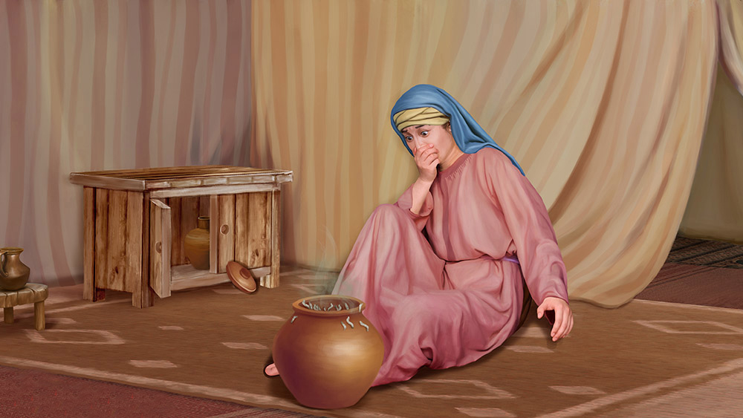
“Pea naʻe folofola ʻa Sihova kia Mōsese, “ʻE tuku ʻafē hoʻomou taʻefietauhi ʻeku ngaahi fekau mo ʻeku ngaahi fono?Vakai, ko e meʻa ʻi he foaki ʻe Sihova ʻae Sāpate kiate kimoutolu, ko ia ʻoku ne foaki ai kiate kimoutolu ʻi hono ono ʻoe ʻaho, ʻae mā ki he ʻaho ʻe ua: mou nofomaʻu taki taha ʻae tangata ʻi hono potu, ʻoua naʻa ʻalu ha tangata ʻe tokotaha mei hono potu ʻi hono fitu ʻoe ʻaho.”Ko ia naʻe mālōlō ai ʻae kakai ʻi hono fitu ʻoe ʻaho.”
‘Ekisotosi 16:28–30

Slide 8
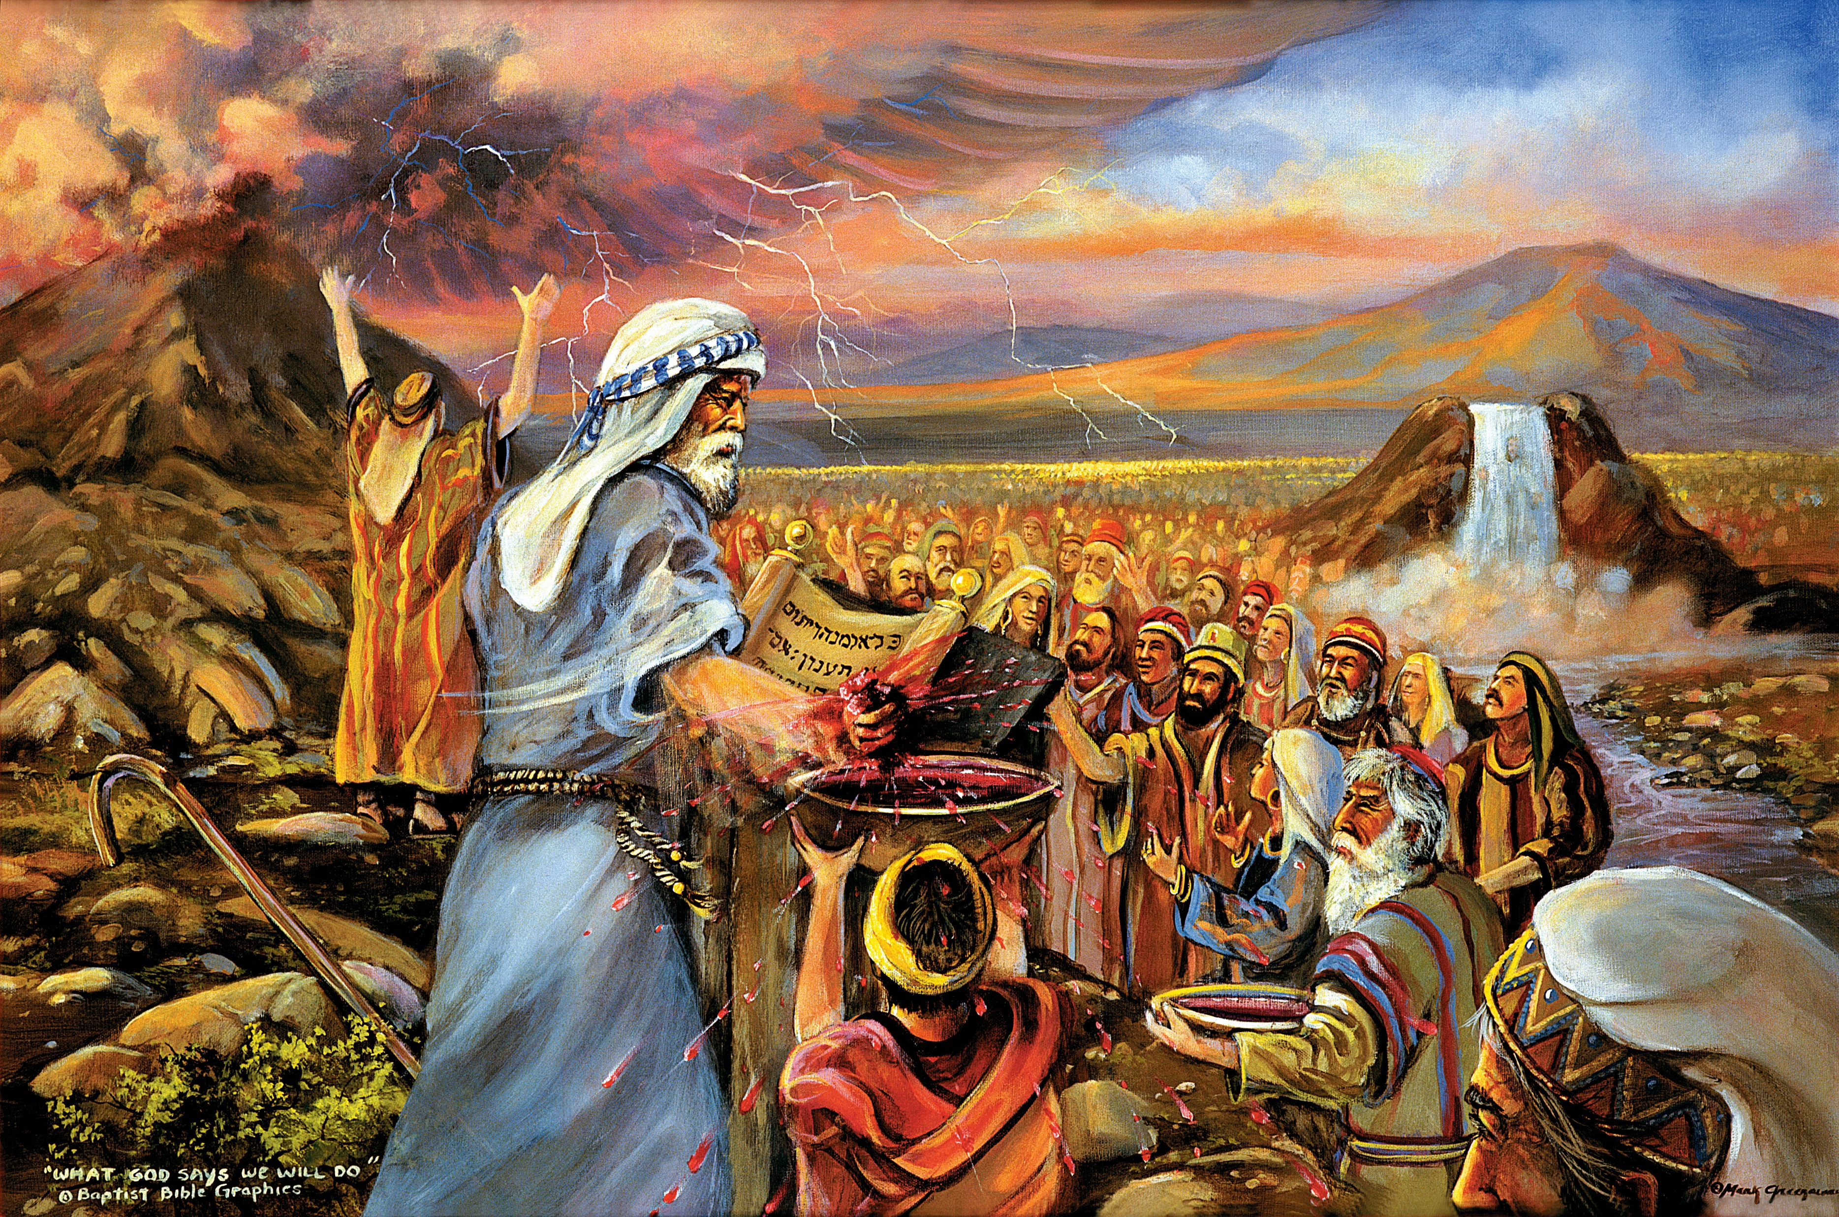
“Kuo mou mamata ki he meʻa naʻaku fai ki he kakai ʻIsipite, mo ʻeku fua ʻakimoutolu ʻi he kapakau ʻoe ʻikale, ʻo ʻomi ʻakimoutolu kiate au. Pea ko ʻeni, kapau te mou tuitala moʻoni ki hoku leʻo, ʻo tauhi ʻeku fuakava, te mou ʻiate au ko e koloa lelei lahi ʻi he kakai kotoa pē: he ʻoku ʻoʻoku ʻa māmani kotoa pē. Pea te mou ʻiate au ko e puleʻanga ʻoe kau taulaʻeiki, mo e kakai māʻoniʻoni.” ‘Ekisotosi 19:4–6,

Slide 9
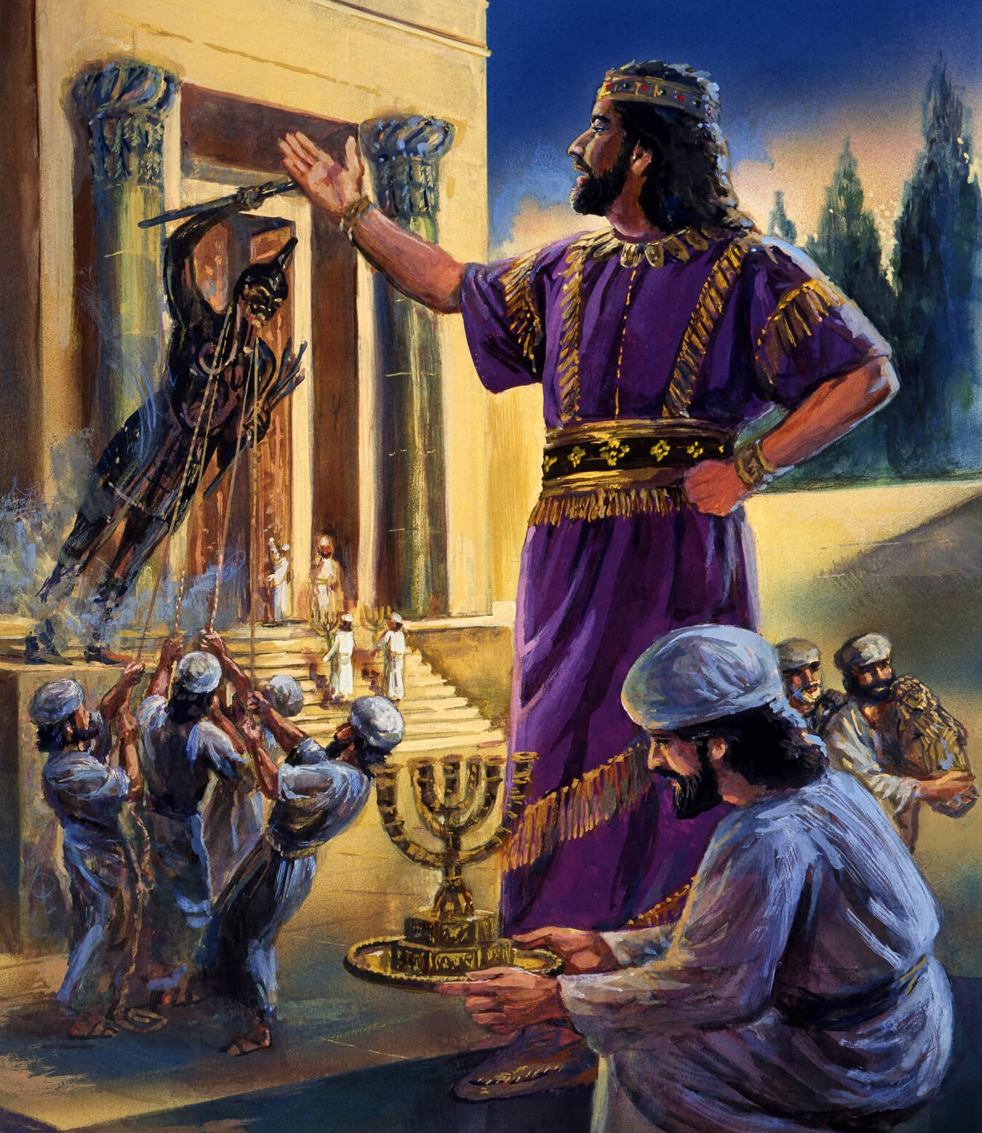
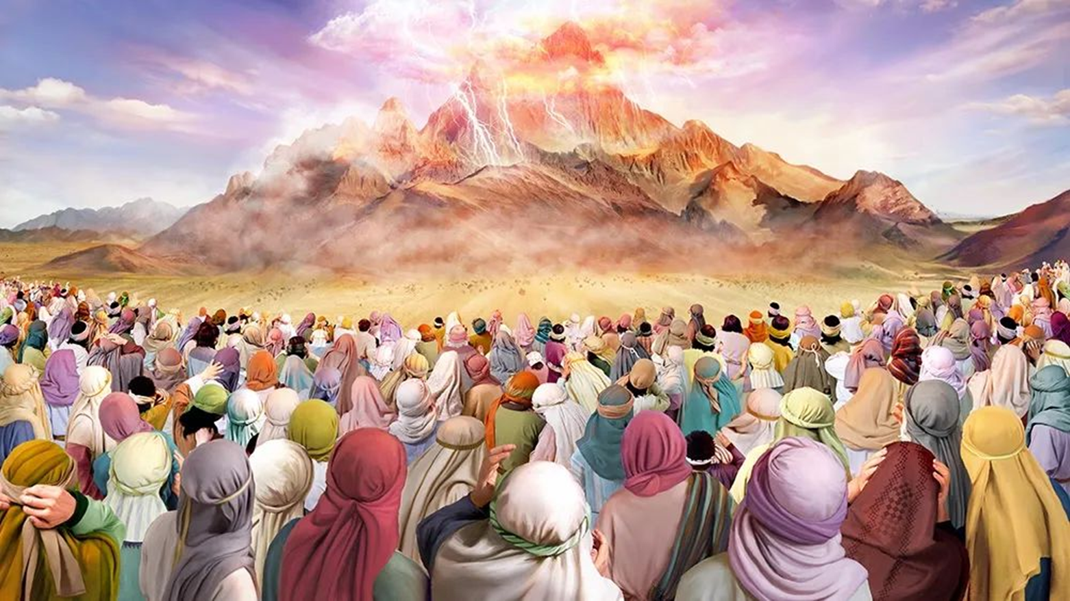
“Pea naʻe folofola ʻa Sihova kia Mōsese, “Ke ke lea ki he fānau ʻa ʻIsileli, ʻo pehē, Kuo mou mamata ki heʻeku lea kiate kimoutolu mei langi.‌ʻOua naʻa mou ngaohi ke fakalahi ʻaki au ha ngaahi ʻotua siliva, pea ʻoua naʻa mou ngaohi kiate kimoutolu ʻae ngaahi ʻotua koula.” ‘Ekisotosi 20:22, 23,

Slide 10
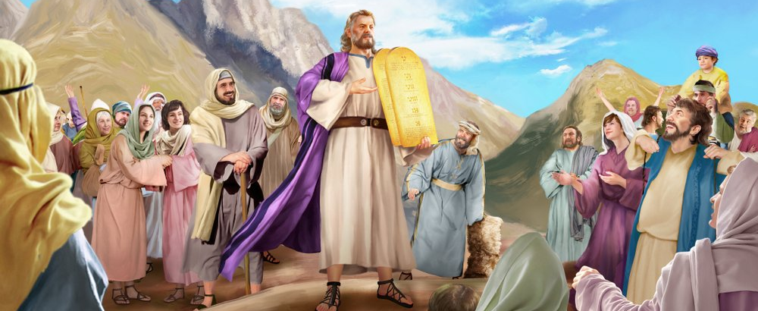
“Pea naʻe haʻu ʻa Mōsese ʻo ne tala ki he kakai ʻae ngaahi folofola kotoa pē ʻa Sihova, mo e ngaahi fono kotoa pē; pea tali lea taha pe ʻae kakai kotoa pē, ʻonau pehē, “Ko e ngaahi lea kotoa pē kuo folofolaʻaki ʻe Sihova te mau fai.”
‘Ekisotosi 24:3

Slide 11
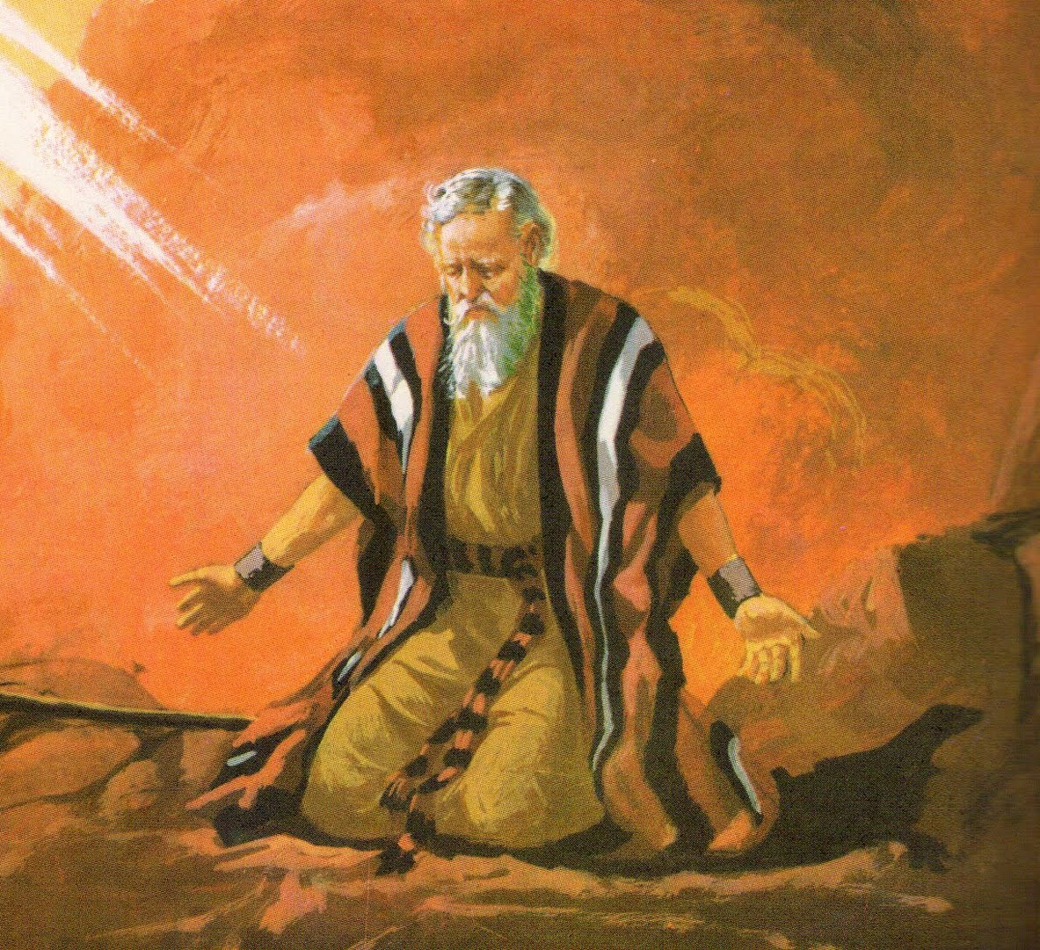
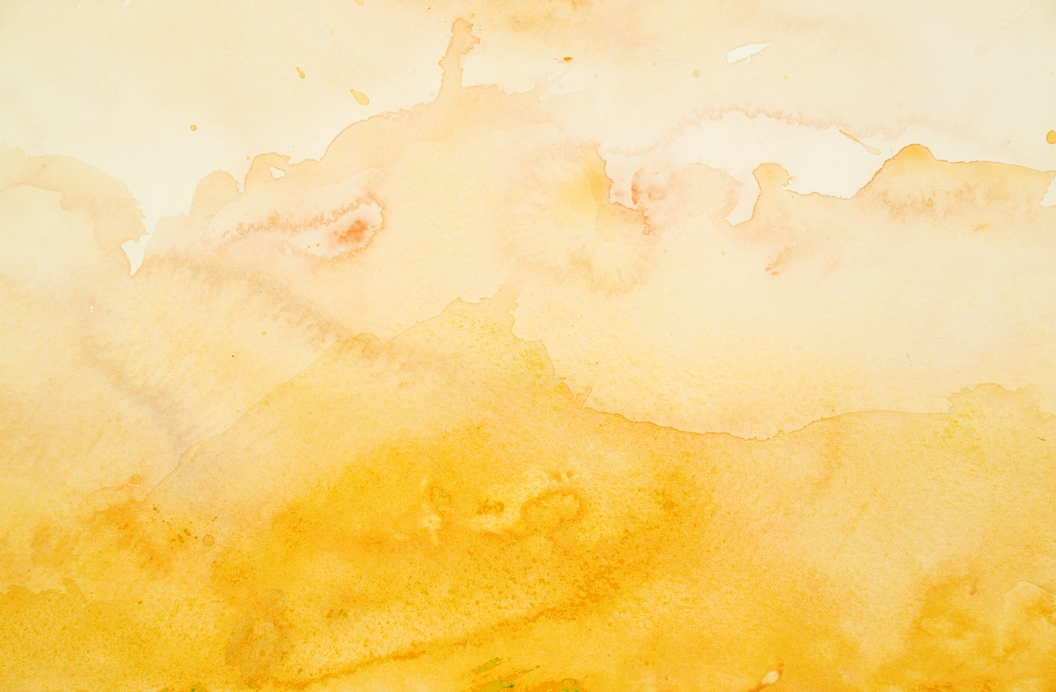
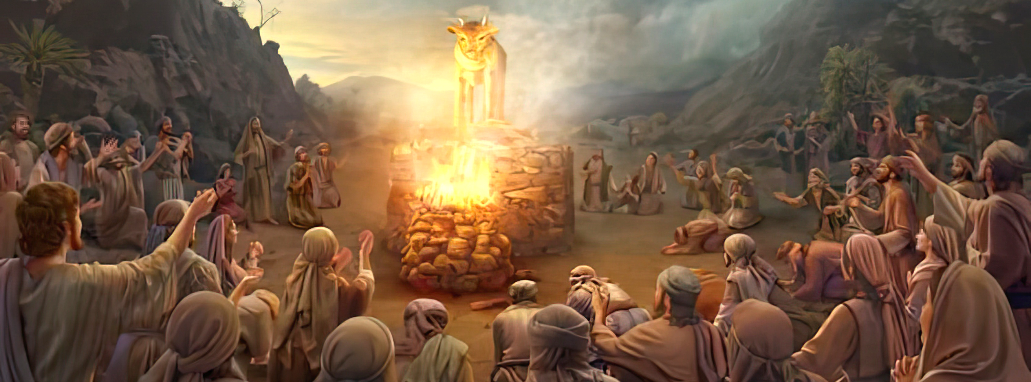
“Pea naʻe toe ʻalu ʻa Mōsese kia Sihova, ʻo ne pehē, “ʻOiauē, kuo fai ʻae angahala lahi ʻe he kakai ni, pea kuo ngaohi honau ngaahi ʻotua koula.Ka ko eni, kapau ʻe lelei te ke fakamolemole ʻenau angahala; pea kapau ʻe ʻikai, ʻoku ou kole kiate koe, tāmateʻi au mei hoʻo tohi ʻaia kuo ke tohi.”
‘Ekisotosi 32:31,32

Slide 12
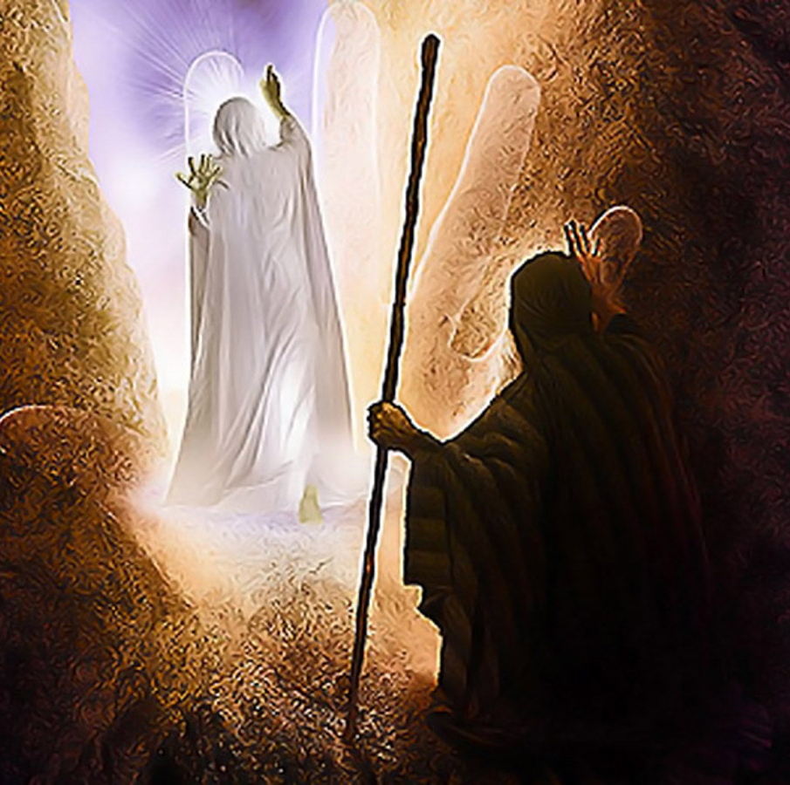
“Pea naʻe hāʻele ange ʻa Sihova ʻi hono ʻao, ʻo ne folofola, “Ko Sihova, Ko Sihova ko e ʻOtua, ʻoku ʻaloʻofa, mo ʻofa mataʻatā, ʻoku kātaki fuoloa, pea mohu ʻi he angalelei mo e moʻoni.ʻOku ne fakahā ʻae ʻaloʻofa ki he ngaahi toko afe, ʻi he fakamolemole ʻae hia, mo e talangataʻa, mo e angahala, pea ʻe ʻikai ʻaupito fakatonuhiaʻi ʻae halaia; ʻoku ʻaʻahi ʻaki ki he fānau ʻae hia ʻae mātuʻa, pea ki he hako ʻo ʻenau fānau, ʻo aʻu ki hono tolu mo hono fā ʻoe toʻutangata.”
Ekisotosi 34:6,7

Slide 13
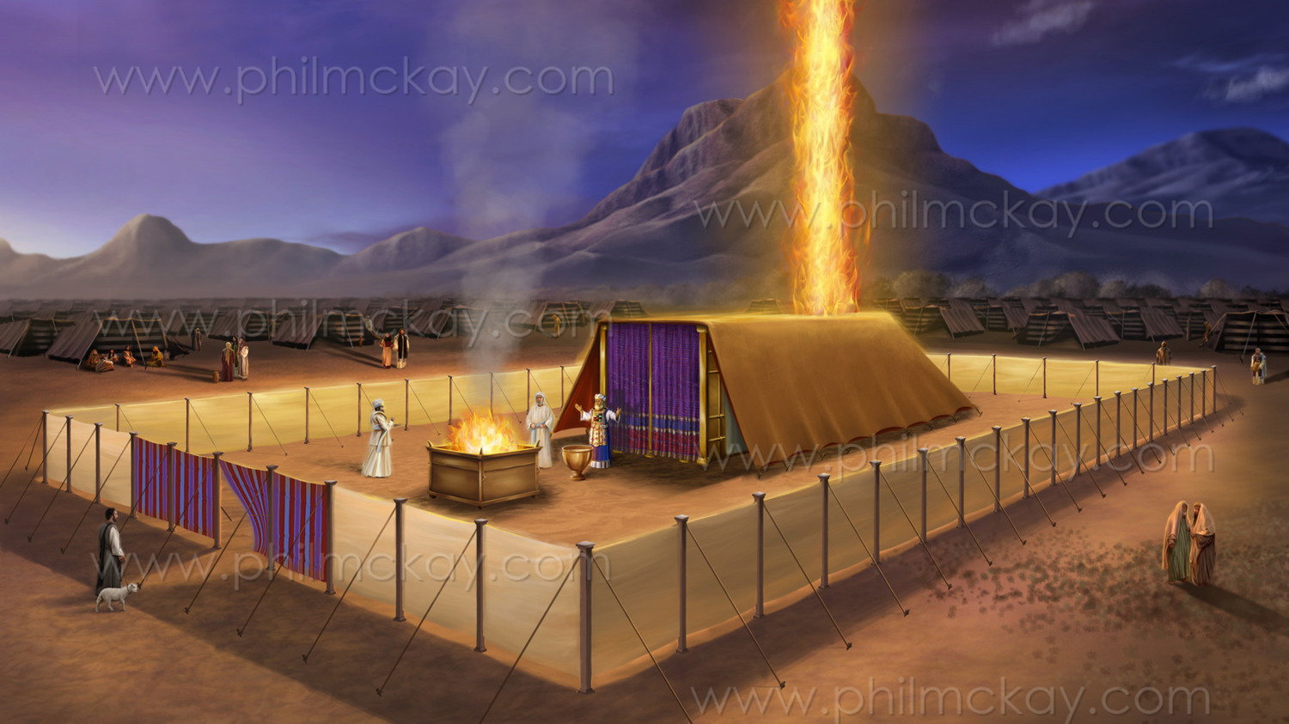
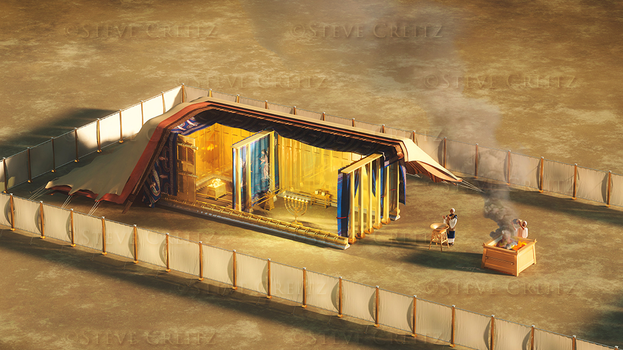
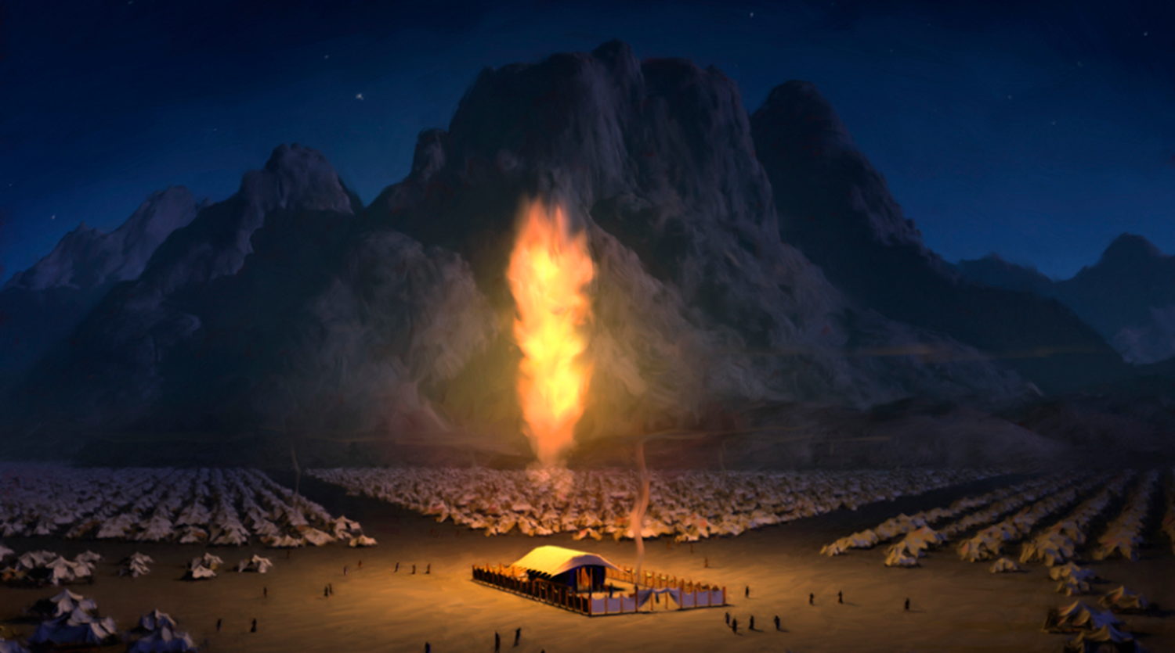
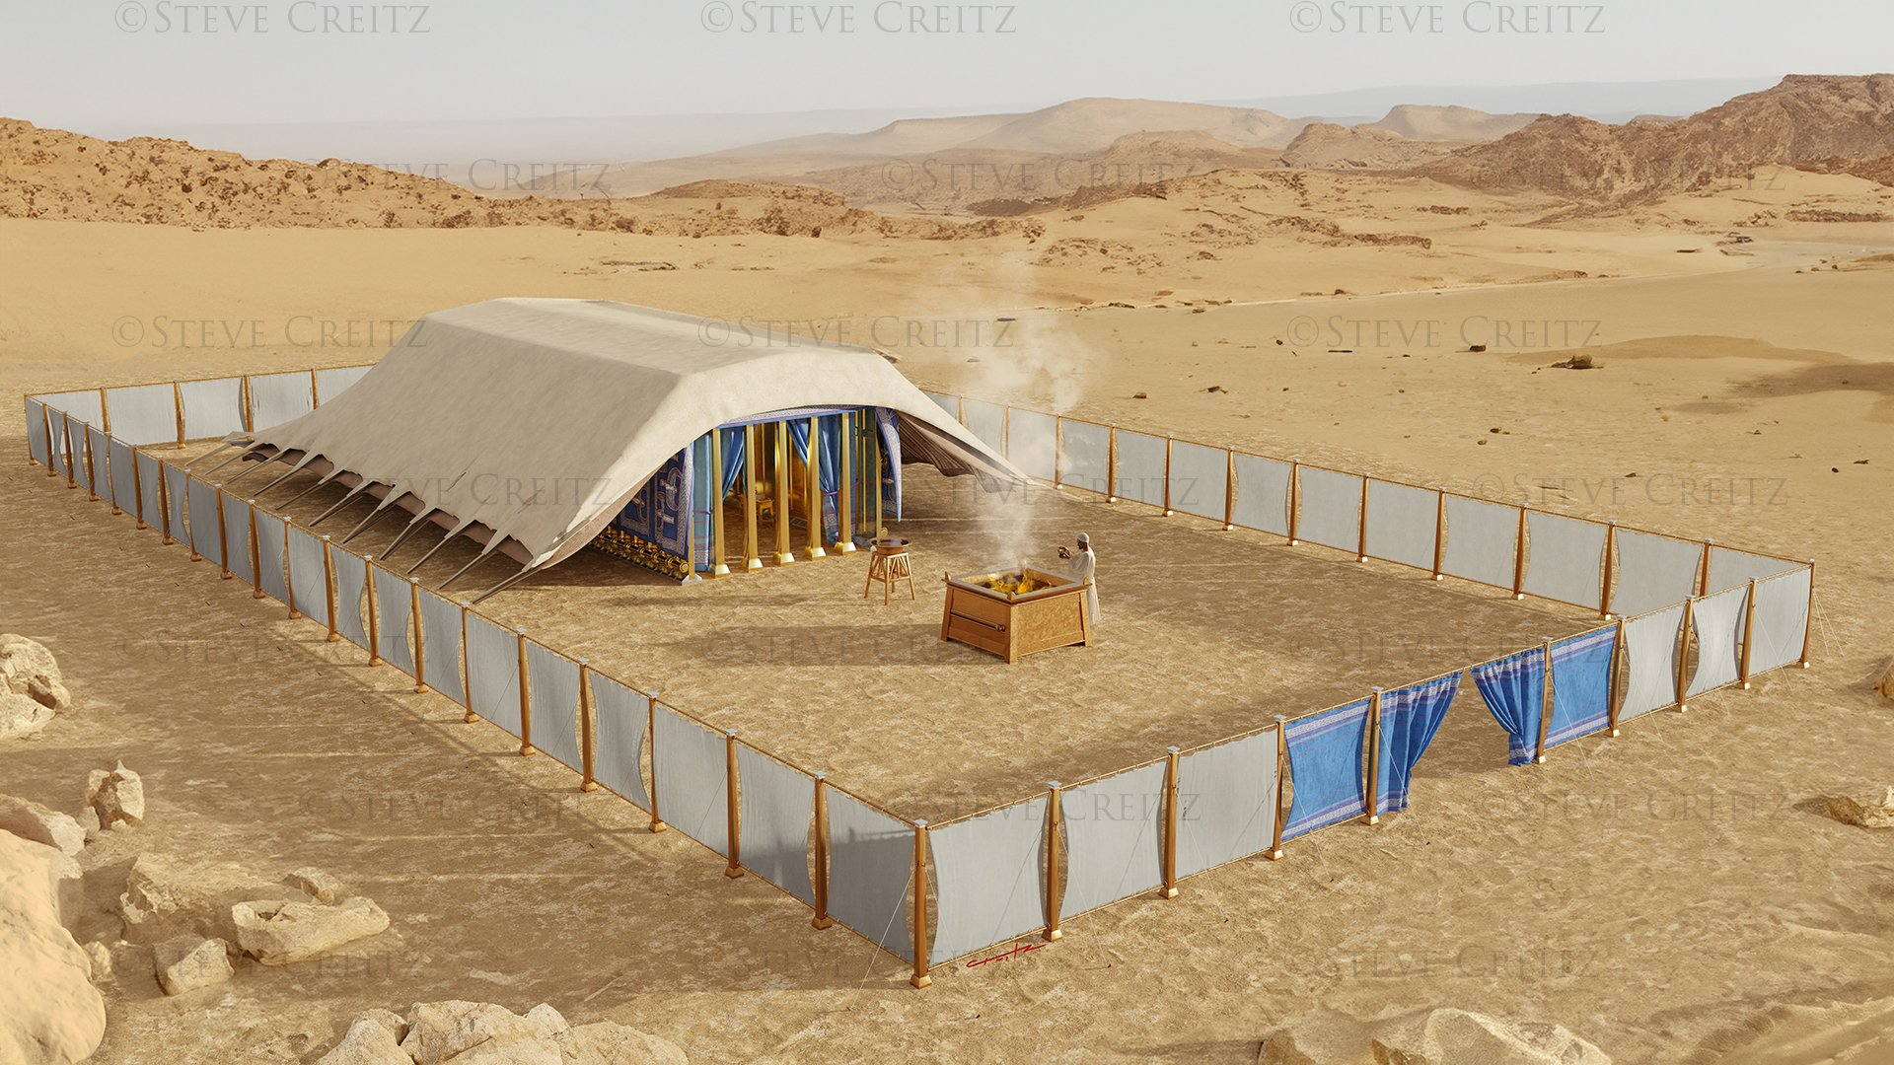
“Pea hili ia naʻe ʻufiʻufi leva ʻe he ʻao ʻae fale fehikitaki ʻoe kakai, pea naʻe fakafonu ʻe he nāunau ʻo Sihova ʻae fale fehikitaki. … He naʻe fakamalumalu ʻae fale fehikitaki ʻe he ʻao ʻo Sihova ʻi he ʻaho, pea naʻe ʻi ai ʻae afi ʻi he poʻuli, ʻi he ʻao ʻoe fale kotoa pē ʻo ʻIsileli, ʻi honau ngaahi fononga kotoa pē.”
Ekisotosi 40:34,38

