Slide 1

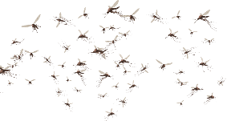
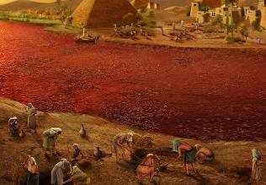
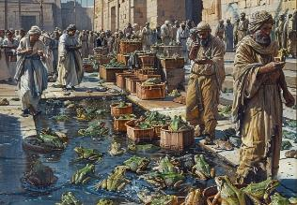
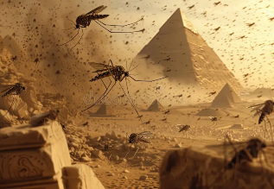
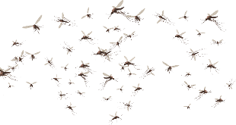
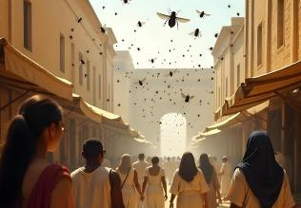
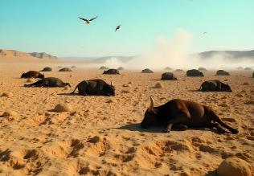
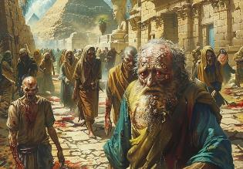
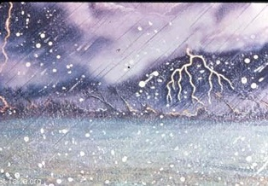
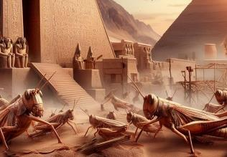
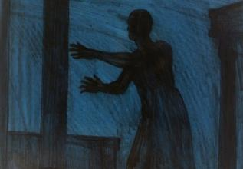
IZIBETHO
Isifundo 4 sowama26 kweyeKhala (Julayi) 2025

Slide 2
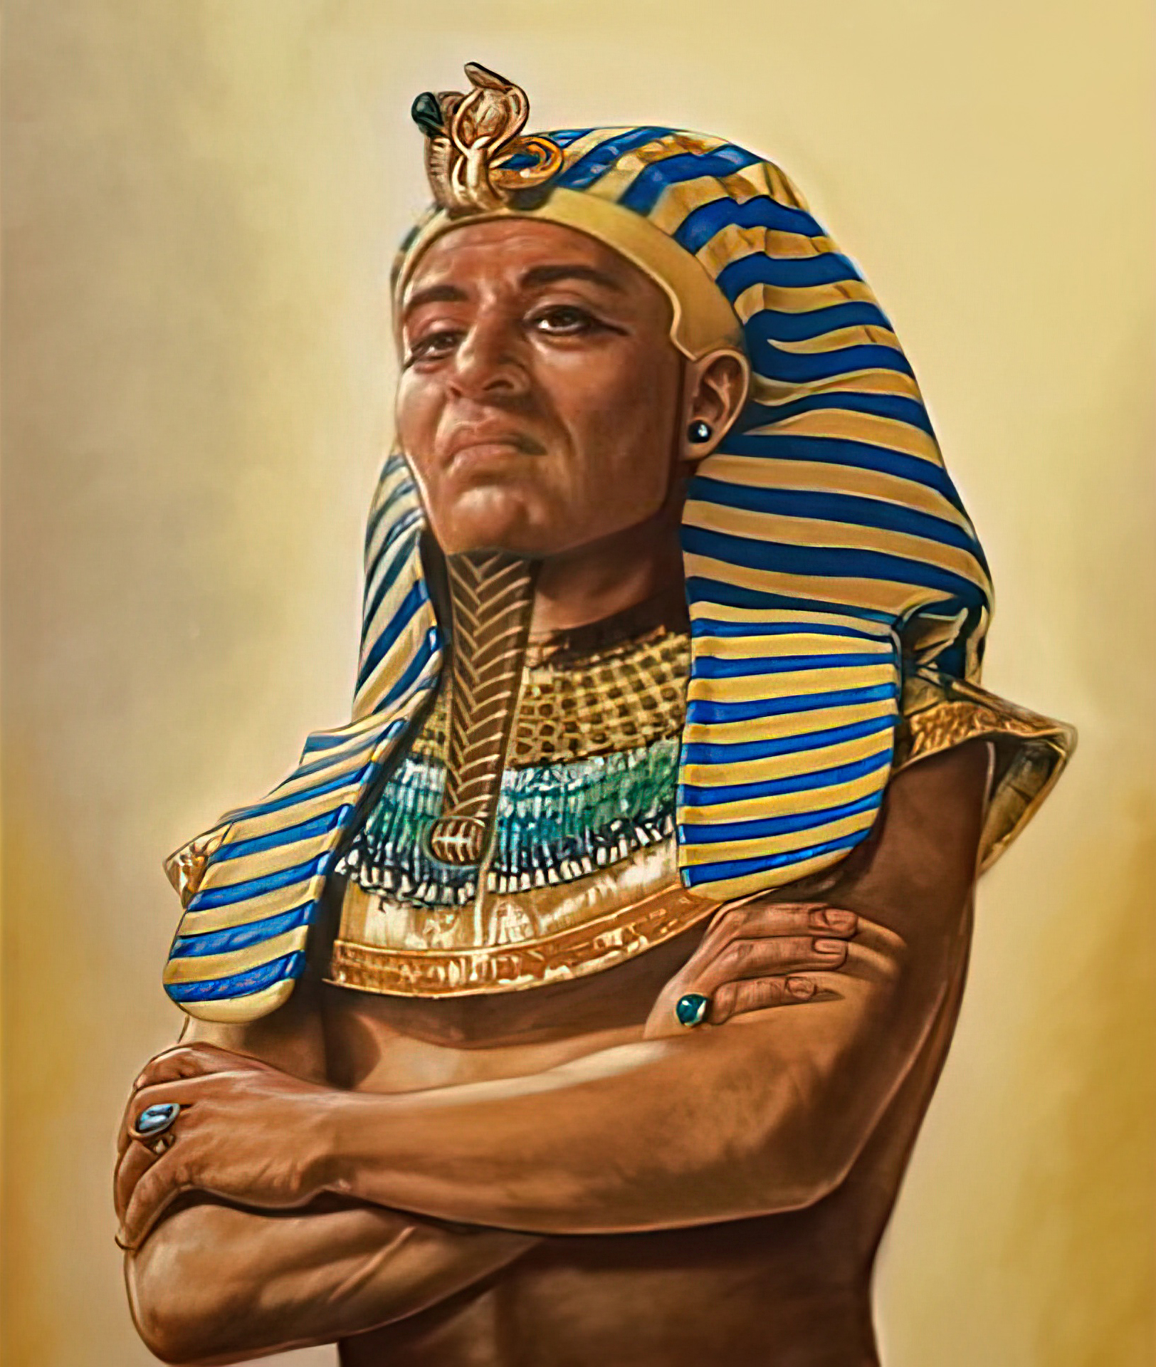
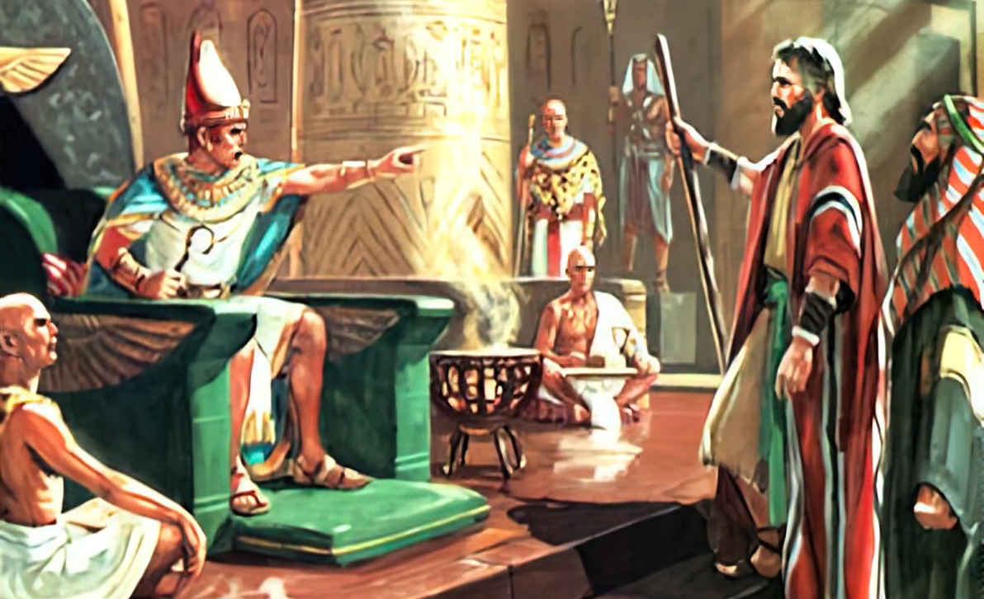
“Yaba lukhuni ke intliziyo kaFaro, akabandulula oonyana bakaSirayeli, njengoko watshoyo uYehova”
Eksodus 9:35

Slide 3

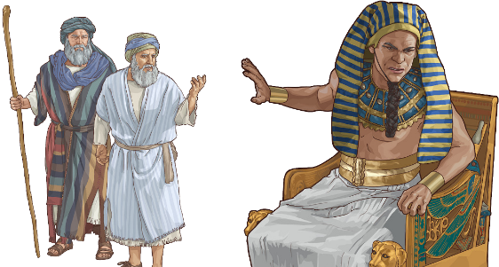
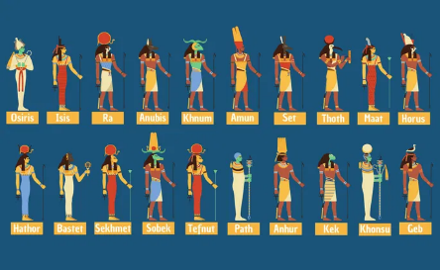
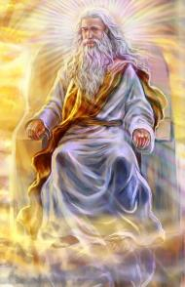




UThixo wayalela abantu baKhe ukuba baqale ngokumemeza uxolo xa besiya emfazweni. Ukuba akubangakho sivumelwano soxolo, bangawuhlasela umzi (Deut. 20:10-12).
Le yindlela uThixo awaqubisana ngayo neYiphutha. Waqala ngesisombululo soxolo, kodwa uThutmose wakhaba ngawo omane. Kwafika ilixa lokuba ahlasele.
Ukuwa kwezibetho, akuzange kubekho nasinye isithixo kwitempile yezithixo ebanzi yaseYiphutha esaba namandla okubakhusela kumandla kaThixo wenyaniso.
Ingabulazigcawu:
  Umlo weenyoka (Exodus 7:8-12)
  Intliziyo eyenziwe lukhuni (Exodus 7:13)
Izibetho:
  Izibetho ezilula ezithathu (Exodus 7:14-8:19)
  Izibetho eziyingozi ezithathu (Exodus 8:20-9:12)
  Izibethu ezitshabalalisayo ezithathu (Exodus 9:13-10:29)

Slide 4

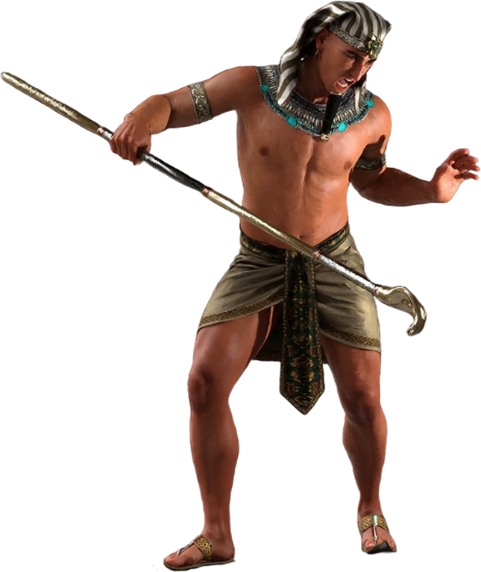
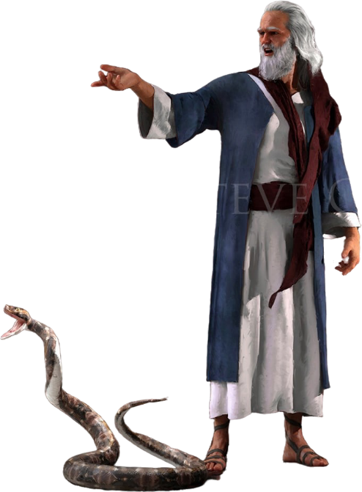
Ingabulazigcawu

Slide 5

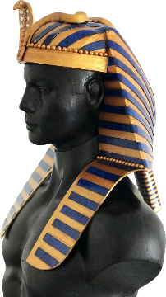
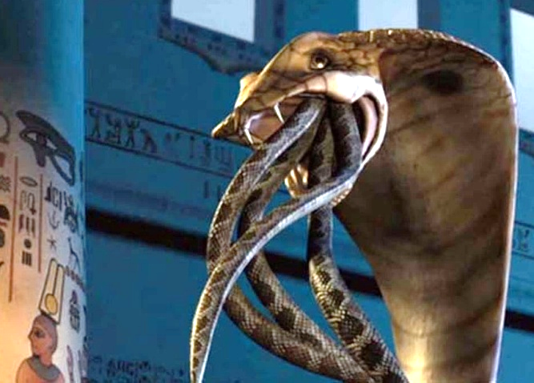
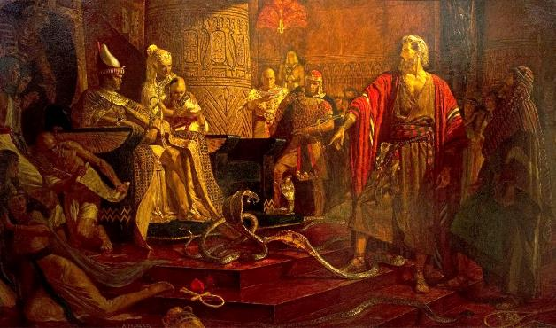
UMLO WEENYOKA
“Elowo waphosa phantsi intonga yakhe, yaba yinyoka; yasuka intonga ka-Aron yaziginya iintonga zabo.” (Exodus 7:12)
UThixo ukuchaza ukuhlangulwa kukaSirayeli njengemfazwe awayilwa noothixo bonke baseYiphutha. (Eks. 12:12; Num. 33:4).
Kwisitshaba sikaFaro, njengophawu lwamandla akhe, kwakukho iphimpi elihle nelalimele uthixokazi uWadjet.
Ngokujika intonga ibe yinyoka, , uThixo wayengqale ngqo kulo thixokazi (Eks. 7:10). Ingaba wakwazi ukumkhusela uFaro?
USathana wasebenzisa abakhafuli ukulinganisa le mimangaliso (Exod. 7:11). Kodwa akakwazi ukudala ubomi; ezakhe iinyoka zazikhangeleka njengeenyoka. Nangona kunjalo, uThixo wayedala inyoka ephilayo, nenamandla okuzibimbiliza ezingaphiliyo. (Eks. 7:12).
Ngaloo ndlela, uThixo wabonisa ukuba nguYe onamandla awongamileyo negunya, hayi oothixo baseYiphutha.

Slide 6
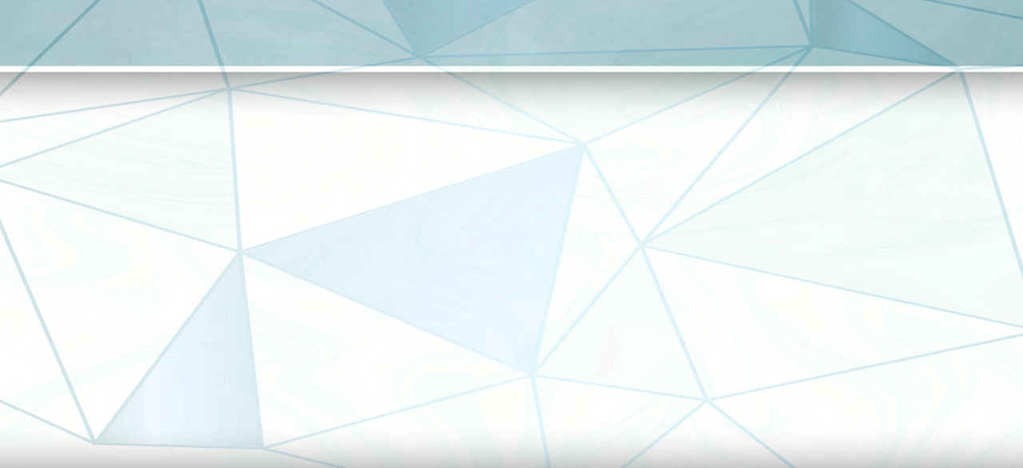
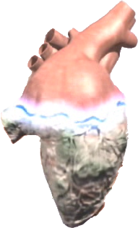
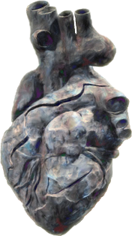


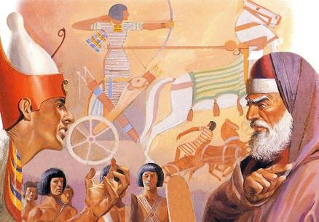

INTLIZIYO EYENZIWE LUKHUNI
“Yaba lukhuni intliziyo kaFaro; akabaphulaphula, njengoko wayetshilo uYehova.” (Exodus 7:13)
Kwincwadi ye-Eksodus, zizihlandlo zilithoba uThixo esenza lukhuni intliziyo kaFaro (Eks. 4:21; 7:3; 9:12; 10:1; 10:20; 10:27; 11:10; 14:4; 14:8), ukanti ezinye ezilithoba kuthiwa nguFaro buqu owayenza lukhuni intliziyo yakhe (Eks. 7:13; 7:14; 7:22; 8:15; 8:19; 8:32; 9:7; 9:34; 9:35). Zintanganye! Ngubani owayenza lukhuni intliziyo kaFaro?
Emveni kwezibetho ezihlanu zokuqala, ibekwe yacaca ukuba uFaro wayenza lukhuni intliziyo yakhe. Oko kukuthi, wakhaba ngawo omane ukusabela kakuhle kubizo loMoya oyiNgcwele lokuyeka uSirayeli ahambe.
Emveni kwesibetho sesithandathu, nguThixo oyenza lukhuni intliziyo kaFaro (Eks. 9:12). UFaro wayesele edlulile kumda wenguquko. Nangona kunjalo, kwisibetho sesixhenxe, walinikwa elinye ithuba, kodwa waphinda wayenza lukhuni intliziyo yakhe (Exod. 9:34-35 ).
Ukususela apho, ikamva lakhe lalitywiniwe. UThixo wayenza lukhuni intliziyo kaFaro, kuba uFaro wayezinzile kwisigqibo sokungaguquki.

Slide 7

EGW ( The Review and Herald , February 17, 1891)
“Kuko konke ukwaliwa kokukhanya, iNkosi yabonakalisa amandla ayo aphawuleka ngakumbi; kodwa ubuntamolukhuni bokumkani banda ngabo bonke ubungqina obutsha bamandla nobungangamsha boThixo wezulu, lwada lwaqotywa utolo lokugqibela lwenceba kumphongolo wobuthixo. Emva koko, le ndoda yaqiniswa ngokupheleleyo kukuxhathisa kwayo okuzingisayo. UFaro wahlwayela ubuntamolukhuni, waza wavuna isivuno esifanayo kwisimo sakhe. INkosi yayingenakwenza nto ngakumbi ukumeyisela, kuba wayevalelwe bubuntamolukhuni kunye nekhethe, apho uMoya oyiNgcwele wawungenako ukufikelela entliziyweni yakhe. UFaro wanikelwa kuko ukungakholwa nobulukhuni bentliziyo yakhe.”

Slide 8

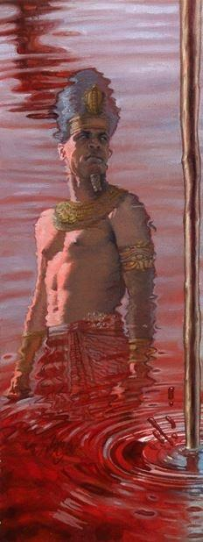
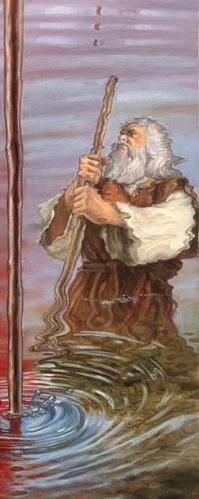
IZIBETHO

Slide 9

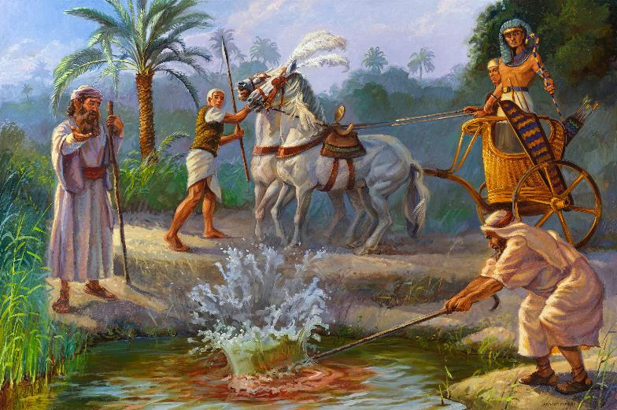
ISIBETHO SOKUQALA (EZILULA): IGAZI
“Utsho uYehova ukuthi, Uya kwazi ngale nto ke ukuba ndinguYehova. Yabon, ndiya kubetha ngentonga esesandleni sam emanzini omlambo, aguqulwe abe ligazi.” (Eksodus 7:17)
UHapi, uthixo weNayile
Eksodus 7:14-25
INayile, nezikhukhula zayo, yayinika ubomi eYiphutha. Kodwa ngubani odale imithombo yamanzi? Izazi zakulinganisa ukuguqulwa kwamanzi, kodwa azange zikwazi ukuwabuyisela kwisimo sesiqhelo.

Slide 10

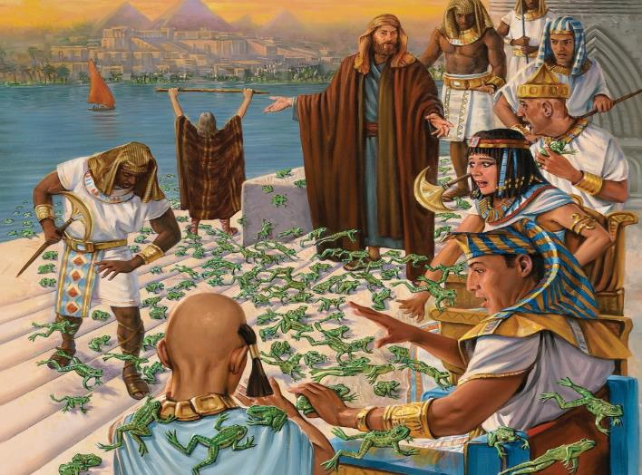
ISIBETHO SESIBINI (EZILULA): AMASELE
“Wathi uYehova kuMoses, Yithi kuAron, Yolula isandla sakho eso sonentonga yakho phezu kwemilambo, naphezu kwemijelo, naphezu kwamachibi, unyuse amasele phezu kwelizwe laseYiphutha.” (Eksodus 8:5)
UHeqet, uthixo wamasele
Eksodus 8:1-15
Kwakhona, abakhafuli basilinganisa isibetho, kodwa basilela ukusithintela.

Slide 11

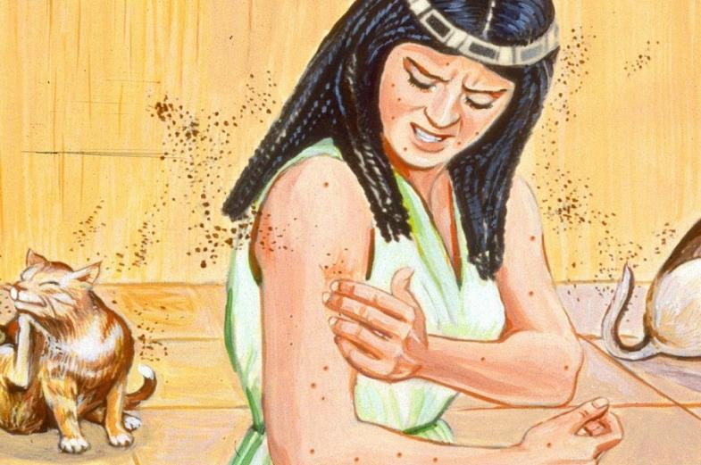
ISIBETHO SESITHATHU (EZILULA): IINGCONGCONI
“Wathi uyehova kuMoses, Yithi kuAron, Yolula intonga yakho, ulubethe uthuli lwelizwe lube ziingcongconi ezweni lonke laseYiphutha.’” (Eksodus 8:16)
UGeb, uthixo womhlaba
Eksodus 8:16-19
Ukudala ubomi ngothuli lomhlaba (Gen. 1:24)? Kwakungasekho kuthandabuza ukuba izibetho zisukela phi: “Ngumnwe kaThixo” (Ex . 8:19). Ekugqibeleni, zavalwa umlomo izazi.

Slide 12

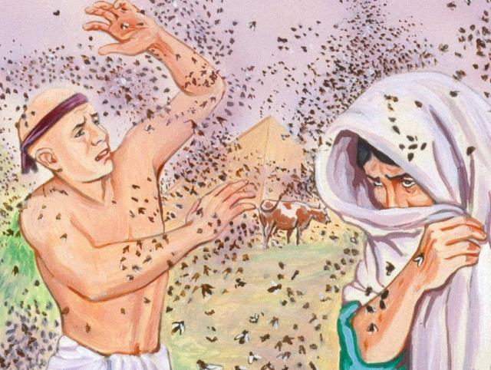
ISIBETHO SESINE (ESIQATHA): IZIBAWU
“Wenjenjalo uYehova. Kweza izibawu ezininzi endlwini kaFaro, nasezindlwini zabakhonzi bakhe, nasezweni lonke laseYiphutha; lonakala ilizwe zizibawu.” (Eksodus 8:24)
U-Uatchi, uthixokazi wezibawu
Eksodus 8:20-32.
Okokuqala, uSirayeli wakhuseleka kwizibetho. Oku kwakhokelela ekubeni uFaro aqalise ukuthethathethana, kodwa wasilela ukuzigcina izithembiso zakhe.

Slide 13

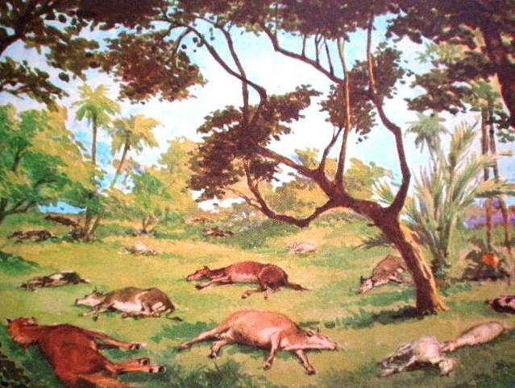
ISIBETHO SESIHLANU (ESIQATHA): UKUFA KWEMFUYO
“yabona, isandla sikaYehova soba semfuyweni yakho esendle, emahasheni, emaesileni, ezinkameleni, ezinkomeni nasempahleni emfutshane, senze indyikityha yokufa enzima kunene.” (Eksodus 9:3)
UKhnum, uthixo wendalo
Eksodus 9:1-7.
Oothixo abaninzi babeneentloko zezilwanyana, esi sibetho sabahlazisa phantse bonke.

Slide 14

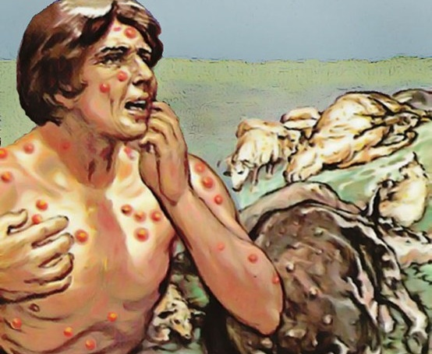
ISIBETHO SESITHANDATHU (ESIQATHA): AMATHUMBA
“Baluthabatha ke uthuthu lweziko, bema phambi koFaro; uMoses waluphosa phezulu esibhakabhakeni, lwaba ngamathumba athe qwele ngamaqhakuva ebantwini nasezinkomeni” (Eksodus 9:10)
USekhmet, uthixokazi wezonyango
Eksodus 9: 8-12 .
Nkqu nezazi azange zikwazi ukuzinyanga (Eksod. 9:11). UFaro zange athandabuze ukuba zisuka phi izibetho. Kodwa wakhetha ukwala ukuqubuda kuThixo, waza uThixo wamvumela avune iziqhamo zovukelo lwakhe (Eksod. 9:12).

Slide 15

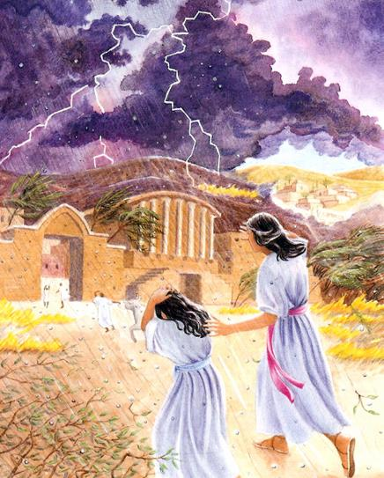
ISIBETHO SESIXHENXE (EZIPHANZISAYO): ISICHOTHO
“Yabona, eli xa ngomso ndiya kunisa isichotho esinzima kunene ekungazange kubekho singangaso eYiphutha, kususela kwimini eyasekwayo kude kube ngoku” (Eksodus 9:18)
UNut, uthixokazi wesibhakabhaka
Eksodus 9:13-35.
Lwaluvavanywa ukholo lwamaYiphutha. Abo bakholwayo kuYehova basindisa ubumo babakhonzi babo nobemfuyo yabo (Eks. 9:20). Yena uFaro akazange akholwe, kwaye nakubeni wazivumayo izono zakhe, wayenganyanisekanga (Eks. 9:27-30).
USeth, uthixo woqhwithelo

Slide 16

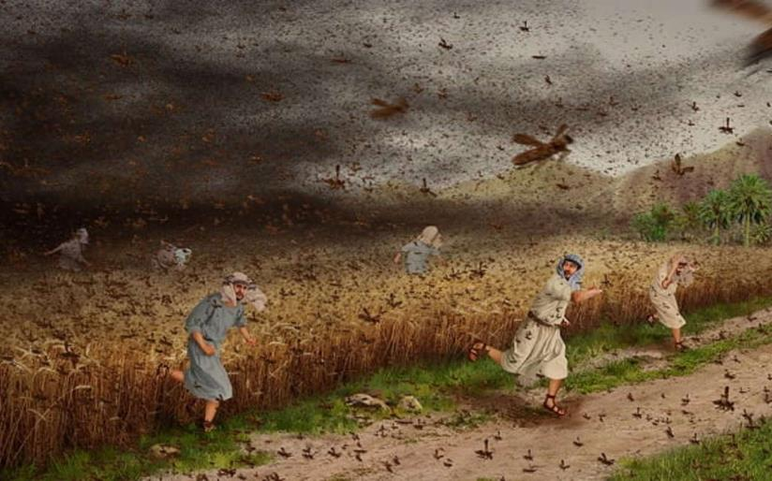
ISIBETHO SESIBHOZO (EZIPHANZISAYO): IINKUMBI
“Okanye ukuba uthe akwavuma ukubandulula abantu bam, uyabona, ngomso ndozisa iinkumbi emideni yakho” (Eksodus 10:4)
UNeper, uthixo wengqolowa
Eksodus 10:1-20.
Njengoko iYiphutha yayitshatyalaliswa, amaYiphutha ngokunokwawo, ambongoza uFaro andulule amaSirayeli (Eks. 10:7).

Slide 17

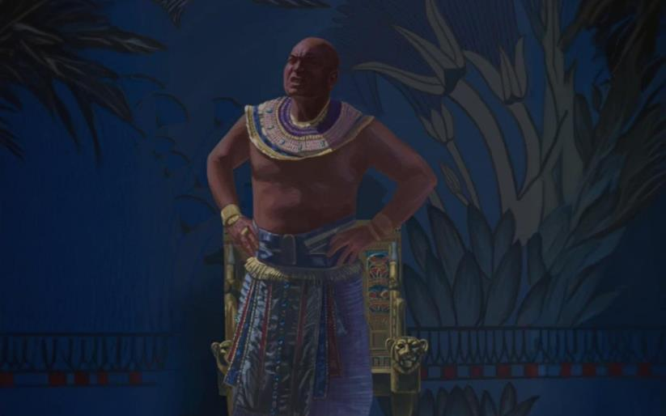
ISIBETHO SETHOBA (EZIPHANZISAYO): UBUMNYAMA
“Wathi uYehova kuMoses, Yolulela isandla sakho ezulwini; kwabakho ubumnyama ibusisithokothoko ezweni lonke laseYiphutha imihla emithathu.’” (Eksodus 10:21)
URa, uthixo welanga
Eksodus 10:21-29.
Ubomi bema ngxi eYiphutha imihla emithathu (ngaphandle kwaseGoshen). UThixo wabanika ixesha lokucamngca, nawathi uFaro wasilela ukulisebenzisa kakuhle.

Slide 18

EGW (Patriarchs and Prophets, p. 263)
“Ngaphambi kokufika kwesibetho ngasinye, uMoses wayemele achaze uhlobo lwaso nemiphumo yaso, ukuze ukumkani azisindise kuso ukuba uyathanda. Sonke isohlwayo esaliwayo sasiya kulandelwa sesinye esiqatha, de intliziyo yakhe enekratshi ithobeke, ivume uMenzi wezulu nomhlaba njengoThixo oyinyaniso nophilayo. INkosi yayiza kunika amaYiputa ithuba lokubona ubulumko bamadoda awo anamandla, indlela abuthathaka ngayo amandla oothixo bawo, xa echasene nemithetho kaYehova. Wayeza kubohlwaya abantu baseYiputa ngenxa yokunqula kwabo izithixo aze avale umlomo ngokuqhayisa ngeentsikelelo ababezifumana koothixo babo abangenangqiqo. UThixo wayeya kulizukisa igama laKhe, ukuze ezinye iintlanga zive ngamandla akhe zize zingcangcazele ngenxa yezenzo zaKhe zamandla, nokuze abantu baKhe bakhohliselwe ekubeni balushiye unqulo lwabo lwezithixo baze banikele kuye unqulo olunyulu.”

