Slide 1
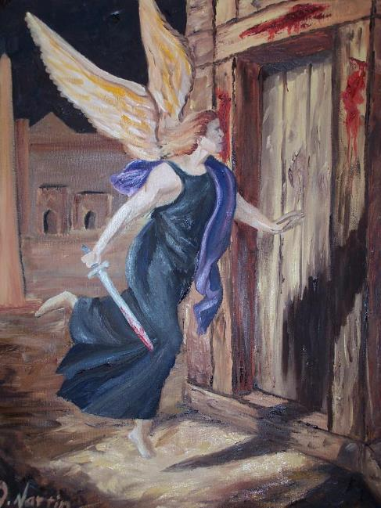
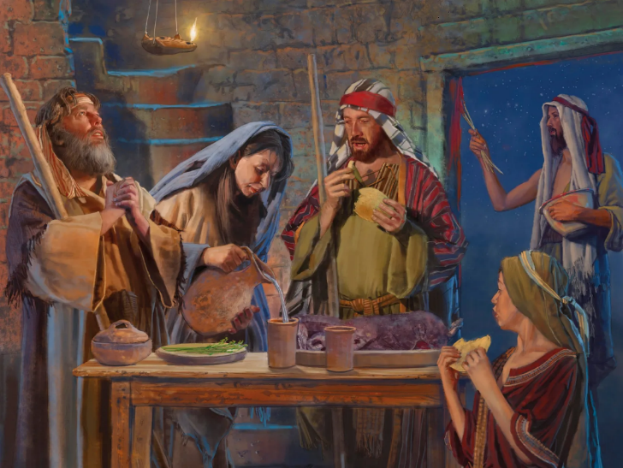
IPASIKA
Isifundo 5 – 2 kweyeThupha (Agasti) 2025

Slide 2
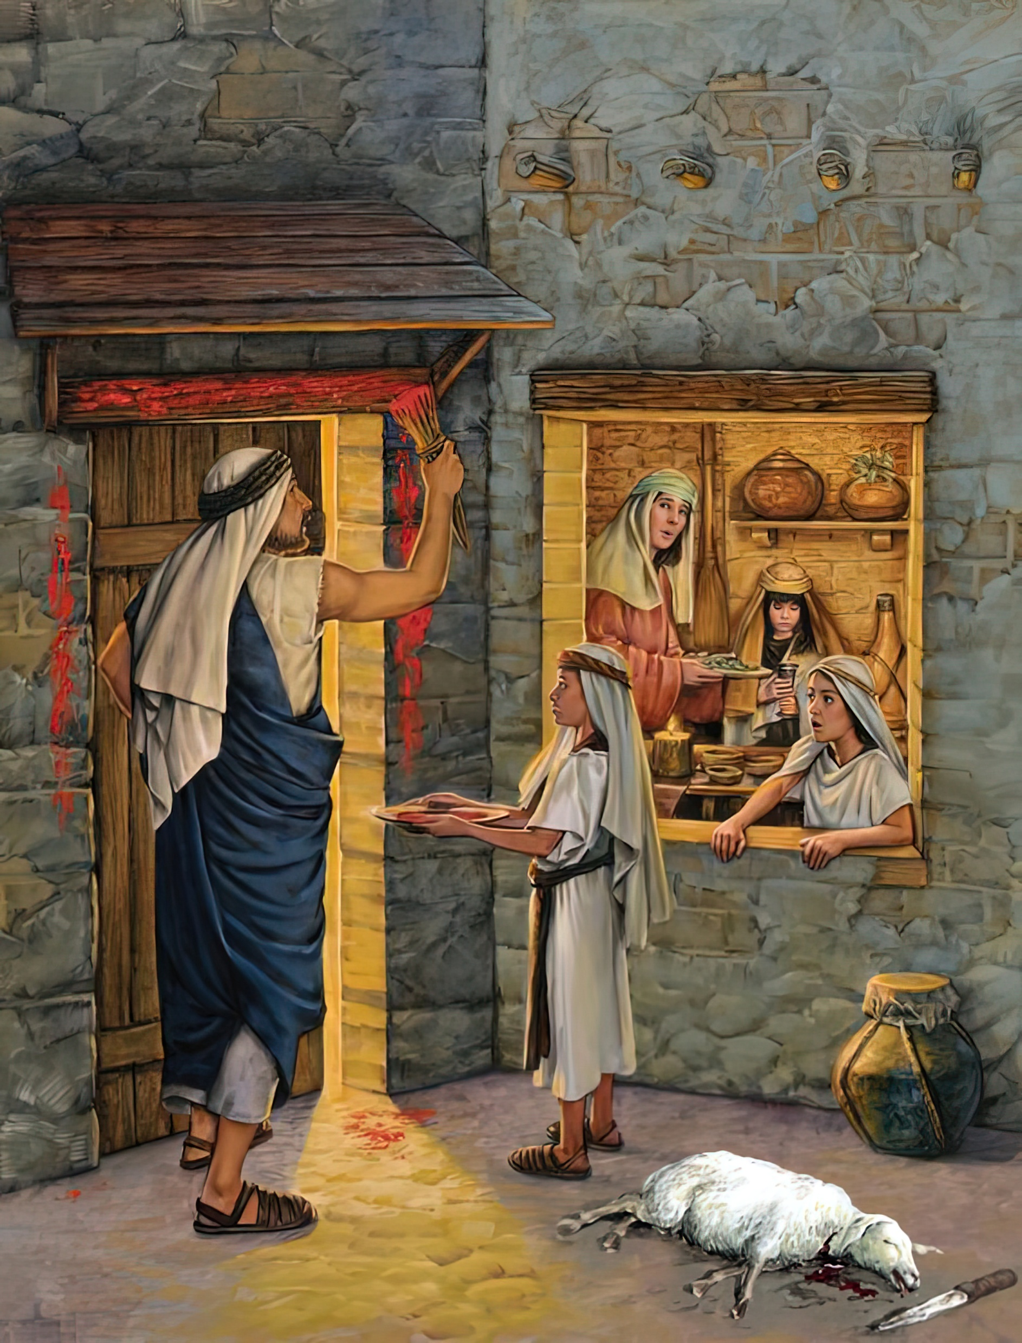
“Kothi, xa bathe oonyana benu kuni,Iyintoni na le nkonzo kuni? nithi ke, Ngumbingelelo wepasika kuYehova, owagqitha ezindlwini zoonyana bakaSirayeli eYiphutha; ekubulaleni kwakhe amaYiphutha, wazihlangula izindlu zethu.”
IEksodus 12:26, 27

Slide 3

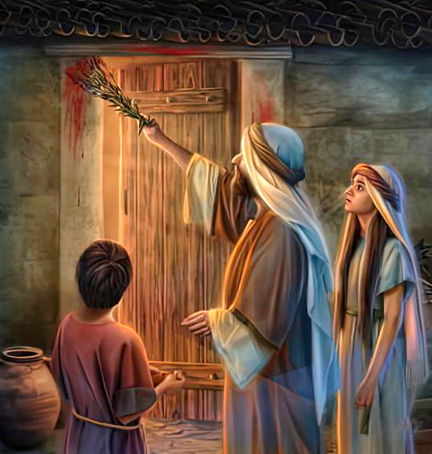
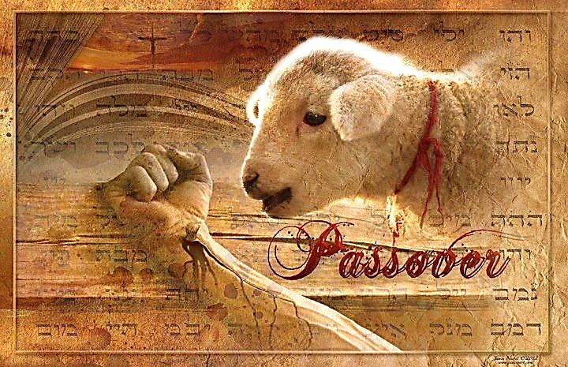
Isibetho seshumi sathwaxa zonke iintsapho zamaYiphutha ezalayo ukulandela imiyalelo kaThixo. Oku akuzange kufike ngesiquphe, kodwa kwaziswa kwangaphambili.
Olu yayiluvavanyo lokholo. Kwakungekho sidingo sokuba kufe mntu ngobuya busuku. Wonke ubani wayenethuba lokusindisa ubomi bezibulo lakhe.
Yayilixhwane kuphela elaligwetyiwe. Lilo kuphela ekwakumele life. Ligazi lalo kuphela elaliza kumenza uMtshabalalisi agqithe. Ngoba? Kuba NGUYESU KUPHELA OSINDISAYO. Kwaye oku kwakuza kuba sisikhumbuzo kwizizukulwana ngezizukulwana…. Ade abuye.
Isilumkiso (Eksodus 11)
Ukulungiselela (Eksodus 12:1-16)
Igazi negwele (Eksodus 12:17-23)
Khumbula kwaye ufundise (Eksodus 12:24-28)
Isibetho seshumi (Eksodus 12:29-30)

Slide 4


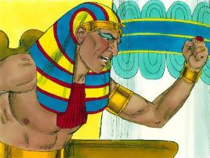
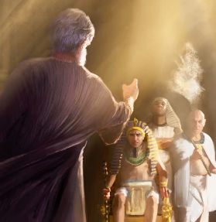
ISILUMKISO
“UYehova wakthi kuMoses, Ndisaya kufikisa isibetho sinye phezu koFaro naphezu kweYiphutha, emveni koko wonindulula nimke apha; xa anindulula kuphele, uya kunigxotha nimke apha.’” (Eksodus 11:1 )
Emveni kweentsuku ezintathu zesithokothoko sobumnyama, uFaro wavutha ngumsindo kuMoses waze wamthintela ukuba abuyele ebhotwe (Eks. 10:28).
Ixesha lomgwebo kaThixo lifikile (Eks. 12:12):
Kwabanekratshi, abaqwayingileyo, nabaxhaphazayo: bafumana isohlwayo nembopheleleko yokubuyisela oko bakuphangileyo (Eks. 11:4-5, 2)
Kwabathobela imiyalelo kaThixo: bayasinda kwisohlwayo, kwaye bakhululwe ( Eks. 11:7-8)
Kodwa uMoses akazange amthobele, kuba ubomi bezibulo likaFaro babusesichengeni. Kwindima yakhe njengothixo kaFaro (Eksod. 7:1), kwanyanzeleka amlumkise ngoko wayeza kukwenza (Amosi 3:7).
Ngoku yaba nguMoses owaphuma kuFaro elugcwabevu ngumsindo it was. Wayevuthiswa yinkani kaFaro neziphumo zesigqibo sakhe. Nakubeni ayemhlonipha uMoses, uninzi lwamaYiphutha awazange asilulamele isilumkiso (Eks. 11:3).

Slide 5


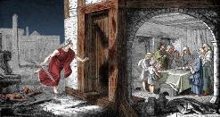
UKULUNGISELELA
“Thethani kwibandla lonke lakwaSirayeli, nithi, Ngolweshumi usuku kule nyanga, elowo makazithabathele ixhwane, ngokwezindlu zooyise, ixhwane ngendlu” (Eksodus 12:3).
UThixo wabacacisela izinto ekufuneka bazenze ukuze uMtshabalalisi “agqithe” (Pesach, Pasika), kwaye angafi amazibulo abo.
Ngosuku lwe10, usapho ngalunye okanye iintsapho kwakufuneka babeke bucala ixhwane eligqibeleleyo (Eks. 12:3-5).
Ngolwe14, ngorhatya, balibingelele (Eks. 12:6)
Baqabe igazi emigubasini nasemiqadini (Eks. 12:7)
Kwakumele bayitye inyama yosiwe, inezonke ezingenagwele, nemithana ekrakra
(Eks. 12:8-10)
Ngeli lixa belitya buphuthuphuthu, kwakufuneka benxibile, belungele ukunduluka (Eks. 12:11)
Xa befudukile eYiphutha, babeza kuqhubeka besitya izonka ezingenagwele iintsuku ezisixhenxe (Eks. 12:15)
UThixo wabalungiselela abantu baKhe baqonde ubabalo lwaKhe, kwaye bamnqule (Eks. 12:27b).

Slide 6


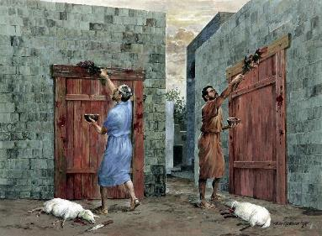
IGAZI NEGWELE
“Wawabiza uMoses oke amadoda amakhulu akwaSirayeli, wathi kuwo, Hambani niye, nizithabathele ixhwane ngokwemizalwane yenu, nixhele ipasika” (Eksodus 12:21)
Ngosuku lwe14, igazi negwele zadlala indima ebalulekileyo kule nkonzo.
Kwakuza kufuneka balisuse igwele ezindlwini zabo kwaye babhake izonka ezingenagwele. Ngenxa yohambo lwabo olwalukufuphi, kwakufuneka lingekho igwele phakathi kwabo (Eks. 12:17–20). Igwele lalimele isono, zona izonka ezingenagwele zimele ubomi obutsha kuYesu Krestu (1 Kor. 5:6–8; 2 Kor. 5:17).
Igazi lalisisici sosindiso. Lalimele igazi likaYesu – elaphalala eemnqamlezweni – ukuze, emgwebeni, uThixo “agqithe” ekusigwebeni. (1 Yohane 1:7 ; 2:1-2).
Isipha sehisope esasetyenziswa ukuqaba igazi
(Ex. 12:22) lalimele ukuhlanjululwa kwesono.
(INdum. 51:7).

Slide 7

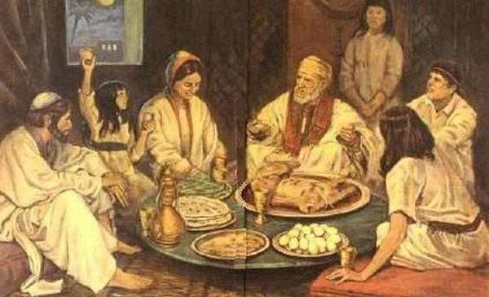
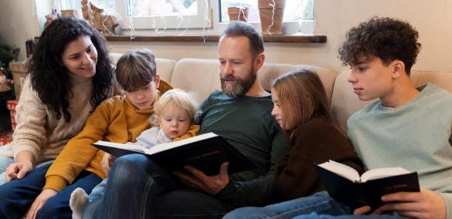
KHUMBULA KWAYE UFUNDISE
“Woligcina elo zwi libe ngummiselo kuwe, nakoonyana bakho kude kuse ephakadeni” (Eksodus 12:24)
Naphambi kokubakhupha eYiphutha, uThixo wafundisa iintsapho zamaHebhere ukulondoloza imbali yawo ngokuyibalisela abantwana babo minyaka le (Eksod. 12:24-27).
Susela loo mini, iPasika yayiza kuba ngumbhiyozo wosapho. Ithuba lokuba abazali badlulisele ebantwaneni ulwazi ngoThixo.
Ibali lokukhululwa kwabo kwakufuneka licaciswe kangangoko, kwaye libaliswe kumntu wokuqala. (Dt . 26:5-9).
Oku kuthwele isifundo esibalulekileyo kuthi. Kufuneka sidlulise ukholo lwethu ebantwaneni bethu. Kufuneka sibaxelele ngoko uThixo asenzele kona, hayi nje kwimbali, kodwa ebomini bethu. Kumele siguqe nabo, sinqule uThixo (Eks. 12:27).

Slide 8
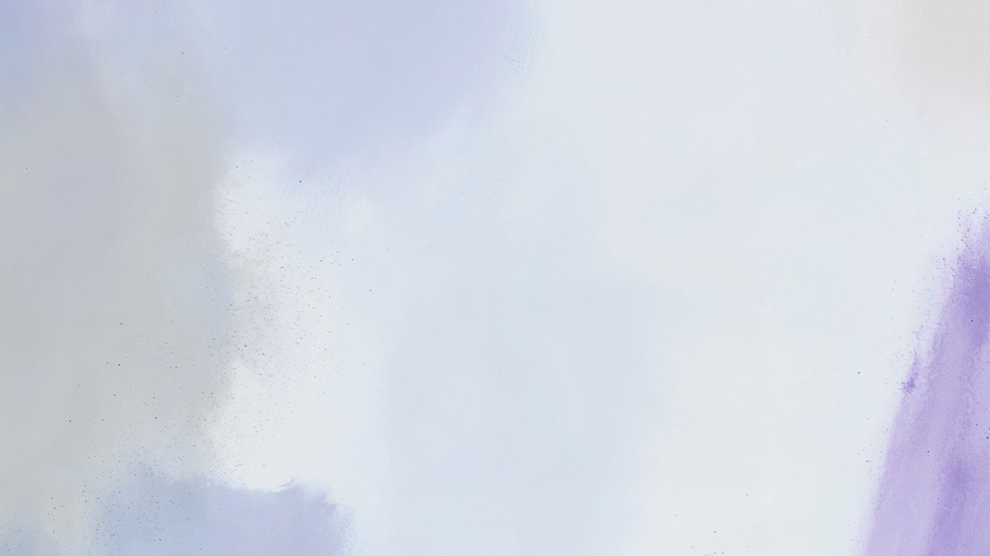

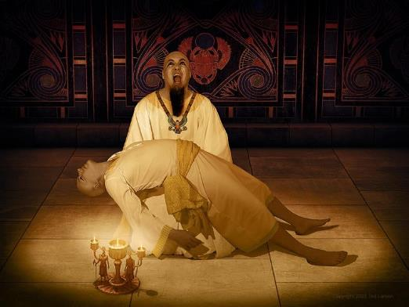
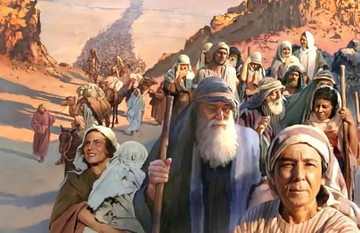
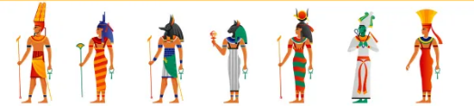
ISIBETHO SESHUMI
“Kwathi ke phakathi kobusuku, uYehova wawabulala onke amazibulo ezweni laseYiphutha, kwathabathela kowamazibulo kaFaro ohleliyo etroneni yakhe, kwasa kowamazibulo omthinjwa osnetolongweni engumhadi, nowamazibulo onke eenkomo” (Eksodus 12:29)
UFaro wayalela kubulawe onke amakhwenkwe amaHebhere, kungakhethwa (Eks. 1:22). Yena uThixo wakhetha ukutshabalalisa amazibulo odwa (Eks. 12:29). Kwindlu nganye apho igazi lalingaqatywanga, kwafa umntu omnye (Eks. 12:30).
Izigwebo zikaThixo zawela ngamandla koothixo namaYiphutha, nawayemele bona uFaro (Eks. 12:12).
Zange kubekho namnye uthixo wamaYiphutha owancedayo, noFaro zange abe nawo amandla okuthintela intlekele.
NjengoFaro, isono sethu singachaphazela abanye ngendlela embi. Kodwa, njengoMoses, ukuthembeka nokuzinza kwethu kungasindisa abaninzi.

Slide 9

“Kwakufuneka bazahlule kumaYiputa, bona nabantwana babo, bahlanganiselane ezindlwini zabo; kuba ukuba kufunyenwe amaSirayeli ezindlwini zamaYiputa, ayeza kuwa ngesandla sesithunywa esitshabalalisayo. Kananjalo, bayalelwa ukuba bawenze umthendeleko wePasika, ube ngummiselo, ukuze, xa bathe babuza oonyana babo ukuba ithetha ukuthini le nkonzo, bababalisele ngokulondolozwa kwabo okumangalisayo eYiphutha. Okokuba, xa isithunywa esitshabalalisayo saphuma ngobusuku, ukuba sibulale owamazibulo umntu, nezibulo lenkomo, sadlula ezindlwini zabo, akwabulawa nokuba abe mnye kumaHebhere ayenomqondiso wegazi emigubasini yawo. […] Abongoza [amanye amaYiputa] ukuba avunyelwe angene ezindlwini zamaSirayeli neentsapho zawo, ngobo busuku boyikekayo xa ingelosi kaThixo yayiza kubulala amazibulo amaYiputa. Ayeqinisekile ukuba izithixo zawo awayezinqula zazingenalwazi, yaye zazingenawo amandla okusindisa okanye okutshabalalisa. AmaSirayeli amkela amaYiputa akholwayo ezindlwini zawo”
EGW ( Spiritual Gifts, vol. 3, p. 223)

