Slide 1
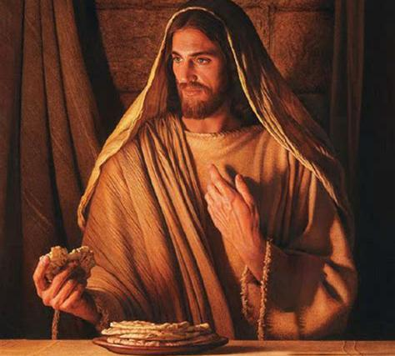
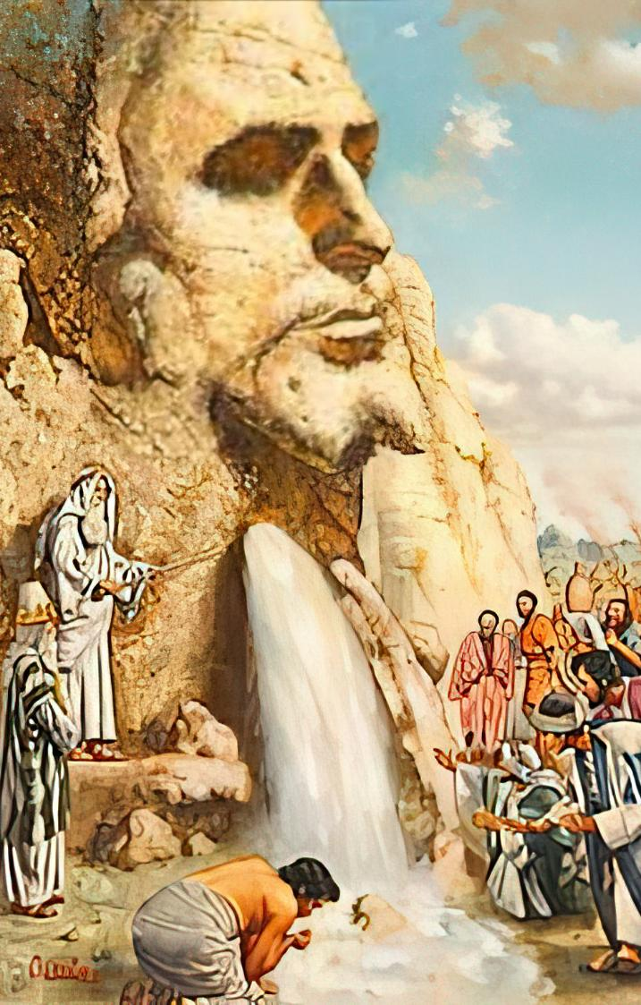
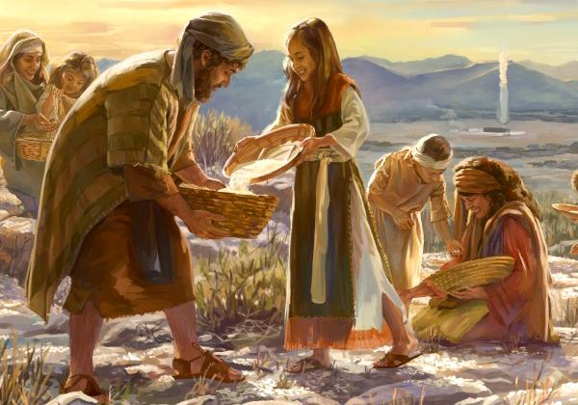
ISONKA KWAKU-NYE NAMANZI OBOMI
Isifundo 7 – 16 kweyeThupha, 2025

Slide 2
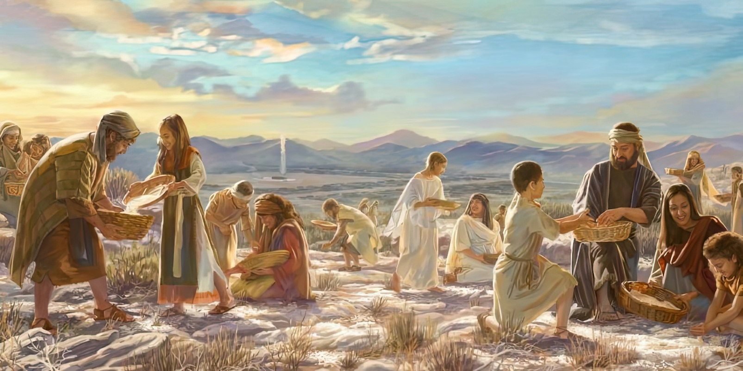

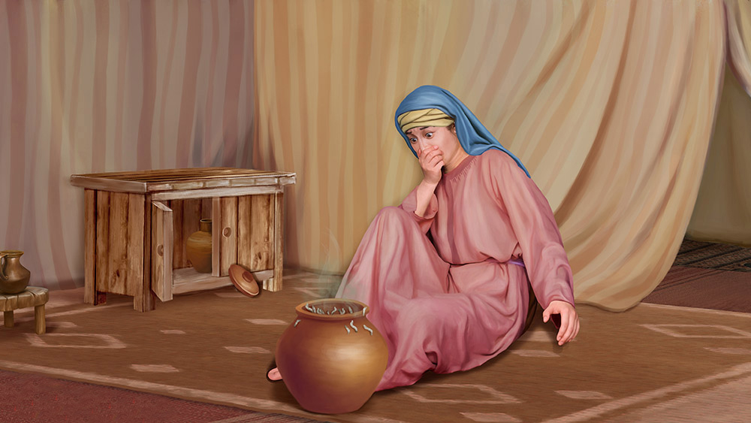
“Wathi uYehova kuMoses, Kuya kuda kube nini na, ningavumi ukuyigcina imithetho yam nemiyalelo yam? Niyabona ke, uYehova uninike isabatha; kungenxa yoko athe ngomhla wesithandathu waninika isonka semihla emibini. Hlalani elowo endaweni yakhe ngomhla wesixhenxe. Baye bephumla ke abantu ngomhla wesixhenxe.”
Eksodus 16:28–30

Slide 3

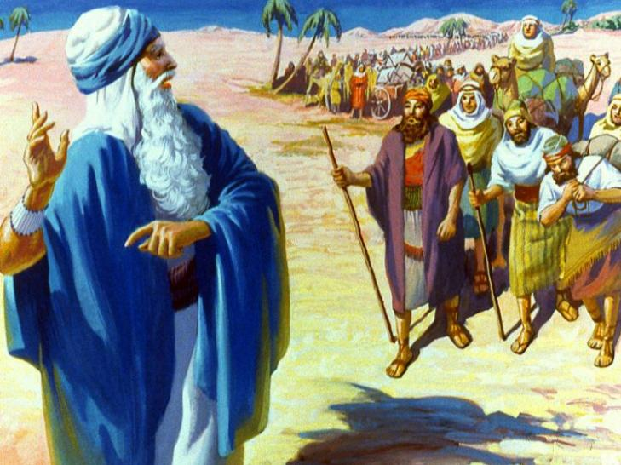
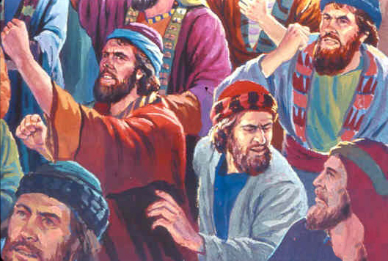
Ekugqibeleni, babemkile emideni yaseYiphutha. Ekugqibeleni, babesendleleni esingisa eKanana, ilizwe elibaleka amasi nobusi.
Intsuku ezintathu, izinto zazikhangeleka zihamba kakuhle. Kodwa oovimba babo bathi gqolo ukuncipha. Babeza kuzondla njani izigidi ezibini zabantu entlango?
Ngokuthi tshe imitshontshi yembandezelo, baqalisa ukukhalaza abantu. Kubo kwakungcono ukufela eYiphutha! Kwakucacile ukuba ukholo lwabo kwakusafuneka lukhule kwaye lomelezwe. Ngako oko, uThixo wabanika amanzi nesonka; wabakhusela kwiintshaba; wabancedisa babuthelana basisizwe.
Amanzi acocekileyo (Eksodus 15:22-27)
Isonka esisuka ezulwini (Eksodus 16:1-36)
ILiwa eHorebhe (Eksodus 17:1-7)
Izandla eziphakanyisiweyo (Eksodus 17:8-16)
Icebiso elilungileyo (Eksodus 18:1-27)
Isonka kwakunye namanzi obomi: UYesu

Slide 4

“Amava azindidi amaHebhere yayisisikolo sokubalungiselela ikhaya lesithembiso eliseKanana. UThixo unqwenela abantu baKhe kule mihla bahlole ngeentliziyo ezithobekileyo nangomoya ofundisekayo iinzima neenzwinini awathubeleza phantsi kwazo uSirayeli, ukuze bafunde kolwabo ulungiselelo olusingise kwiKanana yasezulwini.”
EGW (Patriarchs and Prophets, p. 293)

Slide 5


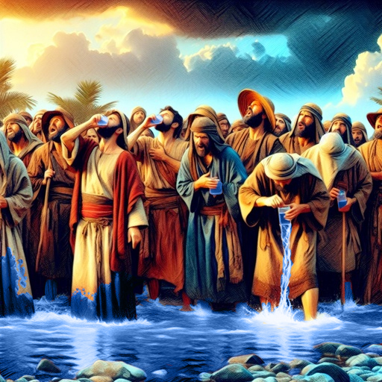
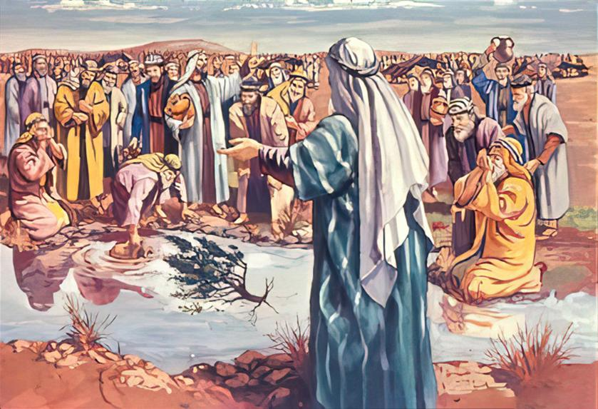
AMANZI ACOCEKILEYO
“Afika eMara, akaba nakuwasela amanzi aseMara, kuba ayekrakra; ngenxa yoko igama laloo ndawo kwathiwa yiMara.” (Eksodus 15:23)
Ukuba uThixo unathi, ingenzeka njani into embi kuthi? Oku kwakubonakala iyifilosofi yabantu bakwaSirayeli emva kokuwela uLwandle oluBomvu.
Ukufumana amanzi angakulungela ukuselwa, bakhalaza, “Siza kusela ntoni?” (Eks. 15:24). Wayenako uThixo ukuwacoca amanzi kwangaphambi kokuba bafike, kodwa walindela ithuba elifanelekileyo.
Kananjalo, wacela noMOses ukuba ancedise ukwenza lo mmangaliso.ngokumcela aphose umthi ukucoca amanzi. (Eks. 15:25).
UThixo unga singasoloko sisazi ukuba ukhona, silindele imiyalelo yaKhe, sisebenzisane naYe.
Ukuba uSirayeli wayeyigcine yonke imimiselo kaThixo, bathobela imithetho abanike yona, babeza kuqiniseka ngenkuseleko yabo ebubini (Eks. 15:26).

Slide 6


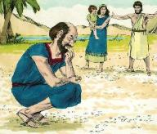
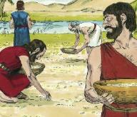
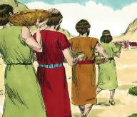
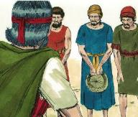
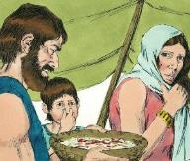
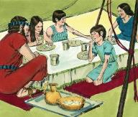
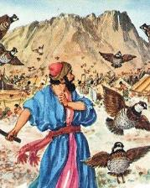
ISONKA ESISUKA EZULWINI
“Bayibona oonyana bakaSirayeli, bathi omnye komnye, Yintoni? Kuba babengazi ukuba yintoni na. wathi uMoses kubo, Sesi sonka aninika zona uYehova, ukuba sibe kukudla” (Eksodus 16:15).
Umnqweno wokutya inyama kwenza uSirayeli bamkrokrele uMoses noAron (Eks. 16:2-3). Kodwa oyena babemkrokrela yayinguThixof (Eks. 16:8). Yayiyintoni ingxaki yabo?
Esi sonka sisuka emazilwini yayingummangaliso wenene:
Babelilibele izolo.
Bagxila kwiinzima neenzwinini zabo zangoku.
Baphulukana nombono wengomzo elithenjisiweyo.
Ukuphakama kwelanga, sanyibilika
(Eks . 16:21)
Umlinganiselo ofanayo wawusiwa iintsuku ezintlanu (Eks. 16:16)
Ngosuku lwesithandathu, iwe kabini (Eks. 16:22)
Emveni kokubanika izagwityi, uThixo wababonelela ngesonka esaneleyo iminyaka engama40! (Eks. 16:35)
NgeSabatha kungawi nto
(Eks. 16:26)
Umbeko kwakuvukwa uneempethu
(Eks. 16:20)
Kodwa ngeSabatha kwakuvukwa ingonakelanga (Eks. 16:23-24)

Slide 7


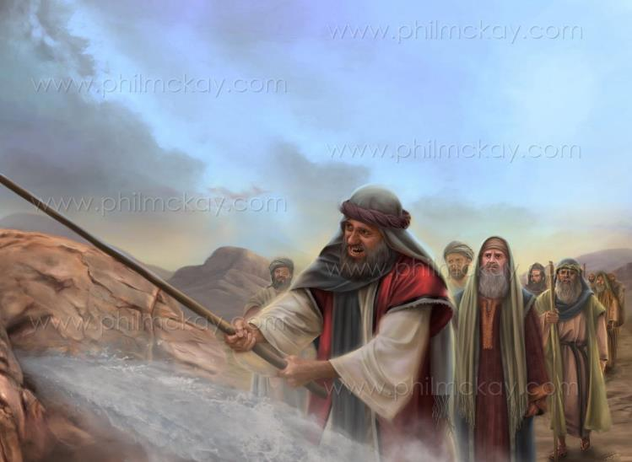
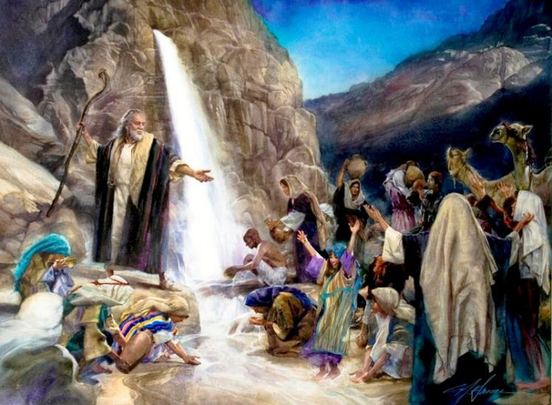
ILIWA LASEHOREBHE
“Yabona, ndiya kuma phambi kwakho khona, phezu kweliwa eHorebhe; uze ulwibethe iliwa; kophuma amanzi kulo, basele abantu. Wenjenjalo ke uMoses phambi kwawo amadoda amakhulu akwaSirayeli” (Eksodus 17:6)
“UYehova ukhona na phakathi kwethu, akakho kusini na?” (Eksod. 17:7). Akazange abathumele isonka esisuka ezulwini mihla le uThixo? Babengamboni kumqulu welifu?
Ukungakholwa okwaboniswa nguSirayeli kuyothusa. Uyasilumkisa uPawulos ukuba singawi kumgibe ofanayo wokungakholwa (Heb. 3:12).
Nakubeni babengakholwa benjalo, uYesu ngokwaKhe wavula iliwa, waqhubeka nokubabonelela ngamanzi kuhambo lwabo lonke. Ulilo “iliwa elileleomoya elibe libalandela” (1 Cor. 10:4).
Kubo, nakuthi, uKrestu unguMthombo wobomi nomNiki wobomi obungunaphakade.

Slide 8

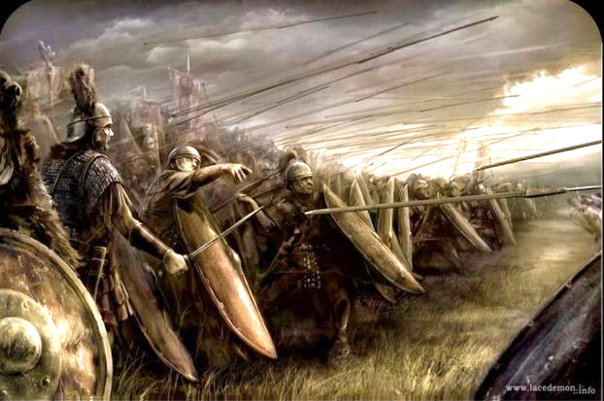
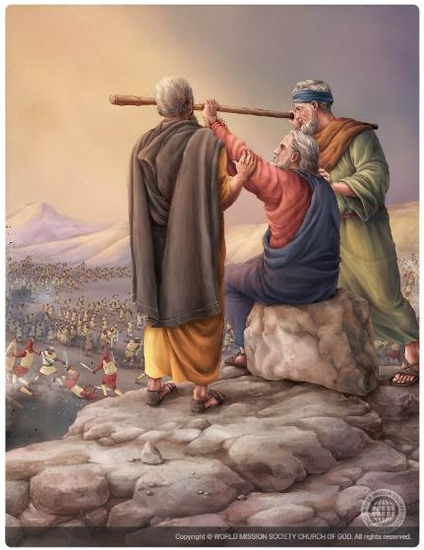
IZANDLA EZIPHAKANYISIWEYO
“UAmaleki weza, walwa noSirayeli eRefidim” (Exodus 17:8)
Njengoko ayedlula entlango, ama-Amaleki ahlasela amaSirayeli, yaye uMoses wacela uYoshuwa ukuba awakhusele ngoxa yena, uAron noHure benyuka intaba “nentonga kaThixo” (Eks. 17:8-10).
Kwakutheni ukuze ama-Amaleki ahlasele?
Babeyivile into awayeyenzile uThixo eYiputa. Kodwa, ngokungafaniyo namanye amaKanan, ayengoyiki. Bamngcikiva uThixo, bamdela ngokuhlasela abantu bakhe, ukuze nje babonise ukuba banamandla kunaYe (Eks. 17:16).
Ngalo lonke ixesha uMoses ephakamisa intonga kaThixo, uSirayeli woyisa. Kodwa zathi zakudinwa iingalo zakhe, uSirayeli oyiswe (Eks.17:11).
Lalifikile ilixa lokuba umthwalo womsebenzi uthwalwe nazezinye iinkokeli. UAron noHure bamxhasa uMoses baza bamncedisa ekwenzeni umsebenzi kaThixo uphumelele, ngaloo ndlela baloyisa utshaba(Ex. 17:12).

Slide 9


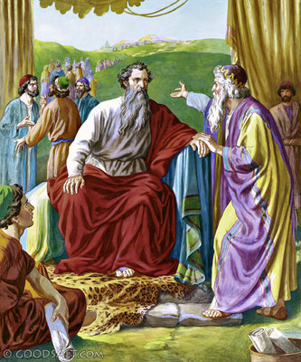
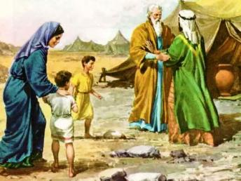
ICEBISO ELILUNGILEYO
“Uze uzikhangelele ebantwini bonke amadoda anobunkunkqele ekuthetheni amatyala, amoyikayo uThixo, amadoda anyanisileyo, ayithiyileyo inzuzo embi, uwamise phezu kwabo, abe ngabathehteli-waka, nabathethelikhulu, nabathetheli bamashumi ngamahlani, nabathetheli bamashumi ngamanye.” (Eksodus 18:21)
Akuwubona umqondiso, abewuthethile uYehova kuMoses, uYitro wahamba noTsipora noonyana bakhe, waya kumbona eHorebhe. (Ex. 3:12; 18:1-5).
UYitro, nangona wayengengomSirayeli, wayemnqula uThixo. Ngoko ke, emva kokufumana ingxelo kaMoses ngoko kwenzeka eYiphutha, wadumisa uThixo waza wanikela imibingelelo kuye (Eksod. 18:8-12).
Ngosuku olulandelayo, emva kokubukela uMoses egweba abantu bonke eyedwa, wamnika icebiso lobulumko: yabelane ngoxanduva
(Eks. 18:17-23).
Ngokuthobeka, uMoses wawamkela amazwi kaThixo kweli cebiso. Ngoko ke, walithobela icebiso likayisezala waza wanyula abantu abanokukwazi ukuthwala iimbopheleleko.
Iimpawu zalo (Ex. 18:21):
Yoyika uThixo
Nyaniseka
Yithiye inzuzo embi

Slide 10


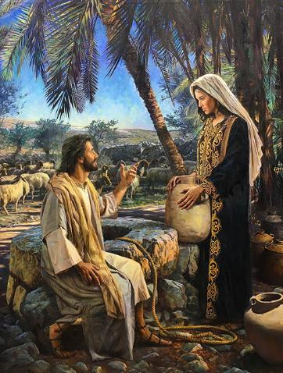
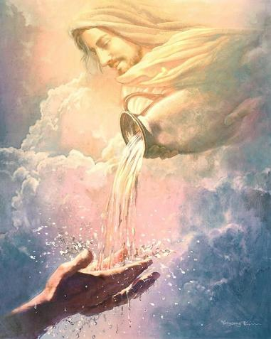
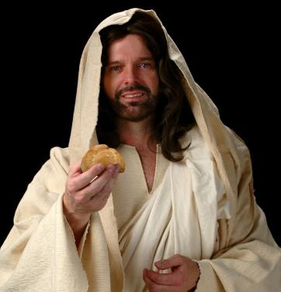
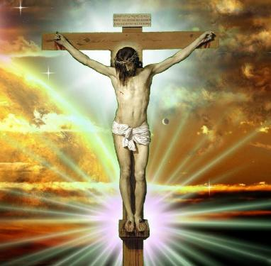
ISONKA NAMANZI OBOMI: UYESU
“Ndim isonka esiphilileyo, esi sehlayo emazulwini. Ukuba ubani uthe wasidla esi sonka, wodla ubomi ngonaphakade; ke isonka endiya kumnika sona mna, siyinyama yam, endiya kuyinikela ubomi behlabathi” (Yohane 6:51)
UPawulos usixelela ukuba amabali e-Eksodus abhalelwa ukuyalela thina, oko kukuthi, anentsingiselo yokomoya kubomi bethu. (1 Kor. 10:1-11).
La mabali asilumkisa nxamnye nokubawa; unqulozithixo; uhenyuzo; ukuhenda uThixo; kunye nokuhleba.
Ngaphaya koko, uYesu wabhekisela ngokukhethekileyo kuye amabali amanzi aphuma eliweni nesonka esivela ezulwini.
NguYe obonelela ngamanzi obomi, efuzisela uMoya oyiNgcwele ( Yoh. 4:14; 7:37-39 ). NguYe kuphela onokwanelisa unxano lwethu lwangaphakathi loxolo, uvuyo nolonwabo.
UYesu wathi Usisonka sokwenyaniso esehla sivela ezulwini. Eso sonka siyinyama yakhe (Yoh. 6:51). Ngumzimba waKhe, owaphulwa emnqamlezweni ukuzisa usindiso kubo bonke abaya “kuwudla”—oko kukuthi, bamamkele njengoMsindisi baze babe nobudlelwane bemihla ngemihla kunye naYe. NguKristu kuphela onokwanelisa unxano nendlala yethu yokomoya.

Slide 11

“UMhlawuleli wehlabathi uyazazi iintswelo zemiphefumlo yonke. Xa sicinezelekile yaye sityhafile, uyakwazi oko, yaye nguYe osinika isiqabu sokomoya. Celani kuYe; lindani nithandaze, wofika. UYesu usisonka sobomi, esityiwa yonke imihla; ungamanzi obomi kumphefumlo otyhafileyo, kwaye bonke bangaxhamla kubabalo lwaKhe.
Amaqula omhlaba ngokufuthi aya kuqongqothwa, amachibi awo ome; ke kuKristu kukho umthombo ophilileyo, esinokuthi ngokuqhubekayo sirhole kuwo. Nokuba sitsala kangakanani kwaye sinikela kangakanani na kwabanye, intabalala iya kushiyeka. Akukho mngcipheko wokuphelisa unikezelo; kuba uKristu ungumthombo wenyaniso ongatshiyo”
EGW (The Signs of the Times, April 22, 1897)

