Slide 1

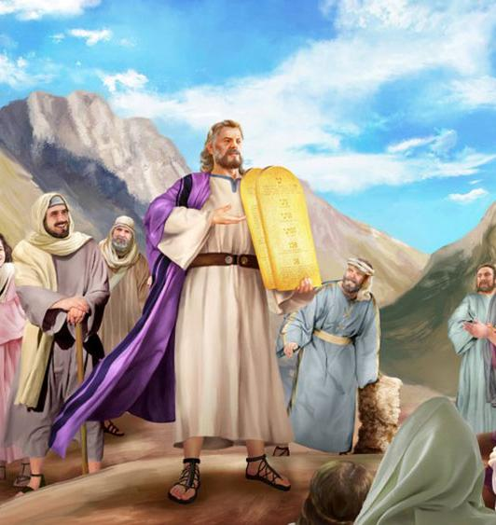
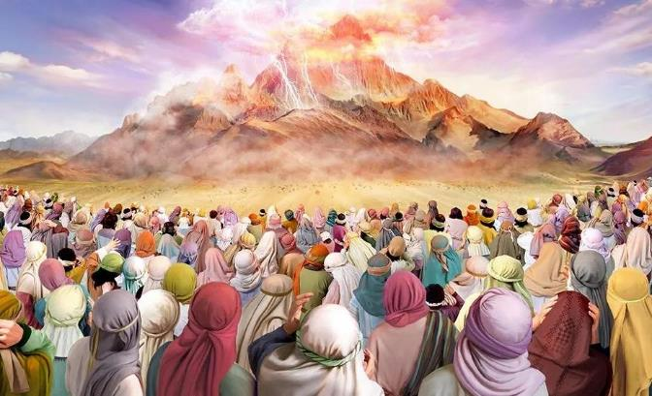
UMNQOPHISO ESINAYI
ISifundo 8 23 kweyeThupha (Agasti) 2025

Slide 2
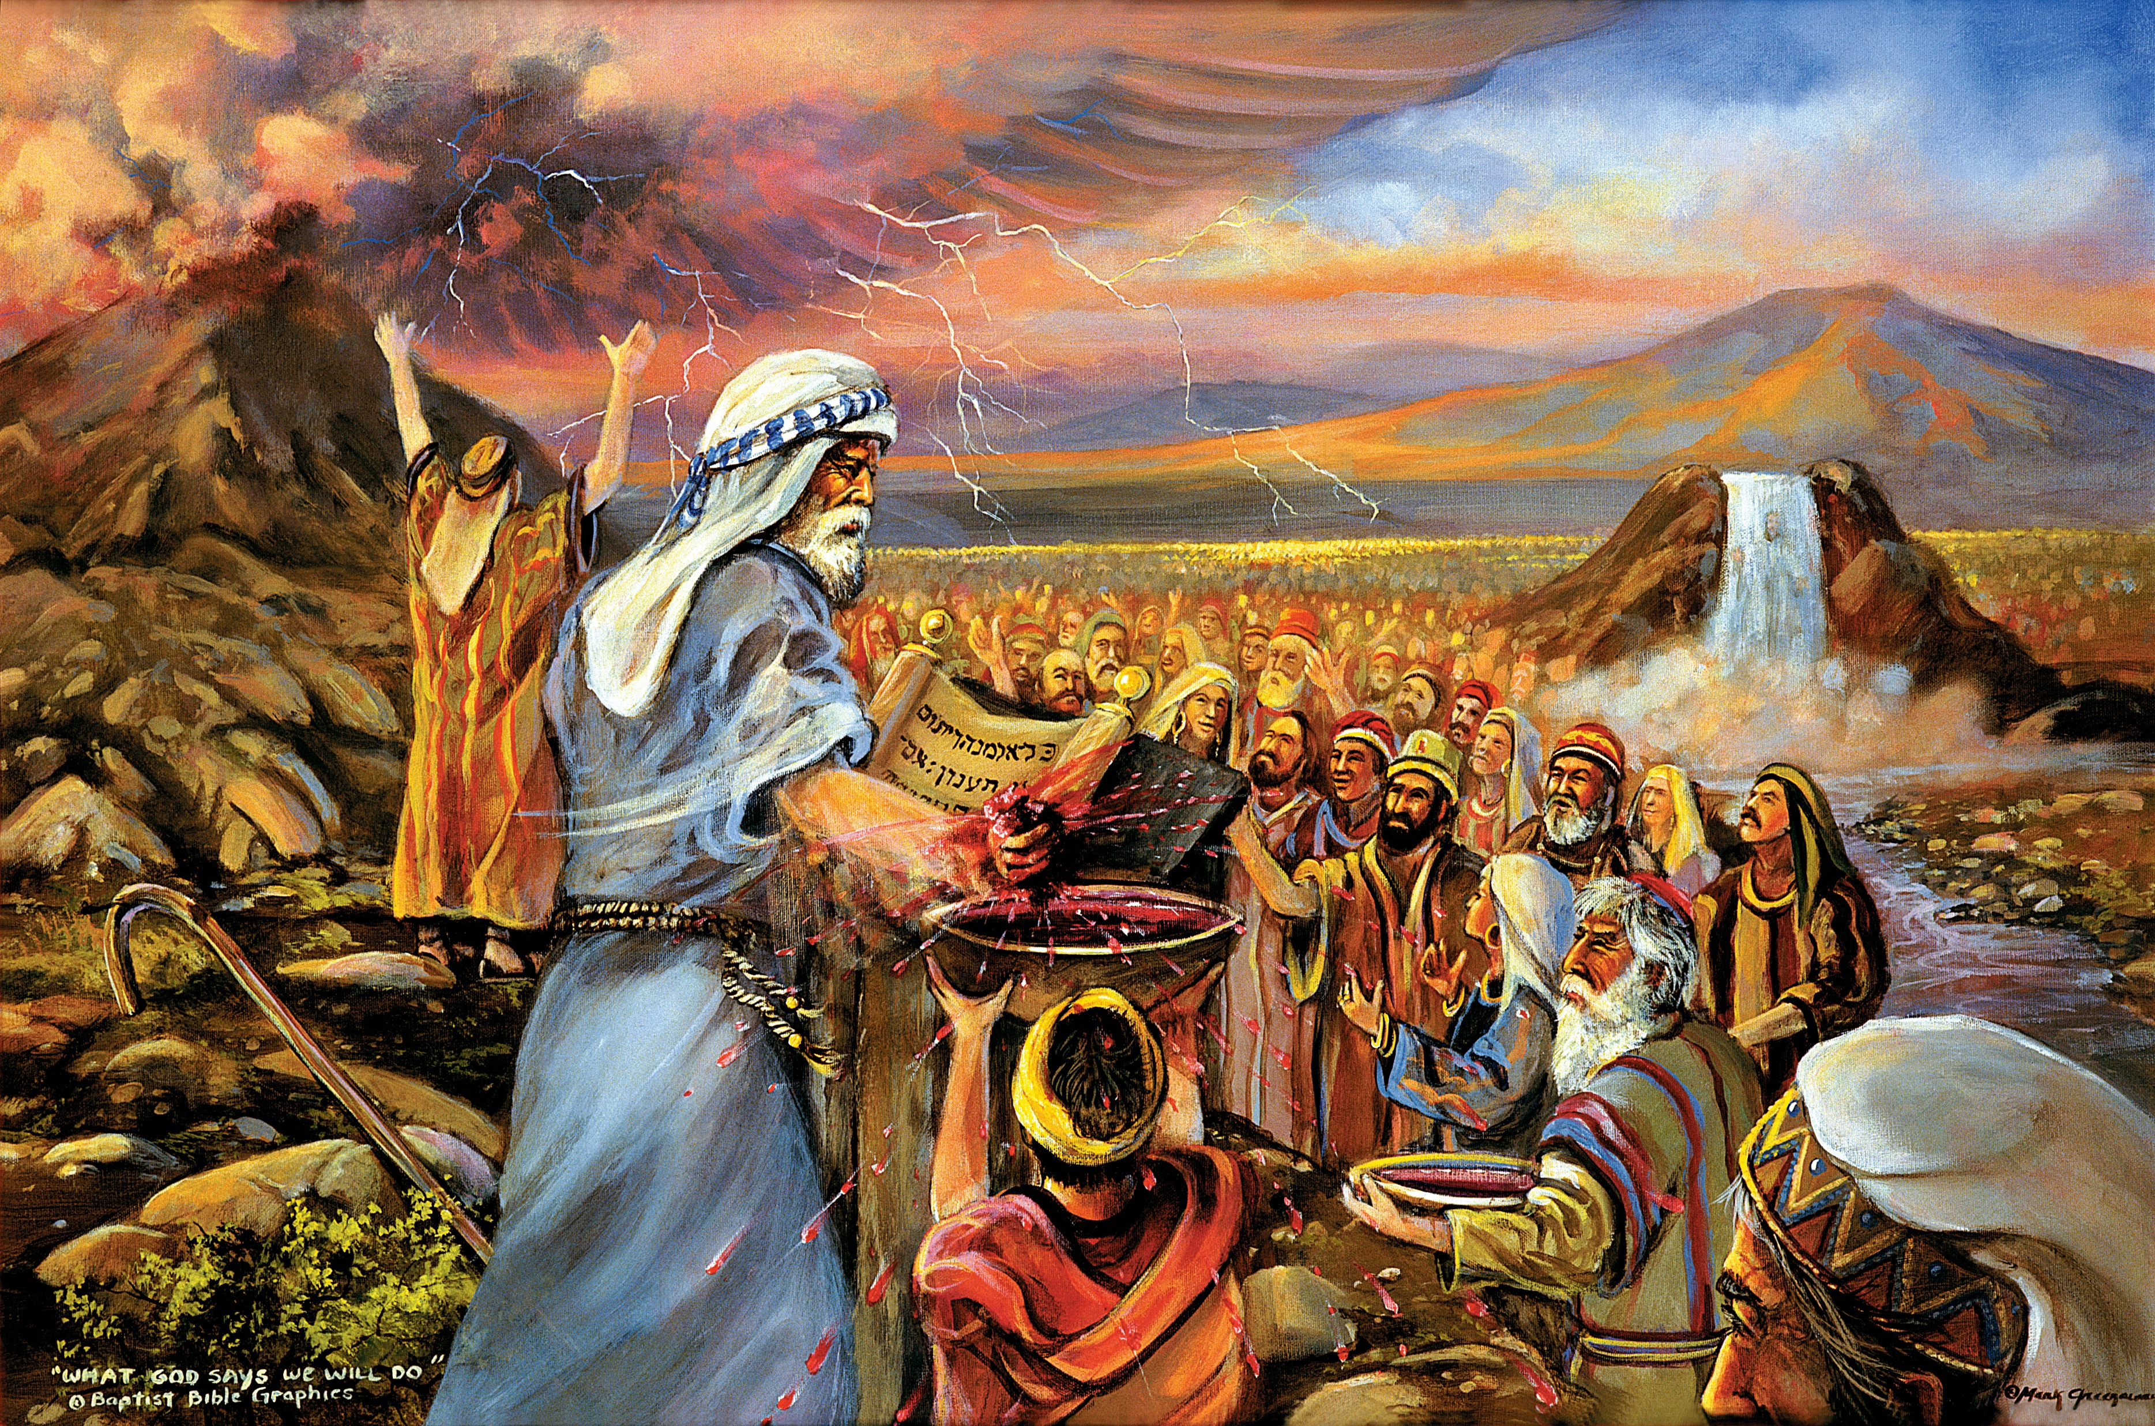
“Nina niyibonile into endiyenzileyo kumaYiphutha, ukuba ndanithwala ngamaphiko okhozi, ndanizisa kum. Ngoku ke, ukuba nithe naliphulaphula okunene izwi lam, nawugcina umnqophiso wam, noba yinqobo kum kwizizwe zonke, kuba ihlabathi lonke lelam; nibe bubukumkani bababingeleli kum, nohlanga olungcwele.”
Ekodus 19:4–6.

Slide 3

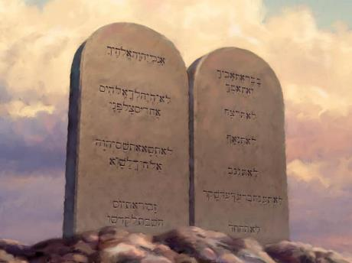
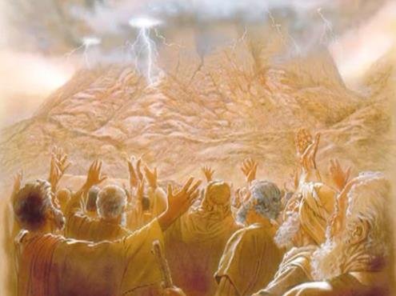








Ukuwela uLwandle oluBomvu kwakusisiganeko esibalulekileyo kwaSirayeli. Isiganeko sesibini esibalulekileyo yayisisibhengezo somthetho ngomlomo kaThixo ngokwaKhe.
Kanye ngaloo mzuzu, uSirayeli wazalwa njengesizwe esingcwele. Bafumena imigaqo eza kulawula ubukho bayo.
Kodwa yayingaphezu nje kwemithetho yonqulo, eyasekuhlaleni okanye yezempilo. IMithetho eliShumi, isiseko sayo yonke le mithetho, iyimbonakaliso yesimilo sikaThixo kwaye, ngako oko, ayisebenzi kuSirayeli kuphela, kodwa nakumntwana ngamnye kaThixo.
Ukunikezelwa koMthetho:
  Abamnkeli boMthetho (Eksodus 19:1-8)
  UMniki-Mthetho (Eksodus 19:9-25)
  IMithetho esiShumi (Eksodus 20:1-17)
Intsingiselo yoMthetho:
  Umsebenzi woMthetho.
  UMthetho njengesithembiso.
  UMthetho njengesiphelo.

Slide 4

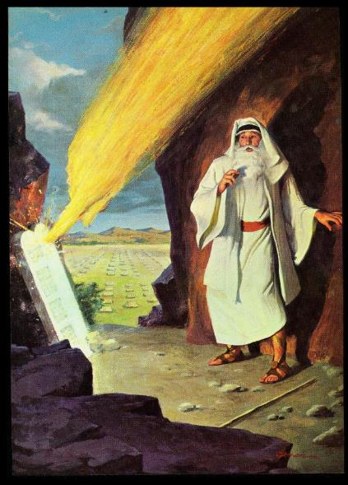
UKUNIKEZELWA KOMTHETHO

Slide 5

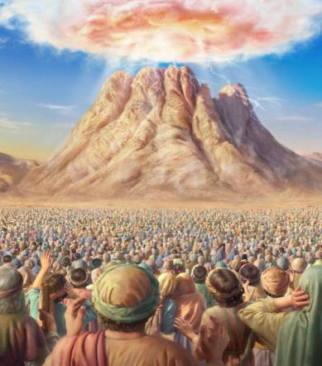
ABAMNKELI BOMTHETHO
“Nina niyibonile into endiyenzileyo kumaYiphutha, ukba ndanithwala ngamaphiko okhozi ndanizisa kum.” (Eksodus 19:4)
Kwakutheni ukuze uThixo akhuphe uSirayeli eYiphutha?
Ukumkhonza (Eks. 5:1; 7:16; 8:1, 20; 9:1, 13; 10:3). Ngokwenjenjalo, babeza kufumana izibonelelo ezinkulu (phakathi kwazo umhlaba waseKanana).
Ngenyanga yesithathu emva kokumka kwabo eYiputa, bamisa iintente kufuphi neNtaba yeSinayi. Kulapho kwabekwa khona isiseko sokuyilwa kohlanga lwakwaSirayeli. UThixo wenza isindululo somnqophiso kubo, basamnkela (Eksod. 19:1-8).
Ngokwamkela umnqophiso, wayeza kuba yintoni uSirayeli (Eks. 19:5-6)?
ABANTU ABANGCWELE
Babeza kuzinikela kuThixo, batyhile isimilo saKhe.
UBUKUMKANI BABABINGELELI
Babeza kunxulumanisa abanye abantu noThixo, baze babafundise imithetho yaKhe.
ABANTU ABAYINQOBO KUTHIXO
UThixo wayeza kwenza uSirayeli ijelo lokukhanyisela ihlabathi ngolwazi ngaYe.

Slide 6

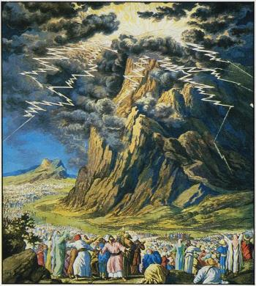
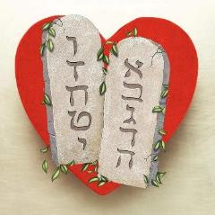
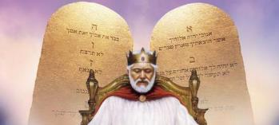
UMNIKI-MTHETHO
“Intaba yeSinayi yaba ngumsi yonke iphela, kuba uYehova wehla phezu kwayo esemlilweni. Umsi wayo wenyuka njengomsi weziko lemfutho; yanyikima kunene yonke intaba” (Eksodus 19:18)
Ukunikezelwa koMthetho kaThixo eSinayi kwakuyeyona nto ibalaseleyo neyoyikeka kakhulu ( Heb. 12:18-21 ). Akukho mntu wayeyilungele into enjalo. Ngako oko, abantu kwakufuneka bazihlambulule kwangaphambili baze bagcine umgama ofanelekileyo ukuze bangagxothwa luzuko lobuthixo (Eks. 19:10-12).
Why was such a staging necessary?
Amazwi uThixo awayeza kuwathetha kubo ayeyimbonakaliso yesimilo saKhe. Ukuyithobela bubomi; Ukungathobeli kukufa. USirayeli kwakufuneka abuqonde ngokupheleleyo ubunzulu kunye nokubaluleka“kwamazwi omnqophiso, iMithetho eliShumi” (Eks. 34:28).
Kuye kwabhalwa iinguqulelo ezimbini zalo Mthetho: enye isekuqaleni kweMfuduko, nenye njengenxalenye yeentetho zokugqibela zikaMoses ngaphambi kokungena eKanana.
Nangona kwakusoyikeka ukunikezelwa koMthetho, uMthetho ubonakalisa esona similo sibalaseleyo sikaThixo: uthando (Rom. 13:10).

Slide 7
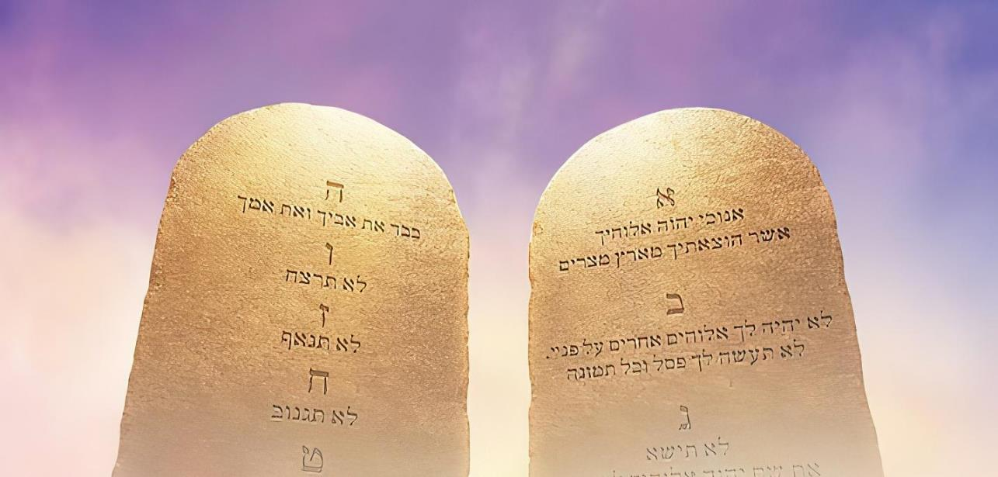

IMITHETHO ELISHUMI
“NdinguYehova uThixo wakho, owakukhupha ezweni laseYiphutha, endlwini yobukhoboka” (Eksodus 20:2)
UThixo wawazisa uMthetho ngokucacisa owona msebenzi wawo: “Ndakukhupha esonweni, ngako oko, naku ekumele ukwenze ukususela apha” (Eks. 20:2). Ukugcina uMthetho kukusabela kwethu kuHlangulo. Yindlela yokusabela ngothando kuthando oluzuziweyo.
“uthando yinzaliseko yomthetho (Rom. 13:10)
“Thanda uThixo (Dt. 6:5; Eks. 20:3-11)
Thanda ummelwane wakho (Lev. 19:18; Eks. 20:12-17)
Hlonipha abanye ukuze ungabi naminqweno ezakudyobha isimilo sakho.
Hlonipha umhla waKhe wokuphumla nonqulo, iSabatha
Mhlonele kwaye umhloniphe uThixo ngokumbeka kwindawo yokuqala kubomi bethu.
Mzukise uThixo ungamthabatheli nasiphi na isithixo
Lihlonele igama likaThixo, isidima nesimilo sakhe
Hlonipha abazali
Hlonipha ubomi
Hlonipha umtshato
Hlonipha izinto zabanto
Hlonipha isidima sabanye

Slide 8

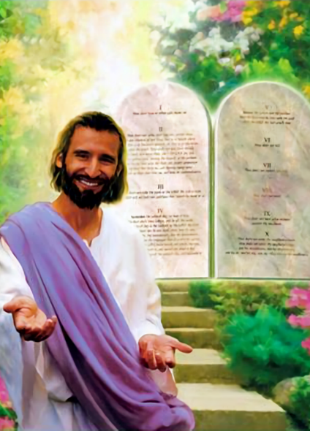

INTSINGISELO YOMTHETHO

Slide 9


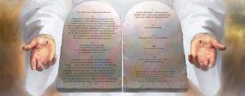
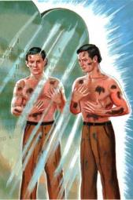
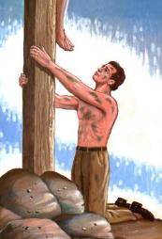
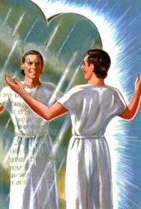
UMSEBENZI WOMTHETHO
“Ngoko ke umthetho waba ngosikhaphela kuKristu, ukuze sigwetyelwe ngokwaselukholweni” (KumaGalati 3:24)
Yeyiphi minye imisebenzi yomthetho?
Usindiso aluyonxalenye yemisebenzi yomthetho (Gal. 2:16). UMthetho ufana nesipili esisibonisa izono zethu (UYakobi 1 :23-25).
Uyasigcina kububi (INd. 119:104)
Usinika ubulumko (Dt. 4:6)
Usinika inkululeko (UYakobi 2:12)
Usinika uxolo (INd. 119:165)
Usinika impumelelo (Yosh. 1:8)
Usibonisa izono zethu (Rom. 7:7)
Usikhokelela kuKrestu
(Gal. 3:24)
Ukophula isipili akukususi ukungcola; kananjalo nokungakuhoyi. Kodwa ngaphandle “kwesipili” [uMthetho] enge singazazanga ukuba singcolile [sisono], kwaye sidinga “itshefu” [uKrestu] ukusisula.
IBhayibhile icacile: uMthetho ulungile (Rom. 7:12); kuluyolo ukucamngca ngawo (Ps. 1:2). “Hayi, ukuwuthanda kwam umyalelo wakho! Imini le yonke ndicamnga ngawo” (INd. 119:97).

Slide 10


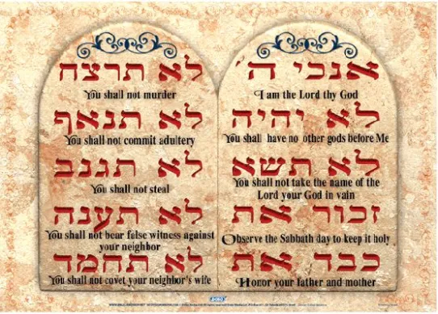

UMTHETHO NJENGESITHEMBISO
“Wanixelela umnqophiso wakhe, awaniwisela umthetho ngawo ukuba niwenze, AMAZWI ALISHUMI; wawabhala emacwecweni amabini amatye” (IDuteronomi 4:13)
KwisiHebhere, izihlandlo ezithathu iMithetho eliShumi ikhankanywa, ibizwa ngokuba “ngamazwi alishumi” (Ek. 34:28; Dut. 4:13; Dut. 10:4).
Makhe sicinge ngale nto. Kusube sisithini xa sisithi emntwini, “Ndikunika ilizwi lam””?
Ngokwenene, akukho nto sikunika yona; siyakuthembisa kuphela. Siyakuqinisekisa ukuba siza kwenza into.
Yiyo loo nto, ingcambu yesiHebhere “dabar” ingaguqulelwa kwlizwi okanye isithembiso.”
Umzekelo: “Akukho nalinye ilizwi [dabar] elifadaleleyo kuzo zonke izithembiso [dabar] ezilungileyo, awazenza ngesicaka sakhe uMoses (1 Kum 8:56).
IMithetho eliShumi zizithembiso ezilishumo azenzayo uThixo kuthi, ngenjongo yokusikhokelela kwindlela elungileyo.

Slide 11

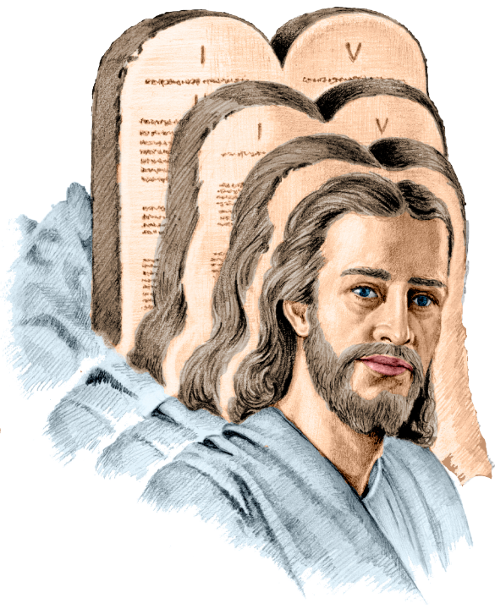
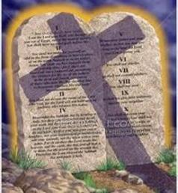
UMTHETHO NJENGESIPHELO
“Kuba intsingiselo yomthetho nguKrestu, ukuze abe bubulungiswa kubo bonke abakholwayo.” (KwabaseRoma 10:4).
Igama “isiphelo” uPawulos alisebenzisa kumthetho “ngu-telos.” Lithetha ukuthini eli gama?
Intsingiselo ephambili yile: inqaku eliboniswe njengomda okanye injongo. Ngokwentsingiselo (intsingiselo yesibini): isishwankathelo, isiphelo, isiphumo, injongo. Intsingiselo yayo ethile kufuneka imiselwe sisivakalisi elisetyenziswe kuso.
Ukuba oku sikuguqulela ngokuthi “uKristu ukukunqanyulwa komthetho,” akusekho mthetho ukususela ekufeni kukaYesu. Ngoko ke, akukho sono. UPawulos uyakuba uthetha eziphikisa (Rom. 7:7).
Ukuba siguqulela sithi “uKristu yindawo owalatha kuyo umthetho,” uPawulos akaguquguquki, kuba umthetho usasebenza, yaye usikhokelela kuKristu. (Rom. 3:31; Gal. 3:24).

Slide 12

EGW (Patriarchs and Prophets, p. 305)
“The law was not spoken at this time exclusively for the benefit of the Hebrews. God honored them by making them the guardians and keepers of His law, but it was to be held as a sacred trust for the whole world. The precepts of the Decalogue are adapted to all mankind, and they were given for the instruction and government of all. Ten precepts, brief, comprehensive, and authoritative, cover the duty of man to God and to his fellow man; and all based upon the great fundamental principle of love.”

