Slide 1

UKUPHILA UMTHETHO
ISifundo 9 – 30 kweyeThupha (Agasti) 2025

Slide 2
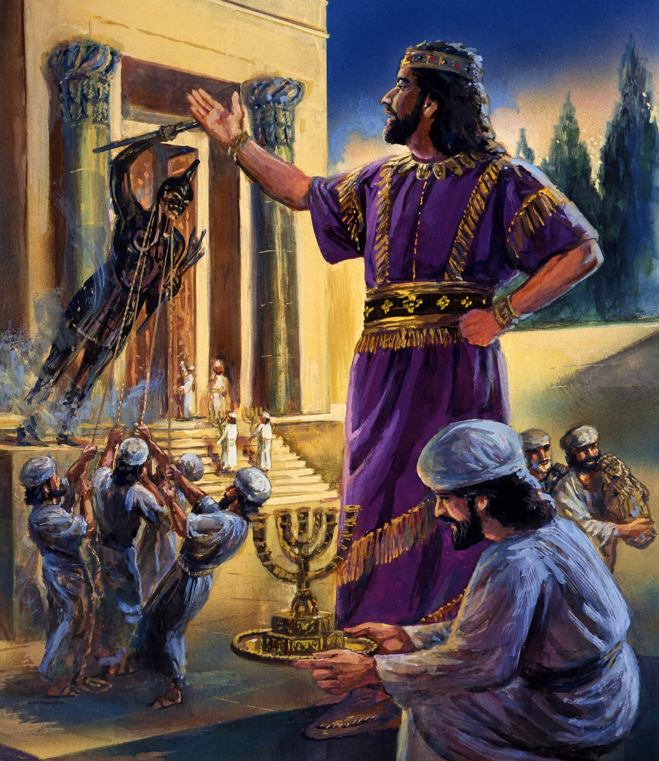
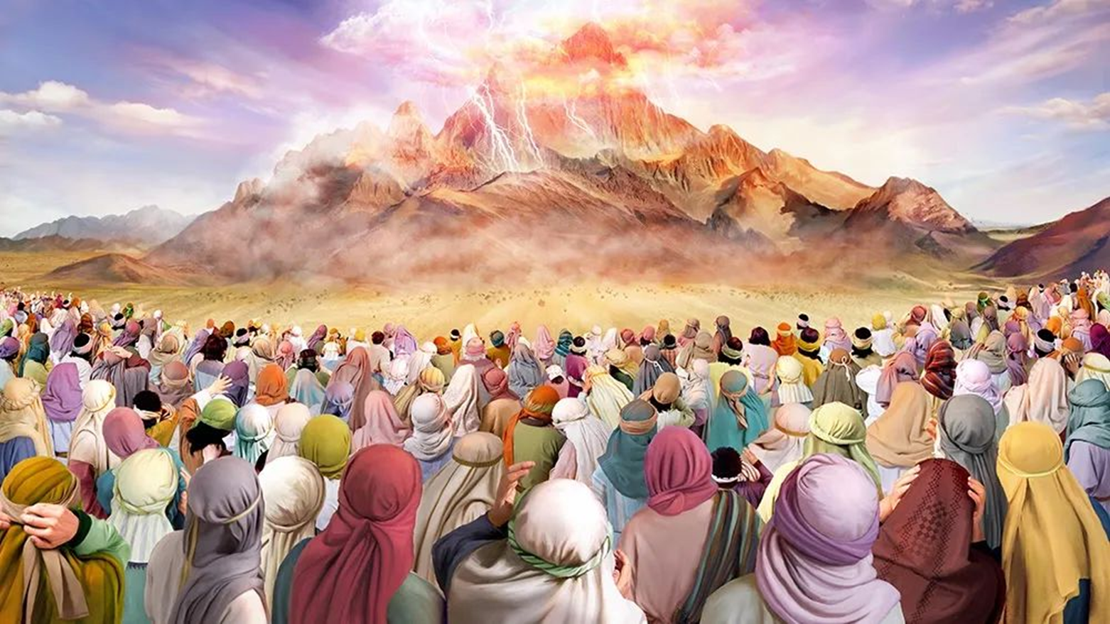
“Wathi uYehova kuMoses, Wotsho koonyana bakaSirayeli, ukuthi, Nibonile niña, ukuba ndithethe nani ndisemazulwini. Ize ningenzi oothixo bokunxulumana nam, ningazenzeli oothixo besilivere, noothixo begolide” ’ ” Exodus 20:22, 23.

Slide 3

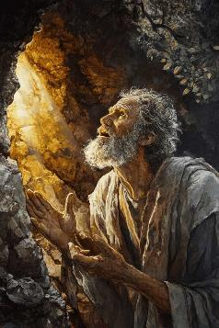
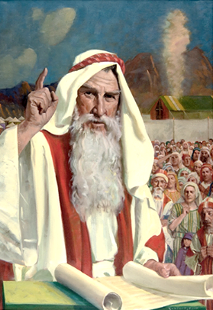
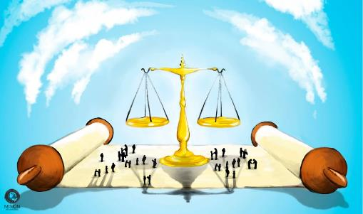


Emva kokuvakalisa iMithetho eliShumi, abantu bacela uMoses ukuba abe ngumthetheli phakathi kwabo noThixo (Eksodus 20:19). Ukususela ngelo xesha, uThixo wanika uMoses imithetho, waza wayidlulisela ebantwini.
Le mithetho, ebizwa ngokuba "yikhowudi yomnqophiso," yayijoliswe ekulawuleni ubomi babantu bakwaSirayeli kwaye, ngako oko, neyethu (kunye nohlengahlengiso oluyimfuneko kwinyani yethu yangoku).
Ngokufutshane, iyindlela yokusebenzisa iMithetho eliShumi kwiimeko ezithile zobomi bemihla ngemihla.
Indlela yokuphila uMthetho:
  Indlela yokuLawula uGonyamelo (Eks. 21:1-32)
  Indlela yokuPhila ekuHlaleni (Eks. 21:33-23:19)
  Indlela yokoyisa (Eks 23:20-33)
Indlela yokuqonda umthetho:
  Umthetho wokuziphindezela.
  Umvuzo kunye nesohlwayo.

Slide 4

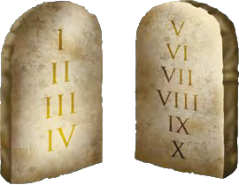

INDLELA YOKUPHILA UMTHETHO

Slide 5

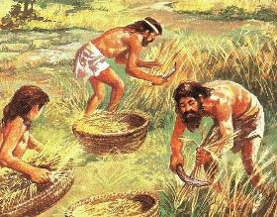
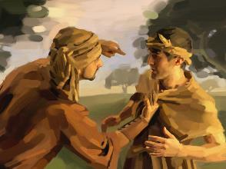
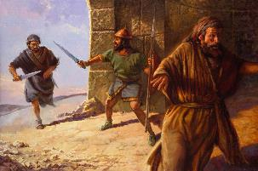
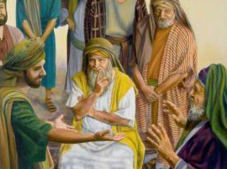
INDLELA YOKULAWULA UGONYAMELO
“Othe wabetha umntu wafa, naye wobulawa afe” (Eksodus 21:12)
Ikhowudi yomnqophiso iqala ngokulawula iinkalo ezintathu ezibalulekileyo zoluntu lwamaHebhere:
Ubukhoboka (Eks. 21:2-11)
  Amadoda ayekhululwa emva konyaka wesixhenxe.
  Abafazi, ukuba babengatshatanga, nabe babekhululwa.
  Indoda ibinokuhlala ilikhoboka ukuba ikhetha oko.
Isigwebo sokufa (Eks. 21:12-17)
  Kobulele ngabom
  Kowenza ububi okanye aqalekise abazali
  Kumqweqwedisi
Ukwenzakala (Eks. 21:18-32)
  Uxanduva lwembuyekezo yemali
  Ukuba kuphume isisu, umgwebi nomfazi (nendoda yakhe) mabawise isohlwayo
Yonke le mithetho yamiselwa ukunqanda ukuxhaphaza nobundlobongela phakathi kwabantu.

Slide 6

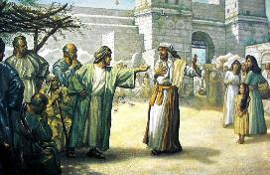
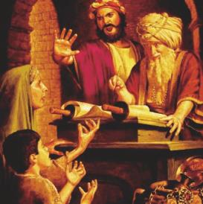
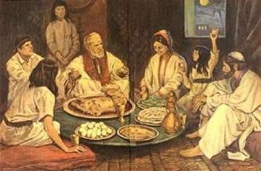
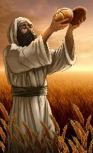
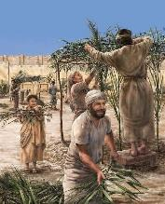
INDLELA YOKUPHILA EKUHLALENI
“Xa athe umntu warhwebesha intombi engaganiweyo, walala nayo, woyilobola ibe ngumkakhe” (Exodus 22:16).
UThixo wayengonelisekanga nje kukusishiya nemithetho "esisiseko” siyisebenzise ngokuthanda kwethu. Waba nenyameko yokunikezela ngemizekelo ebambekayo ukuze sikwazi ukuyisebenzisa ngokufanelekileyo.
Le mizekelo iquka ukuhlaselana kwezilwanyana (Eks. 21:35-36 ); ukubolekisa nokuqeshisa (Eks. 22:14-15 ); ubudlelwane phambi komtshato (Eks. 22:16 ), etc.
Kugxininiswa ngokukhethekileyo ekukhuseleni ababuthathaka nabajongelwe phantsi, kodwa ngaphandle kokubanika iinzuzo ezingafanelekanga—oko kukuthi, ngaphandle kokugqwetha okusesikweni ukuze bazuze inzuzo okanye kubenzakalise (Eks. 22:21-23; 23:2-3, 6).
Ekubeni ingumnqophiso phakathi koThixo nabantu baKhe, le mithetho ikwaquka nendlela esifanele sinxulumane ngayo naYe. Ukongezelela kuphumlo lweSabatha, kwakukho imbopheleleko yokwenza imisitho eyayisikhumbuza ngokukhululeka kwethu esonweni, ekukhuselweni kwethu nguThixo nakwikamva elizukileyo elisilindeleyo.

Slide 7

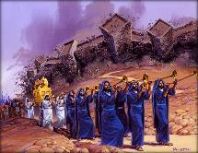
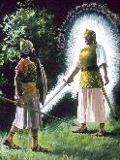
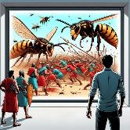
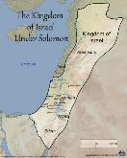
INDLELA YOKOYISA
UThixo uxelela uSirayeli amakakwenze
Aphulaphule ilizwi laKhe, ukuze uThixo abe lutshaba kwiintshaba zakhe (23:21-22)
Nqule uThixo yedwa, ukuze asuse zonke izigulo (23:24-26)
Anganqophisani namaKanana, angakhonzi othixo babo (23:32-33)
UThixo uxelele uSirayeli aza kukwenza
Uza kuthemela isithunywa saKhe sibagcine, kwaye sibakhusele (23:20)
Isithunywa siza kuhamba phambi kwabo, sibakhokelele eKanana (23:23)
Uza kuthumela izothuso kubemi belizwe (23:27)
Uza kuthumela oonomeva ukuba abagxothe (23:28)
Uza kumane ebagxotha kancinane (23:29-30)
Uza kubanikela esandleni sikaSirayeli de balawule ukusuka kulwandle lweMeditare ukuya kumEfrata (23:31)
“Uyabona, ndithuma isithunywa phambi kwakho, ukuba sikugcine endleleni, sikufikise endaweni endiyilungisileyo” (Eksodus 23:20)
Kwakutheni uThixo angamniki uAbraham umhlaba wamaKanana? “kuba ubugwenxa bama-Amori abukazaliseki” (Gen. 15:16).
Emva kweenkulungwane ezine zobabalo, amaKanan akazange aziguqule iindlela zawo. Yayilixesha lokunikezela umhlaba kuSirayeli… ngoxolo! (Eks. 13:17)
Ukuba uThixo wayebakhuphe eYiputa ngaphandle kokulwa, walwahlula ulwandle kubini, wabondla ngokungummangaliso, wabakhokela ngesithunywa saKhe…ubengayi kukwazi na ukubanika iKanana ngaphandle kokulilwela?

Slide 8
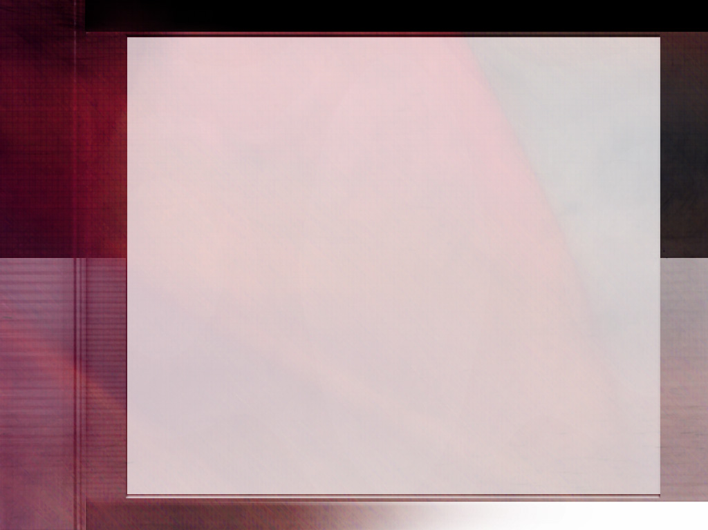
“Ukutyhubela izizukulwana umthetho kaThixo uye wagcinwa njengowona mgangatho uphakamileyo wokuziphatha. Ayizizo zonke izinto eziqanjiweyo zenzululwazi okanye iintelekelelo zeengqondo ezineziqhamo eziye zakwazi ukufumana umsebenzi omnye obalulekileyo ongabandakanywanga kule khowudi.
Umthetho kaThixo lunqabiseko lobomi nempahla noxolo nolonwabo. Yanikelwa ukukhusela ukulunga kwethu kwangoku kunye nokwanaphakade.”
EGW (The Upward Look. October 7)

Slide 9

INDLELA YOKUQONDA UMTHETHO

Slide 10

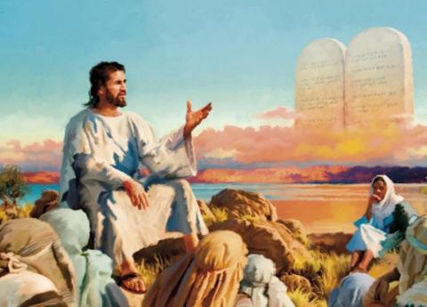

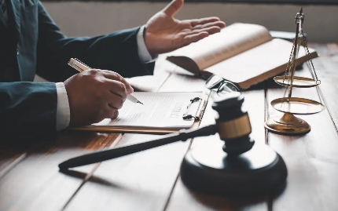
UMTHETHO WOKUZIPHINDEZELA
“iliso ngeliso, izinyo ngezinyo, isandla ngesandl, unyawo ngonyawo,” (Eksodus 21:24)
Ngexesha uYesu ethulula intshumayelo yaseNtabeni, wawubhangisa umthetho wokuziphindezela (Mat. 5:38-42) … okanye hayi?
Ibinzana elithi “nivile ukuba kwathiwa … kodwa Mna ndithi kuni” lalingabhangisi naye nawuphi na umthetho (uYesu wasebenzisa ibinzana elifanayo ekuthini, “uze ungabulali” okanye “uze ungakrexezi” “kodwa zange acebe ukuyibhangisa). Endaweni yoko, uYesu ubesoloko ewuzalisekisa umthetho, egxininisa eyona ntsingiselo yawo.
Yayingeyonjongo yomthetho wokuziphindezela ukuba ubani makaphulukani neliso okanye isandla sakhe ngokuhlungisa omnye.
Lo mthetho wanikwa ngenjongo yokuthintela ukubuyisa isixhiba, ukuphelisa iimbambano zabalamene ngegazi nempindezelo kube kungakhange kuphandwe kuqala. Kwakufuneka umenzakalo uphononongwe ngabagwebi, baze bamisele imbuyekezo efanelekileyo yemali. Esi senzo senziwa ukunqanda abantu ekuthatheleni umthetho ezandleni zabo. Ubulungisa kwakufuneka benziwe ngokomthetho kaThixo.

Slide 11

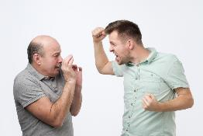

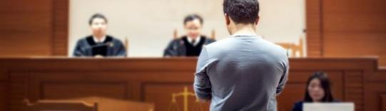
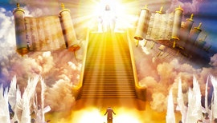
UMVUZO KUNYE NESOHLWAYO
“Ke lowo ubengenanzondo, yanguThixo omqubisane nesandla sakhe, ndokumisela indawo aya kusabela kuyo.” (Eksodus 21:13)
Ulangazelelo lokuziphindezela londele kuthi. Kwaye isoloko ingalingani nobubi esibufumeneyo: “Ukuba undenze oku, ndiza kwenza ngakumbi kuye.”
UYesu usimemela ekwenzeni okuchasene noko sikulangazelelayo: sibuyekeze ububi ngokulungileyo (Mat. 5:44). Buphi ubulungisa apho? Ngubani oza kunika umenzi wobubi okumfaneleyo?
Akatsho uThixo ukuba umenzi wobubi akazokohlwaywa, okanye isenzo asizokuphindezelwa. Kodwa uyasixelela ngokuphandle ukuba impindezelo yeyaKhe (Rom. 12:19-21).
Nangona ukuziphindezelela komntu kunyanyezelwe kwikhowudi yomnqophiso, kwathintelwa ngokuyila inkqubo yokugweba ukuze kuthintelwe ukuphathwa kakubi (Eks. 21:12-13, 22; 22:8-9).
Awukwazi ukuba ngumgwebi, abagwebi nombulali ngexesha elinye. Ukuba isohlwayo kufuneka sibekwe, kufuneka senziwe ngenkqubo yenkundla enobulungisa. Yaye uKristu uya kuba nguMgwebi owongamileyo nowokugqibela.

Slide 12

“NjengoMdali wethu sonke, uThixo unguMongameli wethu sonke, kwaye unyanzelekile ukuba anyanzelise umthetho waKhe kwindalo iphela. Ukufuna okuncinane kwizidalwa zaKhe kunokuthobela umthetho waKhe bekuya kuba kukuzilahlela kwintshabalalo. Ukusilela ukohlwaya ukwaphulwa komthetho waKhe kwakuya kuba kukubeka indalo yonke kwisiphithiphithi. Umthetho wokuziphatha ngumqobo kaThixo phakathi komntu nesono. Ngaloo ndlela ubulumko obungenasiphelo bubeke phambi kwabantu umahluko phakathi kokulungileyo nokungalunganga, phakathi kwesono nobungcwele.”
EGW ( The Signs of the Times , June 5, 1901)

