Slide 1
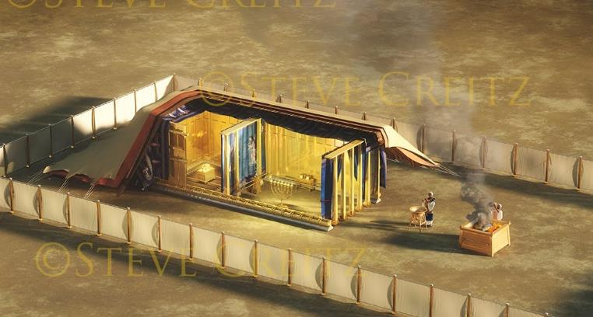
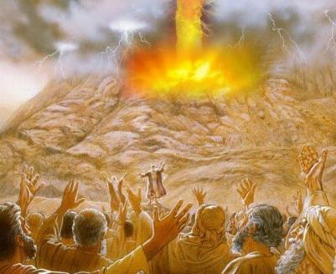
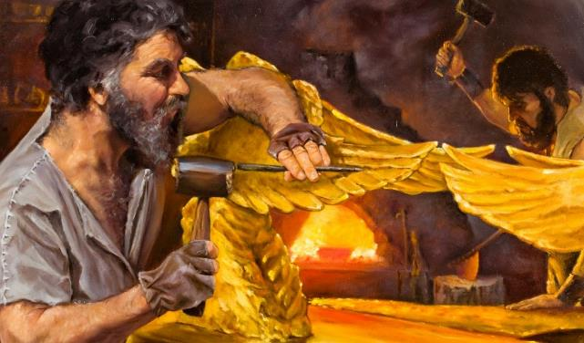
iSifundo 10: 6 kweyoMsintsi 2025
UMNQOPHISO KWAKUNYE NOYILO

Slide 2
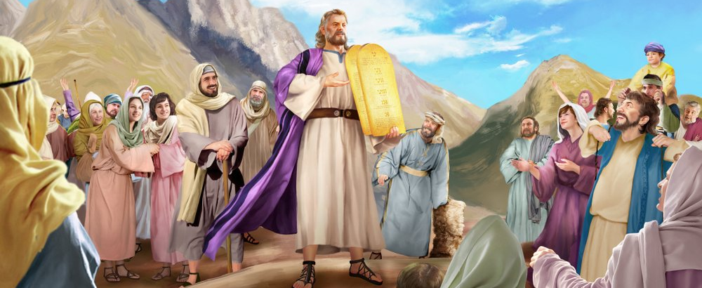
“Waya uMoses, wabaxelela abantu once amazwi kaYehova, namasiko once. Baphendula bonke abantu ngazwi-linye, bathi, ‘Onke amazwi awathethileyo uYehova sowenza”’
Eksodus 24:3

Slide 3

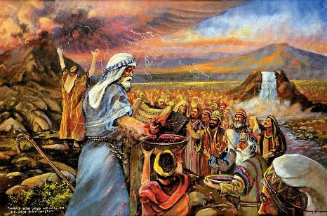
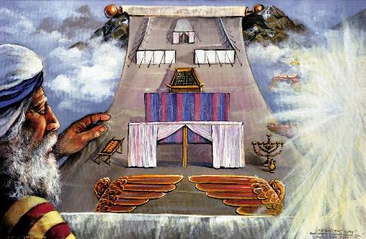


Emveni kokubhengeza iMithetho eliShumi nokunika uMoses imithetho esisiseko, uThixo wayefuna ukwenza umnqophiso noSirayeli.
Umnqophiso wawulula: Ndiza kuba nguThixo wenu, ndiza kunikhusela, kwaye ndinisikelele; nina nigcine imithetho yam.
Emveni kokubhala umnqophiso encwadini, kwafuneka uqinisekiswe ngabo bobabini. Abantu bawuqinisekisa, ngokuthi baza kuwugcina. UThixo wawuqinisekisa njani? Ngegazi; ngesidlo, nangoyilo lokubanceda bawuqonde kakuhle umnqophiso.
Umnqophiso:
  Igazi lomnqophiso (Eksodus 24:1-6, 8)
  Ukuzaliseka komnqophiso (Eksodus 24:7)
  Isidlo soMnqophiso (Eksodus 24:9-18)
Umzekelo:
  Injongo yomzekelo (Eksodus 25:1-9)
  Ukulungiselelwa komzekelo (Eksodus 31:1-18)

Slide 4
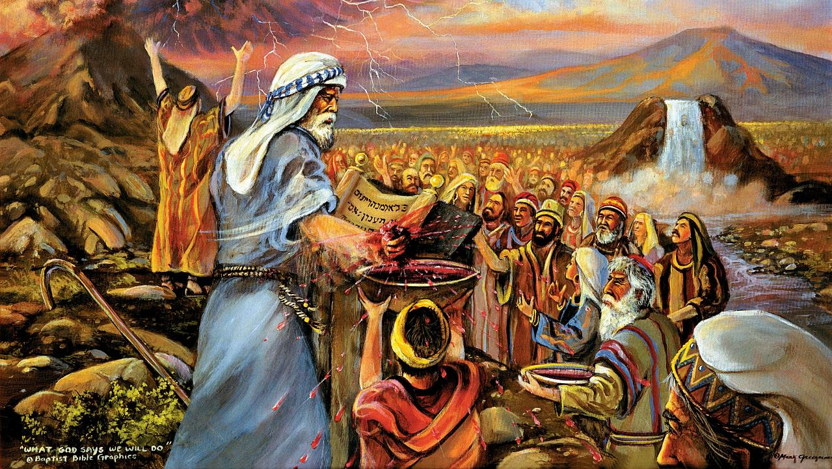
UMNQOPHISO

Slide 5

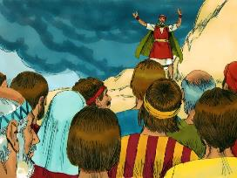
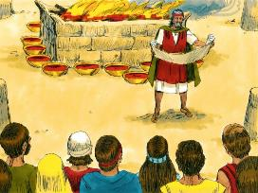
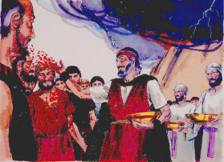
IGAZI LOMNQOPHISO
Walithabatha uMoses igazi, wabatshiza ngalo, wathi, Nalo igazi lomnqophiso awenzayo uYehova nani ngala mazwi onke. (Ekodus 24:8)
Wenziwa njani umnqophiso?
Umnqophiso wafundwa (Eks. 24:3a)
Abantu baphendula ngokuqinisekisa (Eks. 24:3b)
Wabhalwa phantsi (Eks. 24:4a)
Kwakhiwa isibingelelo (Eks . 24:4b)
Kwamiswa izimiso ezili12 (Eks. 24:4c)
Kwabingelelwa amadini anyukayo (Eks. 24:5)
Isiqingatha segazi satshizwa esibingelelweni (Eks. 24:6)
Umnqophiso wafundwa kwakhona (Eks. 24:7a)
Abantu baphendula ngokuqinisekisa kwakhona (Eks. 24:7b)
Esinye isiqingatha segazi satshizwa ebantwini (Eks. 24:8a)
UMoses walibiza “igazi lomnqophiso” (Eks. 24:8b; Mat. 26:28)
Kwenziwa isidlo ukuqinisekisa umnqophiso (Eks. 24:9-11)
UThixo wamazi uSirayeli njengabantu (izimiso ezili12 columns); Ngokukhethekileyo wabaxabisa abantu abatsha; Wazinikela kumntu ngamnye eyedwa (ukutshizwa ngegazi laKhe kubo).
Uthixo unqwenela ubudlelane nathi, umntu ngamnye kunyee noluntu ngokubanzi.

Slide 6

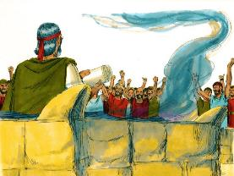
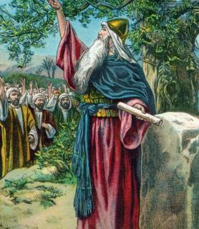
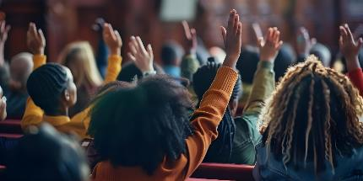
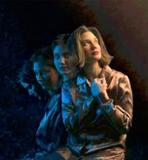
UKUZALISEKISWA KOMNQOPHISO
“Wathabatha incwadi yomnqophiso, wayilesa ezindlebeni zabantu; bathi bona, Yonke into ayithethileyo uYehova soyenza siyive.” (Eksodus 24:7)
Ngokunyaniseka okugqibeleleyo, abantu bazinikela ekugcineni umnqophiso. Oku kuzinikela kwaba kokwexeshana (Eks . 32:8).
Isizukulwana esilandelayo naso sazinikela ekugcineni umnqophiso (Yosh. 24:18b). Kodwa uYoshuwa wabalumkisa ngokucacileyo: “Aninakumkhonza uYehova” (Yosh. 24:19).
Yintoni le isithintelayo ekuthobeleni uThixo nokokuba sele sineenjongo ezintle?
Ngokwemvelo, asithobeli
(Rom. 7:18), kwaye akukho nto sinokuyenza ukutshintsha loo nto (Rom. 7:24).
Kodwa ukuba siyamvumela, uThixo unako ukuyitshintsha imvelo yethu (Hez. 36:26-27). Uyahlambulula, asuse, anike, asibeke apho sinako ukumthobela. Nguye kuphela onako ukusomeleza (2 Kor. 12:10).

Slide 7

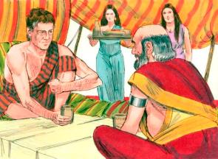
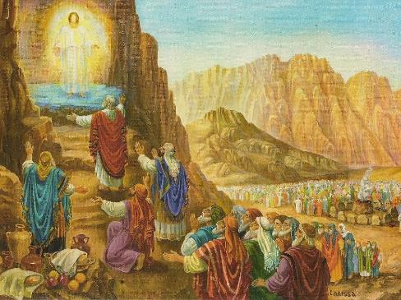
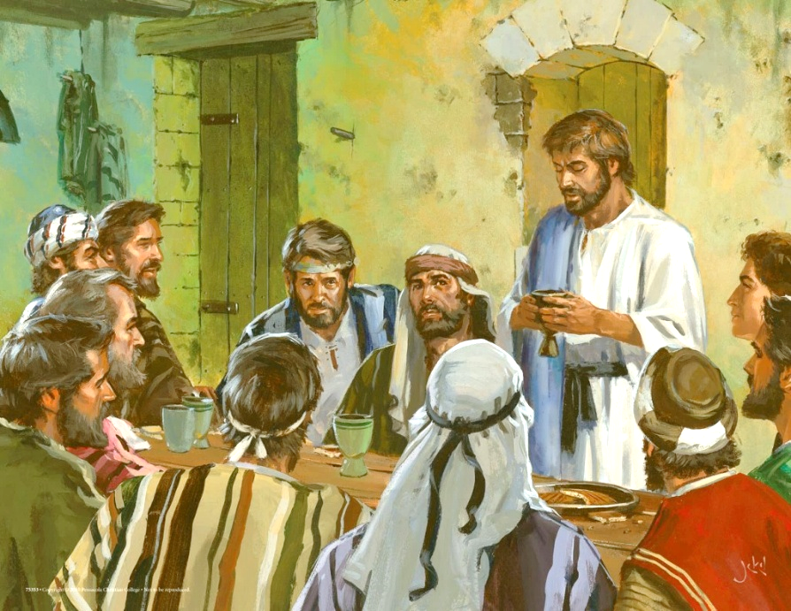
ISIDLO SOMNQOPHISO
“Wenyuka uMoses noAron, uNadabhi noAbhihu, namashumi osixhenxe kumadoda amakhulu akwaSirayeli; […] Ambona ke uThixo, adla, asela” (Eksodus 24:9, 11b)
Njengoko sibona kumzekelo kaYakobi noLabhan, kuMbindi-Mpuma, isidlo phakathi kwamaqela amabini yindlela yokuqinisekisa umnqophiso (Gen. 31:44-54).
ESinayi, uThixo wanikela “isidlo somnqophiso” kubantu abangama74: uMoses, uAron, uNadabhi, uAbhihu namadoda amakhulu angama70, nababemele abantu (Eks. 24:9-11).
Ngethuba uYesu emisela umnqophiso omtsha, naye wakwenza oko ngokwabela ngesidlo nabafundi abali12 (Mat. 26:26-28).
Ngalo lonke ixesha sithabatha kwisidlo seNkosi, sihlaziya umnqophiso wethu noThixo. Ngokuthabatha kwisonka newayini, sibhiyozela ukuxolelwa nosindiso esinalo kuYesu (1 Kor. 11:26).
Nakubeni balubhebhetha usindiso, akukho namnye kuNadabhi, , uAbhihu noJudas, owagxothwayo “kwisidlo somnqophiso”.

Slide 8
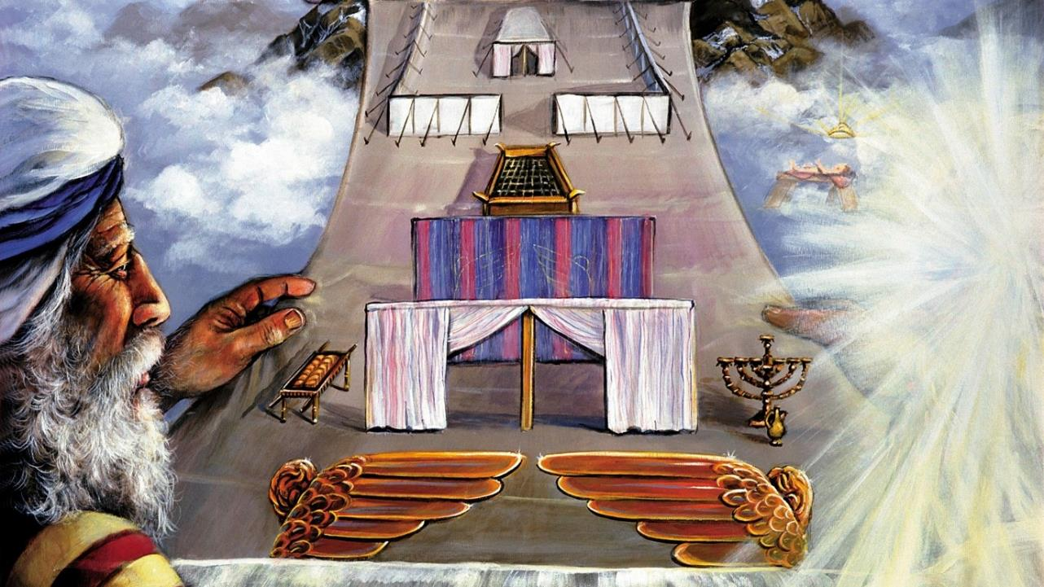
UMZEKELO

Slide 9

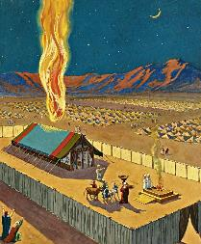
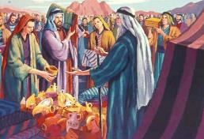
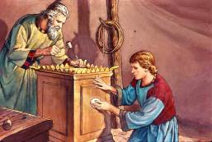
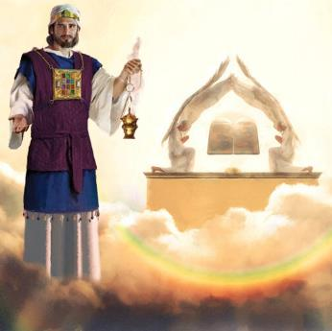
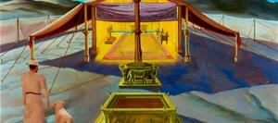
INJONGO YOMZEKELO
“Bandenzele undawo engcwele, ndihlale phakathi kwabo” (Eksodus 25:8)
Njengengqiniseko yokuba uza kulizalisekisa icala lakhe lomnqophiso, uThixo wagqiba ekubeni azokuhlala nabantu baKhe.
Kodwa ubukho bukaThixo ngokwasenyameni babuya kuthetha ukufa kwangoku kubo bonke (Eks. 33:20). Ke ngoko, wabayalela ukuba bakhe ingcwele apho wayenokuthi abonakalise ubukho bakhe. Obu bukho babonakaliswa ngemifuziselo, ekubeni uThixo engahlali ngokoqobo kuyo nayiphi na itempile yasemhlabeni ( IZenzo 17:24 ).
UMoses waboniswa umzekelo waza wanikwa imiyalelo ecacileyo yokwakhiwa kwayo. Abantu bacelwa ukuba banikele ngezinto eziyimfuneko ( Eks. 25:2-7 ).
Zombini ingcwele kunye netempile eyakhiwa nguSolomon yayingumzekelo wengcwele eyakhiwe eZulwini (Heb. 8:1-2; 1 Kum. 8:27, 30).
Xa umSirayeli wayengena engcweleni, wayengena—ngokomfuziselo—ebusweni bukaThixo kanye… de ikhuselo lakrazuka ekufeni kukaYesu.

Slide 10

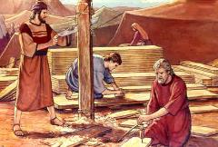
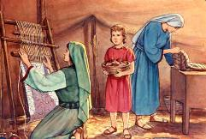
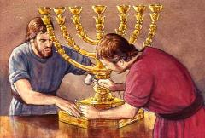
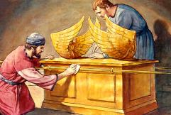
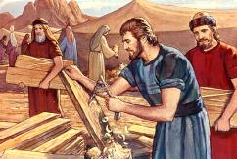
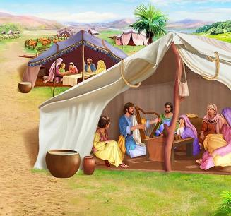
UKULUNGISELELWA KOMZEKELO
“Khangela, ndibize uBhetsaleli unyana kaUri, unyana kaHuri wesizwe sakwaYuda; ndamzalisa ngomoya kaThixo, ngobulumko, nangokuqonda, nangokwazi, nangobungcibi bamashishini onke” (Eksodus 31:2-3)
Nangona uThixo wanika uMoses imiyalelo eneenkcukacha ngolwakhiwo, akazange amxelele zonke iinkcukacha. Lufanele ukuba njani uhehema lwesitya sobhedu, iikerubhi, iminqwazi yababingeleli, njl.njl. Oku kwanika uMoya oyiNgcwele ithuba lokusebenza ngezipho zabakhi.
Kwezi nkcukacha, uMoya oyiNgcwele unikwe izipho ezikhethekileyo:
UBhetsaleli waba ngumlawuli wephulo lonke(Eks. 31:2)
UAholiyabhi wayengumncedisi omkhulu (Eks. 31:6a)
Abanye babeza kuncedisa emsebenzini (Eks. 31:6b)
Phakathi kwemiyalelo yokwakha ingcwele, kukho ukukhankanywa okukhethekileyo kweSabatha ( Eks. 31:12-17 ). ISabatha inantoni yakwenza nantoni kuko konke oku?
Ubungcwele ngundoqo. Ukuze sisondele kuThixo oNgcwele, kufuneka sibe ngcwele njengaye. ISabatha ngulo mqondiso wobo bungcwele (Eks. 31:13; Hez. 20:12, 20).
Notes:
Exodus 31:2
See, I have called by name Bezalel the son of Uri, the son of Hur, of the tribe of Judah;
Exodus 31:6a
And behold, I have set with him Aholiab the son of Ahisamach , of the tribe of Dan;
Exodus 31:6b
and I have put wisdom in the minds of every wise-hearted person, so that they may do all that I have commanded you;
Exodus 31:12-17 And the LORD spake unto Moses, saying, (13) Thou shalt speak unto the children of Israel, saying, Ye shall surely keep my sabbaths: for it is a sign between me and you throughout your generations, that ye may know that I am the LORD that sanctifies you. (14) Therefore ye shall keep the sabbath day, for it is holy unto you: whoso profaneth it shall surely be put to death: for whosoever doeth any work in it, that soul shall be cut off from among his people. (15) Six days shall work be done: but the seventh day is a sabbath of rest holy to the LORD: whosoever doeth any work on the sabbath day shall surely be put to death. (16) Therefore shall the children of Israel keep the sabbath, to observe the sabbath throughout their generations for a perpetual covenant. (17) It is a sign between me and the children of Israel for ever: for in six days the LORD made heaven and earth, and on the seventh day he rested, and was refreshed.

Slide 11

“Ekwakhiweni kwengcwele njengendawo yokuhlala kaThixo, uMoses wayalelwa ukuba enze zonke izinto ngokomfuziselo wezinto ezisemazulwini. UThixo wambizela entabeni, wamtyhilela izinto ezisemazulwini.
Ngoko ke kuSirayeli, awayenqwenela ukulenza indawo yakhe yokuhlala, wayityhila ingqibelelo yaKhe ezukileyo yesimilo. […] Kodwa le njongo, bona ngokwabo, babengenamandla okuyifumana. Isityhilelo eSinayi sabachukumisa kuphela ngentswelo yabo kunye nokungabi nakuzinceda.”
EGW (Education, p. 35-36)

