Slide 1
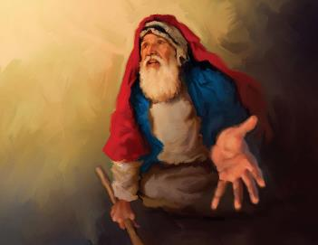
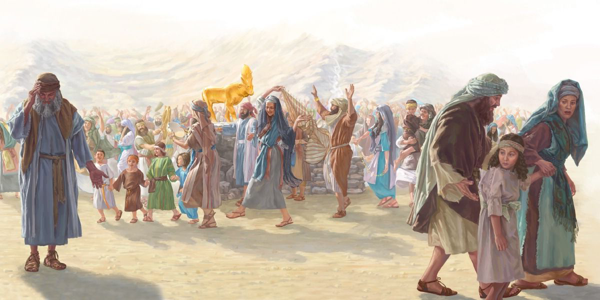
UKREQO KWAKUNYE NENTETHELELO
ISifundo 11: 13 kweyoMsintsi (Septemba) 2025

Slide 2
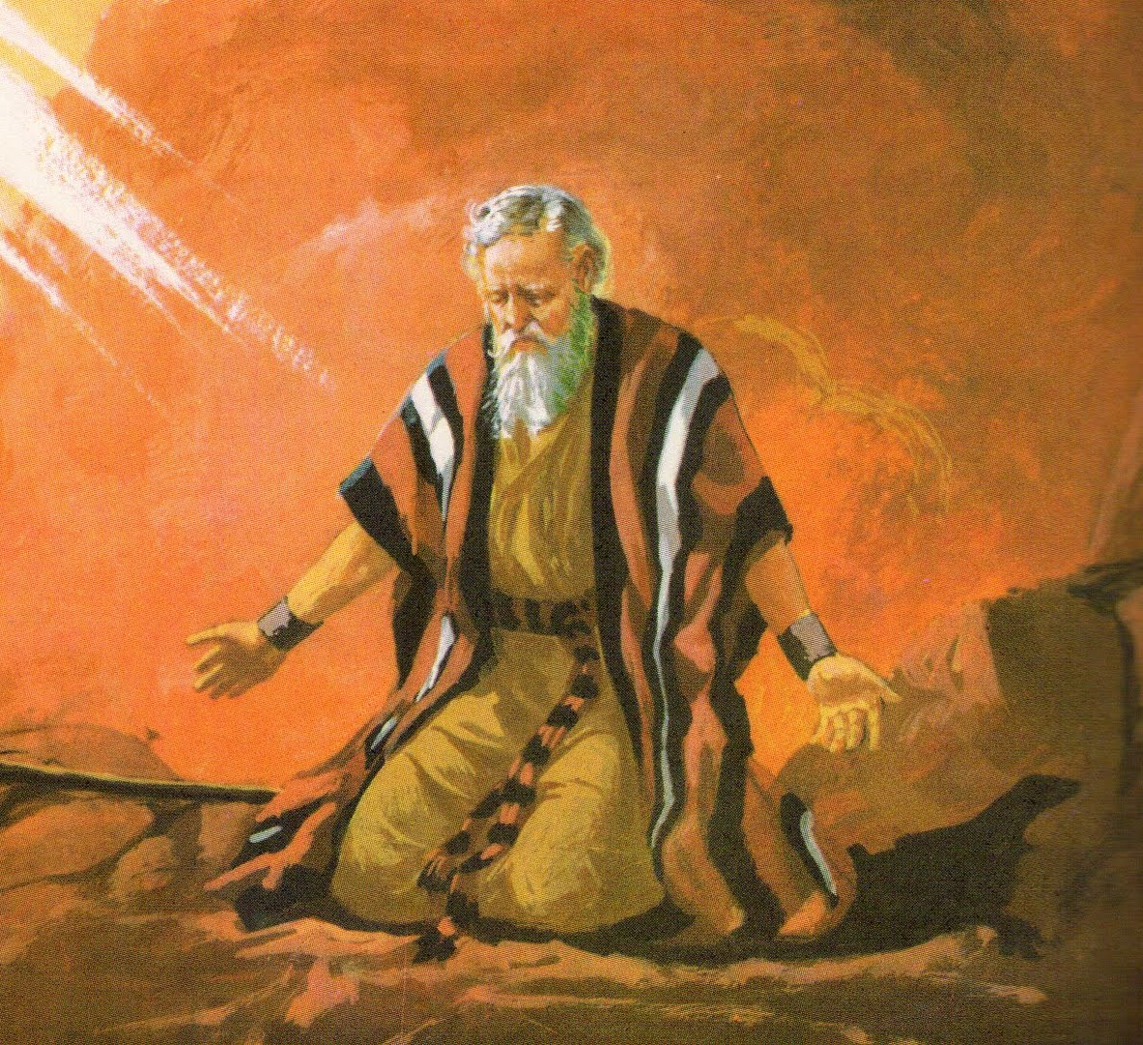
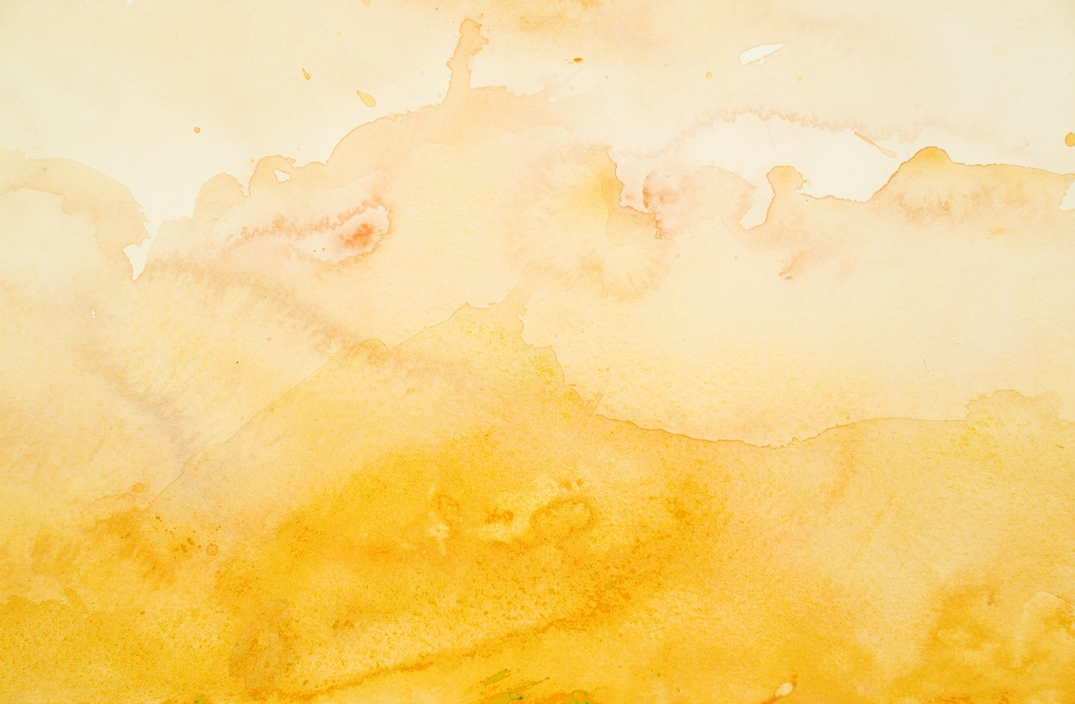
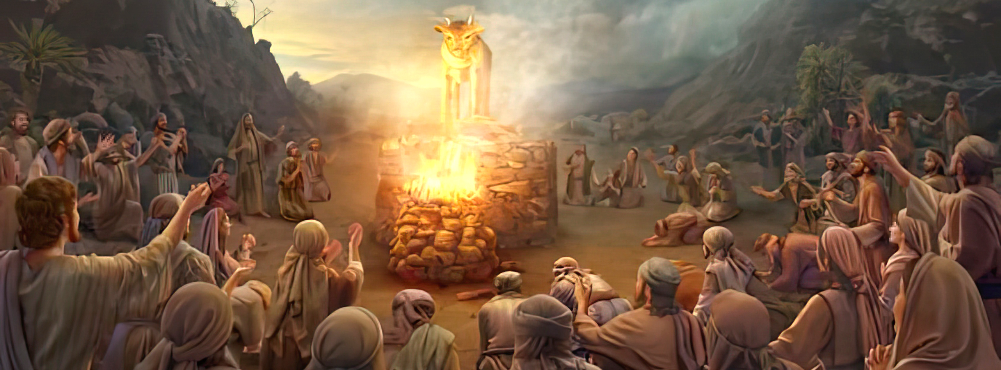
“Umoses wabuya waya kuYehova, wathi, Yoo! Aba bantu bonile, benza isono esikhulu, bazenzela uthixo ngegolide. Khawusixolele ngoko isono sabo; ukuba akunakuba njalo, wose undicima encwadini yakho oyibhalileyo’”
Exodus 32:31, 32.

Slide 3

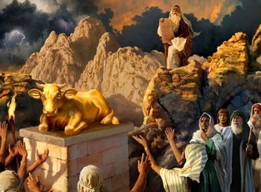
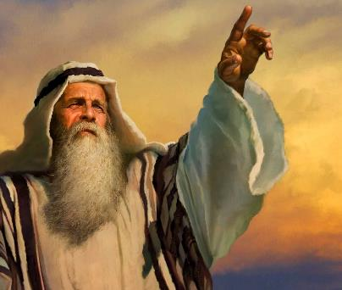


“batyeke msinya endleleni endibawisele umthetho ngayo” (Eks. 32:8).
Kungekudala emva kokufumana iMithetho eliShumi, waza waxelelwa kwakhona ukuba angazenzi izithixo ( Eks. 20:23 ), uSirayeli wenza ithole legolide ukuze alinqule.
Ejongene nolu kreqo, uThixo wacela uMoses imvume yokutshabalalisa uSirayeli aze awenze uhlanga olutsha ( Eks. 32:10 ). Phezu kwako nje ukuwexuka kwabantu, uMoses wabathethelela izihlandlo ezibini phambi koThixo ecela ukuxolelwa nguThixo ababengabafanelanga.
Ukreqo:
  Ubuthathaka buka-Aron (Eksodus 32:1-5)
  Umthendeleko wethole(Eksodus 32:6)
  Ukonaka konqulozithixo(Eksodus 32:7-8)
Intethelelo:
  “Buya ekuvutheni komsindo wakho!” (Eksodus 32:9-29)
  “Ndicime encwadini yakho oyibhalileyo!” (Eksodus 32:30-32)

Slide 4

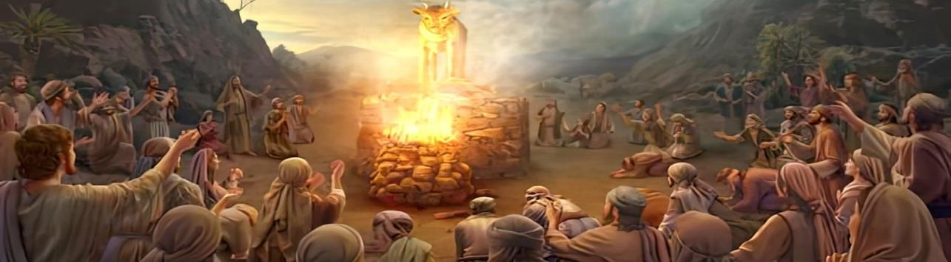
UKREQO

Slide 5

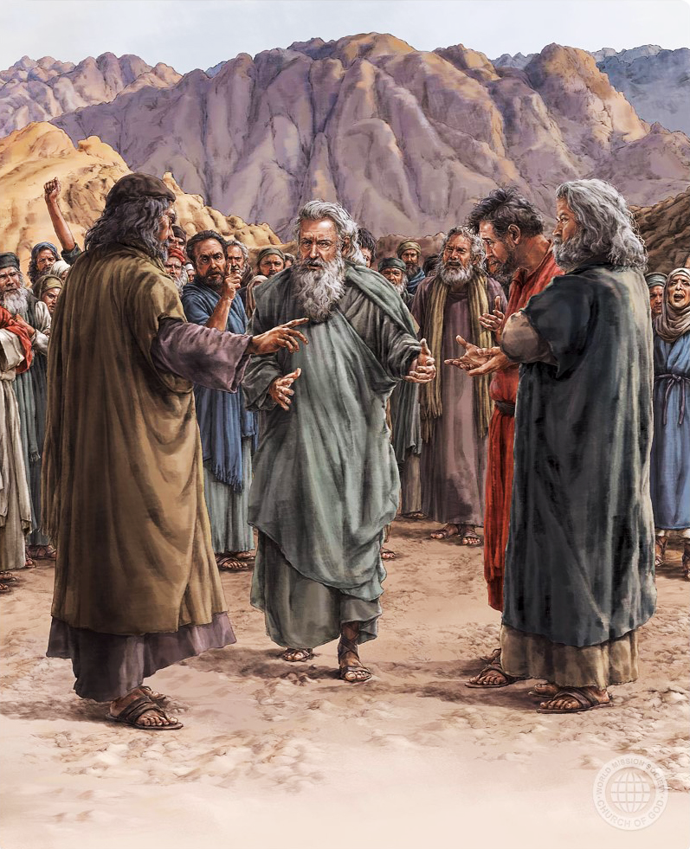
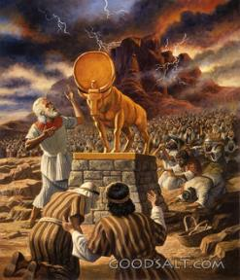
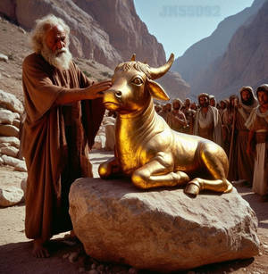
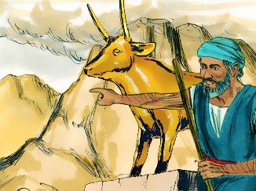
UBUTHATHAKA BUKA-ARON
“Wabona uAron, wakha isibingelelo phambi kwalo, wadanduluka uAron wathi, Ngumthenedeleko kuYehova ngomso” (Eksodus 32:5).
Nakubeni igama lesiHebhere u-elohim esisinika sikathixo, lisetyenziswa ukubhekisa kuThixo omnye: “NdinguYehova uThixo [elohim] wakho, owakukhupha ezweni laseYiphutha” (Eks. 20:2).
Engekho uMoses, abantu bacela uAron ukuba abenzele oothixo ababonakalayo ababenokumnqula ( Eks. 32:1 ). Balibala ngokukhawuleza imiyalelo ababeyifumene kunye nokuzinikela kwabo ekuyithobeleni ( Eks. 24:7 ).
Ukuthingaza kuka-Aron okokuqala ekuzameni ukuthethathethana nabantu (Eks. 32:2) kwamkhokelela ekubeni akhokele uwexuko kunokuba aluphelise.
Kunokuba abakhumbuze ngesalelo sokwenza izithixo, uAron wabenzela ithole legolide, waza wathi: “Nanko uthixo wakho [elohim], Sirayeli, owakukhuphayo ezweni laseYiphutha!
( Eks. 32:4)

Slide 6
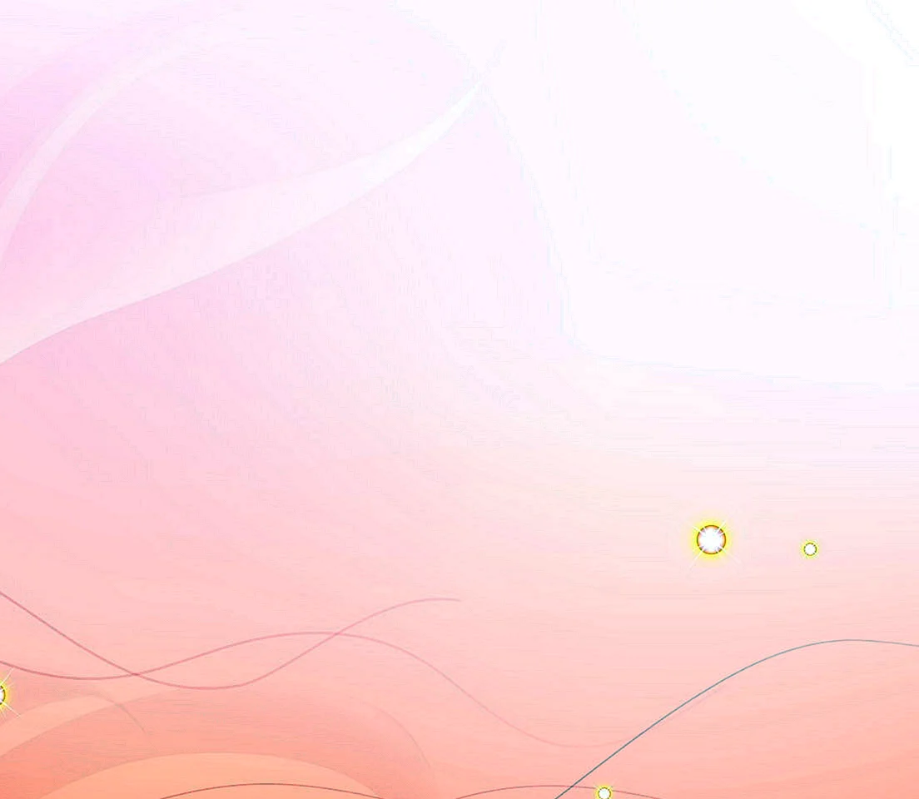
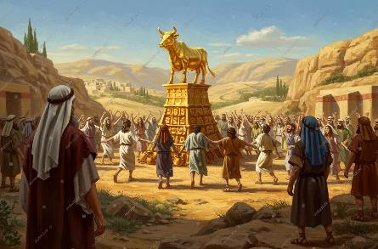
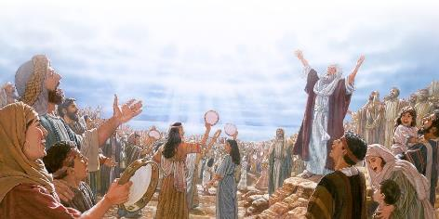

UMTHENDELEKO WETHOLE
“Bavuka kusasa ngengomso, banyusa amadini anyukayo, basondeza imibingelelo yoxolo; bahlala phantsi abantu, badla basela, besuka bema, badlala.” (Eksodus 32:6)
Ngokwenza isithixo ngokokufana nethole, amaSirayeli anciphisa uThixo uSomandla amlinganisa nomfanekiso wesilwanyana, banqula isidalwa endaweni yoMdali (Rom. 1:23).
Babecinga ukuba umfanekiso oqingqiweyo unokubakhokela. Basenokuba babecinga ukuba u-elohim waba lithole! ( Eks. 32:24 ).
Enyanisweni, bayeka ukunqula uThixo banqula iidemon (Dut. 32:17). Ngoxa babenqula uThixo, baziphatha kakuhle, kuba babefana noThixo.
Ngokunqula iidemon, baqalisa ukuthoba isidima sabo, kuba babefana needemon ababezinqula.
Xa singazinikeli iintliziyo zethu kuMdali, kodwa endaweni yoko sikhonze esinye isithixo (kwaye baninzi), kungekudala okanye kamva, oko kuya kusikhokelela ekuwohlokeni kokuziphatha.

Slide 7

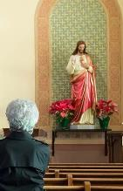
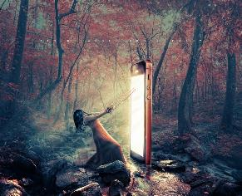

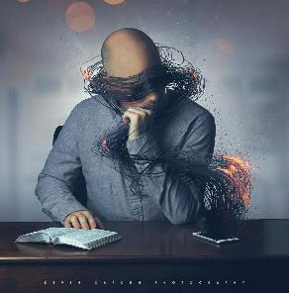
THE CORRUPTION OF IDOLATRY
“Then the Lord said to Moses, “Go down, because your people, whom you brought up out of Egypt, have become corrupt.’” (Exodus 32:7)
To bow down before an image (even if it represents God Himself, Christ, or His saints) is to disobey God's Law (Ex. 20:3-6) and, therefore, to enter into sin and corruption.
What is 21st-century idolatry? Idolatry is worshipping something that replaces God. An idol is anything that captures our imagination, affection, time, and mind more than God, and that enslaves our thinking.
What idols do we worship? You can make your own list. Some suggestions: pride, money, power, sex, food, work, social media…
What does worshiping these idols entail? Our personality, way of thinking, emotions, and even our social life are transformed. We exchange authentic relationships with God for hollow and meaningless interactions that cannot save us.

Slide 8

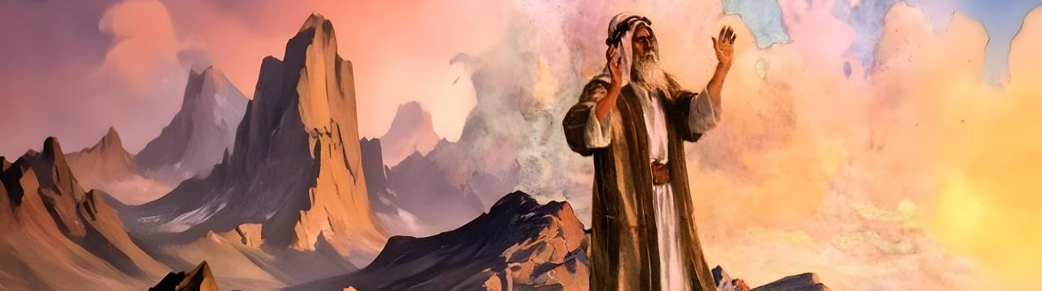
INTETHELELO

Slide 9

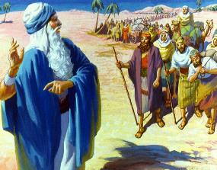
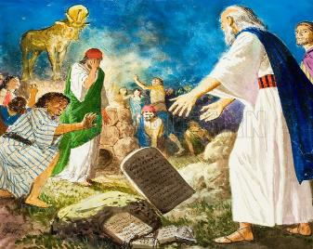
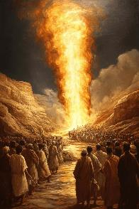
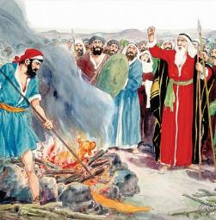
“BUYA EKUVUTHENI KOMSINDO WAKHO!”
“Yini na ukuba amaYiphutha atsho ukuthi, Wabakhuphela ububi, ukuze ababulale ezintabeni, abagqibele bemke emhlabeni? Buya ekuvutheni komsondo wakho, uzohlwaye ngobubi obo ngenxa yabantu bakho!” (Eksodus 32:12)
UThixo wamxelela uMoses, “kuba abantu baKHO, owabanyusayo ezweni laseYiphutha, bonakalisile.” (Eks. 32:7).
UMoses wasabela ngokufanelekileyo: “Ababantu bam, kodwa ngabakho, yaye asindim owabakhuphayo, kodwa nguwe” ( Eks. 32:11 ). UThixo wayemcela ukuba amvumele atshabalalise amaSirayeli ( Eks. 32:10 ), kodwa uMoses akazange avume ukumnika loo mvume.
Ingqumbo kaThixo yayinobulungisa, kodwa uMoses wayesazi ukuba “inceba iyawuqhayisela umgwebo” (Yakobi 2:13). Emva kokuba ethethele uSirayeli, eqinisekile ukuba uThixo wayewuthomalalisile umsindo wakhe, (enomsindo) wehla entabeni ( Eks. 32:12-15 ). Ebona uwexuko, wawaphula umfuziselo womnqophiso: amacwecwe amatye ( Eks. 32:19 ).
Emva kokuphulaphula izizathu ezibuthathaka zomntakwabo, uMoses wakhawuleza wayiphelisa loo mvukelo ( Eks. 32:20-28 ).

Slide 10

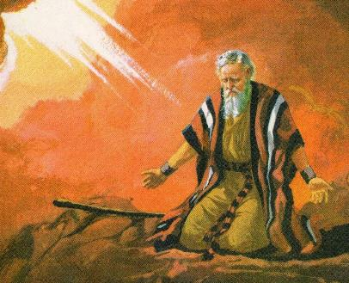
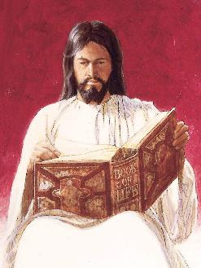
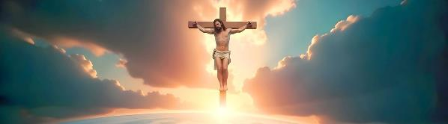
“NDICIME ENCWADINI YAKHO OYIBHALILEYO!”
“Khawusixolele ngoko isono sabo; ukuba akunakuba njalo, wose undicima encwadini yakho oyibhalileyo!” (Eksodus 32:32)
Ngomthandazo wakhe wokuqala, uMoses wakuthintela ukutshatyalaliswa kwabantu. Kodwa kwakucacile ukuba uThixo wayengenakuphinda abasikelele emva kwesi sono. Ngoko ke, wagqiba ekubeni enze ucweyo lwesibini (Eks. 32:30).
UMoses wayekulungele ukuphulukana nosindiso lwakhe ukuba abantu babengaxolelwanga (Eks. 32:31-32). Noko ke, olu yayingelulo uxolelo oluqhelekileyo uMoses awayelucela, kuba akazange asebenzise igama lesiHebhere eliqhelekileyo elithetha “ukuxolela.” Wacela ukuba uThixo “athwale” isono sabantu.
Oku kwakuthetha ukuba uThixo wayeya kuzithabathela kuye isono aze asithwale, ahlawule ixabiso laso: ukufa ( Isa. 53:6; Rom. 6:23 ). Yiloo nto kanye eyenziwa nguYesu emnqamlezweni. Uzithabathele kuye izono zethu ukuze afe ukufa ebesimfanele ( 1 Pet. 2:24 ).

Slide 11

EGW (Patriarchs and Prophets, p. 315)
“Ngeli xesha lokulinda, kwakukho ixesha lokuba bacamngce ngomthetho kaThixo ababewuvile, kwaye balungise iintliziyo zabo ukuba zamkele ezinye izityhilelo awayenokuzenza kubo. Babengenaxesha laneleyo kulo msebenzi; kwaye ukuba babesoloko befuna ukuqonda okucace ngakumbi ngeemfuno zikaThixo, kwaye bezithoba iintliziyo zabo phambi kwaKhe, ngebabekhuselwe ekuhendweni. Kodwa abazange bakwenze oku, yaye kungekudala baba ngabangakhathaliyo, abangakhathaliyo nabachas’ umthetho. […]
Evakalelwa kukuba akanakuzinceda xa inkokeli yawo ingekho, abuyela kwiinkolelo zawo zakudala. […] Abantu banqwenela umfanekiso othile omele uThixo, kwaye uhambe phambi kwabo endaweni kaMoses.”

