Slide 1
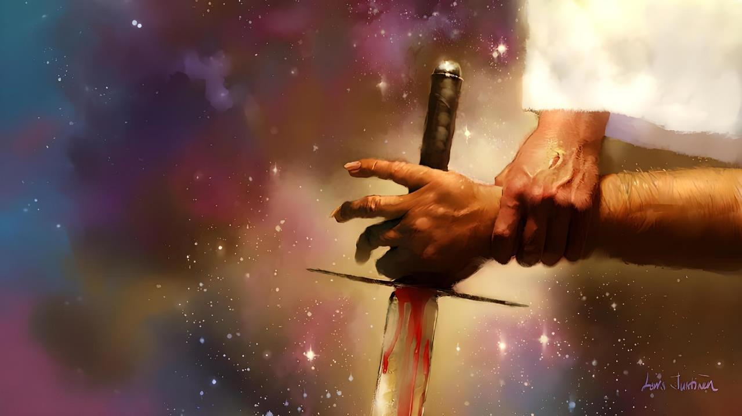
IMFAZWE EZALA ZONKE IIMFAZWE
ISifundo 4 – 25 kweyeDwarha 2025

Slide 2
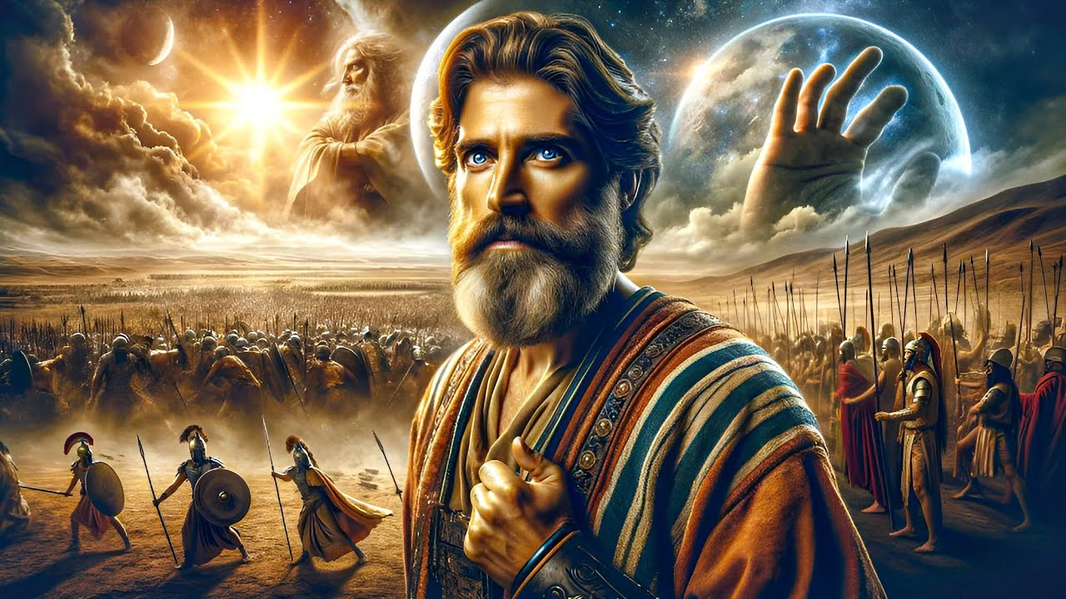
“Akuzanga kubekho mini injengaleyo, phambi kwayo, ngokokude uYehova aliphulaphule ilizwi lomntu; ngokuba uYehova wawalwela amaSirayeli”
Yoshuwa 10:14

Slide 3

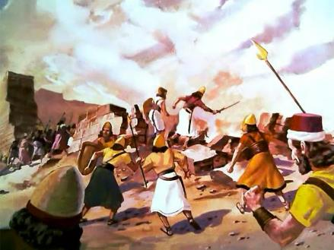
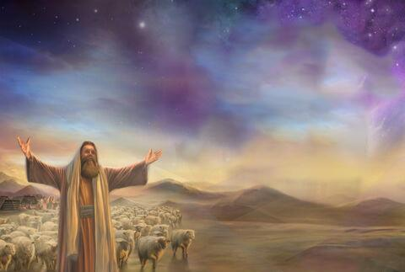
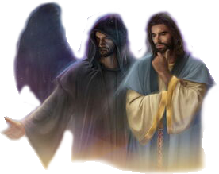
Ukoyiswa kweKanan yayiyimfazwe eyayiyalelwe nguThixo yokutshabalalisa. Kodwa ukuba uThixo uluthando, kwakutheni ukuze ayalele ukubulawa kwabantu ngolu hlobo?
Ukufumana ikroba kwizizathu zezi ziganeko, kufuneka sisondeze ngakumbi.
Simele sandise umbono wethu ngaphaya kokubonakalayo, side siqwalasele ungquzulwano olusemva kwazo zonke iingxabano (kuquka ukoyiswa kweKanan): imbambano enkulu phakathi kukaKristu noSathana, phakathi kokulungileyo nokubi.
Amaqela akungquzulwano :
UMthetheli womkhosi kaYehova.
Umthetheli womkhosi wobubi.
Elona gorha linamandla.
Amacebo ongquzulwano:
UThixo osilwelayo.
Silwela uThixo.

Slide 4
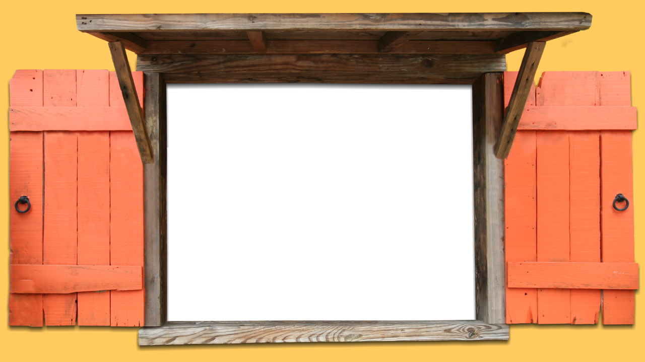
AMAQELA AKUNGQUZULWANO

Slide 5


UMTHETHELI WOMKHOSI KAYEHOVA
“Yathi, Hayi, ndingumthetheli womkhosi kaYehova; ndifikile ngoku. Wawa uYoshuwa ngobuso bakhe emhlabeni, waqubuda, wathi kuyo, Ithetha ntoni na ke inkosi yam kumkhonzi wayo?” (Yoshuwa 5:14)
Njengoko uYoshuwa wayethandaza kufuphi neYeriko efuna ulwalathiso olungokobuthixo lokusithimba isixeko, igorha elirhole ikrele wema phambi kwakhe (Yosh. 5:13).
Xa wayebuzwa nguYoshuwa, le ndoda yakhanyela ukuba yayinxulumana nawo nawuphi na umkhosi wasemhlabeni. WayeyiNkumanda yomkhosi kaThixo (Yosh. 5:14).
Ngokugunyazisa ukunqulwa, wabonisa ukuba wayenguThixo ngokwaKhe, uYesu—owaziwa ngokuba nguMikhayeli kwincwadi kaDaniyeli (Yosh. 5:15; Dan. 12:1).
Umthandazo waphendulwa. Kwathi xibilili kuYoshuwa akufumanisa ukuba nguThixo ngokwaKhe owayeza kuxhuzula imikhala. Njengomphathimkhosi obonakalayo wakwaSirayeli, uYoshuwa wayefanele alandele kuphela imiyalelo yoMphathi-mkhosi wokwenene: uThixo.

Slide 6

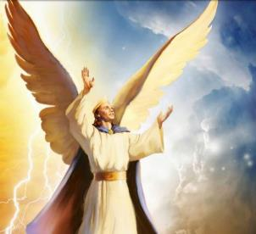
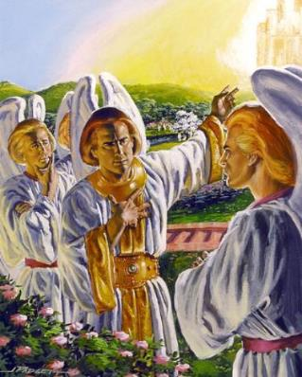
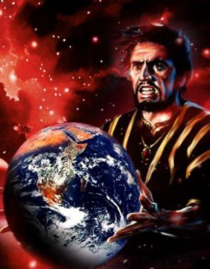
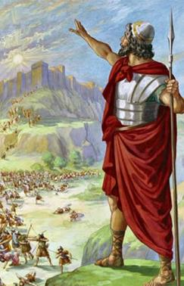
UMTHETHELI WOMKHOSI WOBUBI
“Utheni na ukuwa emazulwini, Khwezi, nyana wesifingo! Ukunqunyulwa uwe emhlabeni, mngquli weentlanga!” (Isaya 14:12)
Sinokuthi wasungula imfazwe. Wazalwa eyinkosana; ikherubhi yodidi oluphezulu; esecaleni kukaThixo kanye; ehamba phezu kwamalahle avuthayo; exabisekile; egqibelele… (Hez. 28:12-15).
Enikwe inkululeko yokuzikhethela – njengazo zonke izidalwa ezikrelekrele ezidalwe nguThixo – uLusifa wagqiba ekubeni avukele aze ahluthe itrone kaThixo (Is. 14:12-14).
Nangona imvukelo yakhe yasilelayo, indalo iphela iye yagutyungelwa yimfazwe ukususela ngoko. Akuba ewuthabathile umhlaba, uSathana neengelosi zakhe banenjongo enye: ukuthintela amacebo kaThixo okusindisa uluntu.
Ukoyiswa kweKanan yayilidabi elibalulekileyo kule mfazwe.

Slide 7

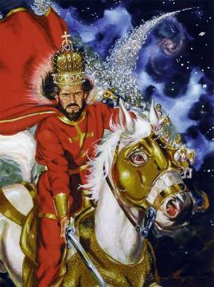
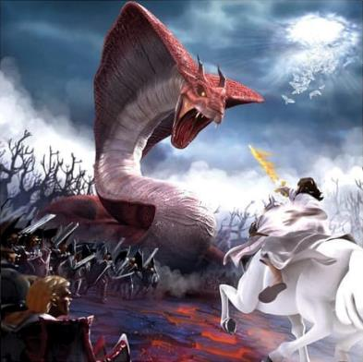
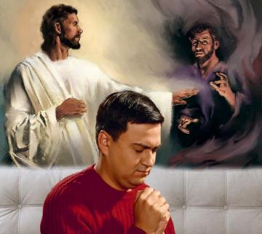
ELONA GORHA LINAMANDLA
“UYehova yindoda elwayo, UYehova igama lakhe” (Eksodus 15:3)
UThixo ngokwakhe uchazwa ‘njengendoda yokulwa,’ elona Gorha linamandla edabini. (Eks. 15:3; INdu. 24:8).
Kodwa uThixo akalwi nabantu, ulwa namandla omoya abambelele kuwo. Ngoko ke, izibetho zichazwa njengemfazwe nxamnye noothixo baseYiputa, oko kukuthi, iidemon (Eks. 12:12; Dut. 32:17).
UThixo unqwenela ukuphelisa ububi emhlabeni. Ngako oko, wabagxotha eKanan abo babenyule ukuba ngakwicala likaSathana, waza walinika ilizwe abantu ababengakwicala laKhe.
Namhlanje imfazwe isaqhubeka, kodwa ayidluli kummandla. Umlo ngowosapho ngalunye, kumntu ngamnye. Akukho mhlaba ungathathi hlangothi. Sikunye noThixo okanye sikunye notshaba.

Slide 8
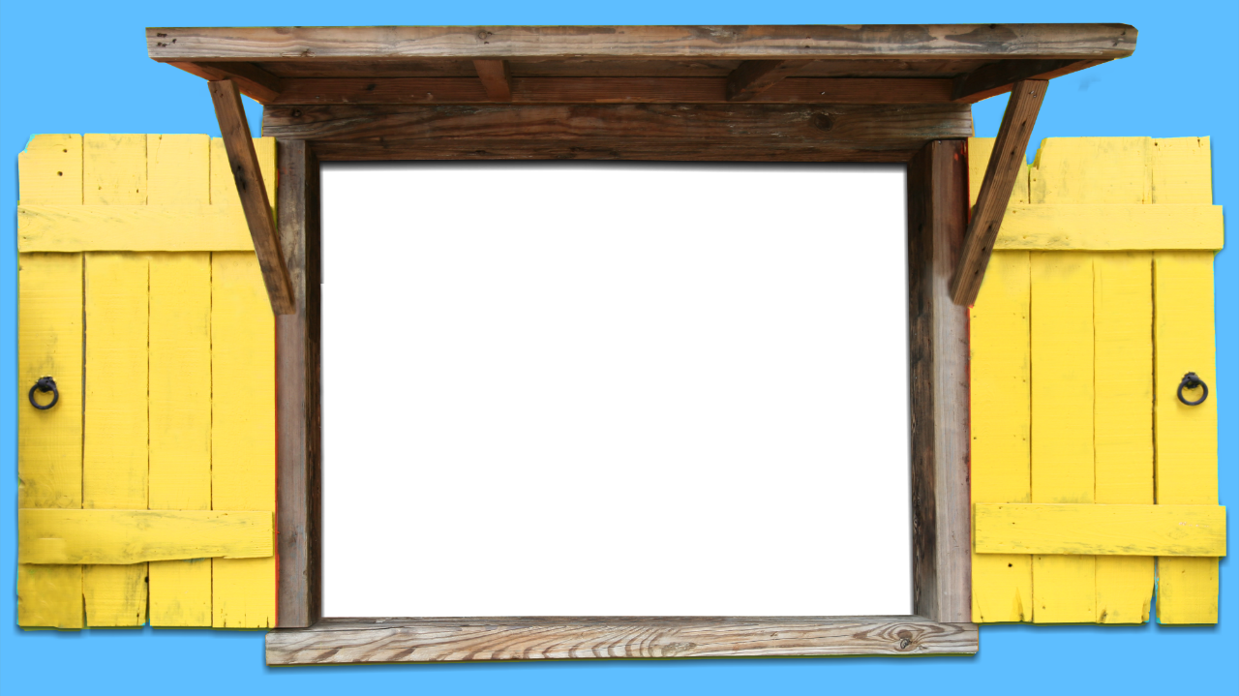
AMACEBO ONGQUZULWANO

Slide 9

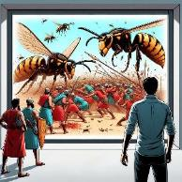
UTHIXO OSILWELAYO
“UYehova uya kunilwela; ke nina niya kuthi cwaka” (Eksodus 14:14).
Watshonisa umkhosi wamaYiputa kuLwandle oluBomvu (Eks. 14:24-28 ).
Wasebenzisa isichotho nxamnye namaKanan
( Yosh. 10:11 ).
Wabatshabalalisa abo babemdelela uEliya (2 Kumkani 1:9-10).
Wathumela iibhere nxamnye nabo babegculela uElisha (2 Kumkani 2:23-24)
Wafumana uxolo ngokumfamekisa umkhosi wamaSiriya (2 Kumkani 6:14-23)
Wenza ukuba ama-Amon namaMowabhi alwe yodwa (2 Kr. 20:15-17, 22-24).
Wabulala ama-Asiriya ali-185 000 ngobusuku nje obunye (2 Kumkani 19:35)
Wathumela isifo esibulalayo kuHerode (IZenzo 12:21-23)
Icebo likaThixo lantlandlolo yayikukuloyisa iKanan ngamandla angaphezu kwawemvelo, ngaphandle kokuba uSirayeli alwe (Eks. 23:28). Ukuba bekungekuko ukungakholwa kwabantu, ngekwakwenzekile oku.
IBhayibhile inikela ingxelo ngemizekelo yoko uThixo anokukwenza ukuze ahlangule abantu bakhe, ngaphandle kokuba bathabathe izixhobo nxamnye neentshaba zabo:

Slide 10

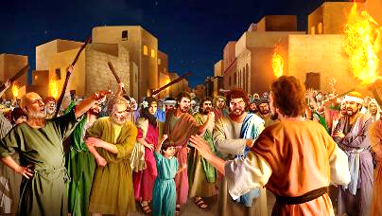
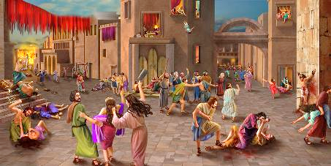

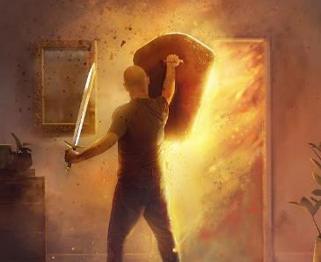
SILWELWA UTHIXO
“Bazisingela phantsi ngohlangothi lwekrele zonke izinto ezkuloo mzi, bethabathela kwindodana besa kwixhego, besa nakwinkomo, nakwimpahla emfutshane, nakwiesile.” (UYoshuwa 6:21)
Njengakwimihla yangaphambi konogumbe, okanye ngeSodom neGomora, amaKanan ayeyigqithile imida yobabalo, aza azibandakanya noSathana (Gen. 6:5; 18:20–21; 15:16).
Bonke babemiselwe ukufa kwesibini, ukufa okungunaphakade. Ukwandisa ubomi babo apha bekungayi kulitshintsha ikamva labo. Yaye uThixo wamvumela uSirayeli, ngesi sihlandlo (ekuthinjweni kweKanan), ukuba abe nenxaxheba ekuxheleni.
Kutheni le nto engazenzi ngokwakhe, njengoko wayecebile? Ngenxa yokungakholwa kwabo, uSirayeli wangcamla imfazwe yokuqala emva kokuba wathi, “Ngaba uYehova uphakathi kwethu, okanye akakho?” (Eks. 17:7-9).
Ngokuthabatha inxaxheba ngokukhutheleyo edabini (elingokwenyama kubo, elingokomoya kuthi), sihlakulela ukukholosa ngokupheleleyo ngoncedo lukaThixo.

Slide 11

“Amadabi kufuneka aliwe yonke imihla. Imfazwe enkulu iqhubeka phezu kwemiphefumlo yonke, phakathi komthetheli wobumnyama kunye neNkosana yobomi .... Njengabameli bakaThixo kufuneka nizinikele kuye, ukuze acwangcise kwaye alathise kwaye alwe idabi ngenxa yenu, ngokubambisana kwenu. INkosana yobomi iyintloko yomsebenzi waYo. Uya kuba nawe kwidabi lakho lemihla ngemihla kunye nawe, ukuze ube nokunyaniseka kumgaqo; ukuze ikhwele, lisingise ekoyiseni, yoyise ngobabalo lukaKristu; ukuba nibe ningaphezu kobeyisile ngaye owasithandayo.”
EGW (Conflict and Courage, April 21)

