Slide 1
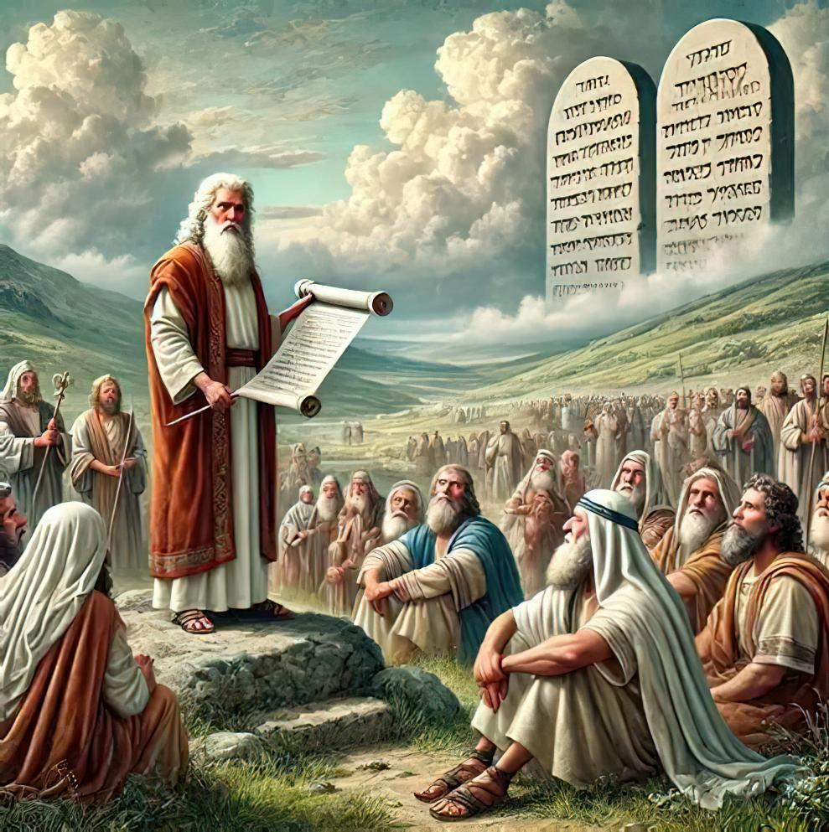
UKUTHEMBEKA KOKUGQIBELA: UNQULO KUMMANDLA WEMFAZWE
Lesson 7 for November 15, 2025

Slide 2
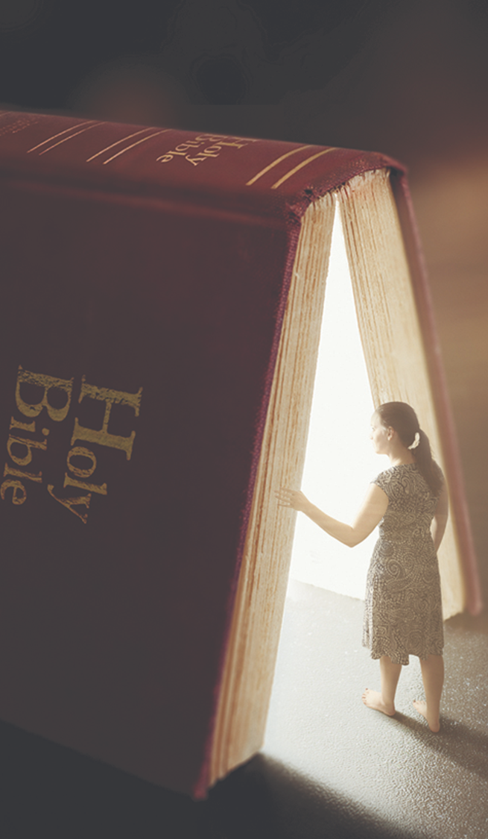
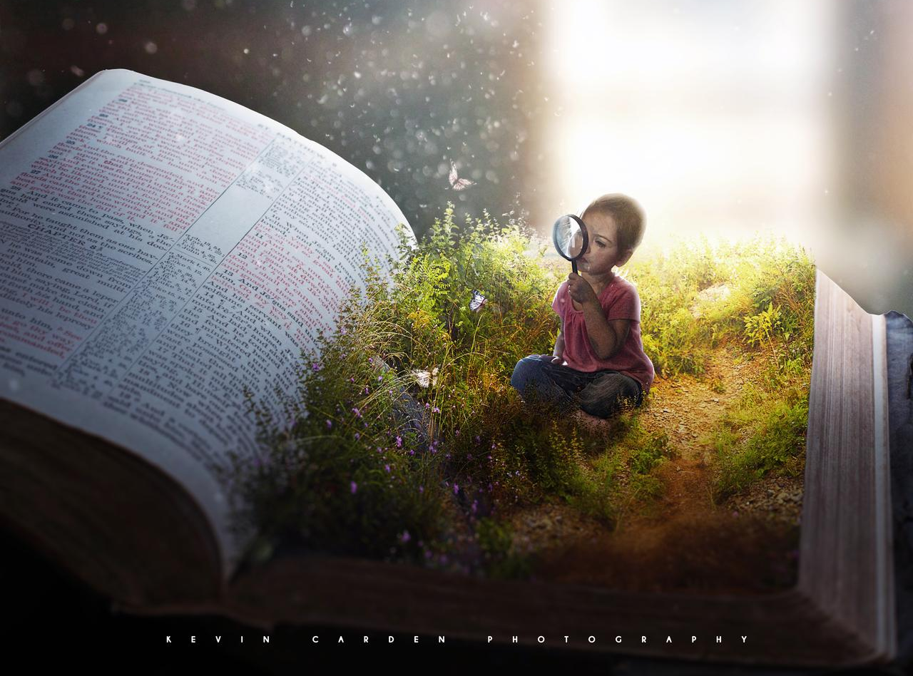

“Funani ke tanci ubukumkani bukaThixo nobulungisa bakhe, zaye zonke ezi zinto ziya kongezelelwa kuni.”
UMateyu 6:33

Slide 3

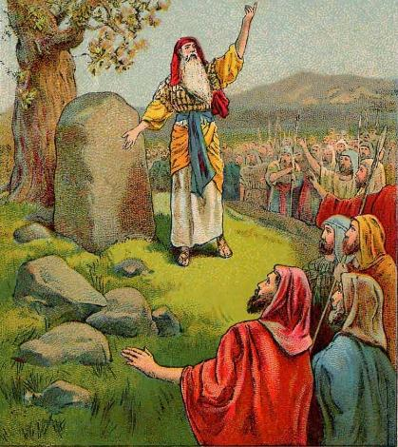
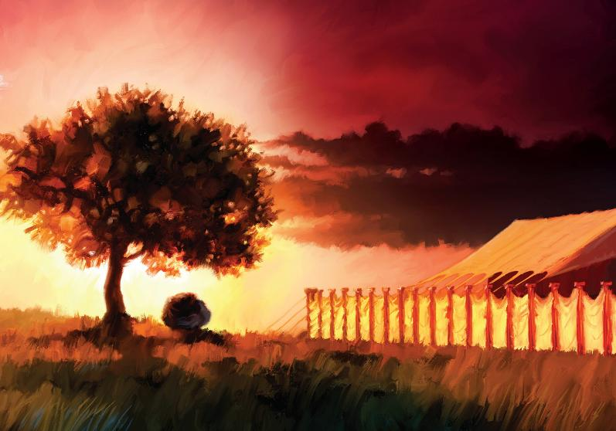








Ekuweleni iYordan ngokungummangaliso, bonke ookumkani baseKanan boyika (Yoshuwa 5:1). Umhlaba wawulungiselelwe ukoyiswa kwangoko.
Nangona kunjalo, oku kwakungeyonto iphambili kuSirayeli. Kwakufuneka baqale bafune unxibelelwano noThixo.
Phakathi koloyiso, bagqiba ekubeni bathathe ikhefu ukuze bazinikele kwakhona eNkosini kwintlanganiso enkulu phakathi kwentaba yase-Ebhali neyaseGerizim.
Kanye xa beza kugqiba ukoyisa, bafezekisa inqanaba elitsha lokunqula: bakha iNgcwele eShilo.
Unqulo phambi kokoyisa:
Ukuhlaziywa komnqophiso (Yoshuwa 5:1-9)
IPasika Yokuqala eKanan (Yoshuwa 5:10-12)
Unqulo phakathi kweentaba:
Isibingelelo sokunqula (Yoshuwa 8:30-31)
Khumbula umthetho (Yoshuwa 8:32-35)
Indawo ekhethekileyo yokunqula:
Ukuphakamisa iNgcwele (Yoshuwa 18:1)

Slide 4

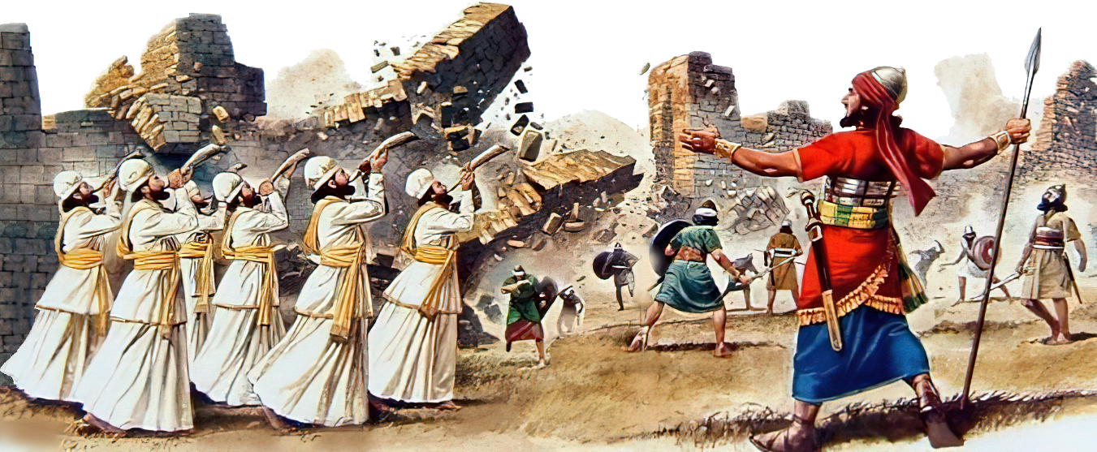
UNQULO PHAMBI KOKOYISA

Slide 5

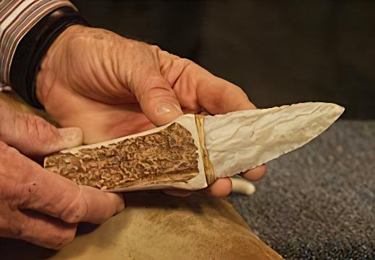
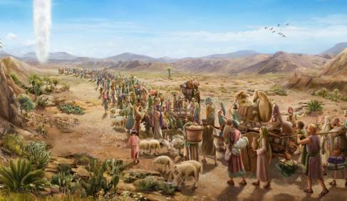

UKUHLAZIYWA KOMNQOPHISO
“Ngelo xesha uYehova wathi kuYoshuwa, Zenzele intshengece, uphinde okwesibini ukubalusa oonyana bakaSirayeli.” (Yoshuwa 5:2)
IGiligali ligama elinikwe inkampu yamaSirayeli, iziko lolawulo ngexesha lokuqala koloyiso. Lalibaluleke ngantoni eli gama (Yoshuwa 5:9)?
Nangona kwakudlule iminyaka engaphezu kwama-40 ukusukela oko baphumayo eYiputa, uSirayeli wayengekangeni kwiLizwe leDinga. Ngoku, iinyawo zabo zazinyathela kulo. Kwakulixesha lokususa “ihlazo laseYiputa” nokuhlaziya umnqophiso noThixo.
Ngaphambi kokutya iPasika yokuqala, amadoda akwaSirayeli oluswa, kuba akukho mntu ungalukanga wayenokutya kuyo (Eks. 12:48). Kodwa ngenxa yokuba bala ukungena eKanan okokuqala, umnqophiso waphulwa, kwaye akukho mSirayeli waluswa entlango (Yosh. 5:5).
Ukuhlaziya umnqophiso, kwakuyimfuneko ukuphinda loo mqondiso wenyama (Gen. 17:10). Esi senzo sabeka into ebalulekileyo kuqala. Kuthi, ngumzekelo omawulandelwe: “Funani ke tanci ubukumkani bakhe nobulungisa bakhe, kwaye zonke ezi zinto ziya kongezelelwa kuni.” (Mt. 6:33).

Slide 6

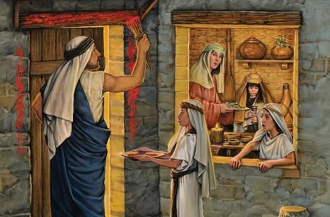
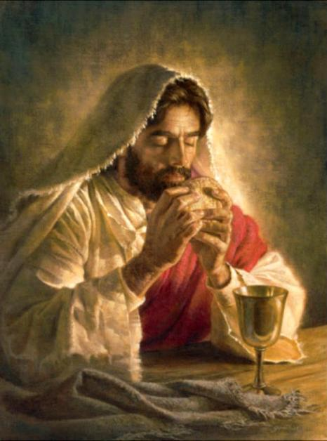
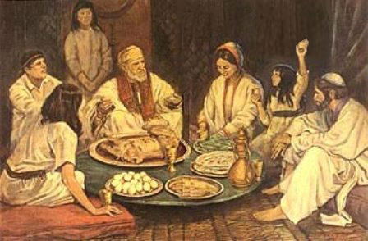
IPASIKA YOKUQALA EKANAN
“Bamisa iintente oonyana bakaSirayeli eGiligali, benza ipasika ngosuku lweshumi elinesine lwenyanga, ngokuhlwa, ezinkqantosini zaseYeriko” (Yoshuwa 5:10)
Ukusuka eYiputa ukuya eKanan, uSirayeli walandela inkqubo “engaqhelekanga”, ephinda iziganeko ngokulandelelana okungasemva::
IYiphutha
Ulwaluko nePasika
Ukuwela uLwandle oluBomvu
Intlango
Ukuwela iYordan
Ulwaluko nePasika
IKanan
IPasika yokuqala yayiluphawu lokukhululwa eYiputa. IPasika yesibini, ebhiyozelwa sisizukulwana esitsha, yayiluphawu lokuthatha kwabo iLizwe leDinga.
Ngaphambi nje kokubethelelwa kwaKhe emnqamlezweni, uYesu wanika eli siko intsingiselo entsha, eneempawu ezintsha: imvana yaba sisonka, kwaye igazi laba yiwayini.
Ngoku zizimpawu zomzimba negazi loMkhululi wethu, osikhupha eYiputa (oko kukuthi, esonweni sethu), aze asizise kwiLizwe leSithembiso (1 Kor. 11:23-26).

Slide 7

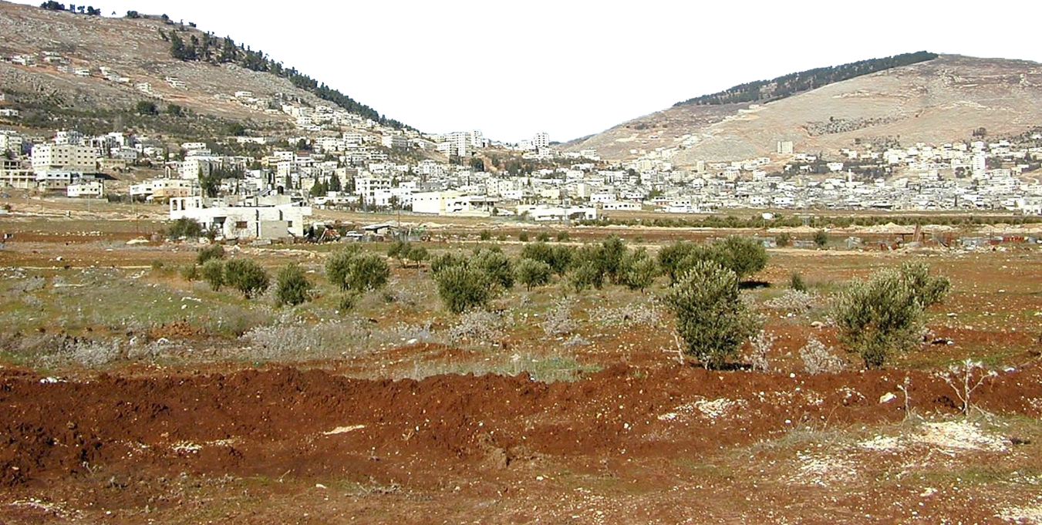
UNQULO PHAKATHI KWEENTABA

Slide 8

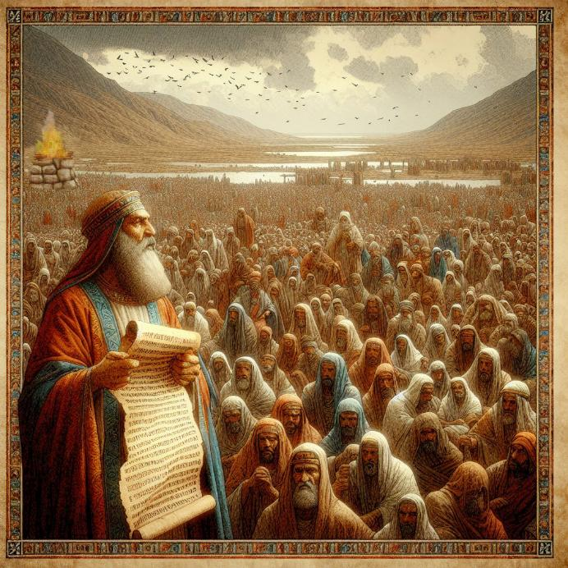
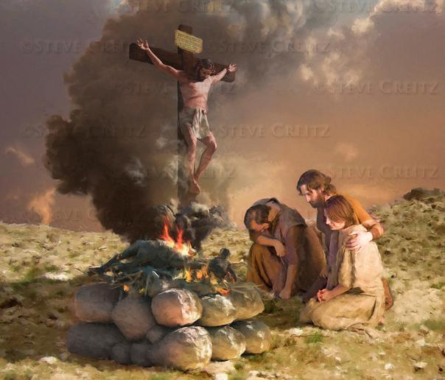
ISIBINGELELO SOKUNQULA
“Waza uYoshuwa wamakhela uYehova uThixo kaSirayeli isibingelelo entabeni ye-Ebhali” (Yoshuwa 8:30)
UMoses wayeyalele ukuba xa Bengena eKanan, ze kwakhiwe isibingelelo eNtabeni iEbhali, kwaye kufanele kunikelwe indumiso kuThixo (Dut. 27:5-7). Kutheni kwiNtaba iEbhali kungekhona eGerizim?
Isibingelelo kunye nemithetho eyayiza kubhalwa kwisikhumbuzo kwaye ifundwe ebantwini yayinxulumene neentsikelelo neziqalekiso (Dut. 27:12-13). Intsikelelo yavakaliswa kwiGerizim, saze isiqalekiso savakaliswa e-Ebhali.
UYesu waba sisiqalekiso ngenxa yethu, ukuze sifumane intsikelelo (Gal. 3:13-14). Esi sibingelelo, kuthi, ngumfanekiso ocacileyo wedini likaYesu egameni lethu.
Phakathi koloyiso, uSirayeli wafuna ithuba lokuzinikezela kwakhona kuThixo. Esi sisimemo sokuba sixelise umzekelo wabo, sizinikezele kwakhona kuThixo, kungekuphela nje ngabanye, kodwa nanjengabantu abakhethiweyo bakaThixo.

Slide 9

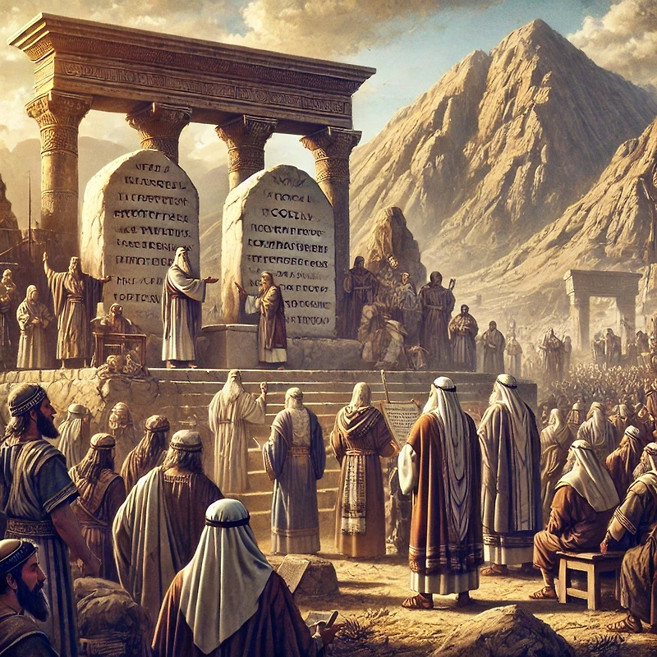
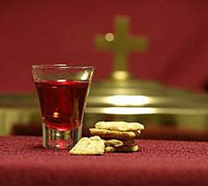
KHUMBULA UMTHETHO
“Wabhala khona ematyeni, wawuphinda ukuwubhala umyalelo kaMoses, awawubhalayo phambi koonyana bakaSirayeli” (Yoshuwa 8:32)
Emva kokwakha isibingelelo kwiNtaba i-Ebhali, uYoshuwa wamisa amatye athile waza wawadyobha mhlophe. Emva koko wabhala kuwo ikopi yomthetho [iDuteronomi, eyayiquka iMithetho Elishumi kunye nemithetho eyahlukeneyo, kunye neentsikelelo neziqalekiso] (Yosh. 8:32; Dut. 27:2-3).
Ekugqibeleni, umthetho wafundelwa abantu, wahlulwahlulwa kabini—enye kwicala ngalinye lentaba (Josh. 8:33-35). Ngale ndlela, umnqophiso phakathi kukaThixo nabantu bakhe wavuselelwa.
Olu lubizo nakuthi. Njengabantu bakaThixo abaseleyo, simele sihlaziye umnqophiso wethu naYe rhoqo, sikhumbula indlela asikhokelele ngayo apha kunye neentsikelelo asinike zona.
Ukongeza ekuvuseleleni kwethu, uMthendeleko oNgcwele usinika ithuba elikhethekileyo lokuhlaziya njengabantu bakaThixo.

Slide 10
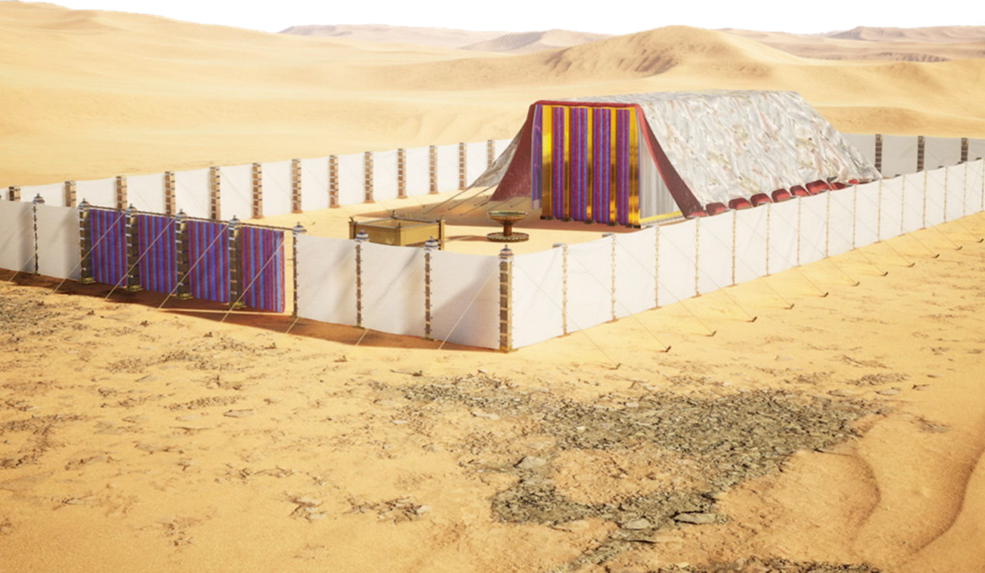
INDAWO EKHETHEKILEYO YOKUNQULA

Slide 11
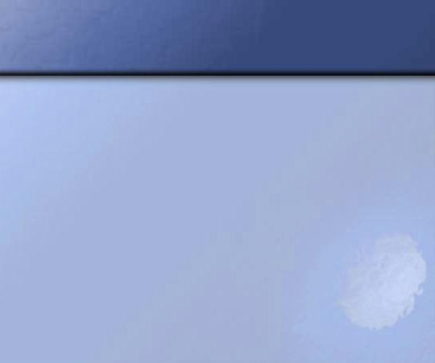
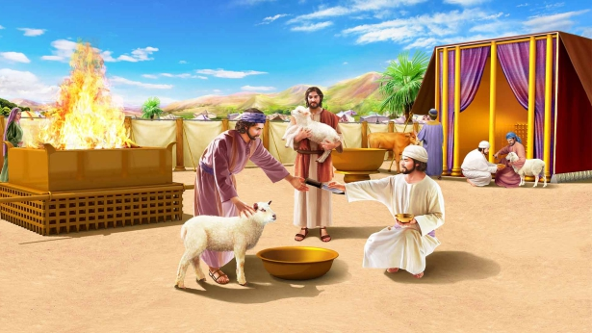
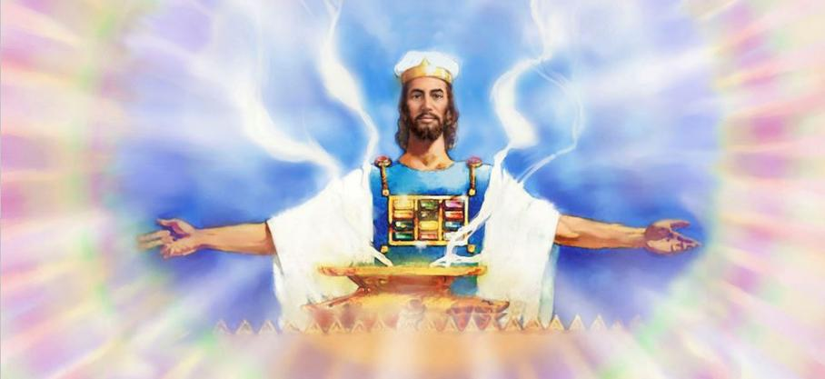
UKUMISA INTENTE YOKUHLANGANA
“Labizelwa ndawonye lonke ibandla lakwaSirayeli eShilo; bayimisa khona intente yokuhlangana. Leyiseka ilizwe phambi kwabo” (Yoshuwa 18:1)
Umhlaba wawusele uthotyiwe nguSirayeli. Lo mhlaba wawusele wahlulwe phakathi kwezizwe ezibalaseleyo, nangona izizwe ezisixhenxe zazingekafumani isabelo sazo. Amajoni kaRubhen, kaGadi, nesiqingatha sesizwe sakwaManase ayeza kuthunyelwa kwiindawo zawo ngaphaya kweJordan.
Ngaphambi kokuba izizwe zahlukane, kwenziwa isenzo esikhethekileyo nesibalulekileyo: kwamiswa intente yokuhlangana, iziko lonqulo lwamaSirayeli (Yosh. 18:1).
INgcwele, njengendawo yokuhlala kaThixo ebonakalayo, yayiyindawo yomanyano apho bonke bamanyana kunqulo. Ngaphandle kobukho bukaThixo, ukuba nomhlaba kwakungenantsingiselo.
Namhlanje, xa kusekho iingxilimbela zanamhlanje nezasemva kwexesha lonyaka ekufuneka zoyiswe, kubaluleke kakhulu ukuba sigxile kwiNgcwele yasezulwini, apho uYesu asithethelela khona.

Slide 12

“Kwakungadlulanga neeveki ezininzi emveni kokuba uMoses wanikela yonke incwadi yeDuteronomi kwiintetho yakhe ebantwini, ngoku uYoshuwa ufunda umthetho kwakhona.”
Yayingengomadoda akwaSirayeli kuphela, kodwa “bonke abafazi nabantwana” baphulaphula ukufundwa komthetho; kuba kwakubalulekile ukuba nabo bazi baze benze umsebenzi wabo. […]
Isahluko ngasinye kunye nevesi nganye yeBhayibhile lunxibelelwano oluvela kuThixo oluya ebantwini. Sifanele sibophe imiyalelo yayo njengemiqondiso ezandleni zethu nanjengezibonda phakathi kwamehlo ethu. Ukuba ifundwe kwaye ithotyelwe, yayiza kukhokela abantu bakaThixo, njengoko amaSirayeli ayekhokelwa, yintsika yelifu emini kunye nentsika yomlilo ebusuku.
EGW (Patriarchs and Prophets, pp. 500-504)

