Slide 1
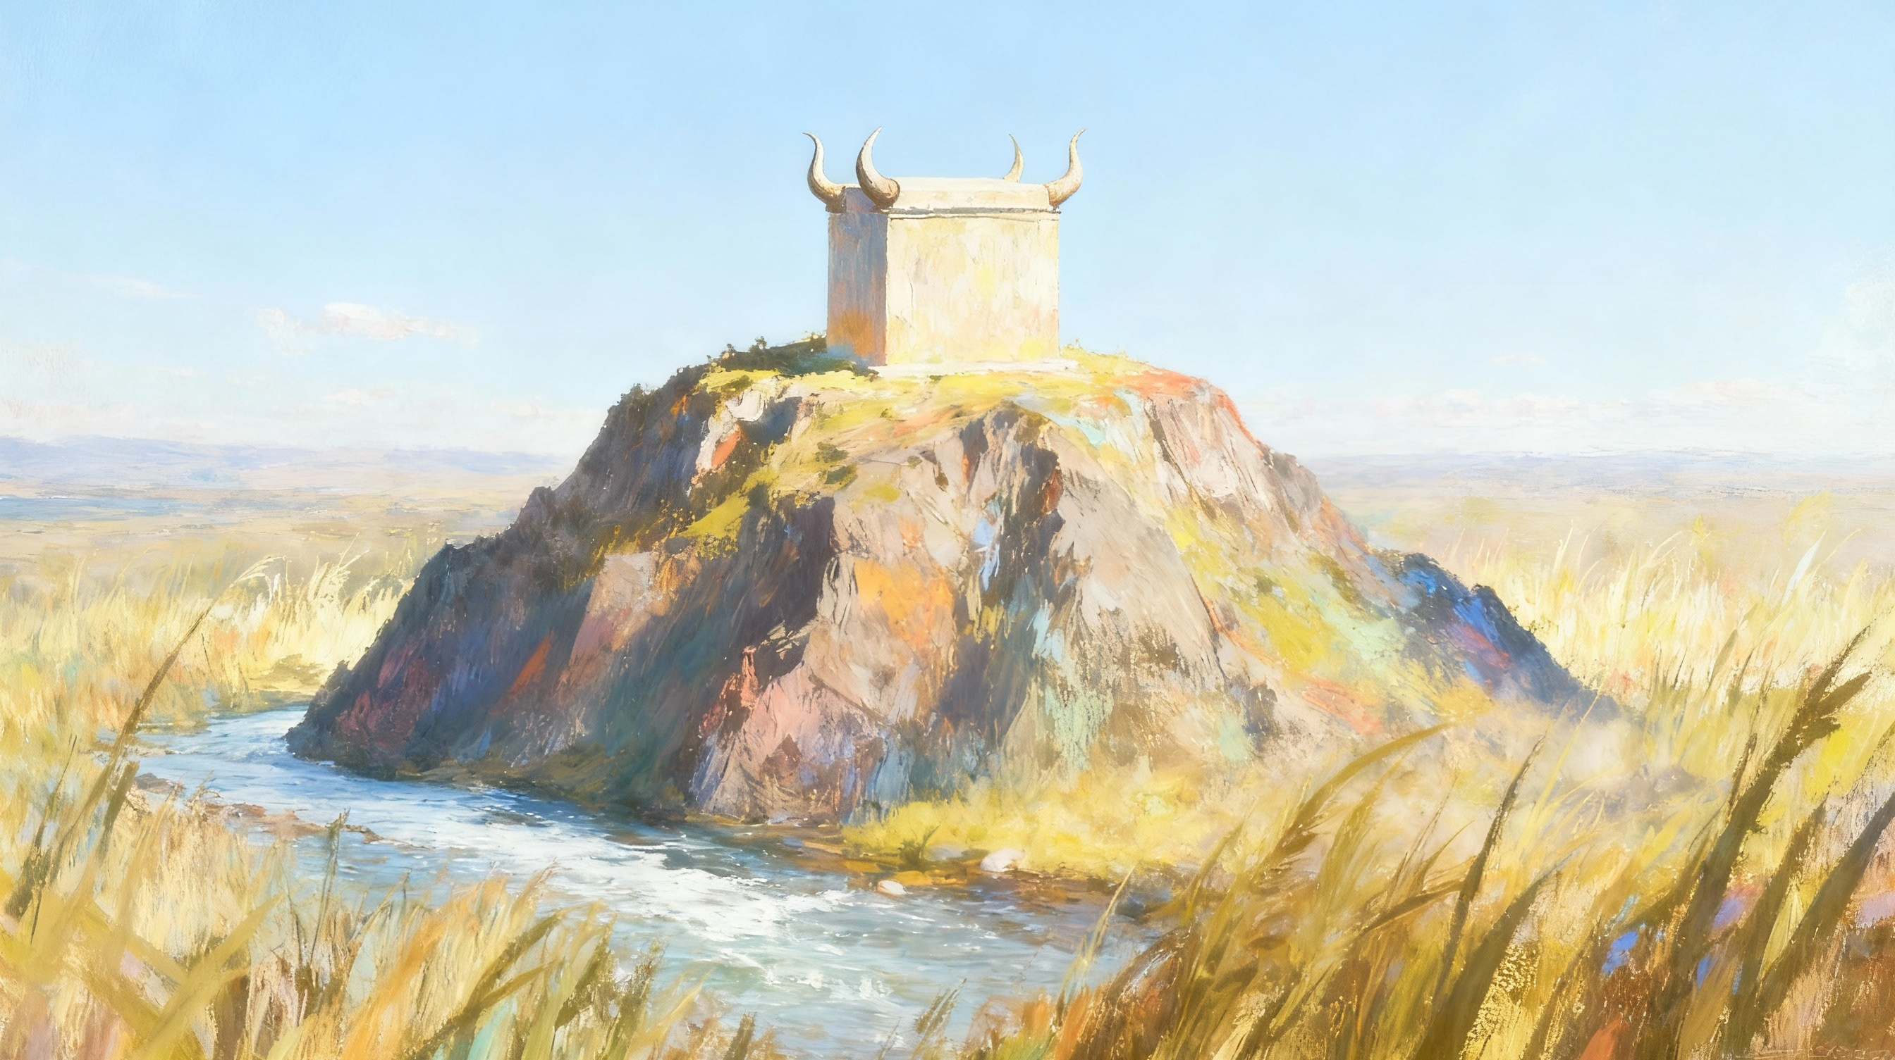
UKUHLALA ELIZWENI
ISifundo 11 – 13 kweyoMnga 2025

Slide 2
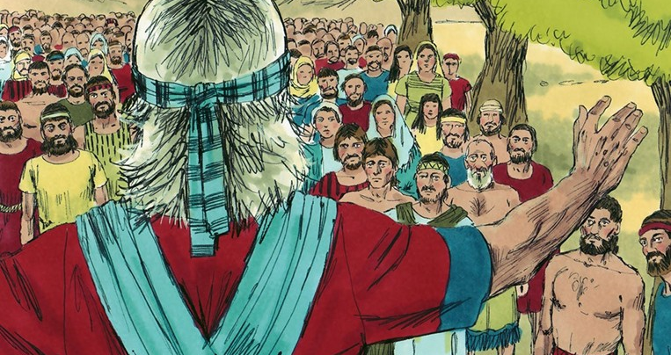

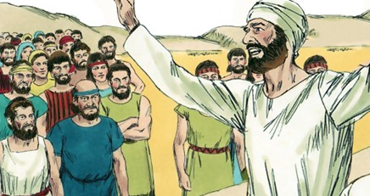
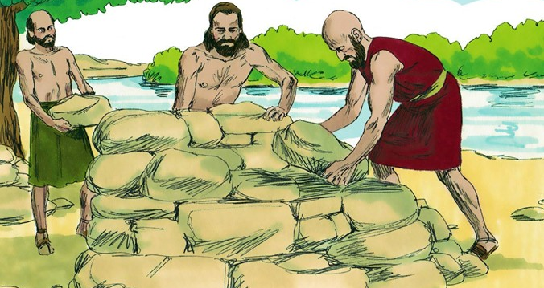
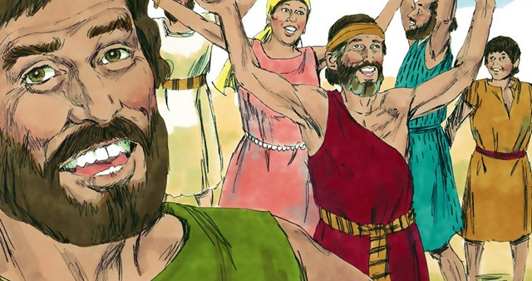
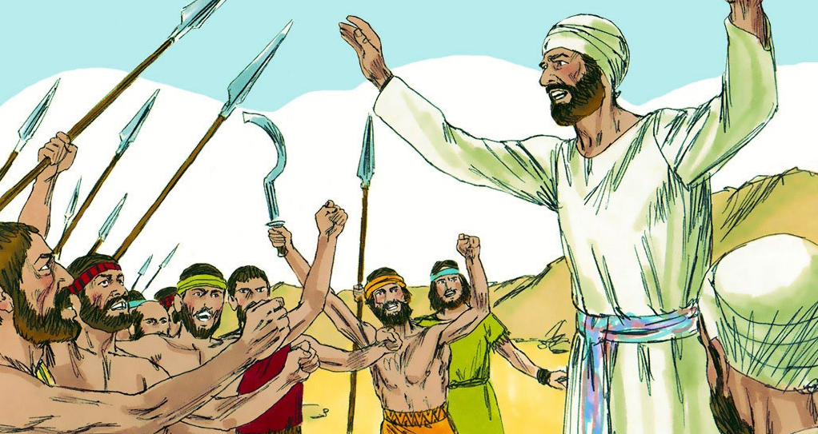
“Impendulo ethambileyo ibuyisa ubushushu; Ilizwi elidubulayo linyusa umsindo” (IMizekeliso 15:1)

Slide 3

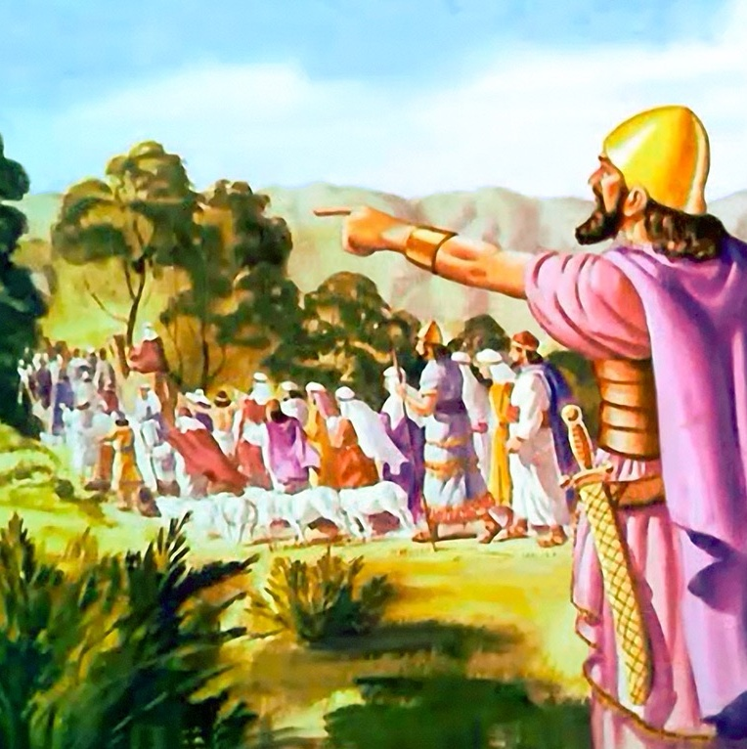
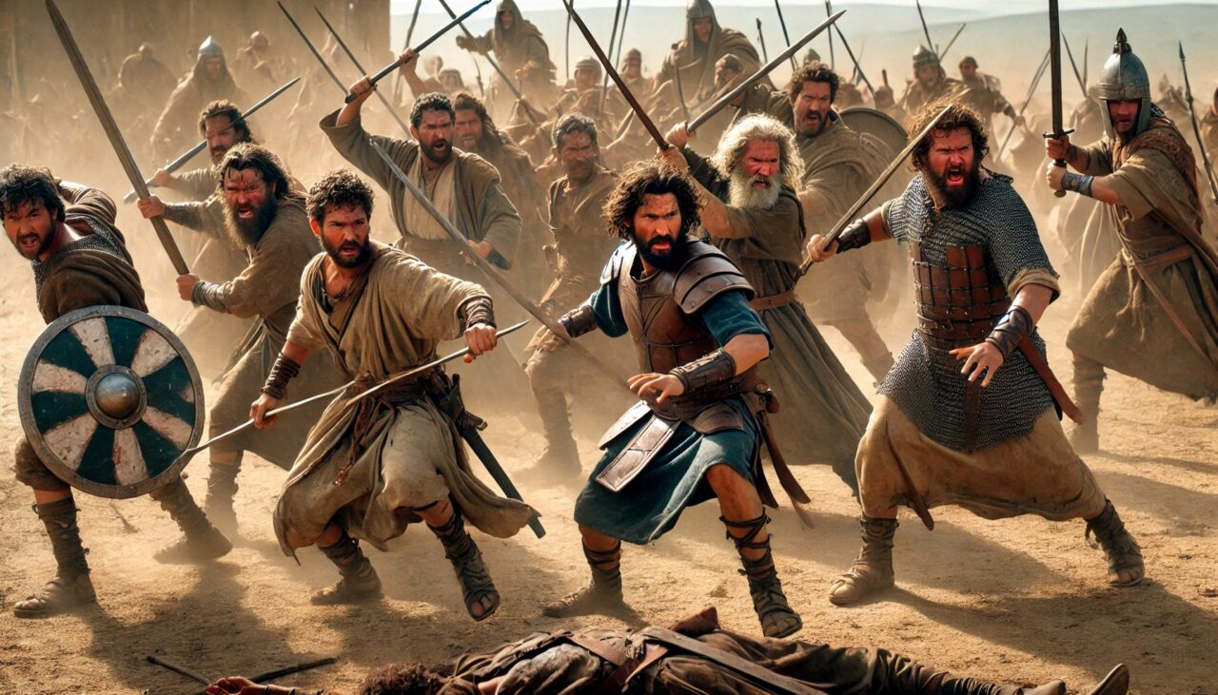





Emva kweminyaka eliqela yemfazwe, uSirayeli wayeyoyisile iKanan, nangona babengekabaduduli bonke abemi bayo.
Izizwe ezibini ezinesiqingatha ezazithathe indawo yasempuma (uRubhen, uGadi kunye nesiqingatha sesizwe sakwaManase), nezaziwele iYordan ukuze zincede ekuloyiseni, zazizalisekise ngokuthembeka isibophelelo sazo.
Ekugqibeleni, ixesha lokwahlukana lalifikile. Emva kokubasikelela nokubacebisa ukuba baqhubeke nendlela kaThixo, uYoshuwa uyabakhulula. Kodwa ukuvalelisa kwagutyungelwa kukungaqondani okukhulu okwakunokutshabalalisa ngokulula ubunye babantu bakwaSirayeli.
Intetho yokuvalelisa (Yoshuwa 22:1-8)
Isizathu songquzulwano (Yoshuwa 22:10-12)
Izityholo (Yoshuwa 22:13-20)
Impendulo ethambileyo (Yoshuwa 22:21-29)
Uxolelwaniso (Yoshuwa 22:30-34)

Slide 4


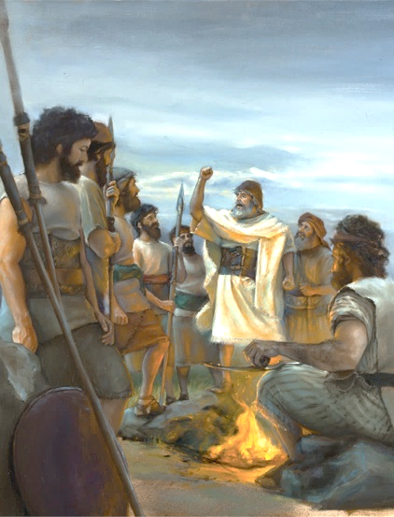
INTETHO YOKUVALELISA
“Kodwa gcinani kunene ukuba niwenze umthetho nomyalelo awaniwiselayo uMoses, umkhonzi kaYehova, wokuba nimthande uYehova uThixo wenu, nihambe ngeendlela zakhe zonke, niyigcine imithetho yakhe, ninamathele kuye, nimkhonze ngentliziyo yenu yonke, nangomphefumlo wenu wonke.”(Yoshuwa 22:5)
Ekubeni iJordani yayiza kubangela ukwahlukana phakathi kwezizwe, uYoshuwa wanika icebiso elinobulumko kwizizwe ezibini ezinesiqingatha ukuze zihlale zithembekile (Yoshuwa 22:5):
Ukuthanda uYehova uThixo wenu
Ukuhamba ngokumthobela
Ukugcina imithetho yaKhe
Ukubambelela kuYe
Ukumkhonza ngentliziyo yakho yonke nangomphefumlo wakho wonke
Uthando ngumgaqo omawusikhokele kuThixo. Siyamthanda ngokuba yena wasithanda kuqala (1 Yohane 4:19)
Le yindlela uYoshuwa abonisa ngayo ukuziphatha okulindelweyo kwabo bakhetha ukuhamba noThixo.
Ukuthobela sisiphumo sendalo sentliziyo enombulelo eqondayo oko uThixo akwenzileyo
Simele sinamathele kuThixo ngaphandle kokuvumela naluphi na ukuphazamiseka ukuba lwaphule olo manyano.
Sifumana injongo yethu yokwenene, ulwaneliseko, nobomi obuninzi xa sikhonza uMdali wethu ngothando ngokuzithandela.

Slide 5


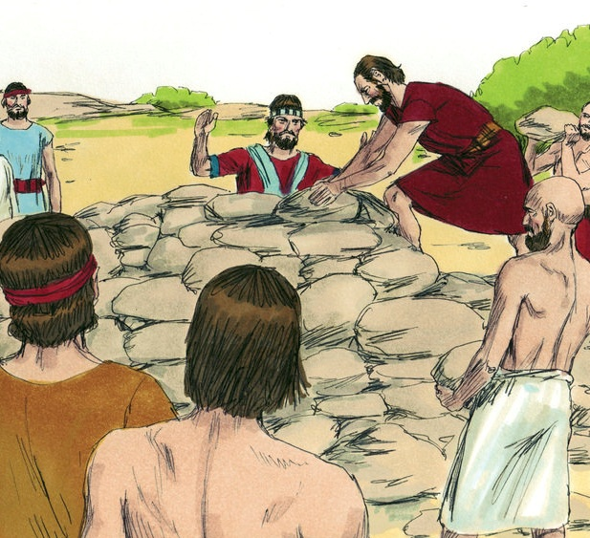
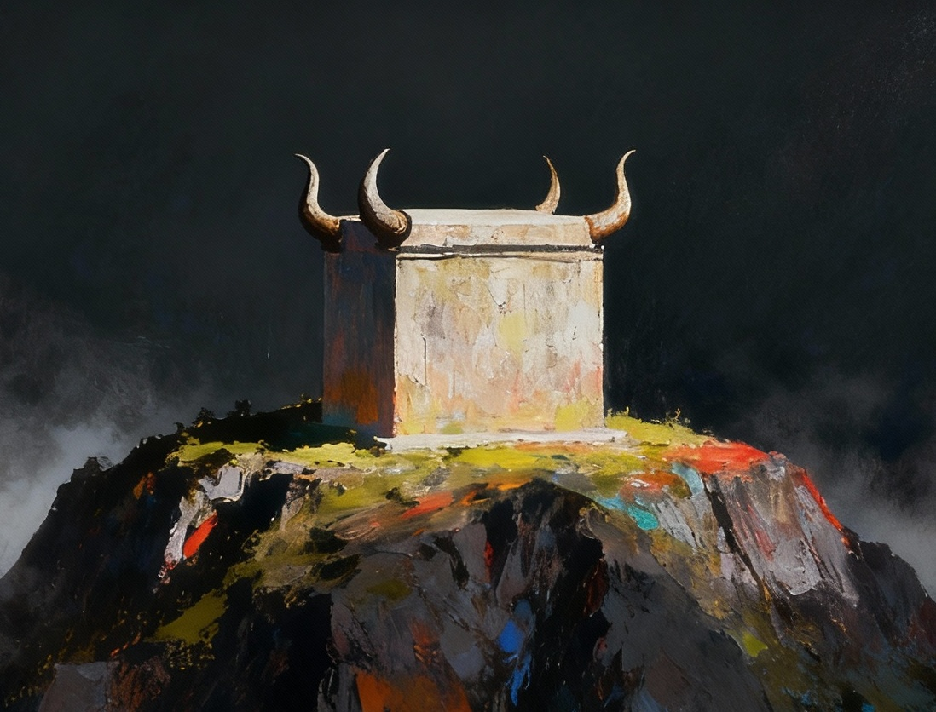
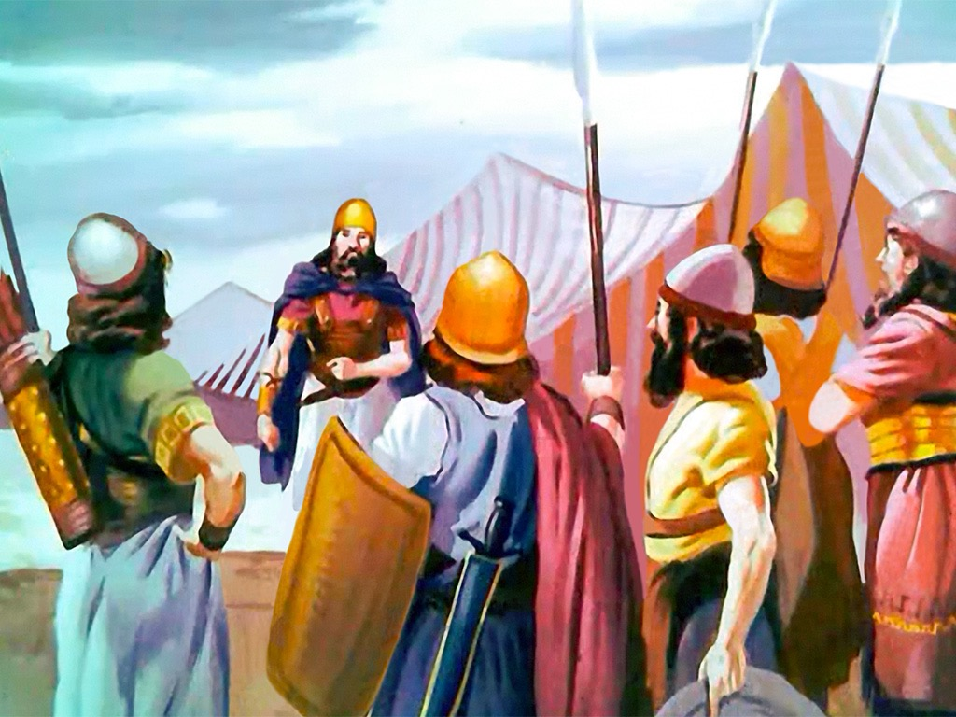
ISIZATHU SONGQUZULWANO
“Bafika emimandleni yaseYordan, esezweni lakwaKanan. Oonyana bakaRubhen, noonyana bakaGadi, nesiqingatha sesizwe sakwaManase bakha khona isibingelelo esikhulu, esibonakalayo.” (Yoshuwa 22:10)
Kufutshane nendawo apho uYoshuwa wayemise khona isikhumbuzo sokuwela iJordan ngokungummangaliso, izizwe ezibini ezinesiqingatha zakha isibingelelo esifana nesibingelelo seNgcwele (Yoshuwa 22:10, 28).
Esi senzo satolikwa njengokwaphulwa komthetho owawuthintela ukunikela amadini kwindawo engaphandle kwesibingelelo seminikelo etshiswayo kwiNgcwele (Lev. 17:8-9).
Amanye amaSirayeli agqiba ekubeni asisuse esi sono ngokuhlasela abazalwana bawo (Yosh. 22:12). Kodwa uThixo wangenelela ukuthintela imfazwe yamakhaya echitha igazi. Wavusa abantu abakhetha ukungagwebi ngaphandle kobungqina bonke; banika ithuba lokungabaza; baza bagqiba ekubeni banike abazalwana babo ithuba lokuzichaza (Yosh. 22:13-14).
Njengoko kwavela, impazamo yakhe kuphela yayikukungabazisi abazalwana bakhe ngeenjongo zakhe… kodwa oko akusiso isono.

Slide 6

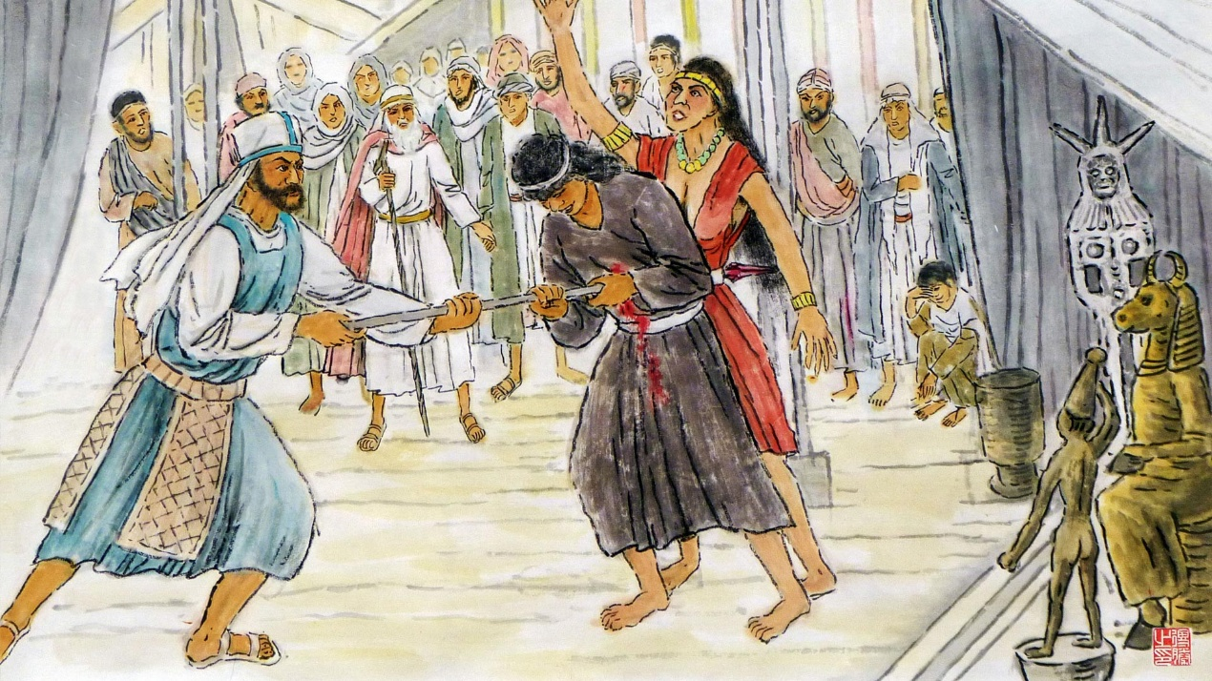
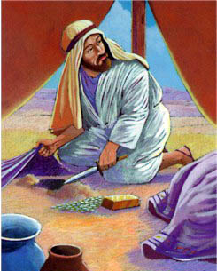
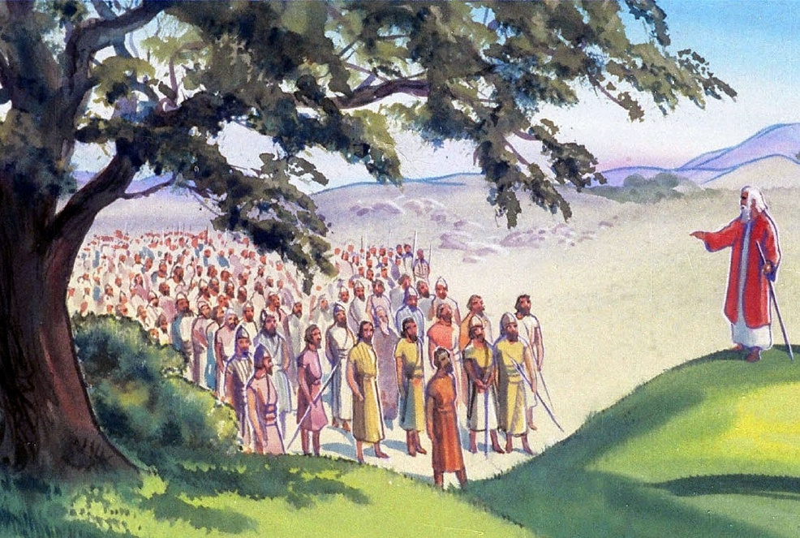
IZITYHOLO
“Litsho lonke ibandla likaYehova, ukuthi, Bubumenemene buni na obu nimeneza ngabo kuThixo kaSirayeli, nibuya nje namhla ekumlandeleni uYehova, ngokuzakhela isibingelelo ukuba nigwilike kuYehova namhla?”
(Yoshuwa 22:16)
Kwakutheni ukuze kukhethwe uPinehasi ukuba akhokele ikomiti ephandayo (Yosh. 22:13-14)?
UPinehasi, unyana wombingeleli omkhulu, wayengenalo uloyiko ekuyekeni isono eBhahali-Pehore (Num. 25:7-8). Kwintetho yakhe, wadibanisa esi sono nesono sika-Akan waza wasifanisa nesono esenziwa zizizwe ezibini ezinesiqingatha (Yosh. 22:16-20).
Intetho kaPinehasi yayinengqiqo epheleleyo. Ukuba amadini ayenikelwa kwisibingelelo esitsha esakhiweyo, uThixo wayeza kohlwaya onke amaSirayeli ngenxa yaso (Yosh. 22:18b).
Nangona kunjalo, wabanika ithuba lokulungisa le mpazamo, ngaphambi kokuba benze isono: wabanika ithuba lokubuyela kwicala laseJordan apho kwakukho iNgcwele (Yosh. 22:19).

Slide 7


IMPENDULO ETHAMBILEYO
“Ukuba sizakhele isibingelelo sokusibuyisa ekulandeleni uYehova, nokuba sinyusa phezu kwaso idini elinyukayo, nomnikelo wokudla, nomnikelo wokudla, nokuba senzele phezu kwaso imibingelelo yoxolo: uYehova ngokwakhe makakubuze oko.” (Yoshuwa 22:23)
Izizwe zakwaRubhen noGadi, kunye nesiqingatha sesizwe sakwaManase, xa babetyholwa, benza ngendlela engumzekelo:
Baziphulaphula izityholo ngokuzola
Babiza uThixo njengengqina labo
Bavuma ukuba bangohlwaywa ukuba bonile
Batyhila eyona nto ibaqhubileyo
Xa amaSirayeli ayengazazi izizathu zabazalwana babo zokwakha isibingelelo, acinga: ukuvukela, umnqweno wokwahlukana, kunye nesohlwayo sikaThixo.
Inyani yayikukuba: umnqweno wokuhlala emanyene nabazalwana bawo kwaye baphephe ukwahlukana kwixesha elizayo ngamaSirayeli (Yosh. 22:24-26).
Nangona izizwe ezazityholwa zazinokuthi zicaphuke zizityholo kwaye zisabela ngogonyamelo ekuzikhuseleni, ngenxa yempendulo yazo enobuhlobo, imfazwe yaphetshwa.

Slide 8

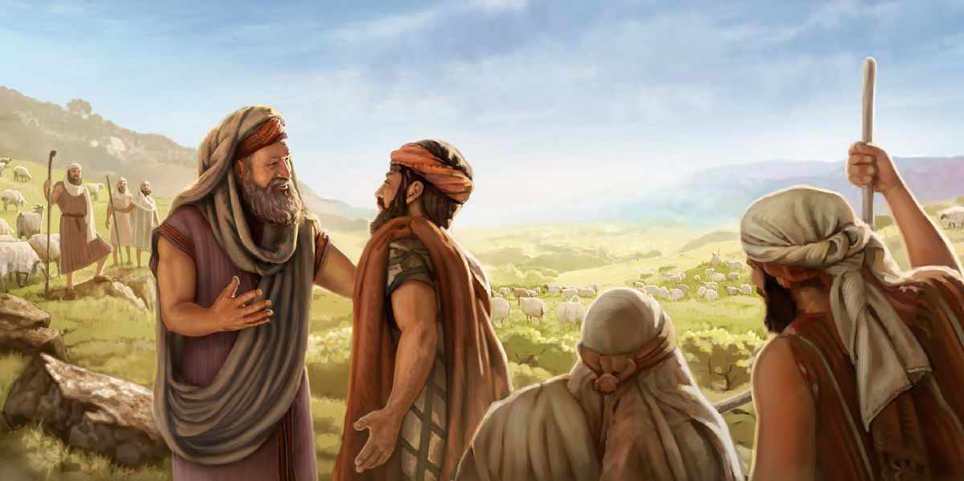
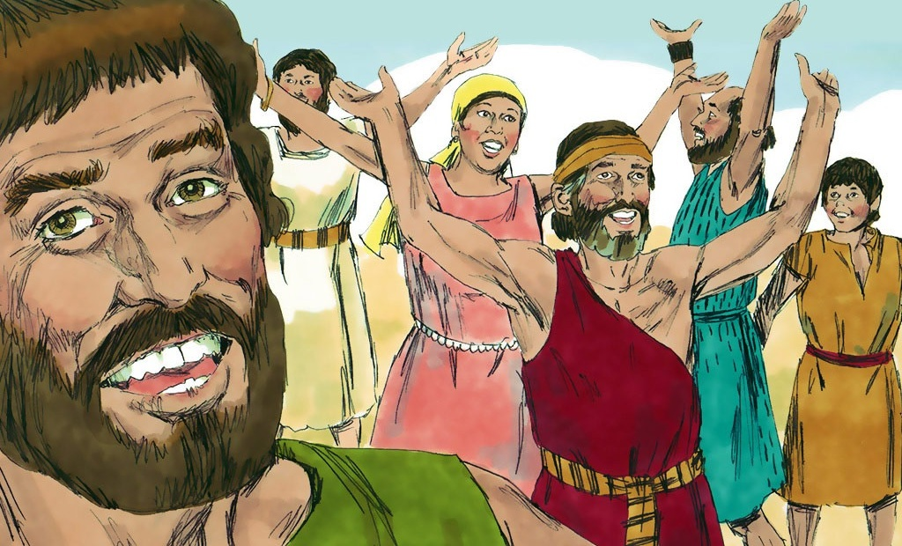
UXOLELWANISO
“Ilizwi elo lalunga emehlweni oonyana bakaSirayeli bakaSirayeli. Oonyana bakaSirayeli bambonga uThixo, ababa sathetha ngokunyuka baye kubo ngobumpi. Balitshabalalise ilizwe abahleli kulo oonyana bakaRubhen noonyana bakaGadi” (Yoshuwa 22:33)
Ebona ukuba eso sityholo sasingenasihlahla, uPinehasi kunye neqela lamaSirayeli bakhululeka (Yosh. 22:30-31). Kwelinye icala, xa amaSirayeli afunda inyaniso, avuya aza amdumisa uThixo (Yosh. 22:32-33).
Ngomzekelo wabo, sinokubona amanyathelo afunekayo okubuyisela uxolo kwiimeko ezifanayo xa kuziwa kusapho, ebandleni, nakuluntu:
Musa ukutsibela izigqibo
Thethani ngeengxaki phambi kokwenza
Kulungele ukuncama ukuze kubekho uxolo
Nika impendulo ethambileyo kwizityholo
Vuyani kwaye nimbulele uThixo ngokubuyisela uxolo
Ukunxibelelana iingcinga zethu

Slide 9

“Abantwana bakaGadi noRubhen ngoku babeka umbhalo kwisibingelelo sabo ochaza injongo yokwakhiwa kwaso; bathi, “Siya kuba bubungqina phakathi kwethu ukuba uYehova nguThixo.” Ngaloo ndlela bazama ukuthintela ukungaqondi kakuhle kwixesha elizayo nokususa oko kunokuba sisilingo.
Zingaphi iingxaki ezinkulu ezivelayo ngokungaqondani nje, kwanaphakathi kwabo baqhutywa ziinjongo ezifanelekileyo; kwaye ngaphandle kokusebenzisa imbeko nokunyamezela, zeziphi iziphumo ezinzulu nezibulalayo ezinokulandela […]
Akukho mntu wakha wabuyiselwa kwindawo engafanelekanga ngokugxekwa nokugxekwa; kodwa abaninzi ngaloo ndlela bagxothwa kude nendlela elungileyo baze bakhokelelwe ekubeni baqinise iintliziyo zabo nxamnye nokukholelwa. Umoya wobubele, ukuziphatha okunembeko, nokungakhathaliyo kunokusindisa abaphambukayo kwaye kufihle inkitha yezono.”
EGW (Patriarchs and Prophets, pp. 519)

