Slide 1

UBUNYE NGOKUTHOBEKA
ISifundo 4 – 24 KweyoMqungu 2026

Slide 2

“Luzaliseni uvuyo lwam, ukuze nicinge ntonye, ninaluthando lunye, ninamphefumlo mnye, nicinga nto-nye”
KwabaseFilipi 2:2

Slide 3







UPawulos usandula ukukhuthaza amakholwa aseFilipi ukuba eme eqinile xa ejongene nemingeni yobomi bobuKristu. Ubacele ukuba baziphathe ngendlela efanele abemi basezulwini, egxininisa umanyano.
Ngebinzana elithi “ngako oko”, uPawulos uqala icandelo elitsha apho asinika khona izitshixo zokuqonda indlela yokufikelela kolo manyano lugqibeleleyo: ngokuxelisa umzekelo kaYesu.
Imvelaphi yokwahlukana (KwabaseFilipi 2:1-3a)
Ubunye ngokuthobeka (KwabaseFilipi 2:3b-4)
Cinga njengoYesu (KwabaseFilipi 2:5)
Ingqondo sikaYesu (KwabaseFilipi 2:6-8)

Slide 4



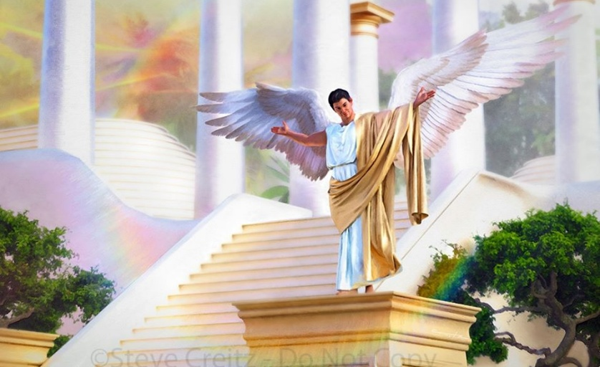

IMVELAPHI YEYANTLUKWANO
“Ningennzi nanye into ngokweyelenqe, nangokozuko olulambathayo” (KwabaseFilipi 2:3a)
Ngaphambi kokuba abeke umnwe wakhe kwindawo ebuhlungu, ebonisa izizathu zokwahlukana okwakubonwa phakathi kwamaFilipi, zeziphi iingcebiso zokuqala azinika zokufezekisa umanyano, ukugqibezela uvuyo lwakhe (Filipi 2:1-2)?
Intuthuzelo kuKrestu
Intuthuzelo eluthandweni love
Ubudlelane bomoya
Uthando olusuka entliziyweni
Inceba
Ubunye bovakalelo nothando
Ubakhuthaza ukuba bafunde baze baxelise ubomi obungumzekelo bukaKristu
Uthando lwabo ngoKristu lunamandla avuselelayo phezu kweengqondo zabo
Bamele bazithobe phantsi kolawulo loMoya
Bafanele babonakalise iimvakalelo ezithambileyo nezifudumeleyo zothando lomntu
Mababonise ubukho bothando lokwenene ngezenzo zomntu ngamnye zenceba.
Ukuthandana kudala iingcinga ezifanayo kukhokelele nakwizenzo zobunye
Konke oku banokukufezekisa kuphela ukuba babebeka ecaleni oko kubahlukanisayo: ikratshi neengxabano (Fil. 2:3a).
Zombini ezi ngxaki zazikho kwimvukelo kaLucifer, kwaye ziphakathi kwezona ngxaki zinkulu kubudlelwane (Gal. 5:26; Yak. 3:16)

Slide 5




UBUNYE NGOKUTHOBEKA
“… Yithini ngokuthobeka kwentliziyo omnye ambalele omnye ekuthini ungoyena wongamileyo kunayo. Makangathi elowo axunele kwezakhe izinto zodwa, elowo makaxunele nakwezabanye.” (KwabaseFilipi 2:3b-4)
Indlela yobumbano ecetyiswa nguPawulos ayisiyonto yangaphandle, kodwa yimeko yangaphakathi: ukuthobeka. Ngaphandle kokuba luphawu oluphawulekayo lukaYesu, wakhuthaza abaphulaphuli bakhe ukuba bathobeke (Mt. 11:29; 18:4; 23:12).
Ukuze sifikelele kolu kuthobeka, uPawulos ucebisa ukuba sibajonge abanye njengababalulekileyo kunathi (Fil. 2:3). Kodwa asilingani na sonke phambi koThixo? Akufanele na kubekho ukulingana ukuze kubekho ubunye?
UPawulos akatsho ukuba singaphantsi kwabanye, kodwa endaweni yoko kufuneka sizicingele ngokwethu. kanye njengokuba isicaka sifuna okulungileyo kwinkosi yaso, nathi sifanele sifune okulungileyo kwabo sibajonga njengabangcono kunathi (Fil. 2:4).
Ukuze sikwazi ukunceda abanye, kufuneka sifunde ukubaphulaphula nokuqonda imbono yabo. Konke oku ngokungathandabuzekiyo ngumsebenzi woMoya oyiNgcwele.

Slide 6




CINGA NJENGOYESU
“Yibani nale ngcinga kuni, wayenayo kuye uKristu Yesu” (KwabaseFilipi 2:5)
Zimiliselwe njani iingcinga zethu? Ngeendlela “zomphefumlo,” oko kukuthi, iimvakalelo zethu. Yonke into esiyifundayo, esiyibonayo, okanye esiyivayo iyasibumba ngandlela thile. Kwaye, ewe, uSathana uhlasela iimvakalelo zethu ukuze abumbe iingqondo zethu ngendlela yakhe yokucinga.
UPawulos ungumntu ongqongqo. Akasimemi nje kuphela ukuba sijonge iingcinga zethu, kodwa usicela ukuba sicinge njengoko uKristu wayecinga (Fil. 4:8; 2:5).
Mhlawumbi singaphumelela, ngomzamo omkhulu, kuqala. Kodwa ukutshintsha iingqondo zethu ukuze zivumelane nengqondo kaYesu kungenziwa kuthi kuphela nguMoya oyiNgcwele.
Oku kungenxa yokuba iingcinga zethu zezenyama, kwaye intliziyo yethu iyakhohlisa (Yer. 17:9). UMoya uya kuguqula ingqondo yethu yenyama ibe yingqondo yokomoya, njengekaKristu (Roma 8:1, 5).

Slide 7

EGW (Patriarchs and Prophets, p. 436)
“Sekunjalo sinomsebenzi ekufuneka siwenze wokulwa nesilingo. Abo bangafuniyo ukuba lixhoba leengcinga zikaSathana kufuneka bavingce amazibuko aya emphefumlweni; kufuneka bakuphephe ukufunda, ukubona, okanye ukuva oko kuya kuthetha iingcinga ezingcolileyo. Ingqondo akufanele ishiywe izulazula kuyo yonke into enokucetyiswa lutshaba lwemiphefumlo.”

Slide 8

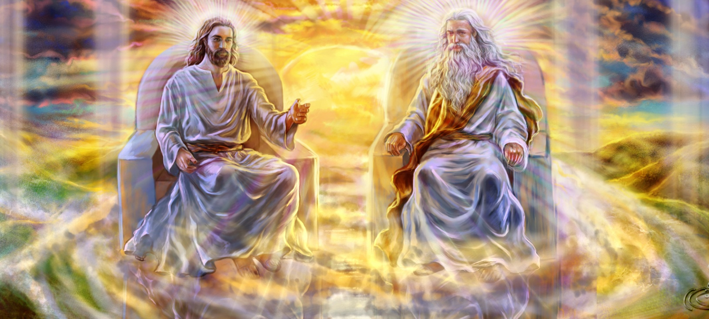


INGQONDO KAYESU(1)
“yena wathi esebumeni bukaThixo, akathi ukulingana kwakhe oku noThixo kulixhoba” (KwabaseFilipi 2:6)
UPawulos uqaqambisa iimpawu ezintathu zikaYesu:
Wazityeshela iimfanelo zaKhe zobuThixo (Fil. 2:6)
Waba ngumntu ukuze asikhonze (Filipi 2:7)
Wathobela ngokuthobeka kuyo yonke into, kwada kwasekufeni (Fil. 2:8)
NjengoMdali, waba sisidalwa. Wavuma ukuphathwa kakubi nokufa emnqamlezweni ukuze asihlangule.
Nangona wayelingana nabanye abantu ababini bobuThixo, ukuzithoba kukaYesu kwintando kaYise kwakusoloko kugqibelele. Akukho xesha apho wala ukuzithoba.
Xa sicinga ngale nto, sinokuguqa size sinqule uMsindisi wethu omangalisayo kuphela.
Ungumzekelo wethu. Simele sizimisele ukuzithoba size sizincame ngenxa yokulunga kwabanye.

Slide 9


INGQONDO KAYESU (2)
“Kananjalo, ngokuvunyiweyo, inkulu imfihlelo yona leyo yokuhlonela uThixo: lowo wabonakaliswa esenyameni, wagwetyelwa esemoyeni, wabonakala kwizithunywa zezulu, wavakaliswa phakathi kweentlanga, kwakholwa kuye ehlabathini, wenyuswa waba sebuqaqawulini”
(1 Timoti 3:16)
Ukuzithoba kukaKristu okumangalisayo ngokuba ngumntu kuya kuba sisifundo esiza kufundwa ngabahlangulweyo ngonaphakade.
Kuyamangalisa ukuba uMntu ongenamda nongunaphakade waba ngumntu onomda, ophantsi kokufa. Yile nto uPawulos ayibiza ngokuba “yimfihlelo yobuthixo” (1 Tim. 3:16).
UYesu wasuka ekubeni negunya eliphakamileyo waya ekubeni ngumkhonzi ogqibeleleyo. Oku kuchasene ngqo noko uLusifa wayekulangazelela, owayenqwenela igunya eliphakamileyo eliphakamileyo, njengomkhonzi.
Lo mzekelo usibiza ukuba silahle ukuba nomna kunye nomnqweno wethu wokukhonzwa, size sithathe indawo yabo ngokuthobeka nokuzimisela ukukhonza abanye.

Slide 10

“UThixo uvumela wonke umntu ukuba asebenzise ubuntu bakhe. Akafuni mntu ufaka ingqondo yakhe engqondweni yomntu ofayo. Abo banqwenela ukuguqulwa engqondweni nakwisimilo akufuneki bajonge ebantwini, kodwa kuMzekelo kaThixo. UThixo unika isimemo esithi, “Yibani nale ngcinga kuni, wayenayo kuye uKristu Yesu.” Ngokuguquka nokuguquka abantu bafanele bafumane ingqondo kaKrestu.”
EGW (That I May Know Him, May 8)

