Slide 1
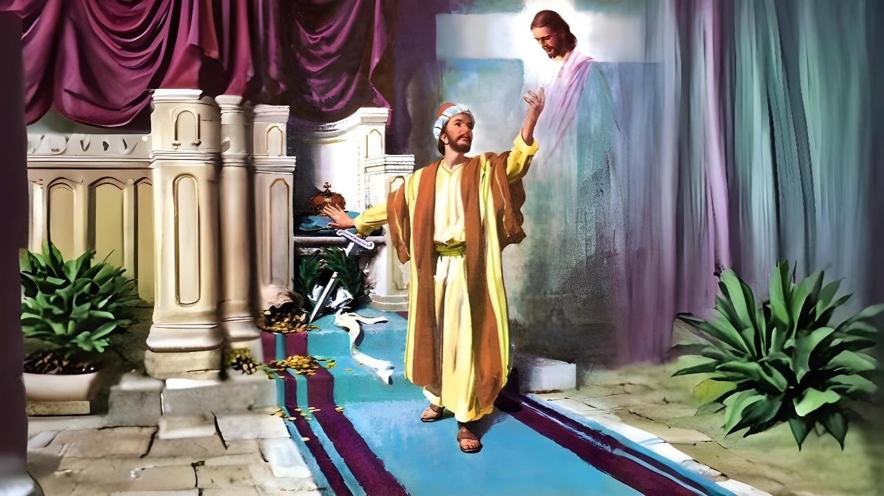
ISifundo 6 – 7 kweyoMdumba 2026
UKUTHEMBELA KUKRESTU KUPHELA

Slide 2


“Ukuba ndimazi, kwanamandla ovuko lwakhe, nokuba ndibe nobudlelane naye ngeentlungu zakhe, ndifaniswe noko kufa kwakhe; ukuba ndingade ndifikelele ekuvukeni kwabafileyo”
KwabaseFilipi 3:10, 11

Slide 3










AbaseFilipi babeyazi indlela esingisa elusindisweni, njengoko uPawulos noSilsa babeyenze yacaca komnye wokuqala owaguqukayo kwesiya sixeko: umgcinimabanjwa (Izenzo 16:30-31).
Njengoko ngoku ibandla lalisele limiselwe, babesemngciphekweni wokulahlekiswa kule ndlela yosindiso.
Ngeso sizathu, uPawulos ubakhumbuza ngeentsika zosindiso ngokholo.
Iingcebiso zokuthintela ukuphulukana nosindiso:
Izinto omele uziphephe (KwabaseFilipi 3:1-3)
Okushiywe ngasemva (KwabaseFilipi 3:4-6)
Okona kubalulekileyo (KwabaseFilipi 3:7-8)
Iingcebiso zokuhlala elusindisweni:
Ukholo lukaKrestu (KwabaseFilipi 3:9)
Ukumazi uKrestu (KwabaseFilipi 3:10-16)

Slide 4

IINGCEBISO ZOKUTHINTELA UKUPHULUKANA NOSINDISO

Slide 5

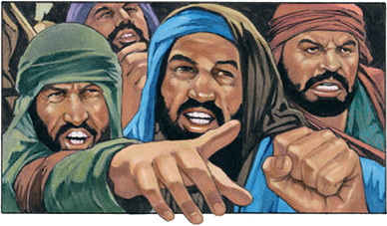

IZINTO OMELE UZIPHEPHE
“Zilumkeleni izinja, balumkeleni abasebenzi beento ezimbi, balumkeleni aborhunulo.” (KwabaseFilipi 3:2)
Ngaphambi kokuba sixoxe ngeengozi ezisongela ukholo, uPawulos usinika icebiso elithi: “Vuyani eNkosini” (Fil. 3:1a). Kule nto wongeza into ebalulekileyo: kulungile ukuphinda inyaniso esinayo, nokuba sele siyazi kakuhle (Fil. 3:1b).
Ukufumana inceba kaThixo (INdumiso 31:7)
Ukubeka ithemba lethu kuYe (INdumiso 5:11)
Ukuzuza intsikelelo yosindiso (INdumiso 9:14)
Ukugcina uMthetho kaThixo (Ind. 119:14; Isa. 58:13, 14)
Ukukholelwa kwiLizwi laKhe (INdumiso 119:162)
Ukukhulisa abantwana abanobbuThixo (Imiz. 23:24, 25)
Singavuya njani eNkosini?
UPawulos ubonisa eyona ngozi inkulu eyayisongela ibandla ngelo xesha: abafundisi bobuxoki ababefundisa ukubambelela ngokungqongqo kumthetho wesithethe (Fil. 3:2). Ubhekisa kwaba ngeendlela ezintathu ezahlukeneyo: izinja (Ps. 22:16; 2 Pet. 2:21-22); abenzi bobubi; aborhunulo (ngokwaluka).

Slide 6

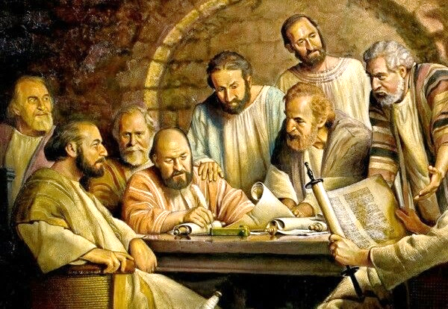
OKUSHIYWE NGASEMVA
“ndalukayo ngomhla wesibhozo, ndingowenzala kaSirayeli, ndingowesizwe sikaBenjamin, umHebhere wamaHebhere, ngokomthetho ndingumFarasi” (KwabaseFilipi 3:5)
KwiBhunga laseJerusalem, kwamiselwa ukuba abeeNtlanga bangakhathazwa ngemicimbi yomthetho wamaYuda (Izenzo 15:19-21). Nangona kunjalo, abanye ootitshala babeze eFilipi befundisa imfuneko yokwaluka (Fil. 3:2-3).
Going back in time, Paul reminds them how perfect he was when he was like those teachers (Phil. 3:4-6):
Woluswa ngomhla wesibhozo; unyana wabazali abazinikeleyo
UmHebhere wamaHebhere, umBhenjamini wokwenene
UmFarasi ongqongqo nomisela umthetho
Engonyamekileyo, elitshutshisa ibandla
Engagungqi ekugadeni uMthetho
Kodwa wayeziqhayisa ngayo yonke le nto ngaphambi kokuba amazi uYesu. Ngoku wayesazi ukuba wayengayiqondi kwaphela imithetho (Mt. 5:21-22). Ngoku wayesazi ukuba nguKristu kuphela osindisayo (Fil. 3:7).

Slide 7

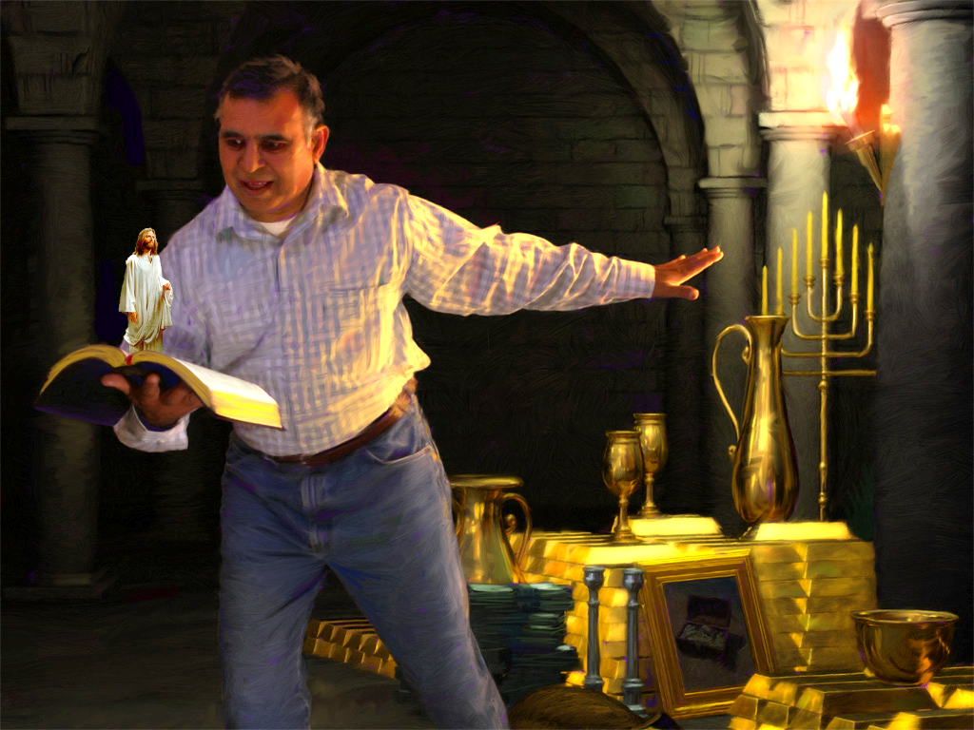
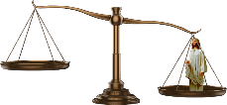


OKONA KUBALULEKILEYO
“Ndisuke, zona ezo zinto zabe ziyinzuzo kum, zona ezo ndizibalele ekuthini ziyinkxwaleko ngenxa kaKristut” (KwabaseFilipi 3:7)
UPawulos uthelekisa ubomi bakhe bangaphambili nobomi bakhe bangoku. Kwelinye icala, ubeka lonke ulwazi lwakhe; ikamva lakhe elizukileyo njengomfundi obalaseleyo kaGamaliyeli; iziphiwo zakhe ezintle zobuFarisi. Zonke iinzuzo.
Ngoku, ubeka ubomi bakhe kwelinye icala ukususela oko wadibana noKristu. Yonke inzuzo iba yinkunkuma, kuba akukho nto inokuthelekiswa nothando lukaKristu (Fil. 3:7-8).
Yintoni enokuba nexabiso ukodlula ubomi obungunaphakade ezulwini nakumhlaba omtsha? Sekunjalo, inzuzo yehlabathi ibenza abantu abaninzi bangakuboni oku. Kukho ukhuphiswano lwendalo phakathi kwezinto ezithathwa njengezibalulekileyo apha kunye noko iZulu likuxabisayo ngokwenene: ubuntu obufana nobukaKrestu kunye nosindiso lomphefumlo.

Slide 8

IINGCEBISO ZOKUHLALA ELUSINDISWENI

Slide 9



UKHOLO LUKAYESU
“ndifunyanwe ndikuye, ndingenabo obam ubulungisa, obo basemthethweni; ndinobo bungokukholwa kuKristu, ubulungisa ke obuphuma kuThixo ngalo ukholo;” (KwabaseFilipi 3:9)
UPawulos, eqinisekile ngobulungisa bakhe, waya eDamasko ukuze abuyisele abahedeni behlelo le "Ndlela" kwindlela yosindiso (IZenzo 9:1-2). Kodwa wangena eDamasko woyiswa bobunye ubulungisa, ubulungisa bukaThixo: "oko kufumaneka ngokukholwa kuKristu" (Filipi 3:9).
Ukususela ngelo xesha, akazange aphinde athembele kubulungisa bakhe. Kuba akuncedi nganto ukuthemba izenzo zethu ukuze sifumane usindiso (Gal. 2:16).
Wayelangazelela “ukufunyanwa kuKristu” (Fil. 3:9). Kuthetha ukuthini oku?
Ngokutsho kweyoku-1 kwabaseKorinte 1:30, ukuba “kuKristu” kuquka yonke into equka iCebo loSindiso, ukususela ekuqaleni kobulumko bethu bokomoya (ubulumko), ngokugwetyelwa ngokholo (ubulungisa) nokulungiselela izulu (ukungcwaliswa), ekugqibeleni, ukuzukiswa ekuBuyeni kweSibini (ukukhululwa).

Slide 10


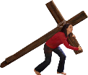




UKUMAZI UKRESTU
“ukuba ndimazi, kwanamandla ovuko lwakhe, nokuba ndibe nobudlelane naye ngeentlungu zakhe, ndifaniswe noko kufa kwakhe.” (KwabaseFilipi 3:10)
Sinokumazi njani uKrestu? (Fil. 3:10-16)?
Ngokufunda iLizwi laKhe
Ngokukhokelwa nguMoya oyiNgcwele
Ngokuba ngamadlelane naYe ngeentlunngu
Ngokuxhunela phamili kumgomo
Ubomi bobuKristu bufana nomdyarho. Kufuneka sibe nenjongo yethu ecacileyo engqondweni. Asiphileli ukuhlala apha size sonwabele obu bomi. Sinethemba lokufikelela eluvukweni lwabafileyo (Fil. 3:11).
De kufike elo xesha, sizabalazela “ukukuganga oko uKristu Yesu wandiganga ngako” (Fil. 3:12). UYesu wandifumana ukuze andinike isixeko; umvuzo; ubomi obungenasiphelo bokuhlala naye (Heb. 11:10; Fil. 3:14; 1 Tes. 4:17).

Slide 11

“Injongo enkulu eyanyanzela uPawulos ukuba aqhubeke phambili nangona ejongene neenzima neenzwinini ifanele ikhokelele wonke umqeshwa ongumKristu ukuba azinikezele ngokupheleleyo enkonzweni kaThixo. Izinto ezinomtsalane zehlabathi ziya kuboniswa ukuze zitsale ingqalelo yakhe kuMsindisi, kodwa kufuneka aqhubekele phambili aye kwinjongo, ebonisa ihlabathi, iingelosi, nabantu ukuba ithemba lokubona ubuso bukaThixo lifanele wonke umgudu kunye nokuzincama okufunekayo ukuze kufunyanwe eli themba.
Umfundi ophantsi kaKristu unokuba ngummi wasezulwini, indlalifa kaThixo kwilifa elingenakonakala..”
EGW (Conflict and Courage, December 13)

