Slide 1
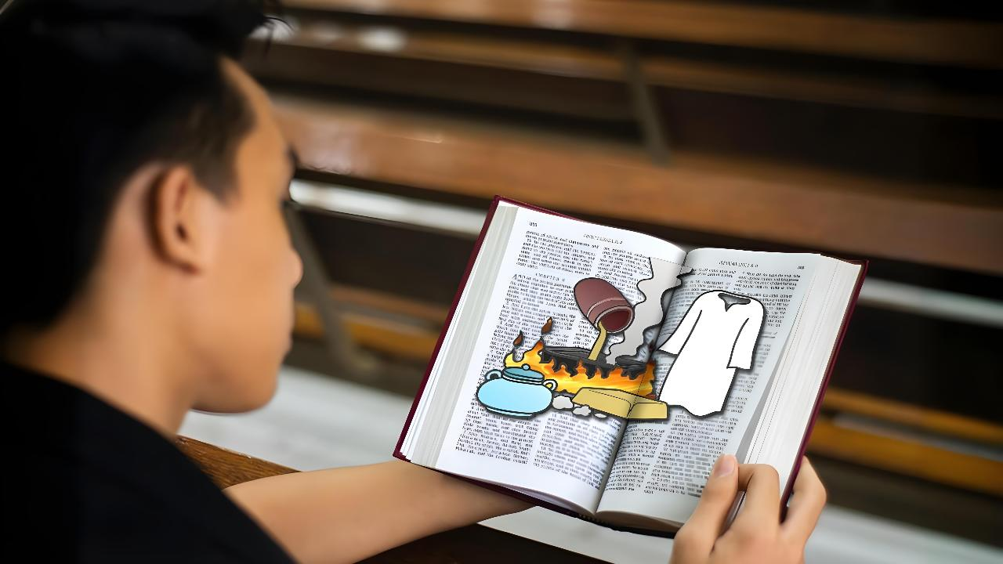
UKUZIBHENCA
Lesson 1 for April 4, 2026

Slide 2
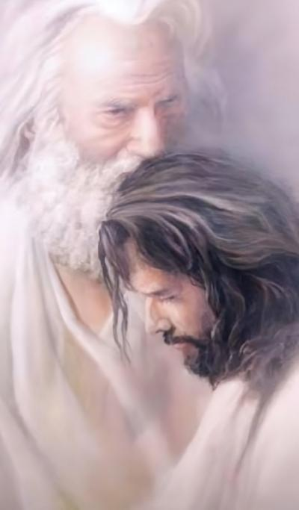
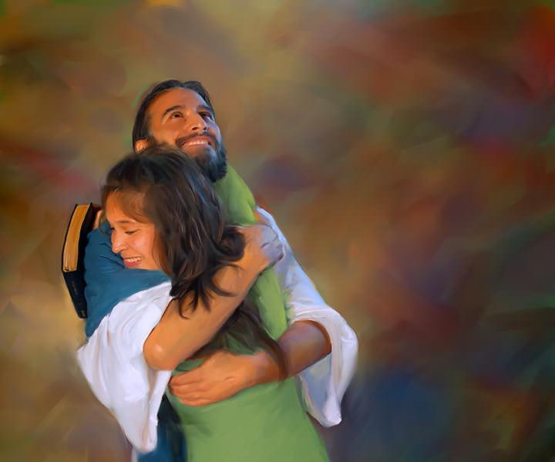
“Njengoko uBawo wandithandayo, nam ndanithanda; hlalani ke eluthandweni lwam.”
(Yohane 15:9)

Slide 3

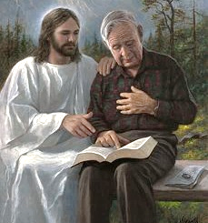



Umntu ngamnye apha kuthi uphuhlise ulwalamano olwahlukileyo noThixo. Kodwa sonke siyavumelana ngento enye: olu lwalamanao lunako kwaye kufuneka lukhule.
Inyathelo lokuqala lokukhula ekufuneka silithathile ukuze sikhule kukuba siyazi imeko yethu yanamhlanje.
UThixo usinike umyalezo okhethekileyo ngesimo sasemoyeni sebandla kule mihla yokugqibela. Lingoku ilixa lokuba sizigocagoce ukuze sifumanise ukuba yeyiphi indawo yalo myalezo engqale ngqo kubomi bethu, nokuba singaluqinisa njani ulwalamano lwethu noThixo.
Umyalezo kaThixo (ISiTyhilelo 3:14-22):
Ukuzihlola (v. 14-17)
Isisombululo (v. 18)
Iziphumo (vv. 19-20)
Ukwaneliseka (vv. 21-22)
Ukuzibhenca (Yohane 15:1-11):
Isebe nomdiliya
Incindi

Slide 4

UMYALEZO KATHIXO
(ISiTyhilelo 3:14-22)

Slide 5


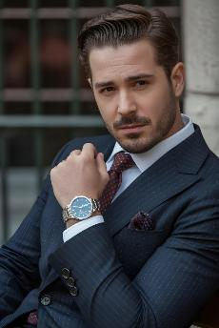

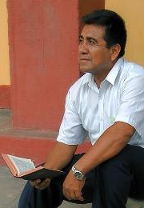
UKUZIHLOLA
“Ngokuba uthi, Ndisisityebi, ndizityebisile, andiswele nto; ube ungazi ukuba uludwayinge, ulusizana, ulihlwempu, uyimfama, uhamba ze” (ISiTyhilelo 3:17)
Imiyalezo eya kumabandla asixhenxe idakanca isimo sebandla lehlabathi ukusuka kwixesha labapostile ukuza namhlanje (ISiTyh 2-3). Ukwandlala lomyalezo kweli lethu ixesha (Lawodike), uYesu uzityhila ngelithi “unguAmen [Inyaniso], ingqina elithembekileyo eliyinyaniso” (ISiTyh. 3:14).
Xa sizijonga sibona Inyaniso ngathi : “Ndisisityebi, ndizityebisile, andisweli nto” (ISiTyh. 3:17a).
Kodwa uYesu ubona inyaniso, okuyinene ngathi: “uludwayinge, ulusizana, ulihlwempu, uyimfama, uhamba ze” ISiTyh 3:17b).
Ngoku lilixa lokuba sizihlole. Ingaba ndiyakwazi endinako nendisakudingayo? Ingaba ndikhule kangakanani kulwalamano lwam noYesu? Ingaba ndinyukela kumhlaba ongasentla?

Slide 6

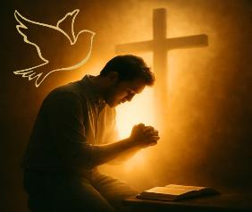
ISISOMBULULO
“ndiyakucebisa, ukuba uthenge kum igolide evutshiswe emlilweni, ukuze ube nobutyebi; neengubo ezimhlophe, ukuze wambeswe, lingabonakali ihlazo lobuze bakho; nentambiso yamehlo, uthambise amehlo akho, ukuze ubone.” (ISiTyhilelo 3:18)
Njengoko ukuzinziswa yimeko yethu kuzala ubudikidiki, uYesu uyasicebisa ukuba senze izinto ezintathu:
Thenga igolide evutshiswe emlilweni
Masingazinziswa ziinyaniso ezingaphelelanga okanye ukuligwengula ilizwi likaThixo. Masizibeke bucala iimfundiso zabantu size sizigrombonce iziBhalo ukuze kusuke konke ukungcola ekuqondeni kwethu.
Thenga iingubo ezimhlophe
Ukwamkela ubulungisa bukaYesu njengeyona ndlela yokuzuza usindiso. Ukuzama ukuzimisa phambi koThixo ngezenzo zethu zobulungisa kukuzimisa size phambi kwaKhe.
Thenga intambiso yamehlo
Zuza uMoya oyiNgcwele. NguYe kuphela onako ukusinceda sihluze ngokwasemoyeni nokusibonisa imeko yethu yenene (Yoh 16:8).

Slide 7

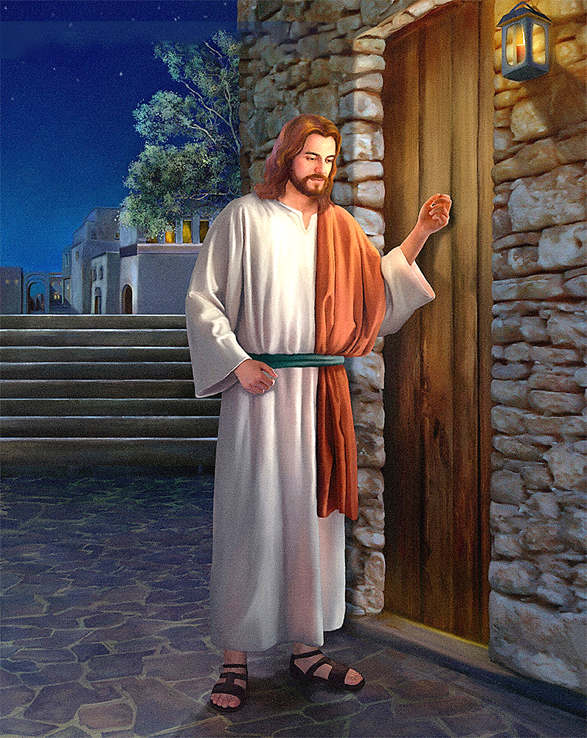
IZIPHUMO
“Yabona, ndimi emnyango ndinkqonkqoza; ukuba uthe umntu waliva izwi lam, waluvula ucango, ndongena kuye, ndidle naye, naye adle nam.” (ISiTyhilelo 3:20)
Kukho ingxaki. Ndiziva ngcono emoyeni, kodwa uYesu ufuna ndiziphucule. Noxa kunjalo, ukuba andiyiqondi intswelo yam yokutshintsha, andisoze nditshintshe. Andisoze ndifune ukuthenga oko ndicinga ndinako.
Ukusombulula le ngxaki, uYesu unendlela yaKhe: “Mna, bonke endibathandayo ndiyabohlwaya, ndibaqeqeshe”, ongeze: “Guquka” (ISiTyh. 3:19).
Ukukhalima nokohlwaya kukaYesu abutshabalalisi. Ukhetha indlela yokuxoxa nati. Ufuna ukuhlala nathi phantsi, ancokole… “Yabona, ndimi emnyango ndinkqonkqoza. Ukuba uthe umntu waliva izwi lam, waluvula ucango, ndongena kuye, ndidle naye, naye adle nam” (ISiTyh. 3:20).
UYesu uyankqonkqoza kumnyango wentliziyo yam kwaye ulinde ngomonde. Akabuphazamisi ubomi bam ngokundinyanzela ngolwalamano naYe. Isigqibo sokuvula singqengqe kum.

Slide 8


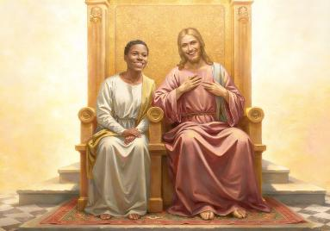
UKWANELISEKA
“Lowo weyisayo, ndiya kumvumela ukuba ahlale nam etroneni yam, njengokuba nam ndeyisayo, ndaza ndahlala phantsi noBawo etroneni yakhe.” (ISiTyhilelo 3:21)
UYesu uyayazi ukuba le ndlela ayikho lula. Uyawazi amalinge ethu okuthenga igolide, ingubo nentambiso yamehlo. Uyakwazi ukuwa sivuka sizamana nokweyisa ubudikidiki, ukuvula ucango, nokunxibelelana naYe. Uthi: Ninako ukweyisa, njengokuba Nam ndeyisa (ISiTyh. 3:21).
Kananjalo, uyayazi ukuba asisokuze sithabathe unyawo lokuqala. UThixo kusoloko inguYe osungulayo.
Wakhetha ukusidala (Gen. 2:7)
Uyasikhangela xa sonile (Gen. 3:8-9)
Wazinikela ukuze asisindise (Yoh. 3:16)
Ufuna ukusinika isipho: sihlale naYe, sonwabele unaphakade kubukho baKHE (ISiTyh.. 3:21)
Isitshixo ekuziphatheni ngokobuthixo (esingakufanelanga) luthando: “Ndikuthandile ngothando olungunaphakade” (Yeremiya 31:3). Ulangazelela ulwalamano nathi. Ingaba ndiyafuna ukuba nolwalamano naYe? Ingaba ndiza kuyivula intliziyo yam, ndimthande njengoko endithanda?

Slide 9

UKUZIBHENCA
(Yohane 15:1-11)

Slide 10

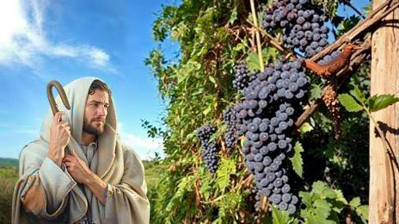
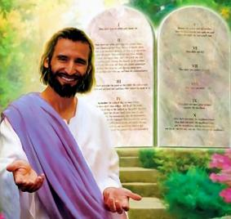

ISEBE NOMDILIYA
“Umdiliya ndim, nina ningamasebe; lowo uhleli kum, ndibe mna ndihleli kuye, yena uthwala isiqhamo esininzi; ngokuba ningekum, aninakwenza nto.” (Yohane 15:5)
Ngaphambi nje kokufa kwaKhe, uYesu wayibeka yacaca ukuba “ungumdiliya,” kwaye abafundi baKhe “ngamasebe.” Kuthetha ukuthetha ukuthini oku?
Isebe linokuphila ixeshana ngaphandle kokunamathela kumdiliya, kungekudala, liyatsha. Ukuze singaphulukani nobomi obungunaphakade, uYesu wenza esi sicelo kuthi: “Hlalani kum” (Yohane 15:4). Kwindima ezili11 apho uYesu anika lo mzekeliso womdiliya namasebe, usebenzisa isenzi “hlala” izihlandlo ezili10. Makube kubalulekile ngokwenene oku.
Ukuhlala kuYesu lichiza kwimeko yobudikidiki yaseLawodike. Ngaphaya koko, ngumthomo wovuyo (Yohane 5:11). Kodwa singahlala njani kuYesu?
Ngokwenza konke okumkholisayo, oko kukuthi, ukugcina imithetho yaKhe (Yohane 15:10). Oku kukusabela kuthando uThixo asibonise lona (1 Yohane 4:19).

Slide 11


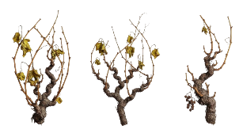

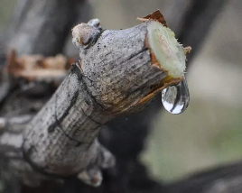
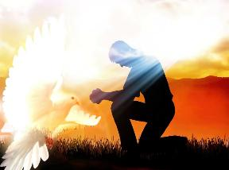
INCINDI
“Hlalani kum, mna ndihlale kuni. Njengokuba isebe lingenako ukuthwala isiqhamo ngokwalo lingahlalanga emdiliyeni, ngokunjalo aninako nani, ningahlalanga kum.” (Yohane 15:4)
Ebusika, amasebe anamathele emdiliyeni, kudwa awathwali ziqhamo. Ngokuba kutheni? Kuba aziyifumani incindi ethwala izondlo.
Kuxa kufika intwasahlobo apho athi afumane incindi esuka kumdiliya, uze uqalise ukutyatyamba. Igama lesiGrike elisetyenziswe nguYohane linokuthetha amasebe ophukileyo.
Nokokuba siyatyatyamba okanye singamasebe ophukileyo, inye kuphela ecacileyo: sidinga incindi enezondlo esika kumdiliya. Singayifanisa nantoni le ncindi yondlayo?
Kwakule ntetho inye (Yohane 14-17), uYesu usinika ingcaciso: UMoya oyiNgcwele nguYe osebenza kuthi ukusinika ubomi, ukuba siyabunqwenela.
UnguMthetheleli wethu (Yoh. 14:16-17)
Ungqina ngoYesu kuthi (Yoh 15:26)
Uyasohlwayo ngenxa yesono (Yoh. 16:8)
Usikhokelela kuyo yonke inyaniso (Yoh, 16:13)

Slide 12

“Le golide kuthiwa masiyithenge ivutshiswe emlwilweni lukholo nothando. Ityebisa intliziyo; kuba ihlanjululwe yade yanyulu; ngalo lonke ixesha ivavanywa, iye ibengezela ngakumbi. Ingubo emhlophe bubunyulu besimilo, ubulungisa bukaKrestu busabelwa umoni. Ngokwenene, le yingubo yodidi lwasezulwini, enokuthengwa kuphela kuKrestu ukuze siphile ubomi bentobelo evumayo. Intambiso yamehlo bobo bulumko nobabalo olusenza ukuba sikwazi ukwahlula okubi nokulungileyo, size sisibhaqe isono phantsi kwayo nayiphi na indlela. UThixo ulinikile ibandla laKhe amehlo afuna ukuba liwathambise ngobulumko, ukuze libone ngokucacileyo; kodwa abaninzi bebeya kuwakhupha amehlo ebandla ukuba babenako; kuba abavumanga ukuba imisebenzi yabo ize ekukhanyeni, ukuze bangohlwaywa. Intambiso yamehlo kaThixo iya kwenza kucace kokuqonda. UKrestu ungowokugcina zonke iinceba. Uthi: “Thenga kum.”— (ISiTyhilelo 3:18).”
EGW (Testimonies for the Church, vol. 4, p. 88)

