Slide 1
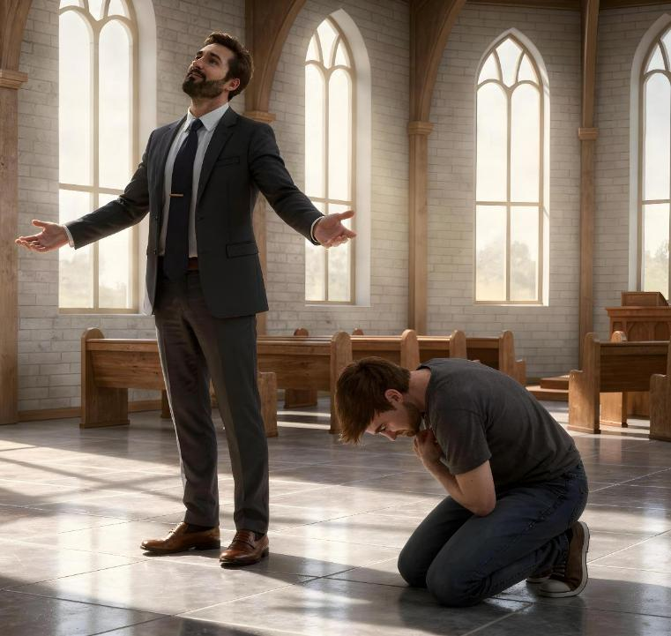
IKRATSHI LITHELEKISWA NENTOBEKO
isIFUNDO 3, 18 kUtSHAZIIMPUZI 2026

Slide 2

“Ngokuba wonke umntu oziphakamisayo uya kuthotywa; nozithobayo uyakuphakanyiswa”
(Luka 14:11)

Slide 3

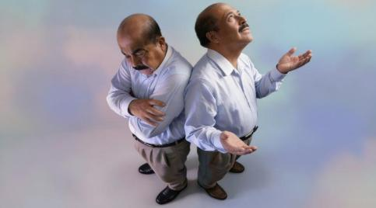
Yintoni exabisekileyo ngam? Lo ngumbuzo ekunzima ukuwuphendila.
Ukuba ndithetha kakhulu (ukuma kwikratshi), ndizingombe isifuba ngelithi konke endinako ndikuzuze ngamandla am.
Kungathini ukuba ndithetha kakhulu kuba uThixo endibona njengonyana waKhe?
Ukuba andithethi kwanto (ukuma kwintobeko), ndiyavuma ukuba konke endikuka nendinako kusuka kuThixo..
Kungathini ukuba ndingathethi nje ndibethwa kukunyongoba?
Imizekelo yekratshi
ULusifa
Abafundi bakaYesu
Imizekelo yentobeko
Umbuthi werhafu
UMoses
UYesu, owona mzekelo

Slide 4

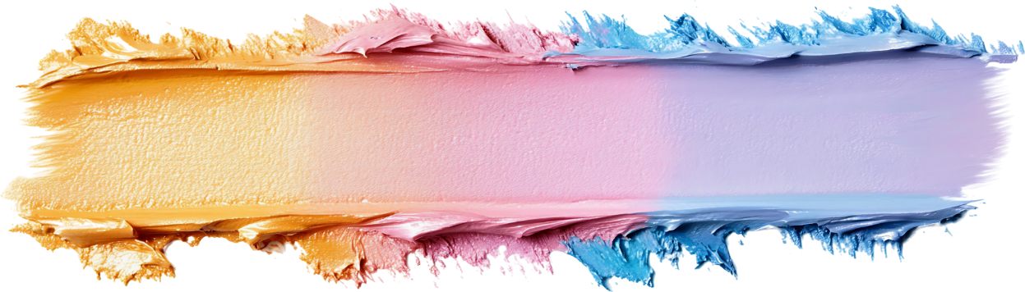
IMIZEKELO YEKRATSHI

Slide 5





ULUSIFA
“Ngokuba konke okusehlabathini, inkanuko yenyama, nenkanuko yamehlo, noqhankqalazo lobu bomi, asikokuphuma kuye uYise, kokuphuma ehlabathini.” (1 Yohane 2:16)
Ukuba sithetha ngekratshi, simele sithethe ngalowo lwavela kuye uluvo lokuqala: uLusifa. Wagqiba ekubeni anganeliseki sisikhundla sakhe, kodwa wayefuna ukunyukela kwesiphezulu. Ekuhambeni kwexesha, wanqwenela ukuphakanyiswa kangangokuba walangazelela ukuhlala kwitrone kaThixo (Isaya 14:12-14).
“Sizuze ilifa” lomnqweno wokwenza nantoni na esiyithandayo, ukuba nayo nantoni na esiyifunayo, nokufumana izikhundla ezisivumela ukuba sifumane udumo okanye ubutyebi. Yiloo nto ihlabathi elisinika yona! (1 Yohane 2:16).
Kodwa ayizizo zonke izinto esizifunayo eziba likratshi. Ulwaneliseko oluvela kwimpumelelo yomntwana, okanye amabhongo akhe, alusoloko lungumzekelo wekratshi elingafanelekanga.
Into ebalulekileyo ekufuneka siyikhumbule kukuba izinto esinazo, izakhono zethu kunye nempumelelo yethu azichazi ixabiso lethu. Ikratshi liquka ukungamzukisi uThixo ngezinto azenzayo ebomini bethu.

Slide 6



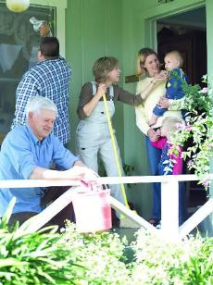

ABAFUNDI BAKAYESU
“Ke kaloku kwabakho nokubangisana phakathi kwabo, kokuthi, nguwuphi na kubo ekungathiwa ngomkhulu.” (Luka 22:24)
Babechithe iminyaka engaphezu kwemithathu noYesu. Wayesandula ukuhlamba iinyawo zabo waza wabaxelela ngegazi laKhe elizakuphalala ngenxa yabo bonke. Sekunjalo, njengoko babesitya isidlo sangokuhlwa, incoko yabo yayingenanto yakwenza nako konke oko: ngubani kubo owayengoyena mkhulu? (Luka 22:24).
Ikratshi labo labenza bakholelwe ukuba bafanelwe yindawo ephezulu. Babengakwazi ukuqonda ubunzulu beemvakalelo zabo. Babembhebhetha uThixo ezintliziyweni zabo ngenxa yekratshi labo.
UYesu wathetha ngqo wathi: “Ndiphakathi kwenu njengoMlungiseleli” (Luka 22:27). Ngamanye amazwi: ukuba ufuna ukuba mkhulu njengeNkosi yakho, khonza abanye.
Ikratshi lethu lisixelela ukuba sifanele ukukhonzwa ngabanye (singcono kunabo). Sidinga ubabalo lukaThixo ukuze sibe ngabakhonzi abathobekileyo.

Slide 7


IMIZEKELO YENTOBEKO

Slide 8





UMBUTHI WERHAFU
“Waye umbuthi werhafu emi kude, engathandi nokuphakamisela amehlo akhe ezulwini; wamana ukubetha esifubeno sakhe, esithi, Thixo, yiba netarhu kum, mna moni! ” (Luka 18:13)
UmFarisi wayexelela uThixo ngemisebenzi yakhe emihle awayeyenza kunye neempawu awayenazo phambi kweZulu. Kodwa uYesu wathi “wayethandaza kuye ngokwakhe,” kungekhona kuThixo (Luka 18:11-12). Umzekelo ogqibeleleyo wokuzingca.
Umbuthi werhafu wayecela uncedo kuThixo, kuba wayengumoni (Luka 18:13). Ngokuziveza ngokuthobeka phambi koThixo, “wehla waya endlwini yakhe egwetyelwe,” kuba “kuba wonke umntu oziphakamisayo uya kuthotywa, nalowo uzithobayo uya kuphakanyiswa” (Luka 18:14).
Ukuthobeka kokwenene kuqala xa sivuma isono sethu size sicele uncedo lukaKristu. Emva koko…
Asisayi kubajonga abanye njengabantu abaphantsi (Fil. 2:3)
Asisayi kufuna ukuqatshelwa luluntu (Luka 14:7-11)
Siza kuvumela abanye basinike ukuqatshelwa (Imiz. 27:2)
Siza kufumana ubabalo lukaThixo (UYakobi 4:6)
Siza kudlulisela olo lubabalo kwabanye (1 Petros 4:10)

Slide 9

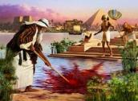






“Ngokholo uMoses uthe, akuba mkhulu, akavuma ukubizwa ngokuthi ungunyana wentombi kaFaro; enyula kanye ukuba aphathwe kakubi ndawonye nabantu bakaThixo, kunokuba axhamle izono okomzuzwana.” (KumaHebhere 11:24-25)
UMOSES
UMoses waqeqeshwa ukuba abe nguFaro olandelayo waseYiputa. Wayengusomaqhinga omkhulu kwaye wayenamandla amakhulu okuqonda (IZenzo 7:22). Kwiminyaka engama40 ubudala, wagqiba ekubeni ayeke konke oku aze azibandakanye nabantu bakhe (Hebhere 11:24-25).
Wayengumkhululi! Ingalo yakhe enamandla yayiza kukhulula abazalwana bakhe! Impazamo enkulu. UThixo wayengenakumsebenzisa ngelixa wayenekratshi elinjalo.
Eminye iminyaka engama40 yokunxibelelana noThixo entlango yamenza waba yindoda ethobekileyo kakhulu (Num. 12:3). Ngoku wayenokusetyenziswa nguThixo ukuthumela izibetho; ukuwela ulwandle; ukufumana imiyalelo elishumi; ukuthetha ngqo noThixo; ukubetha ilitye… Wakwazi nokwamkela ngokuthobeka isohlwayo sesenzo sakhe sokuzingca, ethabatha udumo ngento ayenzileyo (Num. 20:10-12).
Umzekelo kaMoses usibonisa ukuba ukuthobeka akuveli nje kuthi, kodwa simele simcele uThixo ukuba asinike amandla okukwenza yonke imihla.

Slide 10




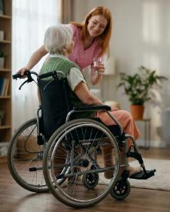
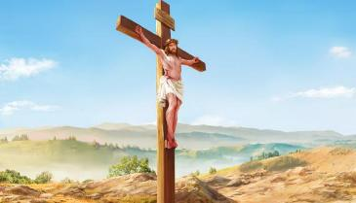
UYESU, UMZEKELO OGQIBELELEYO
“withi ngemo efunyenwe enjengomntu, wazithoba, waba ngolulamileyo, wada wesa ekufeni, ukufa ke kwasemnqamlezweni!” (KwabaseFilipi 2:8)
Akukho mntu kweli hlabathi owakha wanabo—okanye oyakuze abenabo—ubukhulu uYesu awayenabo ngaphambi kokuba abe ngumntu. Sekunjalo wazilahla zonke izinto ngenxa yothando lwaKhe ngakuthi. Sijongene nokuhlaziswa okunjalo, yonke into esinayo, yonke into esiyiyo, okanye yonke into esinokuze sibe yincithakalo xa sithelekiswa nayo.
UYesu wancama iZulu ukuze afele uluntu ngethemba lokuba siza kusiqonda isenzo saKhe sobubele size siphendule kwisimemo saKhe sokuba nolwalamano naYe (Fil. 2:5-8). Ngaphandle kwamathandabuzo, ungumzekelo ogqibeleleyo wokuthobeka.
“Yibani nale ngcinga wayenayo kuye uKrestu Yesu” (Fil. 2:5).
Silandela umzekelo waKhe, masingenzi “nanye into ngokwelenqe, ngokozuko olulambathayo. Yithini ngokuthobeka kwentliziyo omnye ambalele ekuthini omnye nguyena wongamileyo kunaye. Makangathi elowo axunele kwezakhe izinto zodwa, elowo makaxunele nakwezabanye” (Fil. 2:3-4).

Slide 11

“Awu, ndibamba ngazibini, Yehova, ngentliziyo yam yonke; phambi koothixo ndiyakucula ndidumise.
2 Ndiyakuqubuda ndijongise etempileni yakho engcwele, ndibonge igama lakho ngenxa yothando lwakho nokunyaniseka kwakho; ngokuba uliphakamisile ilizwi lakho ngaphezu kwegama lakho lonke.
3 Ndathi ndakukhala kuwe wandiphendula kangangokuba ndatsho ndomelezeka.
4 Zonke izikumkani zehlabathi mazikudumise, Yehova, kuba zizivile izithembiso zakho.
5 Maziwuculele iindlela zikaYehova, ngokuba uzuko lukaYehova lukhulu.
6 Kaloku, nangona uYehova ephakamileyo, uyambona othobekileyo; ke yena oziphakamisayo umazi nakude.
7 Ukuba ndithe ndahamba-hamba phakathi kweembandezelo, uyandiphilisa; wosolulela emsindweni weentshaba zam isandla sakho, sindisindise isandla sakho sokunene.
8 UYehova uyalifezekisa icebo lakhe ngam. Kambe ke, Yehova, izibele zakho zisisimakade; ungabi sawushiya umsebenzi wezandla zakho.”
Ndumiso 138

Slide 12

“Ekuzithandeni, ekuziphakamiseni, nasekuzikhukhumaleni kukho ubuthathaka obukhulu; kodwa ekuthobekeni kukho amandla amakhulu. Isidima sethu sokwenene asigcinwa xa sicinga kakhulu ngathi, kodwa xa uThixo ekho kuzo zonke iingcinga zethu kwaye iintliziyo zethu zivutha luthando kuMkhululi wethu nothando kwabanye abantu. Ukulula kobuntu kunye nokuthobeka kwentliziyo kuya kunika ulonwabo, ngelixa ukuzingca kuya kuzisa ukunganeliseki, ukuzola, kunye nokudana okuqhubekayo. Kukufunda ukuzicingela kancinci kunye nokwenza abanye bonwabe okuya kusinika amandla kaThixo.”
EGW (Testimonies for the Church, vol. 3, p. 476)

