Slide 1
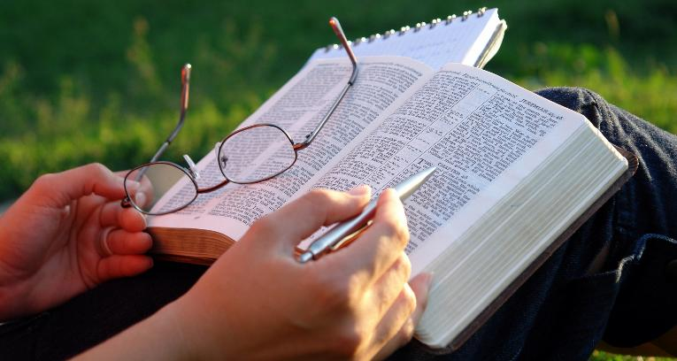
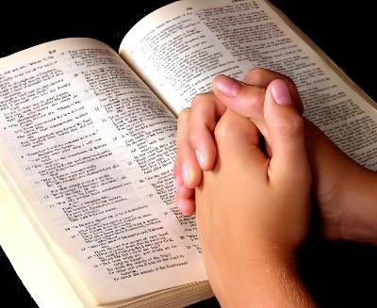

INDLELA YOKUFUNDA IBHAYIBHILE
ISifundo 5: 2 KuCanzibe 2026

Slide 2
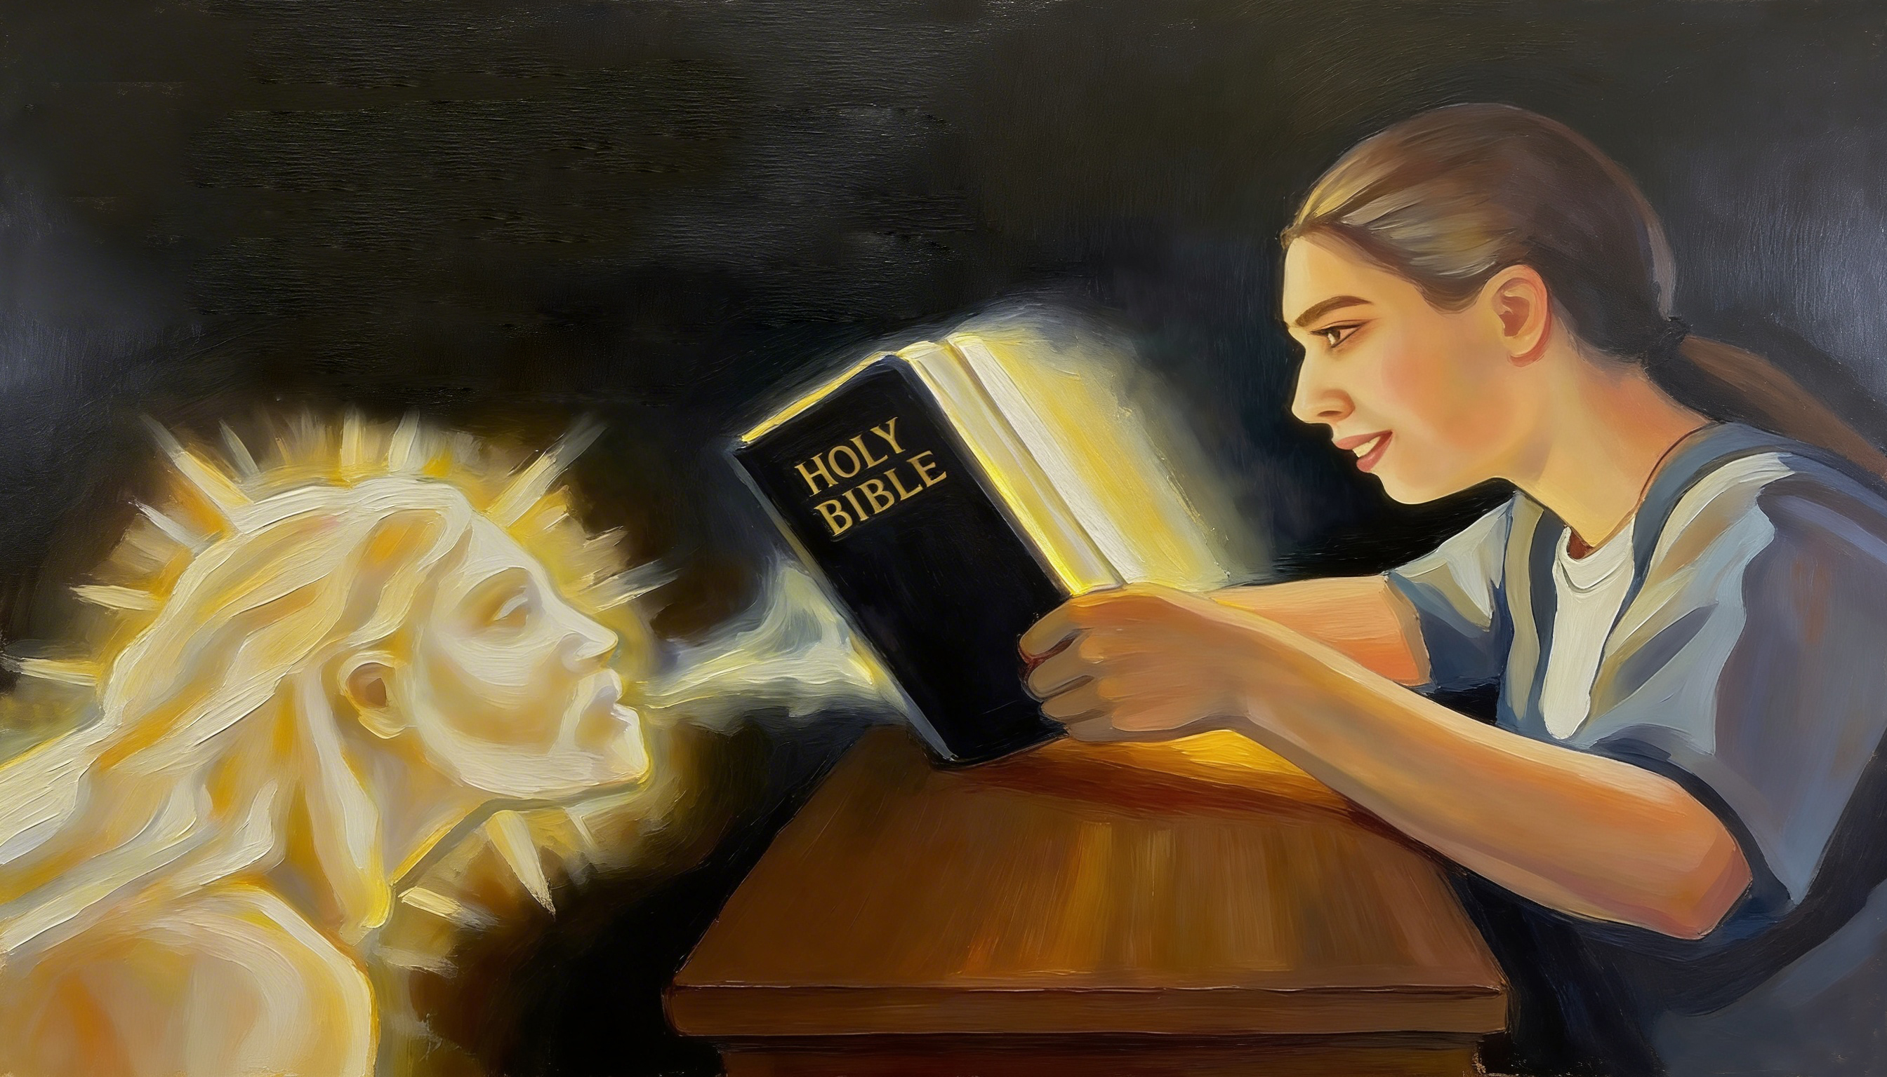
“Liya kuba njalo ilizwi lam eliphuma emlonyeni wam; aliyi kubuyela kuma lilambatha, lingakwenzanga endikuthandayo, lingakuphumelelisanga oko ndilithumela kuko. (Isaya 55:11)

Slide 3

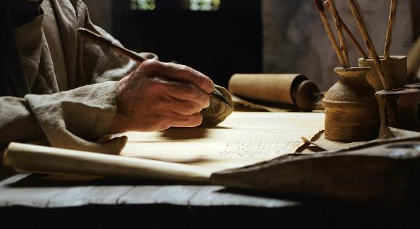

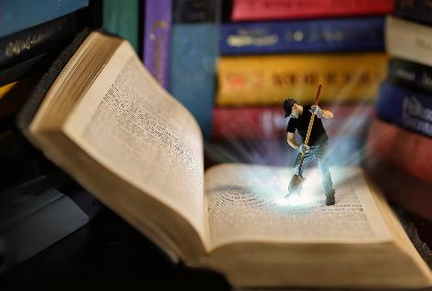
“Abantu abangcwele bakaThixo bathetha beqhutywa nguMoya oyiNgcwele” (2 Pet. 1:21), baza bayibhala phantsi imiyalezo yabo emacwecweni eBhayibhile.
Kuyo sifumana amatye anqabileyo anika ubomi, ithemba, inkuthazo, intuthuzelo, ... Amanye abonakala xa uwajonga okokuqala, amanye kufuneka afunwe ngononophelo.
Singazikhupha njani ezi zinto zixabisekileyo uThixo asilungiselele zona eBhayibhileni, kwaye zsizuza ntoni ngokuzifunda?
Indlela yokufunda iBhayibhile:
Ixesha
Indawo
Indlela
Inzuzo yokufunda iBhayibhile:
Inzuzo yokwabelana
Inzuzo yokulitya

Slide 4

INDLELA YOKUFUNDA IBHAYIBHILE

Slide 5

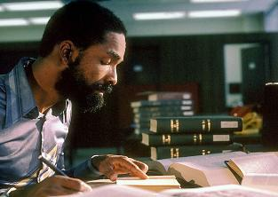
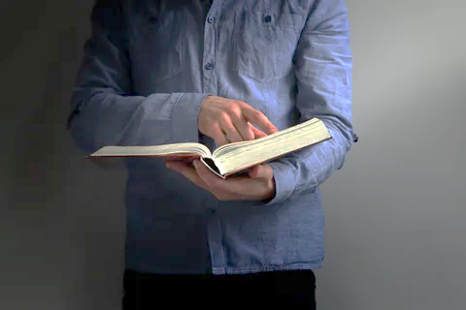

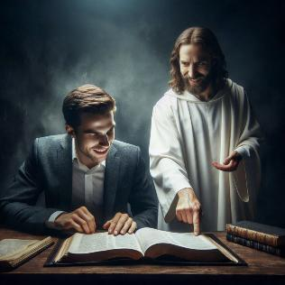
IXESHA
“Niya kundifuna nindifumane, xa nithe nandifuna ngentliziyo yenu yonke.” (Yeremiya 29:13)
Leliphi elona xesha lilungileyo lokufunda iBhayibhile?
Simele siyihlalutye impendulo yethu siqwalasele izinto ezimbini: ixesha kunye nezinga lokusebenzisa elo xesha.
Ngokuqinisekileyo singazuza ngakumbi ngokubekela ecaleni iyure enye kucwangciso lwethu lokufunda iBhayibhile kunokuba sinikele imizuzu emihlanu kuphela.
Noxa kunjalo, ixesha esilinikela ekufundeni alinakuphelela ekufundeni nje. Kulapho ke intshisakalo yethu isebenza khona. Kutheni ndifunda iBhayibhile? Ingaba ndifuna nje ulwazi, okanye ndinomnqweno onzulu wokwazi okungakumbi ngoThixo?
Siza kuzuza lukhulu kwisifundo sethu seBhayibhile xa kufika ixesha lokuba noThixo (Yer. 29:13), size sivuye kuye (INdu. 37:4); xa sikhangela kumaphepha ayo umyalezo okhethekileyo kaThixo kuthi.

Slide 6

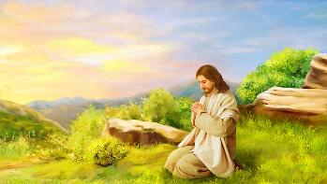


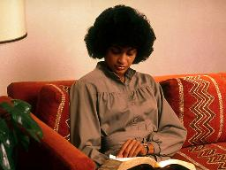
INDAWO
“Uthe kusekusasa, kusemnyama kakhulu, wavuka, waphuma waya endaweni eyintlango, wathandaza khona apho.” (Marko 1:35)
Xa uYesu wayefuna umzuzu okhethekileyo wonxibelelwano noThixo, wayevuka kwangethuba aye kufuna indawo ezolileyo (Marko 1:35). Oku kunokusetyenziswa kumthandazo nakwisifundo seBhayibhile.
Kunzima ukugxila ekufundeni kwindawo enengxolo okanye exakekileyo. Kulula ukukwenza oko kwindawo ekhululekileyo, ethuleyo, neyodwa.
Iiyure zokuqala okanye zokugqibela zosuku, xa kukho inzolo, zinokuba ngamaxesha apho sinokugxila lula ngakumbi kwiingcinga zethu kuThixo.
Nje ukuba sifumane ixesha nendawo efanelekileyo, mayisele isiba sisiqhelo sethu. Mhlawumbi kukho imeko ethile engasenza singalifumani elo xesha, kodwa masingavumi kudlule ixesha elide ngaphandle kwesifundo sethu seBhayibhile semihla ngemihla.

Slide 7


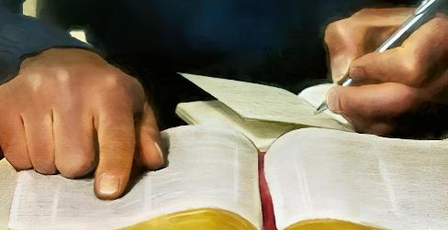
INDLELA (1)
“ilizwi lam eliphuma emlonyeni wam; aliyi kubuyela kuma lilambatha…” (Isaya 55:11)
Ufundo olunzulu lweBhayibhile lunamacandelo amane
Thandaza
Ukufunda nokuqonda
[indlela ecetyiswayo]
Thandaza
Yabelana
Mema uMoya oyiNgcwele akukhokele xa uza kufunda
Khetha ivesa okanye indima eBhayibhileni
Uza kuchukumisa intliziyo nengqondo yakho ukuze ukuqonde okufundayo
Yibhale phantsi ukuze uyikrole engqondweni yakho
Krwelela iimbono ezinundoqo
Bhala phantsi iingcamango ezivelayo ngezo mbono zingundoqo
Cela uThixo akuncede usebenzise iingcinga ozifundileyo
Cinga ngomntu ongabelana naye oko ukufundileyo

Slide 8

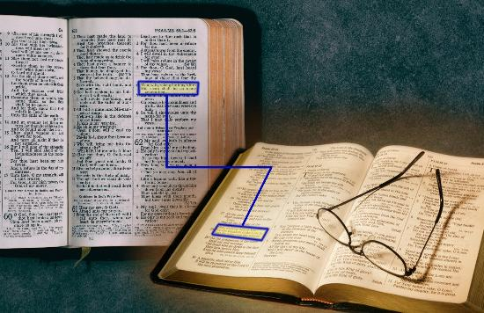
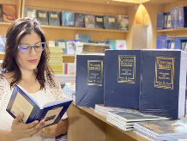
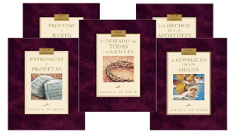
INDLELA(2)
“ilizwi lam eliphuma emlonyeni wam; aliyi kubuyela kuma lilambatha…” (Isaya 55:11)
Ezinye iindlela zokufunda iBhayibhile
Thelekisa ivesi nevesi (Isaya 28:10)
Funda isahluko okanye incwadi yonke
Funda umxholo okanye igama ngoncedo loludwemagama
Jonga kwiingxelo zeBhayibhile okanye kwizichazimagama
Funda ngaxeshanye neziqendu ezikuthotho lwe-“Conflict of the Ages” olubhalwe nguEllen White

Slide 9

INZUZO YOKUFUNDA IBHAYIBHILE

Slide 10



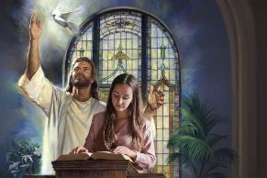
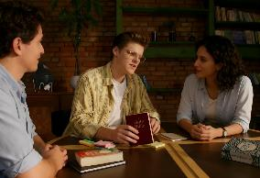

INZUZO YOKWABELANA
“INkosi uYehova indinike ulwimi lwabafundileyo, ukuze ndikwazi ukuzimasa otyhafileyo ngelizwi. Ivusa imiso ngemiso, indivusela indlebe ukuba ndive ngokwabafundileyo.” (Isaya 50:4)
Ucelwa ukuba ulungiselele intshumayelo yenkqubo yangeSabatha. Unikela ixesha elikhethekileyo lokufunda ngomthandazo isihloko uMoya oyiNgcwele akuphefumlele ukuba usikhethe. NgeSabatha, ushumayela ngamandla. Ngubani oza kuzuza kakhulu kule ntshumayelo?
Isifundo seBhayibhile esabelana ngaso nabanye – nokuba sikwintshumayelo okanye sikwinqanaba lomntu ngamnye – sibetha iintaka ezimbini.
Okokuqala, siyazuza koko sikufundileyo. Okwesibini, abantu esabelana nabo ngolu lwazi bayazuza kwaye bayakhuthazeka ukuba badadele enzulwini kolo lwazi.
Kuzo zombini ezi meko, ubudlelwane noThixo buyaqina kwaye buyanda. Lawo ngamandla eLizwi likaThixo, “elingayi kubuyela kum lilambatha” (Isaya 55:11).

Slide 11

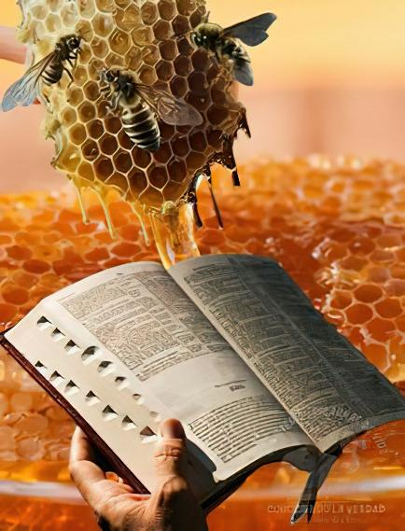

INZUZO YOKULITYA
“Hayi, ukuba mnandi kwentetho yakho ekhuhlangubeni lam!” (INdumiso 119:103)
Kufuneka silitye iLizwi likaThixo (Yer. 15:16)!
Nangona linambitheka kunobusi, asifanele silitye ngokoqobo (INdum. 119:103). Ukufunda iBhayibhile kukutya komphefumlo, kukuhlaziyeka kokwenene okuphilisa umoya wethu nokuguqula ubuntu bethu.
Ngaphaya koko, oku kutya kusimahla (Isaya 55:1)!
Simele nje sisondele size siphulaphule oko uThixo asixelela kona ngeBhayibhile (Isaya 55:3). Okukhona sichitha ixesha elininzi sihlolisisa amaphepha ayo, kokukhona sifumana ukondliwa okungakumbi, kwaye kokukhona sifumana iintsikelelo ezingaphezulu.
" Nokuba yintoni na inkqubela phambili yengqondo yomntu, makangacingi nakancinci ukuba akukho mfuneko yokukhangela ngokucokisekileyo nangokuqhubekayo iziBhalo ukuze kufunyanwe ukukhanya okukhulu. Njengabantu, sibizelwe ngabanye ukuba sibe ngabafundi besiprofeto..” Ellen G. White, Counsels to Writers and Editors, p. 41

Slide 12

“Ukufunda nje iLizwi akuyi kufezekisa isiphumo esiyilelwe liZulu; kufuneka lifundwe, kwaye ligcinwe entliziyweni. Ulwazi ngoThixo alufunyanwa ngaphandle komzamo wengqondo. Sifanele sifunde iBhayibhile ngenkuthalo, sicele uncedo loMoya oyiNgcwele kuThixo, ukuze siqonde iLizwi laKhe. Sifanele sithathe ivesi enye, size sigxile engqondweni kumsebenzi wokuqinisekisa ingcinga uThixo ayibeke kuloo vesi kuthi. […]
ILizwi likaThixo sisonka sobomi. Abo batya kwaye betyisa eli Lizwi, belenza inxalenye yesenzo ngasinye kunye nayo yonke impawu zobuntu, bakhula ngamandla kaThixo. Linika umphefumlo amandla angafiyo, ligqibelelisa amava kwaye lizisa uvuyo oluya kuhlala ngonaphakade.”
EGW (Lift Him Up, April 7)

