Slide 1
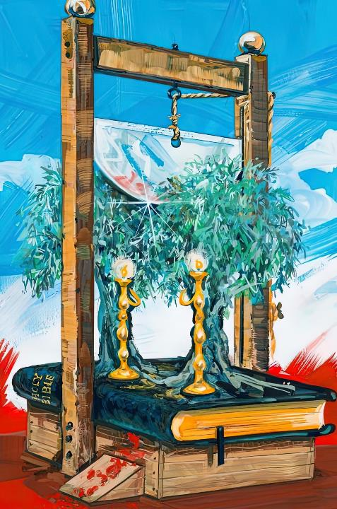
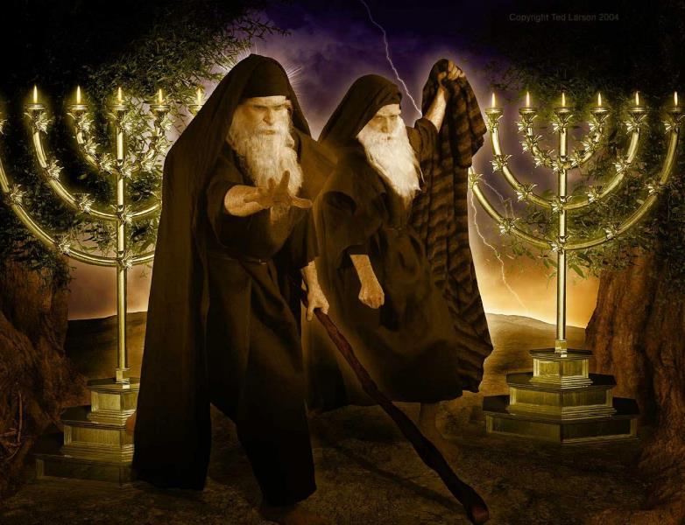
TECI NIHTE
Lesson 6 ading May 11, 2024

Slide 2
“Lopate vulin pakte pulhmang hi. Ahih hangin Pasian kammal kip tawntung hi,” aci hi. (Isaiah 40:8, ZSV)

Slide 3
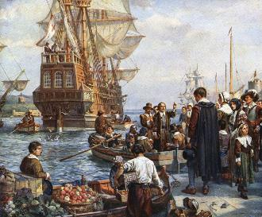
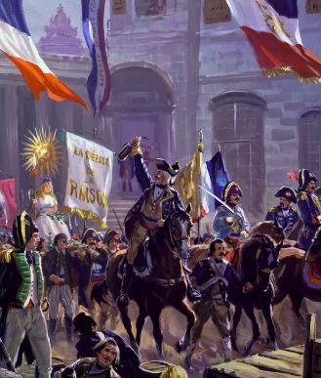
Puahpha makaipite hong sih khit uh ciangin, puahphat napi hong dai hi. A kipuahpha sa pawlpi te-in daihna, khauh takin thuakzo nawn lo uh hi.
Leitung gam vai le thukhan suutna ah kikheelna lianpi hong om hi. Zai takin hih thute kizel in biakna vai tawh suahtakna zongin inn le lo nusia in America leilu lam “suaktakna leitangh” ah hong beel uh hi.
Europe gam sungah, buai na lianpi hong om hi. France gam pen khang thak Europe sungah amasa pen biakna neilo gam in hong ding hi.
Tua hun ciang dong Pasian in a “teci nihte” keem cing’ hi. Tang’thu ah a thupi pen hunte ah amau bang teng piang hiam?
Teci nihte in kuate hiam?
Bangtan vei sawtin teci pang uh hiam?
Amau koi bangin si uh hiam?
Bang hun in thokik a van ah kah uh hiam?
Bang teng pianbeh hiam?

Slide 4
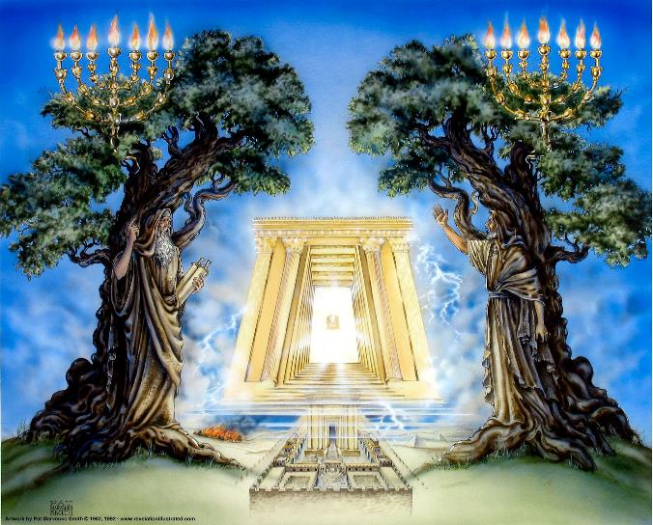
TECI NIHTE IN KUATE HIAM?
“Tua teci nihte pen leitung Topa mai-ah a om olive kung nihte le meivakna nihte ahi uh hi.” (Mangmuhna 11:4)
Olive kung nih le meivak’ khuam nih thu pulakna (Mang. 11:4) in eite’ Zechariah 4 muhna ah hong tun hi. Tua sungah, olive kungte in meivak khuam sagih a kizangh sathau a pia hi (Zech. 4:1-3 , 12).
Olive kungte in “sathau nilh angah nihte” hi in, meivak khuam tawh kibangin “Topa kammal” ai-awh a ngah nihte ahi hi.

Slide 5
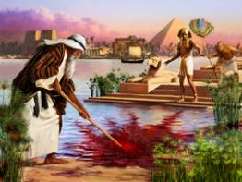
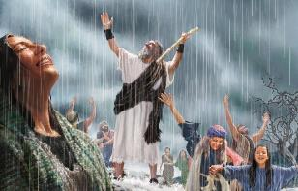
TECI NITE IN KUATE HIAM?
Moses le Elijah te lim’la-in, Mangmuhna 11 in hih teci nihte hibangin ci hi:
Amaute in puanhampi silh uh hi (3)
Haksatna hun sungah Lai Siangtho keemcing uh hi.
Khat peuh in a bawlsiat ding ciangin mei kuang pai hi (5)
Vantung khak in guahzu saklo (6a)
Tuite sisan suak sakin gimna piangsak hi (6b)
Lai Siangtho a kantelte bekin kum zalom laizang bawlsiat hun le kha khuamial hunte pan suakta uh hi.
Amaute Pasian mai-ah ding (4)
Pasian in a kammal te bei mang’ dingin phallo hi
Lai Siangtho thupuak in a galte “valhtum” hi (Jer. 5:14)
Lai Siangtho a nial man un Kha Siangtho guah (sathau) zu nawnlo hi
Moses le Elijah te bangin, Lai Siangtho in nakpi takin bawlsiatna thuak ding hi; biakna neilo ukna neite’ do ding hi; mei tawh kuang bangin a thuaknate kang’tum sak... genkholhnate a diklam tangthu in kip sak

Slide 6
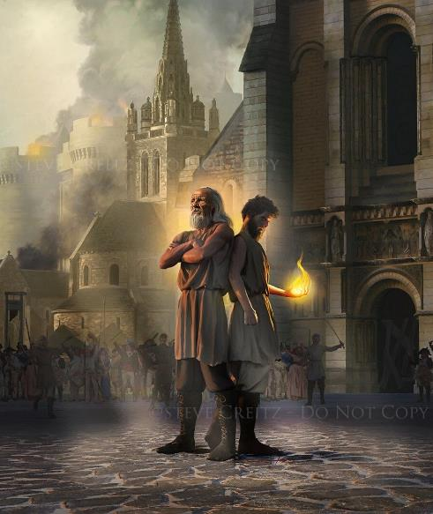
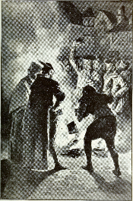
BANGTAN VEI SAWTIN TECI PANG UH HIAM?
“Ka teci nite puanhampih silhin ka paisak ding a, amaute in ni 1260 sung Pasian’ thu a gen ding uhhi,” hong ci hi. (Mangmuhna 11:3)
Mangmuhna 11 in vantung ah siangtho mun ah maang’ muh na le pak namtui biakna tau mai-ah a biate mai-ah muhna kipan hi (Mang. 11:1).
Van biakbuk tualpi in “namdangte” – thu umlote – “Siangtho khupi” – Pasian’ mite in – kha 42 sung a tuatcil uh leitangh ahi hi (v. 2).
Tua hun in, Pasian’ kammal in “puam hampi” silh in – haksat na lianpi thuak – (v. 3) [kha 42 x ni 30 = ni 1,260 (genkholhna suang a, kum 1,260 )].
Kum 538, pan kipan in Rom pawlpi in Pasian kammal sangin amau ngeinate damdam in zat hong kipan uh a Lai Siangtho simding hong khaam in, tua a nei’te, sim ahih keileh tua upna tawh kituakin a nungtate si theihna zah dong bawlsia uh hi (upna thuguipi te).
Hih hun beikuan lam ah, puahphate in bawl siatna pen tawm vei sung nop tuam na ngah uh hi (Matt. 24:22).

Slide 7
AMAU KOI BANGIN SI UH HIAM?
“Amaute in Pasian’ thu genin a teci pan’na a zawhkhit uh ciangin kuahawm thukpi sung panin a hong paikhia ganhing in tua teci pangte sim’in zogawpin that ding hi” (Mang. 11:7)
Mang. 11:7 ah kipulaak guam thukpi in dawi gilote omna pulaak hi (Mang. 9:11; 20:1-3; Luke 8:30-31). Sapi in gam vai ahihkeileh biakna vai ah vang’ khat pulaak hi (Mangmuhna le Daniel te-in adang sapite bangin).
Kum 1260 a bei hun ah bang thuneihna hong kilangh hiam, 1798 kiim’ pawlin?
Kum 1789 pan kipan French kidona tualgal “ngongtat kumpi” (1793-1794) a kici hih ukpi nungpan in tawsawn pen kua hiam cihpen: Satan le a dawi gilote ahihlam kilangh hi. Hih kumpi pen nam thum in kici thei hi (Mang. 11:8):
Sodom : Kidona in paktatna lainpi hun khat kipan khia hi.
Egypt : Biakna neilo kumpi (Pai. 5:2), “paulap pasiannu” bia ding in a lungluut loh uh hangin
Zeisu singlamteh tung sihna: Zeisu’ kipiak na nial uh hi
Tua hun sungin, biakna bei sak in, Lai Siangtho khaam in mei’tawh haal uh hi.

Slide 8
Kuam thukpi sung pan hong pusuak sahang in amaute gal-in do dinga, zogawp in amaute that ding hi. “Tualgal le Ukna Gilo in a uk hunlai-a Pasian neilo France vangliatna in Pasian le A thu siangtho a lang bawlna zah-in ahuaisia dang leitung ah om ngeilo hi. Gambup kikhoppi thukimna tawh Pasian biakna beimang sak uh hi. A huatna uh lahna in Lai Siangtho bute kaai khawm-in mipi mai ah a haal tum uh hi. Pasian thukhamte zong lei-ah sikcip uh hi. Lai Siangtho thusinna mun khempeuh susia uh hi. Nipi kaal tawlngak nite zong kheel in ni sawm sial-in tawlnga-in gualnop bawlna le Pasian neu bawlna lim a lak uh hi. Tuiphumna le neekkhawm bawlnate khaam uh hi. Misi vuina haante ah lai suang uh a, a tawntung in ihmu cip ding hi, cih sak uh hi.”
EGW (The Great Controversy, p. 273.2)

Slide 9
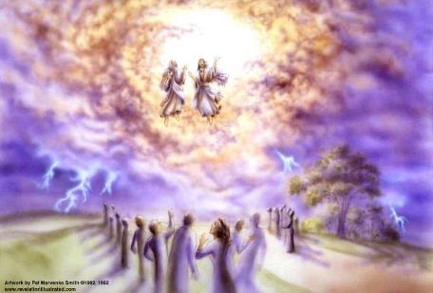
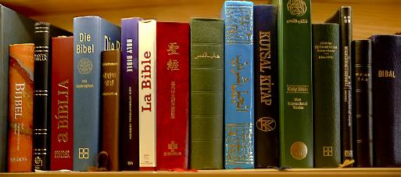
BANGHUN IN THOKIK A VAN AH KAH UH HIAM?
“Ahi zongin nithu le ni lang a cin’ khit ciangin amaute sungah Pasian kiang panin nuntakna hu lutin, amaute a khe-un hong ding uh ahih manin a mute khempeuh nakpi takin lau mahmah uh hi.” (Mangmuhna 11:11)
1793 November 28 ni in Paris in biakna beisak na dingin thu pia hi. Tua thupiakna pen June 17, 1797 ciangin a phiat kik hi. Hih kum thum le alang sungin France in biakna bawlsiatna pan in “suakta” ngah na hangin lungdam lua uh ahih manin Lai Siangtho ii awging pen hong daai sak hi (Mang. 11:9-10).
Daih sakna ahihkeileh bawlsiatna taangin Lai Siangtho in ni dang sangin hong hatzaw hi. Protestant te vaipuak in lungdam na thu lei mong dong ah puak ding hi (Mang. 11:11).
William Wilberforce in Lai Siangtho pen a lomlom in hawm khia dingin amasa pen Lai Siangtho kipawlna 1804 kum in hong phut hi. Leitung ah tam a kizuak pen laibu hong suak in tu’a om Lai Siangtho bu in tulza tampi kitawi hi. Tu in, Pasian kammal Lai Siangtho hawmkhiatna pen kikhaktan thei nawnlo hi. Kuamah in susia theilo ding dinmun ah Pasian in a koih hi (Mang. 11:12).

Slide 10
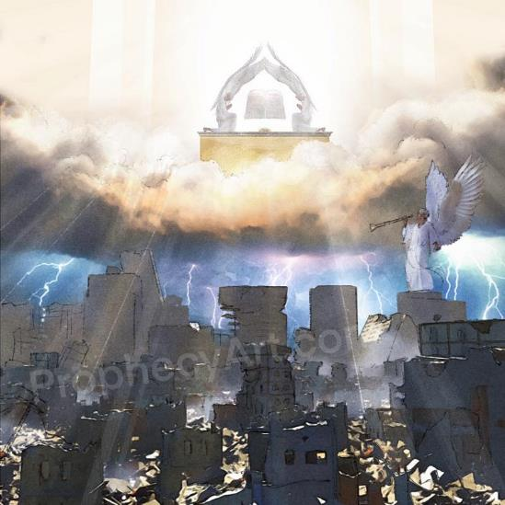
BANGTENG PIAN BEH HIAM?
“Tua ciangin vantungah a om Pasian biakna innpi kihong a, a Thuciamna Singkuang zong biakinn sungah a om a kimu hi. Tua ciangin nakpi takin khua phia-in a ging lianpi om a, van gingin zinling a, gialpi a kia hi.” (Mangmuhna 11:19)
Teci nihte in “thawhkikna” pan kipan in, a nu’nung pen khuavanpi buaina in: hun bei na hi ding hi.
Leitung gam khempeuh in Zeisu’ mun hong suak in, tawn tung maan’ hun ding pen nih vei hong pai kikna ciangin a mong tung ding hi (Mang. 11:15).
Tua hun laitak in namdangte lakah hetsuah thangpaih na om in “leitung a susia mite” ii suksiatna tawh a kisia cip ding hi. (Mang. 11:18).
Hih a piang khempeuh pen vantung a om biakpiak na in a nung a huzaap nei hi (Mang. 11:16-17), vantung a om thukham singkuang muhna (vision) tawh khensat na ahi hi (Mang. 11:19).
“Thukhenna hun” hong tun ciangin (Mang. 11:18), thu khen nading tawh kisai hih leitung ah pulak khai hi: thu kham singkuang sungah thukham sawm suangpek om

Slide 11
“Kha Siangtho in Pasian kammal a zong mi khempeuh gei ah om in a ki imcip thumante a mu thei sak hi. A vang’liang khuavak in a lungsung ah hong tungin thuman thutak pen a thak in a kilangh a thupi khat tawh amah tungah hong kiciamteh hi. Amah in khatvei zong a ngah ngeiloh lungnopna tawh a kidim hi. Pasian nopna ama sungah om hi. Thuman na ii manphatna khatvei zong a mu ngei lo tawh kibang hi. Lungdamna thu tungah van panin khuavak khat hong tang sukin laimal khempeuh in kham tawh kizut bangin hong kilangh hi. Pasian mahmah in lungtang tawh kiho in ama thute in kha le nuntakna piang sak hi.”
EGW (Reflecting Christ, April 14)

