Slide 1
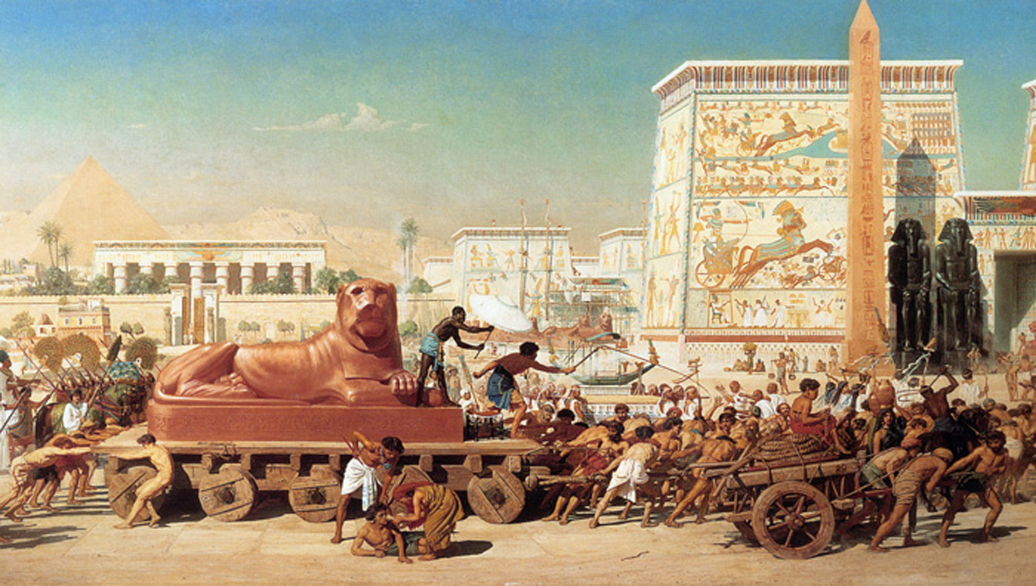
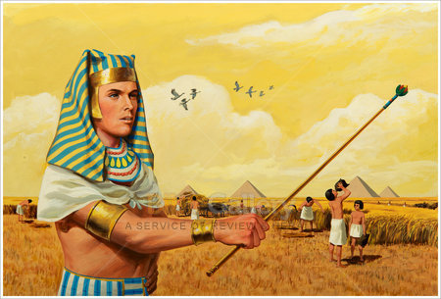
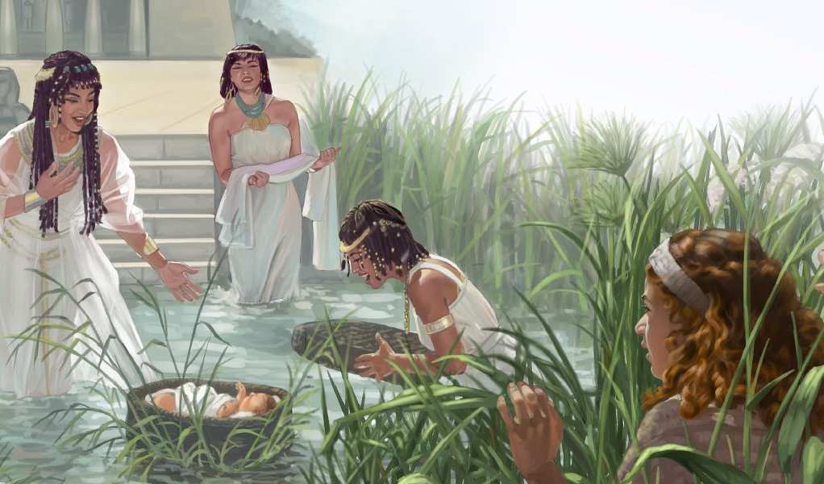
July 5, 2025 ading Lesson 1
NENNIAMNA: MOSES HONG SUAHNA LE ANUNGTHU

Slide 2

“Ni tampi khitciangin Egypt kumpipa a si hi. Israel tate a saltan’na hangun thumin kiko uh a, amaute saltan’na hangin a kikona uh Pasian in a za hi. Tua hi-a, Pasian in amaute thumnate za in, Abraham, Isaac le Jacob tawh a thuciamna Pasian in a phawk hi. Pasian in Israel mite a et ciangin Pasian in amaute om zia a thei hi.” Paikhiatna 2:23–25, ZSV

Slide 3

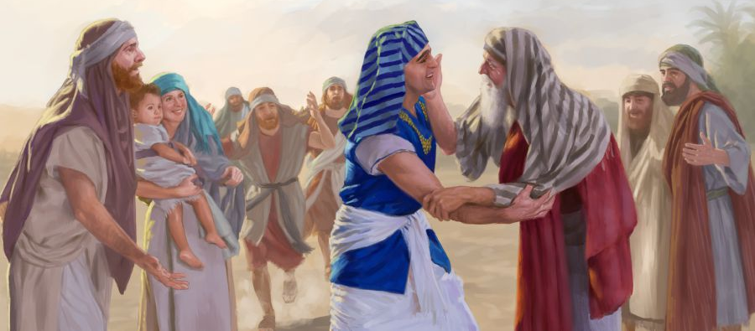
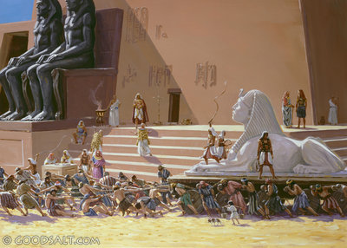
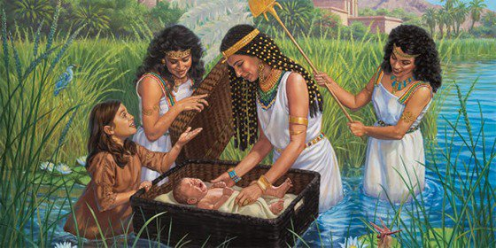





Paikhiatna bu in Pharaoh phalna tawh Egypt gam ah teen’ theihna a ngah innkuan neu khat tawh tua tangthu hong kipan hi.
Tha khat thu-in, hun hong kikheel in, Egypt mite “to” te adingin nasem dingin zawhthawh thu tawh sawlna angah saalte hong suak uh hi.
Hun hongsia semsem hi. Gen’theih haksakna kawmkal ah Shipharah le Puah a kici numei nihte cihtakna hong taang khia-in, Pasian in a mite a muakna lametna khua vak ahi Nile gun panin hotkhiat a ngah a it huai naupang Moses hong khangkhia hi.
Egypt a om Pasian’ mite (Paikhiatna 1:1-14)
Abraham pan Moses dong (Piancil 15:13; Pai. 1:8)
Cihtakna ii Gualzawhna (Paikhiatna 1:15-22)
Nile gun ii tapa (Paikhiatna 2:1-10)
Honkhiapa a puukna (Paikhiatna 2:11-25)

Slide 4

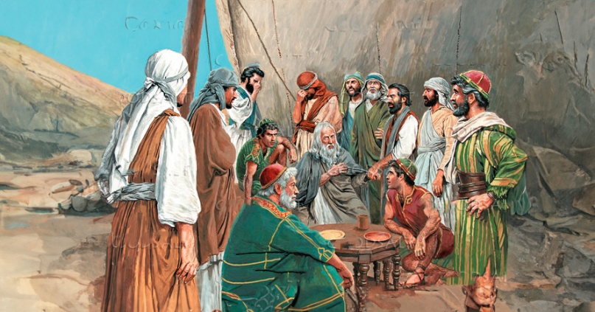
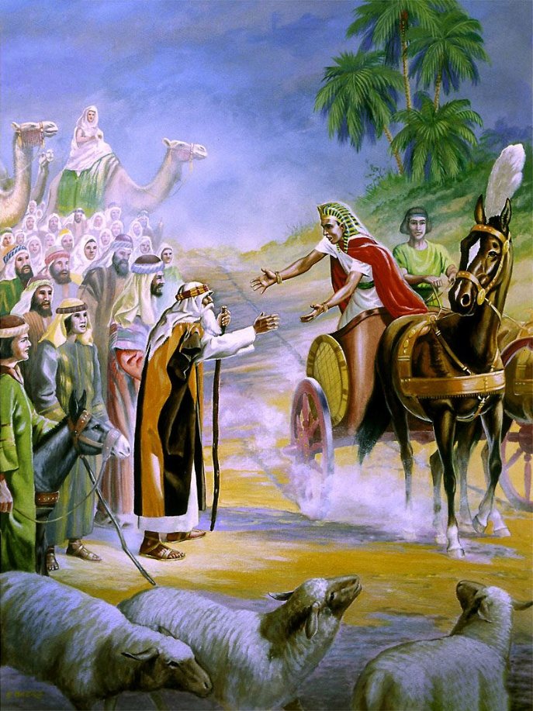
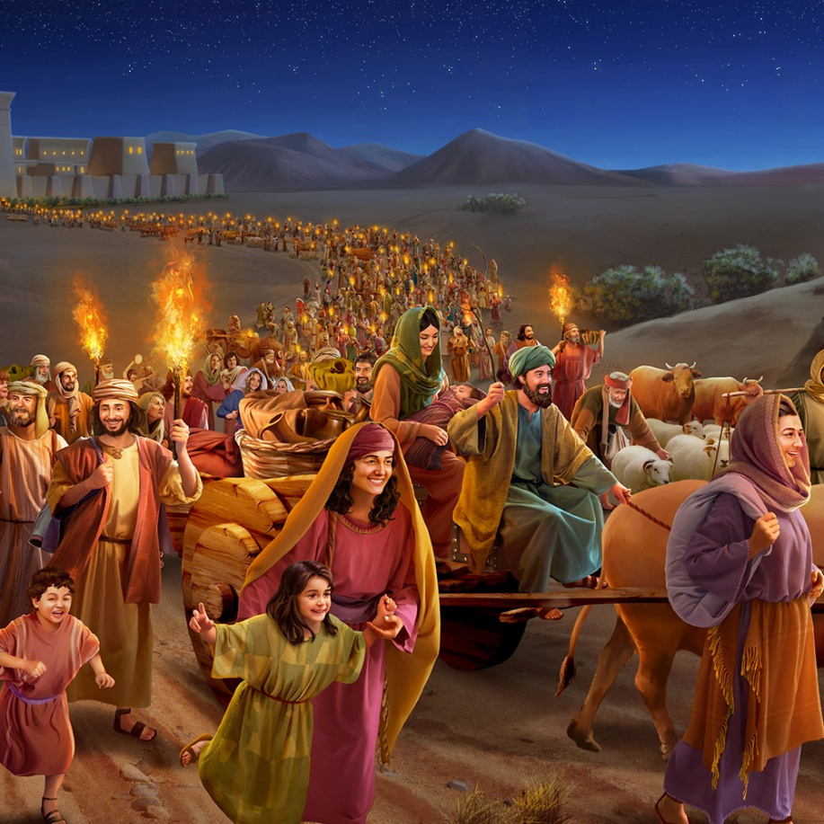
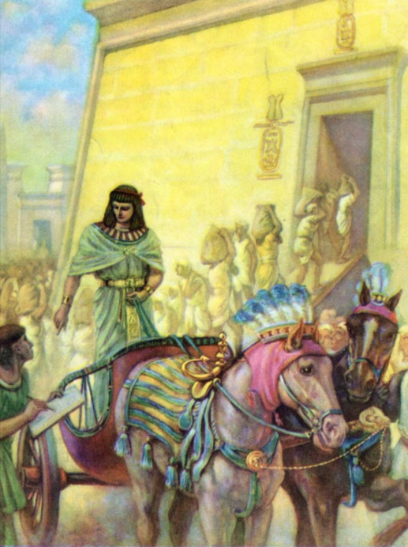
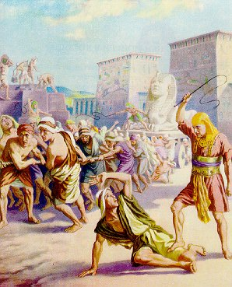
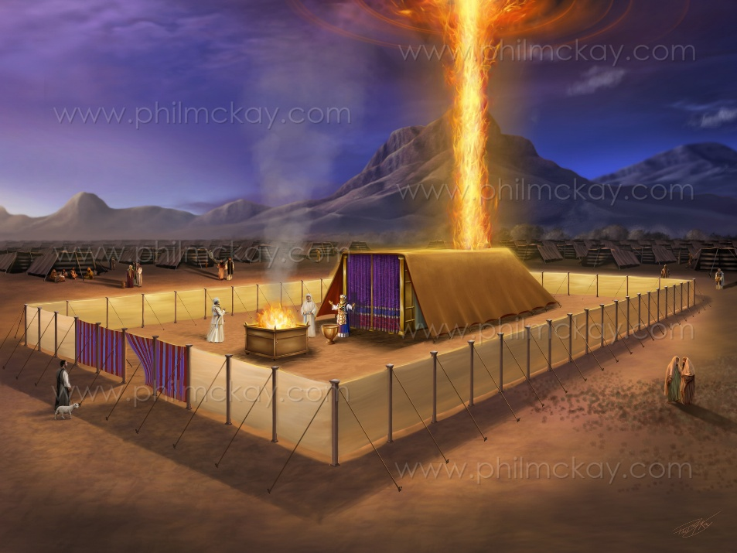
EGYPT A OM PASIAN’ MITE
“Jacob tawh Egypt ah a hongpai, amau’ innkuan ciat tawh ahi Israel’ tapate’ mite.” (Paikhiatna 1:1)
Moses ii laibu nihna pen tua athu paipite hangin Latin pau in “Paikhiatna” ci-in kisam hi. Ahizongin Hebrew pau ah tua kam mal te “Shemot ” (Minte), ci-in mi tampi thei zaw hi (Pai. 1:1).
Hih “minte” pen Jacob le a tate ii mite hi. Mi 70 kipawlna neu khat (Pian. 46:26-27; Pai. 1:5). Hun sawtna zui-in amaute in galkap hang 600,000 bang apha mi nampi khat suak hi (Pai. 12:37).
Jacob’ tapa, Joseph in Egypt minam hilo napi a 17na Hyksos kumpi khanggui pan pharaoh kumpi nasem khat suak hi. Hyksos hong kiat khit ciangin Egypt gam ah “Joseph a theilo” kumpi thak hong kah hi (Pai. 1:7-8).
Hih in Israel te haksatna mun ah hong tun hi (Paikhiatna 1:9-14). Ahizongin, Paikhiatna bu a tawp lam ah a thu lamdang takin hong kilumlet hi: Israel mite in Pasian ompihna a ngah masiah, suakta takin biakpiakna nei uh hi (Pai. 40:38). Laibu hong hilhna ah kician mahmah hi: Pasian in uk hi; a piang theilo ding din mun na ngawn panin Pasian in eite hong hon ding hi.

Slide 5

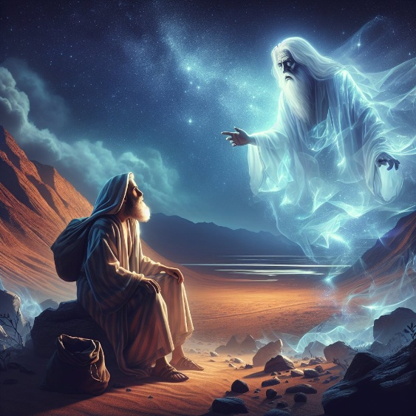
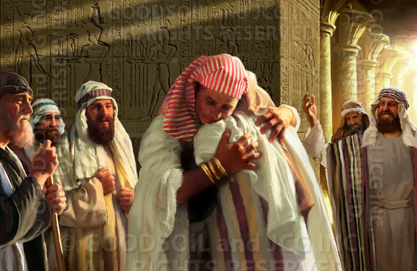
ABRAHAM PAN MOSES DONG
“Tua ciangin Topa in Abram kiangah, "Na suanlekhakte amau' leitang a hilo munah tawlkhat sung omin, tua lai-ah amaute sila hi ding uh a, amaute kum za li sung kinengniam ding ahihna thu a kitel theihna thei in.” (Piancil 15:13)
Pasian in Abraham tungah Canaan gam kongpia ding cih kamciam a piak hangin, hih kamciam a tang’tun theih na dingin kum 400 zekai ding ci-in genkhol hi (Pian. 15:13-16).
Moses le Paul te in hih hun pen kum 30 behlap in Haran ah kilehkik hi (Pai. 12:40; Gal. 3:17):
Haran ah Abraham a pai hun pan in Egypt ah Jacob’ a tun’ dong: kum 215 sawt hi
Egypt gam ah Jacob a tun’ hun panin a paikhiat dong: kum 215 sawt
Jacob pen Egypt ah koici bangin tung hiam? A tuam vilvel lampi tawh hi. Joseph that nakpi takin a han’ciam uh hangin, amah pen Egypt gam in maangpi hong suak hi. Ama’ pan mun hangin, a innkuan pihte a sam thei hi.
Hih khempeuh bang hun in piang hiam? A hun kician takin i theihloh hang in, tangthu sungah kiguang thei ciang i thei hi (ni a kician omlo hi).

Slide 6

ABRAHAM PAN MOSES DONG
“Egypt gam panin Israel mite a paikhiat zawh kum za li leh kum sawmgiatna, Israel-te tungah Solomon' uk a kum lina, a kha nihna ahi Ziv kha-in amah in Topa' biakinn lam ding kipan hi.” (1 Kumpi 6:1)
1 Kumpi 6:1 sungah Paikhiatna pawi pen Solomon kumpi a kah zawh kum 2 acin’ ma kum 480 ah thu piang hi ci uh hi. Hih ni sehna pen maan takpi ding ahihleh 1445 BC kiim hiding hi. Tua pen bulphuh in la hileng’ Pharaoh sih hun ding ngaihsun leeng Paikhiatna pawi pen 1450 BC ah thupiang ahi hi. Hih thu dung zui-in Moses nuntakna a hun tamzaw bangci zat cih i theithei ding hi.
Ahmose I (1575/1550). Hyksos hong zo hi. Amah in “Joseph theilo” in, Israel mite sila a suaksak Pharaoh ahi hi (Pai. 1:8-12)
Amenophis I (1550/1530). Amah pen Israel mite bawlsia suak hi (Pai. 1:13-14)
Thutmose I (1530/1517). Hebrew naupangte that dingin thu a piapa hi (Pai. 1:15-22)
Moses (1530/1410). Amah pen Hatshepsut, Thutmose I ii tanu-in a tapa dingin la hi
Thutmose II (1517/?). Ama’ uk laitak in, Moses Egypt pan in taikhia hi (1490)
Hatshepsut (?/1479). Ama “tapa” Egypt hong tun’kik ma-in si hi
Thutmose III (1479/1450). Paikhiatna pharaoh. A tapa u pen in “gan kawi na lamah thuzeekpi” ahih hangin, gim na 10na ah si ahihmanin kumpi sem manlo hi
Amenophis II (1450/1424). Thutmose III na i ta hih hangin tapa u pen hilo hi.

Slide 7

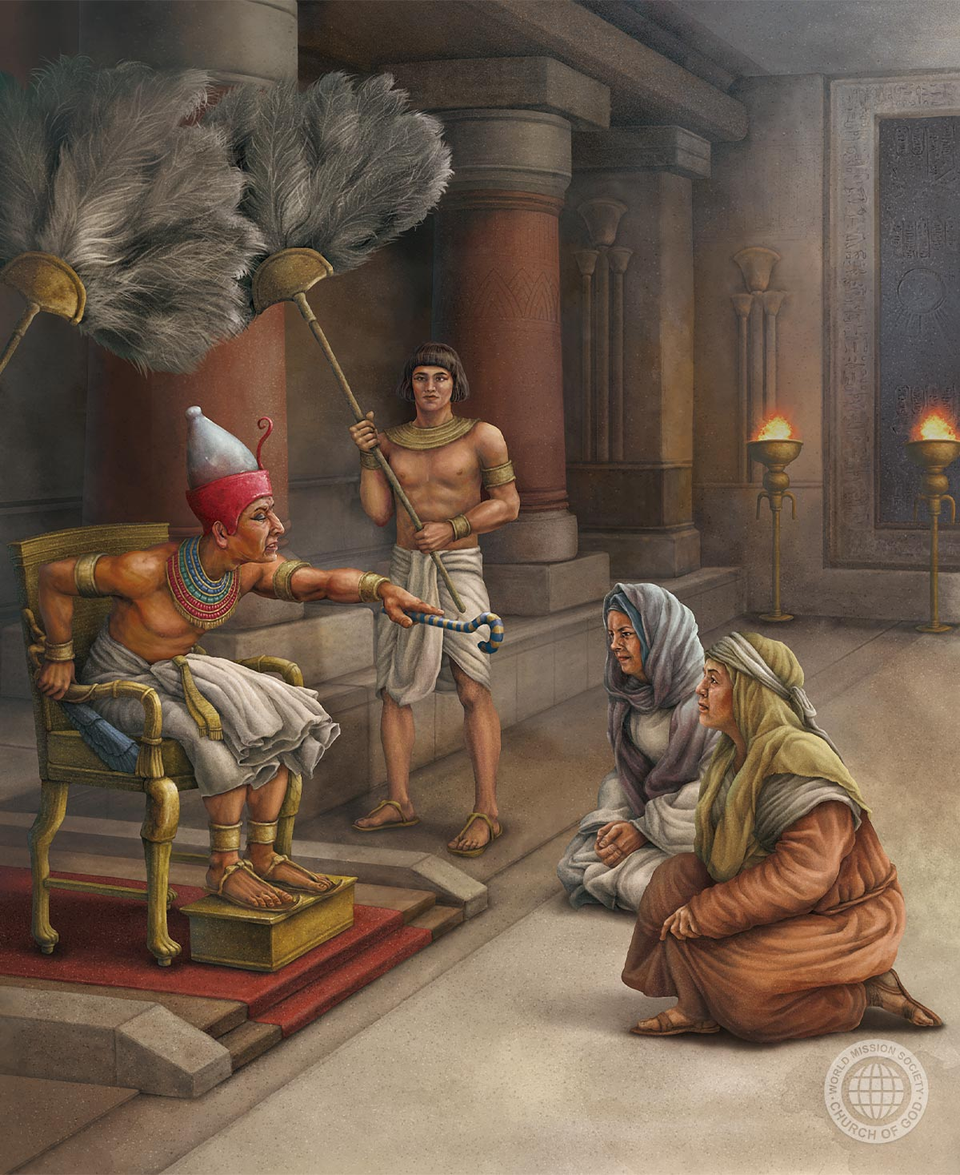
CIHTAKNA II GUALZAWHNA
“Naudomte in Pasian zahtak uh ahih manin amah in amaute tungah suanlekhak a pia hi.” (Paikhiatna 1:21)
A 18na Egypt kumpi in gamdang mite mudah hi. Tua zah khat in, Israel mite langpang zo khop dingin mi tampi om hi (Pai. 1:9-10). Tua manin damdam in hongkipan hi:
1
Amaute in lianpip lam dingin zawhthawh thu tawh sawl hong kipan uh hi (Pai. 1:11)
A ngetnate uh gaak sak semsem uh a, nasem/sila in hong kheel uh hi (Pai. 1:13-14)
Amaute in naudomte zangh in tapasalte thah ding thupia hi (Pai. 1:15-16)
Atawpna ah, amaute in pasal no khempeuh pel lo-in that hamtang dingin thupia hi (Pai. 1:22)
2
3
4
Tua lunggimna lakah naudom siamah ahi Shiphrah le Puah te’ cihtakna hong kilangh hi (Pai. 1:15-19). Moses in Pharaoh’ imm in, amaute min pulaak hi.
Amaute cihtakna hangin amaute Pasian in thupha a piaknate eite’ theih dingin kiciamteh hi (Pai. 1:20-21).

Slide 8

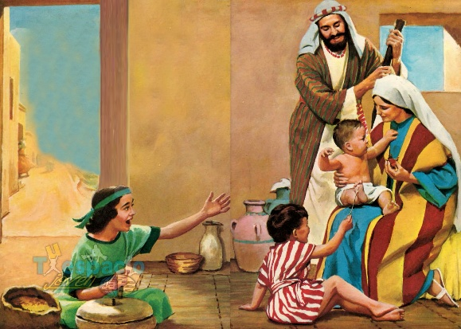
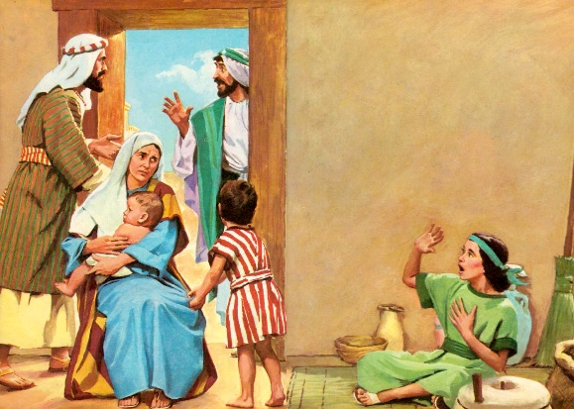
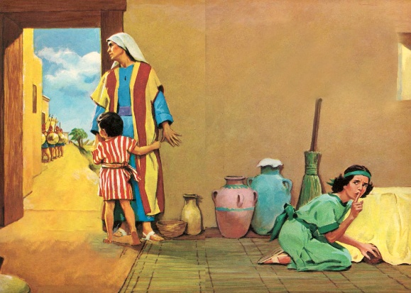
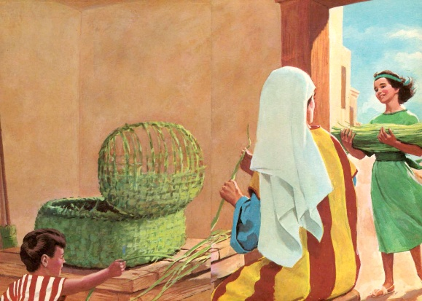
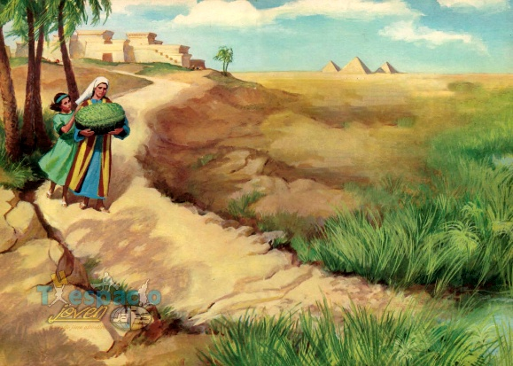
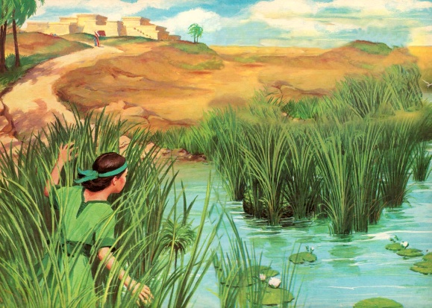
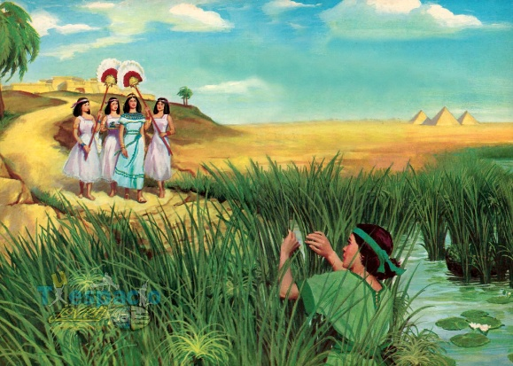
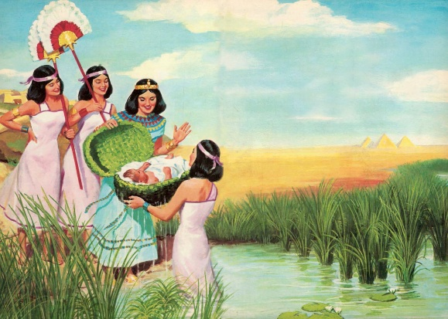
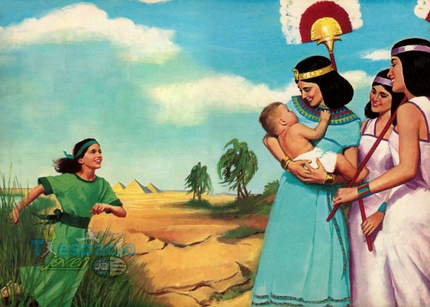
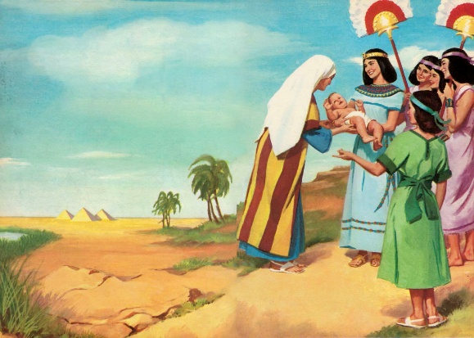
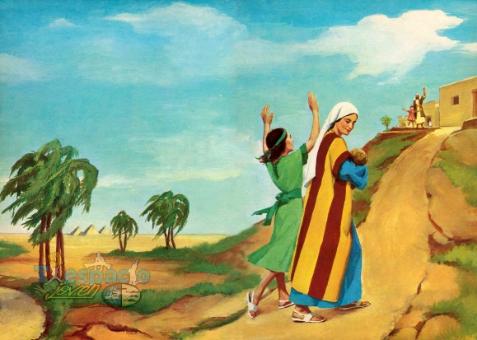
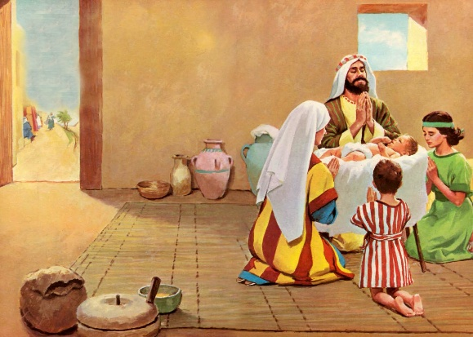
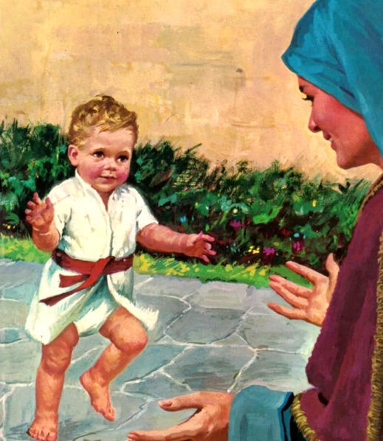
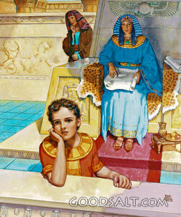
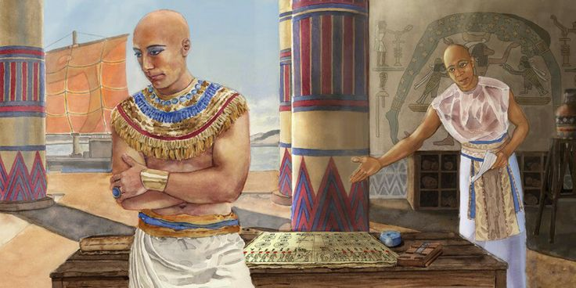
NILE GUN II TAPA
“Tua numei gai-in tapa khat nei a, nau hoih khat hi, ci-in a muh ciangin, kha thum sung a seel hi.” (Paikhiatna 2:2)
Jachebed’ tapa a pulaakna ah a “Hoihna” genlo hi (Pai. 2:2). Hebrew kammal “tob ” (pha hi, hoih hi, kicing hi) cihte in Ama pian’saknate kicin’na pulaakna ah Pasian in a zat kammal khat ahi hi (Pian. 1:31).
Pasian in ama’ adingin a tuamin geelna khat nei hi. Nupi khat in hang’ takin sem ngam hi; khangno numei khat gamtang hi; naupang khat pilvang takin kampau hi… mailam honkhiapa in sihna pan hotkhiat ngah hi (Pai. 2:3-7).
Apian’ma nulepate’ min piak i theih lian loh hangin, ta dingin a la a nu Pharaoh tanu min piak bel i thei hi: Hapimosis (Nile gun pasian tapa). Ahizongin amah le amah “tapa,” “mosis ,” Moses cih bek in kisam hi (Pai. 2:10).
Ama’ nu taktak in kum tawmno a kep sung pen hoih takin zang siam hi (Pai. 2:8-9). A nu in Pasian ta taktak ahihna hilh hi. Pasian zah takna lungsim tawh i tate pattahna ah nute sep ding athupi vaipiak ahihna i thei hi!

Slide 9

“Pasian in nute’ lungsim taawng pan thungetna za hi; a thunget na thaman’ sang hi. Tu-in amah lungmuang le nuamna tawh vaipuak a sep na tung ah lungdam mahmah hi. Amah in Pasian adingin a tano pilna piak theih nading hunpha a ngahte citak takin khang/lawhcing sak hi. Na lianpi khat adingin amah huu zo ahihna lungmuang in a sawtlo-in, amah pen Pasian tawh a kigamla sak thei ding huzaap tuamtuamte lak ahi, kumpi nu a nu kiang aap ding cih thei hi. Tuate khempeuh in naupang dang te sangin a thuhilhna kician zaw le deihsakna tawh gi’na takin hilhcian hi. Amah in Pasian zahtakna, thumanna le thutaan’na te itna tawh a lungsim ah guang dingin hanciam a, a kisia huzap khempeuh pan in a suaktak nadingin nakpi takin thunget sak hi [p. 244]. Amah in milim biakna i siat’huai na le mawhna ahih na theisak in, a haksak hun khempeuh ah amah ahuh ding le a thuumna a ngai ding a nungta Pasian kiang ah thungen dingin hilh hi.”
EGW (Patriarchs and Prophets, p. 243)

Slide 10


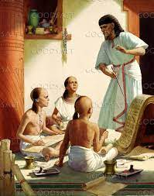
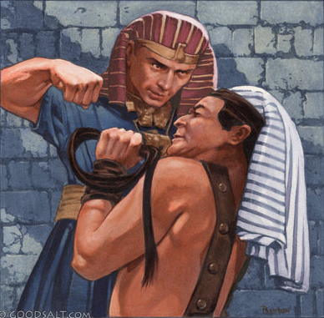
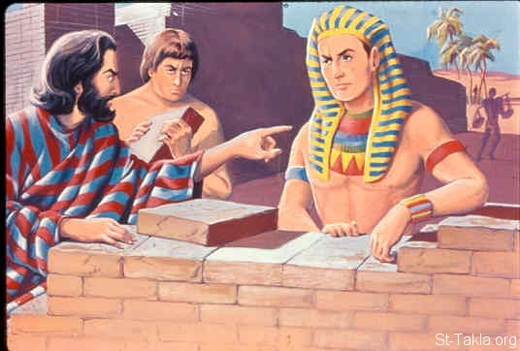
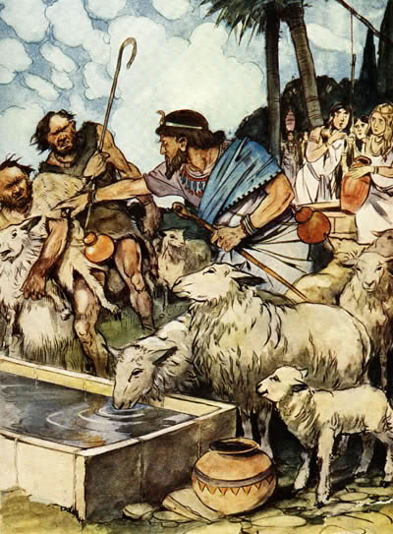
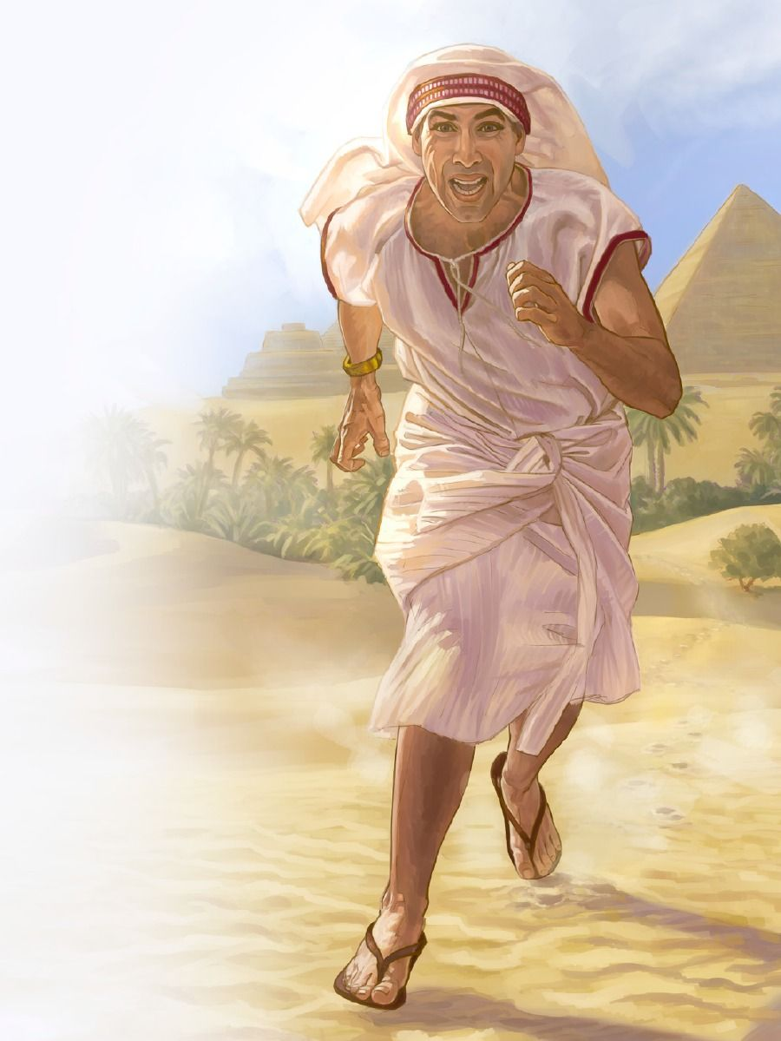
HONKHIAPA A PUUKNA
“Faro in tua thu a zak ciangin Moses thah dingin a zong hi. Ahih hangin Faro kiang panin Moses tai-in Midian gam a tung hi. Nikhat amah tuikhuk gei khatah tu hi.” (Exodus 2:15)
Moses a khangno lai thu tawmno khat bek i thei hi. Kumpiza luah ding mi khat ahihna tawh kizui-in amah in gal le sa vai, le gam ki-ukna vai sin theih pilna a ngah hi (EGW , “Patriarchs and Prophets,” p. 245) .
Moses kum 40 a cin’ ma-in, gam thu vai geelna tawh Thutmose II pen pharaoh dingin a kipulaakna i thei hi. Tua hun laitak in Moses in a minam pih Israel mipa a hotkhiat ding hun hi ci-in ngaihsun hi. Ahizongin amah in Egypt mi khat hong that kha ahih manin a suak tak nading hong kipan hi. Tua pen alian mah mah khialhna khat hi (Pai. 2:11-12 ). Ama mite ngiat in amah pen amaute a honkhia ding pa ci-in sanglo hi (Pai. 2:13-14 ; Sawl. 7:25 ).
Ni tawmno sung in, Pharaoh kumpi inn sungah a kizahtak mi khat hihna panin taikhia in tuucing khat suak hi (Pai. 2:15-22). Ahizongin, Pasian in Moses pen nial lo hi; Amah in khialhna a neih hangin, amah mah zang suak hi.

Slide 11

“A nopci mahmah Pharaoh kumpi inn le a vang’lian to’khomte in Moses lungsim ah iplah sakthei hi; ahizongin Pasian a mang’ ngilh sak thei ding mawh a baang nopsaknate in tua kumpi inn sungah om ahihna a thei hi. Amah in kumpi inn sung nopsakna te khengin, kumpi lukhu khengin, mawh baang’lo gam ah a sang pen a nungta Pasian mi siangthote kipahtawina vaang a lamen hi. Vantung Kumpipa in a gualzo mite lu tungah a kisia theilo lukhu pen upna tawh amah in amu khol hi. Hih upna in leitung ah om to’te kiangpan in kihem’khia in a kiniamkhiat mi khempeuhte tawh kikop sak ding hi, gen’theihna, mawhna i bawl ding sangin Pasian thu’mang ding atel mite thusim’ lo-in a om uh hi.”
EGW (Patriarchs and Prophets, p. 246)

