Slide 1
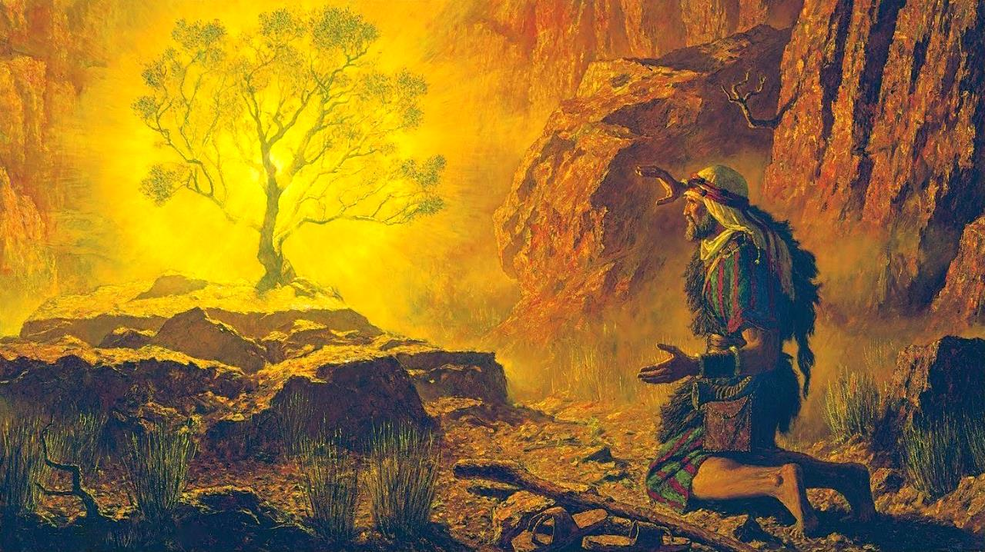
SAWLBAWK MEIKUANG
July 12, 2025 ading Lesson 2

Slide 2
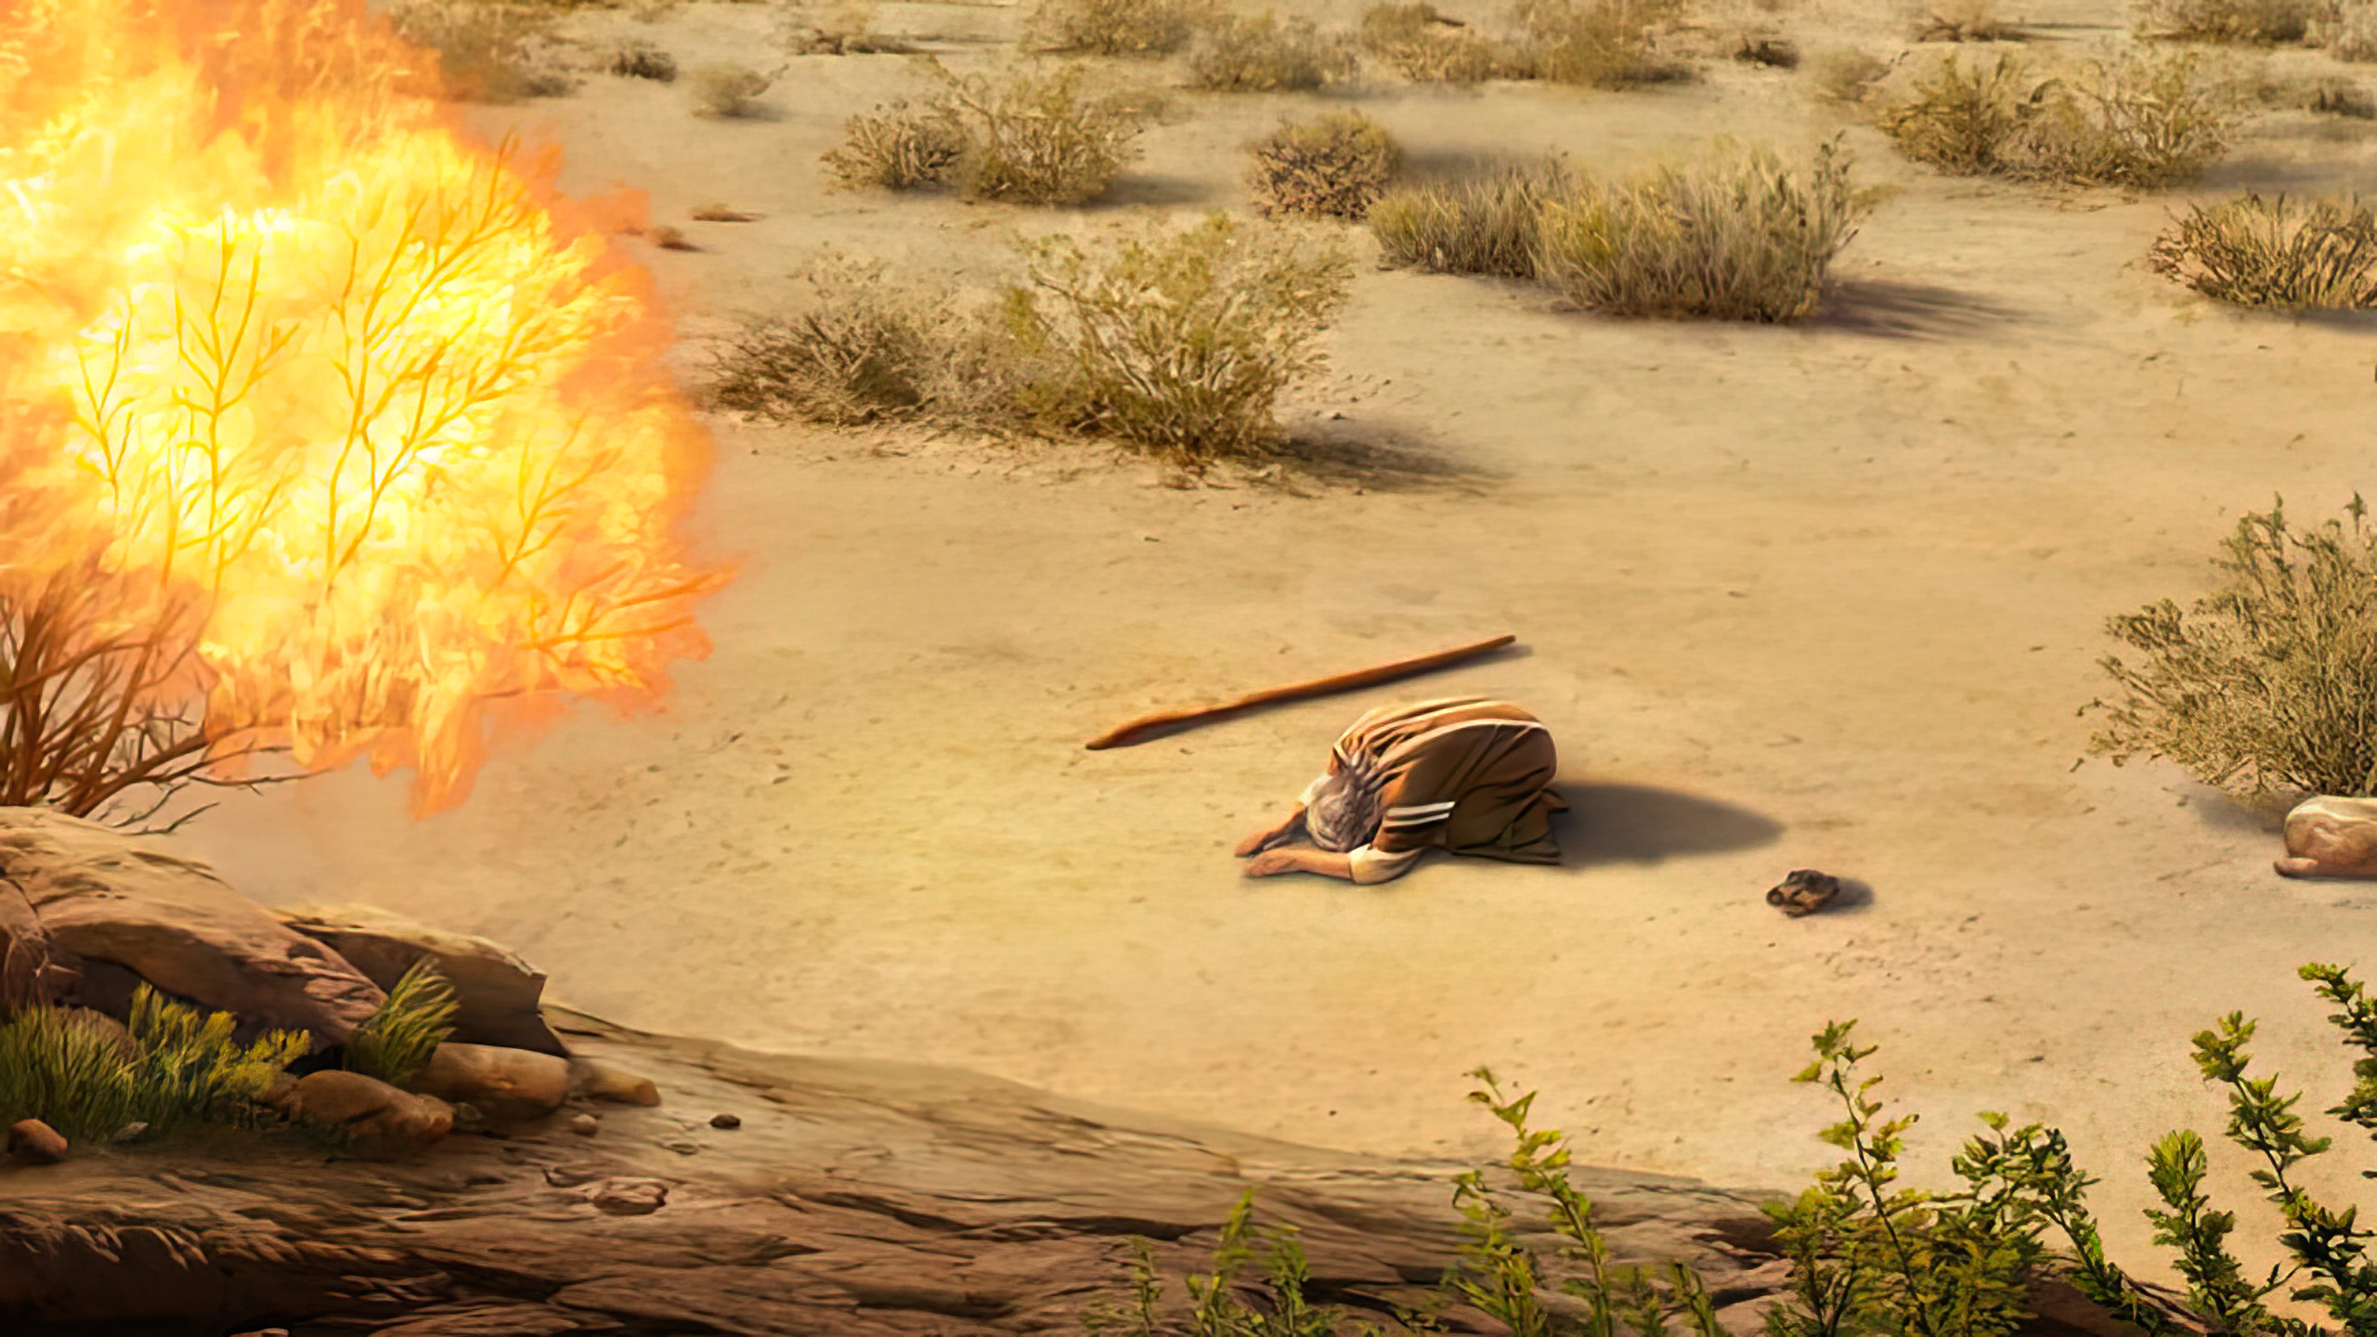
Tuaciangin TOPA in, “Egypt gama ka mite gimna ka mu khin taktak a, nasem ukte bawlsiatna hanga a kikona uh ka za khin hi. Keimah in amaute thuakna ka thei hi. Tua ahihmanin Canaan mite, Hit mite, Amore mite, Periz mite, Hiv mite le Jebus mite teenna, bawngnawi le khuaizu luanna, leitang zap le lei hoihna munah a paipih ding le Egypt mite khut sung pan a honkhia dingin kong paisuk khin hi.” Paikhiatna 3:7, 8, ZSV

Slide 3

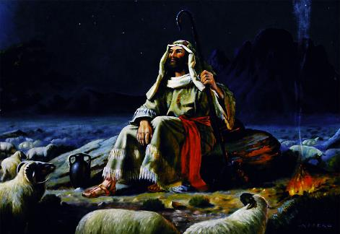
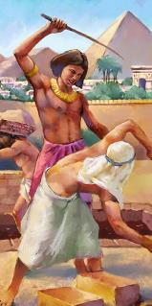
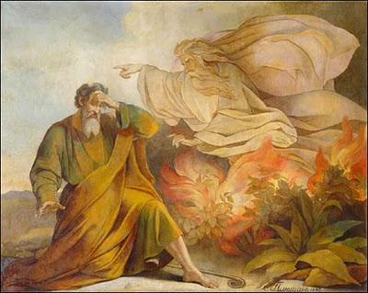







Moses in Israel mite a suahtak theih nadingin a hanciamna a lem’loh khitciangin, Midian sehnel gam ah tuu cing’in kum 40 sung a hun bei sak hi. Tua hun sungteng in amah in Pasian tawh kinai takin kizopna a neih hangin, Israel mite a suakta sak ding cih a ngaihsutna pen beisak hi.
Ahizongin Pasian in tua ngaihsutna bei saklo hi. Moses pen Ama’ ading a kiteeltuam vilvel mi’pa hong suak hi. Banghang hiam cihleh Amah in a mite’ gen’theih haksatnate mangngilh lo ahihman hi. Tu’in Israel mite pen a gamhtat saltan’na pan a suahtak sak ding hun tungta hi.
Sapna (Paikhiatna 3):
  Sawlbawk Meikuang (Paikhiatna 3:1-6)
  Pasian’ Thupiakna (Paikhiatna 3:7-12)
  Pasian Min (Paikhiatna 3:13-22)
Nasep zawhna (Paikhiatna 4):
  Paulap Tuamtuamte (Paikhiatna 4:1-17)
  Egypt gam ah ciahkikna (Paikhaitna 4:18-31)

Slide 4

SAPNA

Slide 5


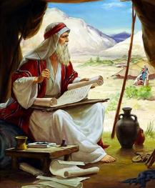
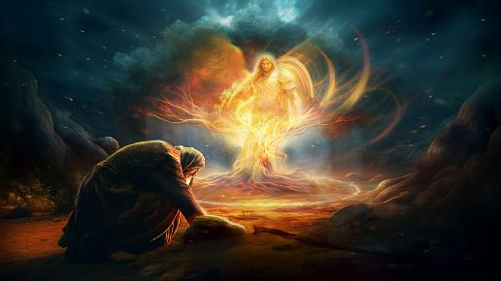
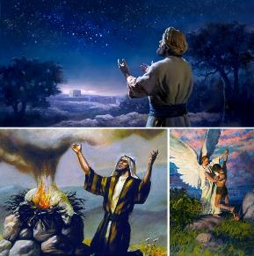

SAWLBAWK MEIKUANG
“Topa' vantung mi sawlpang kawm, meikuang sung panin ama tungah hong kilang hi. Amah khuadak a, sawlpang a kuang a mu hi. Ahi zongin kangtumlo hi.” (Paikhiatna 3:2)
Midian ah Moses a teen’ kum 40 pen a nuai-a bangin tomkaih in kipulaak thei hi: aman’ zi nei-in tapa nih nei hi, a sunghpa adingin tuute a cin’sak hi. Aman’ tua sung in laibu nih gelhna in a hun zangh hi: Job le Piancilna, gupkhiatna a thupit’ na thute pelhlo-in a tel’ ding kisam hi. Ahizongin tomno sungin na khempeuh hong kikhel hi.
Horeb (Sinai Mual) ah, Pasian’ vantungmi in sawlbawk meikuang sung pan Moses mai-ah hong kilangh hi (Pai. 3:1-3). Tua Vungtungmi in khua hiding hiam? Pasian mahmah hi (Pai. 3:4). Mihing bangin hong pian’ma in, Zeisu in “Jehovah Vantungmi” bangin hong kilangh phapha hi” (Pian. 22:11-17; Thukhente 6:11, 16; 13:17-22; Zech. 3:1-2).
Moses tawh a kiho ciangin, Pasian in Amah pen Abraham, Isaac, le Jacob te’ Pasiah ahih na kipulaak hi. Ngaihsutna in kician mahmah hi: Pasian in tuanpupa te tungah a piak kamciam kicing sak ding le Israel mite Canaan gam pia ding in hongpai suk hi (Pian. 12:7; 26:3; 48:3-4).

Slide 6

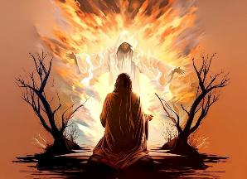
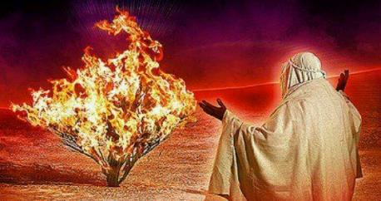
PASIAN’ THUPIAKNA
“Hong pai in, nang in Egypt panin ka mi Israel-te na paikhiatpih theihna dingin Faro' kiangah nang kong sawl ding hi," na ci hi. ” (Paikhiatna 3:10)
Pasian in a gamtatnate ah verb zangin amahmah a gamtang’ khat ahihna kipulaak hi: mu/en, tuaksuk, le la’khia … (Pai. 3:7-8).
EN: Pasian in gen’theih haksak nate don’lo in omlo hi. Amah in na khempeuh mu hi. A diakdiak in a mite tungah a kibawl bawlsiatna le thumanlo in a kibawl nate amu hi (2 Kumpi 9:26).
TUAKSUK: Pasian pen daai takin omlo hi. Eite’ lakah lampai dingin hongpai hi. Amah mihingte’ laizang ah hong teeng hi
(Pai. 29:45; John 14:16-17)
LA’KHIA: Pasian in, Ama’ hun ciangin, gen’theih haksatna pan hong suakta sak in, a kamciamte a kicin’ nadingin a sem hi(Jer. 29:11)
Pasian in Moses kiang pan a kician sepnate ngen hi: Egypt gam panin ka mite paikhiat pih in (Pai. 3:10, 12). Moses in tua vaipauk hangin a lung gim cip hi. Ama’ tha hatna in cinzo nawnlo; amah in tua vaipuak sep zawh nading neilo ci-in kingaihsun hi; amah in “Kei kua ka hiam?” a ci hi (Pai. 3:11). Ama’ kiphatsakna in a niam pen din’mun ah hong tung hi. A tak tak in, tua hun pen a vaipuak adingin a hoih pen hun suak hi.

Slide 7


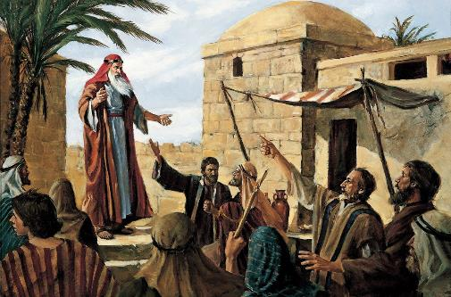
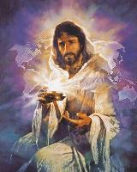
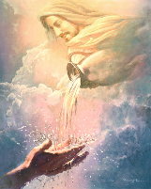
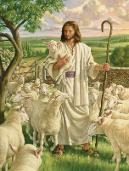
PASIAN’ MIN
Pasian in Moses kiangah, "Keimah kahi hi," ci hi. Tua ciangin Pasian in, "Israel mite tungah hih thu genin, 'Keimah a kicipa in note kiangah kei hong sawl hi,' ci in," a ci hi. (Paikhiatna 3:14)
Egyptte’ pasian khempeuh in min a neih uh hangin, Israel te-in “Vangliatna khempeuh anei Pasian” bia uh hi (Pai. 6:3). Kum zalom tampi Egypt gam tatsiatna khitciangin Israel mite in amaute a honkhiapa min thei nuam uh hi (Pai. 3:13).
Tua hun laitak in amin khat in mi khat i zialetong tawh kizom ahihmanin Pasian in ama’ vaang’ khat pen pen hibangin pulaak hi: 'ehyeh (hithei ding). Pasian pen a tawntung omden hi, a tawntung hi, Amah in “KEIMAH” kahi hi (Pai. 3:14).
Hun sawtna zui-in, hih amin aw’ suah hong mang’ hi. A thupi ah amin bek hilo-in a zialetong ahihna Pasian in phal hi. Eite’ kitang’sapnate amah in a kilawm kituak dingin hong lem’ tuah hi. Amah pen “Tuucingpa,” “Damsakpa,” “Panpihpa,” “PaPasian,” …, “Itna” ci-in i samthei hi.
Athupi pen ah Pasian in ei tawh hong kinai sak nuam, omkhawm nuam, kisam, lawm hoihpen khat hi.

Slide 8
NASEP
ZAWHNA

Slide 9

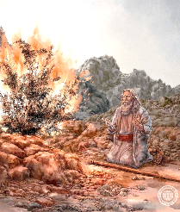
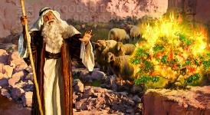
PAULAP TUAMTUAMTE
«Ahih hangin amah in, "Oh, ka Topa aw, hong thum ing; midang khat sawl zaw in," aci hi.”» (Paikhiatna 4:13)
Moses in ama’ tungah Pasian in a piak vaipuak pen sep noplohna a pulaak ma-in, tua thu a nial nading in “a kicing” paulap li genkhia hi. Paulap khat sim adingin Pasian in kamciam khat tawh dawng kik hi.
“Kei kua ka hiam?” (Pai. 3:11)
“Nang tawh kong om khawm hi” (Pai. 3:12)
Topa’ sawlna a semsak zo ding vang’liatna in ei’ hih zawhna hilo-in Pasian in hatna hongpia cih ahi hi. Moses tawh a om khop mah bangin eite tawh zong Amah hong om khawm hi.
“Na min bang hiam?” (Pai. 3:13)
“Kei kua ka hiam” (Pai. 3:14)
Pasian pen thumaan hi, a tawntung hi, le mimal hi; ama’ kamciam pia in, a kamciam kip tawntung hi; bei hun omlo; a tawntung in lungmuan huai hi.
“Amaute in kei hong umlo in, ka pau ngai lo uh hi” (Pai. 4:1)
“Na sep na lamdang te hangin amaute in hong um hi” (Pai. 4:8)
Pasian in Moses pen nalamddang bawl theih nading vang’liat na pia-in, tua nalamdangte a um dingin mite lungsim ah nasem hi. Eite zong tua bang semding hong kamciam hi (Mark 16:17-18).
“Kei pen a dang nal mi kahi kei hi” (Pai. 4:10)
“Na kampau ding kong hilh ding hi”
(Pai. 4:12)
Leei a piangsakpa in a kisap hun in a kisam kammal zat theih nadingin a hilh hi (Pai. 4:11; Luke 12:11-12)
Atawpna ah, Pasian in Moses kiangah, “Na paulapte kicing hi; na sem thei hi, na semzo hi” (Pai. 4:14-17).

Slide 10


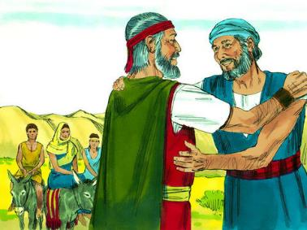

EGYPT GAM AH CIAHKIKNA
“Lampi-ah a giahna khatah Topa in Moses dawntuahin thah a sawm hi.” (Paikhiatna 4:24)
Egypt ah hong ciah kik ciang Moses in a sep masak thu in a sunghpa kiang ah phalna a ngen hi (Pai. 4:18 ). A innkuanpihte sam in khualzin kipan hi (Pai. 4:20). Ahizongin a lamdang thu khat piang hi. Lam tawn tung ah, Pasian in amah that nuam hi (Pai. 4:24 ).
Zipporah in bang thupiang hiam cihtel’ in sih theih nading thu pelh theih ding a kisam sep khiatna nei hi: amah in a tapa van at sak hi (Pai. 4:25).
Moses (a zi huzapna) in a tapa vun at ding phallo hi. Tua ahih manin, Abraham tawh Pasian in kiciamna thute amah in a zuih loh man ahi hi (Pian. 17:10).
Moase in vang’lianpa thupiakna zuih ding siang takin a nialna hangin mihingte a makaih dingin kicinglo hi. Ama’ vaipuak a sep ma-in hih thu a puahpah kik hi.

Slide 11

“Mi khat in ama’ tungah Pasian in a piak vaipuakte a ngah khitciang in tua vaipuak pen maan takin a sep ding ama’ siam’na a cin’ theih nadingin ahih theih tawpin a hanciam ciangin vangliatna le siamna a ngah thei pan ding hi. Ama’ din’mun pen bangzaih takin niamkiat mah taseleh ahihkeileh ama’ hih theihna kiciangtan himah taseleh Pasian’ vang’liatna um in muang in asepna ah citak takin a hamciamleh a dik vangliatna a ngah ding hi. Moase in ama’ hatna le siamna suang in vaipuak lianpi pen lung lawp takin a sang hileh tua bang nasep sem dingin ama’ siam’na a cin’ lohlam kilangh ding hi. Mi khat in ama’ tha neemna thuak kha cihthu ah amah tungah a ki-ap kiangtan nasep pen aman’ thei cihna hi-a, Pasian’ ngaihsut piakna in tha hisak hi.”
EGW (Patriarchs and Prophets, p. 255)

