Slide 1
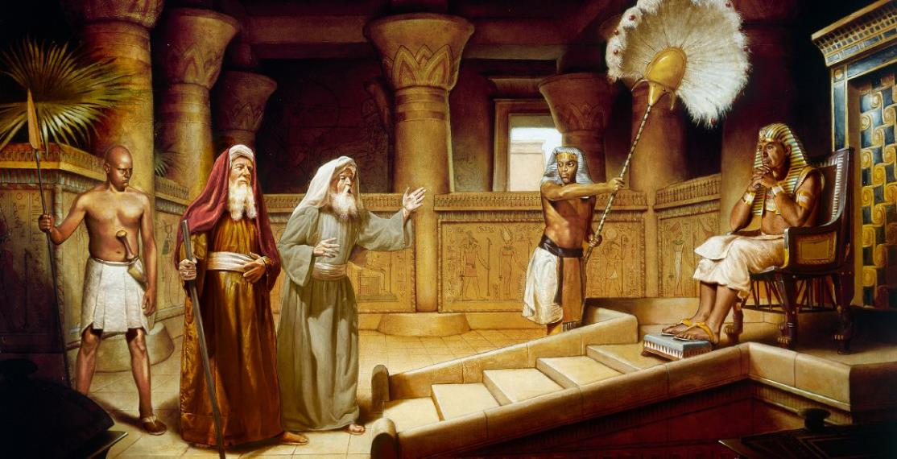
HAKSATNA TAWH KIPAN
July 19, 2025 ading Lesson 3

Slide 2
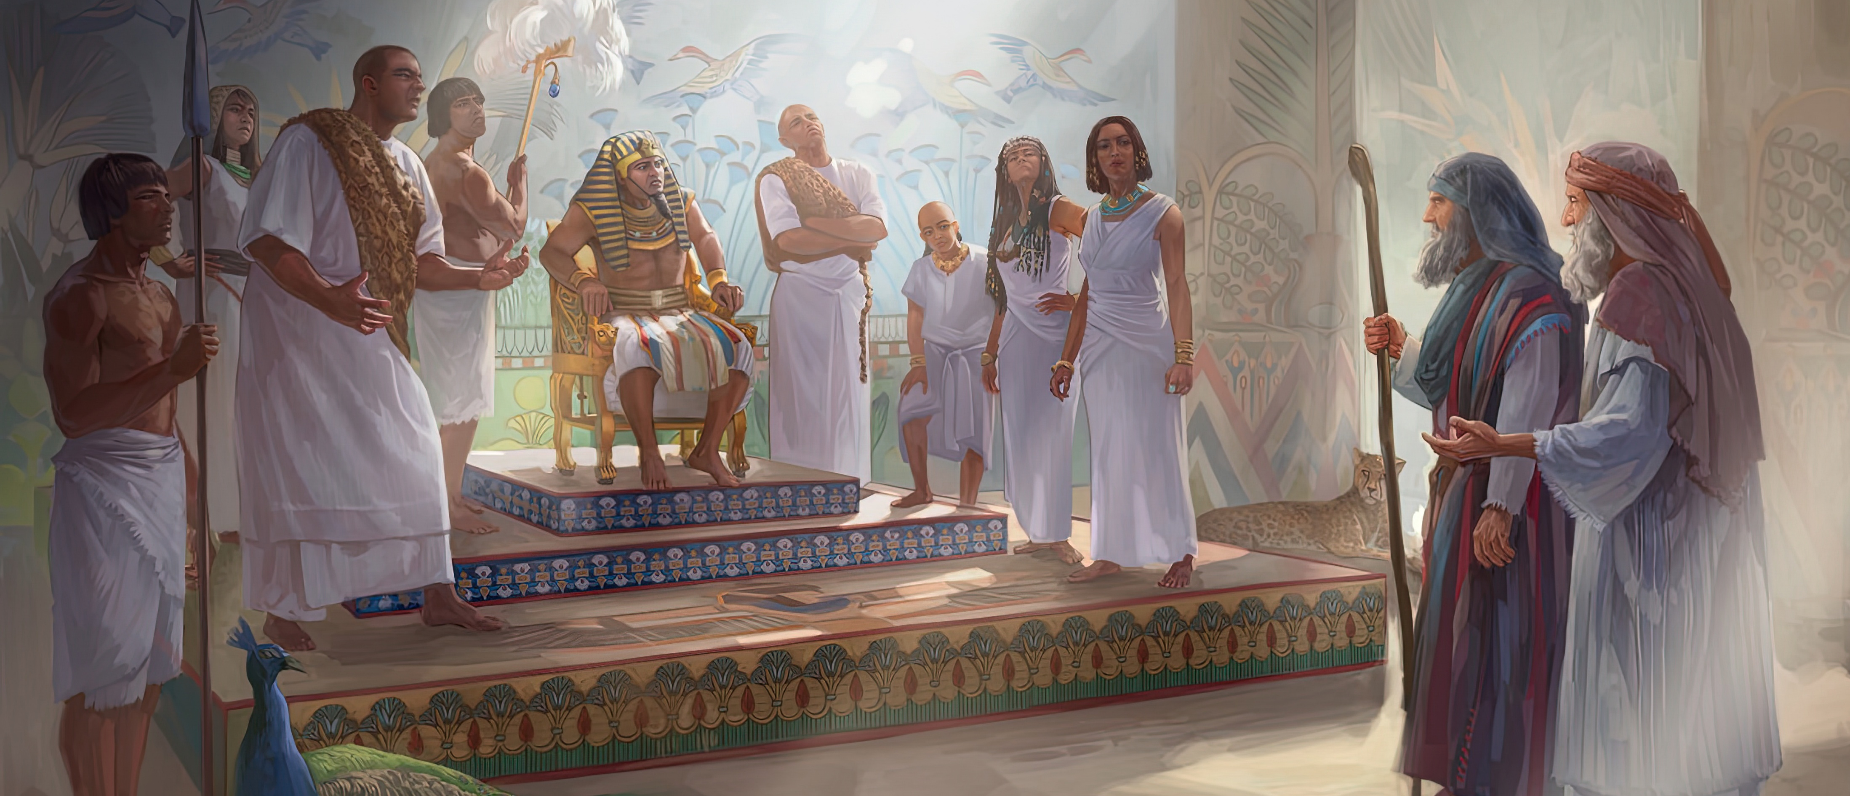
“Tuakhit ciangin Pharoah kiangah Moses le Aaron pai uh a, “Israel Pasian TOPA in hih bangin a ci hi: ‘Ka mite in kei aa ding gamlak ah pawi khat a kham theih nadingun ka mite paisak in,’ ci in,” aci uhhi. Tua ciangin Pharoah in, “Ama thu mangin Israelte ka paikhiatsak nadingin TOPA in kua ahi hiam? TOPA ka thei kei a, Israelte zong ka paisak kei ding hi,” aci hi.” Paikhiatna 5:1, 2, ZSV

Slide 3

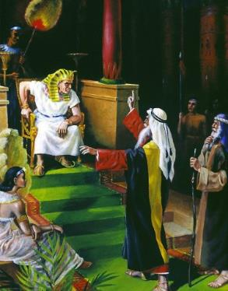
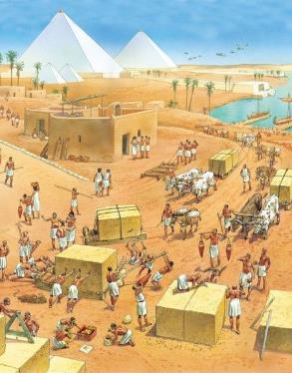
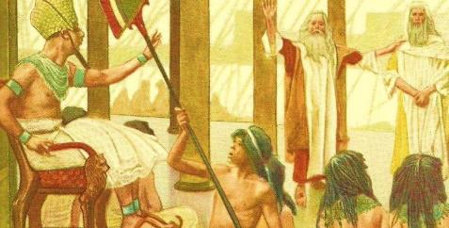




Moses in a theihsa mah bangin, Pharaoh kumpipa in Israelte Egypt pan a paikhiat ding phal pakloding hi.
Egypt mite’ sep noploh nasepte ah a kizangh mah mah mi honpite pen mawk khahkhiat ding cihpen a ahi theilo ding thu khat hi.
Tua ahihmanin, mipite lametna in Pharaoh kumpi tung ah amaute’ ngetna a dawn’ theih nadingin na lamdangte tung ah a kinga hi.
Ngetna nei uh hi; nialna thuak hi; mawh paihna ngah hi; Moses in a lamdang bangmah a bawl kei hi; … lungkiat nading tam semsem hi.
Ngetna: “Ka mite hongpai sak in.”
  Pharaoh’ dawn’na (Paikhiatna 5:1-2)
  Mipite’ thukkikna (Paikhiatna 5:3-21)
  Pasian’ dawn’na (Paikhiatna 5:22-6:8)
  Moses’ dawn’na (Paikhiatna 6:9-13)
Moses le Aaron te’ vaipuak (Paikhiatna 6:28-7:7)

Slide 4

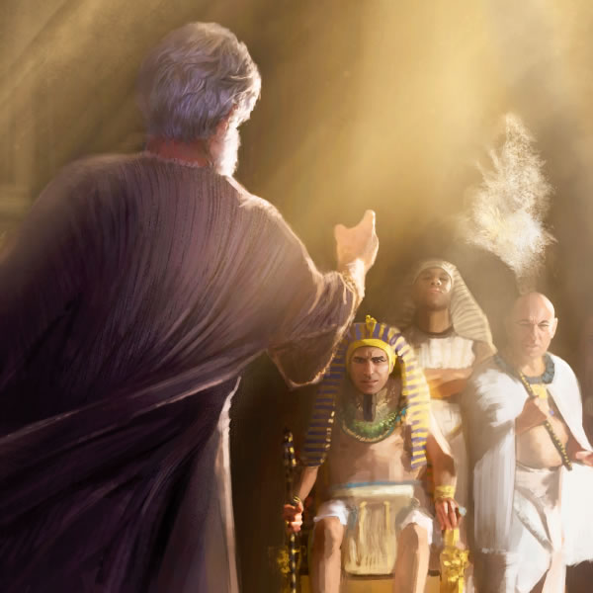
NGETNA: “KA MITE HONGPAI SAKIN”

Slide 5


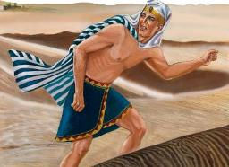
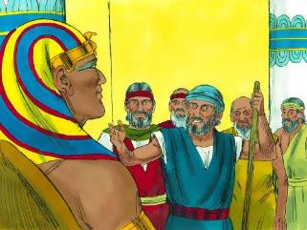
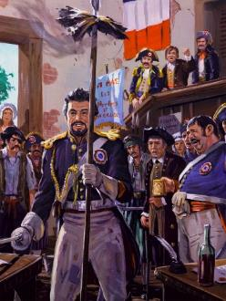
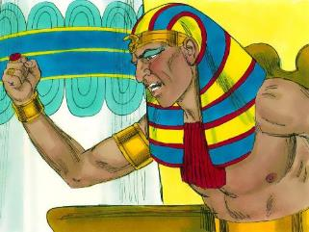
PHARAOH’ DAWN’NA
”Ahih hangin Faro in, "Ama thu mangin Israel mite ka paisakna dingin Topa na cih uh kua ahi hiam? Topa na cih uh ka thei kei hi. Tua thamloin Israel-te ka paisak kei ding hi," na ci hi. (Paikhiatna 5:2)
Thutmose III na in Moses pen Pharaoh kumpi cih gen khiat ding a khaam dingin Hatshepsut ii ukna nuai-ah kumpi za angah in naupangno khat hilai hi. Thutmose kum 10 gual ahihlai-in Moses pen Egypt pan taikhia hi.
Kum 40 khit cingin, Moses pen kumpi in hong tung kik hi. Amah in kumpi tokhom luah ding a hiam? Hi lo hi. Ama’ ngetna pen ahi maimai lel hi: “Ka mite hong pai sak hi” (Pai. 5:1).
Thutmose’ dawn kikna in, Moses to’na hilo hi, Pasian tung ah to’na hi. Atom in genleng, amah in Pasian hihna a to ahi hi (Pai. 5:2).
Ama ngaihsutna pen Mangmuhna sungah kum zalom 18 kipuahphatna hun sung in French gam ai-awh lim’ in kizangh hi (Mang. 11:8). Pharaoh bangin, French kumpi gam in biakna vai a bei’ sakna taangko in amau ngiat in pasian neilo minam in taangko uh hi.

Slide 6


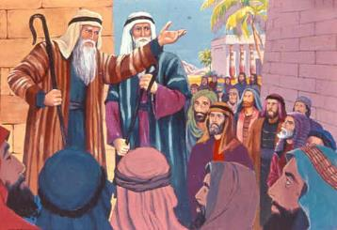
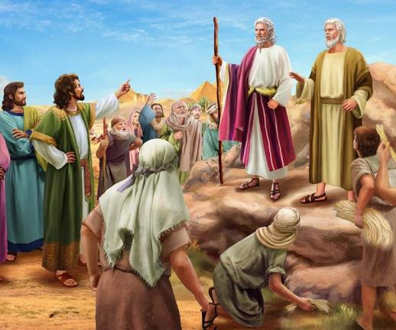
MIPITE’ THUKKIKNA
Amaute in, "Topa in note hong enin thu hong khen hen. Banghang hiam cihleh Pharaoh le a nasemte' muhna-ah kote a khial nong suaksak uh a, kote hong kithah theihna dingin thu a zong na hi uh hi," a ci uh hi. (Paikhiatna 5:21)
Moses in mite mai-ah Pasian in a piak na lamdangte a bawl ciangin, tua mite in um in bia uh hi (Pai. 4:29-31). Amaute ngetnate Pharaoh in bangci dawngkik ding cih lung himawh takin ngak ding cih, na mitkha in bawl in.
A dawn’ kikna pen amau lamet bang hilo hi. Pharaoh in nial bek thamlo-in, a kisam nate pia lo-in, a ni dang ngeina mah bangin nasep ham sawl in semsak hi (Pai. 5:6-8). Tua bang in ahi theilo ding thukhen tatna a piakna bang hang hipen ding hiam?
Moses le Aaron te in—Thutmose mah bangin—amaute “nasepna pan tawlngakna [shabbat] pia hi” (Pai. 5:5). Biak na le suahtakna thu gen theih hun omleh, buh sangh zon hun zong om thei ding hi (Pai. 5:9, 17).
Amaute’ tungah bawlsiatna a thuak ciang in, nasep ukte in Pharaoh kiang a gen’ uh hangin a thusim’ kei hi. Tua khit ciangin amaute in Moses le Aaron tungah, ki-uk dan paizia kisia sak zaw uhteh ci-in a mawhsiat uh hi (Pai. 5:20-21).

Slide 7


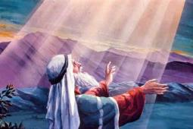
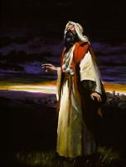
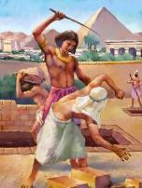

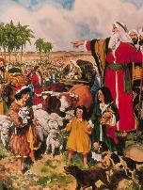
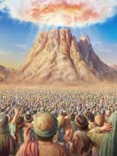
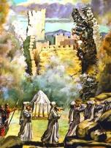
PASIAN’ DAWN’NA
Topa in Moses kiangah, "Tu-in Pharoah tungah ka bawlding na mu ding hi. Banghang hiam cihleh amah in utlopipi-in amaute sawlkhia ding hi. Amah in utlopipi-in ama leitang panin amaute hawlkhia taktak ding hi" aci hi. (Paikhiatna 6:1)
Pharaoh pen Moses tungah heh hi. Mipite zong Moses tungah heh hi. Moses … aheh loh hangin, lungkia in, lung hihmawhna tawh Pasian kiang ah: “Banghang hih mite gen’theih pia na hiam? Banghang kei hongsawl na hiam?” (Pai. 5:22).
Pasian’ dawn’ kikna en khawm ni (Pai. 6:1-8):
Bang sem khin
Kei in kamsangte tungah kilangh khin ing
Bang sem ding
Egypt mite’ bawl siatna amau kiang pan ka hemkhia ding hi
Amaute sila hihna pan ka suakta sak ding hi
Kei in amaute tawh kiciamna ka kipsak hi
Amaute tungah Canaan gam pia ding ka ciam hi
Keimah in amaute tau’na ka za hi
Ka kamciamte ka mangngilh kei hi
Ka vang’liatna ka lak ding hi
Amaute ka mi dingin ka bawl ding hi
Amaute Pasian kahi ding hi
Amaute Canaan gam kapia ding hi

Slide 8


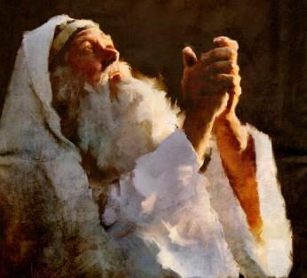

MOSES’ DAWN’NA
“Ahih hangin Moses in Topa kiangah, "En in, Israel mite nangawn in ka thu hong ngailo uh hi. Tua ahih ciangin bangci-in thugen siamlo keima thu, Faro in hong ngai ding ahi hiam?" a ci hi. (Paikhiatna 6:12)
Pasian’ thapiakna kammalte khitciang in, Moses in a mite kiangah a gen’ kik hangin amaute in a zui kei uh hi (Pai. 6:9). Tua khitciangin Pasian in, Pharaoh kiang pai in Israel mite a khahkhiat nading a ngen dingin Moses tungah thupia hi (Pai. 6:10-11).
Moses in nial hi, ama’ paulap a genbeh lai hi: ka mite in ka thugente a mang nuam kei uh hi, ka pau awk hi, Pharaoh in koici bangin ka thugen hong ngai ding ahi hiam? (Pai. 6:12).
Moses a lung neu in, lung kia in, a lung gim mahmah hi. Ahizongin, amah bangin a thuak kha adang etteh ding—Asaph le Job te zong— lungkia om hi. Pasian tungah ama upna in a thuak khak thute sangin tha’hat zaw hi.
Eite’ lungkiatna, lungneu’ nate i tuah khak ciangin, Asaph’ ii kam pau pen ei’ pau bangin pau ni: “Ahih hangin nangmah tawh ka om khawm ngitnget a, ka khut taklamin kei nong len hi. Thulahna tawh keimah nong makaih a, a nung ciangin minthan'na munah na hong tun'pih ding hi. Nang simloh vantungah kua nei kahi hiam? Nang simloh ka deih ding leitungah kuamah omlo hi. Ka lungsim le ka pumpi zawngkhal khading a, ahih hangin Pasian pen ka lungsim hatna le keima-a' hi tawntung ding hi.” (Late 73:23-26).

Slide 9

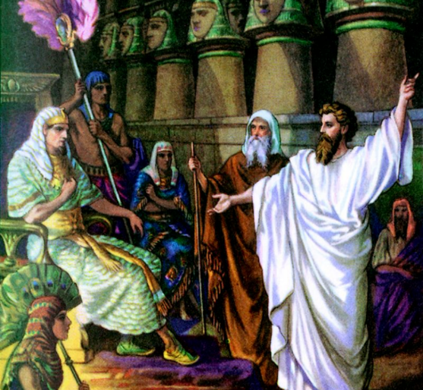
MOSES LE
AARONTE’ VAIPUAK

Slide 10

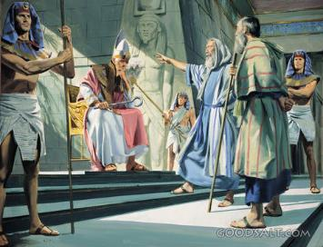
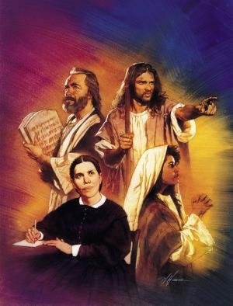
“Topa in Moses kiangah, "Thei in, Pharaoh' tungah Pasian bangin nang kong bawl hi. Na sanggampa Aaron pen na kamsangpa hi ding hi. ” (Paikhiatna 7:1)
“Ka pau ding thei keng” cih pen Moses in a deihpen paulap hih tuak hi. Hih thu tawh Pasian a heh sak hi! Ahizongin Pasian in na khempeuh adingin adawn’na om hi: pau a siam a sanggampa Aaron in Moses kam pau nadingte ah sem hi. Moses in a sanggampa tungah gen in amah in mite tungah gen kik hi (Pai. 4:10-16).
Egypt ah a sep masak a lawhcin loh cingin, Pasian in Aaron pen Moses a huh ding le ai-awh thugen dingin a sawlbeh hi (Pai. 7:1-2).
Himun ah, Pasian in kamsangte’ vaipuak tawh tehkak honglak hi. Kamsang te in Pasian kiangpan thupuak ngah in mihingte’ tungah a gen’ kik mah bangin, Moses in Pasian mun (thupiapa), Aaron pen kamsang mun (thupuakpa) ahi hi.
Hun nu’nung ah kamsang tampi hong om mah bangin, mihingte in Pasian thu manglo in, tua bangin vangliatna tawh zawhna ngah ding ahihlam Pasian in hong thei sak hi (Pai. 7:3).
Hun nu’nung kamsangte bangin, Moses in mite le Pharaoh in a thu gen ngai ahi-a, a nial ahi zongin gen tei’tei’ dingin Pasian in thupia hi, ahang pen amaute in a langpan’ tawntung mite ahihman hi (Ezek. 2:7). Hih thu tu’hun ei’ adingin aman pen hi, eite in leitung ah Pasian’ tongluan a puak sawnte ihi hi.

Slide 11

“Hebrewte in amau’ upna a tuam in sittelna omlo, haksatna le gen’theihnate thuak khalo in suahtakna ngah dingin kilam en uh hi. Ahizongin amaute in suahtak nadingin kiging khin nai kei hi. Amaute in Pasian a upna uh neu mahmah in, Pasian in a hun a cin ciangin honkhia ding cihpen ngak zolo uh hi. A tam zaw in Egypt ah sila din mun ah om ding ut zaw uh a, pawl khat in ahihleh Egypt ngei’nate zang in Egypt ah om suak nuam zaw uh hi; tua ahihmanin Topa in Pharaoh mai-ah ama vang’liatna lakkhia in a mite honkhia masa lo hi. Banghang hiam cihleh Egypt kumpipa’ bawlsiatna nakpi in a kilangh sak dingleh, a mite in tung ah a deihna kicing kilangh sak ding, a mite tung ah Amah mah kilangh ding hi. Tua bang tawh amaute in Pasian thumaanna, vangliatna, le itna te a muh uh ciangin, Egypt gam pan in paikhia in Pasian tung ah kipia dingin hong teel ding uh hi.”
EGW (Patriarchs and Prophets, p. 236)

