Slide 1
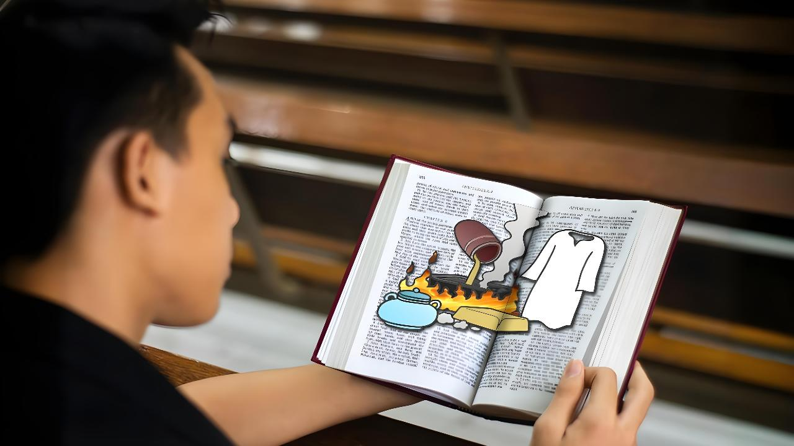
DINMUN TAKTAK SITTELNA
April 4, 2026 ading Lesson 1

Slide 2
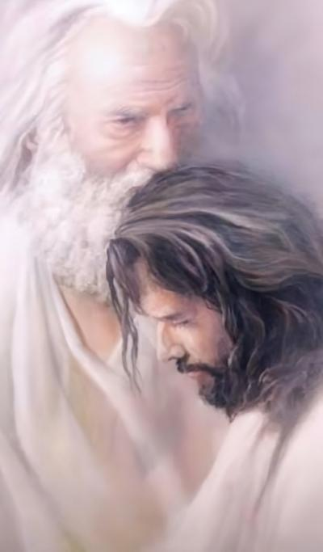
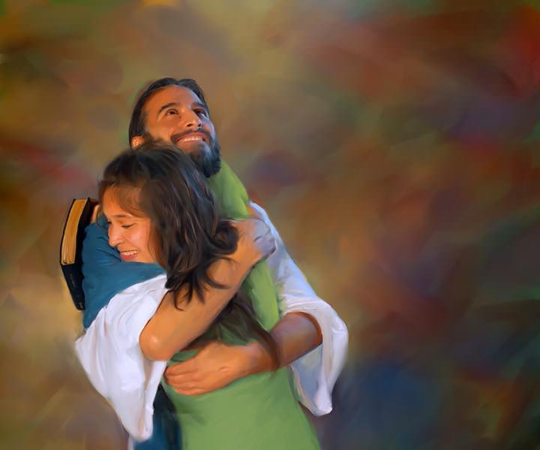
“Pa in kei hong it bangin ken’ zong note kong it hi. Ka itna sungah om tawntung un.”
(John 15:9 ZSV)

Slide 3

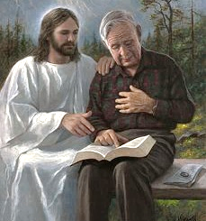



Eite khempeuh in Pasian tawh kizopna tuamtuam i nei hi. Ahih hangin thu khat ah i vekpi in i kithukum hi: hih kizopna khangto thei (khangto ding zong) ahi hi.
I khantoh nadingin i kalsuan masak ding pen i dinmun lian i phawk ding ahi hi.
Pasian in hih nuntakna a tawpna hun ah pawlpi’ kha lam dinmun tawh kisai thupuak khat i kiangah hong pia hi. Tu-in tua thupuak sungpan kua te ei tawh kisai hiam cihleh, Pasian tawh i kizopna i hihkhauh i hihthuk semsem nadingin ei le ei kisit ding eima tungah kinga ta hi.
Pasian’ thupuak (Mangmuhna 3:14-22):
  Etphatna (vv. 14-17)
  Hilhcianna (v. 18)
  Agah (vv. 19-20)
  Lungkimna (vv. 21-22)
Ataktak dinmun sittelna (John 15:1-11):
  Ahiang le leenggui
  Sing tui

Slide 4

PASIAN’ THUPUAK
(Mangmuhna 3:14-22)

Slide 5




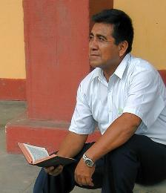
ETPHATNA
“Note a zawng, a mittaw, puansilh ding a neilo, a hehpihhuai, a lungkhamhuai nahih lamtak uh theiloin, kote hau-in ka cithei uh a, bangmah kisapna ka nei kei uh hi, naci uh hi.” (Mangmuhna 3:17)
Pawlpi sagih-te kiangah thupuak in sawltakte hun a kipan tu hun ciang dong leitung pawlpi dinmun lakkhia hi (Mang. 2-3). Tu hun (Laodicea) ading thupuak a piakna ah, Zeisu in amah le amah “Amen [Thutak], thuman le thutak teci” in kilak hi (Mang. 3:14).
Ei le ei i ki-et ciangin i thutakna i mu hi: "Hau ing, sum le paai nei ing, le bangmah kisapna nei keng” (Mang. 3:17a).
Ahih hangin Zeisu in thuman, i dinmun taktak mu a: "Nangmah pen mi genthei, mi khasiat huai, mi zawng, mit-thaw, le vawm na hi hi" (Mang. 3:17b).
Tu-in ei le ei i ki-etphat hun hi. Ka neih taktakte le ka sap lai thute ka thei gige hiam? Zeisu tawh ka kizopna-ah bang tan khangto khin ka hi hiam? A hoih lamah ka kikheel hiam?

Slide 6


HILHCIANNA
“Tua ahih manin na hauhtheihna dingun kei kiang panin kham citak hong lei-in a zumhuaipi-in guaktanga na omna uh na kiselna dingun puanpak hong lei un la, khua na muhtheihna dingun mit zatui hong lei un.” (Mangmuhna 3:18)
I dinmun tawh i lungkimna in thadahna (salo votlo) piangsak ahih manin, Zeisu in thu thum hih dingin thu vaikhak hi.
Kham siang lei in
Thuman kimlo ahih keileh Lai Siangtho thukpi lo-in simna tawh i lungkim ding hi lo hi. Mihing' thupia (tinsel) te i nung ngat ding a, i theihsiamna panin kicinlohna (dross) khempeuh i lakkhiat nadingin Lai Siangtho i simna-ah thukpi zaw-in i lut ding hi.
Puan kang lei in
Hotkhiatna ngah nading lampi khat bek hi ci-in Zeisu dikna i san’na hi. Eima gamtat hoihna tawh Pasian mai-ah kilat i sawmna in Ama mai-ah i guaktatna kilakna ahi hi.
Mit zatui lei in
Kha Siangtho sang un. Ama bek in kha lam khentat theihna hong pia-in, i dinmun taktak hong theisak thei hi (Johan 16:8).

Slide 7

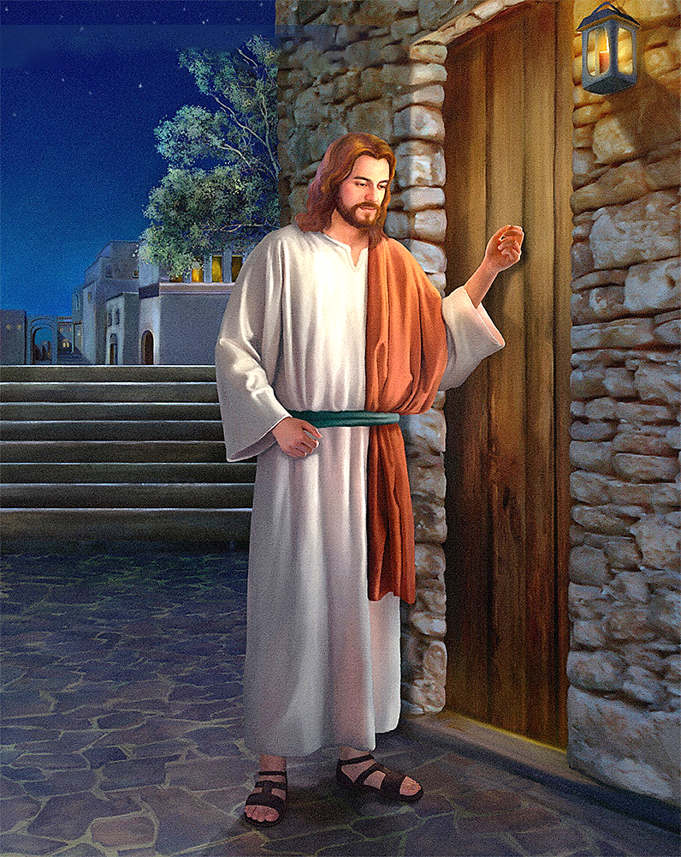
AGAH
“Kongkhakah dingin kong ka hong kiu hi. Ka aw za-in kong hong honte kiangah lutin an ka nekhawm ding uh hi.” (Mangmuhna 3:20)
Buaina khat om hi. Kha lamah hoih kisa mahmah ing, ahi zongin Zeisu in ka khantohna ding deih hi. Ahizongin, kikhelna ka kisapna ka kitel keileh, kikhelna ka nei ngei kei ding hi. Kei’ neihsa kisa ka hih manin lei ding ka lunggulh ngei kei ding hi.
Hih thu bawlpha dingin, Zeisu in kalsuanzia ding nei hi: “Ka it khempeuh ka tai-in ka gawt hi”; amah in behlap in: “Kisik un,” ci hi (Mang. 3:19).
Zeisu’ hong hilh/taina le gawtna pen a sia hi denlo hi. Ama in kiholimna lampi deuh zaw hi. Ama in eite tawh lungnuam tak in tu’khawm a, thugen khawm nuam hi... “En un, kongkhak gei ah ding in ka kiukiu hi. Mi kuate in ka aw za a, kongkhak a hon leh, ama kiangah ka lut ding a, ama tawh an ka ne khawm ding hi, amah zong keimah tawh an a ne khawm ding hi” (Mang. 3:20).
Zeisu in ka lungsim kongkhak hong kiu a, lungduai takin hong ngak hi. Amah tawh kizopna nei dingin ka nuntakna hong nawng kai saklo a, hong lulh kei hi. Kongkhak hon ding pen ka khensat ding ahi hi.

Slide 8


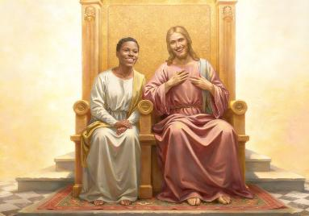
LUNGKIMNA
“Keimah zong gualzo-in ka Pa' tokhomah ka tutkhawm uh mah bangin a gualzote khempeuh zong kei tawh ka tokhom tungah hong tutkhawm theihna dingun thu ka pia ding hi.” (Mangmuhna 3:21)
Zeisu in lampi haksa hi cih thei hi. Kham, puan, le mit nuh ding zatui lei nading i hanciamnate amah in thei hi. Ama in lum-le-vot-lohna i zawh nading, kongkhak i hon nading, le amah tawh i kizop nading i hanciamnate thei hi. Tua ahih manin Ama'n eite kiangah, "Ken ka zawh mah bangin note in zong zo thei uhhi," hong gen hi (Mang. 3:21).
Ama'n zong i kipat masak ngei loh ding a thei hi. Pasian in a kipatna nei tawntung hi.
Ama in eite piangsak dingin khensat hi
(Pian. 2:7)
I mawh ciangin Ama'n eite hong zong hi. (Pian. 3:8-9)
Eite honkhiat nadingin amah a kipia hi (John 3:16)
Ama in thaman khat pia nuam hi: Ama tawh tu khawm ding le Ama kiangah tawn tung nuam i sak na ding hi (Mang. 3:21)
Hih Pasian' gamtatna (i phu loh) bulpi pen itna ahi hi: "Tawntung itna tawh kong it hi" (Jeremiah 31:3). Ama in eite tawh kizopna neih a ut hi. Ama tawh kizopna neih ka deih hiam? Ama in kei hong it bangin, ama tungah ka lungsim honsakin amah ka it ding hiam?

Slide 9

ATAKTAK DINMUN SITTELNA
(John 15:1-11)

Slide 10

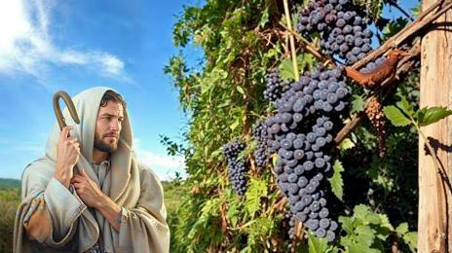
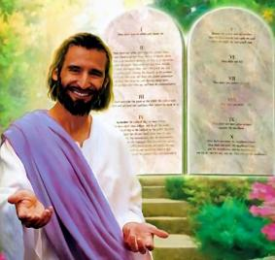

AHIANG LE LEENGGUI
"Kei pen leenggui ka hi-a, note pen a hiang na hi uh hi. Note in kei tawh loin bangmah hih theilo ding na hih manun kei tawh a kizomte in gah tampi na gah ding uh hi.” (John 15:5)
A sih ma deuh in, Zeisu in amah pen “leenggui" ahihna leh a nungzuite pen "a hiangte" ahihna a pulak hi. Hih tawh kisai amah in bang a deihna hiam?
Ahiang khat pen leenggui tawh kizom lo-in hun khat sung nungta thei mahleh, a tawpna ah a vul ding hi. Tawntung nun takna i mansuah loh nadingin, Zeisu'n eite kiangah ngetna nei a: "Kei sungah om un," ci hi (John 15:4). Zeisu in lenggui le a neite thu a genna tang 11 sungah, "omden" cih kammal sawm vei a zang hi. Thupi taktak khat peuh ahih hamtang ding hi.
Zeisu sungah om gige na pen Laodicea mite' lum-le-vot-lohna adingin damdawi ahi hi. Tua banah, tua in lungdam na bulpi ahi hi (John 5:11). Ahih hangin Zeisu sungah bangci bangin i om gige thei ding hiam?
Ama lungkimna ding sepna tawh, tua in Ama thupiakte zuihna ahi hi (John 15:10). Hih pen Pasian in eite tungah a laksa itna tungah itna tawh dawnna ahi hi (1 John 4:19).

Slide 11


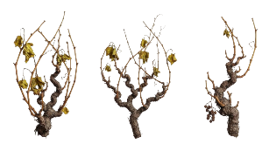

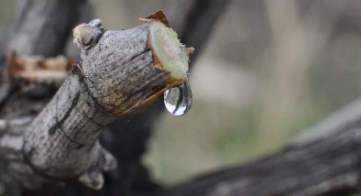
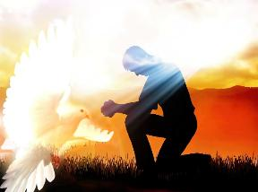
SING TUI
“Kei tawh hong kizom paisuak le uhcin kei zong note tawh a kizom paisuak kahi ding hi. Ahiang pen agui tawh kizom keileh gah agah theihloh mah bangin note zong kei tawh na kizop kei uhleh gah na gah thei kei ding uh hi.” (John 15:4)
Phalbi sungin a hiangte lenggui ah kizom napi-in, gah gah lo uh hi. Bang hang hiam? Ahang in amau singtui ngahlo uh hi.
Phalbi hong tun ciangin bek hihte in lenggui pan a tui ngah uh a, tua khit ciangin atehte hong pusuak khia hi. John in a zat Greek kammal in a kitan khia a, leeng kung ah a kibelh kik hiangte zong kawk thei hi.
Selung no i hi zong, hiang kisia i hi zong, thukhat pen chiang mahmah hi: leeng gui a tui i kisam hi. Hih sing-tui pen bang tawh teh thei ding i hi hiam?
Tua thugen na sungah (John 14-17), Zeisu'n eite kiangah a hilhcianna pia hi: Eite in i deihleh nunna pia dingin i sungah a sempa in Kha Siangtho ahi hi.
Amah in hehnempa hi (John 14:16-17)
Ei’ tungah Zeisu kipulaak (John 15:26)
I mawhnate hong theisak (John 16:8)
Thuman ah hong makaih (John 16:13)

Slide 12

“Hih mun-a mei tawh kihal khin kham kici pen upna le itna ahi hi. Tua in lungsim hau sak hi; a siangtho mateng hahsiang khin ahih manin, tua banah sittel’na a tam semsemleh a vang’ tang semsem ahi hi. Puan-paak pen nuntakna siangthona hi-a, mawhneite kiangah kipia Khazih’ dikna ahi hi. Hih pen vantung a sun’ puan bang hi-a, utna le zuihna tawh a thu mang nuntakna adingin Khazih kiang bek ah kilei thei hi. Mit-za kici pen a hoih le a sia khen thei sak in, bang bang lim tawh kisel zongin mawhna a mu khia thei ding pilna le lungdamna ahi hi. Pasian in ama pawlpi tungah mit pia a, tua mite pilna tawh nuh ding thupia hi, tua hileh kician takin a mu thei ding uh hi; ahih hangin mi tampi in amau hih thei hileh pawlpi' mitte dawkkhia nuam ding uh hi.; banghang hiam cihleh amau' gamtatnate khawvak ah a kilat ding deih lo uh a, a kiphawkkhia ding a lau uh hi. Pasian' mit-za in theihna kician’ pia ding hi. Khazih pen hehpihna khempeuh a kempa ahi hi. Ama’n: “Kei kiang pan lei in” ci hi (Mangmuhna 3:18).”
EGW (Testimonies for the Church, vol. 4, p. 88)

